Slide 1
ModCR - refactoring reaction datastructure
Meeting TSVV-K 19-06-26
P.W. Groen, M. Gordon, D. Borodin

Slide 2
Motivation/background + overview
Addition of spectroscopy task (calculate line intensities) to ModCR
Code-wise resemblance between reactions and (emission) transitions
  species
  states
  rates - PECs (ADF data)
This suggests a superclass for Reaction and Transition (new class): "Transformation"
The current Reaction class is abstract, with subclasses Reaction1d, Reaction2d
"1d" and "2d" refers to the data (rates) defined as a function of Te, Ne (2D) or Te (1D) and the corresponding linear interpolation function
The Transition class needs these interpolation functions as well (PECs)

Slide 3
Current situation
Abstract type / class cRMReaction_t
Two extensions / subclasses: cRMReaction1d_t, cRMReaction2d_t
Dimensions 1d and 2d refer to the data (rate coefficients) to be interpolated (only)
  1d: Te (or Ne) dependent
  2d: Ne and Te dependent
The types cRMReaction1d_t and cRMReaction2d_t only differ in the way
  the "coordinates" the data (rates) are defined on, and
  how they calculate (interpolate) the rate
To be able to place the subclasses in a list (cRMReactionList_t), ...
... this list is a list of "containers" (cRMReactionContainer_t) containing
objects of subclasses of cRMReaction_t (the only way to do this in Fortran)
Call sequence goes via this list:
  type :: cRMReactionList_t has linterp => getLinearInterp1d, getLinearInterp2d
  that call "linterp" on either cRMReaction1d_t or cRMReaction2d_t
  linterp=>linearInterp1d, linterp=>linearInterp2d, resp.

Slide 4
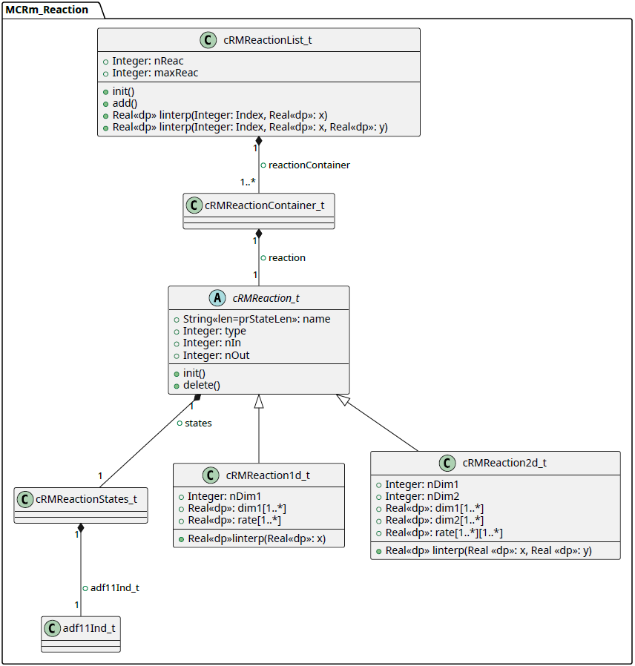
Diagram (current)
[Summarised]

Slide 5
Spectroscopy task
Addition of spectroscopic data, to be able to calculate emission line intensities from population densities and photon emissivity coefficients (PECs)
The photon emissions are related to transitions of states
The PECs are read from a database and are also given for Ne, Te
Analogy (in code) between reactions (with rates) and transitions (with PECs)
"Copying" the reaction structure to the transition structure will cause too much overhead

Slide 6
Proposed setup
create a common superclass for reactions and (to be added) transitions:
'transformation',
and a transformation list (with subclasses reaction list and transition list)
'transformation' has an interface to a linear interpolation function that takes a derived type as an argument,
the subclasses implement their own linear interpolation function (with the same argument)
the "rate" array (reactions) and "pec" array (transitions) are of rank 2, but one dimension can be zero
let cRMReaction_t and cRMTransition_t (subclasses of cRMTransformation_t) be able to take care of both 1d and 2d interpolation (using a derived type as an argument)

Slide 7
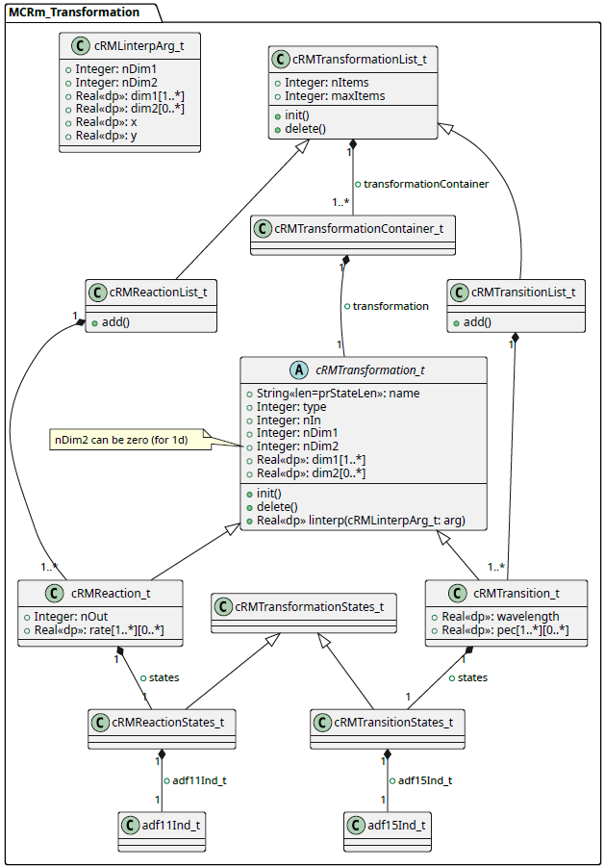
Diagram (proposed)
The method "linterp" returns a
real value (rate or PEC)
Takes a derived type as an argument
that contains the 1d/2d information
needed
This enables to have an interface
that can treat "1d" and "2d" type
instances in the same way
[Summarised]

Slide 8
Test (proof of concept)
Create reaction and transition lists with instances of Reaction, Transition resp.
Allocate the "rate" array per instance, one 2 dimensional, one 1 dimensional
Loop over the lists calling an "interpolation" function on each instance
First also: create a hybrid list of reactions and transitions: worked, but not used

Slide 10
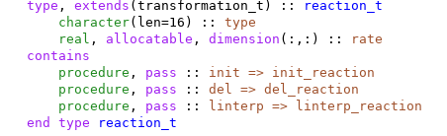
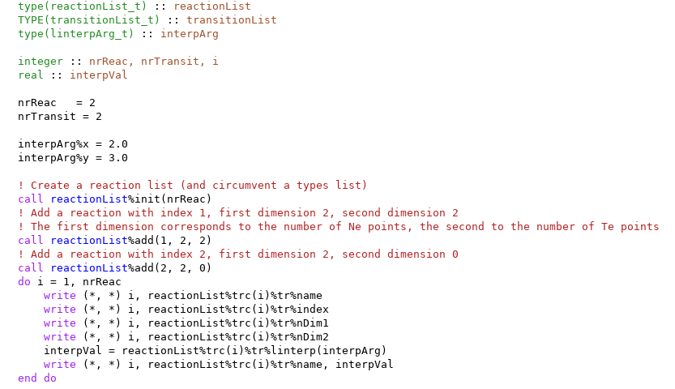
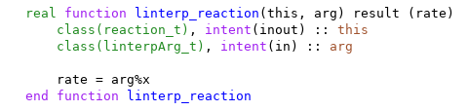

Code snippets
Create reaction and transition lists with instances of Reaction, Transition resp.
Allocate the "rate" array per instance, one 2 dimensional, one 1 dimensional
Loop over the lists calling an "interpolation" function on each instance
test/general_fortran_tests/test_multiple_type_list.f90

Slide 11
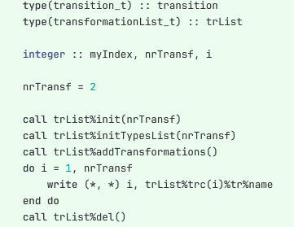
Code snippets
Mixed list of reactions and transitions (deprecated)

