Slide 1

TSVV-H In person meeting
Culham
15-19/06/2026
M. Marin

Slide 2
Introduction and logistics
Welcome everyone!
The most up to date agenda is on indico at https://indico.euro-fusion.org/event/4083/
Presentations should be put in TSVV-H presentations, possibly one day before the day of the presentation
More info about the meeting can be found in the google document
Teams link for remote participation is at microsoft teams
A Whatsapp group has been created at TSVV-H whatsapp for coordination
A mattermost channel is available for those with access
The dinner will be on Tuesday. If you did not sign up and want to come, let me know as soon as possible
Group photo will be on Tuesday afternoon

Slide 3
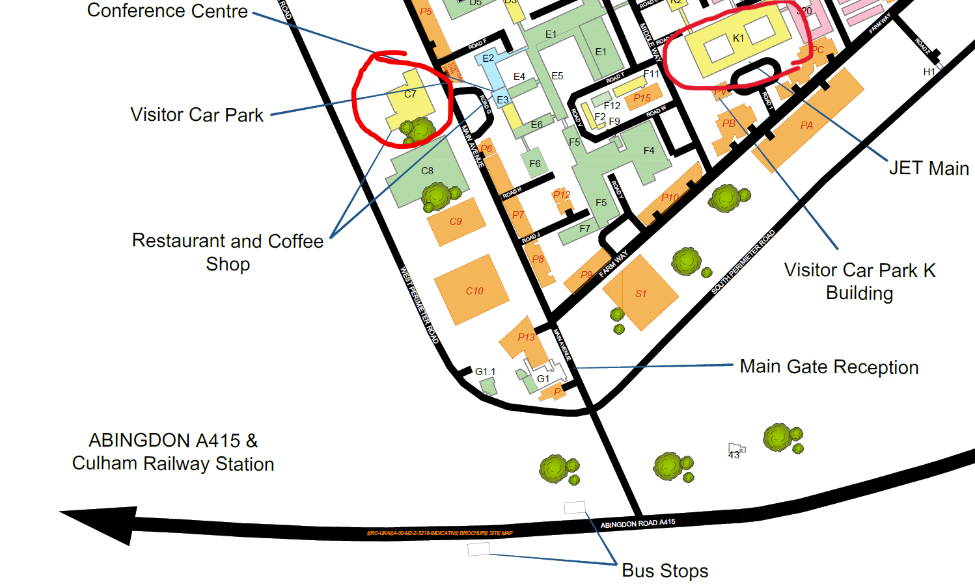
Meeting locations
The room will change depending on the day:
Monday 15th - HOW K1
Tuesday 16th - HOW K1
Wednesday 17th - Culham C7
Thursday 18th - Harwell C7
Friday 19th - Abingdon C7
Wifi: WORLDNet
Password: CCFEguest
Separate rooms for smaller discussions can be found upon request

Slide 4
Program
Main topics:
  HFPS training and targeted support
  Large scale validation
  Benchmark cases
  Pedestal modelling
  Model coupling
Time has been allocated for discussion and work. If you need help with a task, this is the time! If you think you can help with anything, this is the time!
We will start with a round table so everyone is aware of each other objectives and problems

