Slide 1
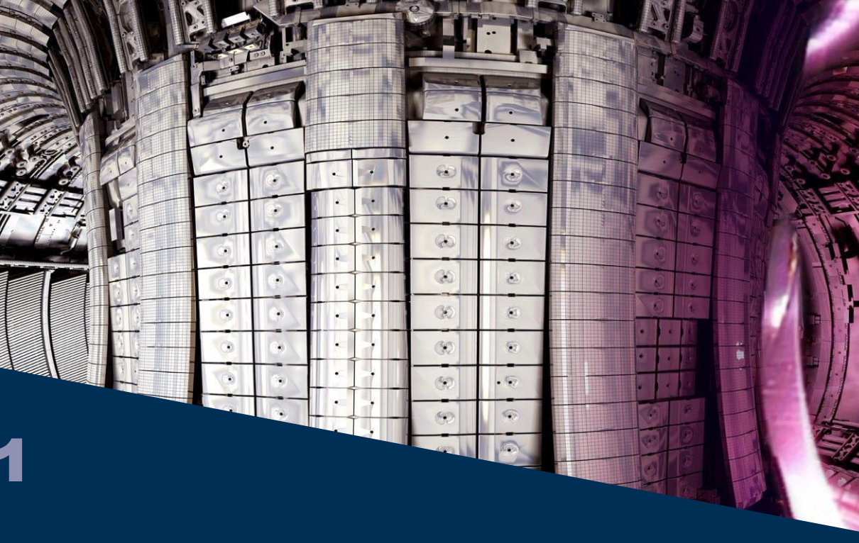
HFPS internal training
M. Marin
31/3/2023

Slide 2
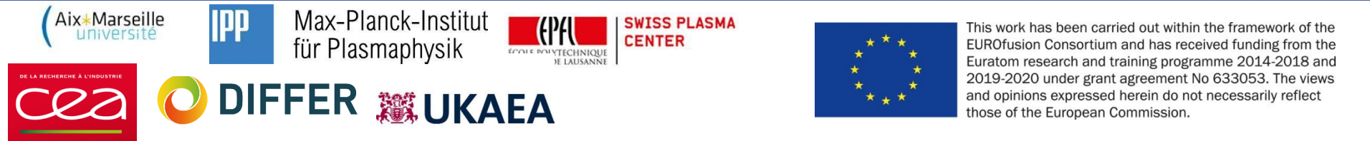
Credits
Presentation adapted from previous HFPS Trainings. Credits to
C. Bourdelle, F. C. Casson, TSVV11 team

Slide 3
TSVV-H : « Validated frameworks for the Reliable Prediction of Plasma Performance and Operational Limits in Tokamaks »
All the physics that we master now has to be available from ITER control room
Guiding principles (continuation of TSVV11):
Align with ITER technical choices in terms of integrated modelling workflow and database management
Improve and validate advanced physics modules focusing on high priority modelling extensions that will be needed for multi-physics full predictive modelling, with the help of other TSVV activities and in coherence with WPTE priorities
Demonstrate validation of full pulse predictive modelling from breakdown to termination, including a realistic assessment of operational limits
Support extended validation against EU operating tokamaks by providing to users outside this TSVV yearly training on the integrated modelling workflow, a detailed and clear documentation on the workflow and the embedded physics modules, a user friendly interface and automated validation tools

Slide 4
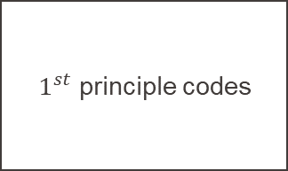
Integrated modelling landscape: focus on the physics understanding aspects
Model integration, longer plasma time frames
Requires faster yet accurate physics models
Physics understandings
Prepare (ITER) operation
Design future devices (DEMO)
$1^{st}$ principle codes
High Fidelity Pulse Simulator
Flight Simulators
System codes
Real time capacity
Validation against measurements
The ultimate goal of integrated modelling is to prepare more reliably tokamak operation.
The focus of here is on the physics understanding side of the coin.

Slide 5
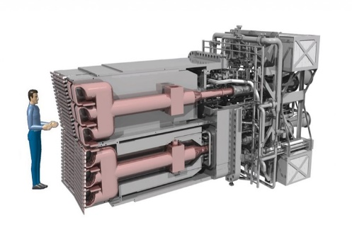
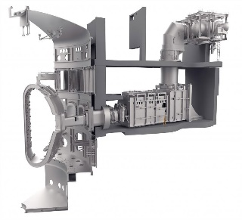
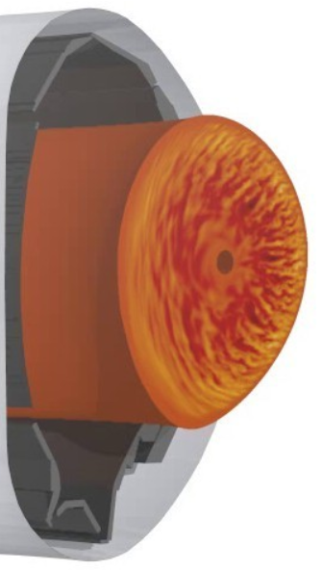
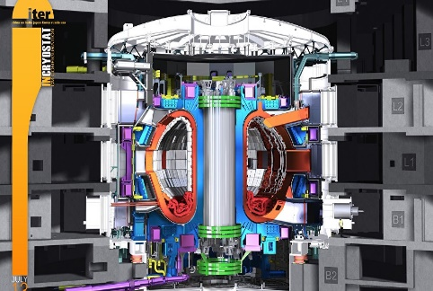
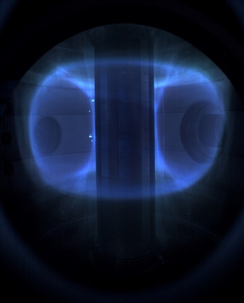
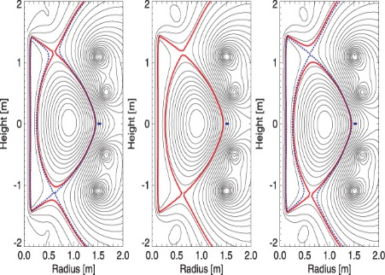
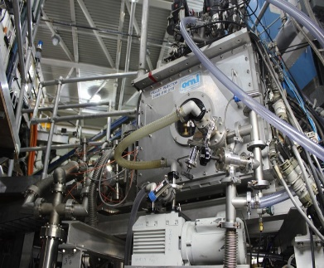


High Fidelity Integrated Modelling of the plasma core: framework
Multi-scale (spatial&temporal) and multi-physics problem
Self consistent, predictive
Radio Frequency heating
Neutral Beam heating
Integrate our physics understanding: radiation, heating, transport, MHD stability, equilibrium, neutrals in a time evolving framework
Turbulent Transport
[PION]
[PENCIL]
Impurity Radiation
$$\frac{∂n_{s}}{∂t}+∇⋅Γ_{s}\left(ψ\right)=S_{s}$$
$$\frac{3}{2}\frac{∂(n_{s}T_{s})}{∂t}+∇⋅q_{s}\left(Γ_{s}, ψ\right)=P_{s}$$
…
$j$, $T_{e}$, $T_{i}$, Ω, $n_{e}$,$n_{H}$, $n_{D}$, $n_{Be}$
HFPS
[SANCO]
[QuaLiKiz]
Magnetic equilibrium
Frozen Pellets injection
ASTRA
ETS
TOPICS
PTRANSP
[ESCO]
[HPI2]

Slide 6
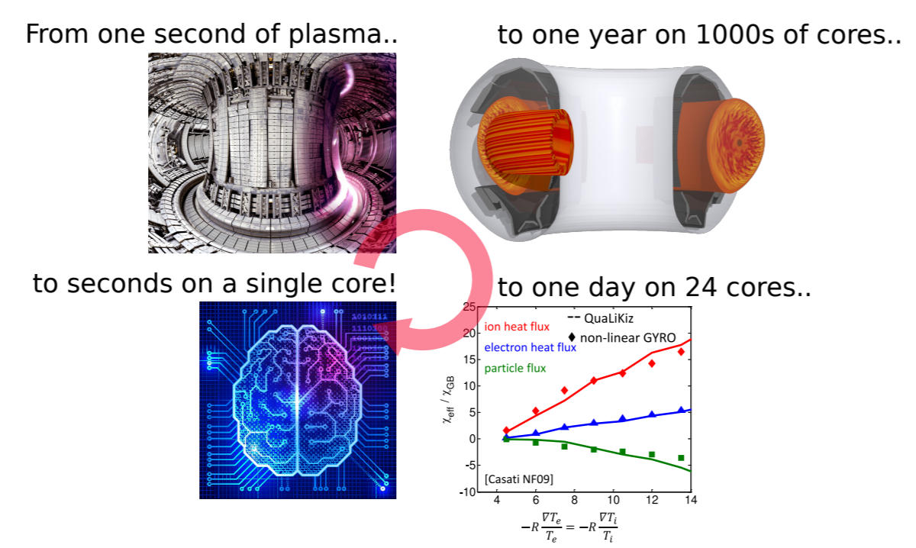
Reduced models are part of a cycle of development for predictive modelling
Gradient driven simulations are difficult to validate!
Make flux-driven, multi-channel predictions with QL models
Extrapolation to future experiments and machines
Use the NL turbulence physics understanding to improve QL rules
Validate flux-driven predictions against experiments, including sensitivity studies
A validation and development cycle is needed for predictive modelling
Similar cycle for even faster models
Validate NL GK against experiments, including sensitivity studies
Identify areas of QL models failure
Compare QL models to NL GK in failure domain
[From F. J. Casson presentation during 2018 TTF]

Slide 7
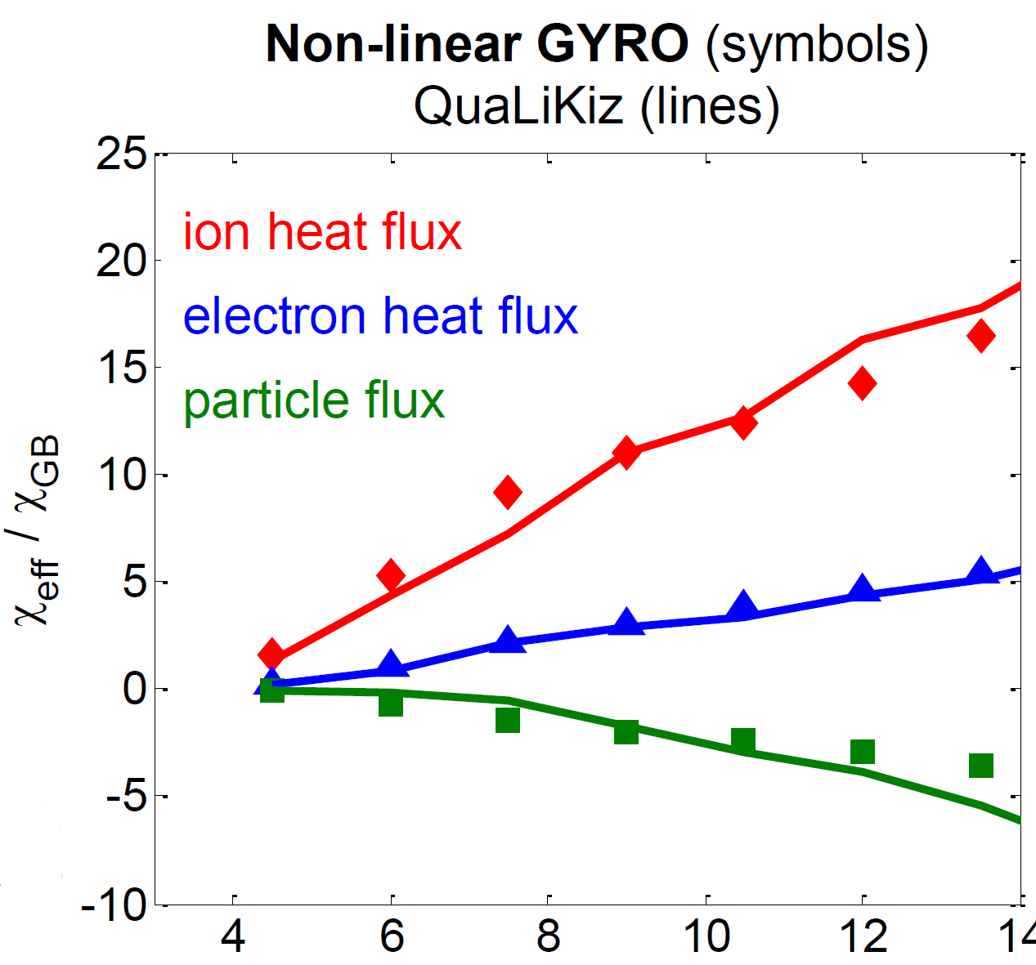
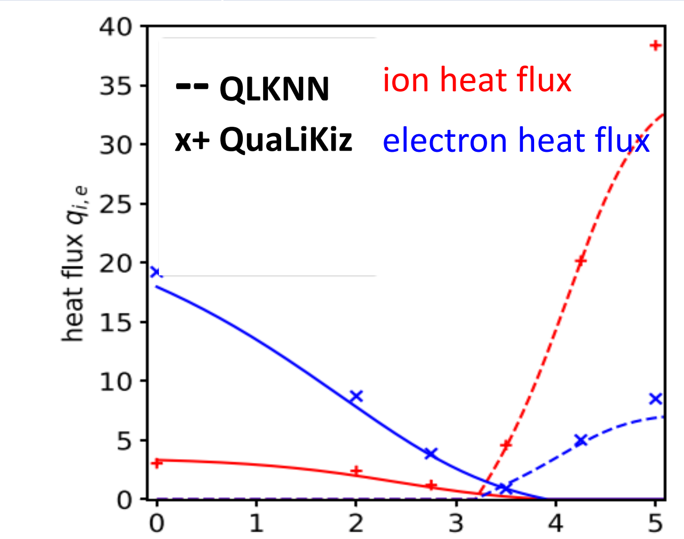
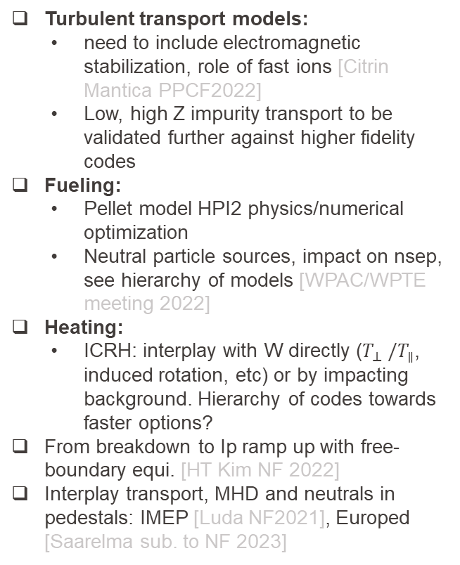




Requires faster yet accurate physics models ex. Turbulent flux prediction speed up: one trillion times faster
Anchoring non-linear gyrokinetic simulations
Quasilinear approximation
Eigenfuntion in fluid limit
Neural network regression
Turbulent transport models:
  need to include electromagnetic stabilization, role of fast ions [Citrin Mantica PPCF2022]
  Low, high Z impurity transport to be validated further against higher fidelity codes
Fueling:
  Pellet model HPI2 physics/numerical optimization
  Neutral particle sources, impact on nsep, see hierarchy of models [WPAC/WPTE meeting 2022]
Heating:
  ICRH: interplay with W directly ($T_{⊥} /T_{∥}$, induced rotation, etc) or by impacting background. Hierarchy of codes towards faster options?
From breakdown to Ip ramp up with free-boundary equi. [HT Kim NF 2022]
Interplay transport, MHD and neutrals in pedestals: IMEP [Luda NF2021], Europed [Saarelma sub. to NF 2023]
${10}^{6}$ times faster
${10}^{6}$ times faster
$$−R\frac{∇T_{e}}{T_{e}}=−R\frac{∇T_{i}}{T_{i}}$$
$$−R\frac{∇T_{i}}{T_{i}}$$
[Casati Nucl. Fusion 2009]
[van de Plassche PoP 2020]

Slide 8
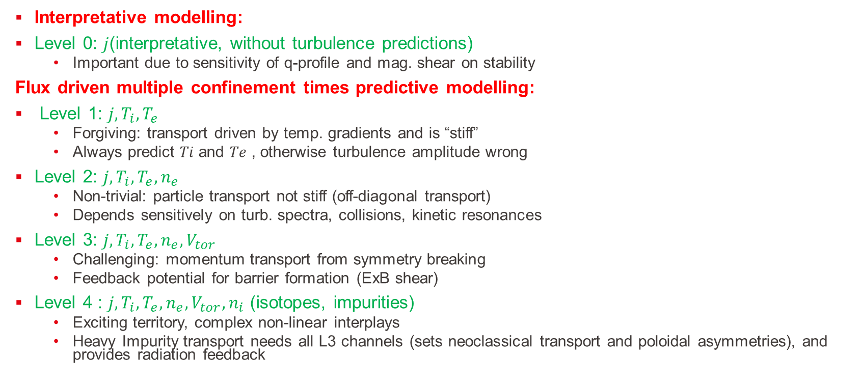
Temporal and spatial non-linear interactions between multiple transport channels, current/equilibrium, sources and sinks
Interpretative modelling:
Level 0: $j$(interpretative, without turbulence predictions)
  Important due to sensitivity of q-profile and mag. shear on stability
Flux driven multiple confinement times predictive modelling:
Level 1: $j, T_{i}, T_{e}$
  Forgiving: transport driven by temp. gradients and is “stiff”
  Always predict 𝑇𝑖 and 𝑇𝑒 , otherwise turbulence amplitude wrong
Level 2: $j, T_{i}, T_{e}, n_{e}$
  Non-trivial: particle transport not stiff (off-diagonal transport)
  Depends sensitively on turb. spectra, collisions, kinetic resonances
Level 3: $j, T_{i}, T_{e}, n_{e}, V_{tor}$
  Challenging: momentum transport from symmetry breaking
  Feedback potential for barrier formation (ExB shear)
Level 4 : $j, T_{i}, T_{e}, n_{e}, V_{tor}, n_{i}$ (isotopes, impurities)
  Exciting territory, complex non-linear interplays
  Heavy Impurity transport needs all L3 channels (sets neoclassical transport and poloidal asymmetries), and provides radiation feedback

Slide 9
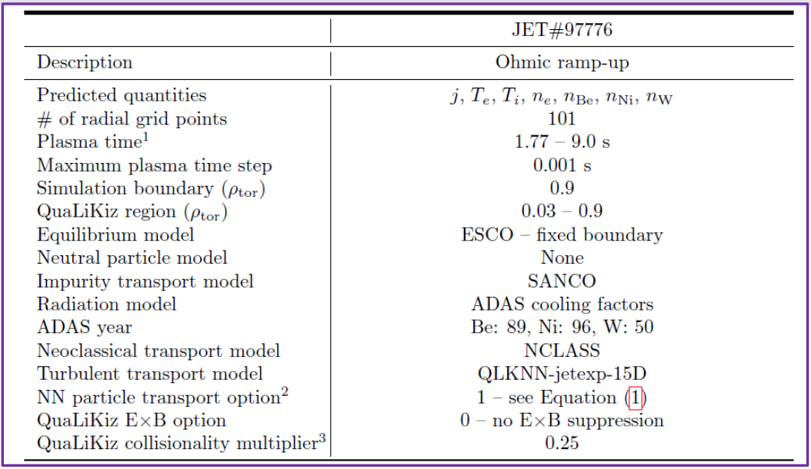
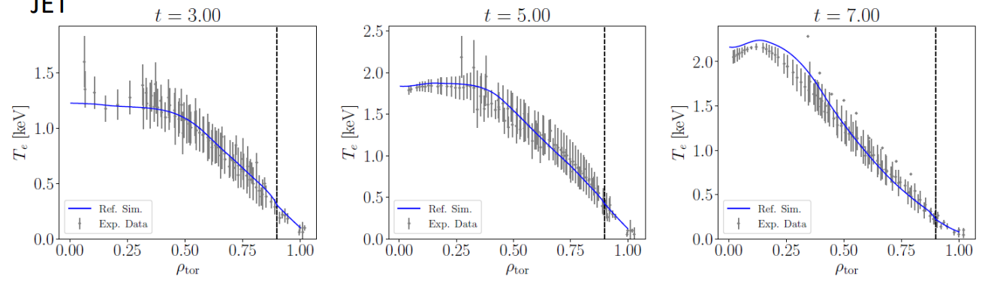
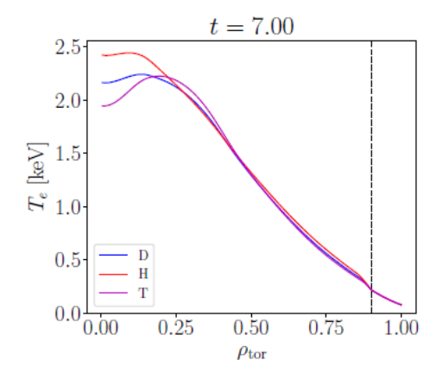
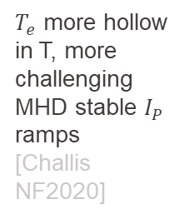
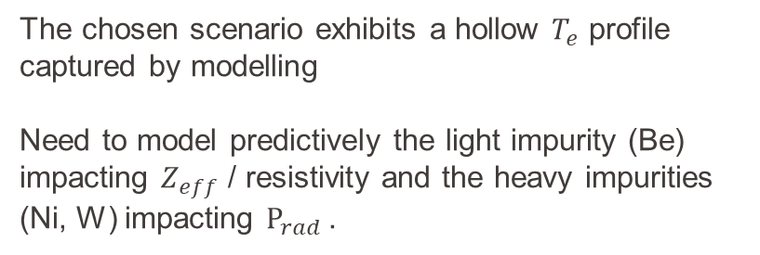
Level 4: Predictive JET current ramp-up modelling in D and T
JETTO settings, 7.25 s of plasma evolution, using QLKNN
The chosen scenario exhibits a hollow $T_{e}$ profile captured by modelling
Need to model predictively the light impurity (Be) impacting $Z_{eff}$ / resistivity and the heavy impurities (Ni, W) impacting $P_{rad}$.
[A Ho NF 2023]
$T_{e}$ more hollow in T, more challenging MHD stable $I_{P}$ ramps
[Challis NF2020]

Slide 10
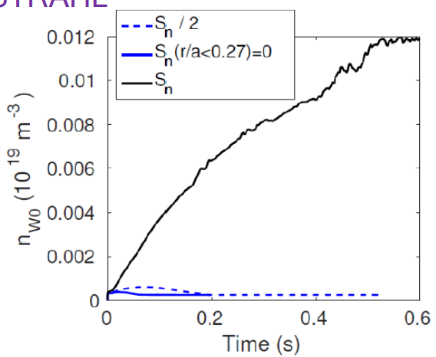
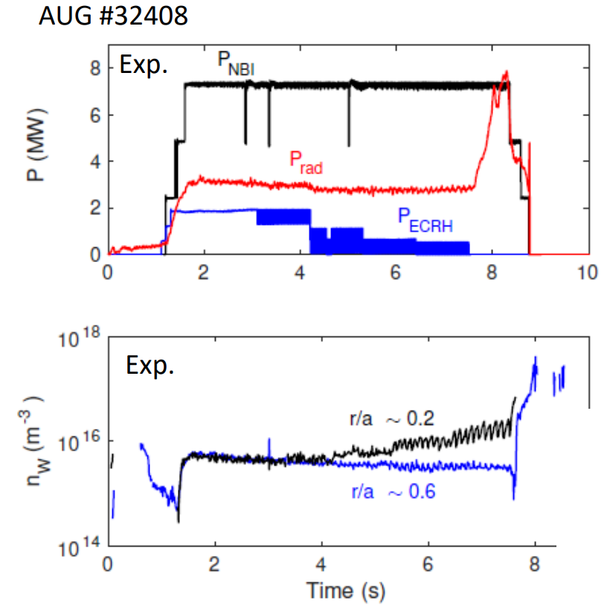
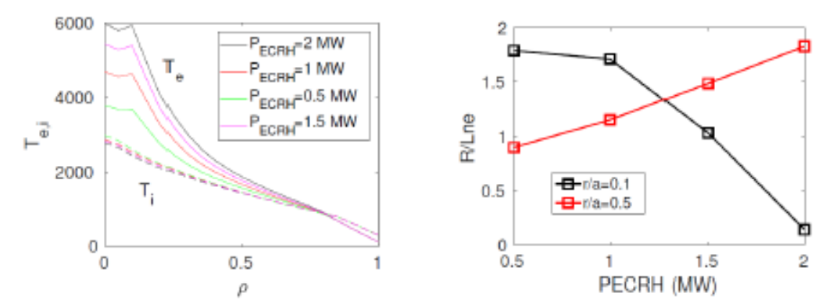

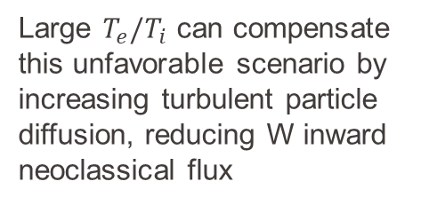
Level 4: W-accumulation avoidance at AUG tokamak thanks to ECRH density flattening, reducing W inward neoclassical flux
ASTRA-QuaLiKiz-NEO-TORBEAM-STRAHL Predictive from pedestal top inward
$$Γ_{W}=2D\left[\frac{1}{Z }\frac{∇n_{W}}{n_{W}}−\frac{∇n_{D}}{n_{D}}+\frac{∇T_{D}}{T_{D}}\right]$$
NBI particle source enhances W inward neoclassical convection
Large $T_{e}/T_{i}$ can compensate this unfavorable scenario by increasing turbulent particle diffusion, reducing W inward neoclassical flux

Slide 11
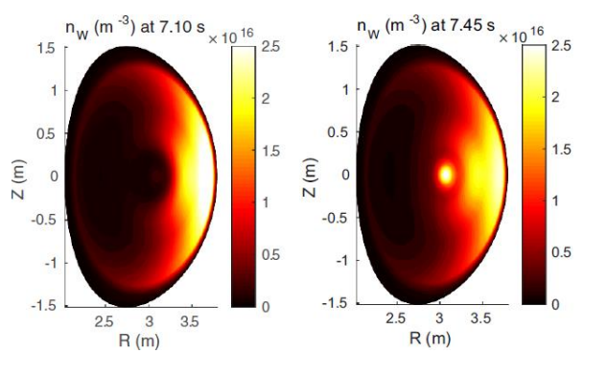
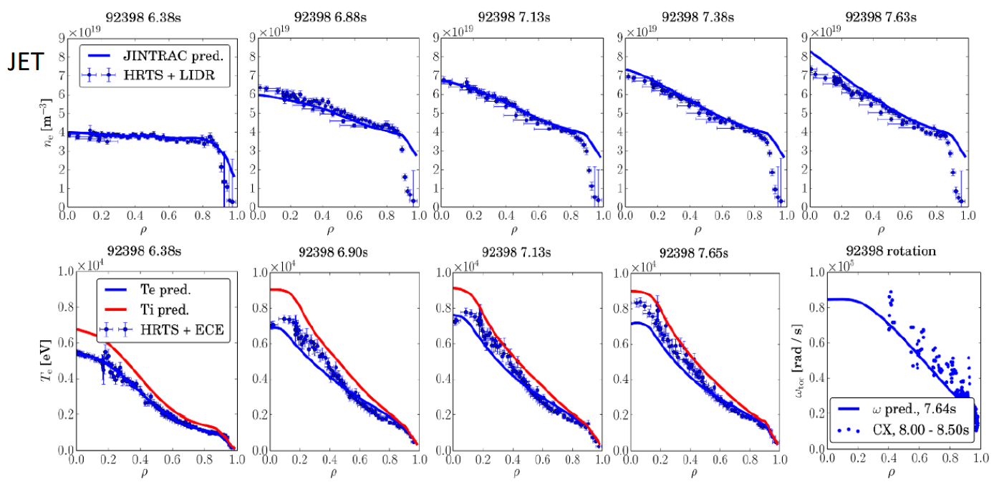
Level 4: W-accumulation at JET tokamak due to density peaking, and avoidance with ICRH
Prediction: from pedestal top inward. Over 1.5 s of plasma evolution.
W-radiation emission peaks at later time due to inward neoclassical W transport driven by density peaking.
Mitigated by on-axis ICRH heating (not shown for brevity)
JETTO-SANCO-QuaLiKiz-NEO-PENCIL-FRANTIC-PION successfully described core W-accumulation due to NBI particle source and momentum [Breton NF 2018]
Mitigation strategy with ICRH heating due to density peaking reduction [Casson NF 2020].
State-of-the-art core plasma integrated modelling evolving j, Te , Ti , nD , nBe, nNi, nW, w, rad., NBI, ICRH

Slide 12
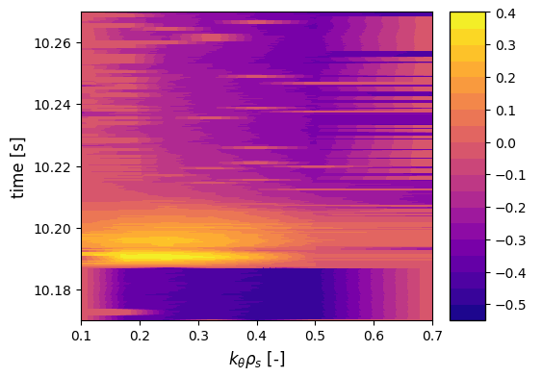
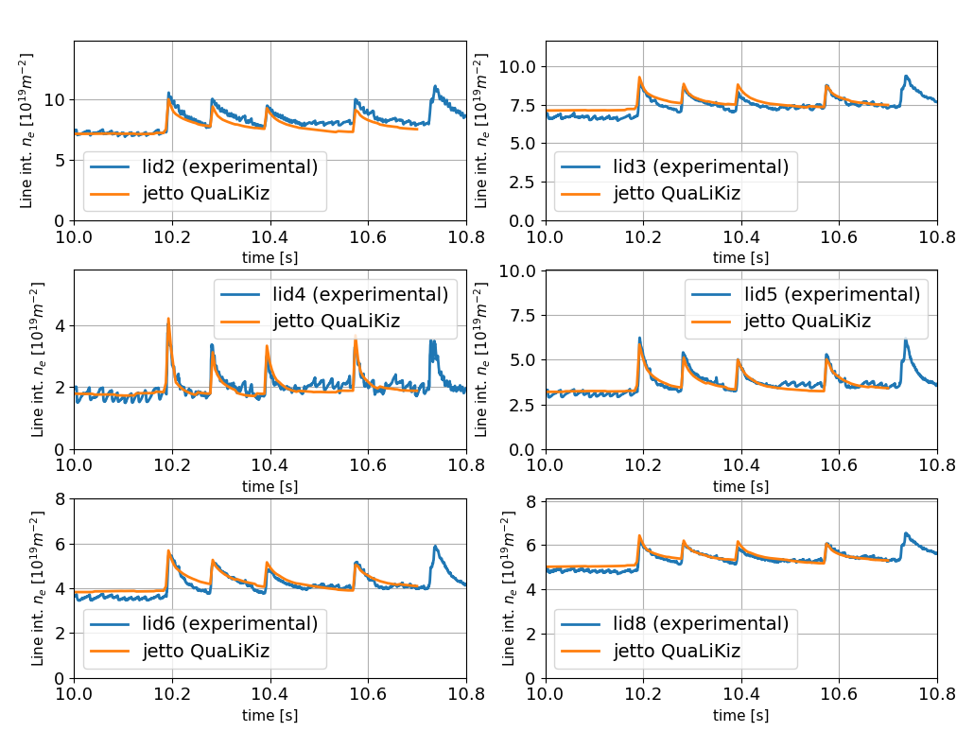
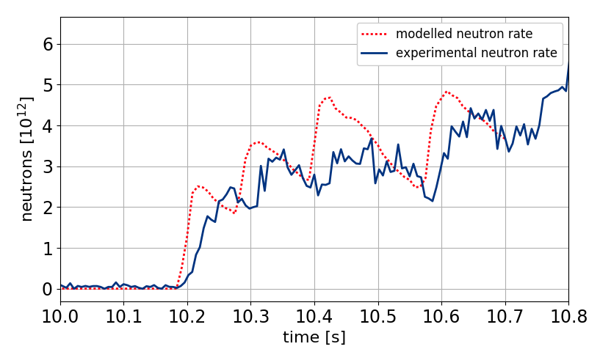
Multiple-isotope pellet cycles captured by turbulent transport modelling in the JET tokamak
JETTO-SANCO-QuaLiKiz-NCLASS-PENCIL-PION-FRANTIC-HPI2
Prediction: from core to pedestal top. Over 0.7 s of plasma evolution, 4 pellets.
ITG to TEM transition can be observed and analyzed
The fast timescale of isotope mixing D pellet in H plasma captured by the modelling
The neutron rate rises sharply after the first pellet
[Marin NF 2021]

Slide 13
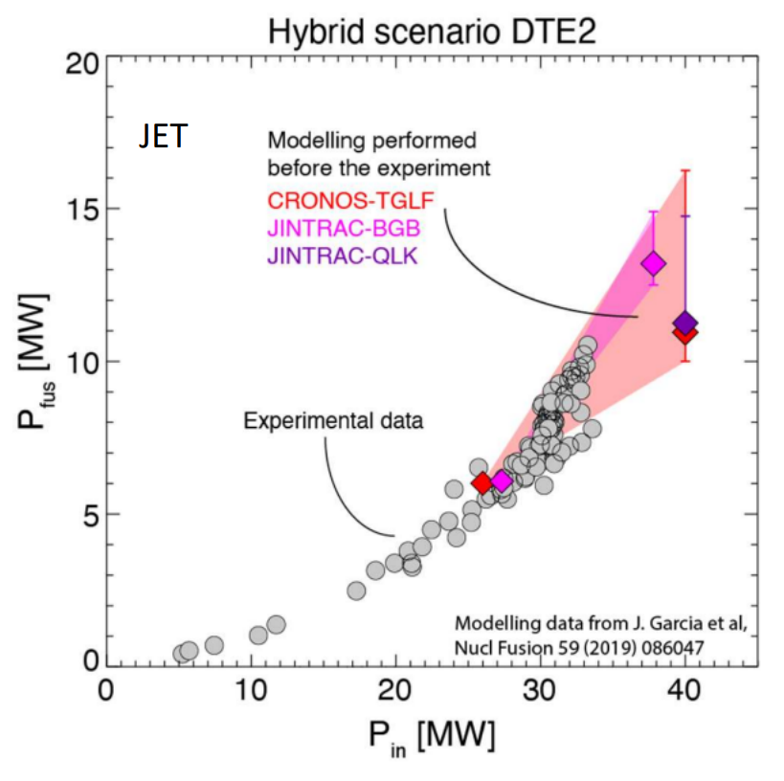
Predict first: Integrated modelling used for JET DT preparation
Strong predict first modelling performed since 2012
D-T fusion power achieved is in broader agreement with predictions
Simplified models can be improved with new DT data
Essential for ITER and future reactors predictions
From core to pedestal top.
Level 4 with JINTRAC-QuaLiKiz
From core to separatrix
Level 2 with CRONOS-TGLF-Ped:Cordey’s scaling
[Garcia APS-DPP 2022]

Slide 14
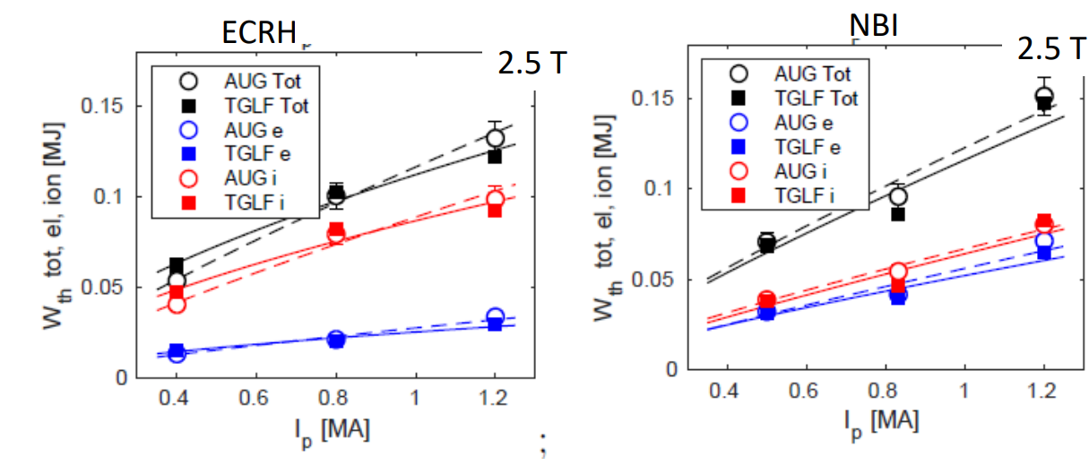
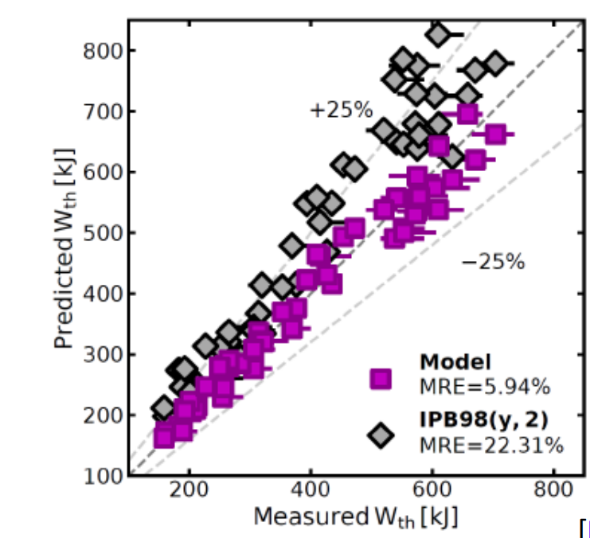
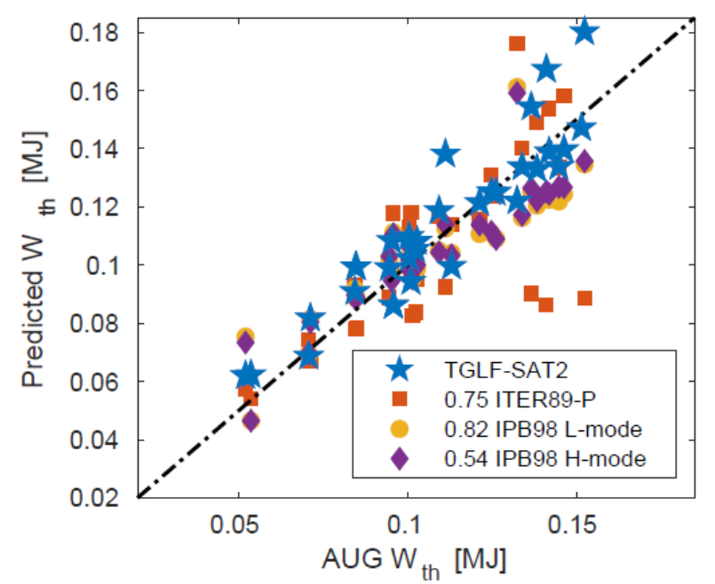
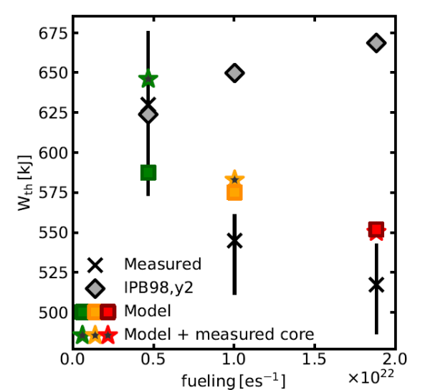
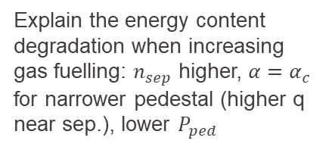
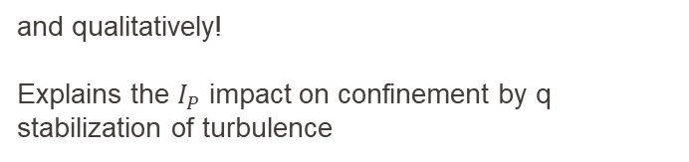
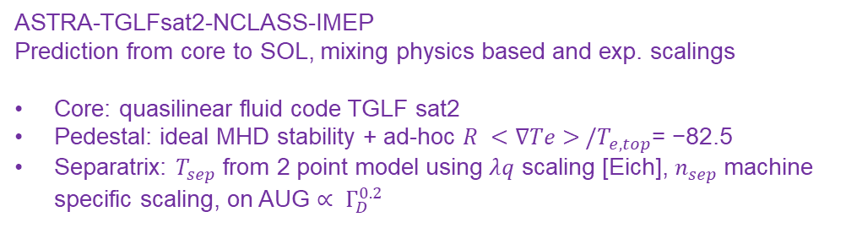
Extending the boundary condition to the SOL: 50 AUG H modes better than empirical scaling laws, quantitavely and qualitatively
and qualitatively!
Explains the $I_{P}$ impact on confinement by q stabilization of turbulence
[Luda NF 2021]
[Angioni NF2022]
ASTRA-TGLFsat2-NCLASS-IMEP
Prediction from core to SOL, mixing physics based and exp. scalings
Core: quasilinear fluid code TGLF sat2
Pedestal: ideal MHD stability + ad-hoc $R <∇Te> /T_{e,top}$= −82.5
Separatrix: $T_{sep}$ from 2 point model using $λq$ scaling [Eich], $n_{sep}$machine specific scaling, on AUG $∝ Γ_{D}^{0.2}$
better than empirical scaling laws, quantitatively ….
Explain the energy content degradation when increasing gas fuelling: $n_{sep}$ higher, $α=α_{c}$ for narrower pedestal (higher q near sep.), lower $P_{ped}$

Slide 15
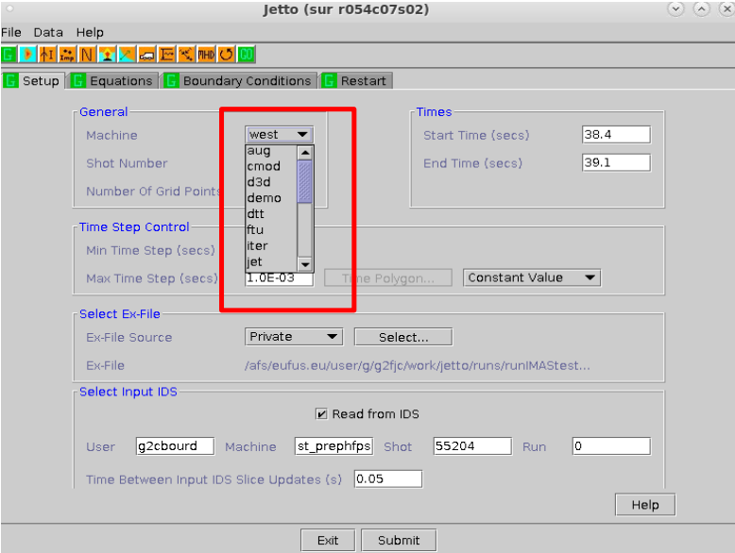
« The » High Fidelity Pulse Simulator
What is the High Fidelity Pulse Simulator?
Python-driven workflow based on IMASified JINTRAC (i.e. JETTO+EDGE2D, from the core to the SOL)
Workhorse for scenario preparation in ITER Physics Dept.
Any IMASified physics module can be included
Coupled to experimental IMAS data from AUG, JET, TCV, WEST, on the EUROfusion Gateway
Automated run generation and analysis pipelines being developed for uncertainty quantification

Slide 16
A key tool: IMAS data structure
IMAS : Integrated Modelling and Analysis Suite Data Dictionary.
Chosen by IO for ITER future experimental data and present modelling in/output.
Machine and code generic. Capable of covering all experiment subsystems and plasma physics, extensible
Promoted as the standard to access all experimental results within EUROfusion in a unique data format in the FAIR and open science requirements
IMAS infrastructure includes:
Data Dictionary: machine generic
  What data exist?
  What are they called?
  How are they structured ?
Data Access : functions to read/write objects
Workflow component generator : encapsulate physics codes to turn them into components that can be coupled in a workflow
Profiles (t)
QuaLiKiz
Fluxes
Profiles (t+dt)
Magnetic equilibrium (t)
ESCO
New Geometry
Magnetic equilibrium (t+1)
Flexible and modular!
Sources (t)
HCD
Sources (t+1)

Slide 17
The IMAS Data extraction is developed by each machine
Data Management Project is developing the mapping with the essential variables needed to run the HFPS for various machines
  This requires dedicated effort and experts from each machine
  When ready and when possible, we should try to get the data through the IMAS mappings
  We can provide feedback if things are not working
ITER collaborating and coordinating this effort
The tooling (plotting, analyzing results) that we develop should also always be IMAS compatible to facilitate reuse from other groups
Example for TCV:
Connect to spcimas
[ids_from_tcv]=tcv2ids2database(64965,0013,'ids_names',{'summary','core_profiles','equilibrium’})

Slide 18
Support and documentation
Documentation (3 copies the same)
  The JINTRAC documentation is available here: JINTRAC wiki EUROfusion
  The same content is also available at JET: JINTRAC wiki at JET
  And ITER: JINTRAC wiki at ITER
IMAS structure in https://imas-data-dictionary.readthedocs.io/en/latest/
IMASpy documentation at imaspy
Wikis for the Eurofusion gateway available here
A TSVV-H wiki with useful info, slides of previous meetings and more is available at TSVV-H wiki. Feedback is very much appreciated.
Questions can be posed in
  Ask on TSVVH Mattermost channel
  Open a ticket on https://gitlab.eufus.psnc.pl/jintrac/support/-/issues

Slide 19
Setting up the environment
Prerequisite:
Wikis for the Eurofusion gateway available here
Complete the following steps # FIRST TIME ONLY
cmg should be in /pfs/work/ and should be linked to home:
  cd
  mv cmg /pfs/work/$USER/cmg
  ln -s /pfs/work/$USER/cmg cmg
public should be in /pfs/work/$USER/public
  cd
  mv public /pfs/work/$USER/public
  ln -s /pfs/work/$USER/public public
If public does not exist:
  cd
  mkdir public
  mv public /pfs/work/$USER/public
  ln -s /pfs/work/$USER/public public
Create the folder, if not existing /pfs/work/$USER/cmg/jams/data/settings
To load the latest version of jintrac:
  module use /pfs/work/g2fjc/jintrac/37.0.0/modules
  module load jintrac
  module use /pfs/work/g2fjc/cmg/jams/37.0.0/modules
  module load jams
  export JINTRAC_IMAS_BACKEND=HDF5
  export IMAS_AL_DISABLE_VALIDATE=1
Central Installation available at
  module load cineca-modules ach-modules
  module load JINTRAC JAMS JETTO-PythonTools

Slide 20
Setting up the environment
Type ‘jams’ anywhere, then ‘Execution’ and ‘jetto’
In the exfile tab, select /pfs/work/g2fkoech/cmg/jams/data/exfile/dummy.ex
In the sanco grid, select /pfs/work/g2mmarin/cmg/jams/data/sanco
Jobs will be created in your work directory
Submitted jobs can be tracked with ‘qme’. The entire queue can be monitored with ‘qstat’. The queue is normally quite short, but try not to flood the server
No central debug file is available at this point. Useful files are jetto.out, hfps_jetto.*, hfps_driver.*, ll.*, TCI_debug.txt when quasilinear models are used
Many options are available to visualize the results

Slide 21
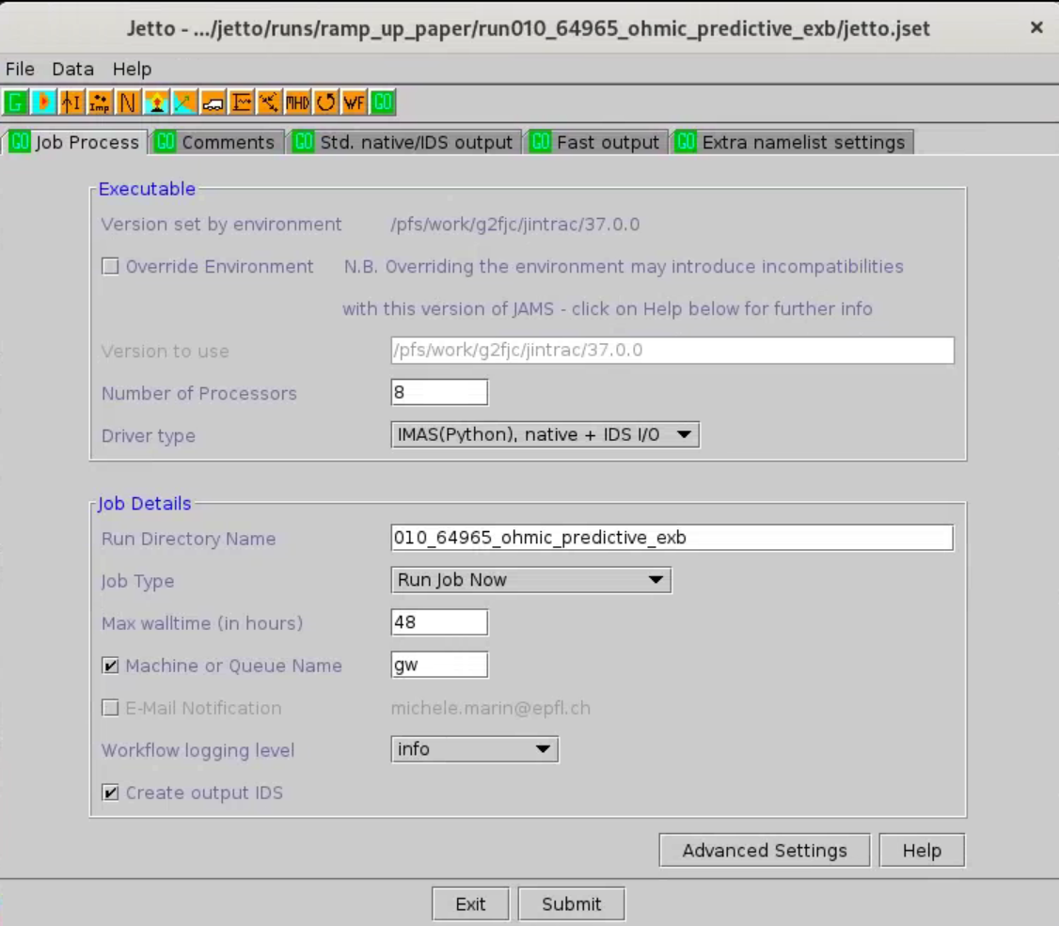
HFPS job can be launched through the HFPS GUI
Start the simulation from an existing simulation

Slide 22
HFPS job can be launched through the HFPS GUI
Start the simulation from an existing simulation
Setup the modules of interest

Slide 23
HFPS job can be launched through the HFPS GUI
Start the simulation from an existing simulation
Setup the modules of interest, each of them consisting of a panel of settings

Slide 24
HFPS job can be launched through the HFPS GUI
Start the simulation from an existing simulation
Setup the modules of interest, each of them consisting of a panel of settings
Setup any expert settings when needed, or use default

Slide 25
HFPS job can be launched through the HFPS GUI
Start the simulation from an existing simulation
Setup the modules of interest, each of them consisting of a panel of settings
Setup any expert settings when needed, or use default
Submit the jobs

Slide 26
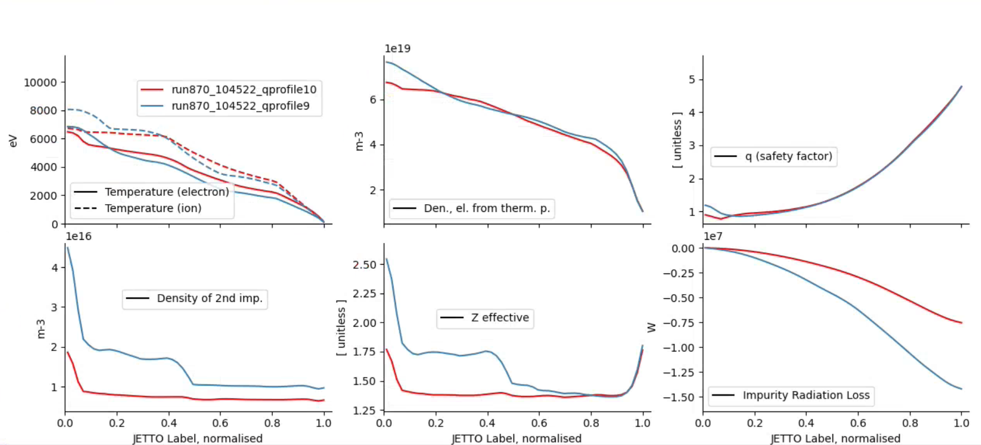
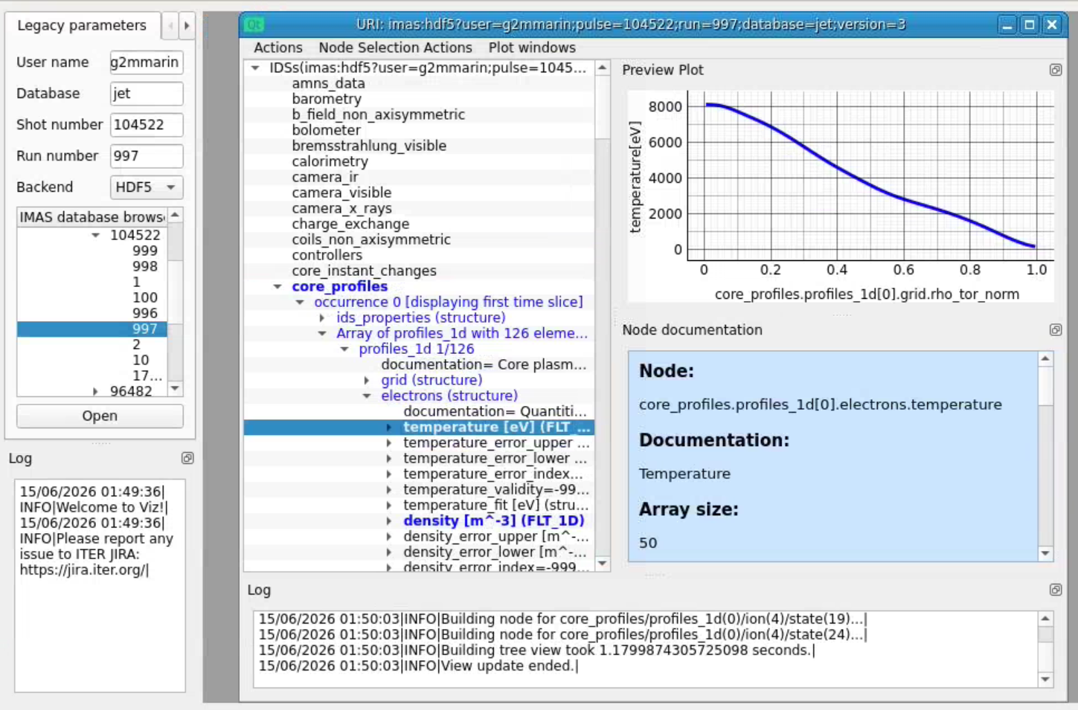
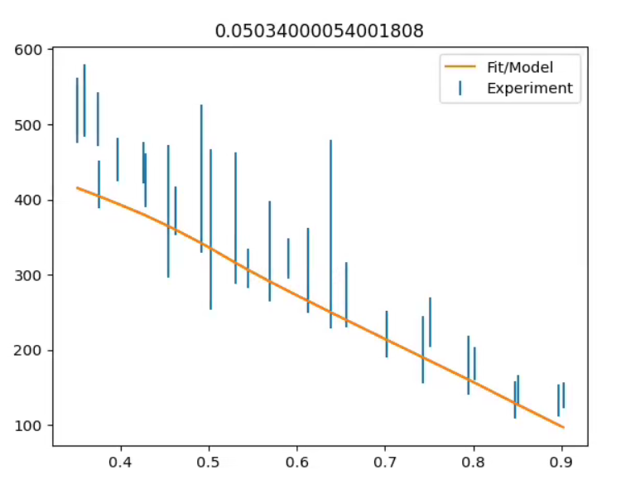
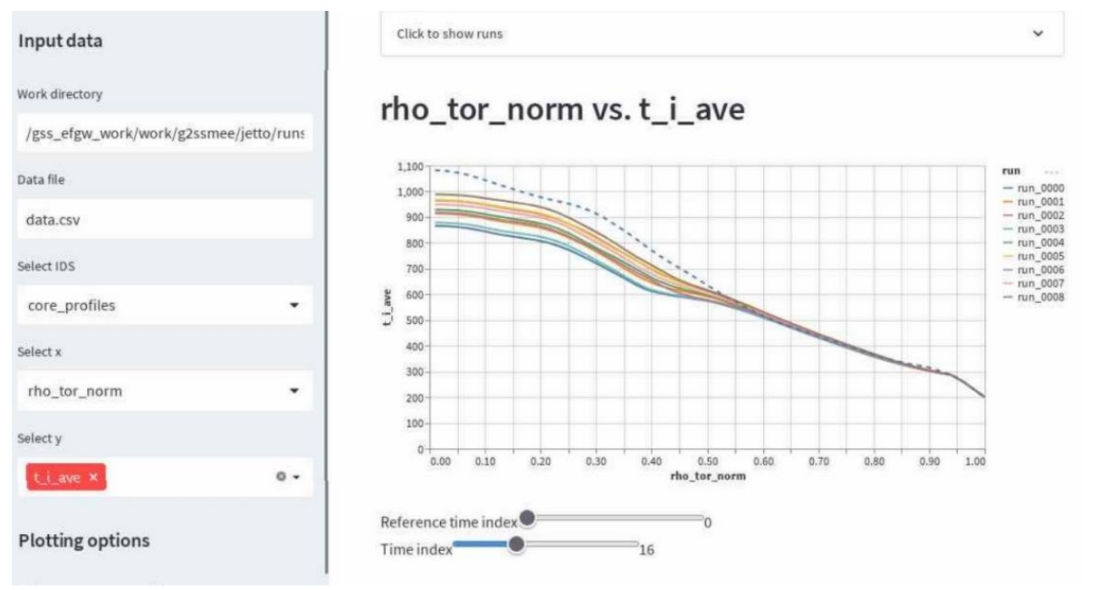
Visualization tools
Jpyplot
Viz
And more!
plotjetto
Duqtools
module purge
module load ach-modules/1.0
module load imasenv/3.42.0/foss/2023b/rc
module load Viz/2.8.0-foss-2023b

Slide 27
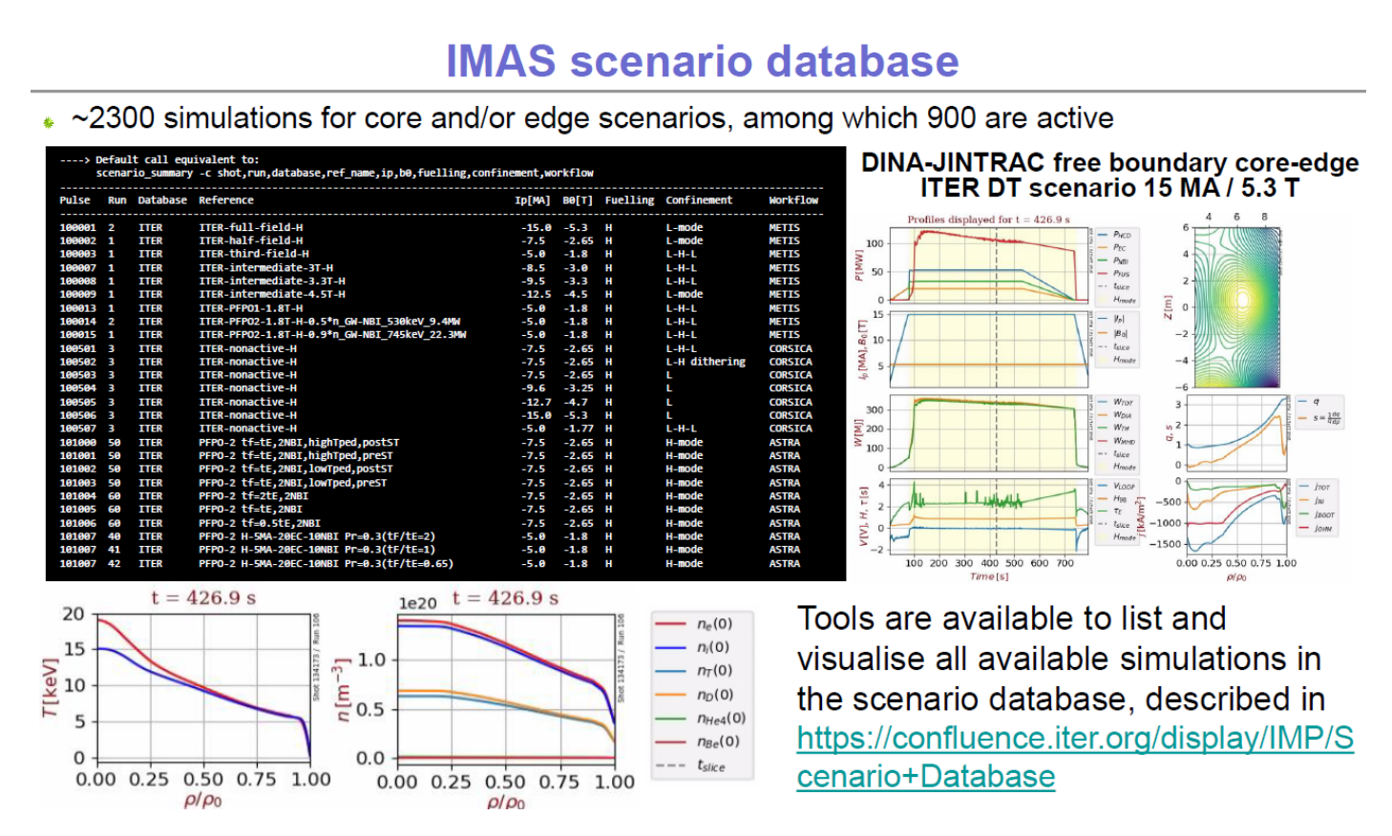
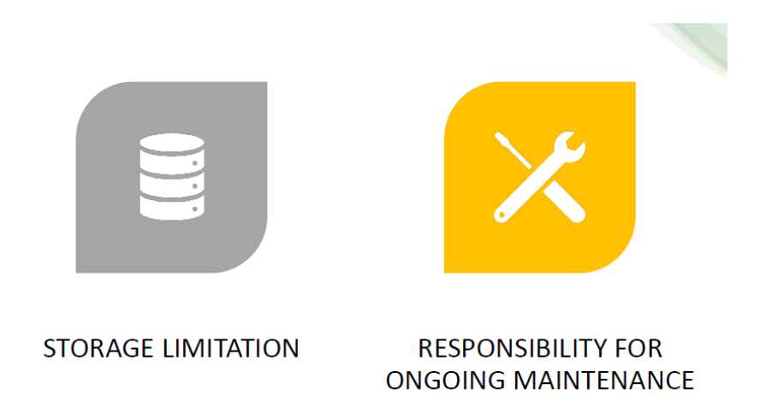
Long Term Storage Facility
Align with ITER simDB
Ready on the gateway
Need EF software and hardware support: Long Term Storage Facility
FAIR:
Findable
Accessible
Interoperable
Re-usable
[Schneider, ITER Org. ITPA diags 2022]

Slide 28
Conclusions
Integrated modelling as a powerful tool to understand and predict tokamak plasmas
Simulations are highly nonlinear and care must be taken in preparing each module
HFPS is one of the possible frameworks and is available for a large number of machines
IMAS and IDSs simplify sharing tools and data
Extensive documentation and support exists for the code and its modules. The community of experts is always available and happy to help with the onboarding of new users

