Slide 1
Status of linear GK pedestal surrogate model for MAST-U
Annual in-person meeting TSVV-H, 17.6.
Anna Niemelä

Slide 2
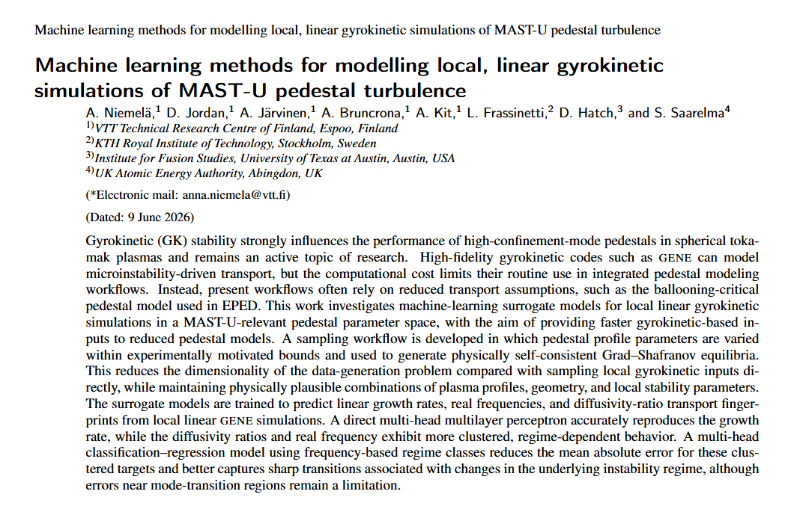
Pedestal GK: Proof-of-principle models for MAST-U
Aim is to support future quasilinear or integrated pedestal workflows with GK microinstability information, while keeping the evaluation cost closer to reduced models​
For MAST-U, several ML approaches have been explored for predicting local, linear GENE outputs

Slide 3
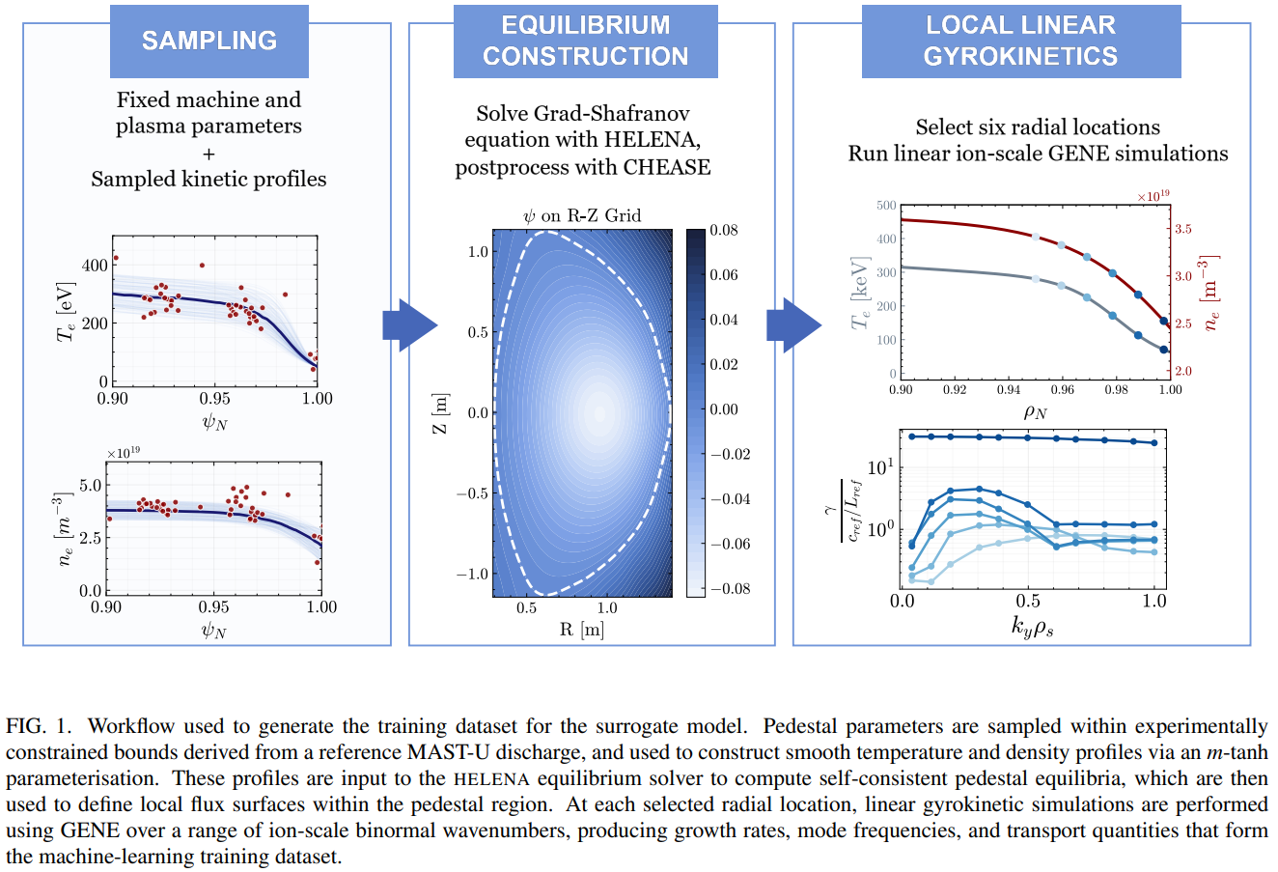
Dataset Generation within single shot experimental uncertainty
Sample pedestal profiles instead of local inputs, generate physically consistent equilibria with HELENA + CHEASE

Slide 4


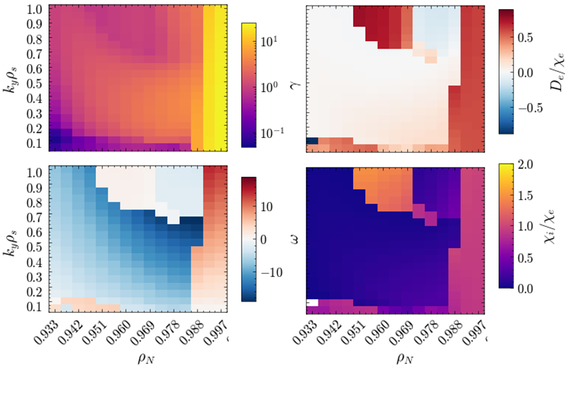
Multiple targets, different (but correlated) behaviour
Some outputs (growthrate) vary smoothly, while others show sharp regime boundaries
The targets are correlated, but not interchangeable
Frequency and transport ratios show more clustered, class-like structure

Slide 5
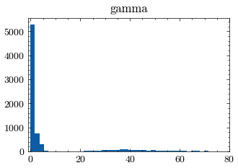
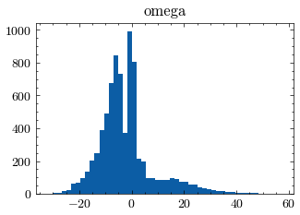
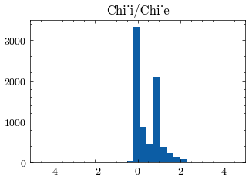
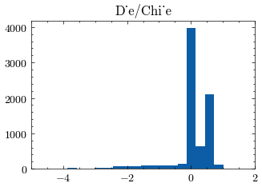
Multiple targets, different (but correlated) behaviour
Target distributions
128 equilibria, 6 radial locations, 10 k_y values at ion scale
Some outputs (growthrate) vary smoothly, while others show sharp regime boundaries
The targets are correlated, but not interchangeable
Frequency and transport ratios show more clustered, class-like structure

Slide 6
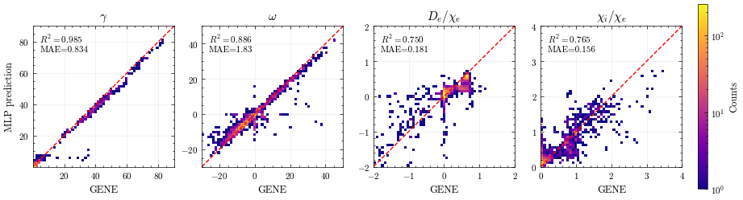
Several ML approaches tested for the task, test prediction metrics similar
Growthrate and frequency are predicted reasonably well in random test splits by standard regression models
Transport ratios are consistently harder, with lower accuracy and larger scatter
Tested MLPs, GPR, XGBoost, CNN (input profiles), single-target and multi-target setups: Similar results in test set prediction metrics
Example from MLPs trained separately for each target
Adam optimizer,
64-32-16 hidden layers,
MSE loss

Slide 7
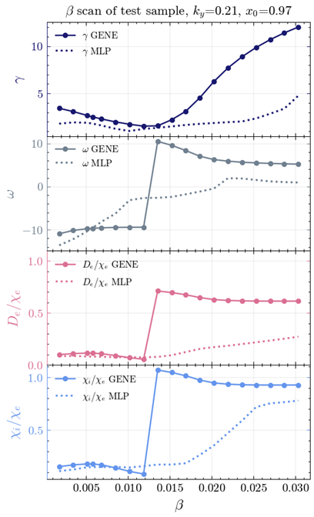
Main issues with previous approaches
Models smooth over mode transitions
  Sharp transitions in frequency and ratios not captured
Models have issues generalizing, for example with beta scans
Outputs not consistent when comparing results: Separate models can't benefit from targets being correlated
KBM transition not captured with models

Slide 8
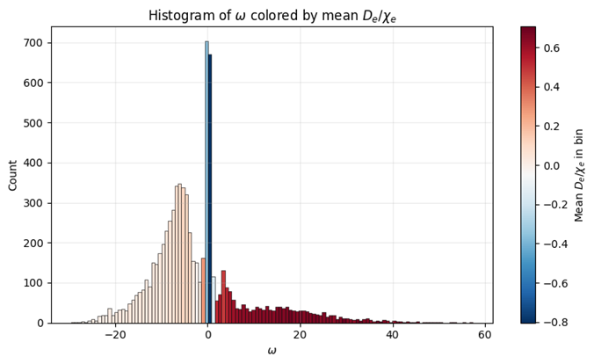
Multi-head approach to improve consistency of outputs, classification + regression to improve mode transitions
Two multi-head variants were tested:
  A direct multi-head regression model
  A multi-head class+regression model
The multi-head regression model predicts all targets at once using a shared trunk with separate output heads
The multi-head class+regression model first classifies each point into a frequency-based class
  After classification, a separate regime-specific multi-head regressor predicts the outputs
Three different classes from frequency, thresholds set to –1 and 1

Slide 9
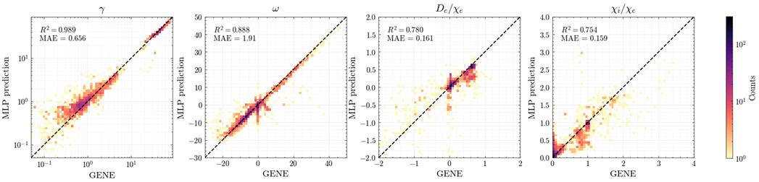
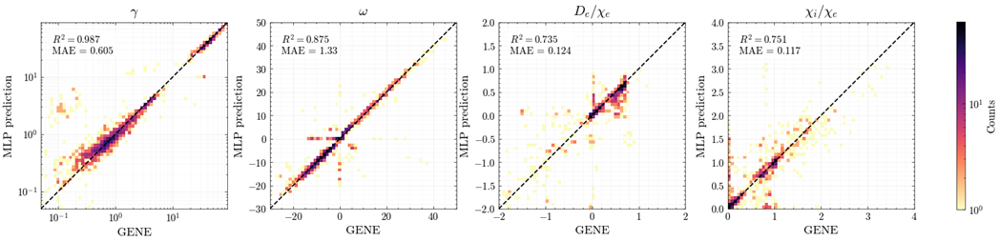
Results of MH models: Parity plots
Regression
Classification + Regression

Slide 10
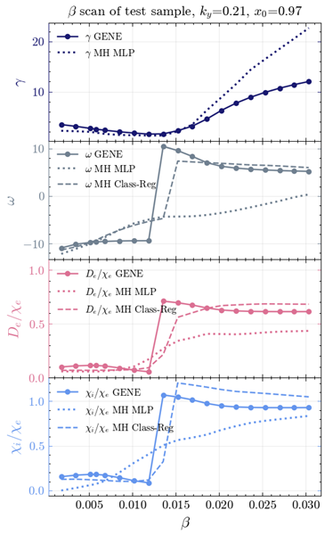
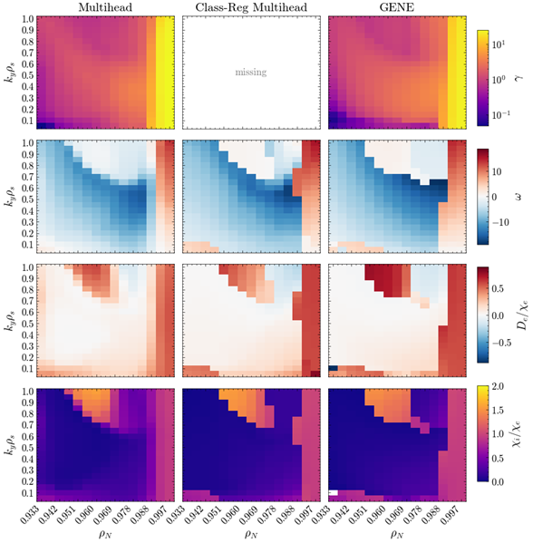
Results of MH models: Generalization tests
Dense scan of radial position and wavenumber for an unseen plasma equilibrium
Scan of input parameter beta, at fixed radial location/wavenumber

Slide 11
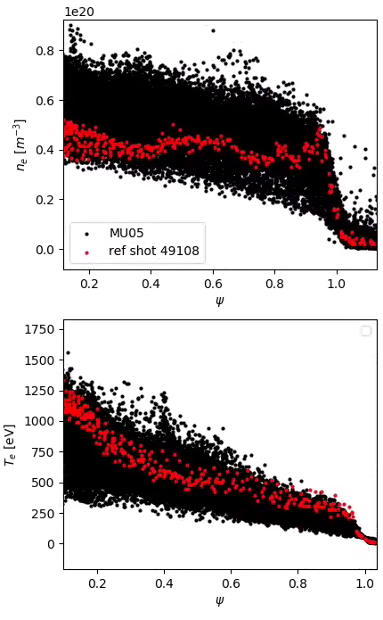
Ongoing/future work: Expanding training dataset to cover parameter space of recent MAST-U campaigns
The next step is to expand the training dataset beyond a single reference discharge parameter space
Ongoing work will use data from recent MAST-U campaigns to build an automated processing pipeline that extracts experimental inputs, defines sampling bounds, constructs equilibrium inputs, and generates a larger training dataset
This will allow fixed assumptions in the current dataset to be gradually relaxed

Slide 12
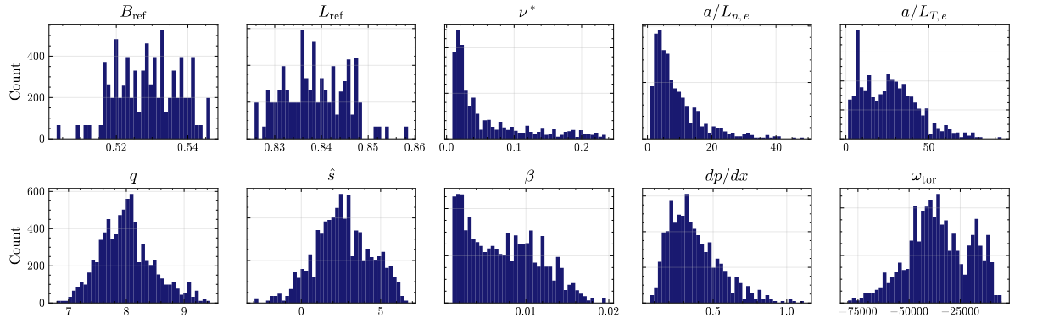
Using the GK surrogate models
Inputs
What we aim to use the model for
  Quasi-linear models for transport modeling
  Other integrated modeling workflows
  Mode classification
Currently you can give the model the local plasma parameters as input (GENE normalization), or run it with eqdsk+profiles

Slide 13
Additional slides

Slide 14
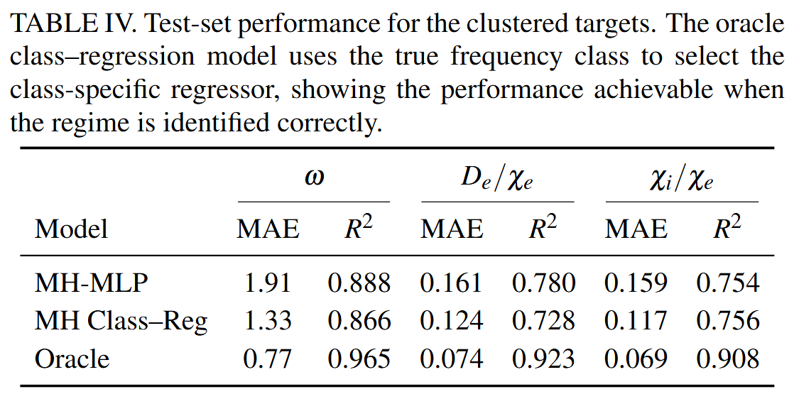
Classification step decreases overall performace
Multi-output prediction useful: targets can benefit from being learned together
  However, classification becomes harder when one class decision controls several outputs
For ratios, oracle-class results are much better than full pipeline results
  This suggests, that classifier errors hurt overall performance significantly
  Changing threholds, class target, and hyperparameters has not significantly improved results

Slide 15
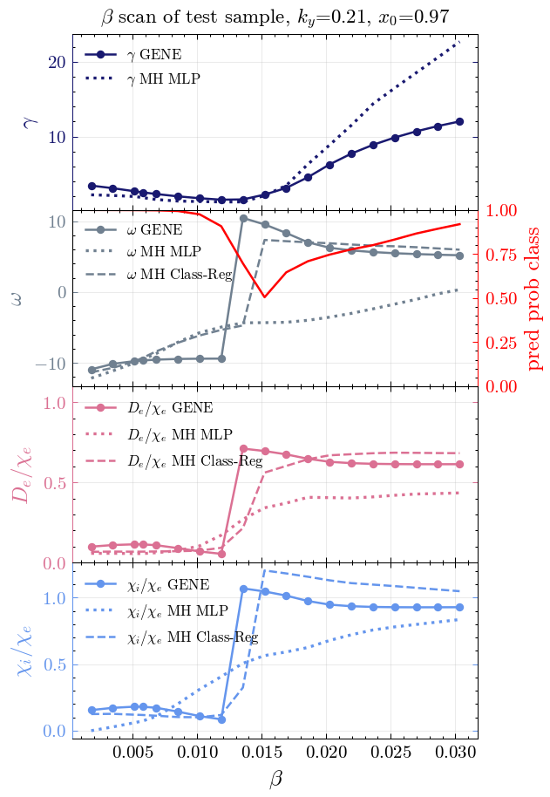
Classification step decreases overall performace

Slide 16
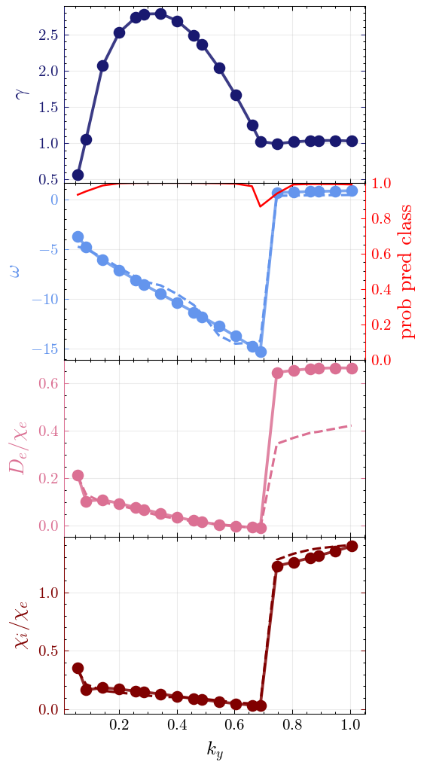
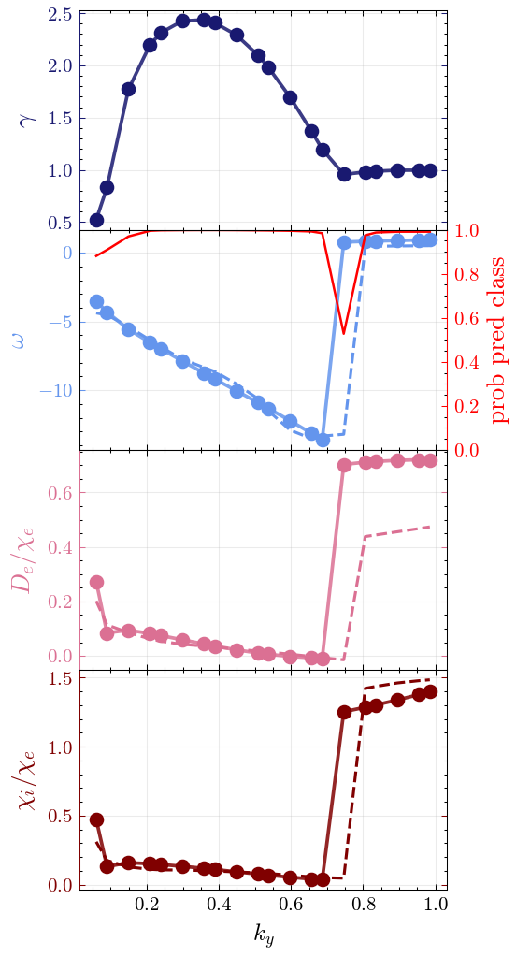
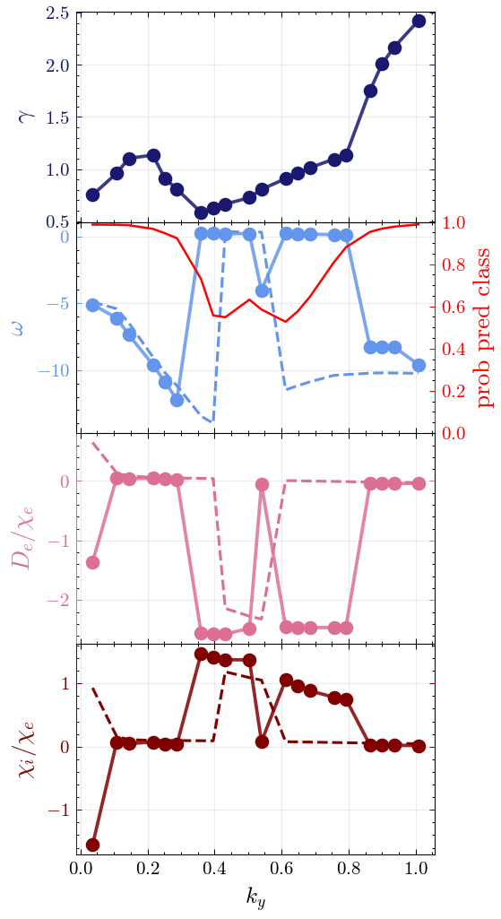
Classification step decreases overall performace

Slide 17
