Slide 1
Muscle3 adaptation of the H&CD workflow
and first results for ITER
Z. Bian, M. Schneider, O. Hoenen, P. Sawantdesai, M. Bellouard
17/06/2026
Zijian.bian_ext@iter.org
Mireille.Schneider@iter.org
The views and opinions expressed herein do not necessarily reflect those of the ITER Organization.
Notes:
Good afternoon everyone, and it’s really an honor to have a talk today. I am Zijian Bian, an intern from the Science Division at the ITER.
Today I will present the MUSCLE3 adaptation of the H&CD workflow— and the first results we obtained on an ITER case. This is joint work with my supervisor Mireille Schneider and other colleagues.

Slide 2
OVERVIEW
Outline
01
Context
HCD-WF in the PDS ecosystem
02
Motivation
why MUSCLE3 — the PDS language
03
Three Execution modes
Legacy, Hybrid M3, Pure M3
04
Architecture
what changed · one micro, many drivers · ports · code map
05
Test ITER results
EC + IC + Fokker–Planck on an evolving plasma · performance
06
Using HCD-WF
run it · configure it · documentation · status & roadmap
MUSCLE3 Adaptation of HCD-WF · TSVV-H Meeting, June 2026
2
Notes:
A quick roadmap of the talk.
I will start with context:
1. what the Pulse Design and the H&CD is.
2. Then the motivation for moving to MUSCLE3,
3. an overview of the three execution modes,
4. and a closer look at the architecture: what actually changed, the port contract and the yMMSL file, and the code map.
5. After that, test ITER results.
6. And I will close with the practical side: how to configure and run the workflow,

Slide 3
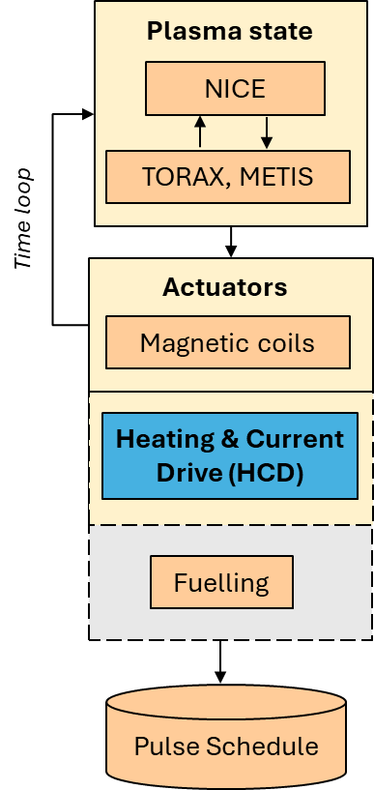

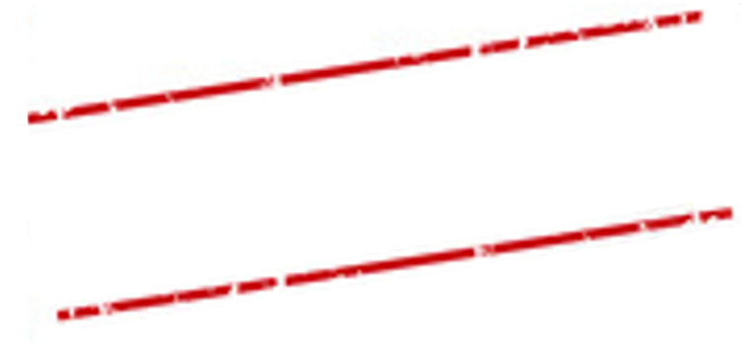
CONTEXT
The ITER Pulse Design Simulator (PDS)
Generating and validating pulse schedules for the Research Plan
Checking operational limits
Supporting plasma operation between shots.
Initial solution for the PDS
Scenario design
Test of controllers
IMAS
Parametric scans
PDS
Waveform optimization
MUSCLE3
Operational limit checks
Pulse preparation
Train physics operators
PYTHON
In line with plans to start training future ITER Session Leaders!
MUSCLE3 Adaptation of HCD-WF · TSVV-H Meeting, June 2026
3
Notes:
First, for those less familiar with the Pulse Design Simulator.
The PDS is ITER's framework for routine, whole-pulse simulation: generating and validating pulse schedules for the Research Plan, checking operational limits, and supporting plasma operation between shots.
In practice it comes as two inter-dependent tools: PDS-design, the GUI where scenarios and waveforms are edited, and PDS-simulator, which actually runs the pulse — and the simulator is what matters for this talk.
Technically, the PDS rests on three choices: IMAS data structures as the common language between components, MUSCLE3 as the coupling framework, and Python.

Slide 4
The ITER Pulse Design Simulator (PDS)
Pulse Design Tool
  PDS-design
inter-dependent
Pulse Simulator Tool
PDS-simulator
  Tool to design a scenario (with a pre-check of operational limits):
    Plasma shape
    Waveforms
  Graphical User Interface
  Tool to simulate a pulse:
    Choose models to be launched
    Various computational modes
    Iteration loops
    Actual pulse simulation
On-going development of a Waveform Editor
Focus of the PDS architecture development
Generic → compatible with any IMAS plasma simulator (HFPS, etc.) ... and control room pulse edition tools!
Notes:
In practice it comes as two inter-dependent tools: PDS-design, the GUI where scenarios and waveforms are edited, and PDS-simulator, which actually runs the pulse — and the simulator is what matters for this talk.

Slide 5
ROLE
HCD-WF: the H&CD engine inside the PDS
Plasma state
WHAT IS HCD-WF?
NICE
Free-boundary equilibrium
A Python workflow that orchestrates the H&CD physics codes — it selects actors from configuration, sequences them, resolves dependencies and merges outputs. It is an orchestrator, not a physics model.
TORAX, METIS
  Core transport solver
Time loop
Actuators
THE CODES IT DRIVES
Magnetic coils
  Magnetic control
EC waves
TORBEAM · GRAY · TORAY …
IC waves
CYRANO · TORIC · PION …
Heating & Current Drive (HCD)
HCD-WF integrates multiple physics solvers for heating simulation
NBI & nuclear
NEMO · BBNBI · AFSI …
Fokker–Planck
FOPLA · STIXREDIST …
Fuelling
Post-process & merge
hcd2core_sources · hcd2core_profiles · merge_waves / _distributions …
Pulse Schedule
The interface with the outside world : IMAS IDS in → IMAS IDS out
equilibrium · core_profiles · ec_launchers · ic_antennas … → waves · distributions · core_sources
MUSCLE3 Adaptation of HCD-WF · TSVV-H Meeting, June 2026
4
Notes:
So what is HCD-WF?
On the left, the PDS core time loop: a pulse schedule goes in, the plasma solvers advance the state, and MUSCLE3 drives the loop in time. Each actuator hangs off this loop as one coupled component — and the heating and current drive slot is HCD-WF.
On the right, what HCD-WF itself is: a Python workflow that orchestrates the H&CD physics codes. It reads the actor selection from configuration, calls the actors, and merges the outputs.
The physics lives in the codes it drives — like TORBEAM for EC, CYRANO for IC, the NBI and nuclear chain, Fokker–Planck solvers like FoPla, and the post-processing actors that map everything onto core sources.
And the interface with the outside world is pure IMAS: IDS in, IDS out. Equilibrium, core profiles, launchers and antennas in; waves, distributions and core_sources out.

Slide 6
MOTIVATION
Why adapt HCD-WF to MUSCLE3?
1
The PDS speaks MUSCLE3
2
M3 pays off on its own
The PDS couples every component through the MUSCLE3 persistent-actor framework. To plug in as its H&CD actuator, HCD-WF itself must become an M3 component — same coupling language, with time stepping driven from outside.
Independent actors can run concurrently
Swap one actor without touching the rest
Scales across processes and nodes
INTEGRATION REQUIREMENT
ARCHITECTURE BENEFITS
GOAL
Make HCD-WF a drop-in MUSCLE3 component for the PDS / JINTRAC …
— with physics results identical to the legacy workflow.
DEVELOPMENT BASIS
IMAS DD 4.1.0
IMAS-Python 2.x
MUSCLE3
Python
DD 3.42.0 back-compat kept
source config_hcd_iter_sdcc.sh
MUSCLE3 Adaptation of HCD-WF · TSVV-H Meeting, June 2026
5
Notes:
Why adapt HCD-WF to MUSCLE3? Two reasons.
1.the PDS speaks MUSCLE3. Every component is coupled through the MUSCLE3 persistent-actor framework, with time stepping driven from outside. If HCD-WF wants to plug in as the H&CD component, it has to speak the same language.
2. MUSCLE3 pays off on its own, even outside the PDS. Independent actors can run concurrently; you can swap one actor without touching the rest; it scales across processes and nodes; and it gives a clean split between time management and physics.
The goal of this work: make HCD-WF a MUSCLE3 component for the PDS — with physics results identical to the legacy workflow.
On the development basis: all of this is developed and tested on SDCC under IMAS Data Dictionary 4.1.0 with IMAS-Python 2, set up by one config script — and we keep backward compatibility with the 3.42 stack for the legacy environment.

Slide 7
EXECUTION MODES
Three execution modes — where the M3 boundary sits
One repository, one runner (run.sh) · same IMAS inputs and outputs in every mode
LEGACY
BASELINE
HYBRID M3
STABLE
PURE M3
EXPERIMENTAL
The original workflow.
Everything runs in one Python process — no MUSCLE3.
HCD-WF becomes ONE M3 component.
Driver (macro) ⇄ whole workflow (micro); actors unchanged inside.
Every actor becomes its OWN M3 component.
Driver couples directly to each actor — the target architecture.
driver
driver · M3 macro
driver · M3 macro
M3
M3
workflow core
workflow core
workflow core removed
actor
actor
actor
actor
actor
actor
*_m3.exe
*_m3.exe
*_m3.exe
one Python process
one M3 component
./run.sh legacy
./run.sh hybrid
./run.sh pure
Same IDS in / out everywhere — only the MUSCLE3 component boundary moves.
M3 granularity: none → workflow-level → actor-level
MUSCLE3 Adaptation of HCD-WF · TSVV-H Meeting, June 2026
6
Notes:
Here is the map for the next few slides: the three execution modes. They all live in one repository, behind one runner, with the same IMAS inputs and outputs. The only thing that changes is where the MUSCLE3 boundary sits.
Legacy, on the left, is the original workflow: everything in one Python process. It is the baseline.
Hybrid M3, in the middle, is the stable default today: the whole workflow becomes ONE MUSCLE3 component. A driver — the macro — exchanges IDS with the workflow — the micro — and inside, the actors run exactly as before.
Pure M3, on the right, is the experimental target architecture: every actor becomes its OWN MUSCLE3 component, and the driver couples to each of them directly.
So as you go left to right, the M3 moves from none, to workflow-level, to actor-level.

Slide 8
ARCHITECTURE · LEGACY
Workflow structure — Legacy (the baseline)
NO MUSCLE3 — everything below runs in a single Python process
THE BASELINE
DRIVER
1
One Python process — driver, workflow core and iWrap actors together.
global time loop
IMAS database I/O
XML / YAML configuration
plain Python calls — same process ▼
2
The driver owns the time loop and all IMAS database I/O.
WORKFLOW CORE — HCDWorkflow · WorkflowExecutor
maps configuration to actors · resolves dependencies · inserts mergers · validates bundles
3
No MUSCLE3 anywhere — the reference behaviour for every comparison.
iWrap calls — actors run in-process ▼
./run.sh legacy
PHYSICS ACTORS
EC waves
TORBEAM · GRAY …
IC waves
CYRANO · TORIC …
NBI & nuclear
NEMO · BBNBI …
Fokker–Planck
FOPLA · RISK …
Post & merge
hcd2core_* …
Stable · DD 3.42.0 back-compatibility verified · the physics ground truth for the M3 modes.
workflow core
physics actors
MUSCLE3 boundary
MUSCLE3 Adaptation of HCD-WF · TSVV-H Meeting, June 2026
7
Notes:
Here is the structure of HCDWF
The driver owns the time loop and prepares the input IDS for every time slice. The ports row is where data crosses between the driver and the workflow. Then the workflow core — the HCDWorkflow class with its executor — which calls the physics actors at the bottom.
In Legacy mode, everything you see is one single Python process. The driver calls the workflow as a function; the 'ports' are just in-memory IDS handovers; the actors run through iWrap bindings inside the same process.
This is the baseline: stable, validated. Now watch what changes — and what does not — when we switch to Hybrid.

Slide 9
ARCHITECTURE · HYBRID M3
Workflow structure — Hybrid M3
MUSCLE3 MANAGER — launches the two components below
WHAT CHANGED VS LEGACY
DRIVER
M3 MACRO
1
The driver becomes the M3 macro — it keeps the time loop and DB I/O.
global time loop
IMAS database I/O
XML / YAML configuration
MUSCLE3 PORTS — serialized IMAS IDS ▼ send · receive ▲
2
The whole workflow becomes ONE M3 micro component.
M3 MICRO — one component
WORKFLOW CORE — HCDWorkflow · WorkflowExecutor
receives one time slice · runs HCDWorkflow.run() · returns output IDS (hcd_workflow_m3.py)
3
IDS now cross MUSCLE3 ports — everything inside the micro is untouched.
iWrap calls — unchanged, in-process ▼
./run.sh hybrid
PHYSICS ACTORS
UNCHANGED — invisible to M3
EC waves
TORBEAM · GRAY …
IC waves
CYRANO · TORIC …
NBI & nuclear
NEMO · BBNBI …
Fokker–Planck
FOPLA · RISK …
Post & merge
hcd2core_* …
Stable · the recommended M3 path today · validates the macro/micro boundary while keeping actor execution close to legacy.
workflow core
physics actors
MUSCLE3 boundary
MUSCLE3 Adaptation of HCD-WF · TSVV-H Meeting, June 2026
8
Notes:
Same diagram — and notice most of it has not moved. That is the point.
What changed, first: the driver is now a MUSCLE3 macro. The ports row is now real MUSCLE3 ports — IDS are serialized and sent as messages instead of handed over in memory. And the workflow core plus all its actors now live inside one MUSCLE3 micro component, in their own process.
What did NOT change: the workflow core itself, the executor, the actor codes, the iWrap bindings — all untouched. The micro receives a time slice, runs the exact same code as Legacy, and sends the results back.
You launch it with muscle_manager and the hybrid yMMSL file, or simply ./run.sh hybrid — it is the default. This mode is stable, and it is the one we validated end-to-end against Legacy.

Slide 10
ARCHITECTURE · PURE M3
Workflow structure — Pure M3
MUSCLE3 MANAGER — launches the driver and every actor component
WHAT CHANGED VS LEGACY
DRIVER (pure)
M3 MACRO
1
Every actor is its own M3 component (*_m3.exe).
global time loop
IMAS database I/O
XML / YAML configuration
MUSCLE3 PORTS — the driver couples DIRECTLY to every actor ▼ ▲
2
The orchestration core is gone — coupling is declared in the yMMSL file.
REPLACED BY yMMSL
HCDWorkflow · WorkflowExecutor — REPLACED
the orchestration layer is gone — the coupling now lives in the yMMSL topology
3
The driver talks to actors directly — one reuse = one time step.
direct M3 coupling — active actors inferred from connected ports ▼
./run.sh pure
PHYSICS ACTORS · individual M3 components (*_m3.exe)
EACH = ONE M3 COMPONENT
EC waves
torbeam_m3.exe
IC waves
cyrano_m3.exe
…_m3.exe
Fokker–Planck
fopla_m3.exe
hcd2core_
sources_m3.exe
Experimental · validated subset runs end-to-end: Torbeam · Cyrano · merge_waves · hcd2core_sources (FoPla coupled, not yet validated).
workflow core
physics actors
MUSCLE3 boundary
MUSCLE3 Adaptation of HCD-WF · TSVV-H Meeting, June 2026
9
Notes:
Same diagram one more time — now Pure M3, the experimental mode.
What changed: the previous driver is replaced by a dedicated Pure-mode macro, driver_pure. The workflow core in the middle is GONE — its sequencing role is taken over by the yMMSL file itself. And each actor at the bottom is now its own MUSCLE3 component, an independent executable, coupled directly to the driver through ports.
Power gating is preserved — if a heating system has zero power in a slice, its actors are simply skipped.
Status: it just passed a Multi-slice run with TORBEAM for EC and CYRANO for IC, FoPla .
the integration is still developer-level.

Slide 11
INTEGRATION
One micro model — many possible drivers
Whoever owns the time loop is the macro; HCD-WF stays exactly the same micro underneath
hcd driver
TODAY
PDS
TARGET
HFPS / others
Future
Standalone macro — used for development and the validation runs shown today.
The Pulse Design Simulator time loop — HCD-WF slots in as its H&CD component.
Any other MUSCLE3 workflow can reuse the same component.
FIXED PORT CONTRACT same IDS messages in, same IDS messages out — for every macro
HCD-WF · M3 micro model
TORBEAM
CYRANO
FoPla
merge
hcd2core
…
runs one time slice per request,
then waits for the next
Today — the hcd driver runs the loop: validated against Legacy, physics identical.
Next — swap the macro, not the workflow: PDS adopts HCD-WF with no change to the physics chain.
MUSCLE3 Adaptation of HCD-WF · TSVV-H Meeting, June 2026
10
Notes:
Once HCD-WF is one MUSCLE3 micro with a fixed port interface, the question 'who drives it?' becomes open.
Today, it is our own hcd driver — that is what all the validation runs use. The target is the PDS time loop: HCD-WF slots in as its H&CD component. And in principle, any other MUSCLE3 workflow — an HFPS-style integrated simulation, for example — can reuse this component.
So the message is: we can swap the macro, not the workflow. When the PDS adopts HCD-WF, nothing in the physics chain changes — and that is exactly how we want it.

Slide 12
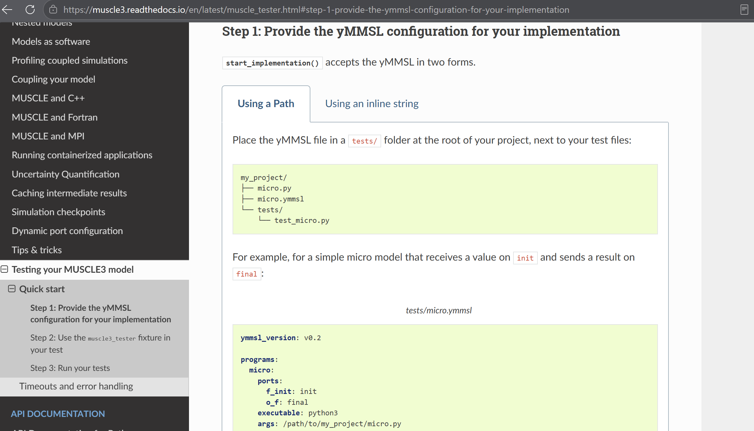
USING HCD-WF
Ports and the yMMSL file — two views of one contract
MUSCLE3 documentation
Ports say what flows each time slice; the yMMSL file wires them up and launches t
PORTS ON THE HCD-WF MICRO
test_hybrid_hcdwf.ymmsl
IN — received every time slice
ymmsl_version: v0.1
model:
name: hcd_workflow_hybrid
components:
driver: hcd_driver
hcd_workflow: hcd_workflow_m3
conduits:
driver.equilibrium_out:
hcd_workflow.equilibrium_in
hcd_workflow.waves_out:
driver.waves_in
# ... one conduit per port
settings: # time grid, options
resources: # cores per component
equilibrium_in
core_profiles_in
workflow_in
ec_launchers_in
ic_antennas_in
core_sources_in
distributions_in
distribution_sources_in
OUT — returned every time slice
waves_out
core_sources_out
core_profiles_out
distributions_out
The yMMSL file turns ports into a runnable model — muscle_manager --start-all <file>.ymmsl launches everything.
MUSCLE3 Adaptation of HCD-WF · TSVV-H Meeting, June 2026
11
Notes:
Now the practical half: if you want to couple to HCD-WF, these are the only two things you need to know
On the left, the port: what the micro receives every time slice — equilibrium, core profiles, the workflow IDS carrying configuration, …. — and what it returns: waves, core sources, core profiles and distributions.
On the right, the yMMSL file — this is where ports become a runnable model. You declare the two components, driver and workflow, and the conduits just wire matching port names together.

Slide 13
CODEBASE
Current Code Map — After Renaming & Consolidation
hcd-wf/
├─ run.sh legacy · hybrid (pure stub: needs integration)
├─ workflow/
│ ├─ workflow_driver.py legacy entry + Hybrid M3 macro
│ └─ ids_prep.py IDS conversion · fix-ups · placeholders · merge
├─ hcdworkflow/
│ ├─ hcd_workflow.py original HCDWorkflow class
│ ├─ hcd_workflow_m3.py Hybrid M3 micro model
│ ├─ workflow_driver_m3_pure.py Pure M3 macro driver
│ ├─ workflow_executor.py actor execution · dependencies · toroidal-mode loop
│ └─ global_configuration/global_lists.yaml actors · algorithms · deps · mergers
├─ test_hybrid_hcdwf.ymmsl default Hybrid yMMSL
├─ test_m3_pure.ymmsl Pure M3 full-chain yMMSL
├─ config_hcd_iter_sdcc.sh DD 4.1.0 / IMAS-Python 2.x / M3 setup
└─ tests/m3_hybrid/
Colour key
directory
Hybrid M3 file
Pure M3 file
shared / legacy
MUSCLE3 Adaptation of HCD-WF · TSVV-H Meeting, June 2026
12
Notes:
A quick look at where things live in the HCDWF’s repository, for when you want to find or modify something.
run.sh at the top is the entry point for 3 modes.
In the workflow folder: workflow_driver.py is both the legacy entry and the Hybrid macro, ids_prep.py does the IDS conversion and fix-ups.
In hcdworkflow: the original HCDWorkflow class, the Hybrid micro hcd_workflow_m3.py, the Pure-mode driver workflow_driver_m3_pure.py, and the executor with the actor dependency logic. The global_lists.yaml file is the registry of actors, algorithms and mergers.
The two yMMSL files at the bottom are the default Hybrid and Pure full-chain model, and one config script sets up the whole DD 4.1.0 environment.

Slide 14
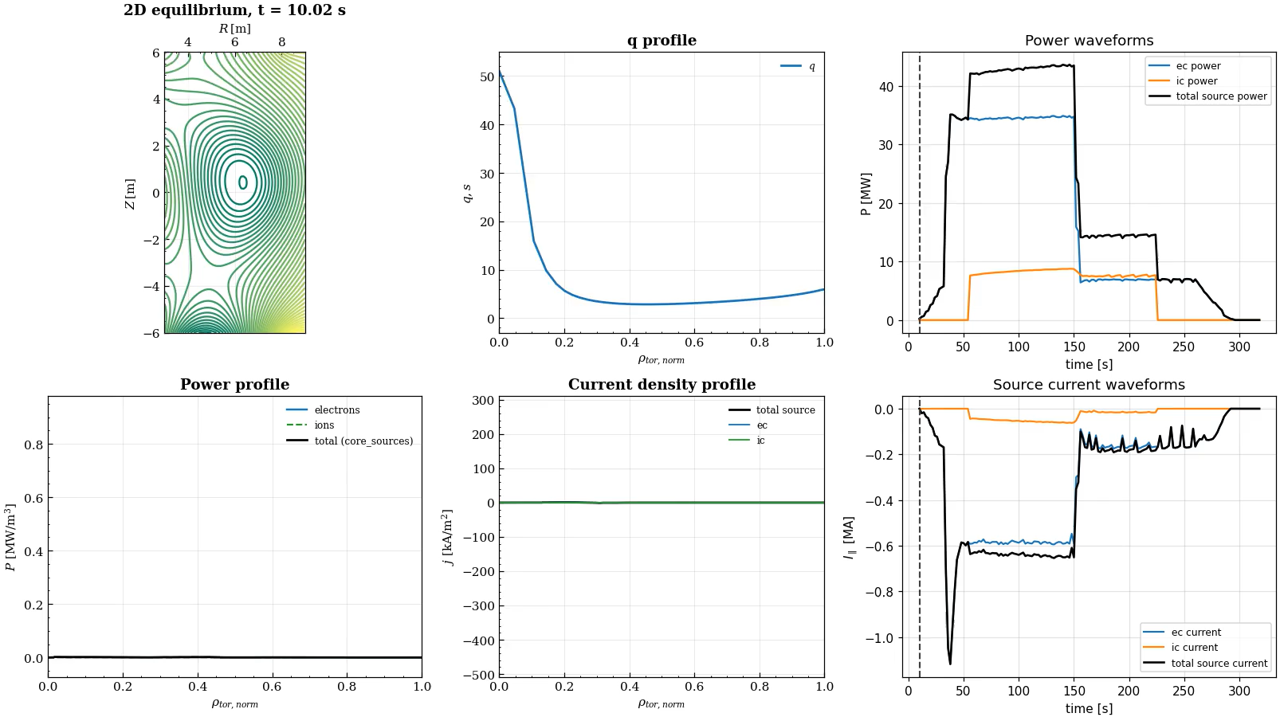
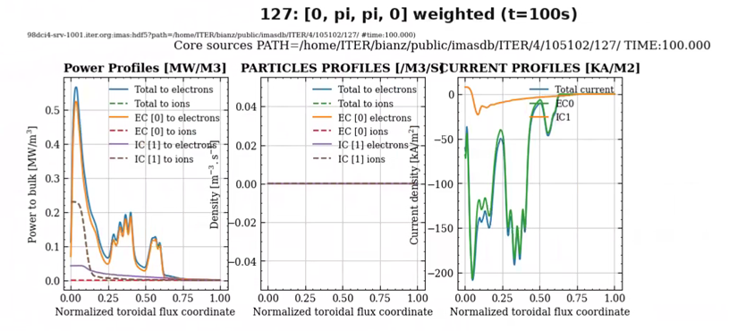
RESULTS
Validated ITER run — what the workflow produces
A validated Hybrid M3 run — EC + IC + Fokker–Planck on a time-evolving ITER plasma
The Output
Equilibrium
the plasma boundary and flux surfaces evolve over the pulse
Absorbed power
EC (TORBEAM) and IC (CYRANO) deposition, slice by slice
Driven current & sources
FoPla + hcd2core_sources turn waves into core_sources profiles
MUSCLE3 Adaptation of HCD-WF · TSVV-H Meeting, June 2026
13
Notes:
Rather than more diagrams, let me show you the workflow actually running. [Play the video.]
This is a validated Hybrid M3 run of the full ITER chain — EC, IC — on a plasma evolving over the pulse.
And you can select a time slice for more details

Slide 15
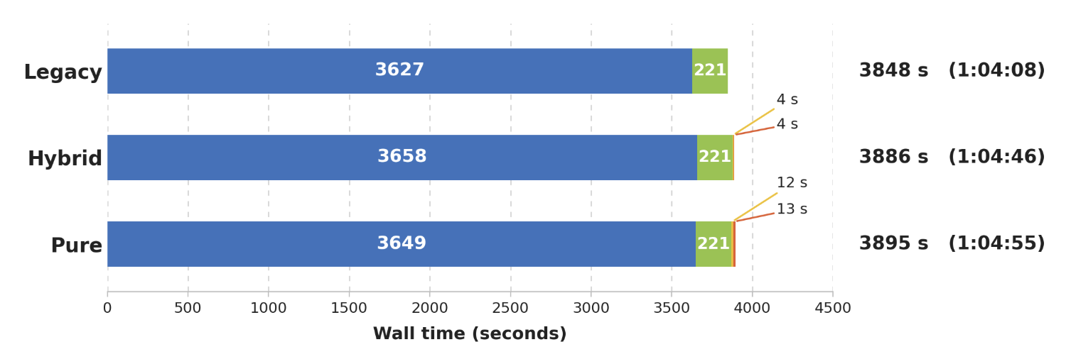
PERFORMANCE
Performance — the M3 layer costs almost nothing
ITER case, 10–315 s, dt = 5 s → 62 time slices · TORBEAM (EC) + CYRANO (IC, Ntor = 35) · same inputs, same outputs in every mode
★
Physics / actor critical path
Explicit M3 transfer
Driver IDS/IMAS prep-write/misc
M3 setup / cleanup
Explicit M3 transfer / setup time is small; most time is in physics work.
Moving the M3 boundary does not move the bill — the physics actors dominate, exactly as before.
MUSCLE3 Adaptation of HCD-WF · TSVV-H Meeting, June 2026
14
Notes:
The MUSCLE3 layer cost almost nothing.
Here is an identical physics case —62 time slices running for ITER SRO scenario, with TORBEAM for EC and CYRANO for IC — run end-to-end in all three modes. Same inputs, same outputs.
The explicit MUSCLE3 cost — message transfer plus component setup — is seconds: zero for Legacy by definition, about eight seconds for Hybrid, twenty-five for Pure. Under one percent of the run. Thet are small; most time is still in physics work.
You will notice the physics bars themselves differ by a few percent between modes. That is run-to-run variation on the shared cluster — actor runtimes fluctuate — not an M3 effect..

Slide 16
USAGE
How Users Can Run HCD-WF Today
# 1. Load the default SDCC environment
source config_hcd_iter_sdcc.sh
# 2. Run Hybrid M3 with the default yMMSL
muscle_manager --start-all test_hybrid_hcdwf.ymmsl
# 3. Or use the runner
./run.sh hybrid
# 4. Run a specific Hybrid configuration
export HCD_HYBRID_YMMSL=.local_dev/tests/ \
105102_ec_ic_ref_p38_weighted_fopla_long_dt10_.../ \
test_hybrid_105102.ymmsl
./run.sh hybrid
# 5. Pure M3 full-chain (developer launch)
muscle_manager --start-all test_m3_pure.ymmsl
Prerequisite
Run source config_hcd_iter_sdcc.sh once per shell session.
A bare ./run.sh defaults to Hybrid mode.
!
Caution — Pure M3
Pure M3 currently uses development yMMSL files with local paths. Useful for developers, but not yet the recommended user entry point.
MUSCLE3 Adaptation of HCD-WF · TSVV-H Meeting, June 2026
15
Notes:
So how do we actually run it?
First, in the shell session, source the SDCC config script — that loads the DD 4.1.0 environment, IMAS-Python 2 and MUSCLE3.
Then, for the default Hybrid mode: you can launch the yMMSL directly with muscle_manager, or just call ./run.sh hybrid — a bare run.sh defaults to Hybrid. If you have a specific configuration, point the HCD_HYBRID_YMMSL variable at your own yMMSL file and run the same command.
Pure M3 full-chain is launched with muscle_manager on the pure yMMSL — but note the caution box: the Pure files still carry development paths, so it is a developer entry point for now, not the recommended user route.

Slide 17
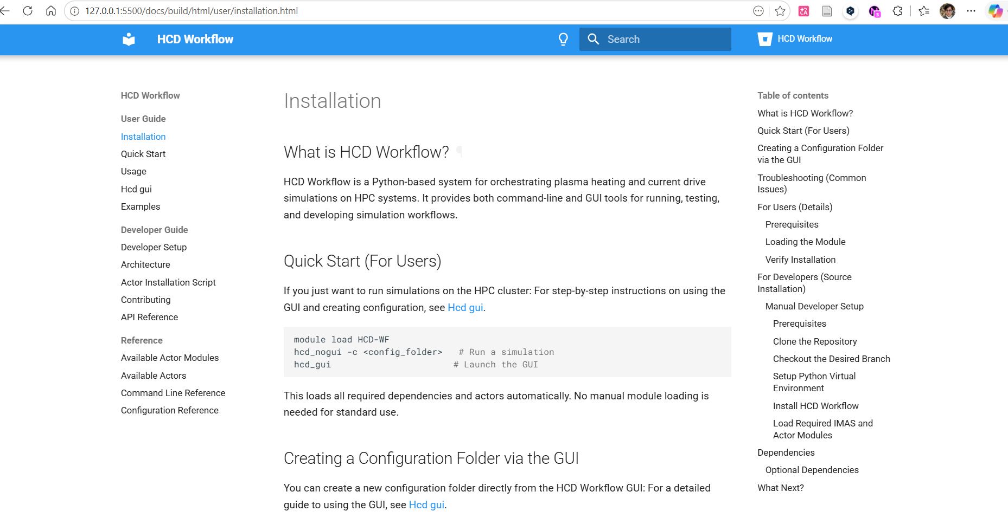

DOCUMENTATION
Everything else lives in the docs
Quickstart, execution modes, validation status, troubleshooting — kept up to date with the code
https://zijianbian.github.io/HCD-WF-M3/
START HERE
Quickstart
Execution Modes
Validation Status
zijianbian.github.io/HCD-WF-M3 — public GitHub Pages site
If it is not on this slide deck, it is on this site — commands, options, yMMSL templates, troubleshooting.
MUSCLE3 Adaptation of HCD-WF · TSVV-H Meeting, June 2026
16
Notes:
The documentation, it is public. The documents in the ITER library haven't been fully reviewed yet, so you can see them under my personal address.
The site is maintained alongside the code, so when the Pure mode graduates, the docs move with it.

Slide 18
CONFIGURATION
What a User Needs to Prepare
EXAMPLE ACTOR SELECTION
config_folder/
├─ input_workflow.xml shot/run · time range & dt · actor selection
├─ ec_waveforms.yaml
├─ ic_waveforms.yaml time-dependent H&CD settings
├─ nbi_waveforms.yaml
├─ ic_toroidal_modes.yaml optional CYRANO multi-mode scan
├─ ECRH/ec_wave_solver/input_torbeam.xml
├─ ICRH/ic_wave_solver/input_cyrano.xml
├─ ICRH/ic_wave_fp/input_fopla.xml
└─ source/fill_core_sources/
input_hcd2core_sources.xml
<ECRH>
<ec_wave_solver list="genray gray grayscale torbeam toray">4</ec_wave_solver>
</ECRH>
<ICRH>
<ic_wave_solver list="cyrano tomcat pion lion">1</ic_wave_solver>
<ic_wave_fp list="stix_redist fopla">2</ic_wave_fp>
</ICRH>
<post_process>
<source>
<fill_core_sources list="hcd2core_sources">1</...>
</source>
</post_process>
one number per category — picks the actor from the list; 0 disables that branch
MUSCLE3 Adaptation of HCD-WF · TSVV-H Meeting, June 2026
17
Notes:
What you need to prepare as a user: one folder, and one decision per actor category.
On the left, the config folder: input_workflow.xml is the master file — shot and run, time range and time step, and the actor selection. The waveform YAML files carry the time-dependent heating settings, and each selected actor has its own XML.
On the right, the actor selection itself, this is literally what you edit. Each category lists the available actors; you pick one by writing its number. One number per category — and zero disables that branch entirely. Here: TORBEAM as the fourth entry of the EC list.
The same files work in all three execution modes.

Slide 19
STATUS & ROADMAP
Where it stands — and what comes next
WHERE IT STANDS
NEXT STEPS
●
Hybrid M3 — stable, default
1
Productize Pure M3
physics identical to Legacy on the full ITER case
run.sh pure · remove local paths
◑
Pure M3 — validated subset
2
Wrap the NBI solvers
full EC + IC + FoPla chain passes; still carries hardcoded paths — cleanup targeted this month
iWrap / M3 wrapping of the NBI physics codes — July
◑
NBI chain
3
Documentation catch-up
physics solvers not yet wrapped for iWrap / M3; planned for July
per-actor validation status, Pure-mode quickstart
●
Documentation
4
Integrate into PDS
quickstart + execution modes online; per-actor validation pages catching up
time control + port semantics with the PDS team — then plug in
Ready when the PDS is — the M3 boundary is in place, and the physics underneath is unchanged.
MUSCLE3 Adaptation of HCD-WF · TSVV-H Meeting, June 2026
18
Notes:
Let me close with an honest status, and what comes next.
Where it stands: Hybrid M3 is stable and the default — physics identical to Legacy on the full ITER case, EC plus IC plus FP solver
Pure M3 is actually validated too — the full EC, IC and Fokker–Planck chain passes — but it still carries a lot of hardcoded paths, so it is not something I would hand to users yet; cleaning that up is our goal for this month. The NBI chain is a different story: the NBI physics solvers are not yet wrapped for iWrap or M3 at all, and that work is planned for July. Documentation covers quickstart and execution modes, with the per-actor validation pages still catching up.
Next steps follow directly from that. First, release Pure M3: targeted this month. Second, wrap the NBI solvers for iWrap and M3 — that is the July item. Then documentation catch-up alongside. And fourth, agree the integration contract with the PDS: time control and port semantics.
The bottom line of the talk: the MUSCLE3 boundary is in place, it costs nothing measurable, and the physics underneath is unchanged. Thank you.

Slide 20
Thank you
19
Notes:
Backup slides from here: MUSCLE3 background, simulator types, actor categories, the Pure-mode yMMSL in full, troubleshooting, and the detailed scheduling deep-dives for Hybrid and Pure.

Slide 21
Backup
MUSCLE3 in one slide · Simulator types (A1) · Actor categories (A2)
Pure-mode yMMSL (A3) · Troubleshooting (A4) · Hybrid & Pure scheduling deep dives
19
Notes:
Backup slides from here: MUSCLE3 background, simulator types, actor categories, the Pure-mode yMMSL in full, troubleshooting, and the detailed scheduling deep-dives for Hybrid and Pure.

Slide 22
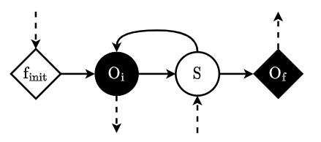
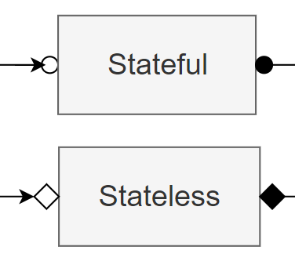
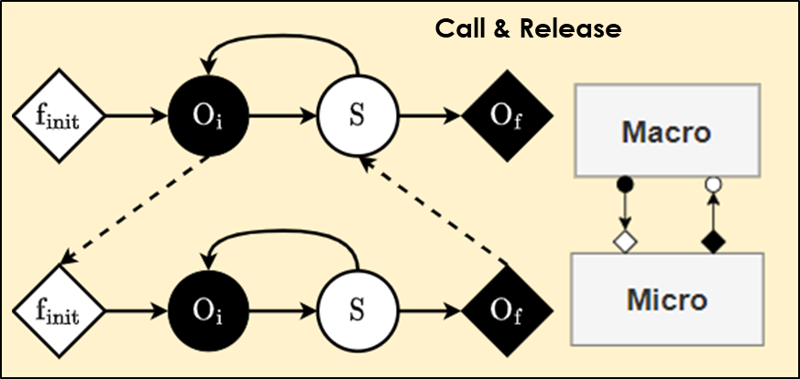
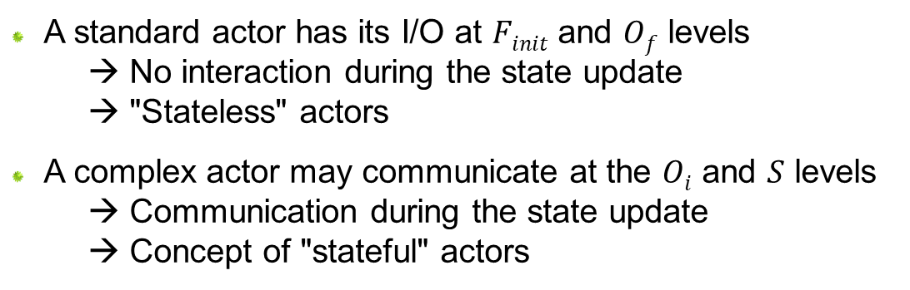
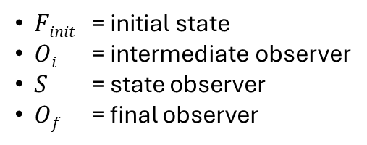
The Muscle3 Persistent Actor Framework
  Documentation: https://muscle3.readthedocs.io/
  Muscle3 is a Multiscale Coupling Library and Environment
  It uses the Multiscale Modelling and Simulation Language (MMSL) to describe the structure of a multiscale model (→ yMMSL yaml file)
  A standard actor has its I/O at $Finit$ and $Of$ levels
    → No interaction during the state update
    → "Stateless" actors
  A complex actor may communicate at the $Oi$ and $S$ levels
    → Communication during the state update
    → Concept of "stateful" actors
$Finit$ = initial state
$Oi$ = intermediate observer
$S$ = state observer
$Of$ = final observer
Notes:
So what is muscle3 and why we need to do that? As a multi-scale complex system, plasma exhibits various phenomena with large temporal and spatial spans. Muscle, which means Multiscale Coupling Library and Environment give us a useful framework to manage different components in different scale. And also let them run parallelly. This can further enhance the modularity and scalability of the workflow.

Slide 23
APPENDIX · A1
The Various Types of Plasma Simulators
High Fidelity Plasma Simulators | Use high accuracy (potentially time-consuming) models to account for all possible physics to simulate the plasma behaviour | ASTRA, CRONOS, ETS, JINTRAC, TRANSP
Flight Simulators | Test and validate controllers in closed loop simulations Strictly restricted to taking input from diagnostics and simulating plasma state from requests sent by the PCS | FENIX
Pulse Design Simulators | To design scenarios → write optimal pulse schedule, using closed or open loops, with or w/o controllers Mostly solves an inverse problem for discharge optimization Compare to OLCs (physics and plant systems) Resulting pulse schedule can be used: As input to HFPS For plasma operation | METIS
Real-Time Simulators | Faster than real-time Test PCS controllers (state estimates, event detection...) | RAPTOR, RAPDENS, PCSSP
PCS: Plasma Control System
OLCs: Operating Limits and Conditions
Notes:
Background taxonomy for non-PDS attendees. High-fidelity simulators evolve the plasma forward with detailed physics; pulse design simulators like METIS solve the inverse problem to design a pulse schedule; flight simulators test controllers in closed loop; real-time simulators run faster than real time for controller and state-estimator testing. HCD-WF feeds the heating/current-drive physics into this stack via IMAS.

Slide 24
APPENDIX · A2
Full Actor Categories
ECRH wave solvers
ICRH wave solvers
Torbeam · Gray · GRAYSCALE · Genray · Toray
Cyrano · PION · TOMCAT · LION
ICRH Fokker-Planck
NBI source
STIXREDIST · FOPLA
NEMO · BBNBI
NBI Fokker-Planck
Nuclear
RISK · SPOT · ASCOT · NBISIM
AFSI · SPOT / ASCOT
Post-processing
Mergers
hcd2core_sources · hcd2core_profiles
merge_waves · merge_distributions · merge_distribution_sources · merge_core_sources
MUSCLE3 Adaptation of HCD-WF · TSVV-H Meeting, June 2026
22
Notes:
The full set of actor categories HCD-WF can orchestrate, by physics role: EC and IC wave solvers, ion and electron Fokker-Planck solvers, NBI source and fast-ion solvers, nuclear-reaction sources, post-processing actors that fill core_sources / core_profiles, and the merger actors that combine outputs when multiple actors write the same IDS type.

Slide 25
APPENDIX · A3
Pure M3 yMMSL Topology
driver
├─ torbeam → waves_ec
├─ cyrano → waves_ic
├─ merge_waves → waves_merged
├─ fopla → distributions
└─ hcd2core_sources → core_sources
Notes
One reuse corresponds to one time step.
The driver sends IDS to all connected actors.
Active actors are inferred from the connected ports.
Each actor is an independent MUSCLE3 component (a *_m3.exe executable).
MUSCLE3 Adaptation of HCD-WF · TSVV-H Meeting, June 2026
23
Notes:
The simplified Pure M3 topology: the driver fans IDS out to each connected actor component, and each writes its output IDS. One reuse equals one time step; the active actor chain is inferred from which ports are connected. This is the distributed-actor direction, currently a developer mode pending path cleanup and runner integration.

Slide 26
APPENDIX · A4
Troubleshooting Notes
Symptom | Check / action
An IDS is empty | The workflow may send a minimal serializable IDS placeholder.
An output IDS was not produced in a slice | It may be marked invalid to avoid writing wrong data.
Pure M3 fails immediately | Check hardcoded actor executable paths and ACTOR_FOLDER.
FOPLA fails on equilibrium geometry / radius | Check rho_tor and toroidal-flux fields.
CYRANO toroidal modes look wrong | Check the sign convention for Ntor and waves.n_phi.
MUSCLE3 Adaptation of HCD-WF · TSVV-H Meeting, June 2026
24
Notes:
Practical troubleshooting. Empty IDS objects are replaced by minimal serializable placeholders; outputs missing from a slice are flagged invalid so the database is not corrupted. Pure M3 failures are usually hardcoded paths or ACTOR_FOLDER. FOPLA geometry failures point to rho_tor or toroidal-flux fields. If CYRANO toroidal modes look wrong, verify the sign convention between Ntor and waves.n_phi.

Slide 27
ARCHITECTURE · HYBRID M3
Hybrid M3: HCD-WF as a MUSCLE3 Component
MUSCLE3 MANAGER
Key point
workflow_driver.py — macro
MUSCLE3 sees HCD-WF as one micro component. The internal physics actors stay invisible to M3.
opens input / output / machine databases · controls global time loop · reads IDS slices · serializes IDS and sends through M3 ports · receives output IDS and writes the database
M3 ports · serialized IDS (send ↓ / receive ↑)
What moved
hcd_workflow_m3.py — micro
To the macro:
database I/O and global time-loop control.
Unchanged:
HCDWorkflow and WorkflowExecutor logic.
receives IDS for one time slice · calls HCDWorkflow.run() · returns output IDS
iWrap actors execute internally — invisible to M3
Torbeam · Cyrano · FOPLA · hcd2core_sources
MUSCLE3 Adaptation of HCD-WF · TSVV-H Meeting, June 2026
25
Notes:
This is the least disruptive adaptation. Database I/O and global time-loop control move to the macro side, but the existing HCDWorkflow and WorkflowExecutor logic are preserved. In Hybrid mode MUSCLE3 only sees two components: the macro workflow_driver and the micro hcd_workflow; the actors such as Torbeam, Cyrano and FOPLA run inside HCDWorkflow.run() and are invisible to MUSCLE3.

Slide 28
ARCHITECTURE · PURE M3
Pure M3: Direct Coupling to Individual Actors
torbeam_m3.exe
waves_ec
cyrano_m3.exe
waves_ic
workflow_driver_
m3_direct.py
merge_waves_m3.exe
waves_merged
macro driver
one reuse = one time step
fopla_m3.exe
distributions
hcd2core_sources_m3.exe
core_sources
DEVELOPER MODE
Implemented: yMMSL topology test_m3_pure.ymmsl — actors as independent M3 components, full chain (Torbeam, Cyrano, merge_waves, FOPLA, hcd2core_sources).
Still needs: remove hardcoded paths · integrate run.sh pure · derive the active actor chain automatically from configuration.
MUSCLE3 Adaptation of HCD-WF · TSVV-H Meeting, June 2026
26
Notes:
Pure M3 is no longer just a Torbeam proof of concept: a full-chain topology exists with Torbeam, Cyrano, merge_waves, FOPLA and hcd2core_sources, each as an independent MUSCLE3 component coupled directly through ports. But it should be presented as a development mode, not the primary user path: the yMMSL files still contain local development paths, run.sh pure is not yet integrated, and the active actor chain should be derived from configuration rather than hardcoded.

