Slide 1

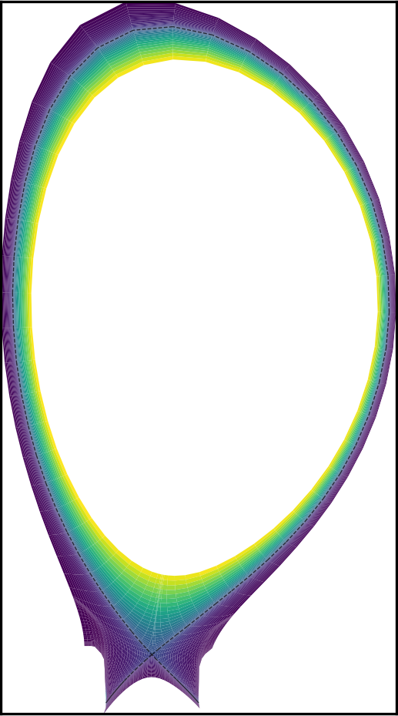

Preliminary integration of SOLPS-NN into JINTRAC: lessons learned and outlook
R.C. van Schaik¹, S. Dasbach¹, R. Futtersack², D. vander Mijnsbrugge³, J. Simpson², L. Zanisi², S. Wiesen^{1,4}
¹ DIFFER - Dutch Institute for Fundamental Energy Research, De Zaale 20, 5612 AJ Eindhoven, The Netherlands
² UKAEA – United Kingdom Atomic Energy Authority, Culham Campus, Abingdon, Oxfordshire, UK
³ University of Ghent, Sint-Pietersnieuwstraat 33, 9000 Gent, Belgium
⁴ EUROfusion, Boltzmannstr. 2, Garching 85748, Bavaria, Germany
TSVV-H in-person meeting
June 18th 2026

Slide 2
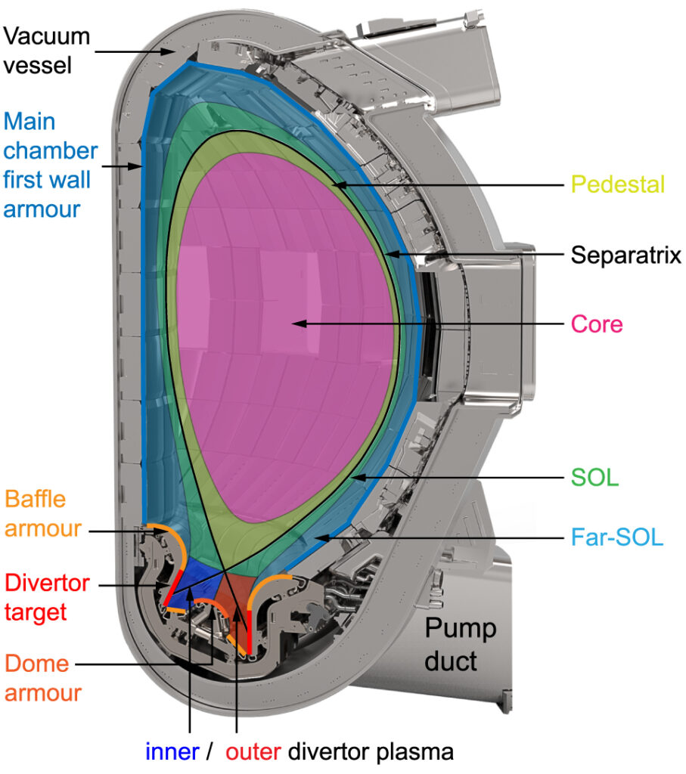
Motivation and Introduction
K. Krieger et al., Nucl. Fusion 65 (2025)
Optimal tokamak design and operation
Need fast and accurate tools to evaluate machine performance
Core-SOL-Wall Integrated modelling for full picture
Prohibitively expensive to scope large operational space (for optimisation, validation and UQ)
SOL model = bottleneck
Aim: Replace SOL model by fast, accurate surrogate
Proof of concept: Integrate SOLPS-NN (“off-the-shelf”) into JINTRAC (focused primarily on the coupling approach and behaviour)
Rick van Schaik – TSVV-H in-person meeting – 18 June 2026

Slide 3
Outline
Introduction to models:
  JINTRAC, SOLPS-NN, core-edge connector model
JINTRAC-SOLPS-NN coupling implementation
  Desired & current implementation, how I use it
JINTRAC-SOLPS-NN investigation
  Objectives, what I learned (summary), example case study
Proof of concept: D puff scan
Summary & next steps
Rick van Schaik – TSVV-H in-person meeting – 18 June 2026

Slide 4
Outline
Introduction to models:
  JINTRAC, SOLPS-NN, core-edge connector model
JINTRAC-SOLPS-NN coupling implementation
  Desired & current implementation, how I use it
JINTRAC-SOLPS-NN investigation
  Objectives, what I learned (summary), example case study
Proof of concept: D puff scan
Summary & next steps
Rick van Schaik – TSVV-H in-person meeting – 18 June 2026

Slide 5
JINTRAC / HFPS
S. Wiesen, IIS Slides (2025)
M. Romanelli et al., Plasma Fusion Res. 9 (2014)
Transport models
Magnetic Equilibrium
Impurities
EDGE2D-EIRENE
2D Edge/SOL model
Plasma performance
Core dynamics
JETTO
1.5D core CFD:
n_{i}, T_{i}, T_{e} ,…
Communication at coupling interface
MHD
Heating and current drive
Fuelling
Rick van Schaik – TSVV-H in-person meeting – 18 June 2026

Slide 6
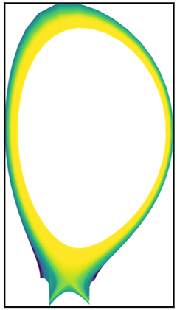
JINTRAC-SOLPS-NN
S. Wiesen, IIS Slides (2025)
M. Romanelli et al., Plasma Fusion Res. 9 (2014)
S. Dasbach, S. Wiesen, Nucl. Mater. Energy 34 (2023)
Transport models
Magnetic Equilibrium
Impurities
SOLPS-NN
Plasma performance
Core dynamics
JETTO
1.5D core CFD:
n_{i}, T_{i}, T_{e} ,…
Communication at coupling interface
MHD
Heating and current drive
Fuelling
Rick van Schaik – TSVV-H in-person meeting – 18 June 2026

Slide 7
What is SOLPS-NN “off-the-shelf”?
S. Dasbach, S. Wiesen, Nucl. Mater. Energy 34 (2023)
Fixed JET geometry, size scaled
5756 standard Fluid Neutral SOLPS-ITER simulations (~steady state)
Spatially homogeneous cross-field transp. coeff.
Deuterium + Nitrogen seeding
Core input power [10 – 200 MW]
Core D+ Flux [1e19 – 1e24 s⁻¹]
D gas puff rate [1e20 – 1e24 s⁻¹]
N gas puff rate [1e18 – 1e23 s⁻¹]
Density transport coefficient [0.1 – 2.0 m²/s]
Major Radius [1 – 10 m]
Toroidal magnetic field [1 – 10 T]
Heat transport coefficient [0.1 – 2.0 m²/s]
* Separate NN for each quantity
2D profiles*:
n_{D+}
T_{i}
T_{e}
n_{N(L)+}
etc…
Just a sketch, the true network is much bigger
Rick van Schaik – TSVV-H in-person meeting – 18 June 2026

Slide 8
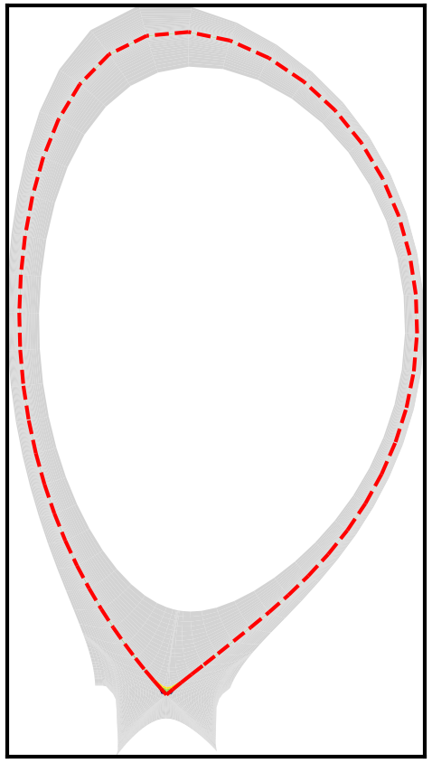
SOLPS-NN connector model for core-edge coupling
Quickly created model for testing
Same dataset
core fluxes → separatrix fluxes
Outputs → 0D quantities (required for coupling)
NN not optimised
Separatrix heat flux [0.1 – 200 MW]
Separatrix D+ Flux [1e19 – 1e25 s⁻¹]
D gas puff rate [1e20 – 1e24 s⁻¹]
N gas puff rate [1e18 – 1e23 s⁻¹]
Density transport coefficient [0.1 – 2.0 m²/s]
Major Radius [1 – 10 m]
Toroidal magnetic field [1 – 10 T]
Heat transport coefficient [0.1 – 2.0 m²/s]
0D quantities: total flux or LCFS volume averaged
Inputs clamped to training range
Just a sketch, the true network is much bigger
Rick van Schaik – TSVV-H in-person meeting – 18 June 2026

Slide 9
Outline
Introduction to models:
  JINTRAC, SOLPS-NN, core-edge connector model
JINTRAC-SOLPS-NN coupling implementation
  Desired & current implementation, how I use it
JINTRAC-SOLPS-NN investigation
  Objectives, what I learned (summary), example case study
Proof of concept: D puff scan
Summary & next steps
Rick van Schaik – TSVV-H in-person meeting – 18 June 2026

Slide 10
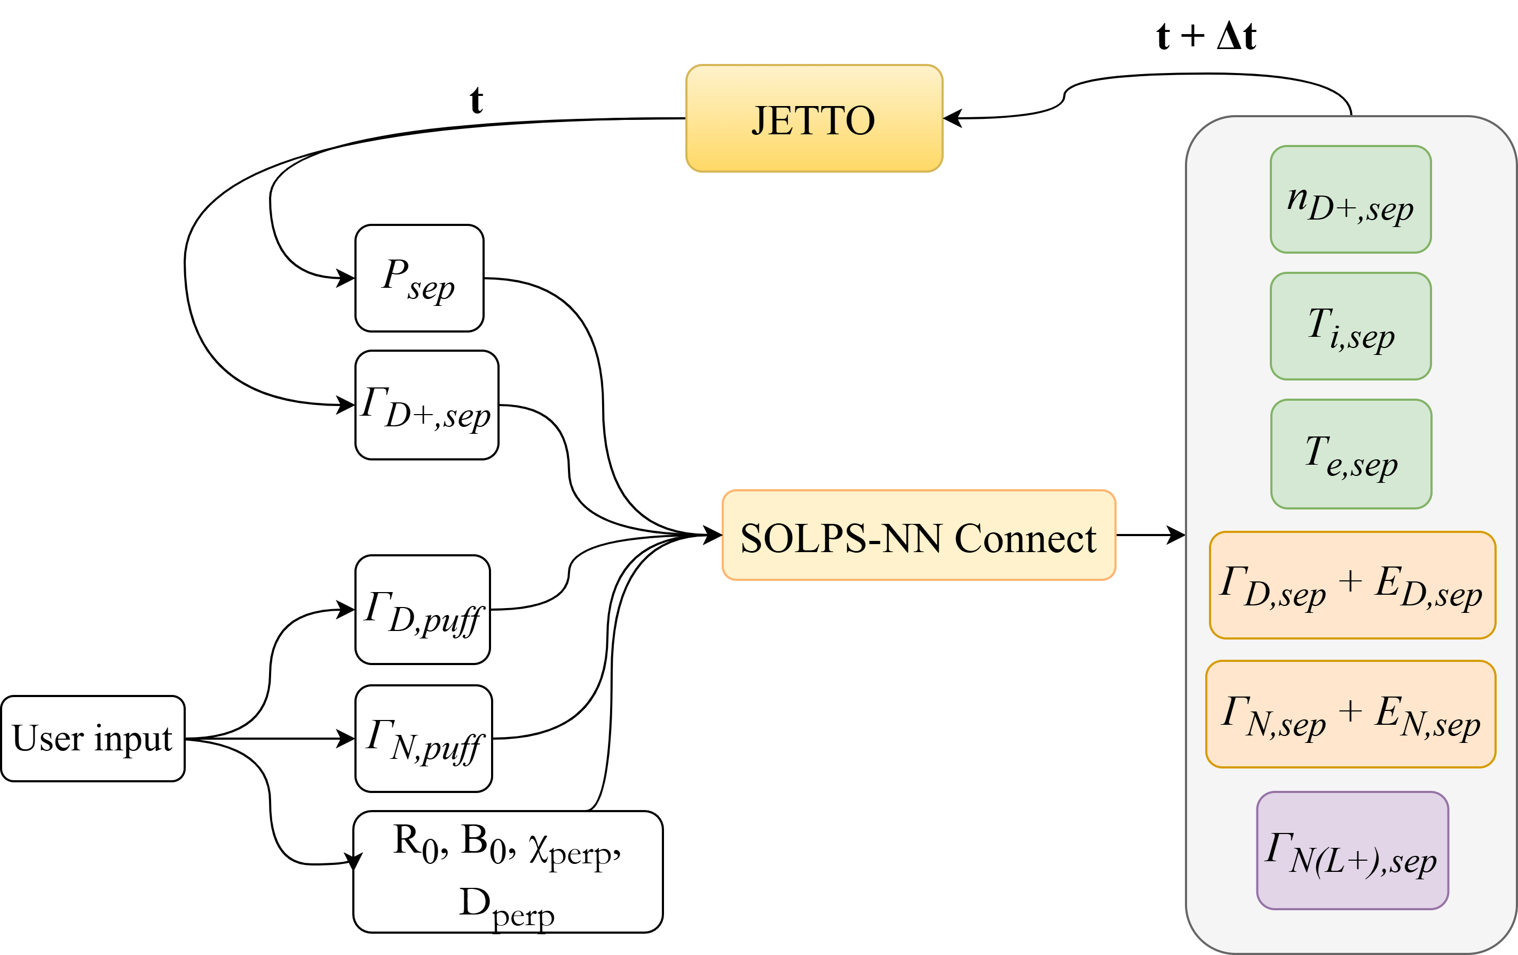
JINTRAC-SOLPS-NN implementation
*Atkinson et al., Journal of Open Source Software, 10(107), 7602 (2025)
Full desired implementation
Calling NN file within Fortran: how? → realised with FTorch*
Currently: explicit scheme
Important points for coupling consistency (where?):
Magnetic equilibrium (fixed by SOLPS-NN training set)
Coupling interface: separatrix (JETTO boundary location = chosen SOLPS-NN location)
*
*
*
*
Torchscript file (.pt)
via JAMS
*
fixed for one simulation
* Volume averaged
Rick van Schaik – TSVV-H in-person meeting – 18 June 2026

Slide 11
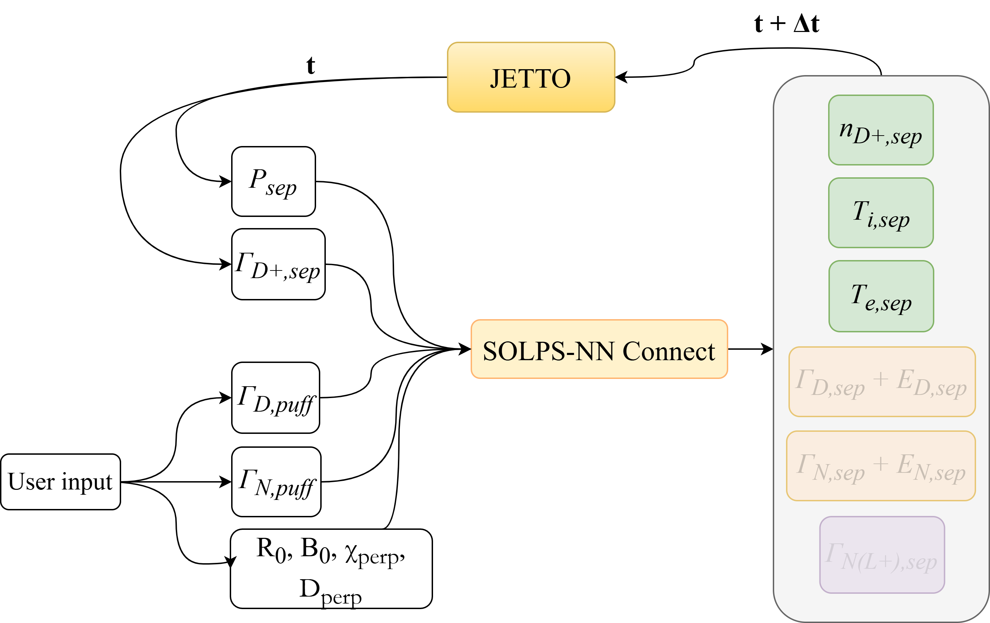
JINTRAC-SOLPS-NN implementation
*Atkinson et al., Journal of Open Source Software, 10(107), 7602 (2025)
Current implementation
Calling NN file within Fortran: how? → realised with FTorch*
Currently: explicit scheme
Important points for coupling consistency (where?):
Magnetic equilibrium (fixed by SOLPS-NN training set)
Coupling interface: separatrix (JETTO boundary location = chosen SOLPS-NN location)
*
This work
*
*
*
Torchscript file (.pt)
via JAMS
*
fixed for one simulation
* Volume averaged
Rick van Schaik – TSVV-H in-person meeting – 18 June 2026

Slide 12
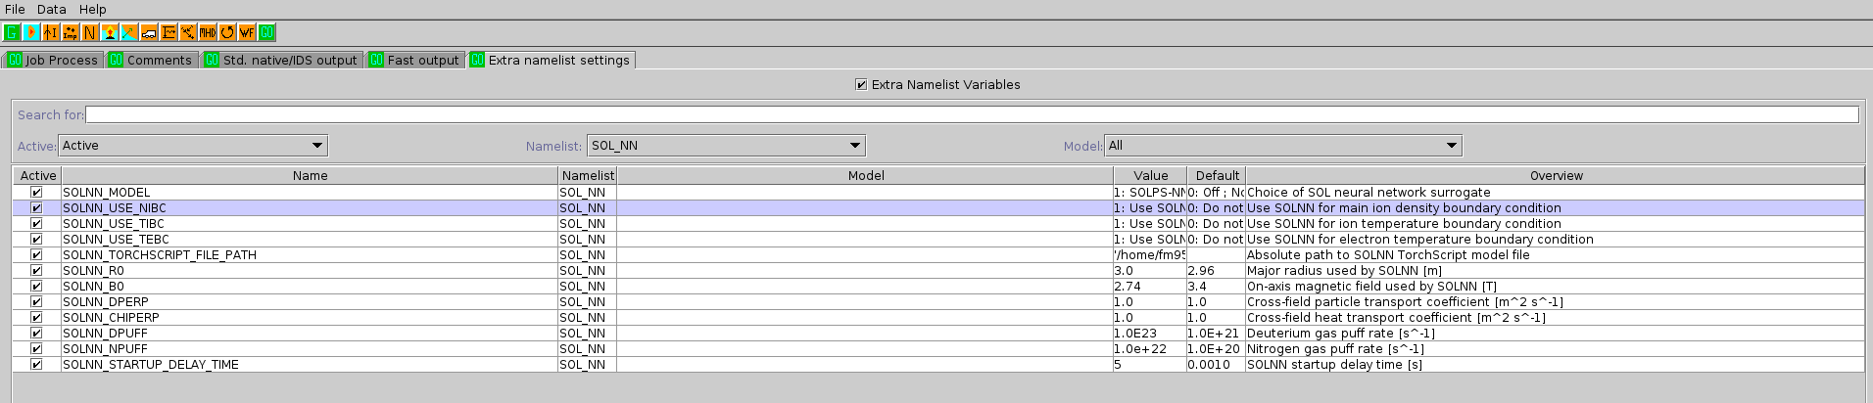
JINTRAC-SOLPS-NN implementation: How I use it
SOL_NN settings:
model: SOLPS-NN
BCs to update: n_{i}, T_{i}, T_{e}
torchscript file path (where NN lives)
SOLPS-NN user inputs
SOLNN_STARTUP_DELAY_TIME (time after simulation start when SOL surrogate is ‘activated’)
  Gives additional control and sim. time to start up
  JAMS prescribed boundary conditions used before update
submit
Implementation can be found on CCFE GitLab:
JINTRAC repository → branch = rvanschaik/solpsnn_integration
JAMS repository → branch = rvanschaik/solpsnn_integration
Rick van Schaik – TSVV-H in-person meeting – 18 June 2026

Slide 13
Outline
Introduction to models:
  JINTRAC, SOLPS-NN, core-edge connector model
JINTRAC-SOLPS-NN coupling implementation
  Desired & current implementation, how I use it
JINTRAC-SOLPS-NN investigation
  Objectives, what I learned (summary), example case study
Proof of concept: D puff scan
Summary & next steps
Rick van Schaik – TSVV-H in-person meeting – 18 June 2026

Slide 14
JINTRAC-SOLPS-NN investigation: what to learn?
Know how, where, what? Question remains: when? (every core time step or not?)
Objectives:
Reach consistent/converged state between core and SOL with all three BCs turned on
Understand the behaviour of the coupling scheme depending on which BCs turned on, core time step and BCs update frequency.
Understand the limitations of the scheme for applications and how it can be improved
How will we proceed?:
General summary of what I did/learned
Show what result looks like from one simulation
Dive into specific example case study
Rick van Schaik – TSVV-H in-person meeting – 18 June 2026

Slide 15
JINTRAC-SOLPS-NN investigation: what I did/learned (summary)
Journey: (sorry.. lot of text)
Initially focused on reaching consistent state, updating BCs at each core time step with effective iterations (1e-8s core time steps, undamped)
  Coupling in almost all cases fundamentally unstable (BC ←→ flux interplay drives instability)
  In some cases Ti or Te can be stable (depending on core state and NN state)
  ni is most sensitive to instability and never seen stable with this strategy
  Realised this is not a robust approach
Then exploring updating BCs at each core time step with larger time steps (undamped)
  increasing core time step makes coupling more stable (because internal points effectively damp flux response on core side)
  Increasing core time step makes it possible to get Ti or Te stable when turned on individually
  Increasing core time step does not make it possible to get ni stable, and thus also not all three at same time
  Realised I need to drop each core time step update approach as it is not robust
Decouple BCs update from core time step (undamped)
  Realised that this approach is more robust and able to respect assumption of this scheme (more on this later)
  With this strategy it is possible to obtain a consistent converged state for all three BCs, provided that the core has enough time to relax before the next update
Rick van Schaik – TSVV-H in-person meeting – 18 June 2026

Slide 16
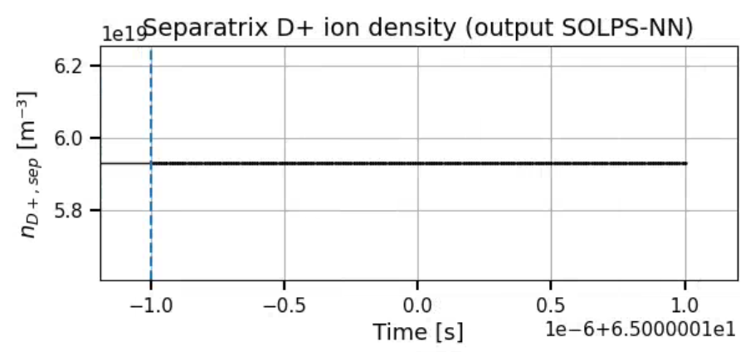
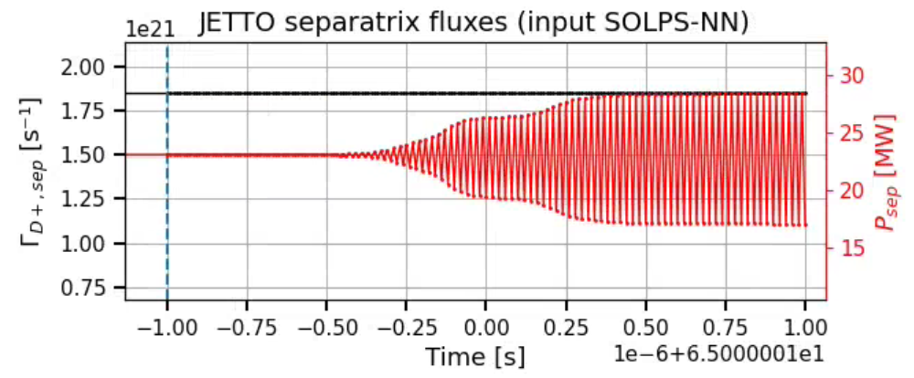
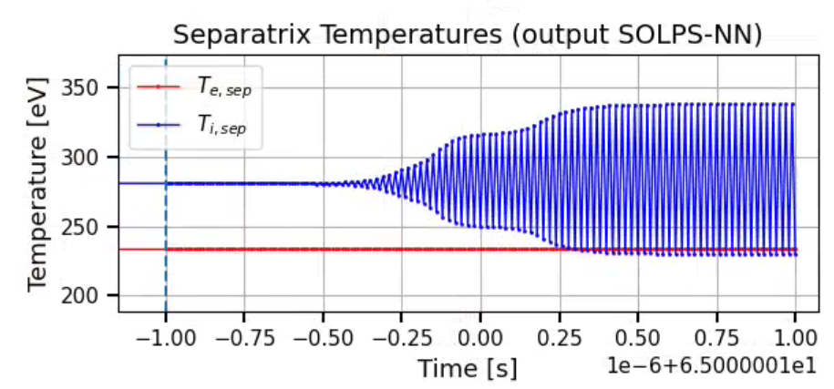
JINTRAC-SOLPS-NN investigation: result example
BC updated: Te (@ each core step)
time step: 1e-8s
Rick van Schaik – TSVV-H in-person meeting – 18 June 2026

Slide 17
JINTRAC-SOLPS-NN investigation: example case study
Aim: highlight effect of temporal coupling strategy on stability of scheme
Consistent conditions:
Simplified jetto simulation → constant transport coefficients / particle and heat sources and sinks (removed all non-linearities)
Start from same initial profiles (already steady state)
Identical pre-coupling interval: 1ms steps for 1s, same constant BCs
Same perturbation when activating SOLPS-NN (equal NN inputs)
Variations shown:
Δt_{core} & Δt_{SOL_update} coupled (Δt_{core} = Δt_{SOL_update} )
  ni, Ti, Te → Δt = 1e-8s, 1e-3s
  Ti, Te → Δt = 1e-8s, 1e-3s
Δt_{core} & Δt_{SOL_update} decoupled (Δt_{core} = 1ms)
  ni, Ti, Te → Δt_{SOL_update} = 1e-2s, 1e-1s, 1s
Δt_{SOL_update}
Δt_{core}
Δt_{SOL_update}
Δt_{core}
Δt_{core}
Δt_{core}
Δt_{core}
Δt_{core}
Rick van Schaik – TSVV-H in-person meeting – 18 June 2026

Slide 18
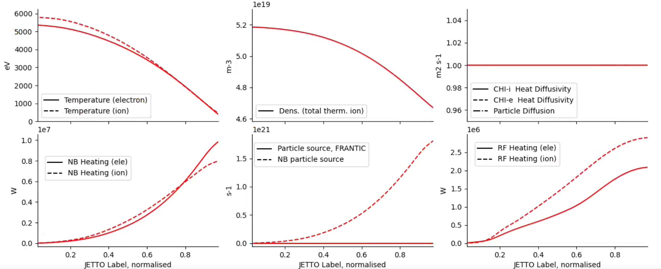
Example case study: initial conditions
Steady state fluxes:
NN inputs:
R₀ = 3 m
B₀ = 2.74 T
D_{puff} = 3.4e22 s⁻¹
N_{puff} = 1.9e20 s⁻¹
D_{perp} = 0.1 m² s⁻¹
χ_{perp} = ~0.46 m² s⁻¹
P_{sep} = ~23 MW
Γ_{D+,sep} = ~1.85e21 s⁻¹
Rick van Schaik – TSVV-H in-person meeting – 18 June 2026

Slide 19
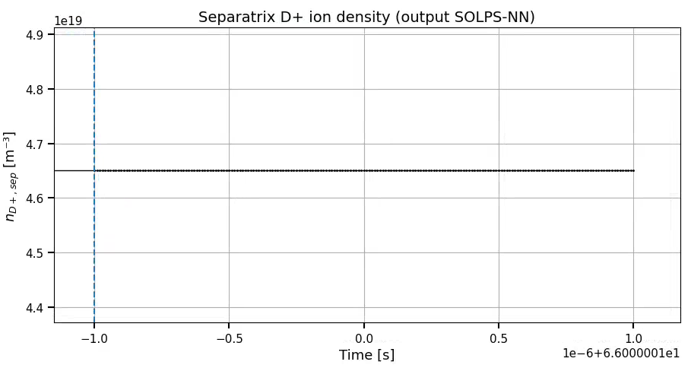
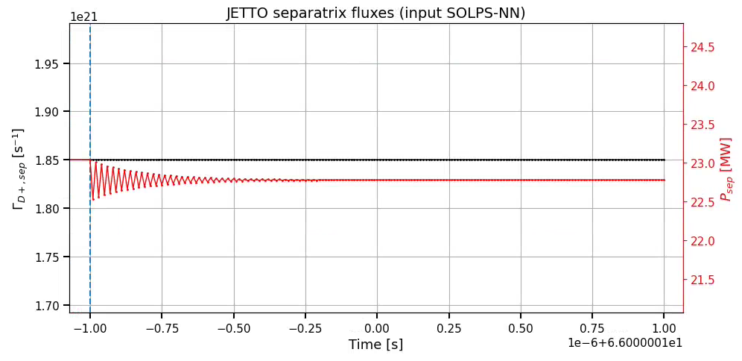
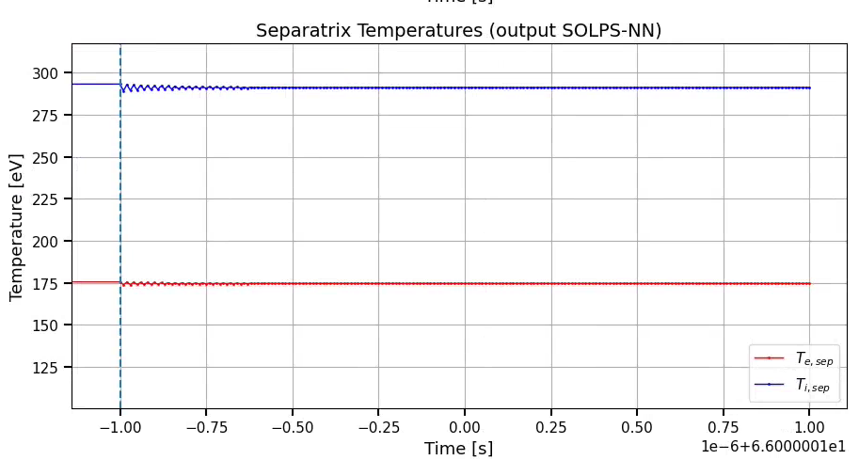
Δt_{core} & Δt_{SOL_update} coupled (Δt_{core} = Δt_{SOL_update} )
Δt_{SOL_update}
Δt_{core}
  ni, Ti, Te → Δt = 1e-8s, 1e-3s
  Ti, Te → Δt = 1e-8s, 1e-3s
Rick van Schaik – TSVV-H in-person meeting – 18 June 2026

Slide 20
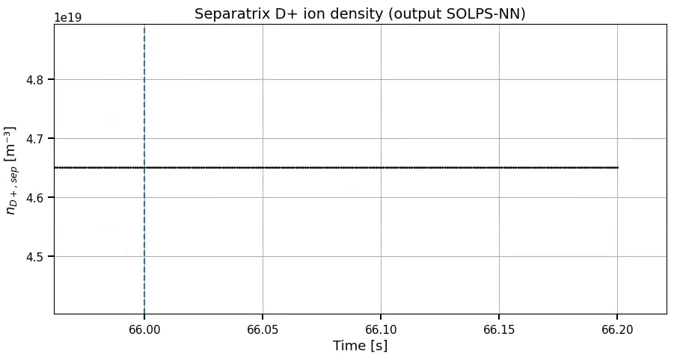
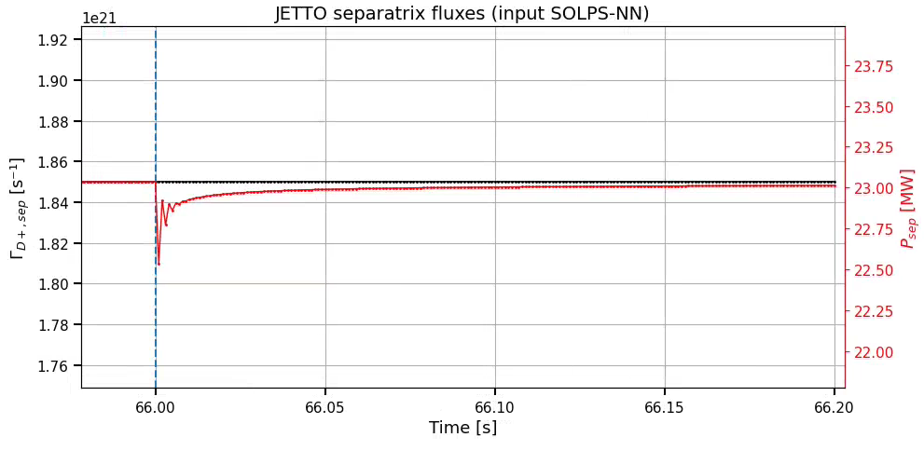
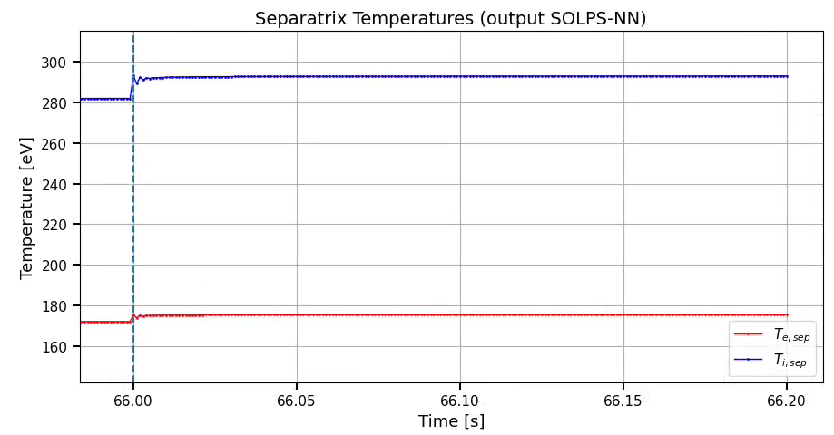
Δt_{core} & Δt_{SOL_update} coupled (Δt_{core} = Δt_{SOL_update} )
Δt_{SOL_update}
Δt_{core}
  ni, Ti, Te → Δt = 1e-8s, 1e-3s
  Ti, Te → Δt = 1e-8s, 1e-3s
Rick van Schaik – TSVV-H in-person meeting – 18 June 2026

Slide 21
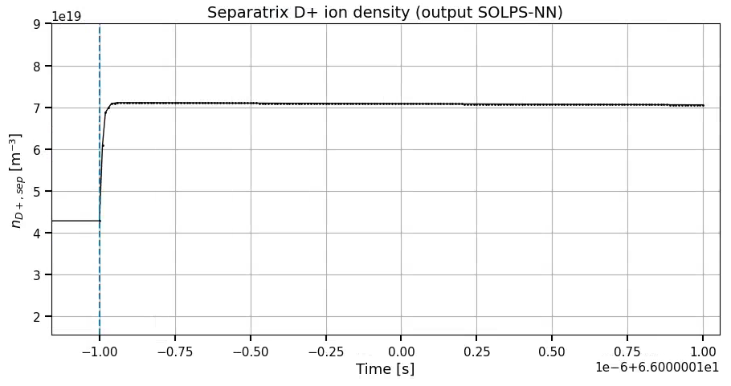
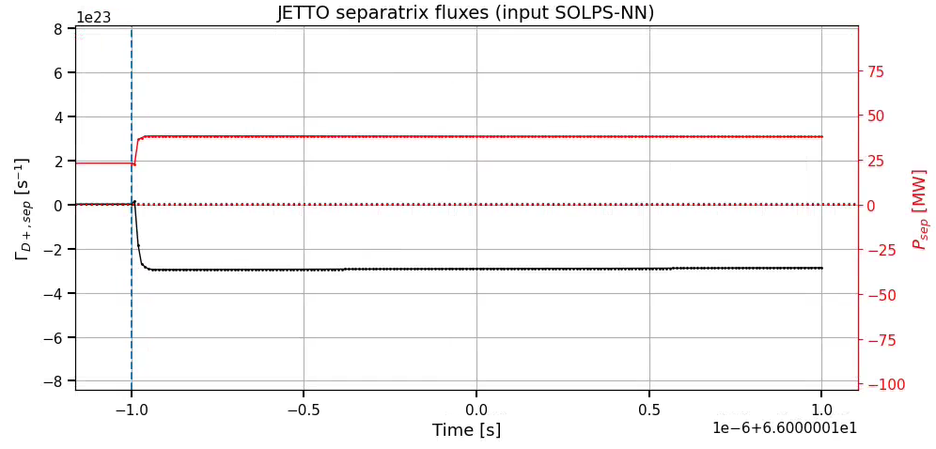
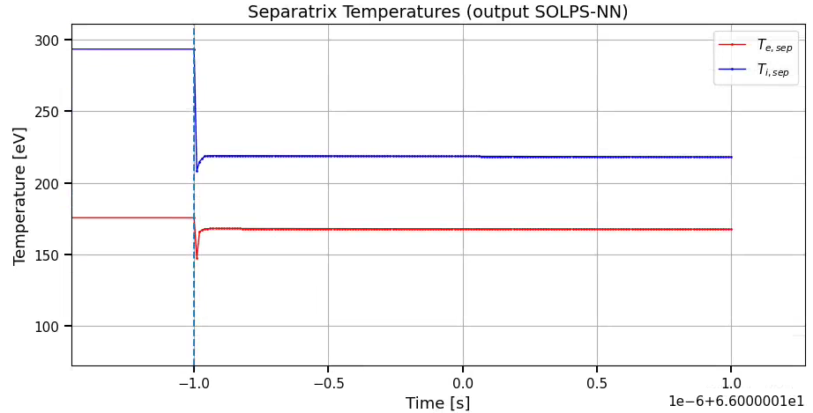
Δt_{core} & Δt_{SOL_update} coupled (Δt_{core} = Δt_{SOL_update} )
Δt_{SOL_update}
Δt_{core}
  ni, Ti, Te → Δt = 1e-8s, 1e-3s
  Ti, Te → Δt = 1e-8s, 1e-3s
Rick van Schaik – TSVV-H in-person meeting – 18 June 2026

Slide 22
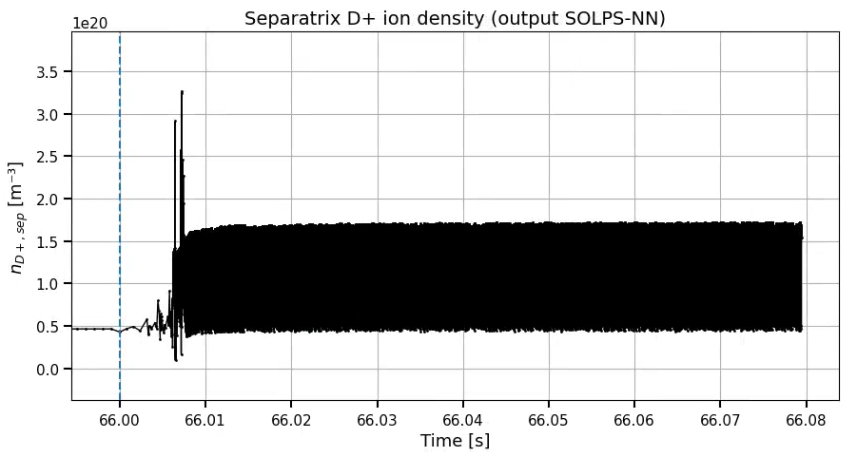
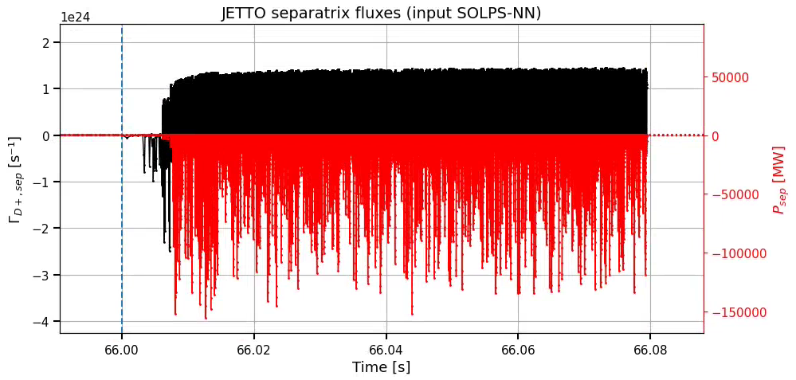
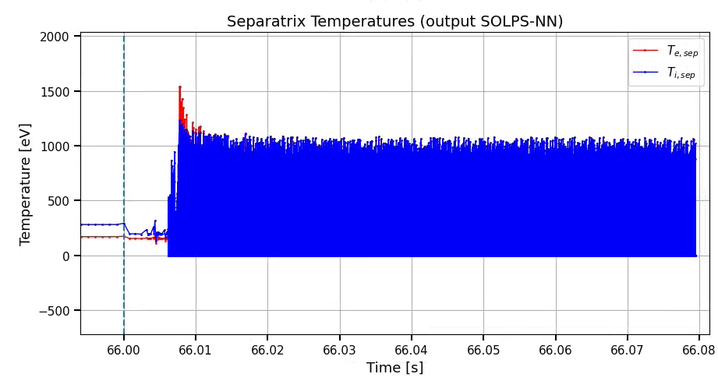
Δt_{core} & Δt_{SOL_update} coupled (Δt_{core} = Δt_{SOL_update} )
Δt_{SOL_update}
Δt_{core}
  ni, Ti, Te → Δt = 1e-8s, 1e-3s
  Ti, Te → Δt = 1e-8s, 1e-3s
Rick van Schaik – TSVV-H in-person meeting – 18 June 2026

Slide 23
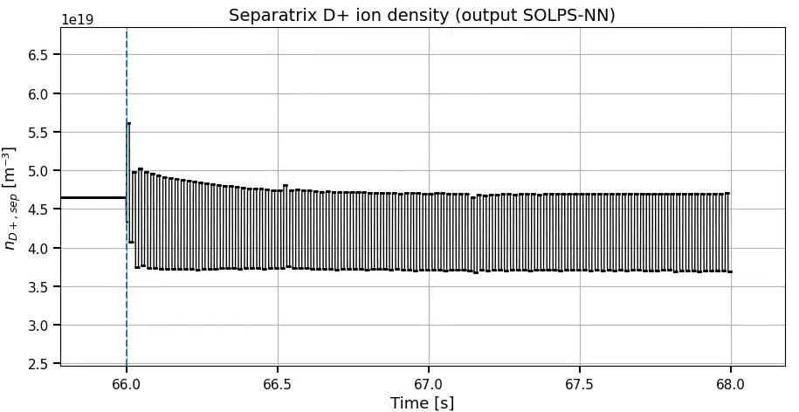
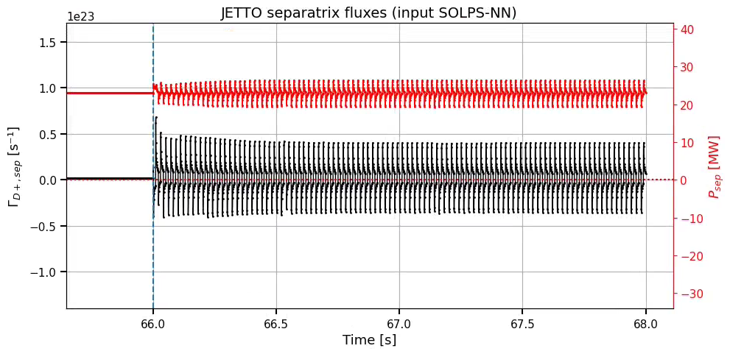
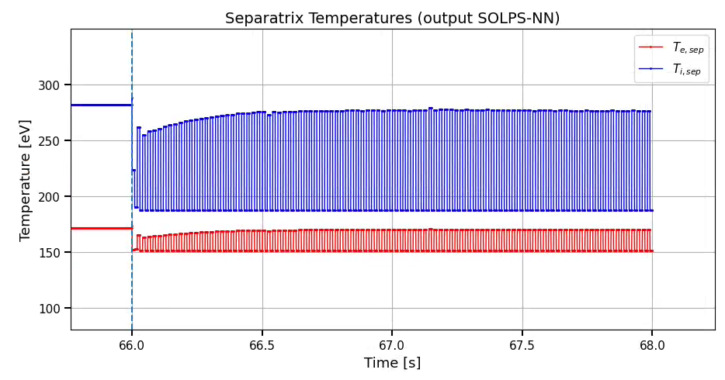
Δt_{core} & Δt_{SOL_update} decoupled (Δt_{core} = 1ms)
Δt_{SOL_update}
Δt_{core}
Δt_{core}
Δt_{core}
Δt_{core}
Δt_{core}
  ni, Ti, Te → Δt_{SOL_update} = 1e-2s, 1e-1s, 1s
Rick van Schaik – TSVV-H in-person meeting – 18 June 2026

Slide 24
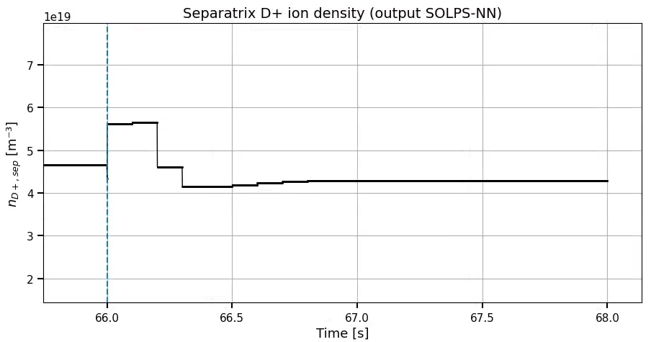
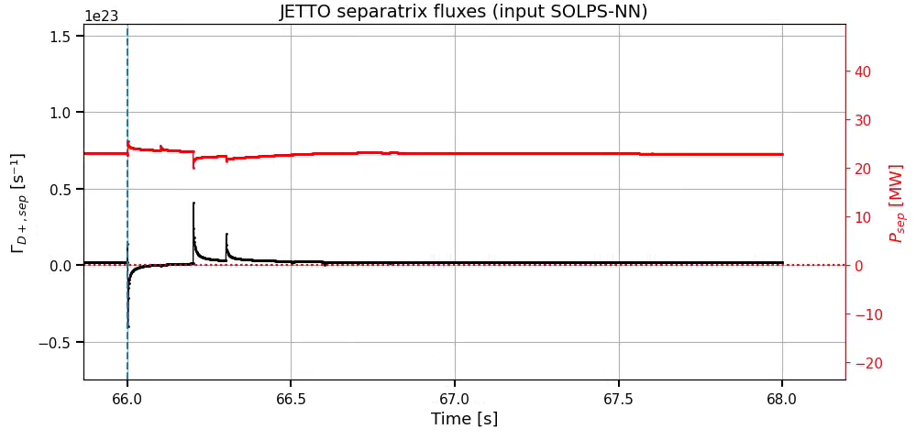
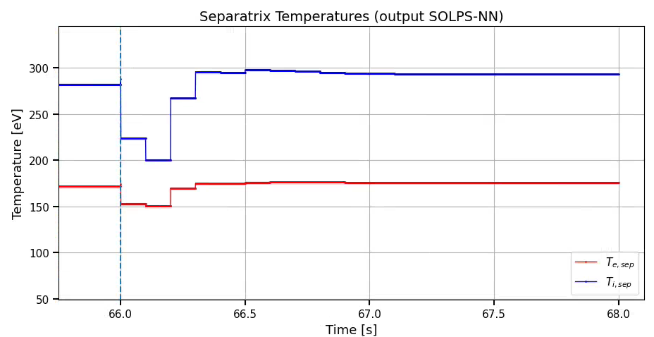
Δt_{core} & Δt_{SOL_update} decoupled (Δt_{core} = 1ms)
Δt_{SOL_update}
Δt_{core}
Δt_{core}
Δt_{core}
Δt_{core}
Δt_{core}
  ni, Ti, Te → Δt_{SOL_update} = 1e-2s, 1e-1s, 1s
Rick van Schaik – TSVV-H in-person meeting – 18 June 2026

Slide 25
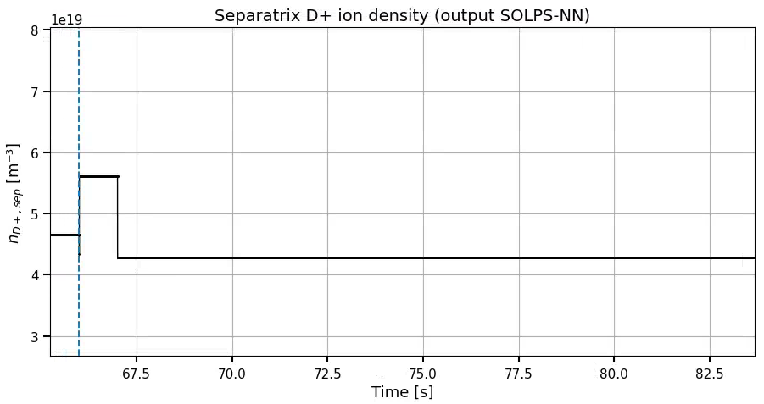
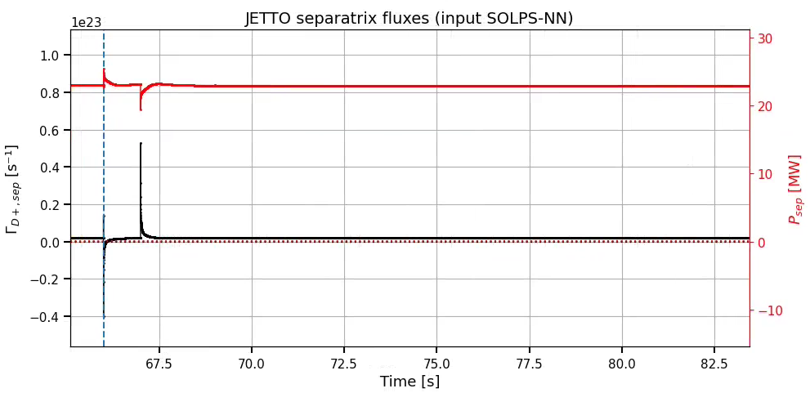
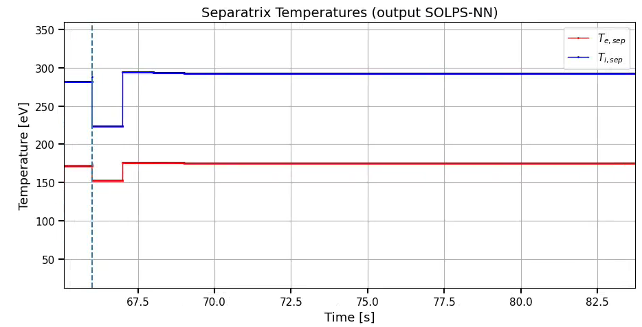
Δt_{core} & Δt_{SOL_update} decoupled (Δt_{core} = 1ms)
Δt_{SOL_update}
Δt_{core}
Δt_{core}
Δt_{core}
Δt_{core}
Δt_{core}
  ni, Ti, Te → Δt_{SOL_update} = 1e-2s, 1e-1s, 1s
Rick van Schaik – TSVV-H in-person meeting – 18 June 2026

Slide 26
Important note on core-edgeNN coupling
If SOL/edge surrogate is steady state → this must be respected physically and numerically
  Dynamic core model ← → steady state SOL
  Minimum SOL update time should be on the order of SOL equilibration time
  And coupling should be stable (explicit scheme stability might limit update frequency)
Rick van Schaik – TSVV-H in-person meeting – 18 June 2026

Slide 27
Outline
Introduction to models:
  JINTRAC, SOLPS-NN, core-edge connector model
JINTRAC-SOLPS-NN coupling implementation
  Desired & current implementation, how I use it
JINTRAC-SOLPS-NN investigation
  Objectives, what I learned (summary), example case study
Proof of concept: D puff scan
Summary & next steps
Rick van Schaik – TSVV-H in-person meeting – 18 June 2026

Slide 28
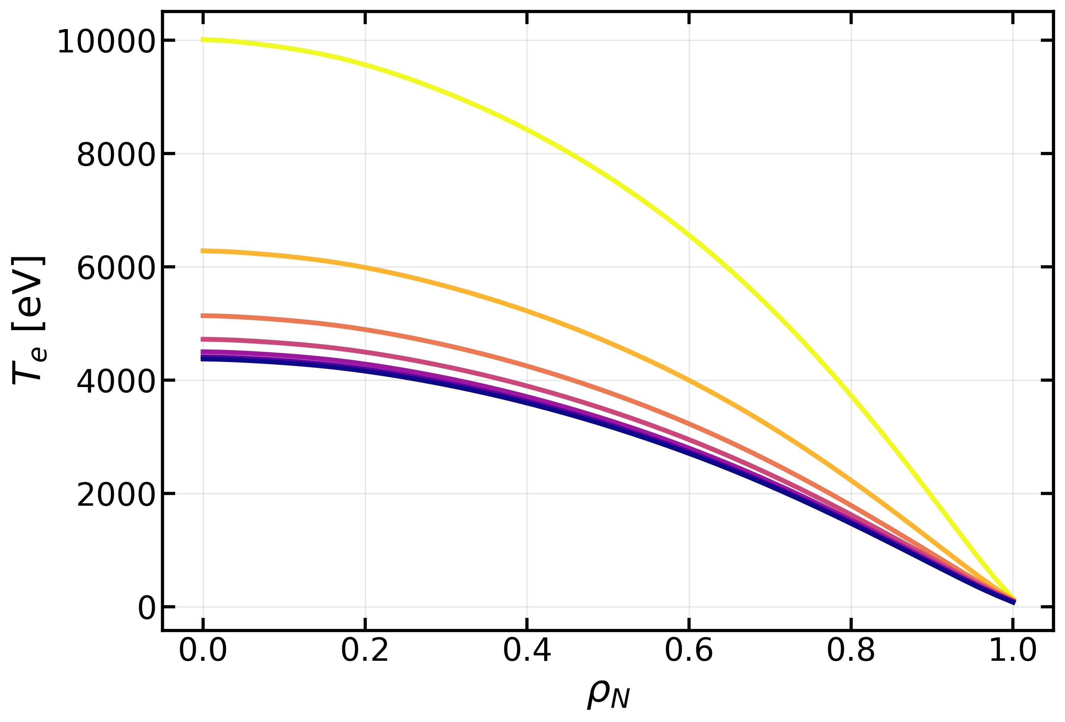
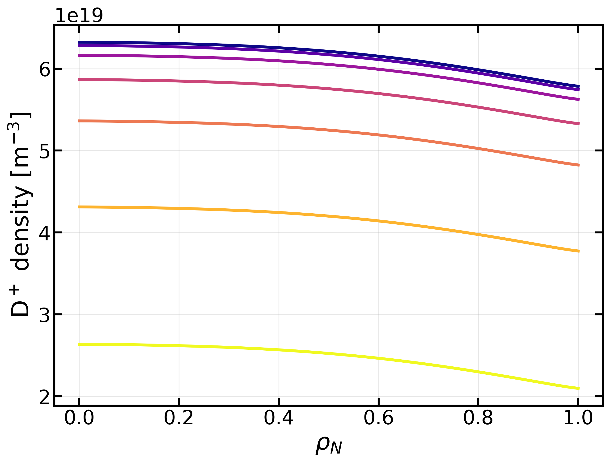
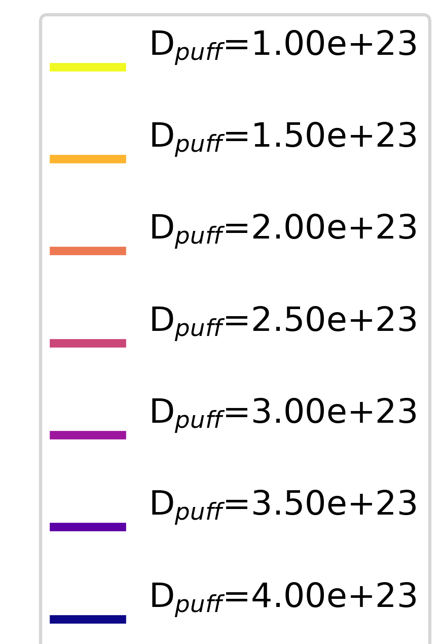
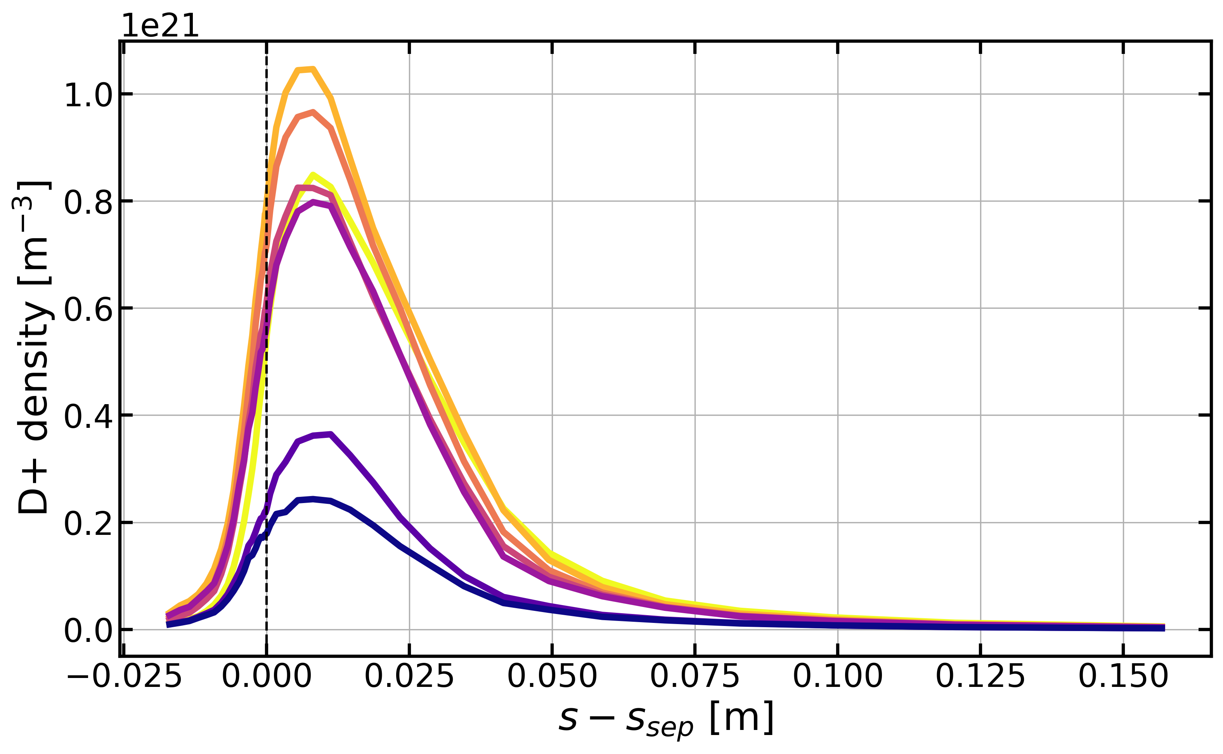
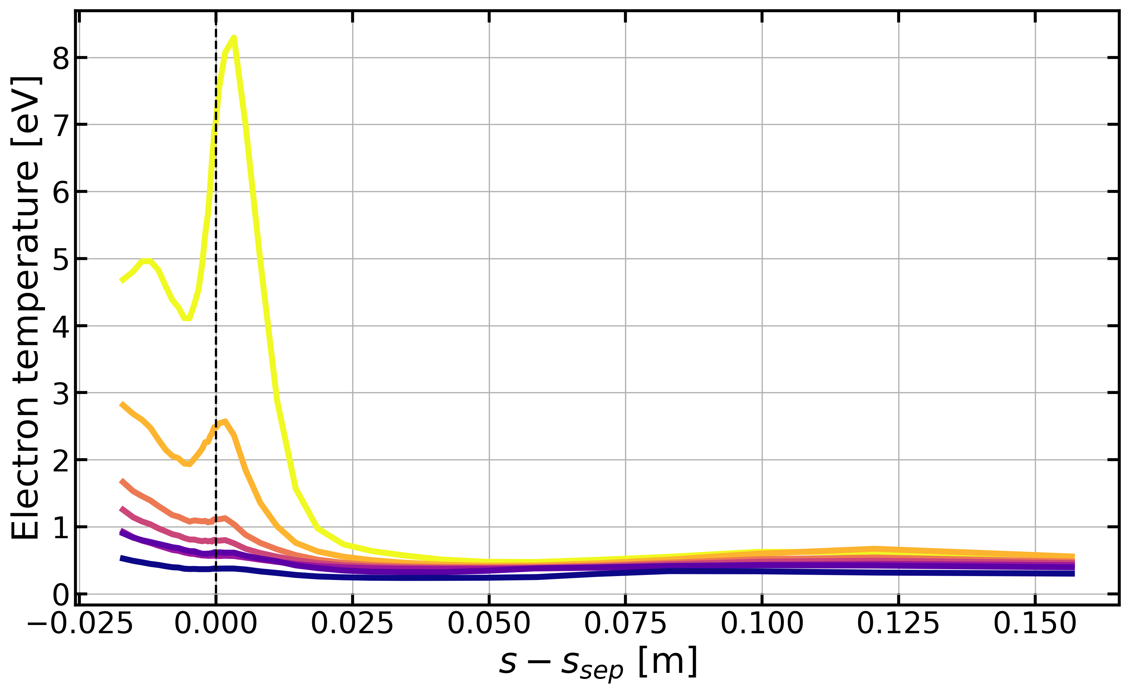
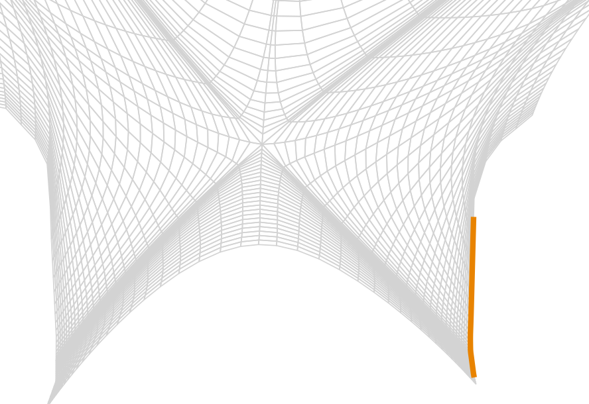
Proof of concept: D puff scan
Fixed core transport and sources
Δt_{core}=1ms, Δt_{SOL_update}=1s
NN inputs:
R₀ = 3 m
B₀ = 2.74 T
P_{sep} = ~23 MW
Γ_{D+,sep} = ~1.85e21 s⁻¹
N_{puff} = 1e22 s⁻¹
D_{perp} = 0.1 m² s⁻¹
χ_{perp} = ~0.46 m² s⁻¹
Rick van Schaik – TSVV-H in-person meeting – 18 June 2026

Slide 29
Outline
Introduction to models:
  JINTRAC, SOLPS-NN, core-edge connector model
JINTRAC-SOLPS-NN coupling implementation
  Desired & current implementation, how I use it
JINTRAC-SOLPS-NN investigation
  Objectives, what I learned (summary), example case study
Proof of concept: D puff scan
Summary & next steps
Rick van Schaik – TSVV-H in-person meeting – 18 June 2026

Slide 30
Summary & next steps
Demonstrated first JINTRAC-SOLPS-NN coupling
Investigated coupling behaviour with three BCs:
  Steady state property of SOLPS-NN and finite core response must be respected (for physical and numerical behaviour)
  Unstable scheme with Δt_{core} = Δt_{SOL_update}
  More stable with larger Δt_{SOL_update}
Demonstrated fast scanning capabilities with example D puff scan
Next steps
Investigate possible improvements to coupling strategy (numerical tricks?)
Implement neutral and impurity communication to core (coupling with Frantic / Sanco?)
Quantify and improve connector NN performance (be open to different ML techniques)
Converge on use cases to challenge, validate and exploit this initial model
Identify and explore methods to expand accuracy and applicability
Rick van Schaik – TSVV-H in-person meeting – 18 June 2026

