Slide 1
TGLFNN surrogate models and beyond
Lorenzo Zanisi
Notes:
Symbiotic relationship

Slide 2
Contributors
TGLFNN work:
F. Casson (UKAEA)
T. Brown (UKAEA, GDM)
S. Gabriellini (UKAEA)
Z. Stancar (UKAEA)
M. Marin (EPFL)
E. Vergnaud (CEA)
C. Bourdelle (CEA)
H. Dudding (UKAEA)
C. M. Roach (UKAEA)
A. Snodin (UKAEA)
J. Citrin (GDM)
A. Fernando (GDM)
T. Norman (GDM)
C. Siddle (UKAEA)
High fidelity GK surrogates:
G. Galletti (JKU Linz)
F. Paischer (JKU Linz)
G. Gutenbrunner (JKU Linz)
J. Brandstetter (JKU Linz)
P. Setinek (JKU Linz)
W. Hornsby (UKAEA)
N. Carey (UKAEA)
S. Pamela (UKAEA)

Slide 3
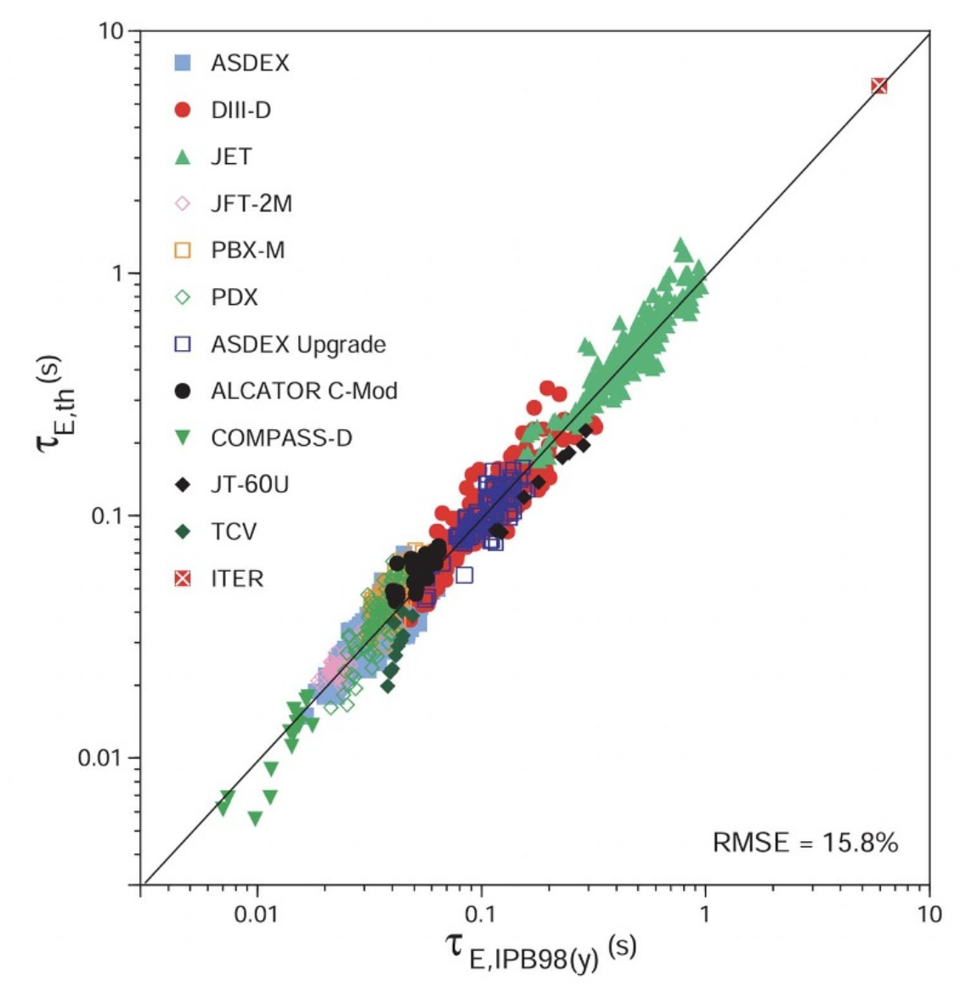
Scaling law extrapolation is risky
Experimental scaling laws extrapolated to predict confinement in power plants –scale devices
Turbulence modelling is crucial
  Understand transport in current tokamaks
  Design a power plant with good confinement
Each plasma profile prediction may require >100-1000 turbulence simulations: impractically slow even at low fidelity
Power plants
Today’s tokamaks
ITER , 1999 Nucl. Fusion 39 2175

Slide 4
Turbulent transport fidelity ladder
Bohm / Gyro-Bohm
  Extremely fast (analytic)
  Large simulation sweeps (e.g., E. Tholerus's STEP flat top paper)
  Not so reliable
Reduced Quasilinear (e.g., TGLF, QuaLiKiz)
  1-10s per run
  Routinely used for design and validated on several experiments
  Large-scale validation and high-throughput scenario optimisation out of reach
Linear GK + Sat rule
  ~100-1000s per run
  Higher fidelity than TGLF/QLK
  Used in some cases (not in JETTO to my knowledge)
Nonlinear GK
  ~10⁵ –10⁷ s
  Used very occasionally in integrated models (not in JETTO to my knowledge)
  E.g., PORTALS
Speed
Accuracy
TGLFNN: TGLF prediction in ~ms

Slide 5
Surrogate models

Slide 6
Modelling and design
Traditional simulation workflow
Turbulence model in a transport solver is called many times
Not possible with higher fidelity turbulence codes
New quantitative answer = new solve
Data is not reused : users need to wait on potentially similar turbulence calculations again
AI-aided workflow
Amortised
  Pay data generation cost upfront at
  massive HPC scale
Near-zero latency
  Fast NN surrogate models approximate simulators
Continuous
  New quantitative answer = NN query
Transformative
  Enabling previously inaccessible highly iterative applications

Slide 7
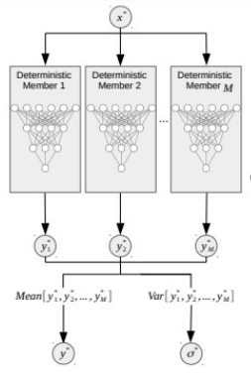
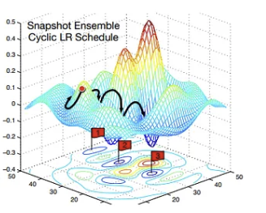
NN ensembles
NNs are fast: ~ms for a prediction
Several NNs are initialised at different random points in their parameter space
Each NN follows a different optimisation trajectory towards a local minimum
Different minimisers for the NNs result in different predictions
This gives average and std of prediction

Slide 8
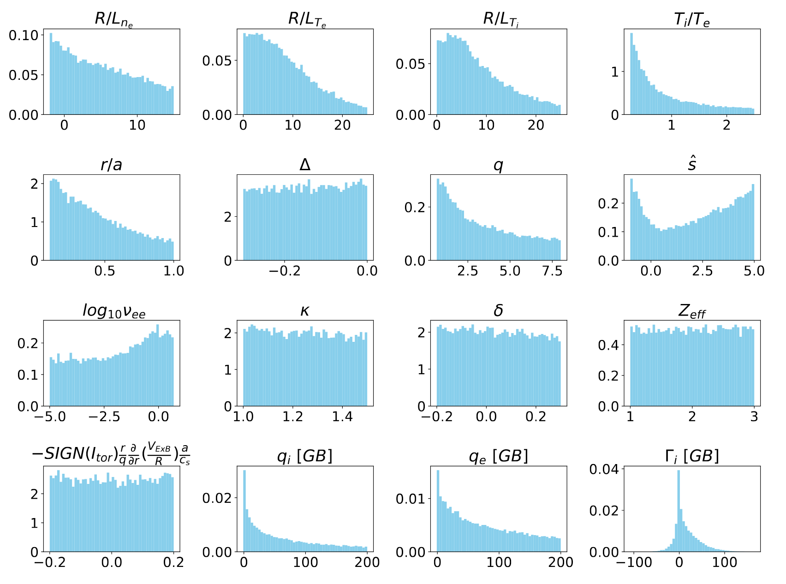
TGLFNN-Hyper
https://github.com/ukaea/tglfnn-ukaea/tree/main/MultiMachineHyper_1Aug25
QLKNN (K. Van de Plassche, A. Ho, J. Citrin+) has had a lot of uses but is limited to s-alpha geometry
TGLFNN-Hyper: NN that mimics QLKNN-10D but with TGLF
Extra dimensions compared to QLKNN
  Shafranov Shift
  Elongation
  Triangularity
Simulations were ran in hypercube, but solver failures and flux cut below 200GB results in non uniform distributions
​
10M simulations generated in ~24h on 10 nodes, 76 cores per node --> ~20k CPUh, cheap!

Slide 9
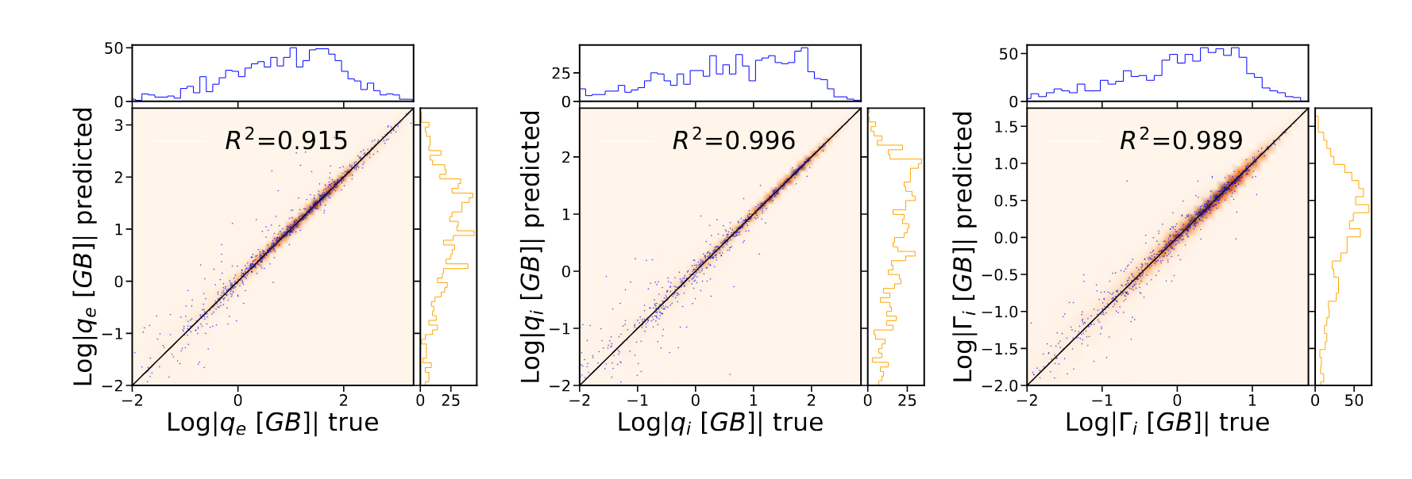
TGLFNN-Hyper performance
Coupled to JETTO as compiled torchscript models (A. Snodin, F. Casson)
Coupled to TORAX loading weights into JAX (T. Brown+ GDM team)

Slide 10
Instructions for use

Slide 11
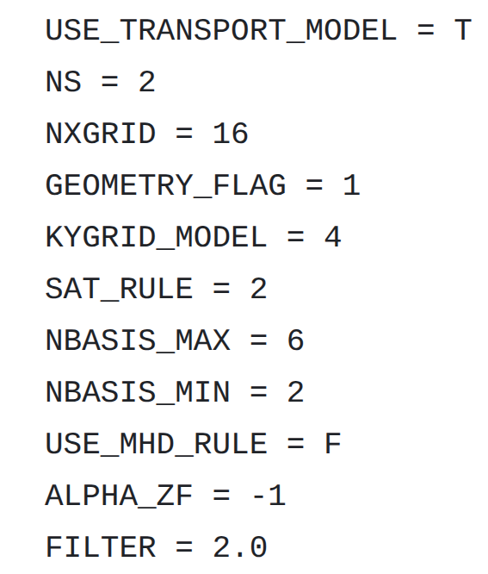
How to use TGLFNN-Hyper
Only valid in space shown on the right
  Careful to use outside of this space
  Plotting script being developed to assess whether TGLFNN out of distribution
Only valid for a specific set of numerical parameters (bottom right)
  Do not compare with TGLF with other settings
  Only SAT2
  Only ES
  Only pure D plasma (but Zeff>1 supported)
Only validated for a set of JETTO settings for current work (see next slides)
  Untested in, e.g., full radius prediction
  You must validate settings on a handful of shots before deployment in large scale validation
TGLF defaults for other numerical and physical inputs

Slide 12
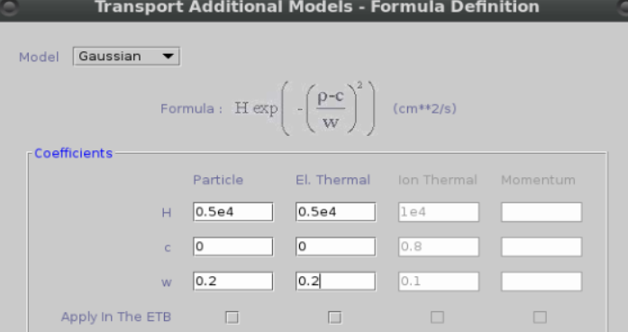
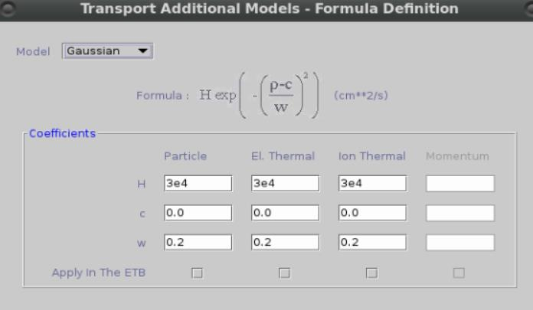
Recommended JETTO settings
ITRTGLFFLSP = 2 (D/V splitting, "ASTRA-like")
ITRTGLFNN_VER = 3.2.1 (version of NN used in this presentation)
  when active in extra namelist it runs NN otherwise runs TGLF
TGLFRHOMIN = 0.2
TGLFRHOMAX = 0.85 / 0.93 (ITER) / 0.9 (TCV)
BCINTRHON = 0.85 / 0.93 (ITER) / 0.9 (TCV)
Small extra transport at rho<0.2 as shown in image to avoid null transport
Same settings reproduced in TORAX-TGLFNN
  TGLF integrated in TORAX by A. Ho and G. Snoep
  Some TGLF defaults in TORAX conflict with TGLFNN training. TORAX-TGLF runs will not be shown, but WIP.
Extra inner core transport in JET, TCV, WEST
Extra inner core transport in ITER

Slide 13
Validation
RRMSE of JETTO-TGLF vs JETTO-TGLFNN shown
RRMSE of TORAX-TGLF vs TORAX-TGLFNN not shown
Speedups shown for JETTO-TGLFNN, some still being worked out

Slide 14
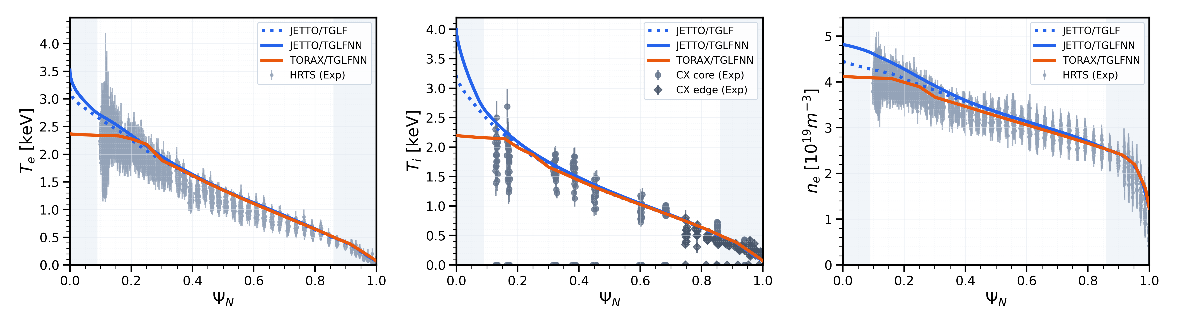
Validation: JET #89723
RRMS T_{e} | RRMS T_{i} | RRMS n_{e}
1.2% | 1.12% | 2.27%
Excellent agreement between TGLF and TGLFNN runs
Slight difference in the core between TORAX and JETTO, WIP
Speedup: 227x
Z. Stancar, S. Gabriellini, T. Brown, GDM

Slide 15
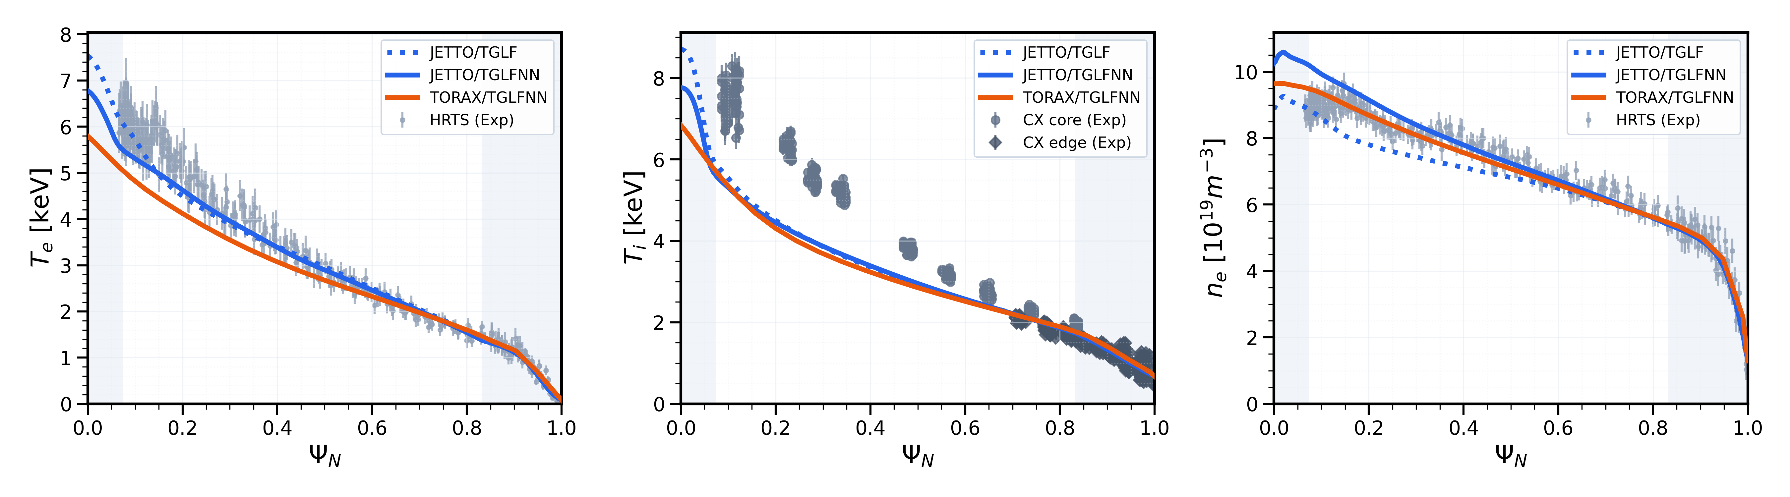
Validation: JET baseline
#96482
RRMS T_{e} | RRMS T_{i} | RRMS n_{e}
2.94% | 1.58% | 11.77%
Good agreement between TGLF and TGLFNN runs, except for density underprediction
Ti prediction doesn't reproduce data well, likely limitation of not including EM effects in TGLF
Speedup: WIP
Z. Stancar, S. Gabriellini, T. Brown, GDM

Slide 16
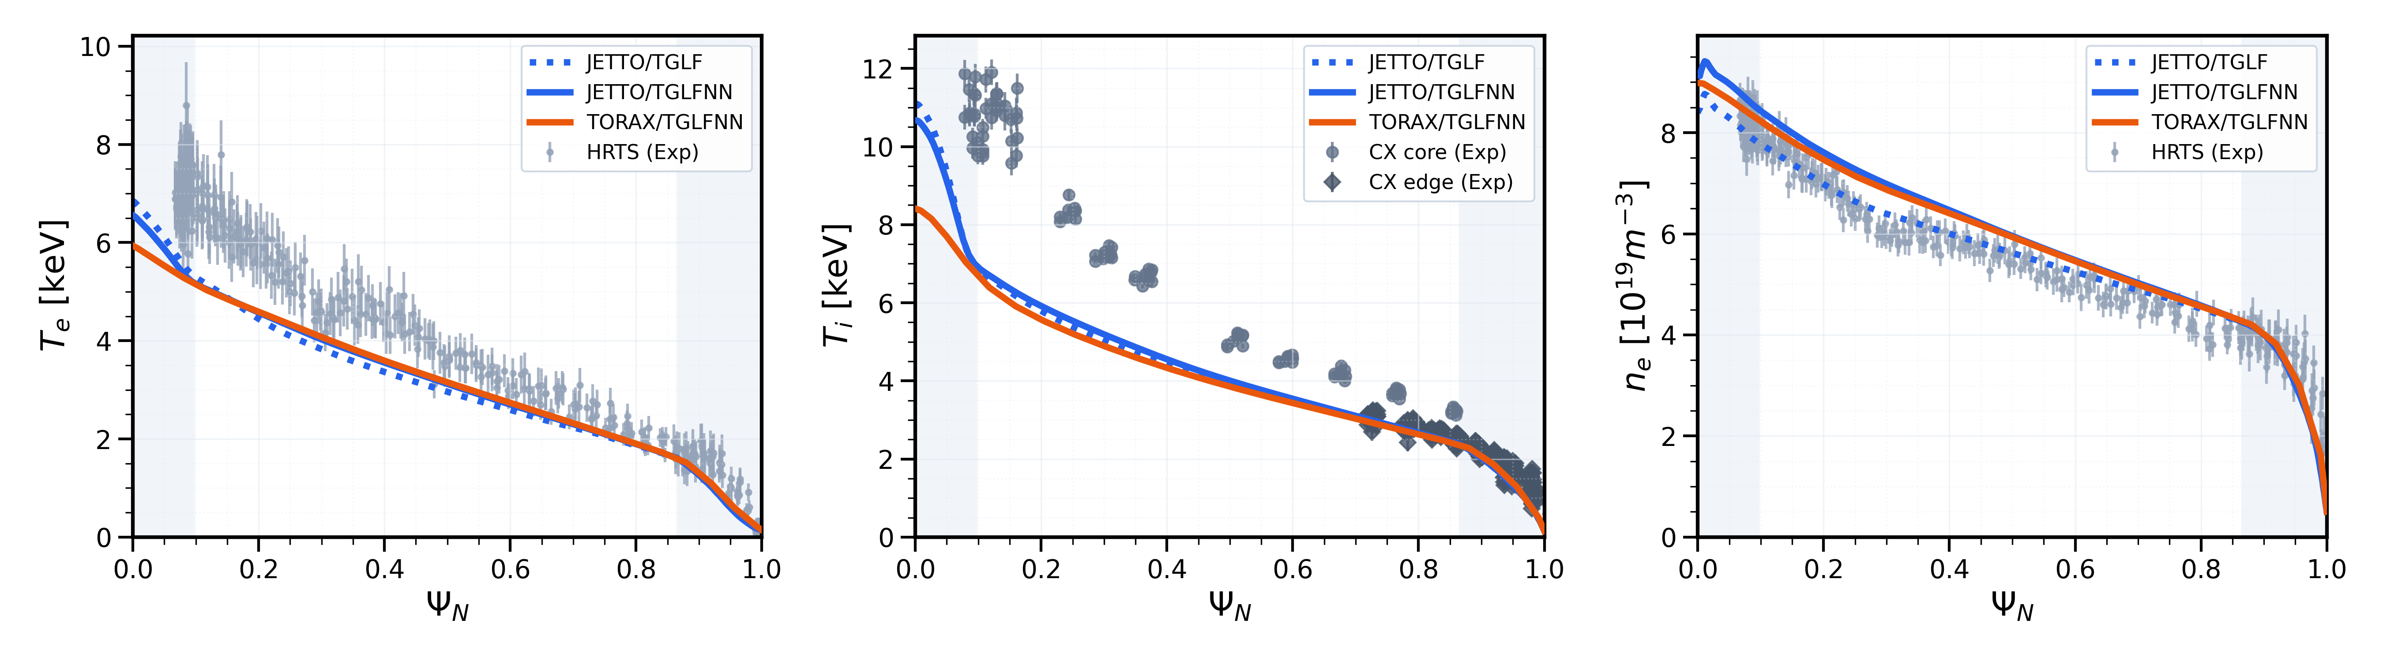
Validation: JET hybrid
#97781
RRMS T_{e} | RRMS T_{i} | RRMS n_{e}
4.09% | 2.59% | 7.1%
Good agreement between TGLF and TGLFNN runs
Ti, Te prediction doesn't reproduce data well, likely limitation of not including EM effects in TGLF
Speedup: 117x
S. Gabriellini, T. Brown, GDM

Slide 17
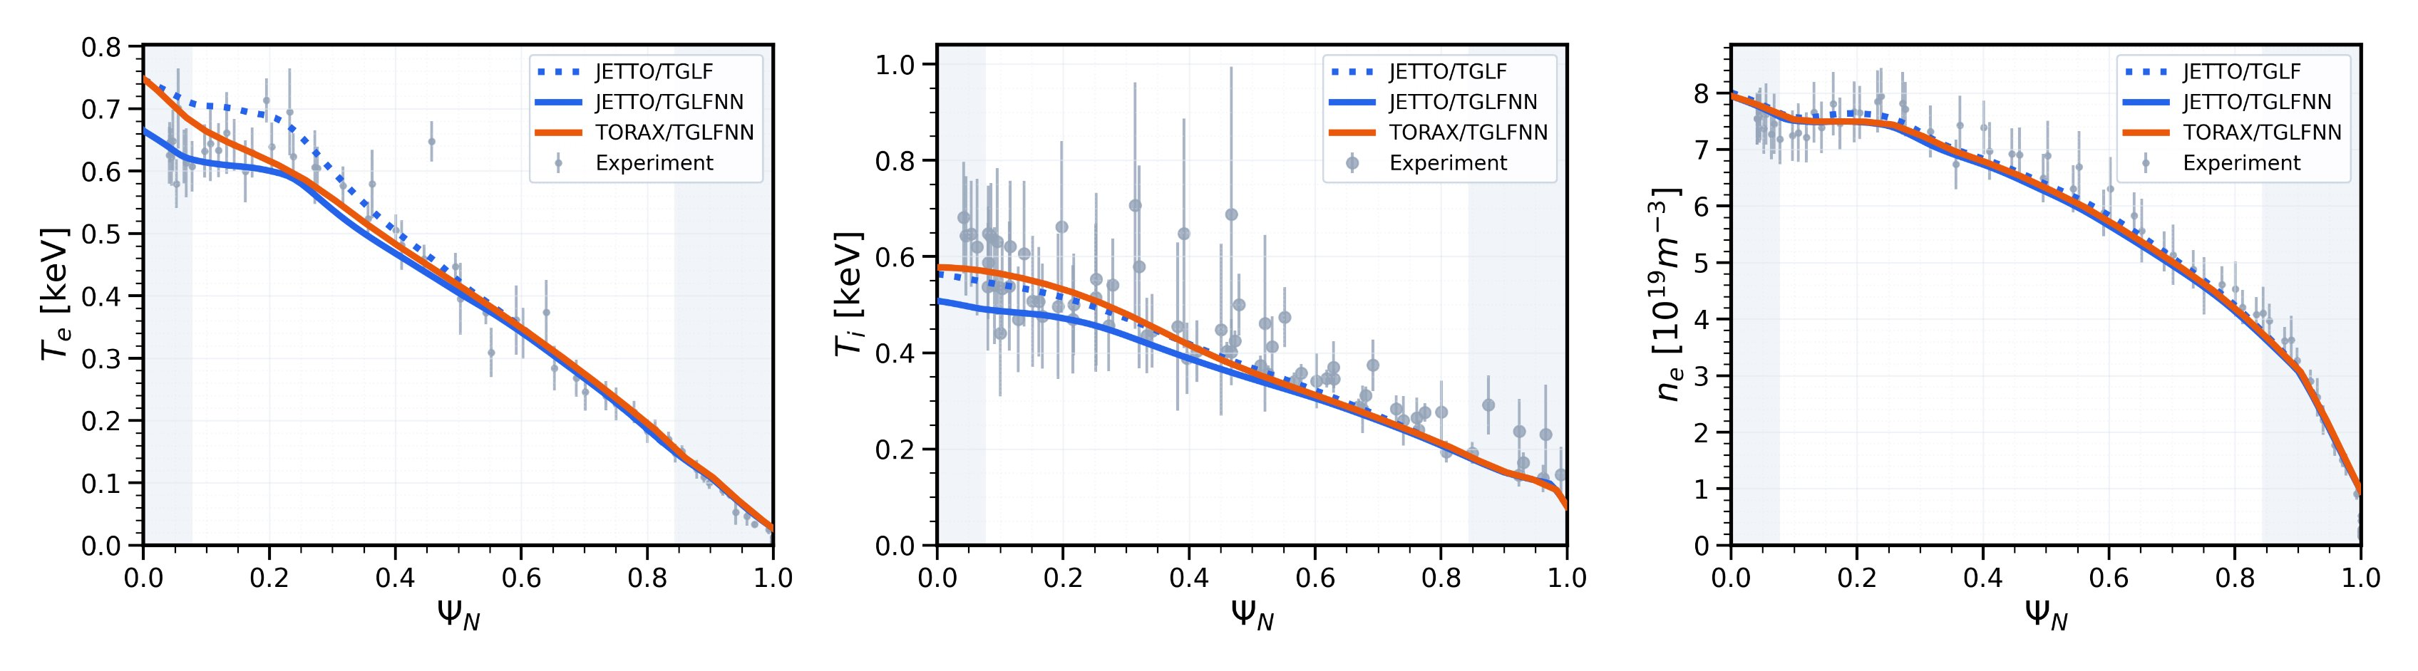
Validation: TCV #64965
RRMS T_{e} | RRMS T_{i} | RRMS n_{e}
8.25% | 6.65% | 1.64%
Good agreement between TGLF and TGLFNN, but a bit worse than than before
TORAX may have different sawtooth model
Speedup: 129x
M. Marin, S. Gabriellini, T. Brown, GDM

Slide 18
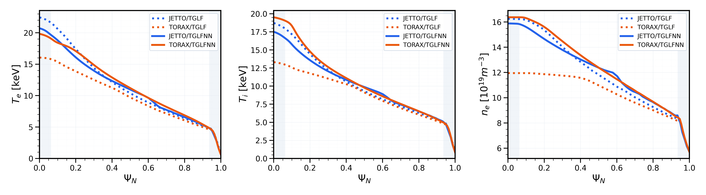
Validation: ITER 15MA baseline
RRMS T_{e} | RRMS T_{i} | RRMS n_{e}
3.33% | 3.61% | 2.51%
Again good agreement, apart from kink at psi~0.6 in JETTO-TGLFNN
TORAX-TGLF ran with different TGLF settings
  this is how wrong the comparison can go if TGLF is not ran exactly with the same TGLFNN settings shown before.
C. Bourdelle, S. Gabriellini, T. Brown, GDM

Slide 19
A note on WEST cases
Performance for TGLFNN shown on WEST cases on Monday was extremely poor
We found that BPERP=True for TGLF while TGLFNN is ES only
It's clear that EM effects are important for TGLF, but TGLFNN does not include them yet
WEST runs from Monday running again, results will be shared soon
TGLFNN/JETTO settings will be in the github NN repo

Slide 20
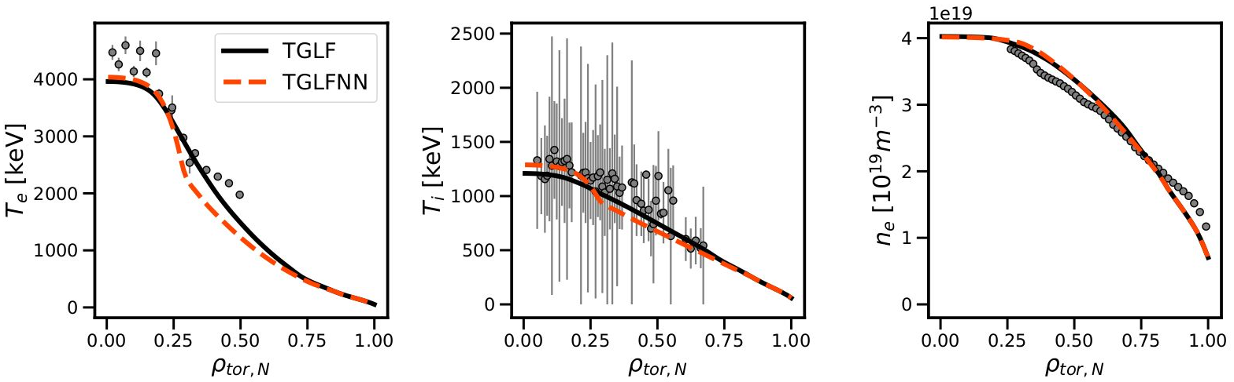
Validation: WEST #57757
RRMS T_{e} | RRMS T_{i} | RRMS n_{e}
9.7% | 7.5% | 0.9%
Note: density feedback, TGLFRHOMIN=0.3
Speedup WIP
E. Vergnaud, T. Brown, GDM

Slide 21
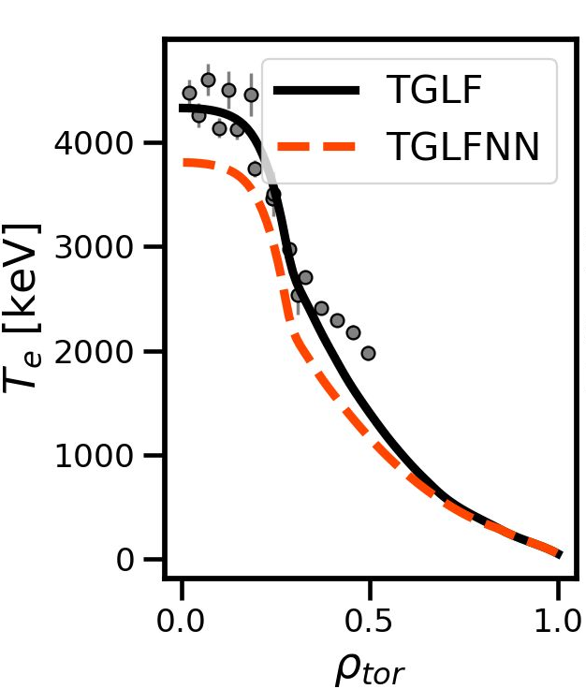
Validation: WEST #57757
TGLFNN vs TGLF w BPERP=True
TGLFNN vs TGLF-ES
E. Vergnaud, T. Brown, GDM

Slide 22
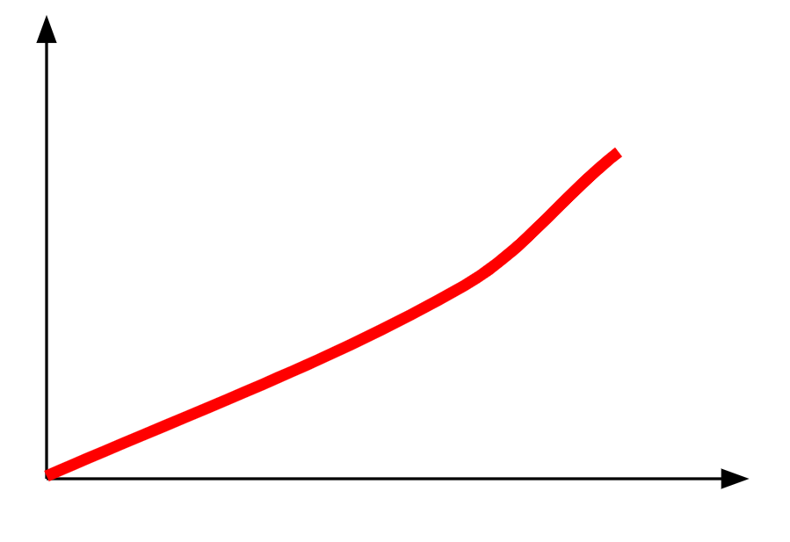
Practical next steps for large scale validation
NNs are great but not perfect. How to include them practically in large-scale validation?
  TGLFNN can provide their own uncertainty about flux prediction
  High NN uncertainty should trigger fallback to TGLF
  Speed-accuracy tradeoff calibration:
    Define NN uncertainty threshold
    Run TGLF and TGLFNN in JETTO on some validation shots
    Compute RRMSE between TGLF and TGLFNN runs
    Scan uncertainty threshold
  Inspired by A. Kit's EPS 2025 similar work with ASTRA
  Looking for volunteers!
Higher acceptable uncertainty = more NN calls, fewer TGLF calls, worse performance, higher speed
Profile RRMS(TGLF-TGLFNN)
NN uncertainty threshold

Slide 23
TGLFNN summary
TGLFNN ES, SAT2, pure D plasma developed
Instructions on how to use provided – please follow these to avoid surprises
Validation on 6 scenarios for TGLF and TGLFNN in JETTO
  sub-10% profile RRMS
  100-200x speedup factors
TORAX: broadly similar to JETTO but exact numbers WIP
Upcoming features:
  EM effects are important and should be included in the training set of the NN
    But current version of TGLFNN doesn't support EM. Do not compare it to EM TGLF!
  Harvest TGLF simulations from JETTO runs to retrain TGLFNN
    Expand training space in relevant directions
  More species --> curse of dimensionality, WIP

Slide 24
Beyond TGLFNN

Slide 25
Turbulent transport fidelity ladder
Bohm / Gyro-Bohm
  Extremely fast (analytic)
  Large simulation sweeps (e.g., E. Tholerus's STEP flat top paper)
  Not so reliable
TGLFNN
Reduced Quasilinear (e.g., TGLF, QuaLiKiz)
  1-10s per run
  Routinely used for design and validated on several experiments
  Large-scale validation and high-throughput scenario optimisation out of reach
Linear GK + Sat rule
  ~100-1000s per run
  Higher fidelity than TGLF/QLK
  Used in some cases (not in JETTO to my knowledge)
Nonlinear GK
  ~10⁵ –10⁷ s
  Used very occasionally (not in JETTO to my knowledge)
  E.g., GENE-TANGO, PORTALS
Speed
Accuracy
Ideally, we want nonlinear GK in ~ms

Slide 26
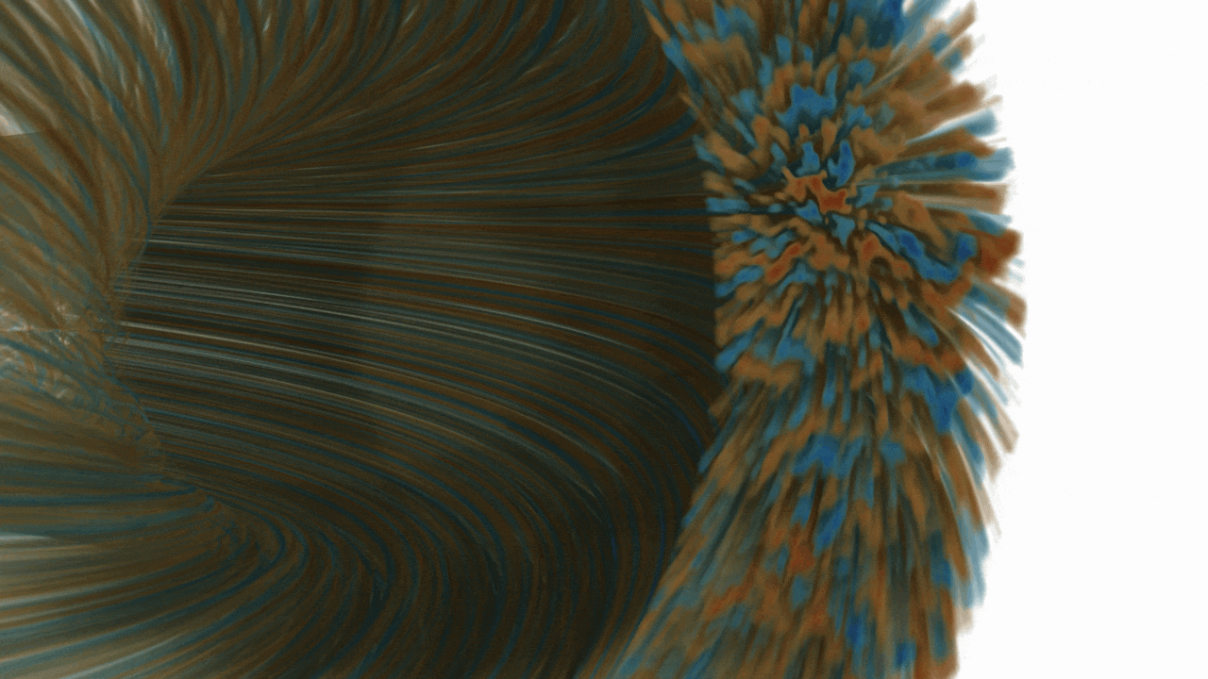
Nonlinear GK data
TGLFNN makes a simple regression on fluxes
Nonlinear GK data: rich information about turbulence
More information than just input-->flux relationship
Each time slice of a simulation can be used: a lot of data to fill the space!
Volume render of nonlinear GKW simulation
[Courtesy of Rui Costa]

Slide 27
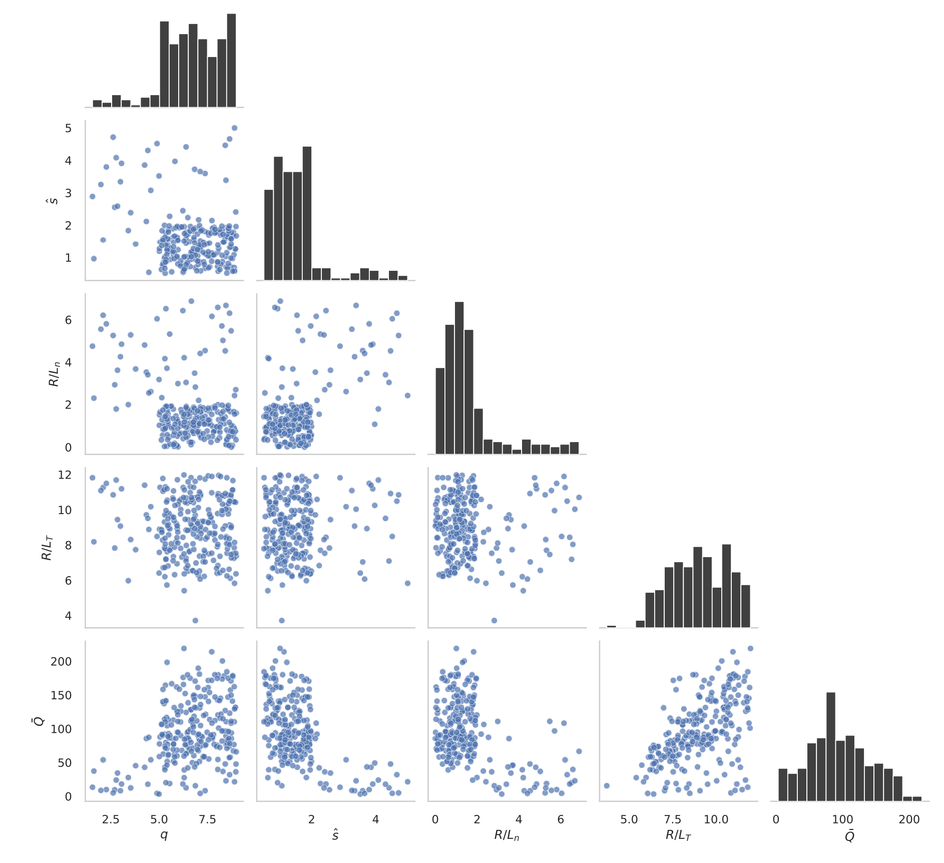
Proof of concept
Adiabatic electrons GA std case (~cheap)
Very driven ITG
Only 4 dimensions
GKW code
241 simulations (~20k CPUh)
We store the 5D snapshots along simulation time

Slide 28
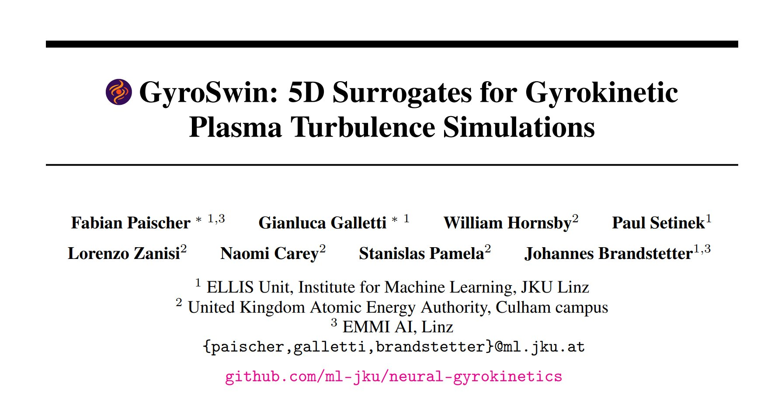
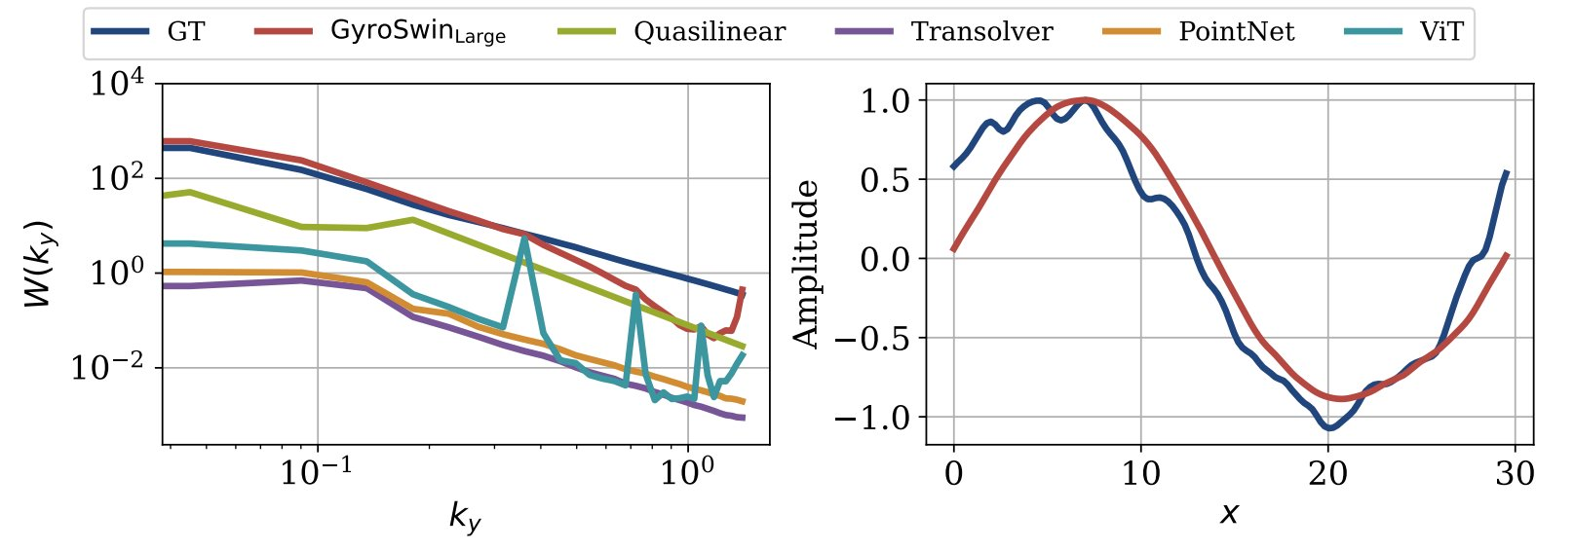
Nonlinear GK surrogate models
GyroSwin: NN that learns in 5D and replaces time dependent simulation
input parameters +initial condition --> 5D(t)
  Zonal flows
  Velocity space structure
  Phi fluctuations
  Flux
From 2h on 76 cores --> ~200ms
 | Linear GK + QuaLiKiz sat rule | MLP (~TGLFNN) | Gaussian Process | GyroSwin
q_{i} RMSE [GB] | 56.68 ± 14.09 | 49.54 ± 13.36 | 36.95 ± 9.24 | 18.35 ± 1.56
Predicted spectrum (left) and zonal flow (right)

Slide 29
Outlook for high fidelity GK surrogates
Demonstrated millisecond-capable surrogate models for nonlinear GK that improve on QLK saturation rule for adiabatic electron ITG (GA std case)
Now moving to reactor-relevant space
JINTRAC integration
TORAX integration

