Slide 1
Status on data validation issues of
WEST C7 simulation database
DMP : June 10th, 2026

Slide 2
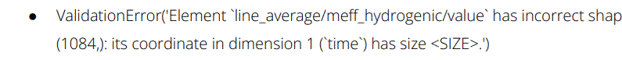
Blocking issue as reported by Kamil:
about ~60% shots are impacted
fixed by Jean-François
TODO: rerun of the campaign C7 post-processing tasks needs to be scheduled

Slide 3
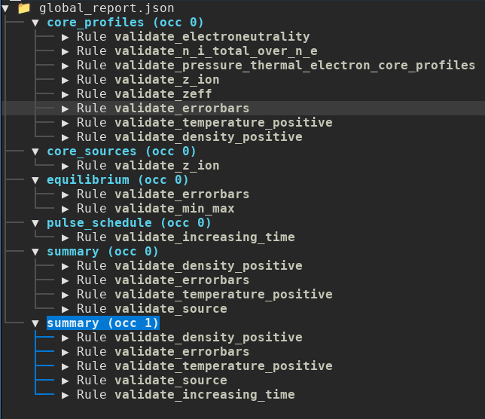
Adressing other data validation issues

Slide 4
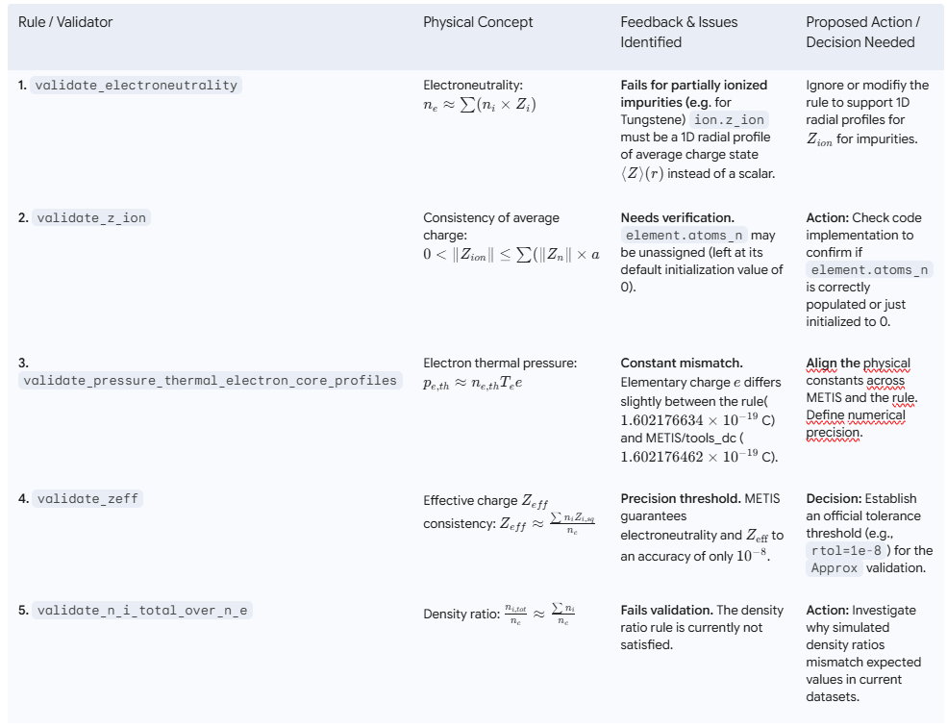

→ The same validation issues and feedback apply to core_sources as they do to core_profiles.

Slide 5
