Slide 1
ICRF HCD for DEMO: Some information on antenna design
IPP/POLITO: V. Bobkov, H. Faugel, Th. Franke, A. Kostic, D. Milanesio, R. Maggiora, R. Ochoukov, M. Usolceva, W. Tierens, F. Zeus, W. Zhang

Slide 2
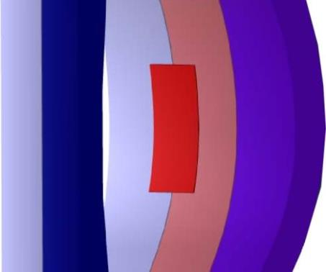
Possible mounting options in relation to area (≈power capability)
“Port plug”:
“Poloidally Arranged Halves”:
“Toroidally Arranged Halves”:
• Max. size: port limited
1.04 x 2.76 m (~2.9 m²)
assuming 1.08 m port
can port be wider 1.08 m ?
• Max. size for 9” feeders:
2.16 x 2.12 m (~4.6 m²)
assuming 1.08 wide port
• Max. size for 9” feeders: 1.57 x 2.76 m (~4.3 m²)
assuming 1.08 m port
• Easier to model during optimisation
• Some impact on BB
• Mounting procedure as in ITER
• Largest impact on BB at a fixed area
• Mounting procedure different to ITER
• Difficult installation with rotation

Slide 3
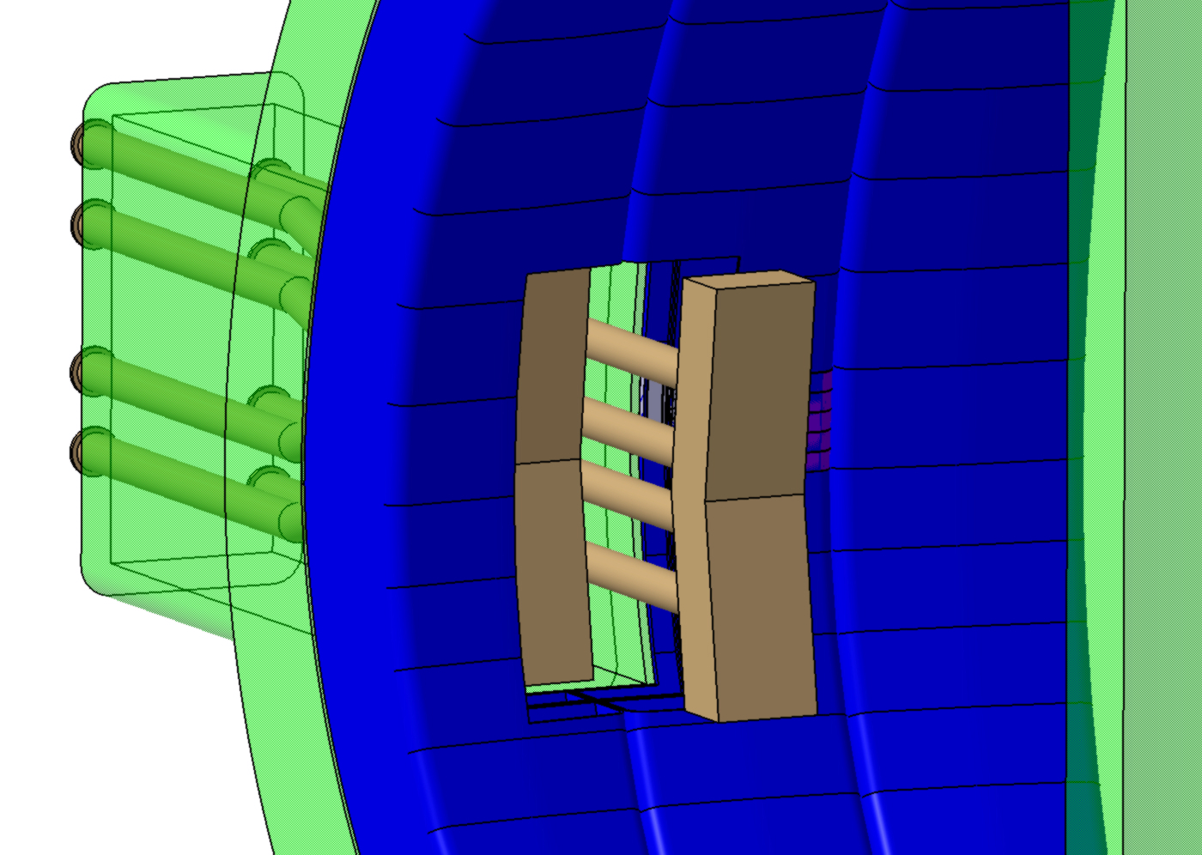
Installation of antenna with toroidally arranged halves into vessel
1) Insert first half deep through port
2) Shift first half to the side
3) Insert second half deep through port (see picture)
4) Shift second half to its end position
5) Shift first half close to the first half and retract to its end position

Slide 4
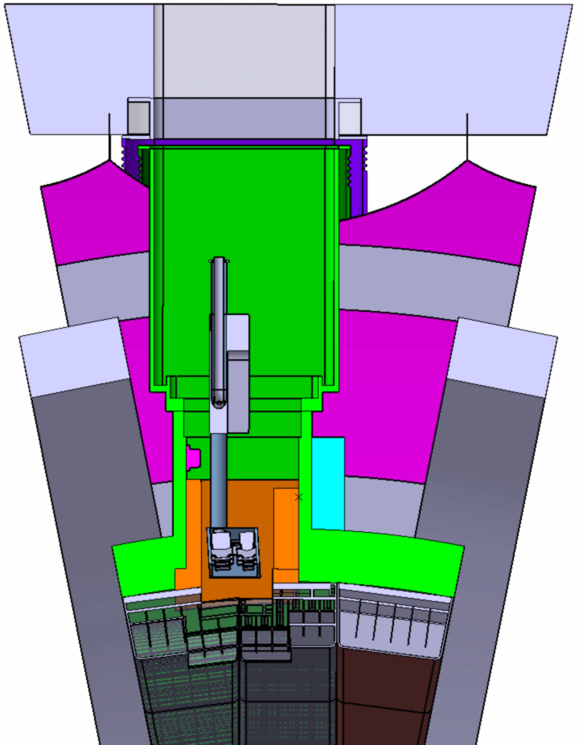
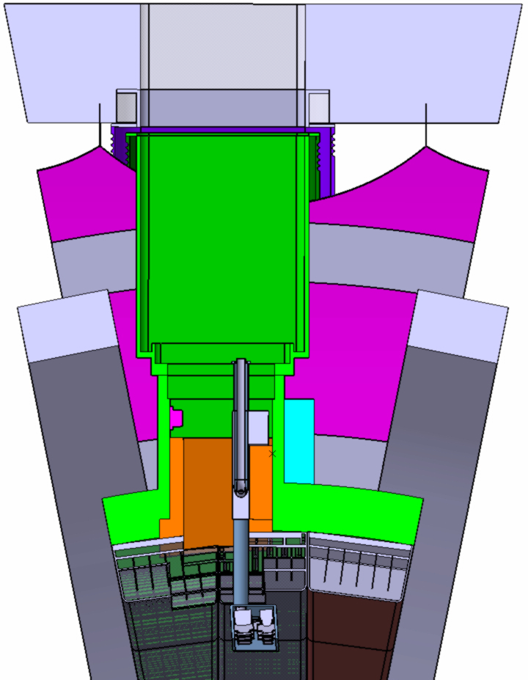
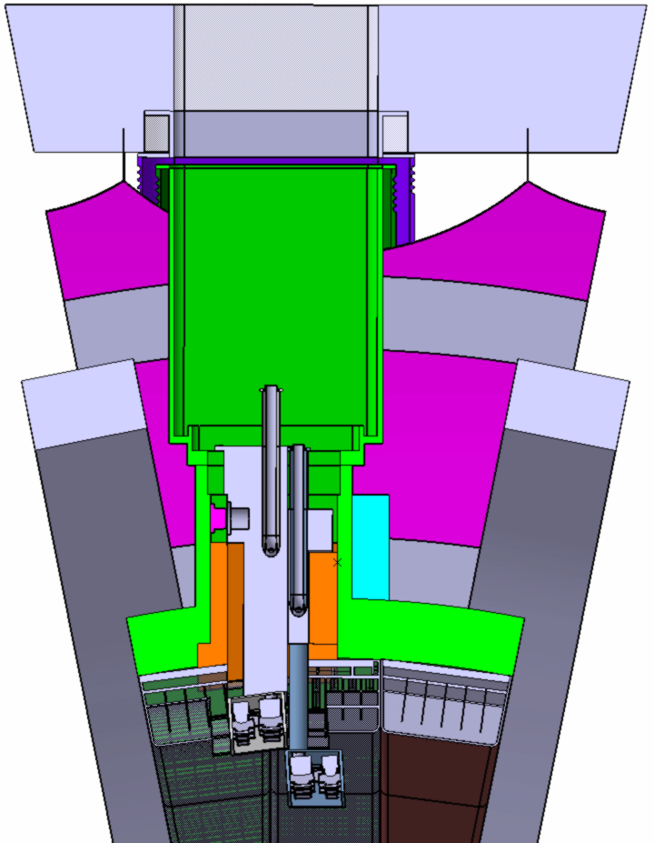
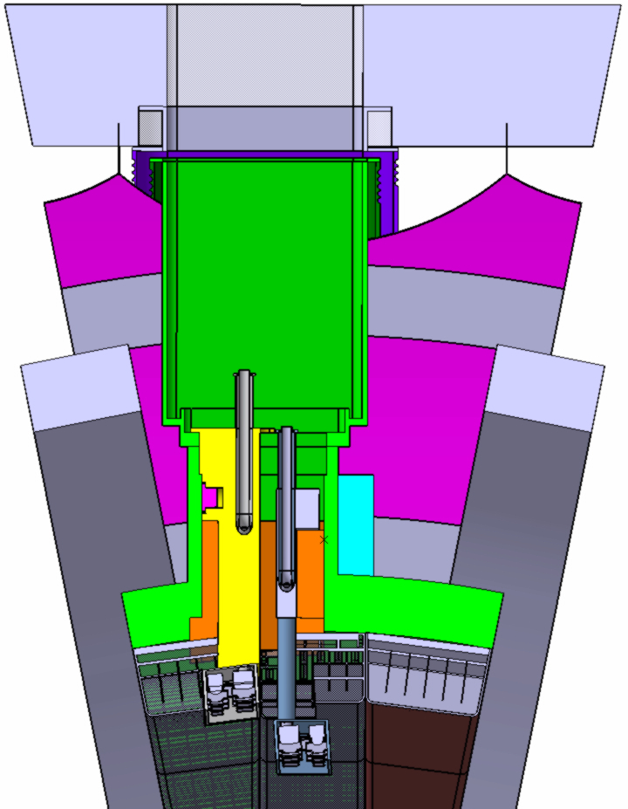
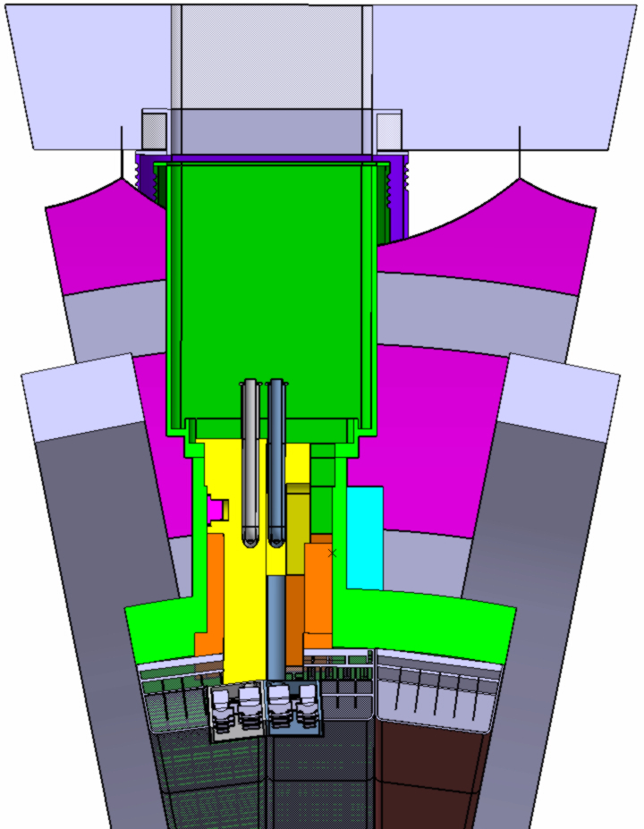
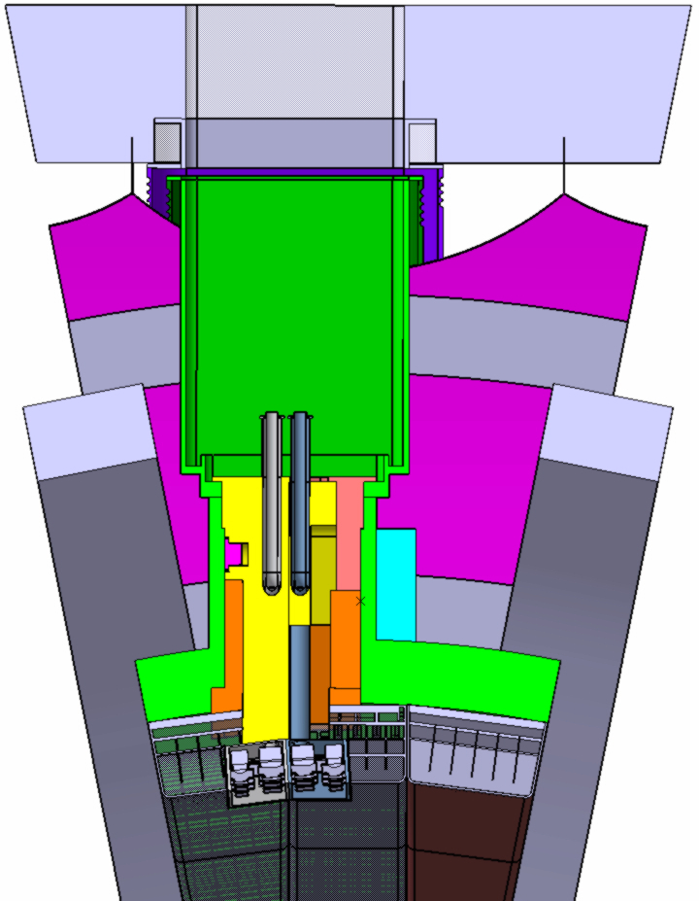
Outcome of the optimisation process: still ongoing
TAH antenna mounting procedure:

Slide 5
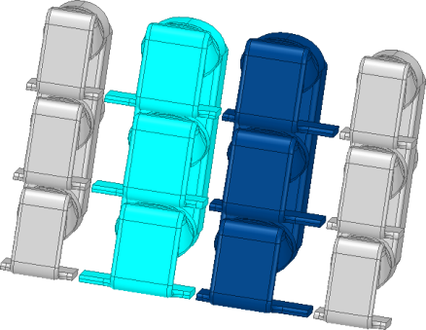
Antenna design optimization
• First use HFSS code with lossy dielectric for comparative analysis
• RAPLICASOL / TOPICA with DEMO-like (ITER-low) profiles after (on-going)
0
π
π
0
• Things to optimize: minimize near fields, minimize TL voltages, balance TL voltages, optimize k|| spectrum (one peak close to 4.5 m⁻¹, avoid k||=0)
P_{central}
P_{outer}
• Algorithm: 1) Define geometry and run HFSS calculations
2) Find optimum P_{central}/P_{outer} for min of E|| near-field at PFCs
3) Compare TL maximum voltages: voltage balance
4) Check k|| spectrum

Slide 6
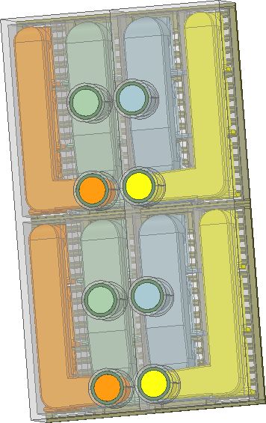
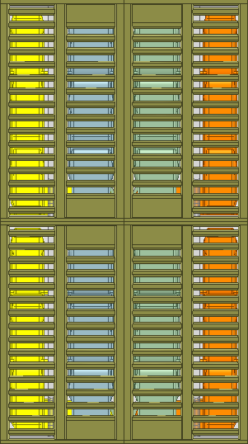
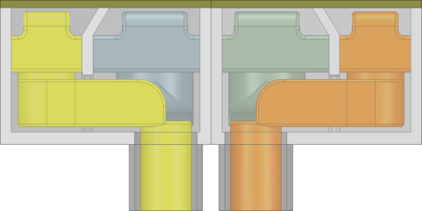
Example: case 10 antenna
Two toroidally arranged halves with maximum width/height:
2.76 m
Depth reduced from ~0.62 cm to ~0.5 cm
(see explanation later)
1.57 m
connection line of halves

Slide 7
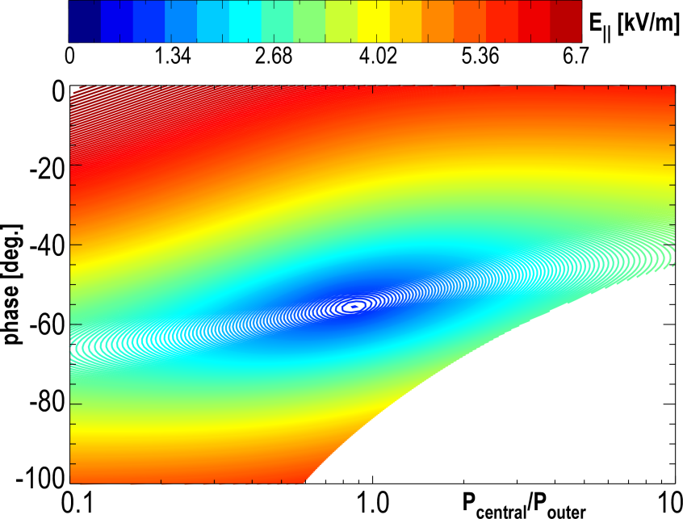
Example: case 10 antenna
39kV 41kV 41kV 39kV
39kV 41kV 41kV 39kV
• Near-fields reduced well
close to P_{central}/P_{outer} ≈ 0.9,
narrow region of decrease

Slide 8
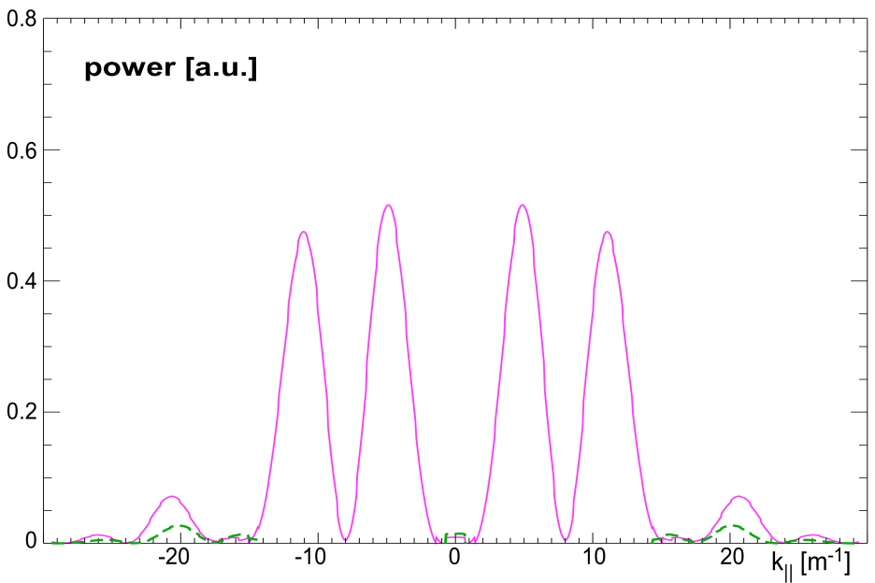
Example: case 10 antenna
39kV 41kV 41kV 39kV
Near-fields
Reduced voltage
Voltage balance
k|| spectrum
bad
39kV 41kV 41kV 39kV
good
• Near-fields reduced well
close to P_{central}/P_{outer} ≈ 0.9,
narrow region of decrease
• Central septum makes second peak of k|| spectrum significantly stronger

Slide 9
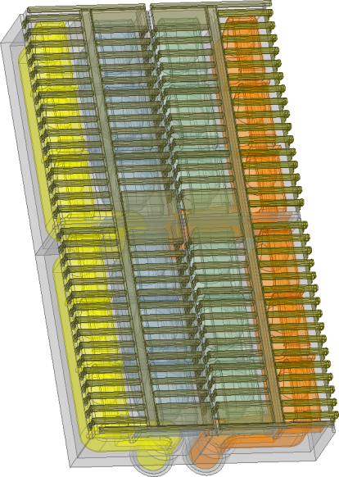
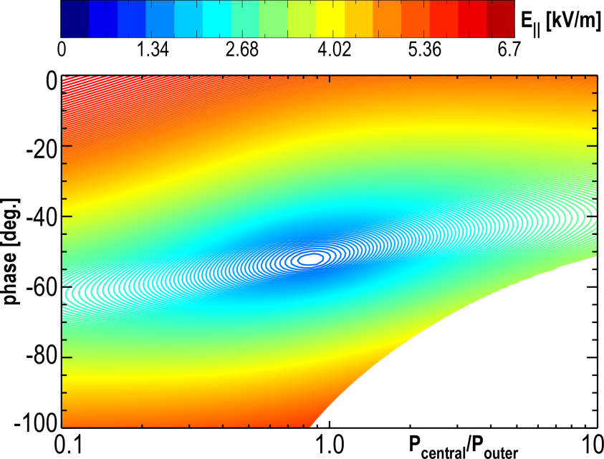
Further optimized: case 11 antenna
35kV 33kV 33kV 35kV
• Near-fields reduced well
close to P_{central}/P_{outer} ≈ 0.9,
narrow region of decrease

Slide 10
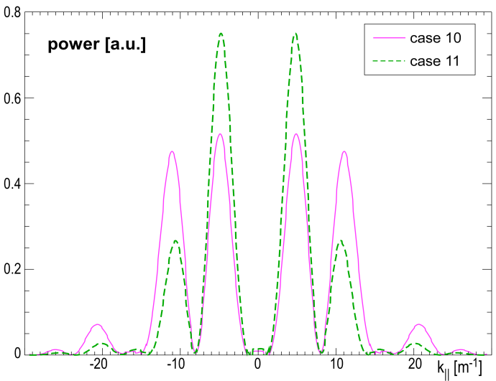
Further optimized: case 11 antenna
35kV 33kV 33kV 35kV
Near-fields
Reduced voltage
Voltage balance
k|| spectrum
bad
good
• k|| spectrum significantly better than in case 10

Slide 11
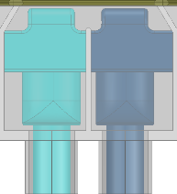
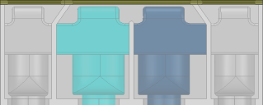
Further optimisation in the future
case-11:
• Further optimization steps:
comparison between triplets and quadruplets in detailed geometry
using larger depth
for central straps
curvature of return
conductor to match BB banana shape
and toroidal tilting of antenna face
effect of poloidal phasing
35kV 33kV 33kV 35kV
• Nevertheless the current state of the TAH antenna should be a good representative for MCNP simulations – further development of antenna design should not affect neutron shielding significantly

