Slide 1


USER GUIDE
MATLAB High Level Interface
for IMAS
Manipulating Interface Data Structures using the Matlab HLI for IMAS

Slide 2





TUTORIAL OVERVIEW
IMAS Library
Reading IDS
Writing IDS
Loading the environment and initializing the MATLAB setup.
Accessing existing data, extracting structures, and data visualization.
Creating new database entries, populating and saving them.

Slide 3
STEP 01
Loading the Library
Setting up your working environment

Slide 4
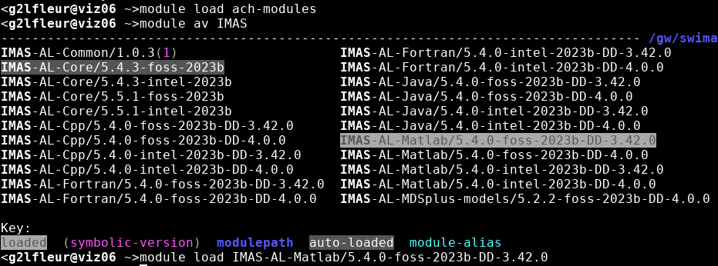
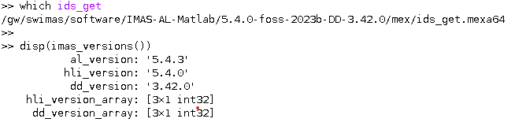
INITIAL CONFIGURATION
  Gateway example:
Check available modules:
module avail IMAS-MATLAB
Loading the module:
module load IMAS-MATLAB
<g2lfleur@viz06 -> matlab
Inside matlab:
Verification: Check if the library is loaded properly
-> launch Matlab from the terminal
$ matlab
-> check for example if the function ids_get exists from Matlab prompt
>> which ids_get
ITER documentation: https://imas-matlab.readthedocs.io/en/latest/getting_started.html

Slide 5
STEP 02
Reading Data
Exploring an existing Interface Data Structure (IDS)

Slide 6
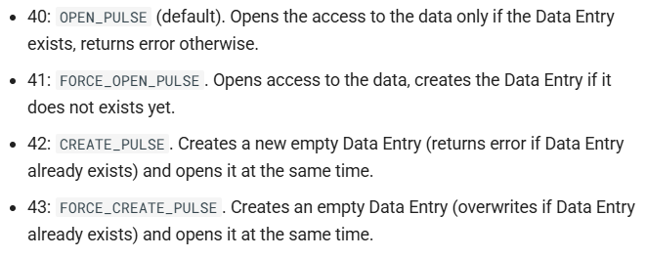
OPENING A URI
What’s an IMAS URI?
URIs follow the format: imas:backend?query_options
For example:
‘imas:hdf5?path=/path/to/data‘ → Read from HDF5 files ‘imas:mdsplus?path=./test_db‘ → Read from MDSplus
‘imas:uda?backend=hdf5; path=/Imas_public/public/imasdb/west/3/57410/3;‘ → Read from UDA backendd
Before to read data, use first imas_open() by specifying an URI.
Note: The idx handle is required for all subsequent data operations.
% Open a database entry (WEST example)
uri = 'imas:hdf5?path=/Imas_public/public/imasdb/west/3/54178/0';
idx = imas_open(uri, 40);
if idx < 0
error('Unable to open database');
end
ITER documentation: https://imas-matlab.readthedocs.io/en/latest/load_store_ids.html#open-an-existing-imas-database-entry

Slide 7
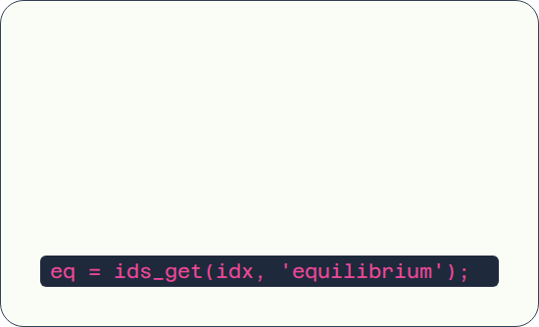

IDS FULL DATA FETCHING: IDS_GET
Exploration
Retrieval
Use eq (or eq. follows by a struct name) to explore the IDS tree.
The ids_get(idx, 'name') function loads the complete data structure into MATLAB memory.
For example:
>> eq.vacuum_toroidal_field
ans =
r0: 2.3700
r0_error_upper: -9.0000e+40
r0_error_lower: -9.0000e+40
r0_error_index: 0
b0: [49x1 double]
b0_error_upper: []
b0_error_lower: []
b0_error_index: 0
>> eq.grids_ggd{1}
ans =
grid: {[1x1 struct]}
time: 32.1071
Example
Example
>> eq = ids_get(idx,'equilibrium')
eq =
ids_properties: [1x1 struct]
vacuum_toroidal_field: [1x1 struct]
grids_ggd: {[1x1 struct]}
time_slice: {49x1 cell}
code: [1x1 struct]
time: [49x1 double]
ITER documentation: https://imas-matlab.readthedocs.io/en/latest/load_store_ids.html#load-an-entire-ids

Slide 8
DATA FETCHING OF A SPECIFIC IDS OCCURRENCE
Retrieval a specific IDS occurrence
Use ‘ids_name/occurrence’ to retrieve a specific occurrence.
For example:
eq = ids_get(idx, ‘equilibrium/2’)
will retrieve the occurrence 2 (third occurrence) of the equilibrium IDS.

Slide 9
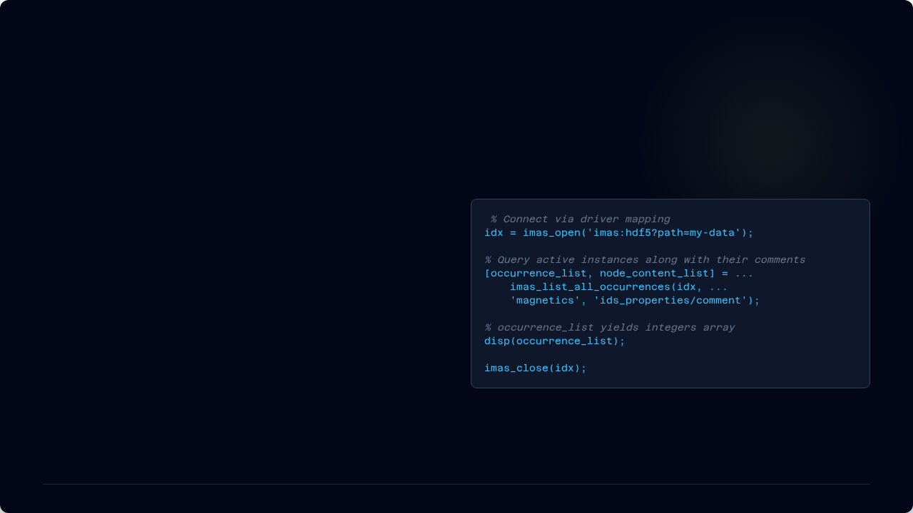

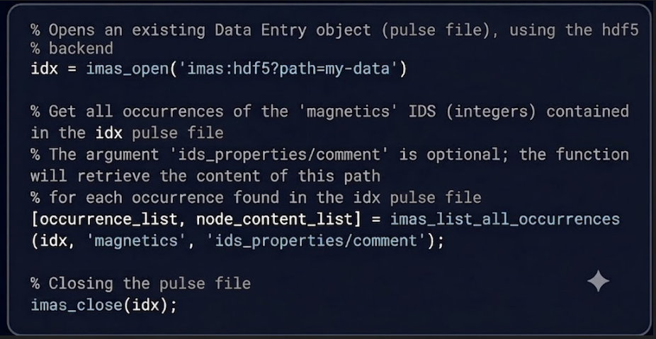

LISTING ALL OCCURRENCES FROM AN IDS
You can optionally crawl specific meta-paths like comments simultaneously:
MAP NON-EMPTY INSTANCES
With imas_list_all_occurrences() you can list all non-empty occurrences of an IDS using its name in the dataset, and optionally return the content of a descriptive node path..
BACKEND VERSION CONSTRAINT
MDS+ backend Warning: occurrences infos are natively stored only for Access Layer version > 5.0.0. Calling this function on legacy pulse files (≤ 5.0.0) will raise an exception handle.
ITER documentation: https://imas-matlab.readthedocs.io/en/latest/load_store_ids.html#listing-all-occurrences-of-an-ids-from-a-backend

Slide 10
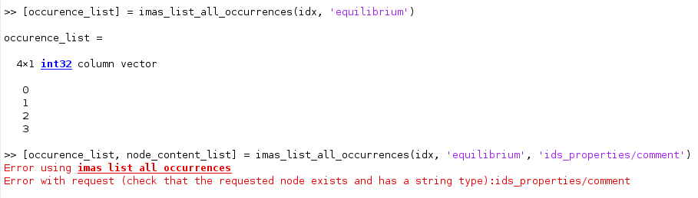
LISTING ALL OCCURRENCES FROM AN IDS
You can optionally crawl specific meta-paths like comments simultaneously:
MAP NON-EMPTY INSTANCES
With imas_list_all_occurrences() you can list all non-empty occurrences of an IDS using its name in the dataset, and optionally return the content of a descriptive node path..
BACKEND VERSION CONSTRAINT
MDS+ backend Warning: occurrences infos are natively stored only for Access Layer version > 5.0.0. Calling this function on legacy pulse files (≤ 5.0.0) will raise an exception handle.
ITER documentation: https://imas-matlab.readthedocs.io/en/latest/load_store_ids.html#listing-all-occurrences-of-an-ids-from-a-backend

Slide 11
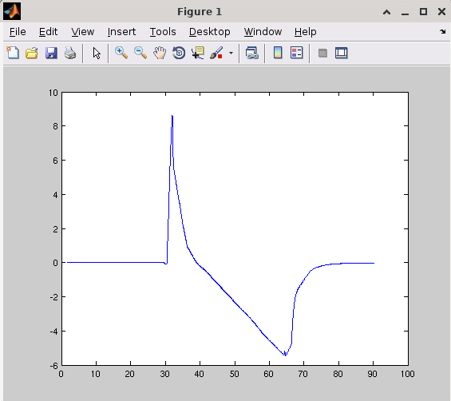
EXPLORING THE MAGNETICS IDS (WEST SHOT 54178)
Getting Full magnetics IDS
Accessing first flux loop
Writing 3 first values of the flux data
>> mag = ids_get(idx,'magnetics')
mag =
ids_properties: [1x1 struct]
flux_loop: {17x1 cell}
bpol_probe: {130x1 cell}
b_field_pol_probe: {}
b_field_tor_probe: {}
b_field_phi_probe: {}
rogowski_coil: {}
shunt: {}
method: {[1x1 struct]}
ip: {}
diamagnetic_flux: {}
latency: -9.0000e+40
…
time: [24896x1 double]
>> mag.flux_loop{1}
ans =
name: 'Flux_loop'
identifier: 'identifiernotdefined'
type: [1x1 struct]
position: {[1x1 struct]}
indices_differential: []
area: -9.0000e+40
area_error_upper: -9.0000e+40
area_error_lower: -9.0000e+40
area_error_index: -999999999
…
flux: [1x1 struct]
voltage: [1x1 struct]
>> mag.flux_loop{1}.flux.data(1:3)
ans =
0.0007
0.0016
0.0049
>> plot(mag.time, mag.flux_loop{1}.flux.data)
>> mag.flux_loop{1}.flux
ans =
data: [24896x1 double]
data_error_upper: []
data_error_lower: []
data_error_index: -999999999
validity_timed: []
validity: -999999999
time: []

Slide 12
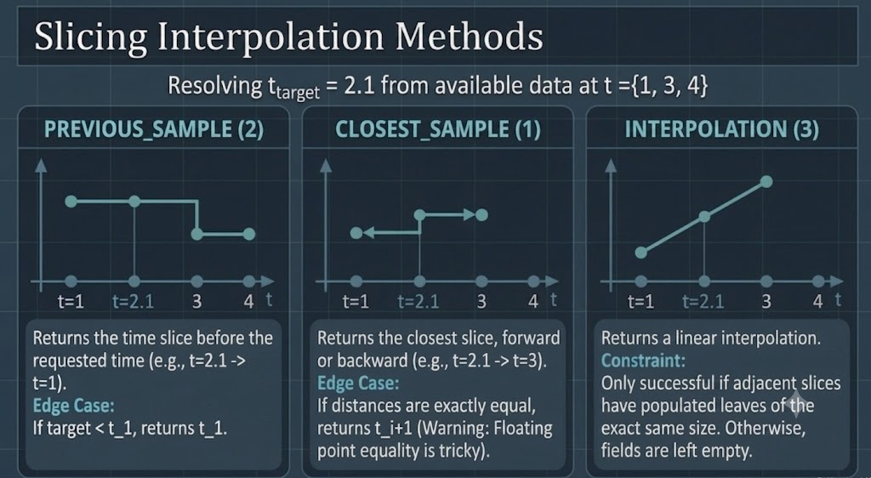
IDS DATA RETRIEVAL USING TIME SLICING
Retrieval
Time interpolation
Instead of loading the full time evolution, ids_get_slice() pulls a specific timestamp, ideal for integrating IDS data into step-by-step simulations.
Note that the access layer assumes all time arrays are stored in increasing order.
Because requested times rarely align perfectly with data sample frequency, IDS data are interpolated at the requested time using one of the following methods given below.
Example
% Request data at t = 2.1 s
target_time = 2.1;
interp_method=3 % 3 = linear interpolation
mag_slice = ids_get_slice(idx,'magnetics', target_time, interp_method)
ITER documentation: https://imas-matlab.readthedocs.io/en/latest/load_store_ids.html#id18

Slide 13
FETCHING PARTIAL DATA
ids_get_sample
ITER documentation: https://imas-matlab.readthedocs.io/en/latest/api_ids.html#ids_get_sample
out = ids_get_sample(expIdx, IDSpath[, occurence], tmin, tmax, dtime, interp)
Read the contents of an IDS over a specific time range into memory.
This method fetches an IDS with all time slices in a time range between tmin and tmax.
Example: out = ids_get_sample(expIdx, 'magnetics’, 2.5, 7.5, 0.2, 3)
imas_partial_get
Not yet documented: avaibility of this feature depends on plugins installation
out = imas_partial_get(expIdx, IDSname, occurence, includes, excludes [, debug])
Read the partial contents of an IDS into memory.
This method fetches partially the IDS according to 'includes' and 'excludes' queries.
Example: out = imas_partial_get(expIdx, 'magnetics', includes='flux_loop(1:6);bpol_probe(1:2)’)

Slide 14
STEP 03
Writing Data
Saving a new IDS to the database

Slide 15
SAVE WORKFLOW
Step | API Function | Description
1. Opening URI | idx = imas_open(URI, 43) | Creates a new pulse file.
2.Initialization | ids_object = ids_init(ids_name) | Populates all branches with their default values (arrays of structures default to empty cells and default values for scalars).
3. Setting IDS data | ids_object.ids_properties.homogeneous_time = 1; ids_object.time = [1., 2., 3.]; | Populates the IDS object created at the previous step.
4. Writing | ids_put(idx, ids_name, ids_object) | Pushes the IDS data into the pulse file.
5. Closing file handler | imas_close(idx) | Closes the file handler.
ITER documentation: https://imas-matlab.readthedocs.io/en/latest/load_store_ids.html#store-imas-data

Slide 16
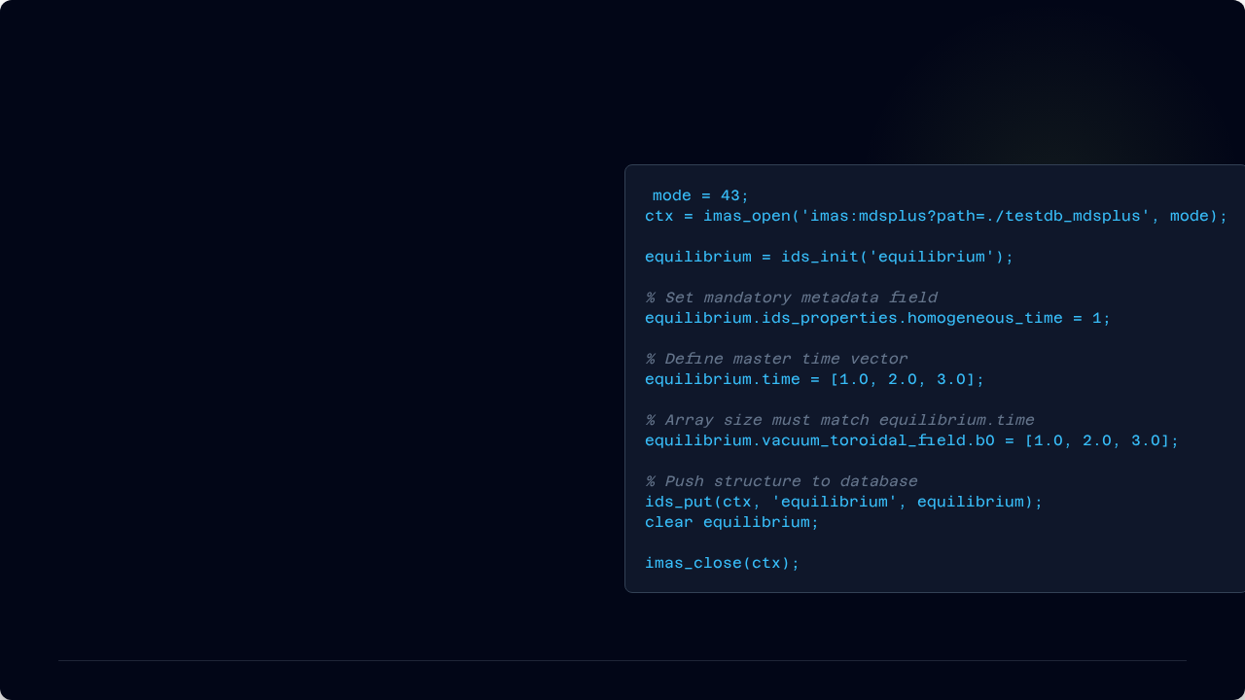
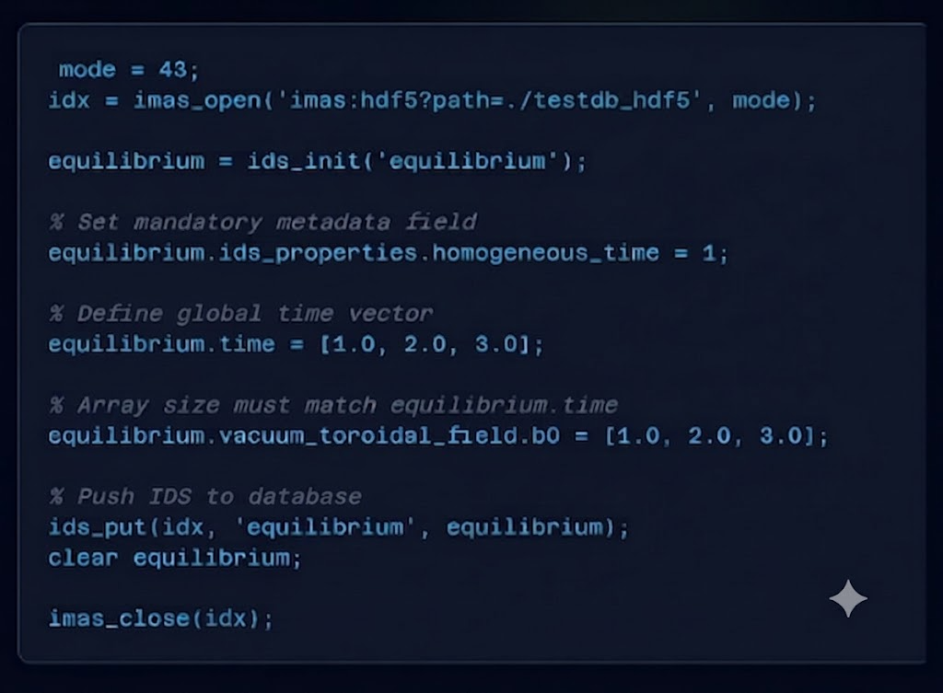


POPULATING AN IDS BEFORE SAVING
TIME ALIGNMENT
When ids_properties.homogeneous_time = 1, all dependent fields (like b0) must match the exact size of the main time vector.
AUTOMATED FIELDS
The Access Layer automatically populates metadata versioning branches upon execution of ids_put:
•
.../version_put/data_dictionary
•
.../version_put/access_layer
•
.../version_put/access_layer_language

Slide 17
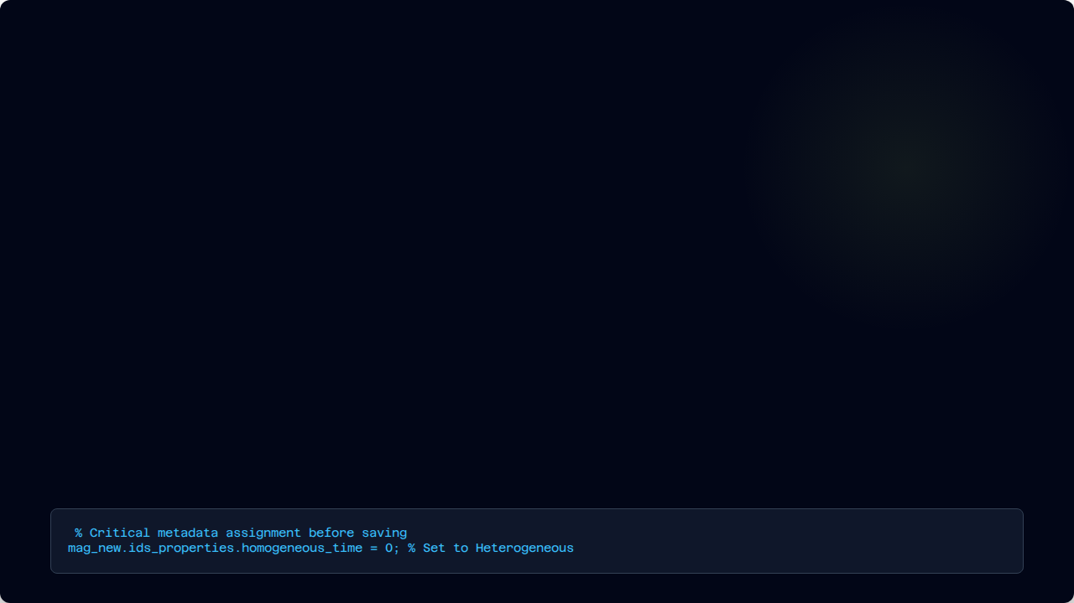



THE IDS TIME MODE
Metadata defining how signals time basis are handled.
HOMOGENEOUS (=1)
HETEROGENEOUS (=0)
INDEPENDENT (=2)
Mechanism: All quantities in the IDS share a single, global time vector.
Mechanism: Data nodes can have unique timebases (e.g. different frequencies).
Mechanism: The IDS contains no time-dependent information.
Location: Root node (e.g. magnetics.time)
Requirement: Time fields must be empty.
Location: Local nodes (e.g. flux_loop{i}.flux.time)

Slide 18
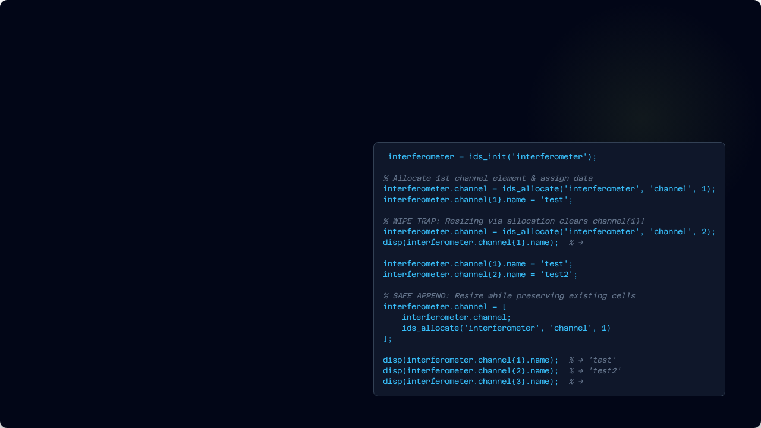


RESIZING ARRAYS OF STRUCTURES: IDS_ALLOCATE
2 examples:
Allocate 10 channels for interferometer IDS →
interferometer.channel = ids_allocate(‘interferometer’, ‘channel’, 10)
2. Allocate 1 profiles_2d element for equilibrium IDS →
eq.time_slice{1}.profiles_2d = ids_allocate(‘equilibrium’, ‘time_slice/profiles_2d’, 1)
In MATLAB, IMAS arrays of structures (AoS) are implemented as cell arrays. Resizing them correctly is critical.
1. THE DATA DESTRUCTION TRAP
Re-calling ids_allocate('interferometer', 'channel', ) resets the existing index {1}. The previously stored string 'test' is completely wiped out.
<empty>
2. SAFE GROWTH WORKFLOW
By using cell array grouping [existing_cell; new_element], elements {1} and {2} keep their properties intact while appending a fresh, empty {3} slot.
<empty>
ITER documentation: https://imas-matlab.readthedocs.io/en/latest/use_ids.html#resizing-an-array-of-structures

Slide 19
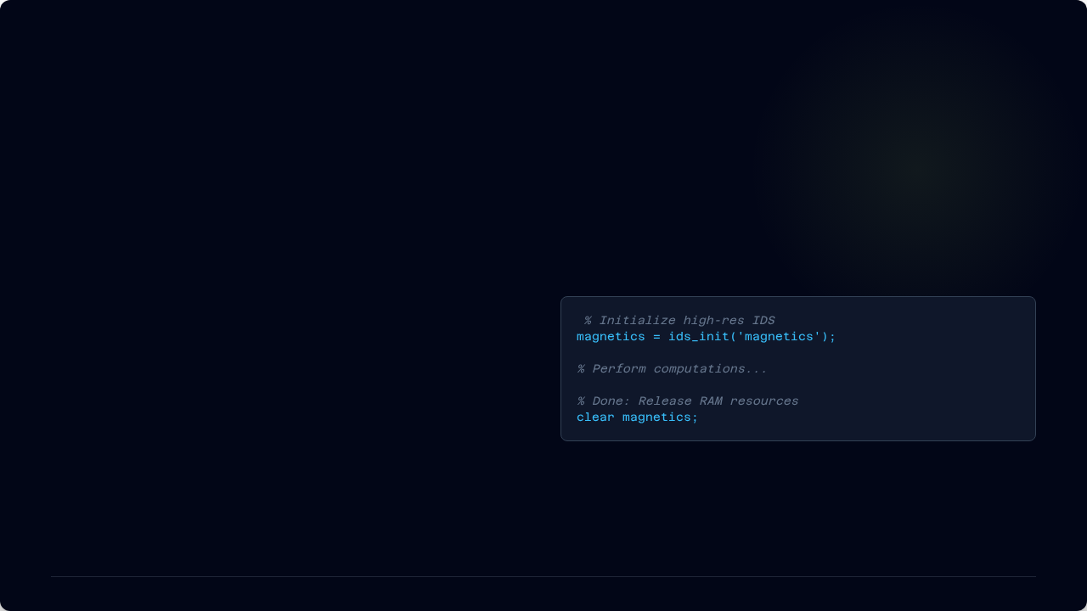


FREEING MEMORY: DEALLOCATION
Releasing Resources
Large Interface Data Structures (IDS) can consume significant amounts of RAM, especially with high-resolution 2D grids.
MANUAL MEMORY MANAGEMENT
Once you are finished processing an IDS, explicitly clear the variable to release the memory resources used by the data.
ITER documentation: https://imas-matlab.readthedocs.io/en/latest/use_ids.html

Slide 20
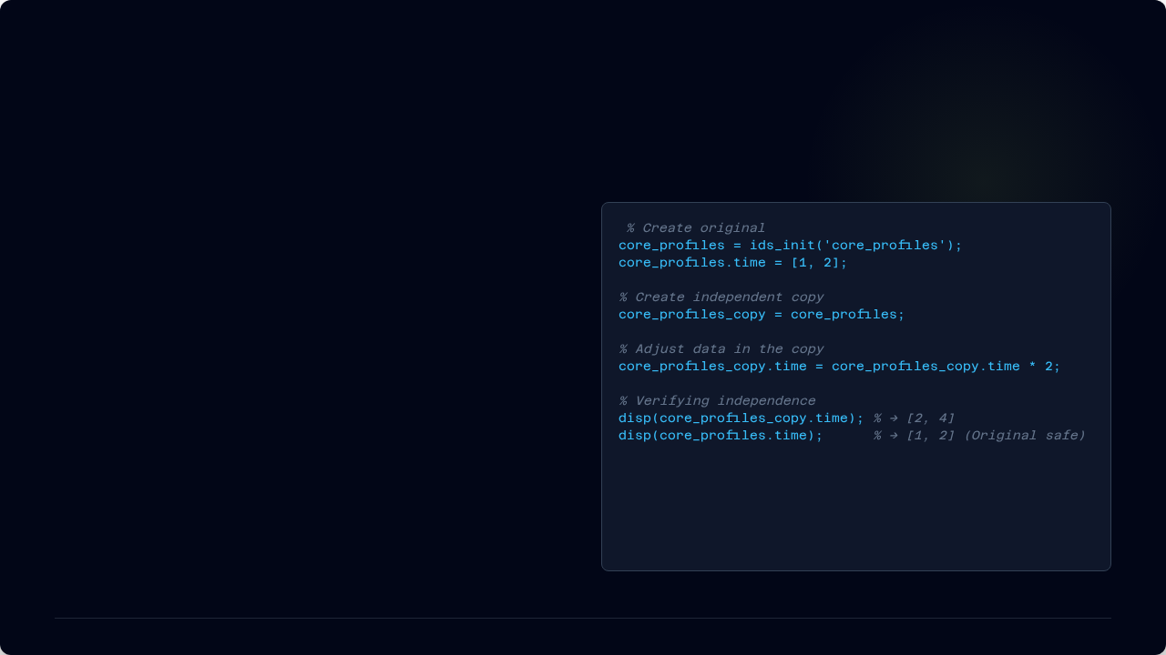


CLONING IDS: DEEP COPYING
INSTANCE INDEPENDENCE
Assigning an IDS to a new variable (B = A) performs a Deep Copy in MATLAB IMAS API.
SAFETY GUARANTEE
Modifying the copy does not affect the original structure. This is vital for comparative analysis or what-if scenarios.
ITER documentation: https://imas-matlab.readthedocs.io/en/latest/use_ids.html

Slide 21



SLICING OPERATIONS: IDS_PUT_SLICE()
When dealing with long plasma pulses or step-by-step physical simulations, keeping the entire time history in your system memory can trigger RAM saturation.
STREAM DIRECTLY TO STORAGE
The ids_put_slice() function appends a single time slice to an existing database entry. The Access Layer handles the sequential stacking at the backend level, keeping your MATLAB workspace footprint lightweight.
Loop Iteration → Slice Injection → Database Growth
ITER documentation: https://imas-matlab.readthedocs.io/en/latest/load_store_ids.html#append-a-time-slice-to-an-already-stored-ids

Slide 22
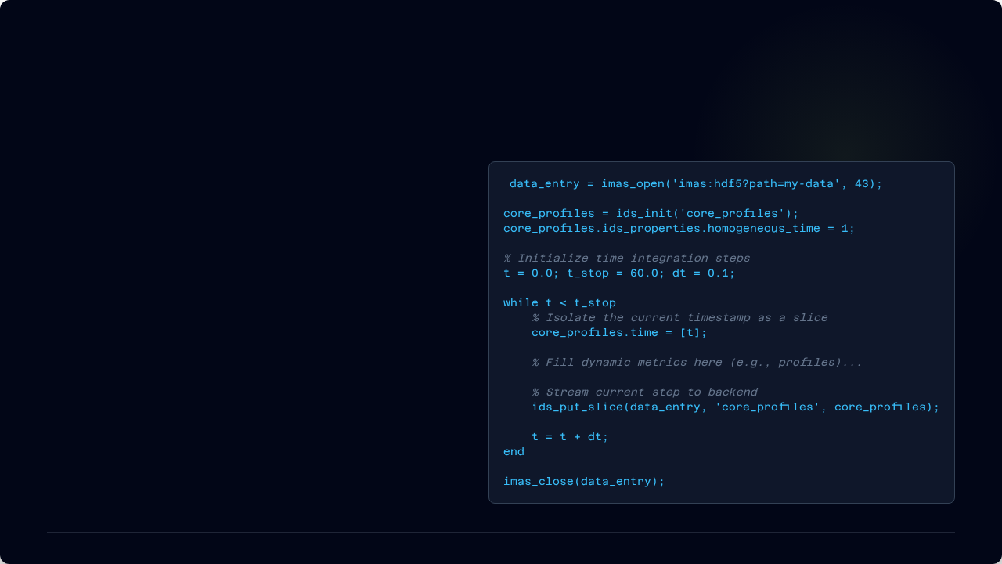

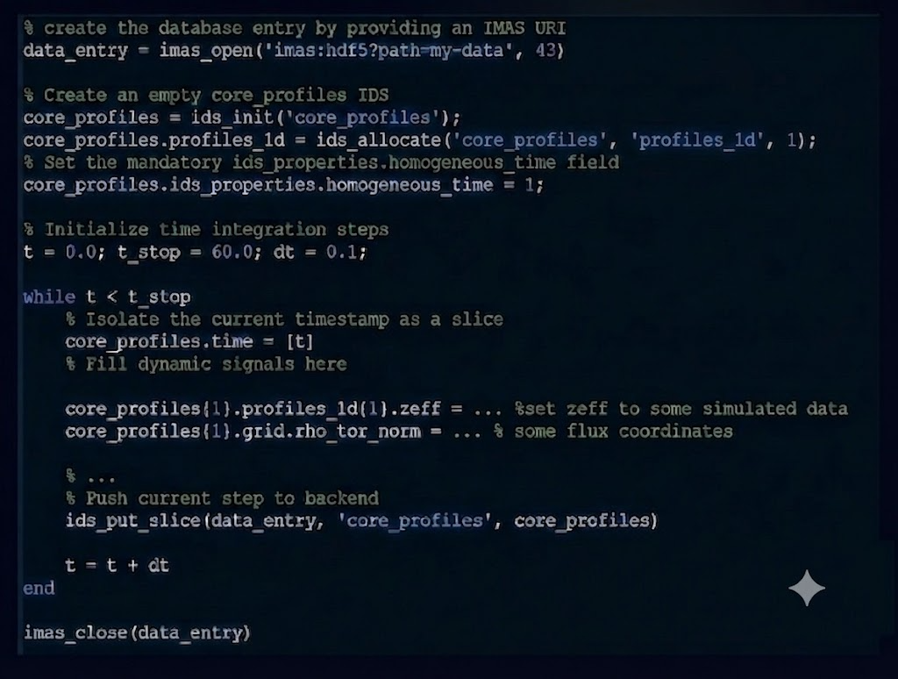
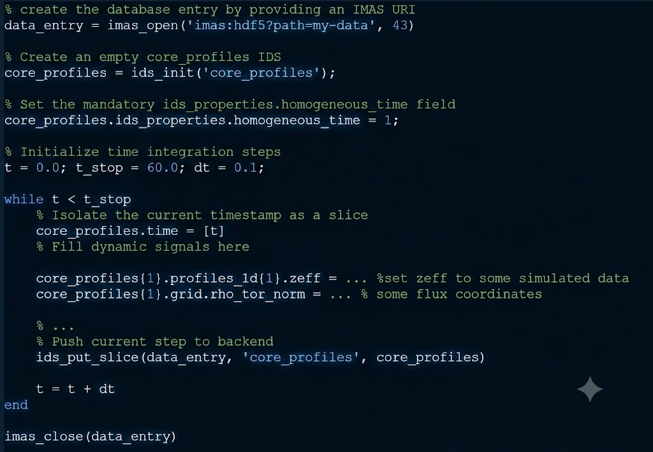

CODE EXAMPLE: TIME INTEGRATION LOOP
STORING TIME SLICES
Inside the loop, a time slice is built at the current time of the iteration:
- for dynamic arrays of structures AOS(itime) only the first index at itime=1 is allocated and set
- for N-dimensional dynamic signals S(t, i1, i2, …, iN), only a N-1 dimensional slice (or array) is allocated and populated for the current time step t
BACKENDS
This pattern remains identical whether using MDSplus or HDF5 backends.
ITER documentation: https://imas-matlab.readthedocs.io/en/latest/load_store_ids.html#append-a-time-slice-to-an-already-stored-ids

Slide 23

Questions?
Thank you for your attention.
Report an issue: https://github.com/iterorganization/IMAS-MATLAB/issues
Documentation: https://imas-matlab.readthedocs.io/en/latest/

