Slide 1
Evaluation of hydrogen-dopped boron coating stability, erosion rates, and lifetime under wall conditioning plasmas
WP PWIE SP F lick-off meeting
A. Goriaev, K. Crombé, D. López-Rodríguez, J. Buermans
LPP-ERM/KMS

Slide 2
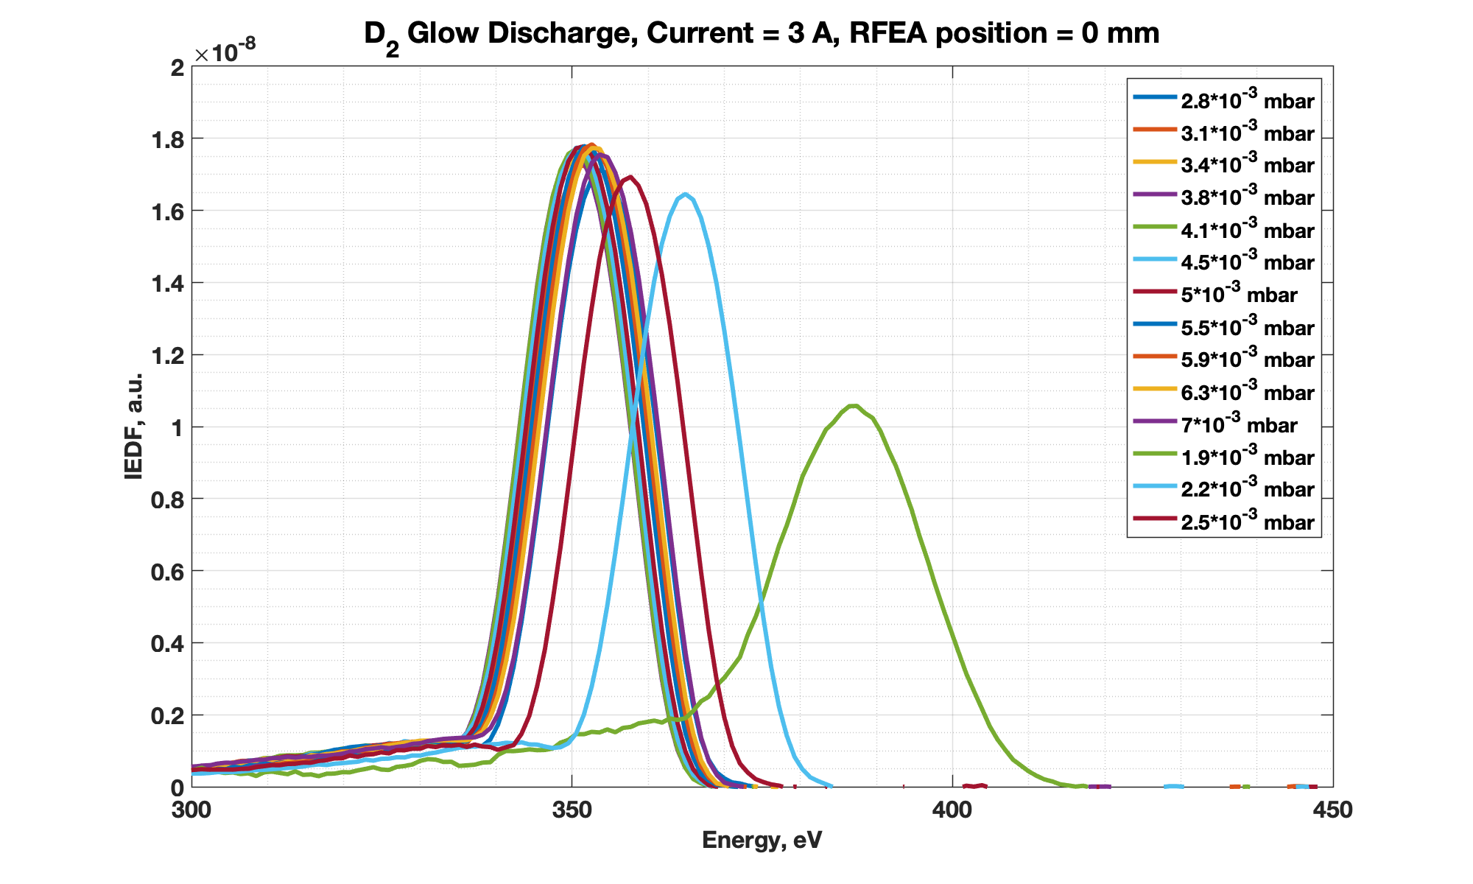
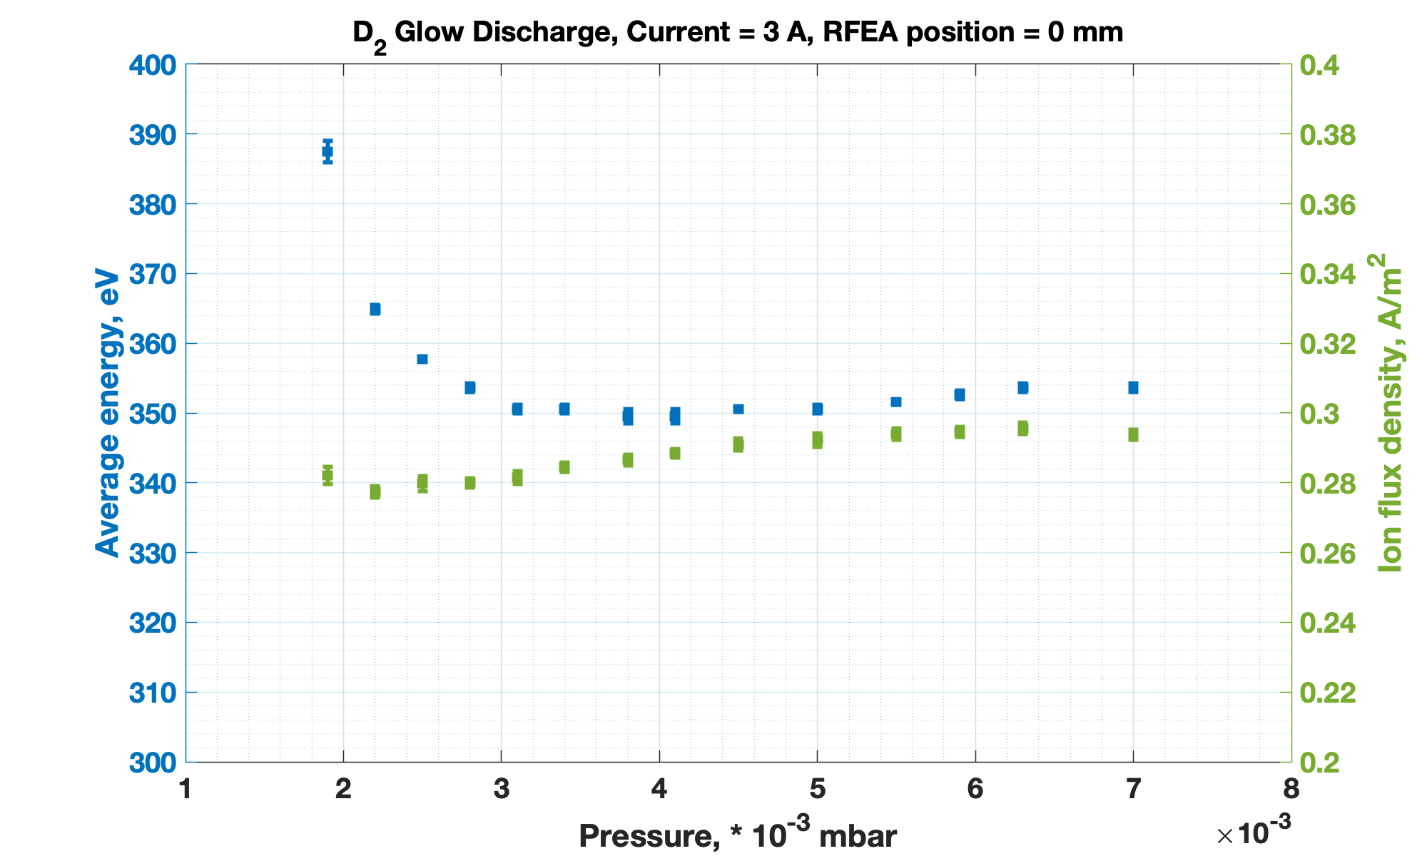
SP F1 D005: Evaluation of hydrogen-dopped boron coating stability, erosion rates, and lifetime under wall conditioning plasmas
Wall Conditioning plasma characterization
  Characterization of deuterium Glow Discharge (GD) plasma by Residual Field Energy Analyzer and Langmuir probes
    Local ion energy distribution functions -> Average ion energy and flux density as function of pressure, GD current and RFEA probe position
    Quasi – 2D scan of electron temperature, density and plasma potential as functions of pressure and GD current
  Characterization of deuterium Ion Cyclotron Wall Conditioning plasma by Residual Field Energy Analyzer, Langmuir probes and Time-of-Flight Neutral Particle Analyzer
    Local ion energy distribution functions -> Average energy ion and flux density as functions of pressure, RF frequency, RF power, magnetic field and RFEA probe position
    Quasi – 2D scan of electron temperature, density and plasma potential as functions of pressure, RF frequency, RF power, magnetic field and
    Charge exchange neutral energy distribution function -> Average CX neutral energy and differential flux as functions of pressure, RF frequency, RF power, magnetic field
  Comparison with hydrogen plasma characterization
Characterization of deuterium Glow Discharge by RFEA

Slide 3
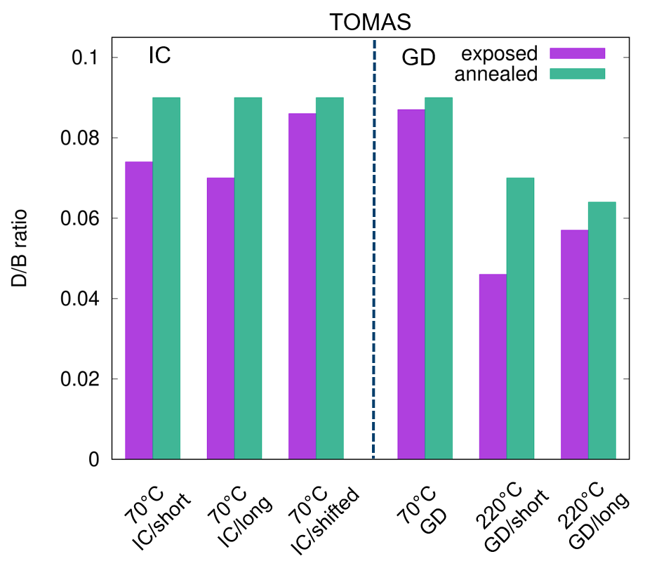
SP F1 D005: Evaluation of hydrogen-dopped boron coating stability, erosion rates, and lifetime under wall conditioning plasmas
Boron-coated mixed layers exposure to GD and ICWC plasmas
  Sample exposure to GD and ICWC at selected plasma parameters
    B:H layers on W substrate prepared and characterized by FZJ IFN-1 (see talk A. Houben)
    Mixed B:D:W layers (with O and N) on W substrate prepared and characterized by VR (see talk E. Pitthan Filho)
  Analysis of layer erosion
    Calculation of erosion rates based on plasma parameters
    Comparison with experimental results
  Evaluation of isotope exchange effect and impurity removal
    Dependence on plasma parameters
    Exposure duration and sample temperature
  Comparison of isotope exchange rates and impurity removal with previous exposure experiments
    Isotope exchange in B:D layers in H plasmas
    Impurity removal from B:C mixed layers
Exposure of thin (~160 nm) B:D layers to TOMAS hydrogen wall conditioning plasmas

