Slide 1
Exploration of optimal breakdown conditions and magnetic configurations for Electron Cyclotron Wall Conditioning scenarios for JT-60SA and ITER
WP PWIE SP F lick-off meeting
A. Goriaev, J. Buermans, K. Crombé, D. López-Rodríguez
LPP-ERM/KMS

Slide 2
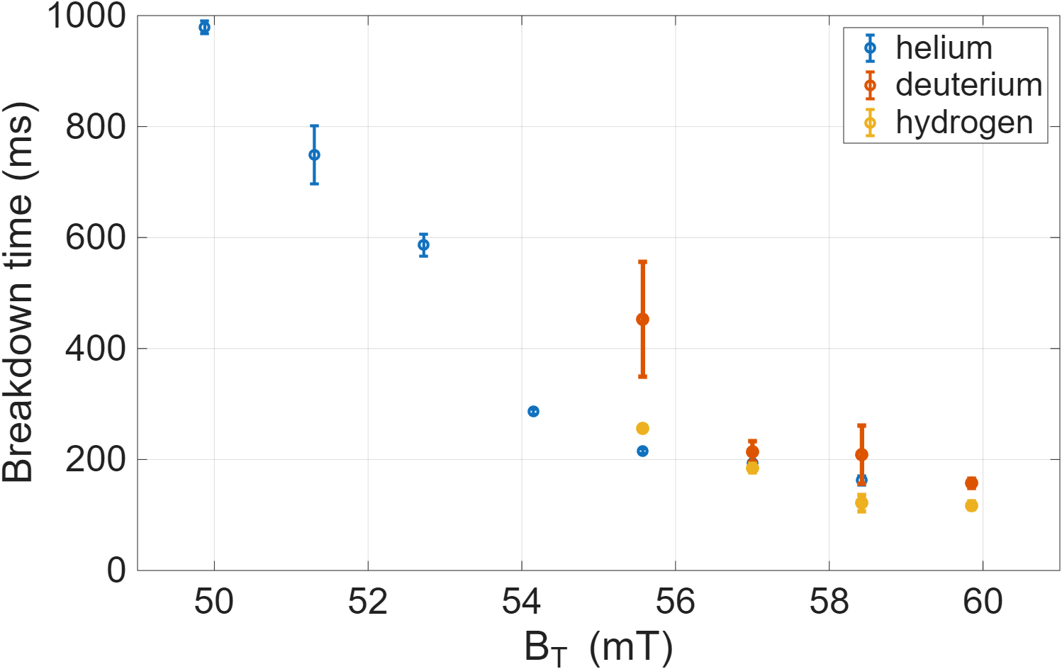
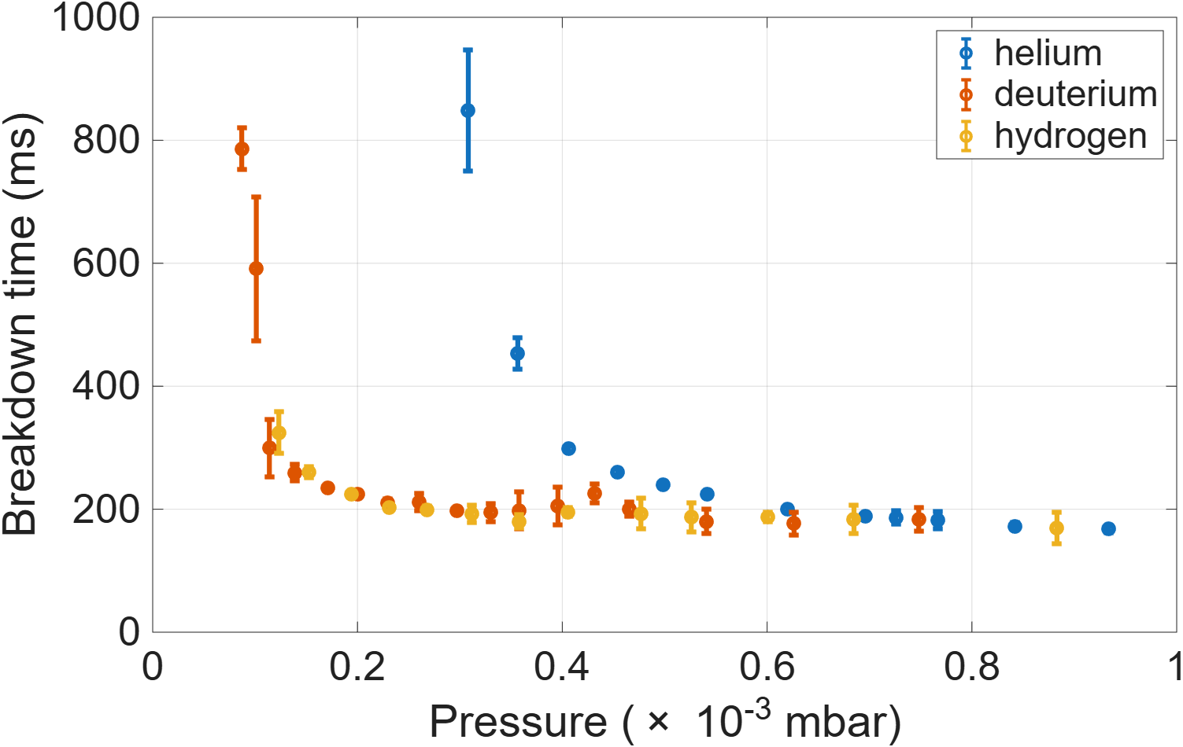
SP F2 D001: Exploration of optimal breakdown conditions and magnetic configurations for Electron Cyclotron Wall Conditioning scenarios for JT-60SA and ITER
Breakdown experiments on TOMAS to complement the TCV experiments and observations on other devices.
  Compare fundamental and second harmonic¹
    Fundamental wave is optimal for breakdown, but encounters a density limit, leading to conversions and parametric decay²
    Second harmonic is optimal for increased plasma density, but can cause stray radiation and parametric decay at the start¹
  Explore the influence of several parameters on the breakdown time^{1,2}
    Injected power, toroidal/poloidal injection angle, toroidal magnetic field, horizontal/vertical poloidal field, gas pressure and gas species.
  Explore the influence of several parameters on the density build-up^{1,3}
    Injected power, toroidal/poloidal injection angle, toroidal magnetic field, horizontal/vertical poloidal field, gas pressure and gas species.
Paper and presentation (AAPPS-DPP 2026) under preparation:
Exploration of optimal breakdown conditions and magnetic configurations for Electron Cyclotron Wall Conditioning scenarios for JT-60SA
Preliminary results
¹M. Fukumoto et al, Nucl. Mater. Energy, 2025
²J. Buermans et al, EPS plasma conference, 2024
³J. Buermans et al, EPS plasma conference, 2025

Slide 3
Characterization and analysis of H and D mixed wall conditioning plasmas in TOMAS utilizing the improved data analysis methods for TOMAS plasma diagnostics
WP PWIE SP F lick-off meeting
A. Goriaev, D. López-Rodríguez, K. Crombé, J. Buermans
LPP-ERM/KMS

Slide 4
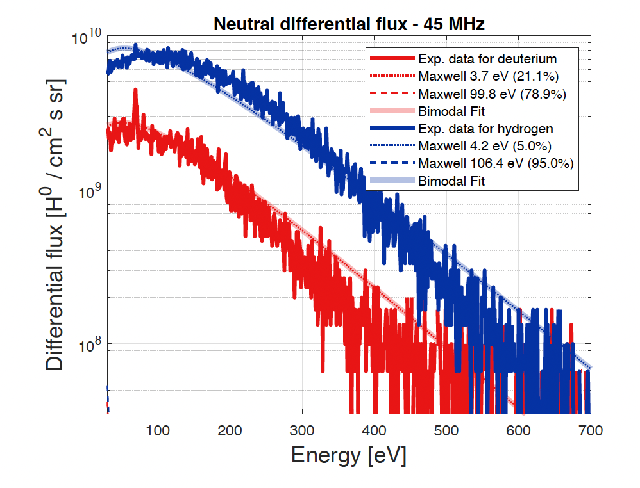
SP F2 D002: Characterization and analysis of H and D mixed wall conditioning plasmas in TOMAS utilizing the improved data analysis methods for TOMAS plasma diagnostics
Characterization of H+D mixed ICWC plasma at various magnetic field strengths, RF frequencies and power and gas compositions
  Langmuir probes
    Horizontal and vertical scans of electron density, electron temperature and plasma potential
  Time-of-Flight Neutral Particle Analyzer
    Charge exchange neutral ion energy distribution functions -> Average neutral energy and differential flux
  Residual Field Energy Analyzer
    Local ion energy distribution functions -> Average ion energy and ion flux density
  Spectroscopy (see talk of M. Sackers)
    Test of multi-channel high resolution spectrometer in mixed ICWC plasma
Differential flux of neutrals from the ToF-NPA in hydrogen and deuterium at f = 45MHz [D. Lopez-Rodriguez, PhD thesis, submitted]

Slide 5
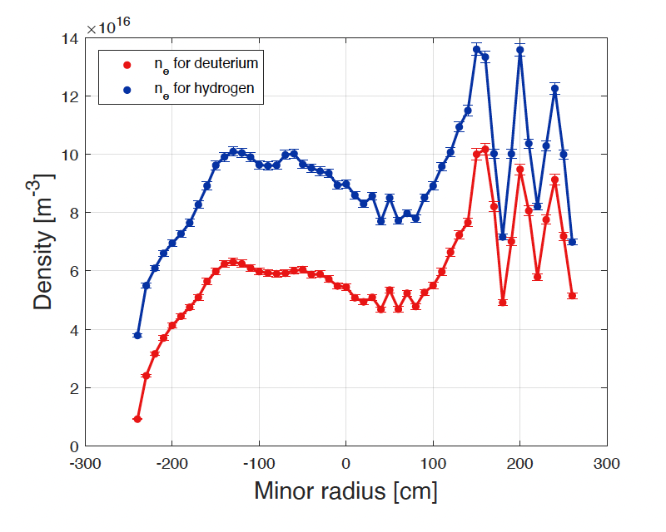
SP F2 D002: Characterization and analysis of H and D mixed wall conditioning plasmas in TOMAS utilizing the improved data analysis methods for TOMAS plasma diagnostics
ICWC plasma break-down studies at at various magnetic field strengths, RF frequencies and power and gas compositions
  Langmuir probe scan
    Localization of plasma expansion and density build-up
    Evaluation of break-down time and density build-up time
  Fast cameras
    Localization of plasma expansion and density build-up
    Evaluation of break-down time and density build-up time
    Comparison to Langmuir probe scan
  Determination of the most suitable ICWC break-down scenarios
    Mapping parameter range where ICWC break-down is possible
    Analysis of break-down time dependencies on experimental parameters
Comparison of electron density profiles in hydrogen and
deuterium at matched discharge parameters: B₀ = 0.090T,
p = 6 * 10⁻⁴ mbar, P_{RF} = 5 kW, and f = 25 MHz

Slide 6
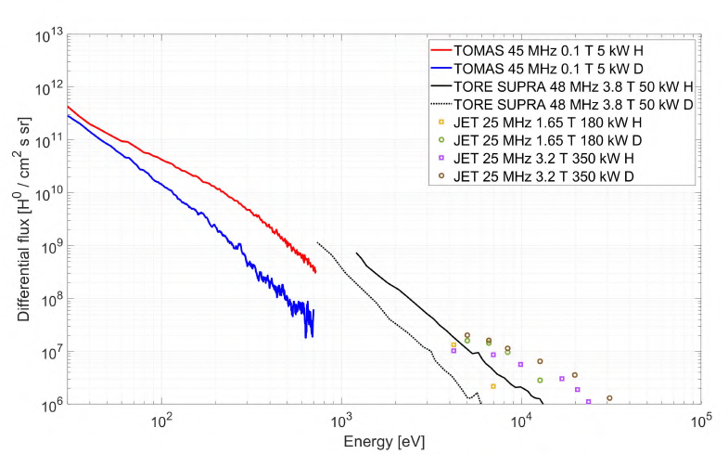
SP F2 D002: Characterization and analysis of H and D mixed wall conditioning plasmas in TOMAS utilizing the improved data analysis methods for TOMAS plasma diagnostics
Further analysis and extrapolation of ICWC scenarios
  Analysis and comparison with pure H and D plasmas
    Determination of plasma parameters profile dependencies and qualitative trends in isotope mixtures
  Utilizing the mixed ICWC plasma characterization test cases for TOMATOR-1D validation and development of new 3D model
    Support to predict the wave propagation, the per-species power deposition, and the resulting plasma in the low-density, weakly-ionised regime
  Extrapolation to large fusion devices scenarios
    Extension of the available measurements to the low-energy regime relevant for ICWC sample exposure studies
Differential flux of neutrals for ICRF plasmas in TOMAS, Tore Supra and JET, with TOMAS hydrogen and deuterium curves overlaid at P_{RF} = 5 kW, f = 45MHz, B₀ = 0.10T. [D. Lopez-Rodriguez, PhD thesis, submitted]

