Slide 1
WP PWIE SP F - kick-off meeting for 2026 activities
Production and characterization of boron-coated W samples with different boron thickness and deuterium concentration for LIBS studies in PSI-2 (IAP)
Corneliu Porosnicu, Paul Dinca, Bogdan Butoi & all EPPA team
Notes:
Please Indicate your subproject

Slide 2
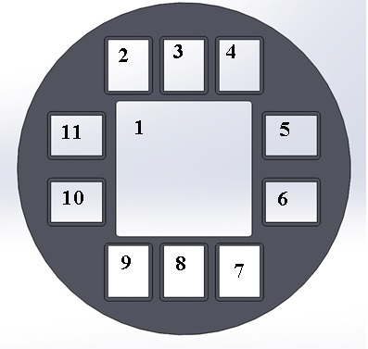
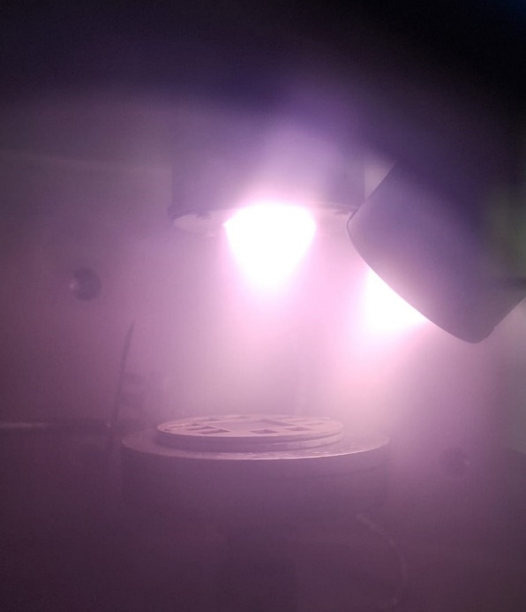
Production and characterization of boron-coated W samples with different boron thickness and deuterium concentration for LIBS studies in PSI-2
Deposition of B (2 and 5 µm) on with specific D (0, 3, 5 at%) content
Substrates for each:
W (36*36) – 1 pc
3 buc W (12*15) – 3 pcs
7 buc Si (12*15) – 7pcs
Rotated substrate
Gas flow: Ar = 20 sccm
D₂ = 20 sccm
p=0.8 to 1*10⁻² mbar
Samples were sent to FZJ for LIBS studies in PSI -2
No Sample code Sample Type
1 60260114_1 B , no D, 5000 nm, (36*36) W 1
2 60260120_1 B + D (10%), 2000 nm, (36*36) W 1
3 60260121_1 B + D (10%), 5000 nm, (36*36) W 1
4 60260127_1 B + D (3%), 2000 nm, (36*36) W 1
5 60260202_1 B + D (3%), 5000 nm, (36*36) W 1
6 60260210_1 B + D (5%), 5000 nm, (36*36) W 1
One sample prepared, ready to be sent: 2µm B on W, D content: 3at%
TDS, SEM (top and surface) and XPS analisys performed on whitness samples.

Slide 3
Production and characterization of boron-coated W samples with different boron thickness and deuterium concentration for LIBS studies in PSI-2
Deposition of B (2 and 5 µm) on with specific D (0, 3, 5 at%) content
Substrates for each:
W (36*36) – 1 pc
3 buc W (12*15) – 3 pcs
7 buc Si (12*15) – 7pcs
Rotated substrate
Gas flow: Ar = 20 sccm
D₂ = 20 sccm
p=0.8 to 1*10⁻² mbar
Samples were sent to FZJ for LIBS studies in PSI -2
No Sample code Sample Type
1 60260114_1 B , no D, 5000 nm, (36*36) W 1
2 60260120_1 B + D (10%), 2000 nm, (36*36) W 1
3 60260121_1 B + D (10%), 5000 nm, (36*36) W 1
4 60260127_1 B + D (3%), 2000 nm, (36*36) W 1
5 60260202_1 B + D (3%), 5000 nm, (36*36) W 1
6 60260210_1 B + D (5%), 5000 nm, (36*36) W 1
LIA-LIBS-QMS Studies. Objectives: distinction betwen H isotopes in B-D (2026) and B-T (2027) samples using laser ablation and MW-plasma (ongoing with Institute of Physics Belgrade)
One sample prepared, ready to be sent: 2µm B on W, D content: 3at%
TDS, SEM (top and surface) and XPS analisys performed on whitness samples.

