Slide 1


Commissioning of ps-LIBS on BiGyM and first tests with boron-coated samples
WP PWIE SP F kick-off meeting for 2026 activities
L. Laguardia, A. Cremona, S. Almaviva, S. Cipelli, A. Uccello, F. Cani

Slide 2
Deliverable 2026
Deliverable ID | Deliverable Title
D007 | Complete installation and optical integration of LIBS on BiGyM and perform system calibration with test samples (ENEA)
Human Resources 2026
Deliverable Owner | Beneficiary | PM | Deliverable (Team)
L. Laguardia | ENEA | 4 | L. Laguardia, S. Almaviva, A. Cremona
Machine Resources 2026
Device | Beneficiary | Days | Related Deliverable
GyM/BiGyM | ENEA | 5 | D007

Slide 3


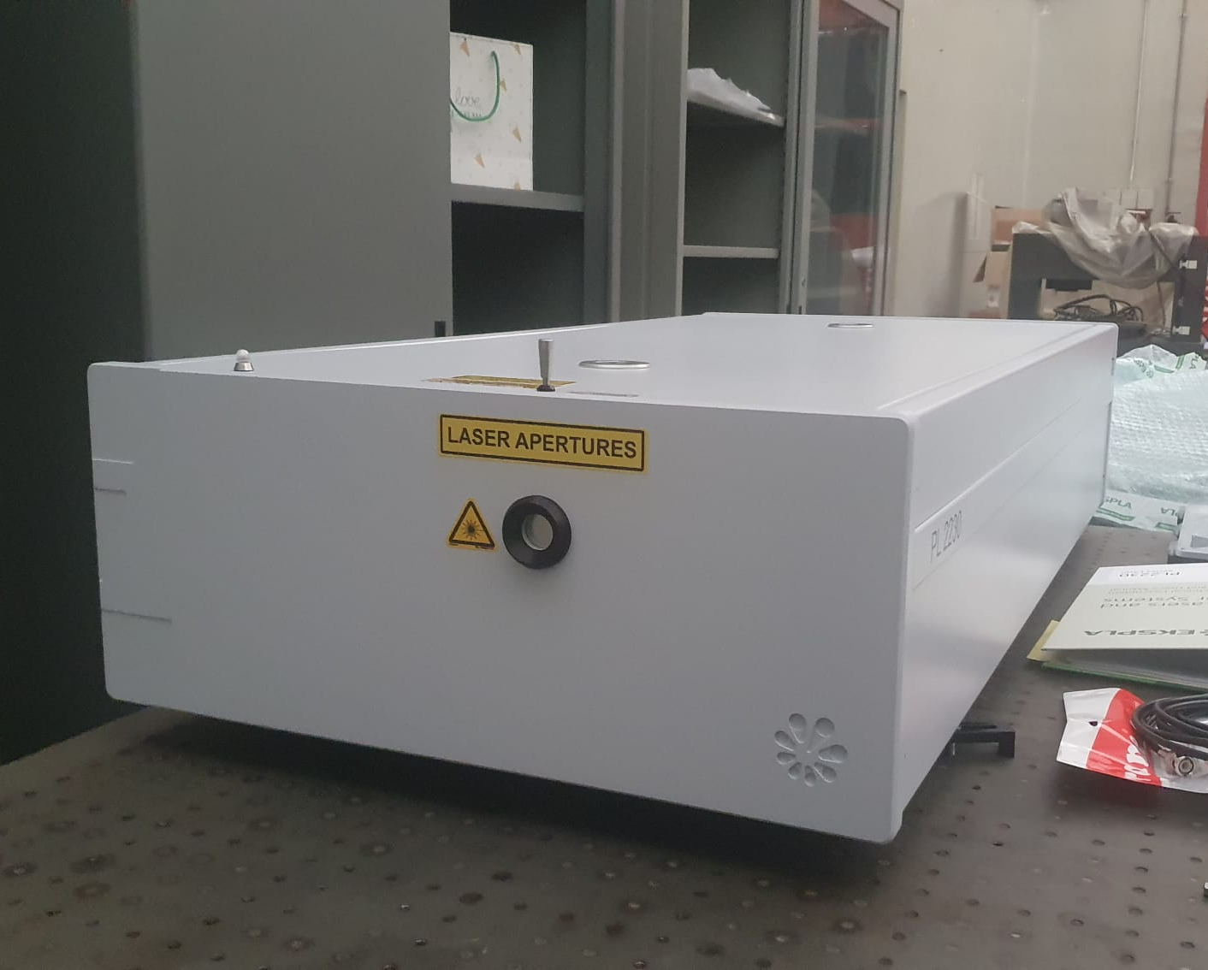
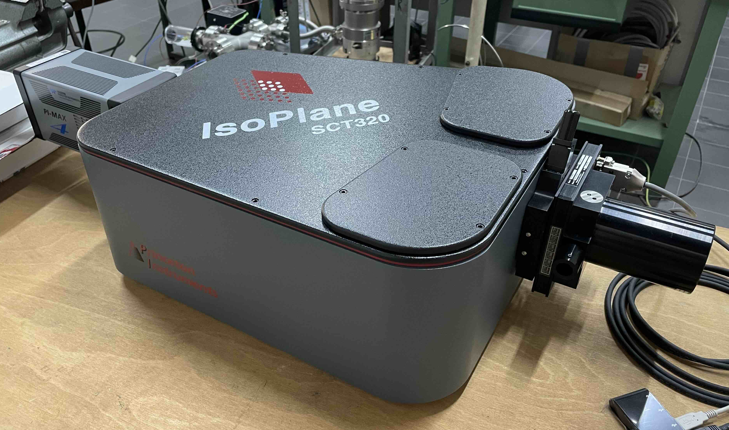
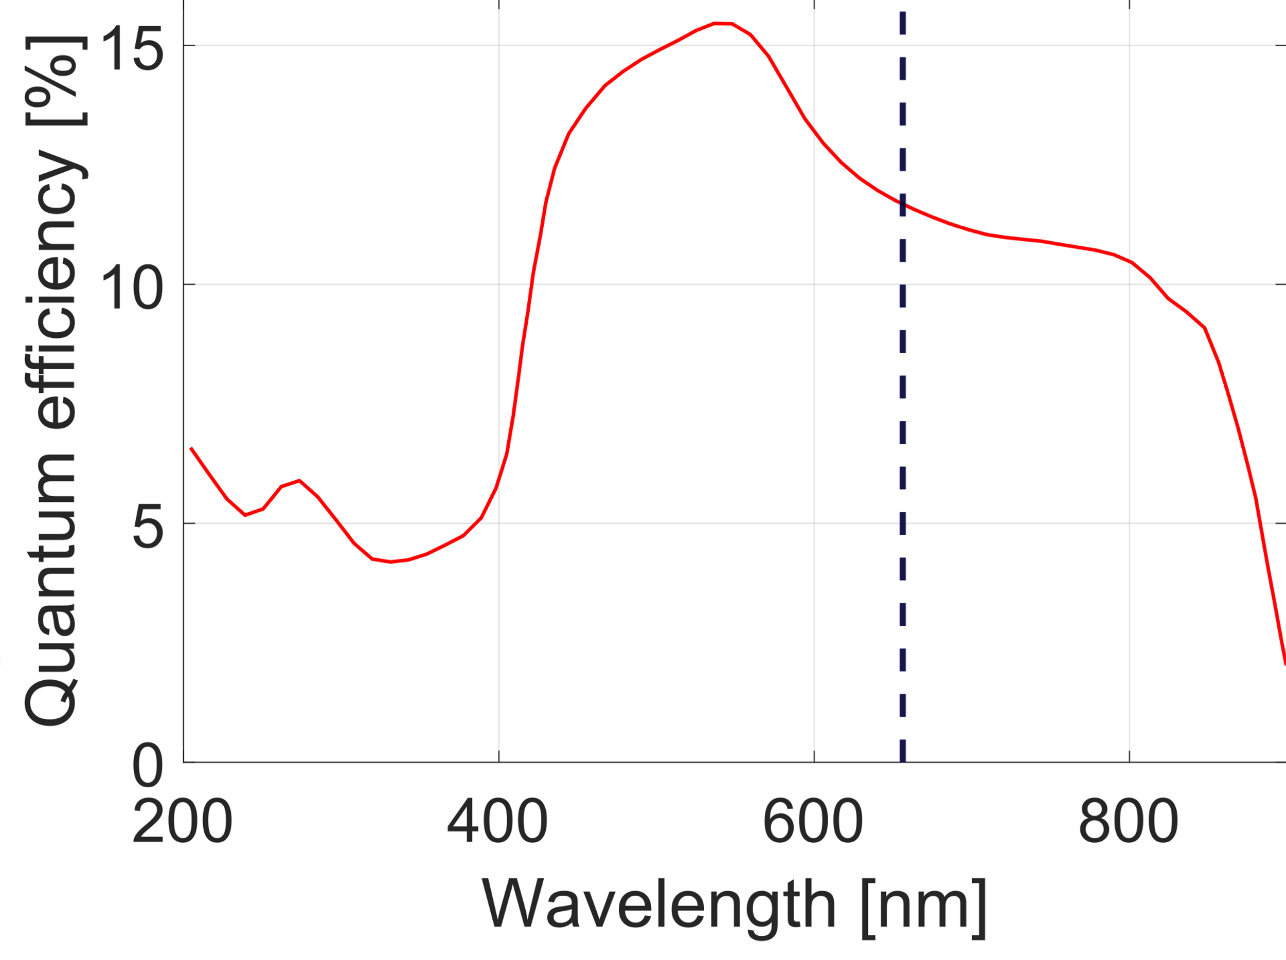
Status of activities
ps-LIBS has been installed and tested in Diagnostic Laboratory at ISTP RU
Compact design
Correction of optical aberrations
Set of 3 interchangeable gratings
PMAX Intensified CCD camera (Gen II SR intensifier)
Hα, Dα
Nominal λ [nm] | 1064
Pulse duration [ps] | 29 ± 5
Max pulse energy [mJ] | 70
Repetition rate [Hz] | 10
Spectral resolution (nm) | Up to 0.064
Focal lenght [mm] | 320
Min slit width [μm] | 10
S. Cipelli curtesy
L. Laguardia | WP PWIE SP F kick-off meeting | 23 June 2026

Slide 4
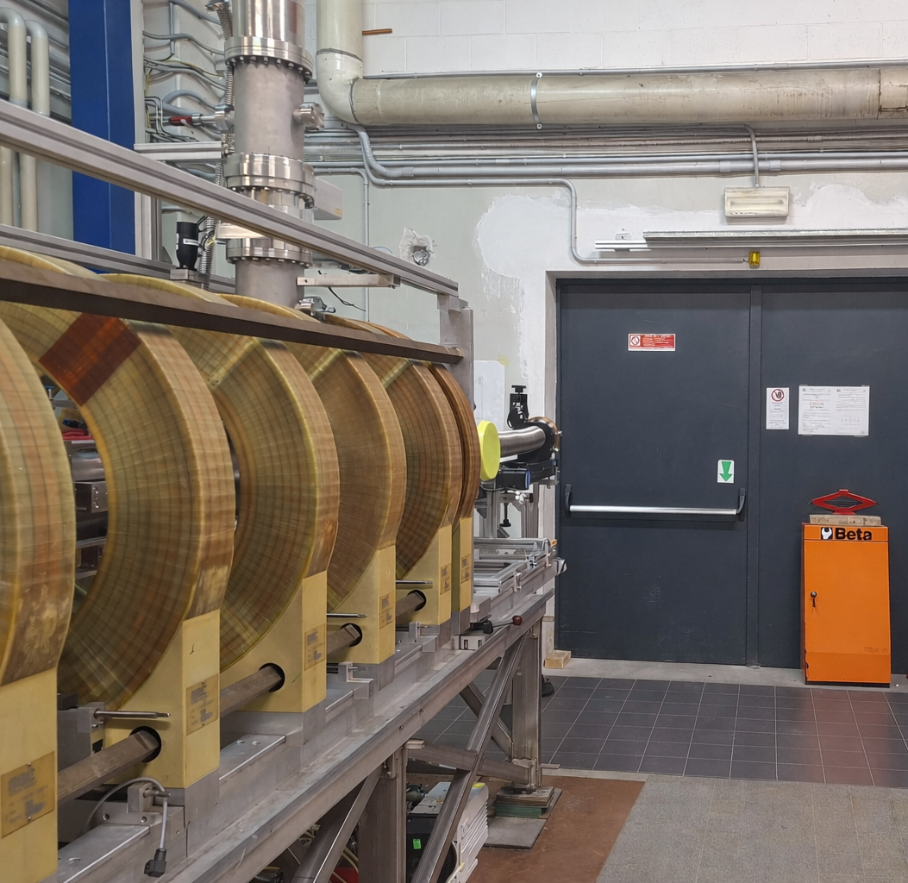
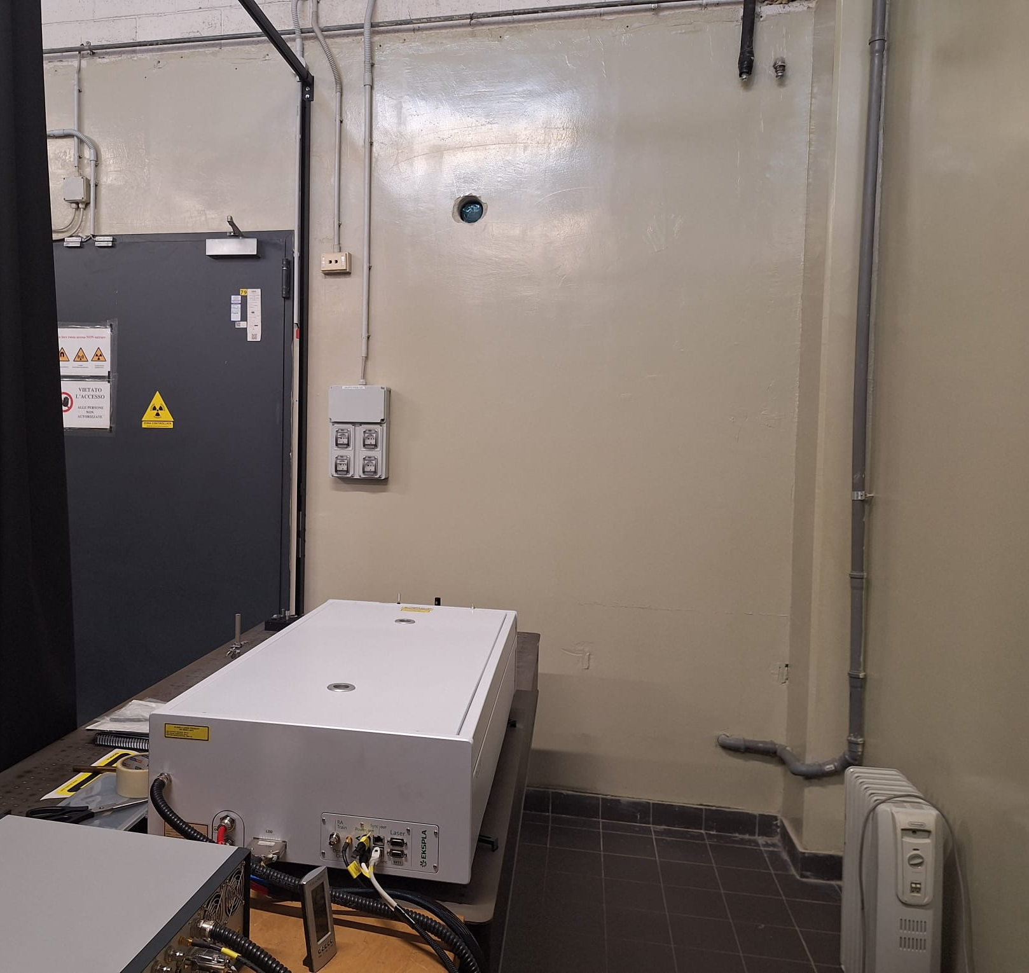
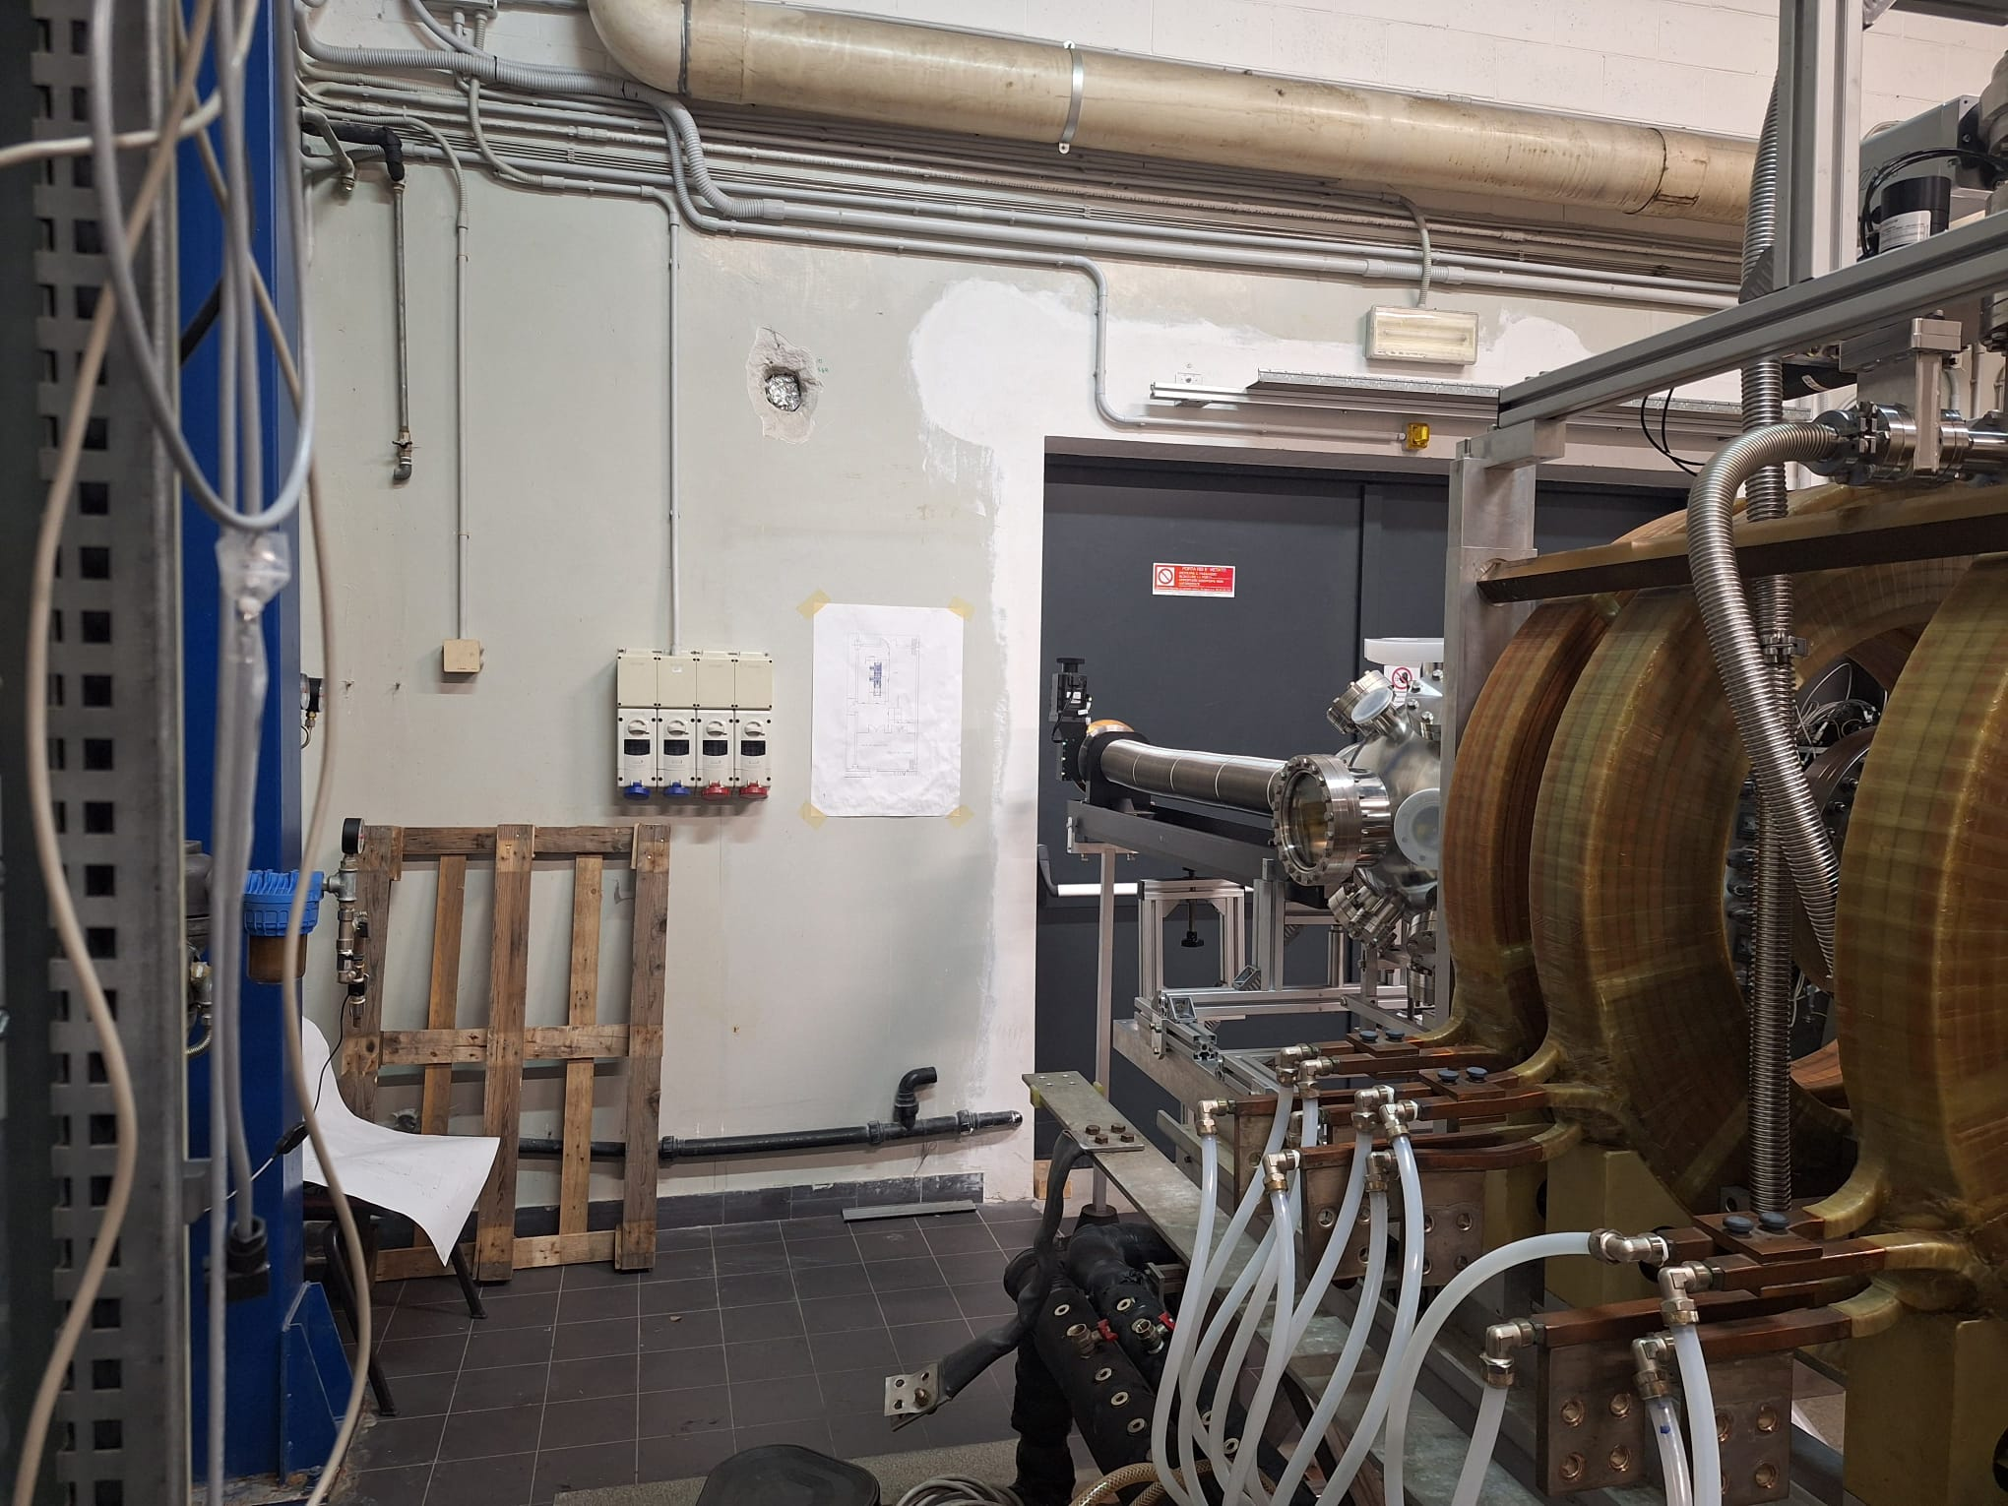
Status of activities
Over the past year, alongside the GyM→BiGyM upgrade, the Diagnostics Laboratory was reorganized and equipped with all required safety systems to host LIBS and enable laser beam delivery from the Diagnostics Lab to BiGyM.
BiGyM linear device laboratory
Diagnostics laboratory
BiGyM pre-chamber
Hole for the optical path
Hole for the optical path
EKSPLA laser
S. Cipelli curtesy

Slide 5
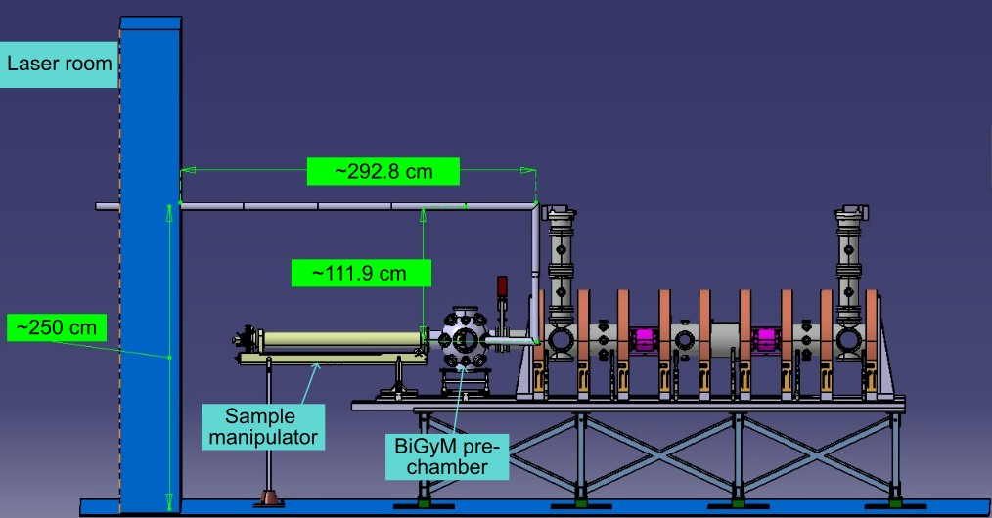
ISTP-ENEA PLAN 2026
Commissioning of an in-situ LIBS on the BiGyM linear plasma device
Technical drawing of an optical path connecting the laser system to the BiGyM pre-chamber
Diagnostic
Laboratory
BiGyM laboratory
~8 m optical path length
Beam enclosed by safety tubes
Use of 3 fixed mirrors + 1 motorized steering mirror for beam position scanning
Focusing lens
Lens + optical fiber for collection of plasma light
Side view
ps-laser
source
BiGyM sample
Exhange chamber
S. Cipelli and F. Cani curtesy

Slide 6
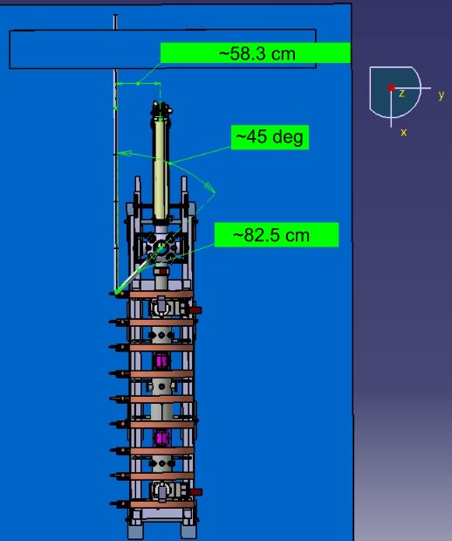
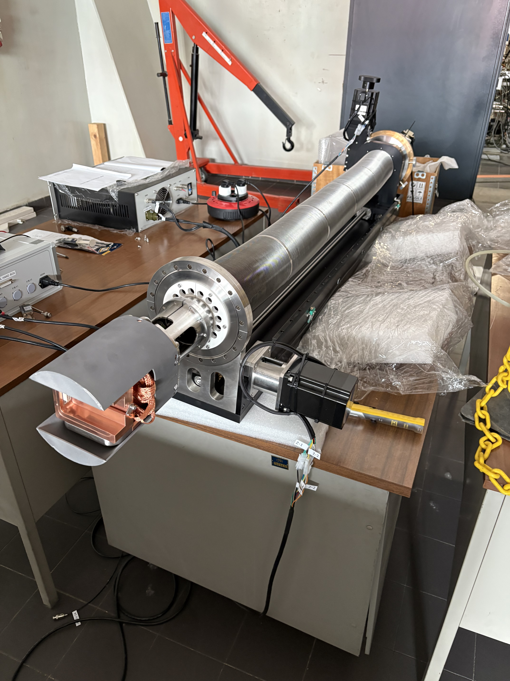
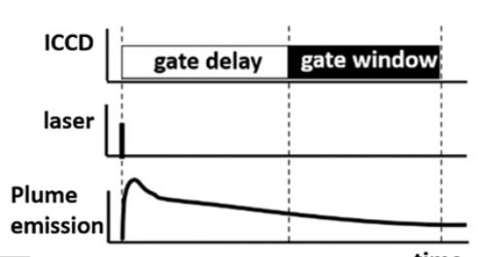
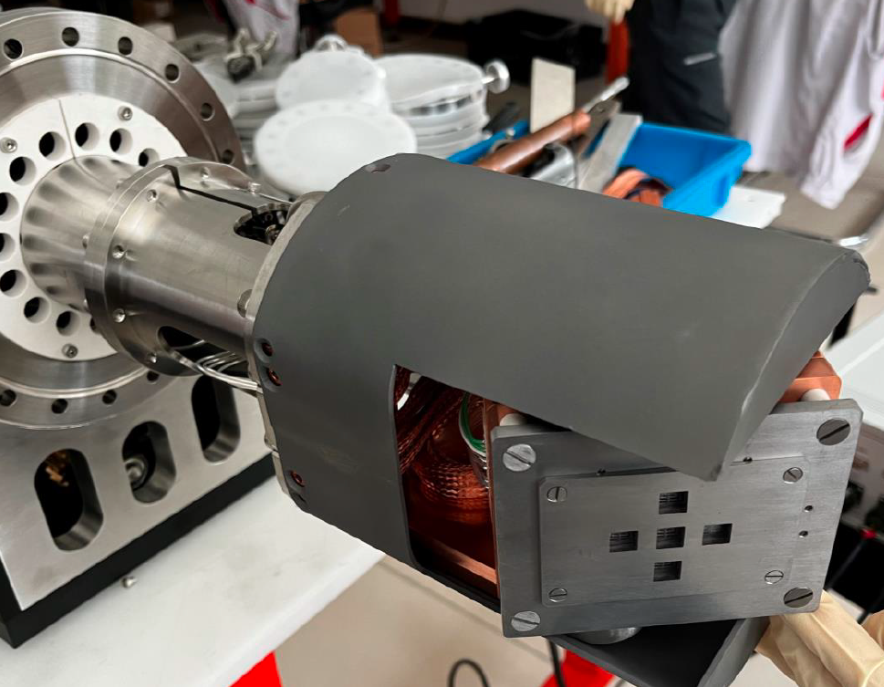
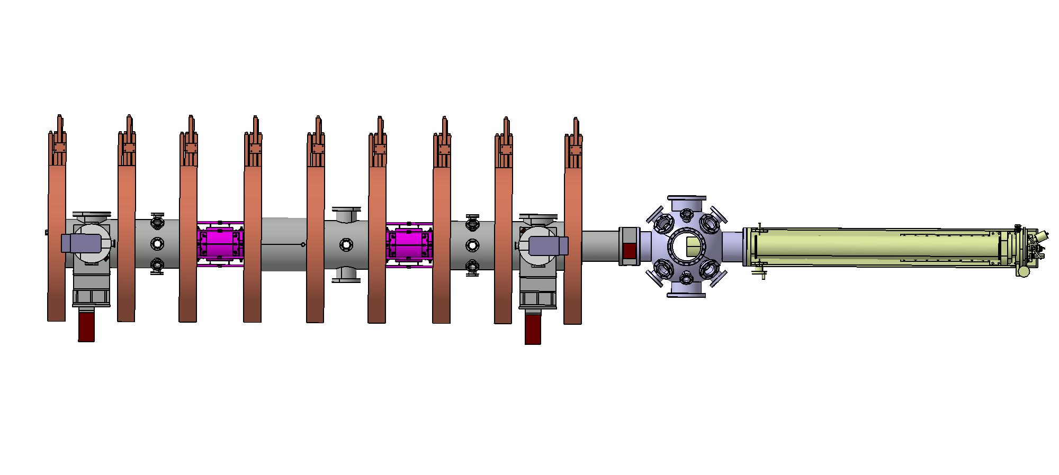
ps-LIBS optical layout and X–Y scanning
Focusing optics
BiGyM Top view
ps Nd:YAG
Motorized Mirror
Princeton spectrometer
ICCD
Collection optics
z
Plasma plume
Tantalum shield
θ
sample
φ
Sample Holder
z-θ-φ translation stage
x-y scanning
Laser beam guide
Y mm
10
9
8
7
6
5
4
3
2
1
Optical fiber
1
2
3
4
5
6
7
8
9
10
X mm

Slide 7
On-going activities
Procurement of:
safety tubes
mirrors
motorized steering mirror
lenses
fiber‑bundle
Time-line
Summer holydays
Testing with H. Wu and S. Almaviva
Results
July
August
September
October
November
December
Procurement
Installation
Testing

Slide 8
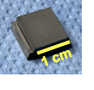
Boron-coated samples
Where will the boron samples we will use for the first tests come from? From FZJ, from IAP, or from somewhere else?
For the first tests with H. Wu and S. Almaviva, we would prefer the samples to already contain D, as it remains to be confirmed whether BiGyM will be ready for PWI experiments in October (although it is scheduled to become available by the end of 2026), leaving open the question of whether deuterium loading onto boron samples will be feasible in time.
5 Flush-mounted "PSI-2" samples
Tantalum
Rear-side
thermocouples

