Slide 1

Implementation of in-situ laser-based diagnostics on TOMAS
Jun 23, 2026 I Huace Wu
WP PWIE SP F kick-off meeting

Slide 2
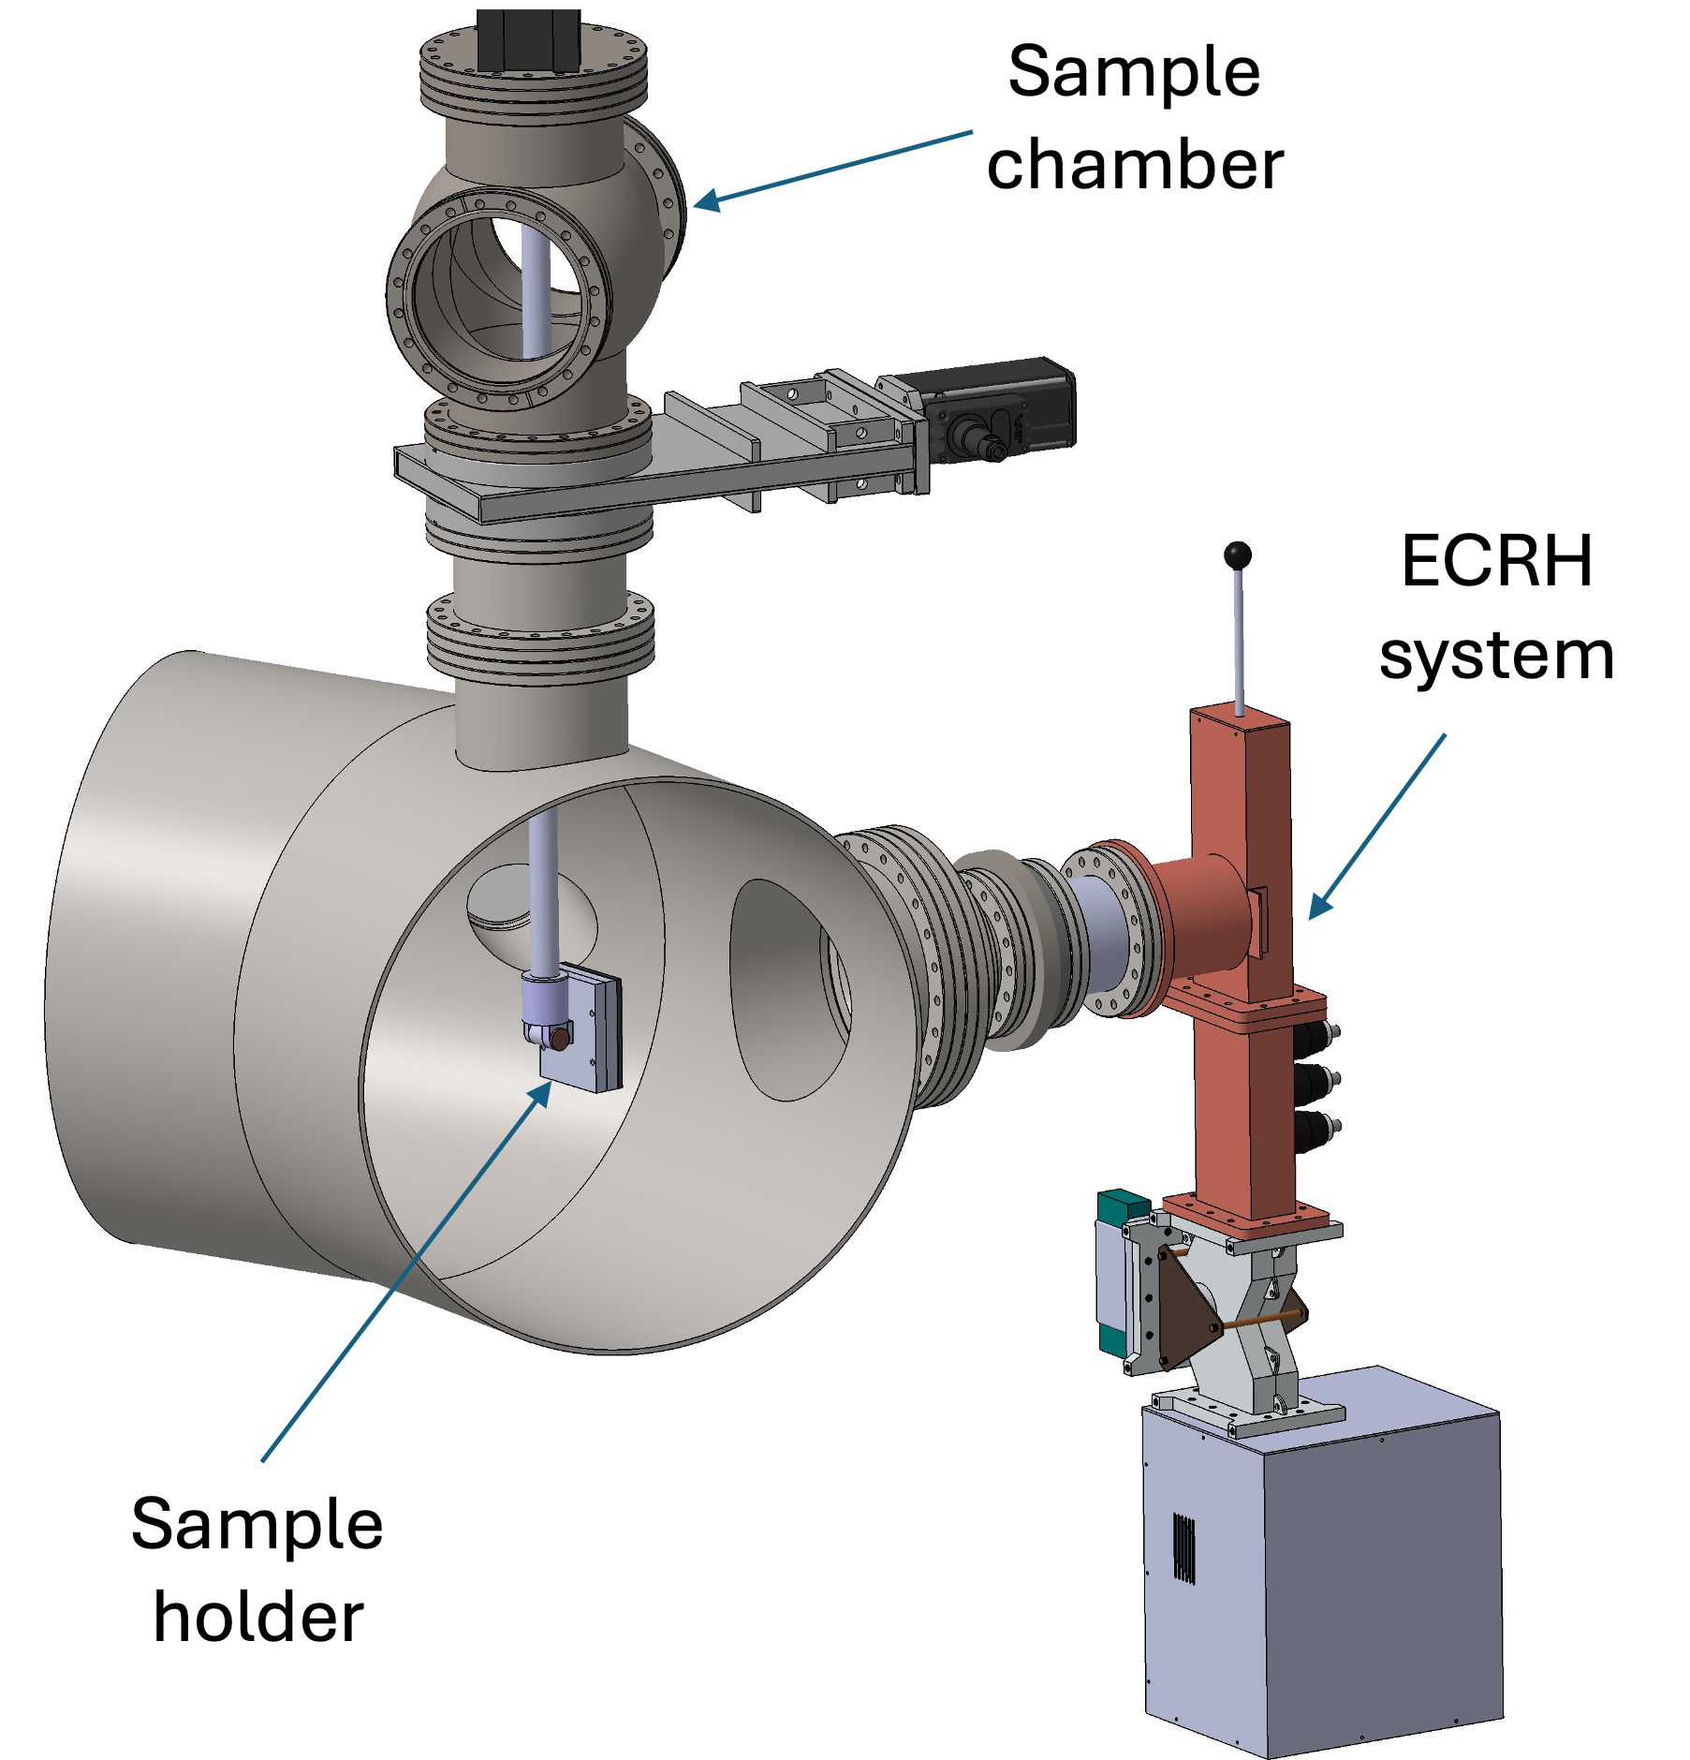
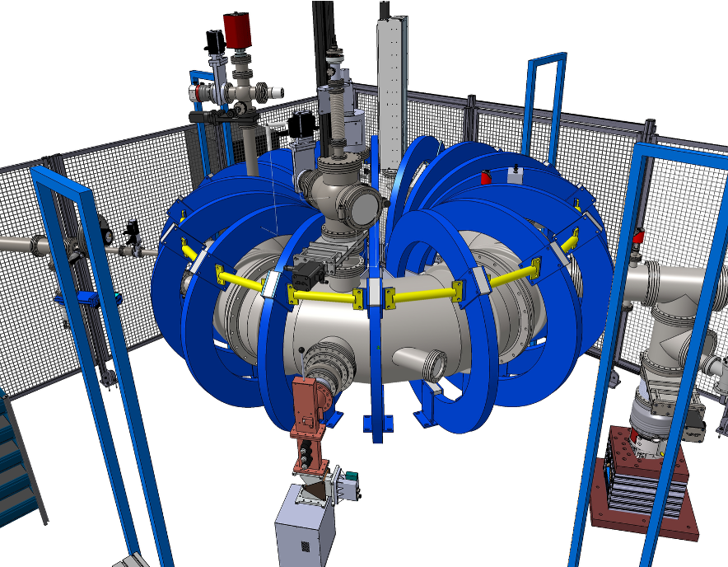
3D view
Design of in-situ laser-based diagnostics
Sample chamber
The ECRH magnetron will be removed
Two candidate optical ports for laser diagnostics
Two candidate optical ports for laser diagnostics

Slide 3
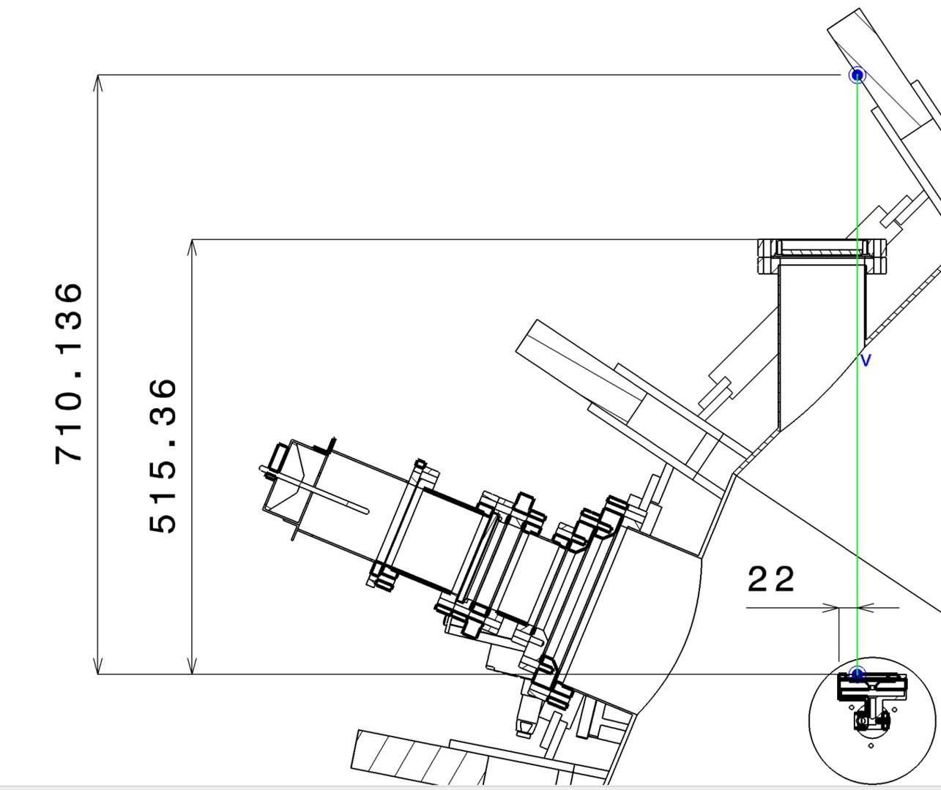
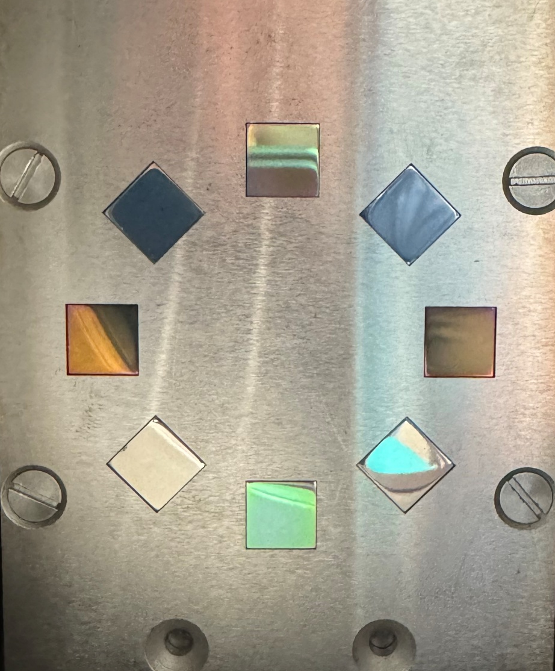
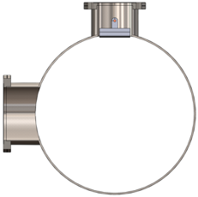
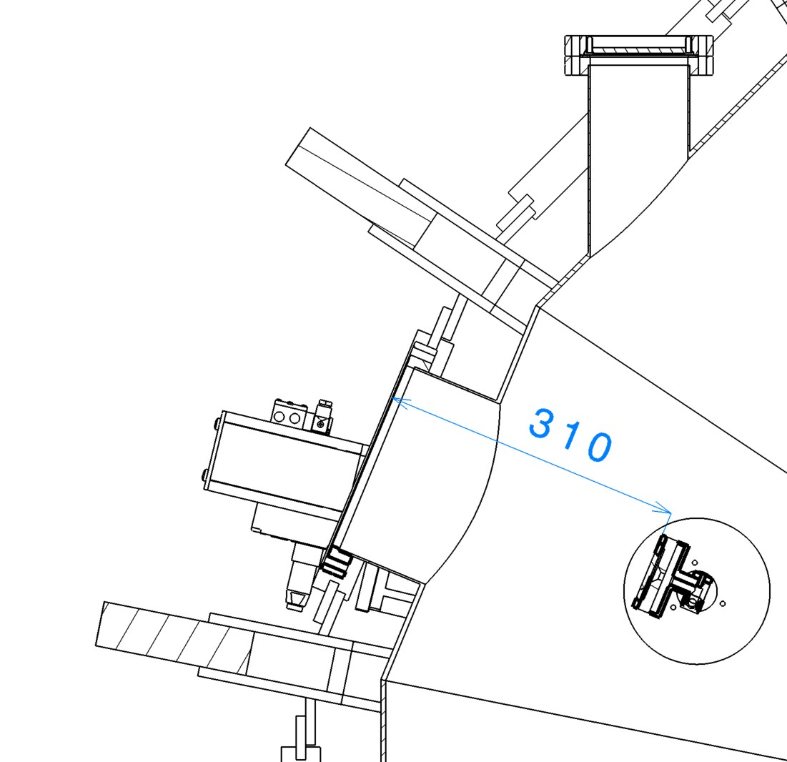
Recent Vacuum Manipulator Modification
The TOMAS sample chamber has been modified.
The center of sample holder can now be positioned at the vessel midplane.
Two ports can be used to test direct laser ablation of samples.
Midplane

Slide 4
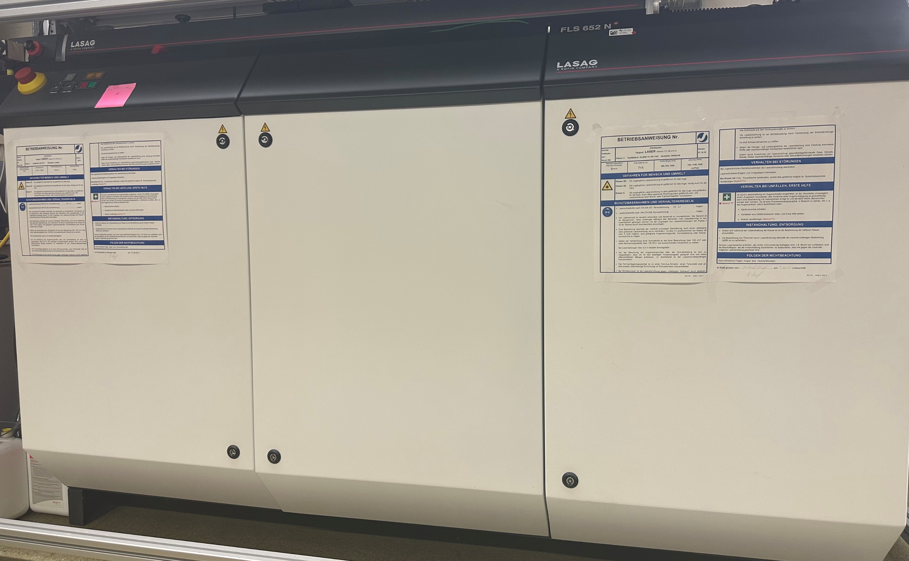
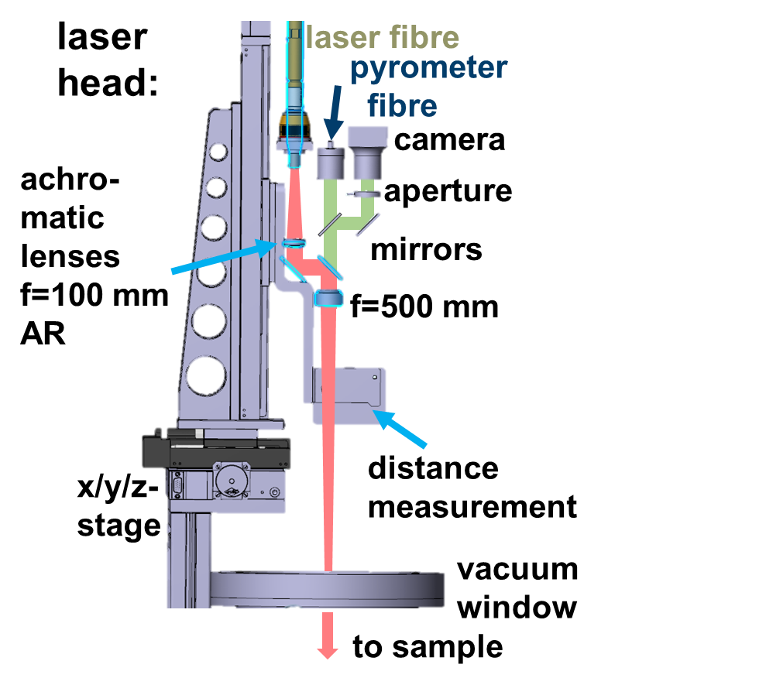
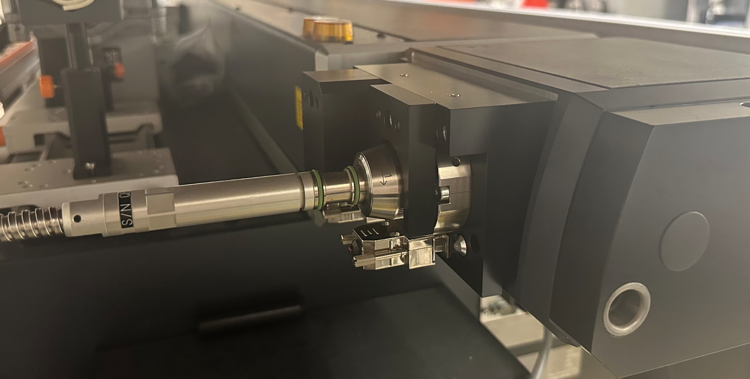
ms-LID-QMS Set up (will be used for TOMAS)
LID-QMS laser parameters:
pulsed Nd:YAG laser (1064 nm)
Pulse duration: 0.1-20 ms
Peak power: up to 40 kW at 2.5 ms pulse duration
Pulse energy: up to 100 J for pulse durations above 2.5 ms
Repetition rate: up to 1 kHz, limited to a maximum average power of 500 W
1. The LID-QMS laser and optical fiber are ready for integration.
2. The laser beam quality meets current operating requirements.
3. The optical design for coupling the system to TOMAS has been verified.

Slide 5
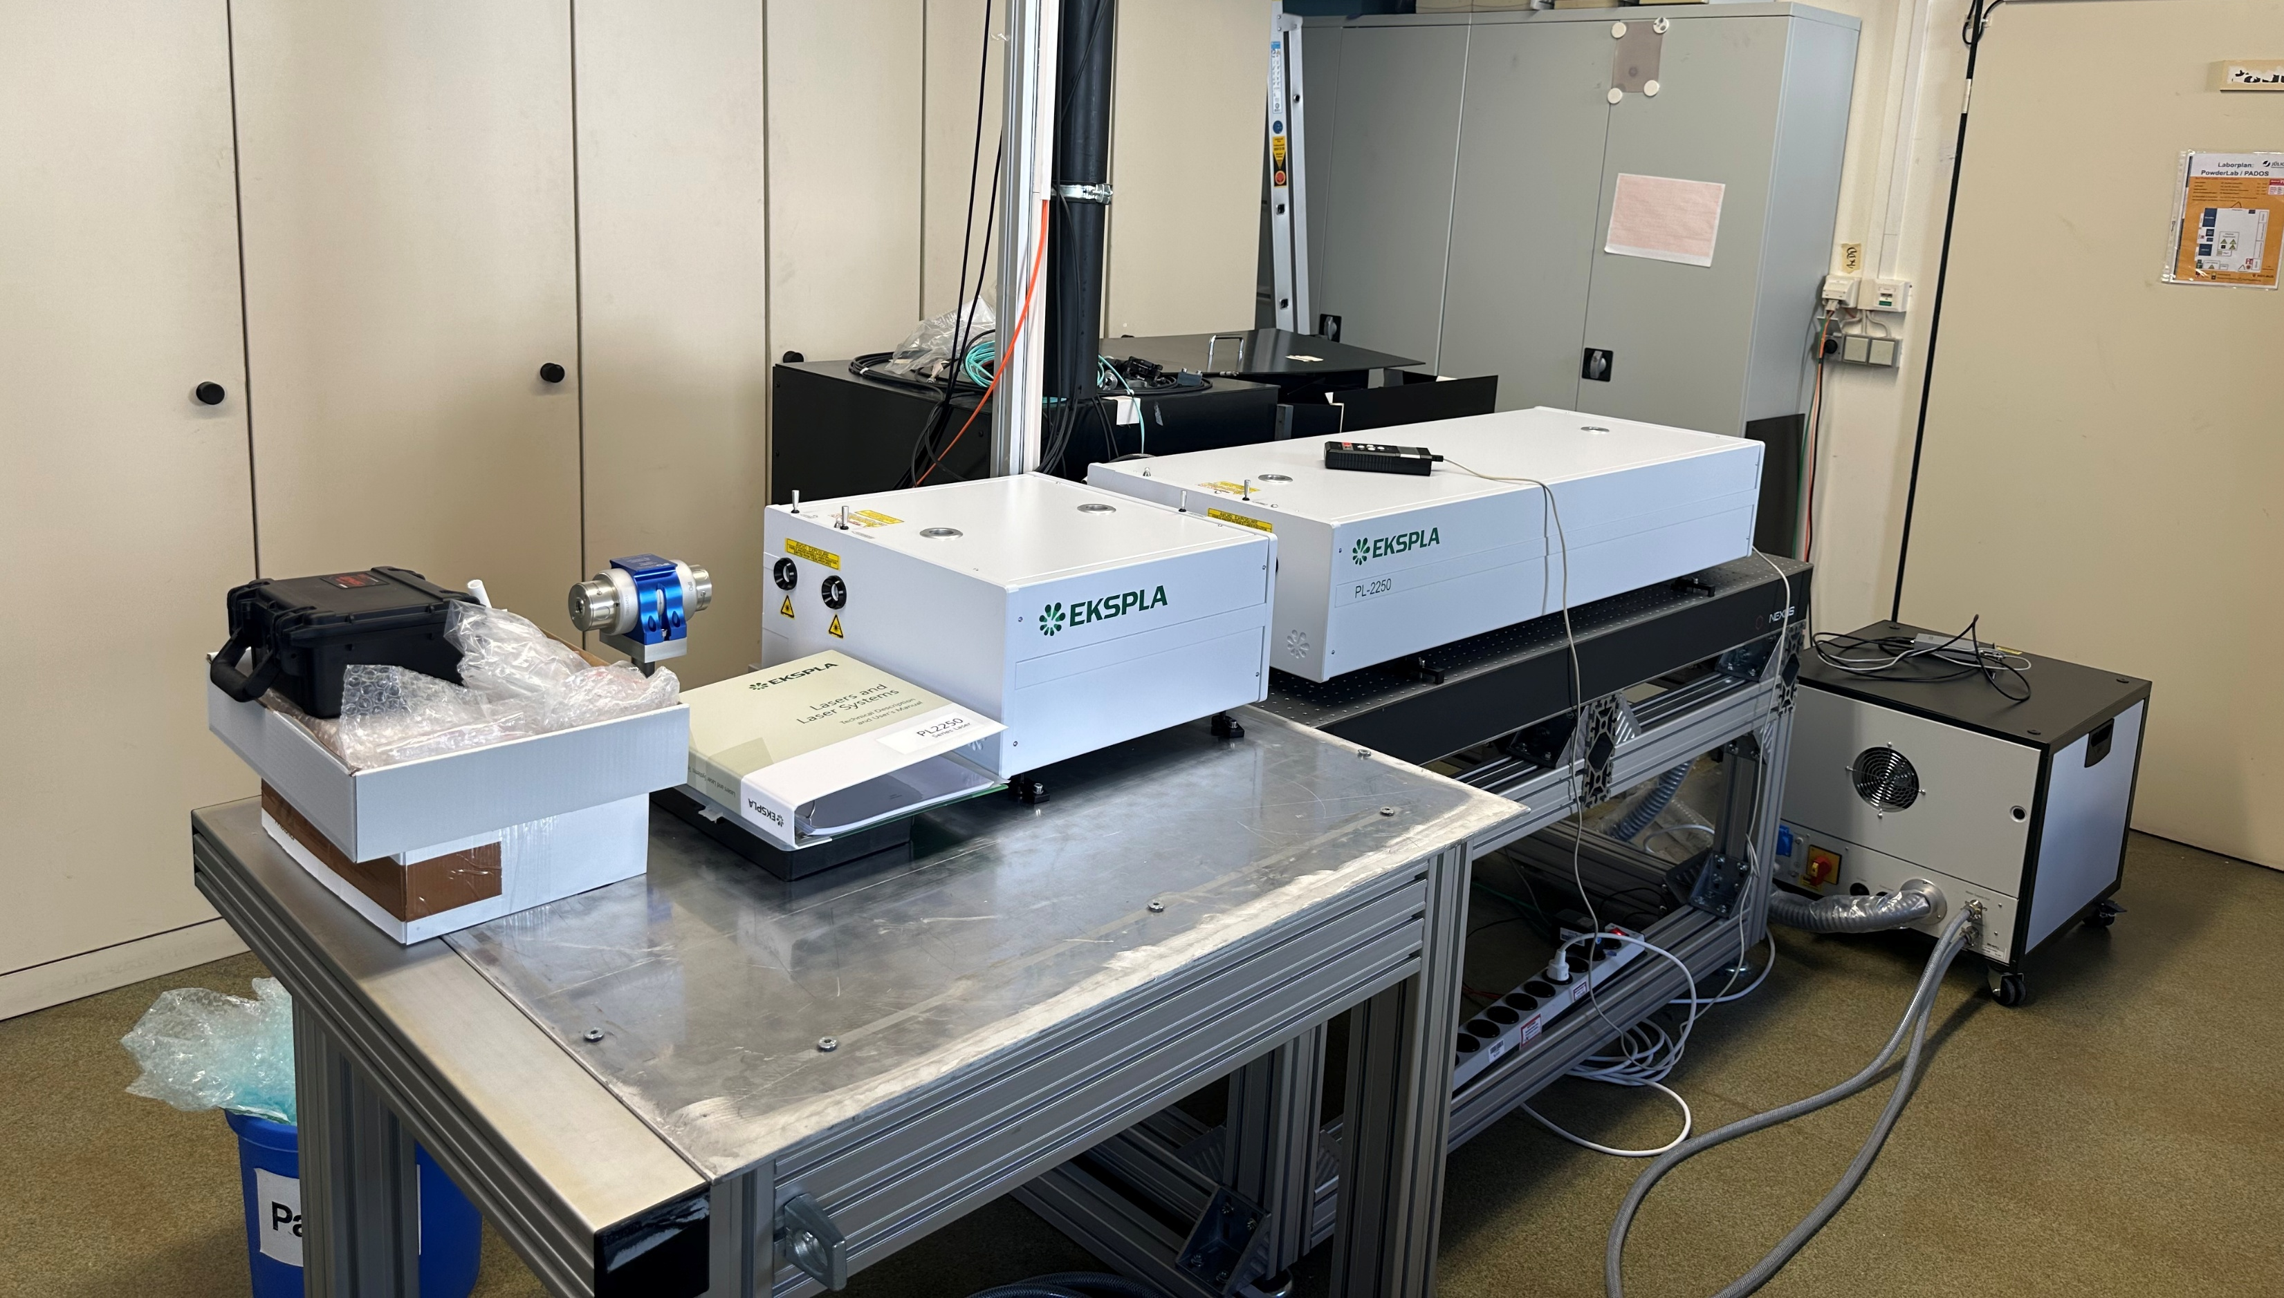
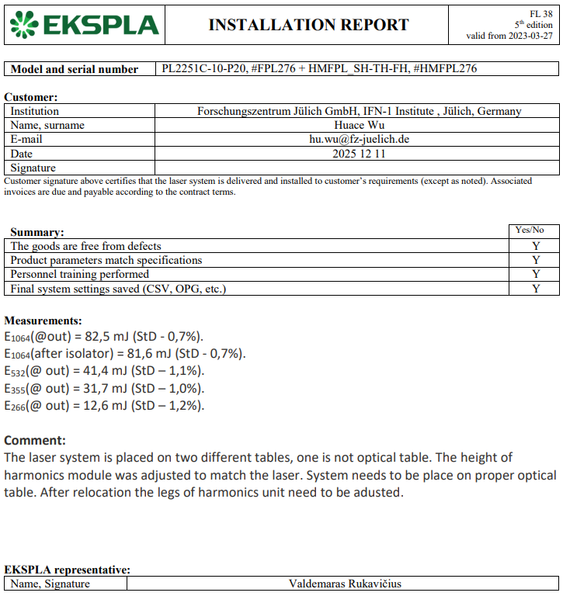
ps-LIBS Set up (will be used for TOMAS)
1. ps-laser has successfully passed the acceptance test and is ready for integration.
2. Its output energy and stability meet the requirements for LIBS measurements.
3. Beam-delivery layout and laser-safety system are being finalized.
Nucl. Mater. Energy (41) 2024, 101812 and (45) 2025,102018

Slide 6
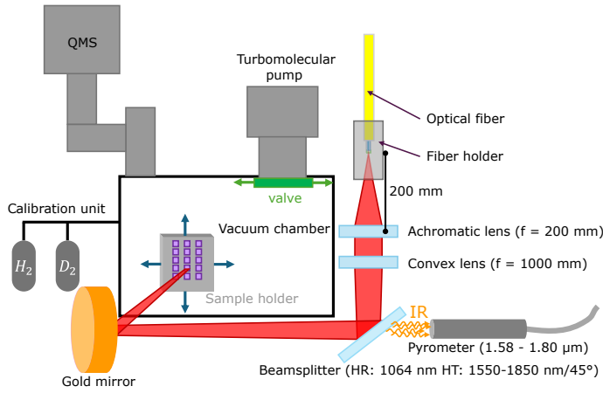
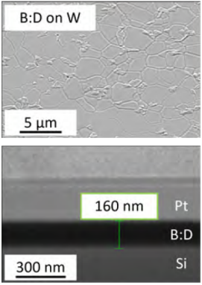
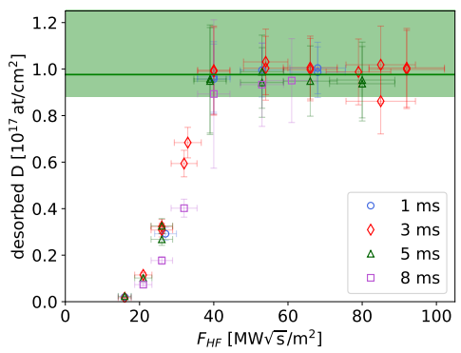
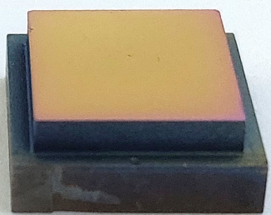
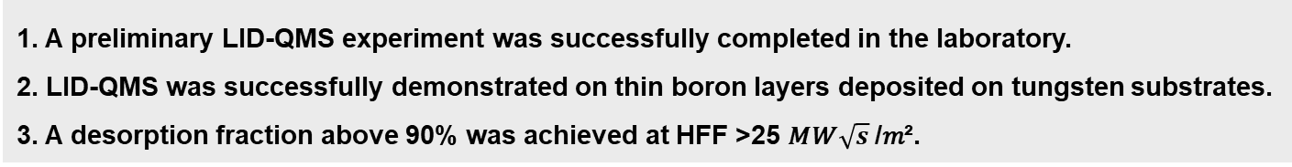
Preliminary Laboratory Demonstration of LID-QMS
D content $≈{10}^{17} atoms/cm²$，D/B ratio $≈10 at\%$
1. A preliminary LID-QMS experiment was successfully completed in the laboratory.
2. LID-QMS was successfully demonstrated on thin boron layers deposited on tungsten substrates.
3. A desorption fraction above 90% was achieved at HFF >25 𝑀𝑊$\sqrt{s}$/𝑚².
ITER-grade tungsten

Slide 7
Conclusion & Outlook
The TOMAS vacuum manipulator is being modified, with two candidate optical ports reserved for in-situ laser diagnostics.
The laser systems for both LIBS and LID-QMS are ready for integration.
LID-QMS has been successfully demonstrated on thin boron layers on tungsten substrates. Operating conditions for achieving more than 90% desorption have been identified.
Select the final optical port and confirm the available line of sight.
Finalize the optical paths and interface designs for LIBS and LID-QMS.
Complete installation, alignment, safety integration, and commissioning on TOMAS.

