Slide 1
WPTE Consideration on
European engagement in BEST exploitation
FSD Department Discussion on BEST · June 2026
E. Tsitrone & N. Vianello
On behalf of WPTE TFLs
E. Tsitrone, N. Vianello A. Hakola · Y. Kazakov · V. Igochine · D. Keeling · B. Labit · V.K. Zotta
D-T Plasma Physics
MHD & Disruptions
PWI & H&CD
Theory & Modelling

Slide 2
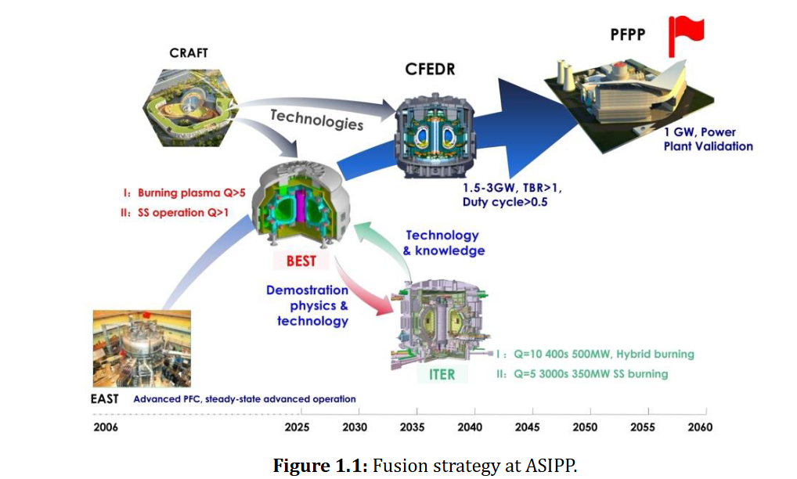
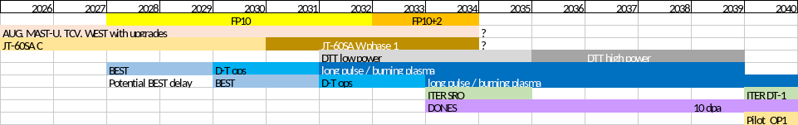
Background
BEST is considered as a step between EAST and CFEDR and do represent the ASIPP strategy
It is presented as running in parallel to ITER with lesson transferred and learnt (bidirectional relation)
Should be clear that already in FP10 BEST (even with 2 years delay) will largely expand the operational window available EU device (including JT-60SA)

Slide 3
Context: BEST Unique Position & Device Parameter Comparison
Period of interest: FP10+2 · Complementary and largerly expanding capabilities to EU devices
Burning Plasma D-T
High Plasma Current
Full-W in Large Device
D-T during FP10+2 with large alpha fraction; thermonuclear Q~1 (not beam-target). Precedes ITER DT1.
Up to 7 MA before JT-60SA W-wall and DTT. New territory for confinement, stability and disruptions.
Full-W first wall and divertor at BEST scale before JT-60SA W and DTT. Critical ITER/FPP preparation.
Long-Pulse D-T
Versatile Heating Mix
ASIPP Strategy Bridge
Pulse >> JT-60SA & DTT. DT density evolution, scenario sustainment, fuel retention: unexplored.
High-power NNBI + ICRH + ECRH with upgrade room. Flexible actuator set for scenario optimisation.
BEST+CRAFT bridge between EAST and CFEDR, also supporting ITER. Size intermediate JET–ITER.
 | AUG | MAST-U | TCV | WEST | JET ILW | JT-60SA C | JT-60SA W | DTT | BEST
Full W | inertial cooling |  |  | active cooling |  |  | active cooling | active cooling | active cooling
High current |  |  |  |  | 3-3.5 MA in ILW | 5.5 MA | 5.5 MA * | 5.5 MA | up to 7 MA
DT ops |  |  |  |  | Q~0.3-0.4 |  |  |  | Q~0.3-1 (Q~5 transient*)
Long pulse |  |  |  | 1000 s | 60 s | 100 s | 100 s | 60 s | 100-1000 s
ADC | All | All + Super X | All | DN |  |  |  | All
Heating mix | P NBI + ECRH + ICRH | P NBI + EBW | P NBI + ECRH | LH+ICRH+ECRH | P NBI + ICRH | P and N NBI+ECRH | P and N NBI+ECRH | ECRH+ICRH (+ N NBI) | D P NBI (and N NBI) + ECRH + ICRH + LH
† JET decommissioned 2023 · S.S. = Steady State

Slide 4
Theme 1 · D-T Plasma Physics & Scenario Development
Chapters 2 (Plasma Scenarios) · 4 (Transport & Integrated Modelling) · 9 (Energetic Particles)
Scenario & Transport (Ch. 2, 4)
Energetic Particles (Ch. 9)
QCE as main workhorse:
q₉₅~3 at large current — novel territory. H₉₈=1 gives Q~1–1.5 at 6–7 MA.
D→DT portability:
Development in D up to 5 MA; DT required for 7 MA (mirrors ITER/and concide with knowledge acquired on JET). JET DT frad > DD — radiation assumptions need revisiting.
ELM mitigation deemed essential:
Type-I ELMs challengin with full-W. QCE + small-ELM at >20 MW significantly expands JET envelope. Se point above on operating at reduced q95
Long-pulse DT:
Limited experience (JET limited in power/pulse length). Clearl expansion of available dataset also to check Density evolution over full flat-top. Current profile tailoring via LHCD deemed important
Deep fuelling (FOAK):
Fast pellets (55 mm³, 5 Hz, ρ<0.7) + Compact Torus Injector. CTI core fuelling exceeds NBI — genuinely first-of-a-kind.
Advanced scenario:
Paux=40 MW, Q~3–5 exploration — less mature, limited Ip shaping actuators. Complementary to JT-60SA.
Large alpha fraction:
Genuine burning plasma — distinct from JT-60SA where EP will be generated by heating (N-NBI and ECRH accelerated). Large thermonuclear alpha drive.
Alpha–turbulence:
GK studies: ~10% ITG stabilisation via EM effects; fast-ion impact small at baseline Paux → alpha benefit requires high-Q operation extending to unexplored territory before ITER.
EP/wave coupling:
ICRH + NNBI + alphas — direct test of alpha heating efficacy and Alfvénic instability drive.
Live diagnostic tests:
Confined and lost alpha distributions. New territory if Q~5: self-regulation, 4He ash accumulation.
⚑ TFL assessment:
QCE at large current (q₉₅~3) is unproven in nowadays tokamaks. H₉₈≥1.1 in a full-W device is not guaranteed — JET DT experience shows higher W impurity burden than in D. The RP must include contingency scenarios if QCE cannot sustain Q>1. Alpha turbulence stabilisation is likely marginal at baseline Paux; high-Q regime is needed to see the effect.

Slide 5
Theme 2 · MHD Stability, Control & Disruptions
Chapter 8 | MHD, Control and Disruptions
MHD Stability with Alpha Particles
Disruption Avoidance & Mitigation
Control Integration & Commissioning
Alpha-driven instabilities:
TAE, EAE, RSAE driven by large alpha fraction — qualitatively different from beam-driven EPs on JET or JT-60SA. Competes with bulk plasma damping. There will be as well fast particle from ICRH and medium energy from N-NBI
Burning plasma MHD:
BEST accesses the regime where alpha-particle drive is dominant. Critical unknown for ITER extrapolation — must be measured before ITER DT1.
Integrated stability:
NTMs, sawteeth, ELMs simultaneously in DT plasma with alpha drive — unprecedented simultaneous control challenge.
Higher hazard than JET:
7 MA stored energy — thermal and EM disruption loads more severe than any current device.
SPI listed, DMS absent:
Shattered Pellet Injection mentioned but Disruption Mitigation System (DMS) design is absent from RP v1.1 — this is a critical gap.
AI/ML control:
Real-time disruption prediction and avoidance; path toward disruption-free operations.
Runaway electrons:
Generation and suppression at 7 MA — nuclear licensing prerequisite.
Ramp-up/down:
Versatile heating mix to minimise flux consumption — directly transferable to ITER/FPP.
Commissioning baseline:
Machine commissioning phase establishes control infrastructure before D-T operations commence.
Methods transfer:
AI/ML plasma control and integrated MHD control methods feed directly into ITER and EU Pilot Plant commissioning strategy.
⚑ TFL assessment:
Chapter 8 is the least developed in RP v1.1. A credible DMS design — SPI specifications, runaway suppression strategy, and nuclear licensing requirements — is MANDATORY before 7 MA D-T operations. This might represent an area of interest for EU to expand EU strategy to a wider range in parallel to JT-60SA

Slide 6
Theme 3 · Plasma-Wall Interaction, Divertor & Heating
Chapter 6 (Divertor, SOL & PWI) · Chapter 5 (Heating, Current Drive & Fuelling)
Plasma-Wall Interaction & Divertor (Ch. 6)
Heating, CD & Fuelling (Ch. 5)
Full-W at scale:
V-shaped SND (corner config., VT option). λ_q ~1 mm at high Ip — divertor power handling in novel parameter space.
No-ELM regime mandatory:
Unmitigated Type-I ELMs incompatible with W wall at these heat fluxes. QCE + XPR + detached divertor are the reference with Ar as primary impurities → might inform as well for VNS/Pilot.
Core-edge integration:
Core edge integrated scenario will be essential for BEST performance activities and on this respect EU involvement will expand the work initiated on JET
First-wall erosion in Q>1:
Real-time W erosion monitoring essential. Fuel retention in DD/DT/T, He pumping, fast-particle wall loads considered as topic of interest. Also characterization of first-wall heat loads will be essential information before ITER (and inform 2nd first wall design for ).
Conditioning:
GDC/ICWC boronisation + Impurity Powder Dropper.
Not in RP v1.1:
RE/disruption wall loads and RT control are not discussed, need to be assessed and considered.
NNBI:
Complementary to ITER/ JT-60SA NNBI — long-pulse performance data for EU Pilot Plant.
Deep fuelling (FOAK):
9×GIM + 3×pellet + 2×mol. beam + 1×CTI. Core CTI fuelling exceeds NBI source — truly first-of-a-kind.
RF-only heating:
Can ICRH/ECRH alone sustain plasma? Directly relevant to FPP where NBI may be absent.
Ramp-up/down:
Versatile actuator mix, minimise flux consumption — ITER operational relevance.
Long-pulse NBI:
Long-pulse P-NBI and N-NBI input for EU Pilot Plant design.
⚑ TFL assessment:
Full-W wall at 7 MA is the highest-risk operational challenge. N-NBI upgrade (required for Q~5) has no defined timeline. Long-pulse wall monitoring identified as needed but no diagnostic specification given. RE/disruption loads must be addressed before DT phase.

Slide 7
Theme 4 · Theory and Modelling
Chapter 10 | Theory and Simulations
Scientific Scope (Ch. 10)
ATEP and FI code validation on BEST:
Burning plasma transport — coupling between EP-driven self-organised modes and global transport. Expand JET-validated ATEP to higher Q regime with larger fraction of naturally born energetic particles.
EPED & pedestal:
Allow testing for existence and prediction of no-ELM regimes with low pedestal nu* expanding our pedestal prediction capabilities
EU code suite:
Validation of EU code (JINTRAC, ASTRA, GK codes) on wider operational space even w.r.t. Keep in mind that China has access to IO Codes and indeed IO recommends using IO code suite.
TSVV validation:
BEST data critical for burning plasma TSVV tools. To be checked willingness to use IMAS as data access which will simplify usage of EU codes
⚑ TFL assessment:
Having (full access) to BEST data will provide unvailable dataset for validation of EU tools in an operation range unreachable within EU/JT-60SA devices

Slide 8
Conclusions
TFL consideration based primarily on BEST Research Plan document: purely scientific leaving apart any potential issues on collaboration framework
Access to BEST data will widely expand parameter space explored in EU devices even w.r.t. JT-60SA (e.g. EP and burning plasma condition)
Will offer the possibility to keep D-T operation experience after JET and before ITER
Might provide confirmation of extrapolability of FOAK like scenarios (ELM-free, detachment, good confinement, D-T operation…): unclear if expected scenario might provide information also for Pilot physics (burning plasmas vs beam-target with dominant NBI heating)
TFL view: BEST is a unique scientific opportunity in the FP10+2 window. EU engagement must be strategic, rights-based — essential to maximise EU scientific return (win-win approach) while managing geopolitical risk

