Slide 1



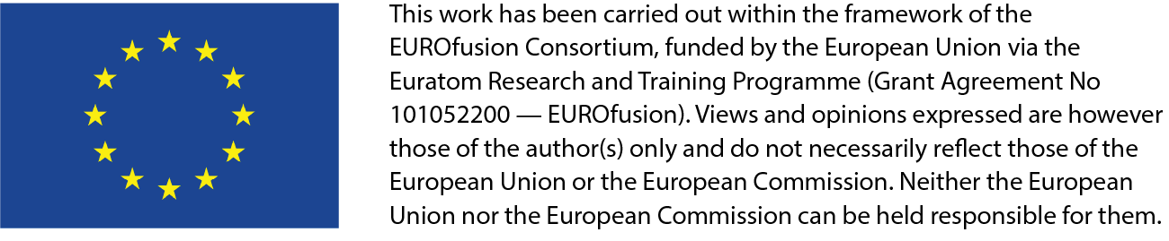

Integrated Digital Twin Framework for Breeding Blanket Systems:
Coupling Plasma, Fuel Cycle, and Thermal Hydraulic dynamics
DSO Jour Fixe Meeting | Aug 3rd, 2026
Carlos Moreno
carlos.moreno@heffen.es

Slide 2
Objectives
Main Objective
Develop a dynamic, integrated simulation framework for tritium transport, coupling EcosimPro® models with fuel cycle and incorporating thermal-hydraulic temperature profiles from RELAP5/mod3.3, while preparing the plasma-edge interface.
Specific Objectives
Domain | Objective
Fuel Cycle Integration | Develop dynamic interface between EcosimPro® and fuel cycle simulators (Julia-based TFV code or ASPEN); exchange tritium partial pressures and extraction fluxes at every simulation timestep
Thermal Integration | Implement two-way coupling between EcosimPro® and RELAP5/mod3.3; enable dynamic feedback of temperature distributions to update tritium transport parameters (diffusion coefficients, solubility, release rates)
Plasma-Edge Interface | Consolidate and validate exchange variables at plasma-facing first wall; ensure compatibility with plasma-edge codes (TRIM, IMAS data exchange approach)
Validation & Demonstration | Apply framework to realistic DEMO breeding blanket scenarios; benchmark against standalone simulations
AI/ML Enhancement | Explore surrogate modelling approaches; develop reference surrogate model for system element; establish computational/accuracy criteria for surrogate model usability

Slide 3
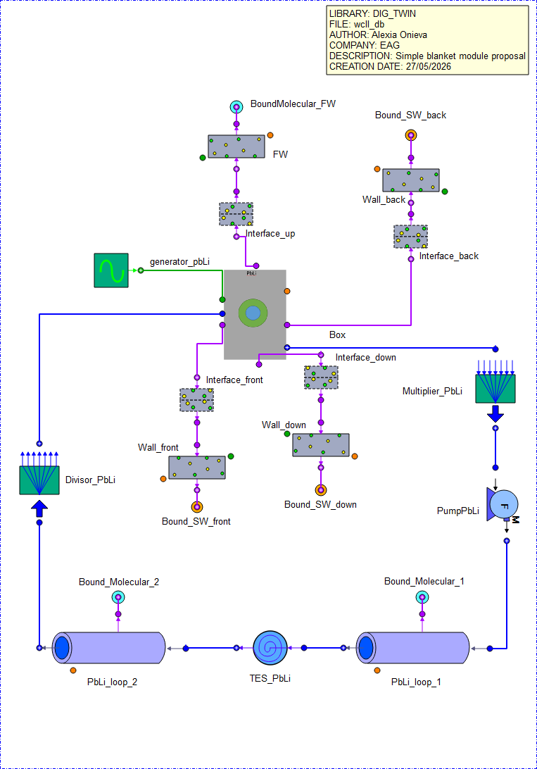
Thermal Integration
A single representative PbLi breeder box has been selected for the initial EcosimPro–RELAP model.
The 39 cooling tubes are represented by one tube with unchanged geometry, scaling the heat-transfer surface or flux by 39.
The 15 mm First Wall is included; cooling water is treated as a permeation sink.
The blanket model uses 895 m³ of PbLi, equivalent to about 55.3 segments and 1,147 breeder boxes.
PbLi flow is derived from the box geometry and a reference velocity of 1.1 mm/s, then distributed among six loops.
External PbLi inventory is 565 m³, with approximately 200 m per loop and 82% extraction efficiency.
Tritium generation is fixed at 320.26 g/day for the full blanket and scaled to the representative box.
Trapping and detailed water loops are excluded initially; 10- and 20-cell RELAP models will support sensitivity studies.

Slide 4
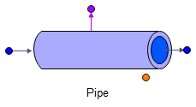
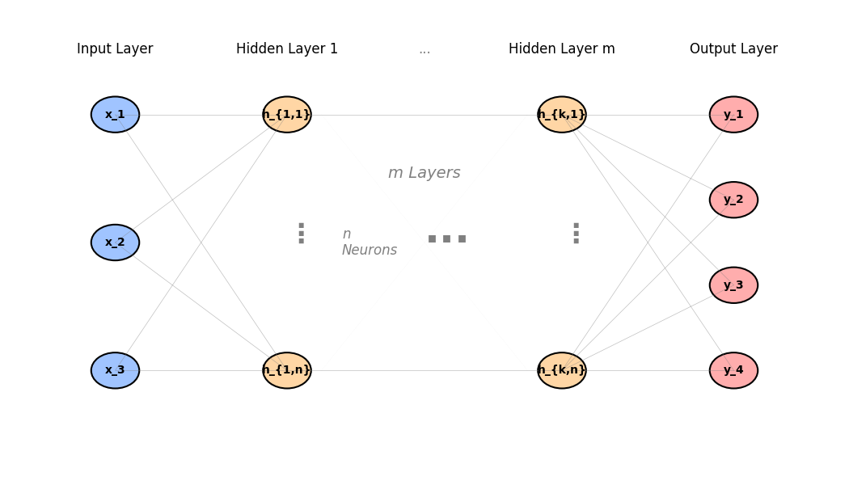


Train and validate surrogate models for specific system elements
Multilayer Perceptron Neural Network (MLP) as subrogate model
First assessment on using a MLP Neural Network for computing directly steady state signals
Transient EcosimPro model: Tritium permeation through a liquid pipe
Pe
892 simulations
Péclet number
Sherwood number
Permeation number
Training set
Test set
Validation set
Sh
Data shuffling
W
Implementation and training in parallel (CPU) build with flux package written in Julia for high performance

Slide 5
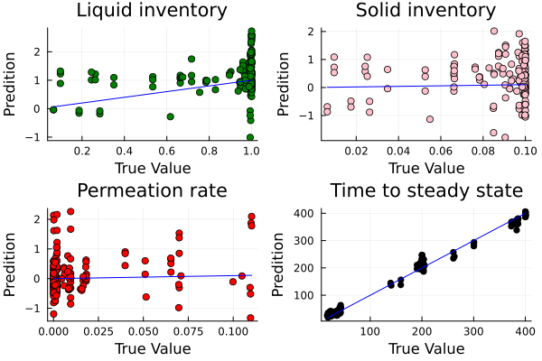
Train and validate surrogate models for specific system elements
Multilayer Perceptron Neural Network (MLP) as subrogate model
So far the performance of the network is poor nor being able to produce accurate predictions within the validation test:
  Too broad input data set including too many different regimes -> Split the network
  Tuning of hyperparameters
  Change of methodology to time series predictor (convolutional network)
Pe
Sh
W

Slide 6
Next steps
Finalise the representative WCLL breeder-box models in EcosimPro and RELAP5, including consistent geometry, heat loads, PbLi flow and boundary conditions.
Define the EcosimPro–RELAP5 coupling architecture, exchanged variables, timestep synchronisation and data-mapping strategy.
Implement temperature feedback in the tritium model to dynamically update solubility, diffusivity, permeation and release rates.
Perform initial 10- and 20-cell discretisation sensitivity studies and benchmark coupled results against standalone simulations.
Refine the ML approach by splitting the training domain into operating regimes, tuning hyperparameters and assessing time-series architectures.
Benchmark surrogate models against first-principles models in terms of accuracy, robustness and computational speed.
Explore TRIM simulations of ion implantation profiles in the First Wall and define the relevant source terms for the plasma-edge interface.
Prepare the subsequent integration with the fuel-cycle model and define the first representative DEMO transient for integrated validation.

