Slide 1
Brief overview of the implementation of the DMP
General Jour FIxe
Pär Strand, Chalmers for the DMP team
P, Strand^{1,} D. Coster², L. Kripner³, I. Hanák³, D. Kománek³, A. Gonzalez Beltran⁴, N. Cummings⁴, S. Dixon⁴, T. Farmer⁴, J. Hollocombe⁴, L. Kogan⁴, A. Parker⁴, C. Powell⁴, G. Szepesi⁴, R: Coelho⁵, J. Decker^{6,} L. Simons⁶, S.C Yildiz⁶, L. Fleury⁷, F. Imbeaux⁷, P. Maini⁷, J. Morales⁷, P. Grabowski⁸, K. Niznik⁸, M. Owsiak⁸, B, Pogodzinski⁸
¹Chalmers University of Technology, Sweden, ²Max-Planck-Institut für Plasmaphysik, Germany, ³Institut for Plasma physics, CAS, Czech Republic, ⁴UKAEA, United Kingdom, ⁵IST, Portugal, ⁶SPC/EPFL Switzerland, ⁷CEA, France, ⁸IPPLM (PSNC IBCH PAS), Poland

Slide 2
Background
The Data Management Plan is a grant deliverable describing the intention of EUROfusion in terms of data governance and sharing.
Developed in a working group including high level experts from the experimental facilites and modelling/simulation communities.
Brief document (already shared) : EFDA_D_2PZ2QY - EUROFUSION GA (22) 39 - 4.3a - data-management-plan-EUROfusion
The “Implementation of the DMP” project turns the DMP into practice by developing the required infrastructure, access methods and detailed implementation framework while balancing concerns of data quality and control. The aim is to make EUROfusion data progressively more FAIR — Findable, Accessible, Interoperable and Reusable.
Deliberately federated: existing experimental data systems remain at the facilities, while central services make them easier to discover and access. Maintaining control over data quality and access. Embargos respected but void when data is published.
Modelling data will additionally be supported by long-term storage and stronger provenance management.

Slide 3
”Issues”
Manpower changes has slowed down progress on some data mapping activities
Authorisation services at each facility still needs to be rolled out - requires technical and managerial support on some devices
Unclear scope and capability in relation to PID minting on the LTDSF need to be urgently resolved
Managing the transition from DD3 to DD4 need coordination and joint work
Next steps (starting now):
Testing and validation of existing data mappings and tools with users (TSVV, DTEs)
Further requirements capture with WP TM
DSO:ers: If you are using IMAS data /data mappings etc we would love to discuss with you!

Slide 4
Current status and plans
Original (ambitious) project reduced in scope and limiting activities towards prototyping BUT
Infrastructure now largely in place – some elements need further work.
2026-27: starting to exploit and open up the data
  Waveform catalogue now online – being extended.
  Finalize infrastructure bringing controlled access to AUG, [COMPASS/-U], JET, MAST/MAST-U, TCV and WEST online. (Authetication and Authorisation extensions to sites)
  Make the tools available for user (TSVV’s, ENR’s, DTE’s and WP TE modelling)
    User inputs and requirements needed (task/code specific) - broader kick off now
  Add simulation/modelling data as another facility
  Enhance provenance and promote the use of Persistent identifiers (PID’s).
  Build a strategy for fully open data and release a subset of data from participating deviceces.
  Manage move from IMAS DD3 to DD4.
  Two main lines of work (IMAS based):
    Data inventory/waveform explorer
    Access to profile data for analysis and modelling

Slide 5
Milestones
No | Title | Description | Expected date
1 | MA. 1 | Provide scenario A data using DD 3 | 2026/Q1
2 | MA. 2 | Provide a list of recommended signals for scenario A | 2026/Q2
3 | MA. 3 | Provide updated scenario A data using DD 4 | 2026/Q4
4 | MA. 4 | Include modelling and simulation data in metadata Catalogue | 2027/Q2
5 | MB. 1 | Provide a list of recommended signals from first use cases (live document) | 2026/Q1
6 | MB. 2 | Provide scenario B data using DD 3 | 2026/Q2
7 | MB. 3 | Strategy for Migration DD 4 | 2026/Q2
8 | MB. 4 | Implement AAI access to data (on all sites?) | 2026/Q4
9 | MB. 5 | Provide scenario B data using DD 4 | 2027/Q2
10 | MC. 1 | Strategy for PID integrations | 2026/Q3
11 | MC. 2 | Release of data with enhanced provenance | 2026/Q4
12 | MC. 3 | Release of data with PIDs | 2027/Q2
13 | MD. 1 | Plan for open data releases | 2026/Q4
14 | MD. 2 | Release of open data from at least one device | 2027/Q4
Data Inventory/
dashboard
Data access
and
provenance
Open data

Slide 6
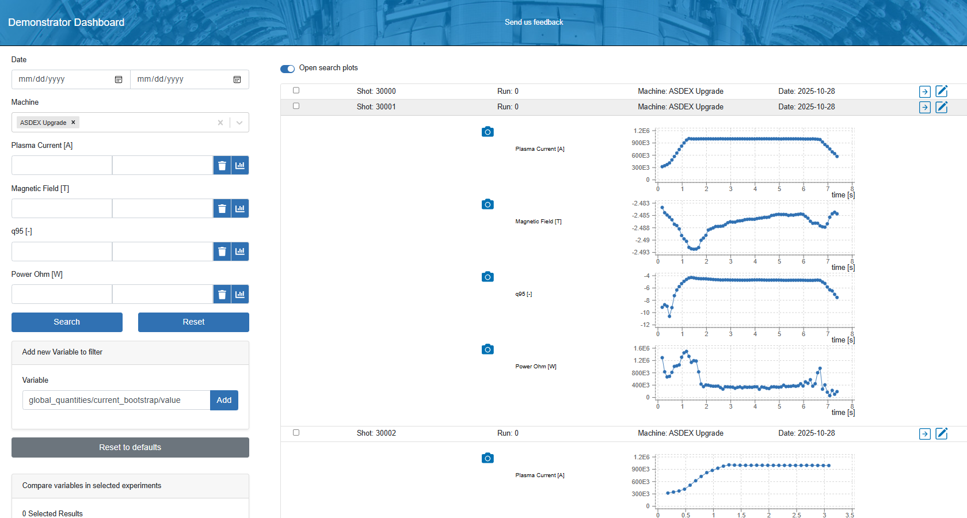
A. Searchable Inventory of experimental data
Provide a searchable catalogue of experimental data from EUROfusion.
  IMAS based conventions (consistent conventions over devices)
  Production version to be updated on the Gateway. (dmp.eufus.eu)
  New backend infrastructure introduced for robustness and performance
Overview data (IDS_summary)
  Time dependent waveforms
    IP, BT, q95, vloop,…
    Extendable on user requests
    Link to actual data sources

Slide 7
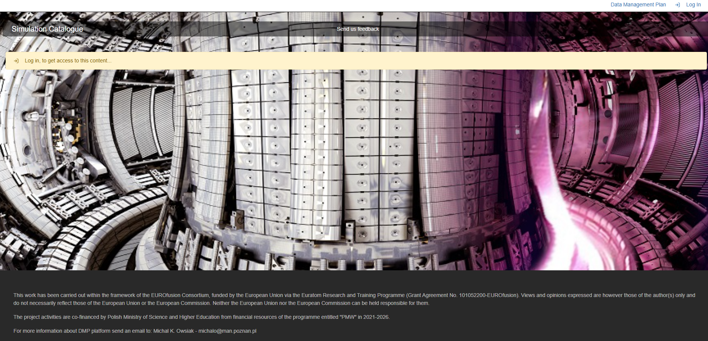
https://dmp.eufus.eu
Access for EUROfusion (Gateway) Users

Slide 8
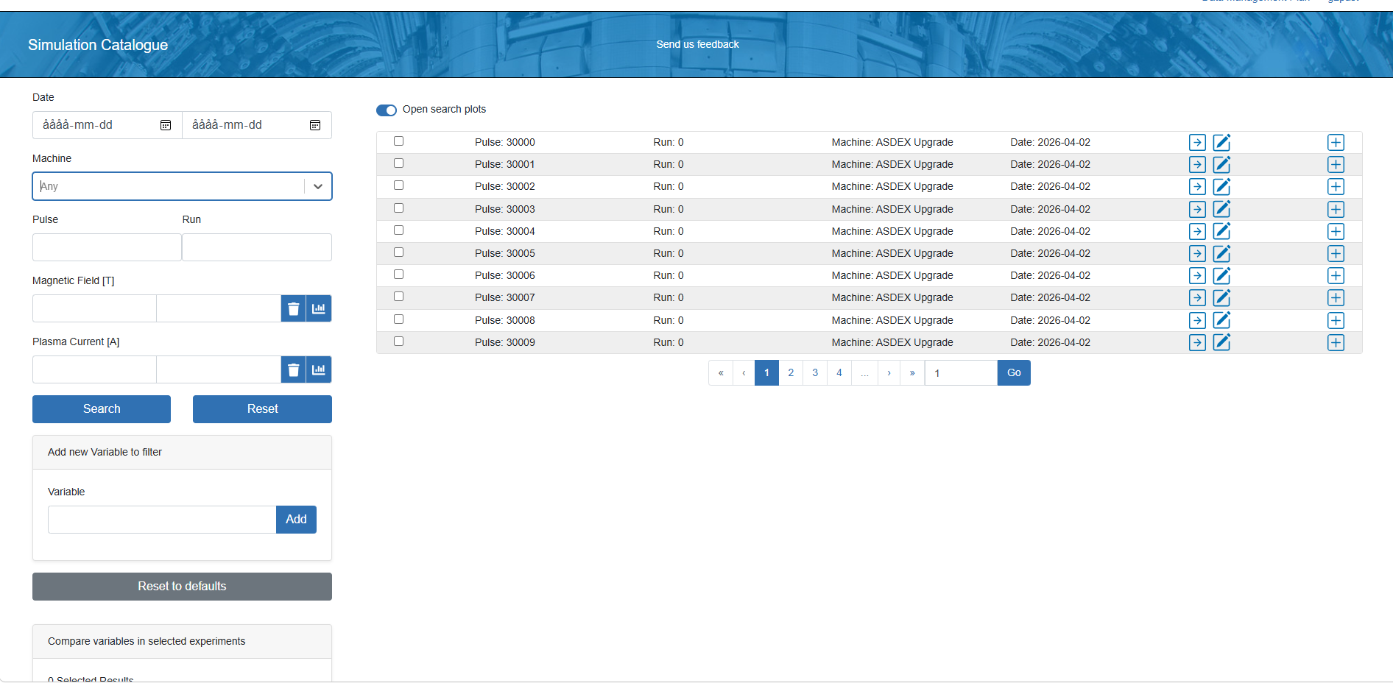

Slide 9
Annotations
Simple plots
Several devices:
AUG, TCV, WEST (30000+discharges)
+ EF pedestal databases
Data, data sources and (some) provenance
Several search option - data consists of waveforms (time dependent) ingested form IDS Summary

Slide 10
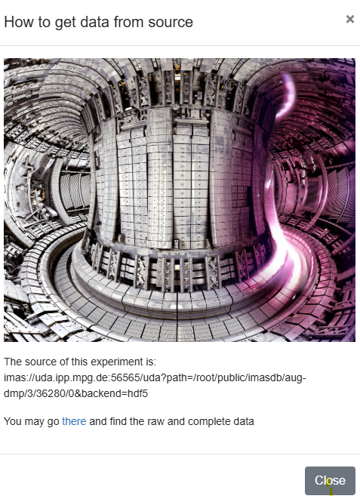
Annotations
Simple plots
Several devices:
AUG, TCV, WEST (30000+discharges)
+ EF pedestal databases
Data, data sources and (Some) provenance
Several search option - data consists of waveforms (time dependent) ingested form IDS Summary

Slide 11
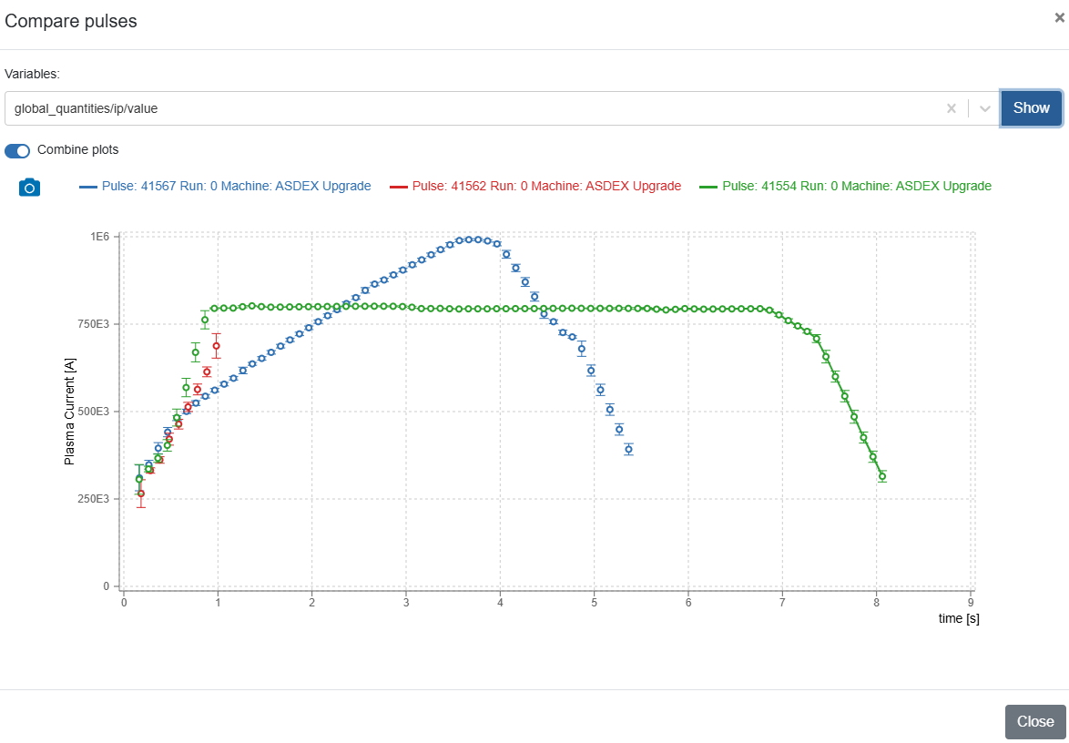
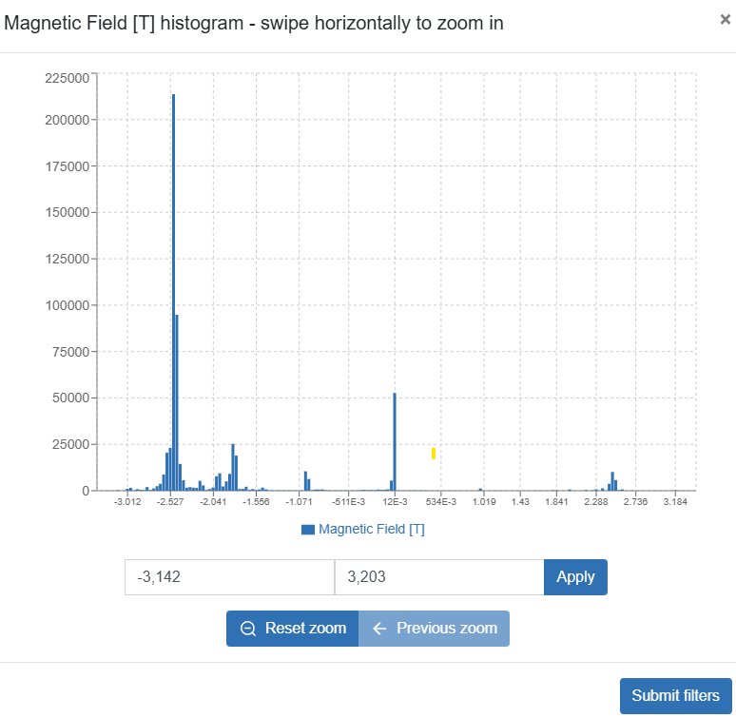
Data statistics and typical waveforms
More devices and shots to come available: input/feedback needed
- minimum list of ids_summary quantities - user interface…

Slide 12
A. Searchable Inventory of experimental data (adding simulation data)
Extend data coverage: with users (TSVVs etc) define minimum list of required quantities (all sites)
Collect user feedback to improve usability, interfaces and identify performance bottlenecks.
Integrate site data with push requests to core services for automated ingestion and updates of released data.
Concerns: disruptive change DD3→ DD4.
Potential for use with data centric analyses
Device | Description | # of shots | Comment
AUG | Summary and dataset_description IDSes | 11150 | Currently with DD 3.39.0 and AL 5.0.0
COMPASS/COMPASS-U | Summary and dataset_description IDSes |  | Currently with DD 3.39.0 and available only internally. Selected COMPASS tokamak discharges will be provided, mapped to IMAS format via the UDA server. The infrastructure will be ready for the operation of the COMPASS Upgrade tokamak.
JET | Summary and dataset_description IDSs | DTE2: 99294 - 99982 DTE3: 103987- 104697 | DTE2 and DTE3 3.42.0 Subset of pulses selected for demonstration but can be extended to include all pulses
MAST-U | Summary and dataset_description | 40000 onwards (current shot is 52634) | Shot 40000 - current 3.42.0 Not publicly available due to embargo and data policy
MAST | Summary and dataset_description | M4 - M9 | 3.42.0 Not publicly available due to embargo and data policy
TCV | Summary and dataset_description | More than 10000 shots | Mostly DD 3.41 and AL 5
WEST | Summary and dataset_description IDSes | 8000 | All shots from campaigns C4 to C11

Slide 13
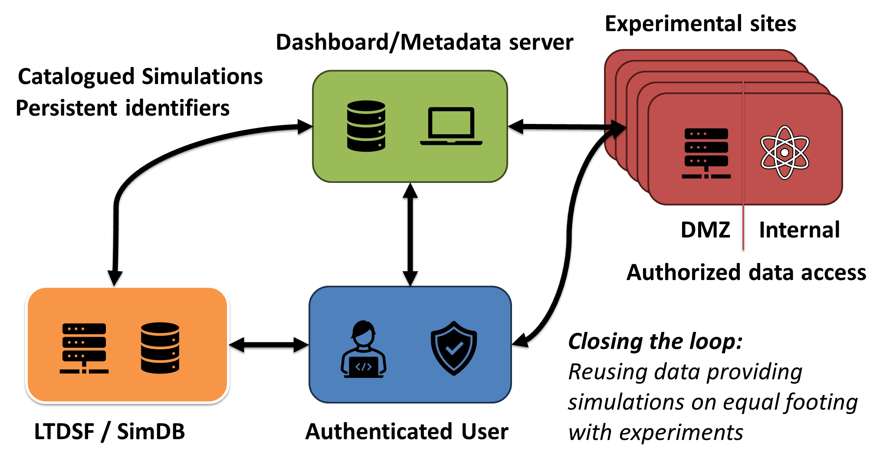
Access to experimental data
Ingredients
Remote data access
  UDA servers at the different sites
Relevant data mappings being developed
  continued work from ITM, WPCD
Access control
  complying with facilities requirements
Provenance capture
  traceability from experiment to end user
FAIR compliance
Supported by central services for integration on gateway.
Modelling data proposed to be supported by connecting simDB to the dashboard and a UDA server. (Modelling data as a facility).

Slide 14
Dashboard/Metadata server
Experimental sites
DMZ
Internal
Authorized data access
Two schools for providing data to DMZ area:
Standalone IMAS data service updated on need/request
Dynamic mapping with firewall passthrough
Availability of data resides with the devices. NB there is no
Magic Bullet - data need to be mapped to IMAS unless native
Authenticated User on GW

Slide 15
Dashboard/Metadata server
Experimental sites
DMZ
Internal
Authorized data access
Two schools for providing data to DMZ area:
Standalone IMAS data service updated on need/request
Dynamic mapping with firewall passthrough
Currently only available for select test discharges – need to
roll out Authorisation on the sites for broader access.
Authenticated User on GW

Slide 16
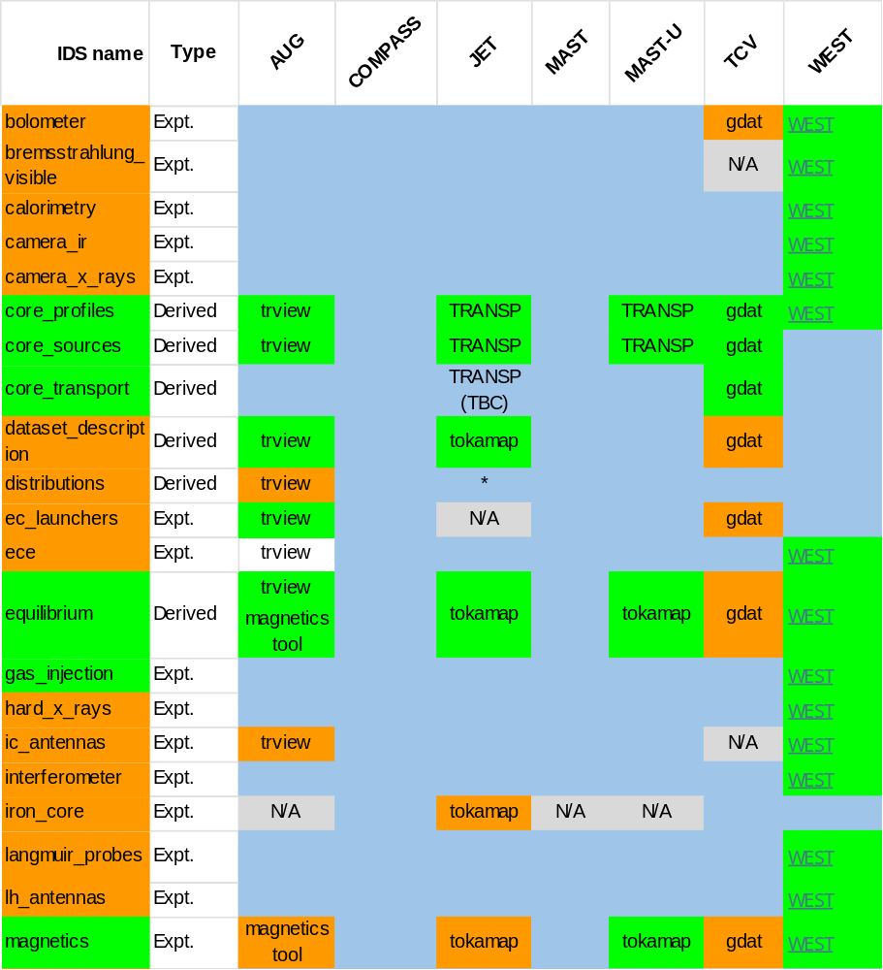
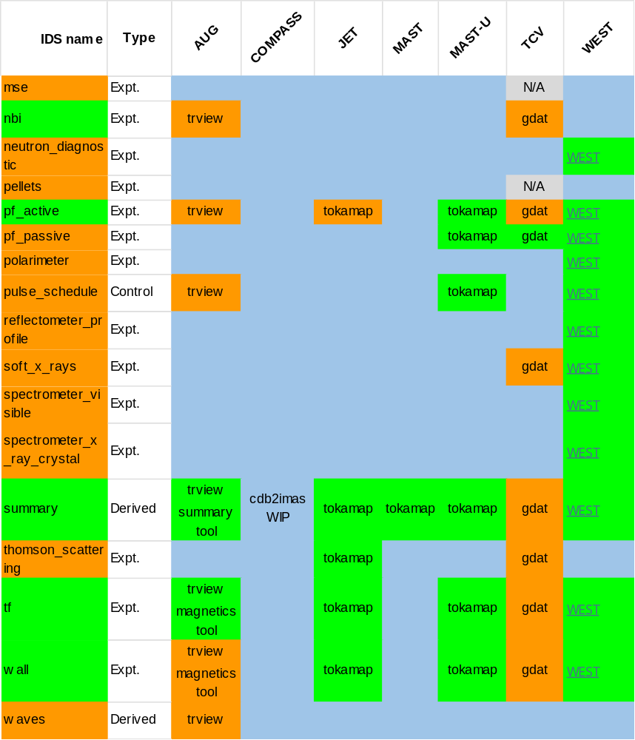
Color coding:
IDS – active, alpha Mappings – (partially) validated, available needs work,
No data is available, Not applicable (N/A)

Slide 17
Mapping coverage being extended:
Action to ensure that users needs (TSVV, DTEs,..) are covered prioritised.
TSVV – with WP TM (ad hoc now to be systemised)
DTEs - preliminary discussions started with Synthetic diagnostics, IDA
Move from DD3 to DD4 need to be managed.
Many TSVV users ”only” need derived data such as core_profiles
– generally means an expert person in the loop.
Two approaches:
link in with existing TRANSP (or equivalent data)
Promote a hardened local IMAS based ”IDA” tool in production chain.
Color coding:
IDS – active, alpha Mappings – (partially) validated, available needs work,
No data is available, Not applicable (N/A)

Slide 18
core_profiles
· core_profiles/profiles_1d(itime)/q(:)
· core_profiles/profiles_1d(itime)/electrons/density_thermal(:)
· core_profiles/profiles_1d(itime)/electrons/temperature(:)
· core_profiles/profiles_1d(itime)/t_i_average(:)
· core_profiles/profiles_1d(itime)/zeff(:)
core_sources
· core_sources/source(inbi)/profiles_1d(itime)/electrons/energy(:)
· core_sources/source(inbi)/profiles_1d(itime)/total_ion_energy(:)
· core_sources/source(inbi)/profiles_1d(itime)/j_parallel(:)
· core_sources/source(inbi)/profiles_1d(itime)/ion(iion)/element(1)/a (ion(iion)
(needs to be set for the main ion species that are set up in JETTO)
· core_sources/source(inbi)/profiles_1d(itime)/ion(iion)/element(1)/z_n
· core_sources/source(inbi)/profiles_1d(itime)/ion(iion)/atoms_n
· core_sources/source(inbi)/profiles_1d(itime)/ion(iion)/particles(:)
· core_sources/source(inbi)/profiles_1d(itime)/momentum_tor(:)
· core_sources/source(iic)/profiles_1d(itime)/electrons/energy(:)
· core_sources/source(iic)/profiles_1d(itime)/total_ion_energy(:)
· core_sources/source(iic)/profiles_1d(itime)/j_parallel(:)
· core_sources/source(iec)/profiles_1d(itime)/electrons/energy(:)
· core_sources/source(iec)/profiles_1d(itime)/j_parallel(:)
· core_sources/source(ilh)/profiles_1d(itime)/electrons/energy(:)
· core_sources/source(ilh)/profiles_1d(itime)/total_ion_energy(:)
· core_sources/source(ilh)/profiles_1d(itime)/j_parallel(:)
Equilibrium
· equilibrium/time_slice(itime)/boundary/outline/r(:)
· equilibrium/time_slice(itime)/boundary/outline/z(:)
· equilibrium/time_slice(itime)/global_quantities/ip
· equilibrium/vacuum_toroidal_field/r0
· equilibrium/vacuum_toroidal_field/b0(itime)
· equilibrium/time_slice(itime)/global_quantities/magnetic_axis/r
· equilibrium/time_slice(itime)/global_quantities/magnetic_axis/z
· equilibrium/time_slice(itime)/profiles_2d(1)/grid_type/name = ‘rectangular’
· equilibrium/time_slice(itime)/profiles_2d(1)/grid_type/index = 1
· equilibrium/time_slice(itime)/profiles_2d(1)/grid/dim1(:)
· equilibrium/time_slice(itime)/profiles_2d(1)/grid/dim2(:)
· equilibrium/time_slice(itime)/profiles_2d(1)/psi(:,:)
· equilibrium/time_slice(itime)/profiles_1d/psi(:)
· equilibrium/time_slice(itime)/profiles_1d/f(:)
· equilibrium/time_slice(itime)/profiles_1d/q(:)
· equilibrium/time_slice(itime)/profiles_1d/pressure(:)
· equilibrium/time_slice(itime)/boundary/psi
· equilibrium/time_slice(itime)/profiles_1d/rho_tor_norm
· equilibrium/time_slice(itime)/profiles_1d/j_tor
· equilibrium/time_slice(itime)/global_quantities/psi_axis
· equilibrium/time_slice(itime)/global_quantities/psi_boundary
We want to expand the data mappings to cover
the different use cases in EUROfusion.
A list of needed IDS’s is a good start but need
more details - down to signal level -to be really useful.
Validation of data mappings still needed

Slide 19
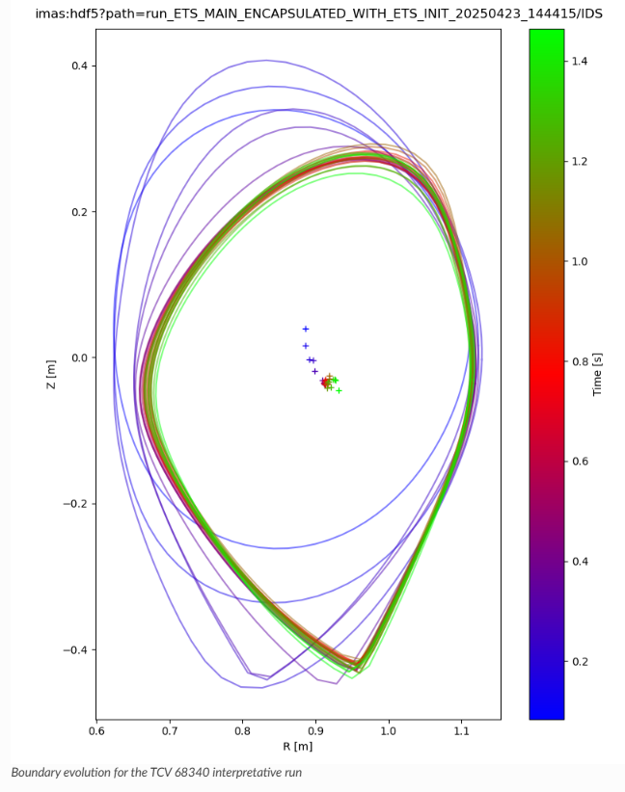
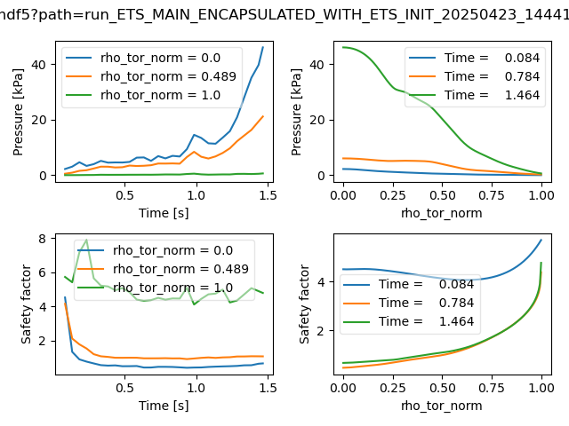
Validation of TCV data - interpretative run with ETS
The workflow has been saved in simdb as ecf65ca0-210c-11f0-8eb7-0894ef442712 with the alias g2dpc/tcv/68340/run_ETS_MAIN_ENCAPSULATED_WITH_ETS_INIT_20250423_144415.

Slide 20
Increased high level interest and a possible expanded scope
Strong suggestion for EUROfusion to go further from the reviewers of the 2026-27 WP:
Establish a unified experimental data platform as a 2027 global objective:
  “Currently, experimental data remains siloed among individual consortium members who independently manage access and FAIR compliance.
  The consortium must formally mandate the deployment of a unified, IMAS-based data access platform as a global strategic objective to be achieved by 2027.
  This will effectively replace fragmented data repositories with a single, standardised gateway for all European fusion experiments.”

Slide 21
Increased high level interest and a possible expanded scope
Strong suggestion for EUROfusion to go further from the reviewers of the 2026-27 WP:
Establish a unified experimental data platform as a 2027 global objective:
  “Currently, experimental data remains siloed among individual consortium members who independently manage access and FAIR compliance.
  The consortium must formally mandate the deployment of a unified, IMAS-based data access platform as a global strategic objective to be achieved by 2027.
  This will effectively replace fragmented data repositories with a single, standardised gateway for all European fusion experiments.”
This goal is moving beyond current common ground for data sharing BUT can be fostered by moderate expansion of the tool set.
Requires additional resources and longer-term horizon well into FP10.

