Slide 1
Status of the EF databases work
DSO Jour Fixe September 2026
Pär Strand, Chalmers. Area Coordinator
P, Strand^{1,} D. Coster², A. Pau^{3,} L. Frassinetti⁴, E. Lerche
¹Chalmers University of Technology, Sweden, ²Max-Planck-Institut für Plasmaphysik, Germany, ³Institut for Plasma physics, ³SPC/EPFL Switzerland, ⁷CEA, France, ⁴Royal institute of Technology, Stckholm, Sweden

Slide 2
Database work in EUROfusion
Implementation of the DMP and Data Area Coordinator; Pär Strand, VR
Scalable Production and Collaborative Environment for EUROfusion Multi-Machine Databases; Alessandro Pau, EPFL
EUROfusion’s multi-machine pedestal databases (JET, MAST-U, TCV, AUG); Lorenzo Frassinetti, KTH/VR
Continued support and maintenance of the AMNS database; David Coster, MPG
Update and Maintenance of the International CICLOP database on Long Pulse Operations; Ernesto Lerche, LPP-ERM-KMS

Slide 3
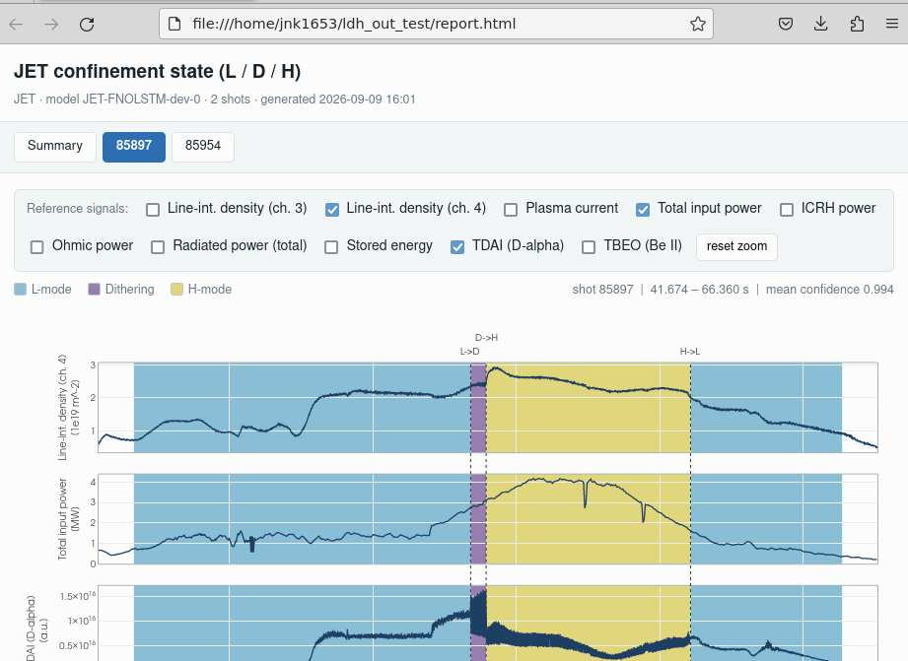
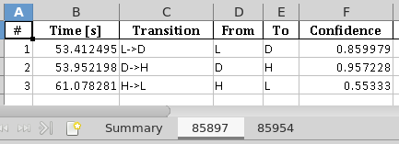
EUROfusion E-TASC DATA Alessandro Pau
Scope and progress
Shared tools for multi-machine disruption, LH, pedestal and confinement databases
SCOPE
ONGOING ACTIVITIES
Build tools for construction, collaborative validation and query of multimachine DBs with common data access, quality and provenance layers.
Database population and expert validation, improved event timing and confidence/uncertainty propagation, and final testing for tool automation.
MAIN GOAL FOR 2026
Validation of JET-ILW disruptions and LH-transition databases:
~6,000 disruptions above 750 kA
~1,000 discharges with LH-transitions and confinement states
Python/MATLAB SQL APIs, validation GUIs and IMAS IDS read/write. End-to-end qualification on spcdefuse and migration/deployment on the new EUROfusion Gateway
Expert validation of confinement states and events
Swiss Plasma Center · EPFL
01

Slide 4
EUROfusion E-TASC DATA Alessandro Pau
2026–2027 roadmap and future needs
Proposed goals building on the delivered PrIO EUROfusion Database previous years activities
2026
2027
Gateway migration and consolidation
Productization and “IMASification”
Complete Gateway transfer once user authentication & access are agreed with the DMP group.
Productize the validation, mapping to IMAS and maintenance of the multimachine DBs.
Support the extension of the databases to the other EUROfusion devices within DEFUSE tools ecosystem for data preparation, expert validation, querying and integration/mapping to IMAS.
Consolidate versioned JET-ILW and TCV DBs, releases (disruptions and LH-transitions) and start scientific exploitation.
RISKS AND NEEDS
Gateway delays: agree access and an operational owner. Validation capacity: allocate expert effort.
Productization: secure long-term maintenance effort, IMAS mapping expertise and compute/storage.
Swiss Plasma Center · EPFL
02

Slide 5
The EUROfusion pedestal database
Size
  JET: 5900 entries (all available H-modes with good pedestal data)
  TCV: 490 entries (provided by B. Labit, M. van Rossem)
  AUG: 200 entries (EUROfusion shots with H-modes from WPMST1 campaigns, provide by M. Dunne)
  MAST-U: 100 entries (all EUROfusion shots with H-modes and good pedestal data till June 2025)
Location: EUROfusion gateway (EFGW)
  Data stored in IMAS.
  The database is stored on EFGW in:
    JET: /afs/eufus.eu/user/g/g2lfrass/imasdb/pedestalDB_JET
    TCV: /afs/eufus.eu/user/g/g2lfrass/imasdb/pedestalDB_TCV
    AUG: /afs/eufus.eu/user/g/g2lfrass/imasdb/pedestalDB_AUG
    MAST-U: /afs/eufus.eu/user/g/g2lfrass/imasdb/pedestalDB_MASTU

Slide 6
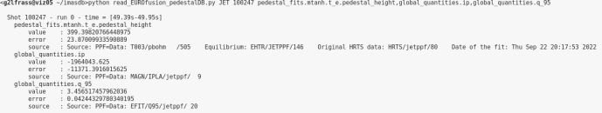
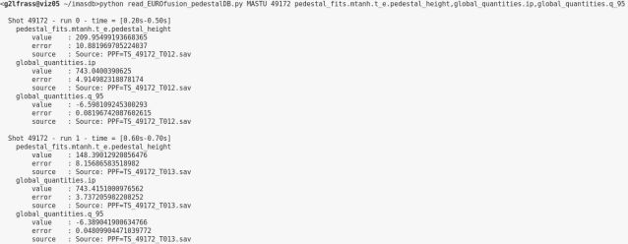
The EUROfusion pedestal database: access
https://wiki.euro-fusion.org/wiki/WPPrIO_wikipages:_DB_Pedestal
Scripts to read the database are on the EFGW
  /afs/eufus.eu/user/g/g2lfrass/imasdb/read_EUROfusion_pedestalDB.py
    python read_EUROfusion_pedestalDB.py JET 100247 pedestal_fits.mtanh.t_e.pedestal_height,global_quantities.ip,global_quantities.power_steady
    python read_EUROfusion_pedestalDB.py MASTU 49172 pedestal_fits.mtanh.t_e.pedestal_height,global_quantities.ip
  /afs/eufus.eu/user/g/g2lfrass/imasdb/create_csv_EUROfusion_pedestalDB.py
    python create_csv_EUROfusion_pedestalDB.py TCV pedestal_fits.mtanh.t_e.pedestal_height,global_quantities.ip,global_quantities.power_steady TCV_DB_table

Slide 7
The EUROfusion pedestal database: scope in 2026-27
Extensions:
  extend the MAST-U part of the database with the new EUROfusion shots
  extend the TCV part of the database with the new EUROfusion shots,
  assuming support from the local team
  extend the AUG part of the database with the new EUROfusion shots,
  assuming support from the local team
Updates and support:
  update the JET part of the database upon request from the users
  store the new data into the IMAS format on the New Gateway server
  maintain the tools to access the database up-to-date.
  provide support to the users.

Slide 8
The EUROfusion pedestal database: on-going work
Extensions:
  extend the MAST-U part of the database with the new EUROfusion shots: ongoing
  extend the TCV part of the database with the new EUROfusion shots,
  assuming support from the local team
  extend the AUG part of the database with the new EUROfusion shots,
  assuming support from the local team
Updates and support:
  update the JET part of the database upon request from the users: ongoing
  store the new data into the IMAS format on the New Gateway server
  maintain the tools to access the database up-to-date: ongoing
  provide support to the users: ongoing

Slide 9
The EUROfusion pedestal database: planned by end of 2026
Extensions:
  extend the MAST-U part of the database with the new EUROfusion shots: ongoing
  extend the TCV part of the database with the new EUROfusion shots,
  assuming support from the local team
  extend the AUG part of the database with the new EUROfusion shots,
  assuming support from the local team
Updates and support:
  update the JET part of the database upon request from the users: ongoing
  store the new data into the IMAS format on the New Gateway server planned
  maintain the tools to access the database up-to-date: ongoing
  provide support to the users: ongoing

Slide 10
The EUROfusion pedestal database: planned in 2027 and risks
Extensions:
  extend the MAST-U part of the database with the new EUROfusion shots: ongoing
  extend the TCV part of the database with the new EUROfusion shots,
  assuming support from the local team
  extend the AUG part of the database with the new EUROfusion shots,
  assuming support from the local team
Updates and support:
  update the JET part of the database upon request from the users: ongoing
  store the new data into the IMAS format on the New Gateway server planned
  maintain the tools to access the database up-to-date: ongoing
  provide support to the users: ongoing
Planned in 2027, low risk
higher risk

Slide 11
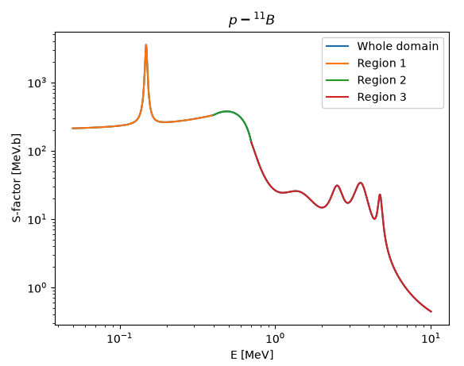
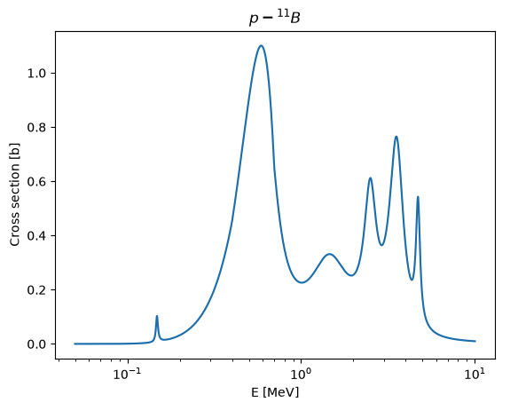
AMNS progress (David Coster)
AMNS activity targets the maintenance of the AMNS software infrastructure and the provision of new data
Some work has gone into an additional nuclear cross-section
Some discussions will need to occur about ADAS updates (e.g. B) (and licensing issues)
Find somebody to take over this activity in the 2nd half of 2027
Notes:
Title
Scope
Status/Ongoing activities
(Risks - not meeting goals etc)
future needs!
aim for 2026 - goals for 2027 with a nice illustration if possible.

Slide 12
Summary of recent CICLOP activity (X. Litaudon, E. Lerche et al)
The CICLOP database has been updated for the 2025 IAEA-FEC to incorporate 2023-2025 experiments, including recent records in performance and additional variables
(WEST and EAST t>1000s, JET longest pulses, W7X improved performance, JET D-T, …)
Updated database now comprises a total of 238 pulses (vs 109) with a up to 54 variables per pulse (vs. 29)
X. Litaudon et al 2026 Nucl. Fusion 66 095001
https://iopscience.iop.org/article/10.1088/1741-4326/ae89cc
Plasma performance and fusion predictions based on reduced models ongoing (collaboration with the US)
Analysis / classification of long discharge limits in the CICLOP database ongoing
(update in the IAEA-TM on Long pulses, Hefei, October 2026)
→ Need some help (manpower) on this

Slide 13
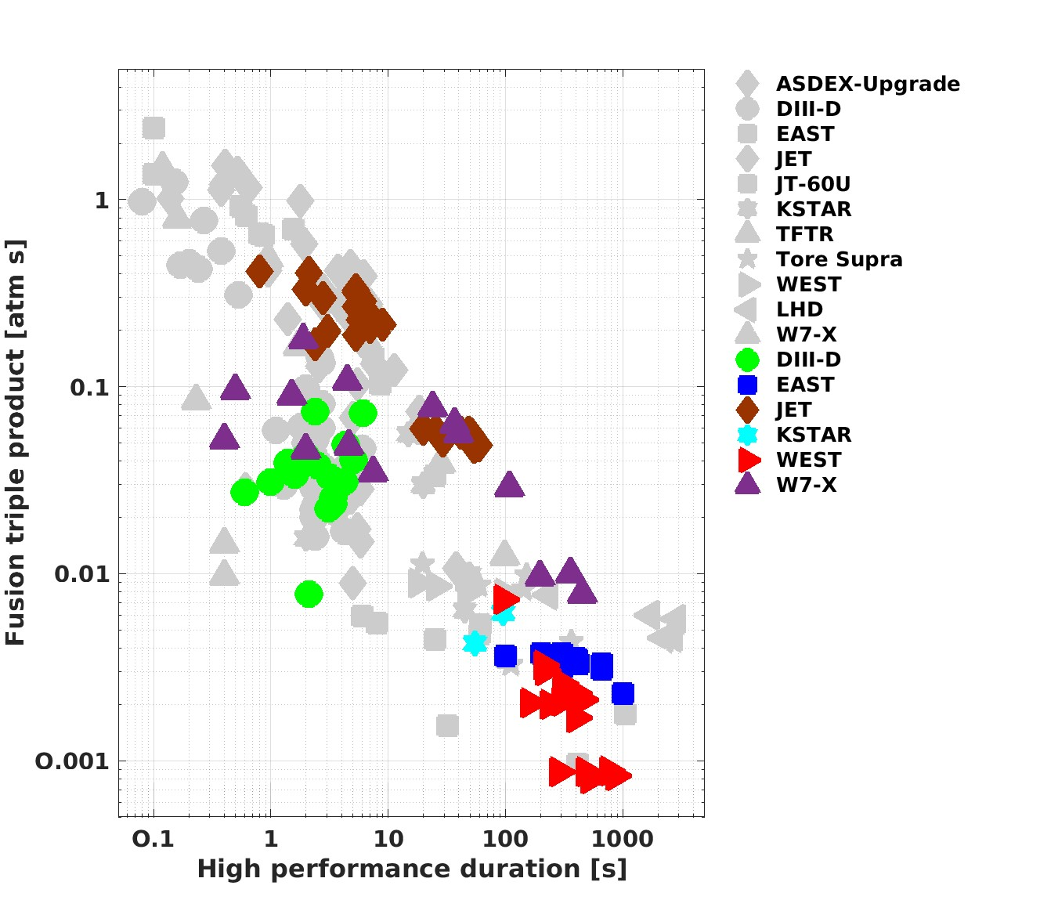
Summary of recent CICLOP activity (X. Litaudon, E. Lerche et al)
Good progress at constant performance
JET & W7X:
High performance up 60-100s
EAST & WEST:
t~1000s but low performance

