Slide 1
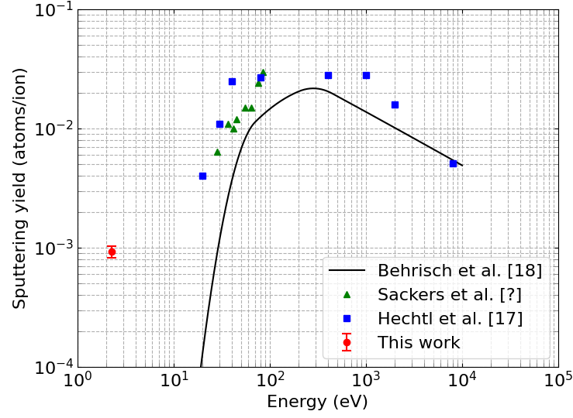
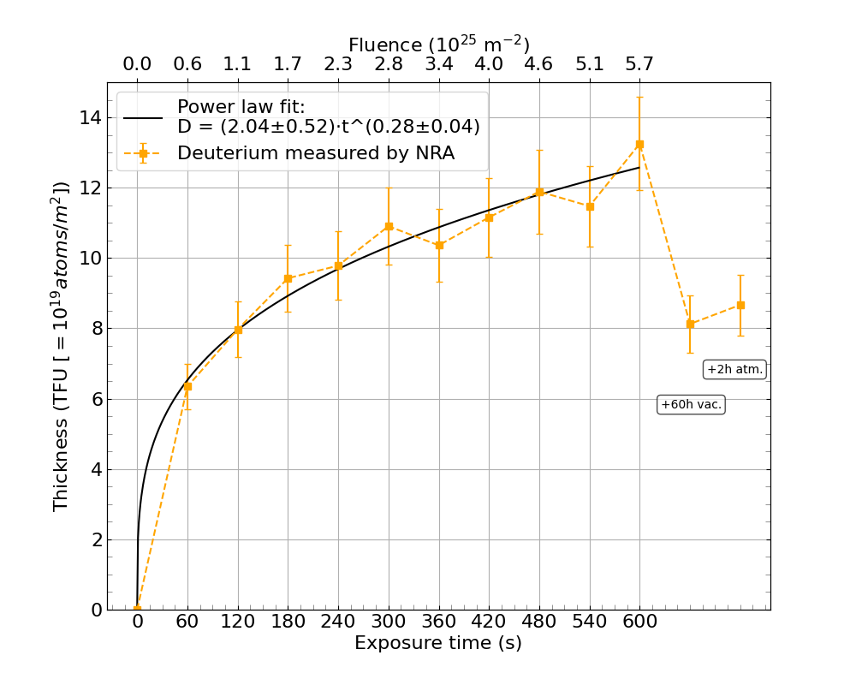
DIFFER SPB/SPC activities: Chemical erosion and retention
2025 summary
Sputtering yield of 9.22×10⁻⁴ atoms/ion at an ion energy of 2.26 eV, below the physical sputtering limit of ≈10 eV, chemical erosion is observed
First in situ deuterium retention measurements in boron show low (D/B ≈0.007) retention with a power law dependency: D[B] ≈ fluence^{𝟎.𝟑} and strong outgassing
2026+ activities
Measure sputtering yield as a function of energy (<60 eV)
Chemical erosion/retention as a function of temperature
Chemical erosion/retention as a function of deposition method
(Tokamak GD, MS, PLD, PG-PLD)
Effect of oxygen and deuterium concentration on (chemical) erosion and retention

Slide 2
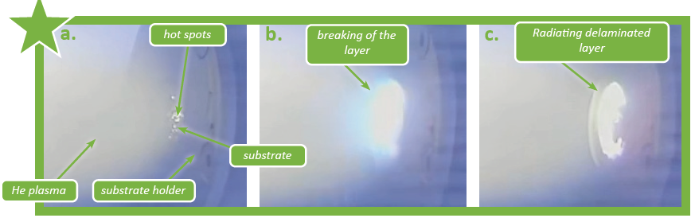
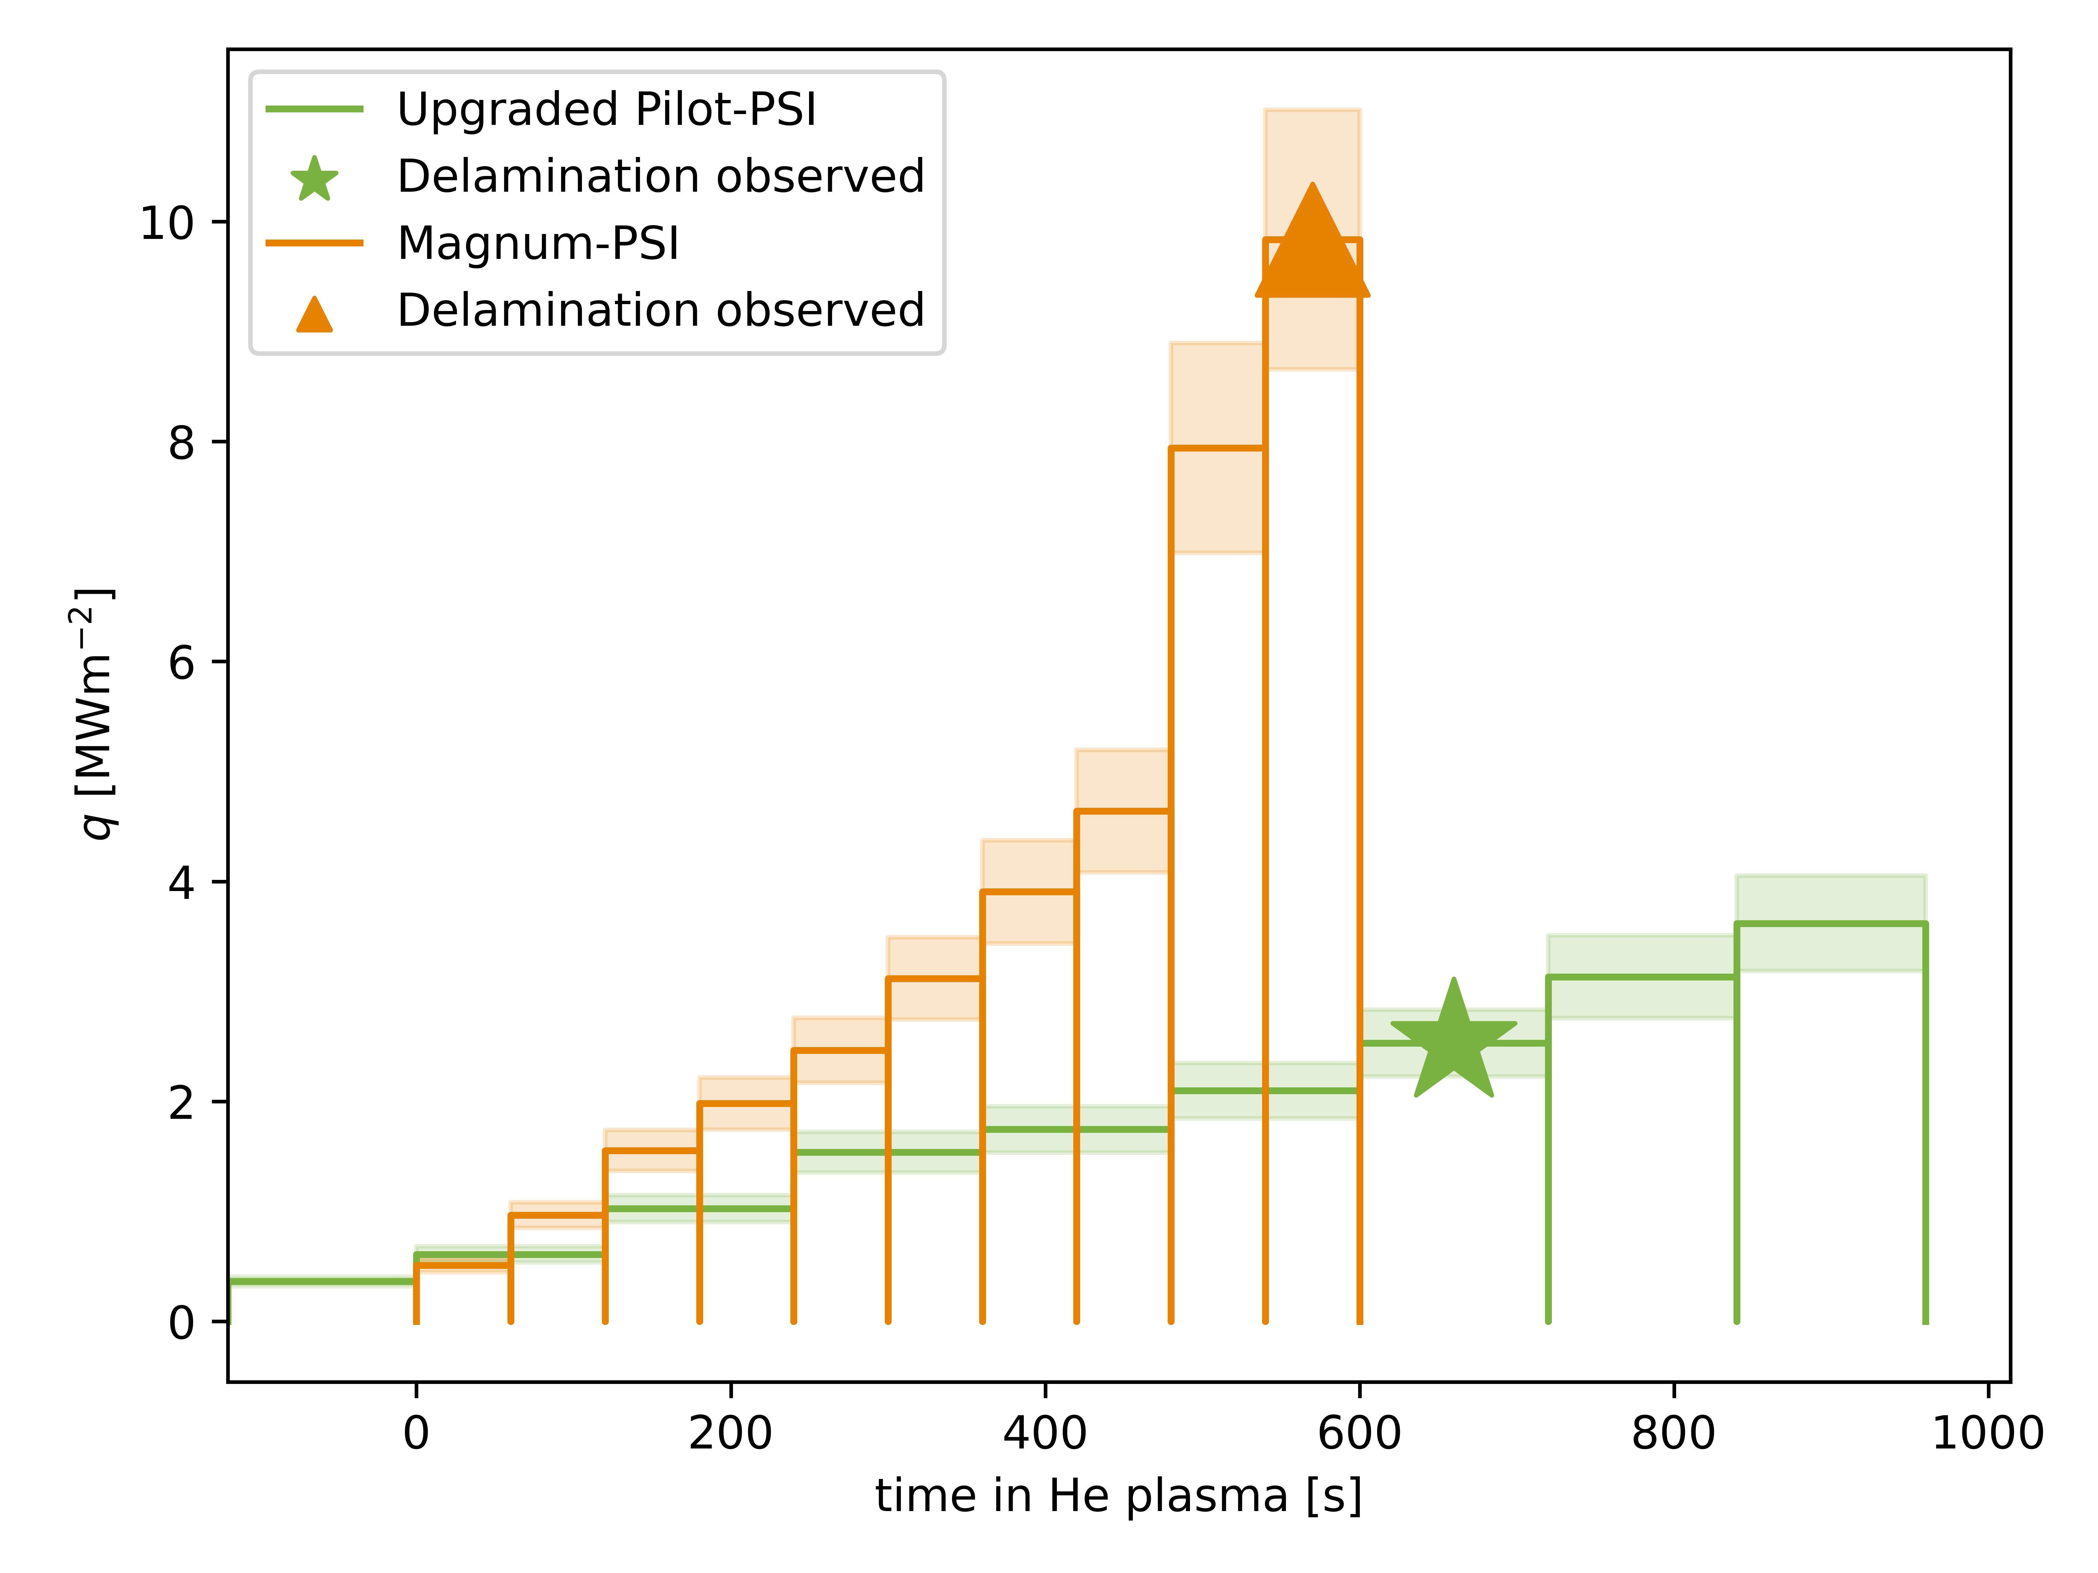
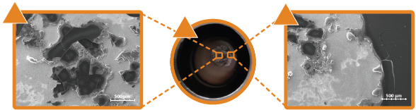
DIFFER SPB activities: Growth and stability of thick boron layers
Results so far
Goal: evaluate stability and properties of thick (co-) deposits of B (+O,+D,+W)
Succesful He PG-PLD growth in UPP producing compositionally relevant boron layers at an accelerated growth rate compared to ITER and magnetron grown layers
UPP and Magnum-PSI plasma exposures on PG-PLD layers and lab grown (HiPIMS) up to 10 MW/m²
Layers on smooth surfaces can be delaminated, while layers on rough substrates are stable for all conditions tested
2026+:
Stability assessment to transients
Assess stability as function of composition, layer thickness, growth speed, and roughness

Slide 3
Sample needs: erosion/retention
Goal | # | Target | Method | By | Status
Effect of oxygen at.% on chemical erosion of boron | 18 18 | 1 um BO on Si 1 um BO on W | HiPIMS | IAP | In production
Effect of deuterium at. % on chemical erosion of boron | 10 | 100-200 nm B:D on Si | MS | Basel | In testing
Chemical erosion and deuterium retention as a function of B deposition method | 6 2 | Au coated 100 nm B on W Non-coated 100 nm B on W | WEST boronization | WEST | Delivered
 | 6 | 100 nm B on W | DIII-D boronization | DIII-D | In process
 | 100 | 200 nm B on Si | DC MS | DIFFER | Delivered
 | n.a. | B on chosen substrate | PG-PLD | DIFFER | n.a.
 | - | B on Si | PLD | Milano | Not yet discussed

Slide 4
Sample needs: stability thick layers
Goal | # | Target | Method | By | Status
Testing the stability of thick boron layers with various D:B:W composition | n.a. | Variable D:B:W, few um thick | PG-PLD | DIFFER | n.a.
Testing the stability of thick boron layers with various D:B:W composition | 7x? | variable D:B:W, few um thick | HiPIMS | IAP | In production
Goal | Sample set label | D ratio | B ratio | W ratio
effect of D concentration in mixed layers | 1 | 0 | 1 | 1
 | 2 | 1 | 3 | 3
 | 3 | 1 | 2 | 2
 | 4 | 1 | 1 | 1
effect of W concentration in mixed layers | 5 | 2 | 2 | 1
 | 6 | 1 | 1 | 2
 | 7 | 1 | 1 | 3

