Slide 1
Update on quasilinear modelling in W7-X and H-J
Lorenz Brössner, MJ Pueschel, Paul Mulholland
DIFFER
13/07/2026

Slide 2
KBM basics
Kinetic ballooning modes are pressure gradient driven instabilities in regions of bad curvature
Favoured when field-line bending cannot fully stabilize the pressure drive
Sets limit to achievable $β$
Sets limit to achievable 𝛽

Slide 3
stKBMs as context of this work
stKBM: subthreshold kinetic ballooning mode
Nonlinear process setting heat flux, presumably not included in standard QL models
Can we capture transport with quasilinear models in low shear stellarators such as W7-X and H-J?
stKBM : likely reason why we cannot in W7-X at high $β$ [Mulholland 2025]
stKBM : likely reason why we cannot in W7-X at high 𝛽 [Mulholland 2025]
This work: Use quasilinear models for stellarator configurations to check if they break down where stKBMs become relevant

Slide 4
Quasilinear transport model
Eigenmodes determine the quasilinear transport
For each $k_{y}$there are many eigenmodes in stellarators
For each 𝑘_𝑦 there are many eigenmodes in stellarators
$$Q_{ql}=ω_{T}\sum_{k_{y},j}{c(k_{y}) \frac{{γ(j,k_{y})w}_{ }(j,k_{y})}{\left\langle \left.{{k_{⊥}(j,k_{y})}_{ }}^{2}\right\rangle \right.}}$$
𝑄_𝑞𝑙=𝜔_𝑇 ∑_(𝑘_𝑦,𝑗)▒〖𝑐(𝑘_𝑦) (〖𝛾(𝑗,𝑘_𝑦)𝑤〗_ (𝑗,𝑘_𝑦))/⟨├ 〖〖𝑘_⊥ (𝑗,𝑘_𝑦)〗_ 〗^2 ⟩┤ 〗
$ω_{T}$: temperature gradient –a($∇T)/T$
𝜔_𝑇: temperature gradient –a(∇𝑇)/𝑇
$γ(j,k_{y})$ : growth rate of mode j
𝛾(𝑗,𝑘_𝑦) : growth rate of mode j
${w(j,k_{y})}_{ }$: quasilinear weight (includes $Φ×T$phase)
〖𝑤(𝑗,𝑘_𝑦)〗_ : quasilinear weight (includes Φ×𝑇 phase)
$\left\langle \left.{{k_{⊥}(j,k_{y})}_{ }}^{2}\right\rangle \right.$: weighted ballooning angle average of $k_{⊥}:$ $\int_{−3π}^{3π}{ {k_{⊥}}^{2}Φ^{2}dθ/\int_{−3π}^{3π}{ Φ^{2}dθ}}$
⟨├ 〖〖𝑘_⊥ (𝑗,𝑘_𝑦)〗_ 〗^2 ⟩┤: weighted ballooning angle average of 𝑘_⊥: ∫_(−3𝜋)^3𝜋▒〖 〖𝑘_⊥〗^2 Φ^2 𝑑𝜃/∫_(−3𝜋)^3𝜋▒〖 Φ^2 𝑑𝜃〗〗
$c(k_{y})$: model parameter
𝑐(𝑘_𝑦): model parameter

Slide 5
Initial- vs eigenvalue run on GENE
$$Q_{ql}=ω_{T}\sum_{k_{y},j}{c(k_{y}) \frac{{γ(j,k_{y})w}_{ }(j,k_{y})}{\left\langle \left.{{k_{⊥}(j,k_{y})}_{ }}^{2}\right\rangle \right.}}$$
𝑄_𝑞𝑙=𝜔_𝑇 ∑_(𝑘_𝑦,𝑗)▒〖𝑐(𝑘_𝑦) (〖𝛾(𝑗,𝑘_𝑦)𝑤〗_ (𝑗,𝑘_𝑦))/⟨├ 〖〖𝑘_⊥ (𝑗,𝑘_𝑦)〗_ 〗^2 ⟩┤ 〗
Initial value runs:
Only dominant $γ(k_{y})$, w$(k_{y})$, $\left\langle \left.{{k_{⊥}(k_{y})}_{ }}^{2}\right\rangle \right.$ for each $k_{y}$
Only dominant 𝛾(𝑘_𝑦), w(𝑘_𝑦), ⟨├ 〖〖𝑘_⊥ (𝑘_𝑦)〗_ 〗^2 ⟩┤ for each 𝑘_𝑦
Limited to fastest growing structure
Computationally cheap
Eigenvalue runs:
Specified number of eigenmodes results in spectrum of $γ\left(j,k_{y}\right),w(j,k_{y})$, $\left\langle \left.{{k_{⊥}(j,k_{y})}_{ }}^{2}\right\rangle \right.$
Specified number of eigenmodes results in spectrum of 𝛾(𝑗,𝑘_𝑦 ),𝑤(𝑗,𝑘_𝑦), ⟨├ 〖〖𝑘_⊥ (𝑗,𝑘_𝑦)〗_ 〗^2 ⟩┤
Includes subdominant modes
More complete picture, but computationally more expensive (smaller range of $k_{y}$)
More complete picture, but computationally more expensive (smaller range of 𝑘_𝑦)

Slide 6
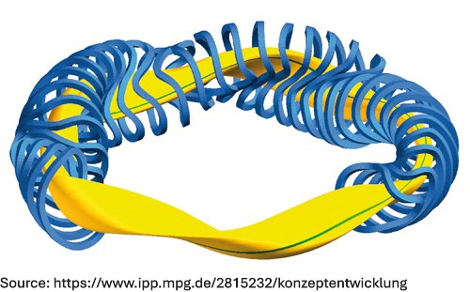
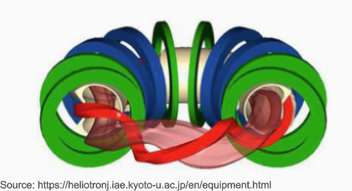
Device configurations considered
W7X – configurations: KJM, DKH, DKM, DKS
KJM: high mirror ratio; iMHD-optimized
D: low mirror ratio
K: standard rotational transform
H/M/S: horizontal plasma position shifted outward/not/inward leading to lower/normal/higher magnitude of magnetic shear
H-J-configurations: ST, HB
ST: standard
HB: high bumpiness (strong toroidal ripple); higher mirror ratio

Slide 7
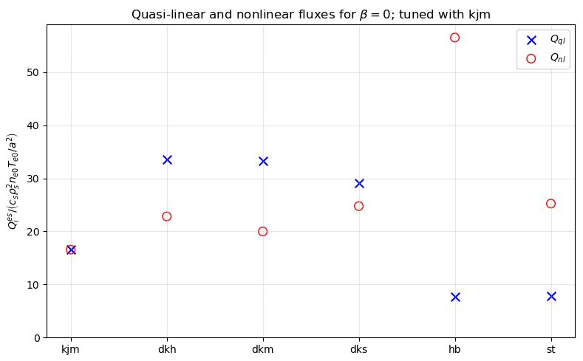

Initial value runs at $β=0$
Quasi-linear model tuned to KJM-configuration gives correct order of magnitude but of the flux for the other W7-X configurations
Poor fit for H-J configurations

Slide 8
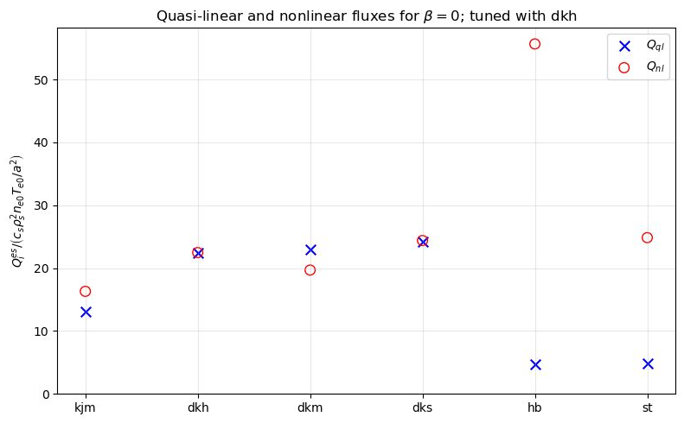
Initial value runs at $β=0$
Quasi-linear model tuned to DKH configuration has a better fitter for other DK configurations
More similar configuration; mirror ratio

Slide 9
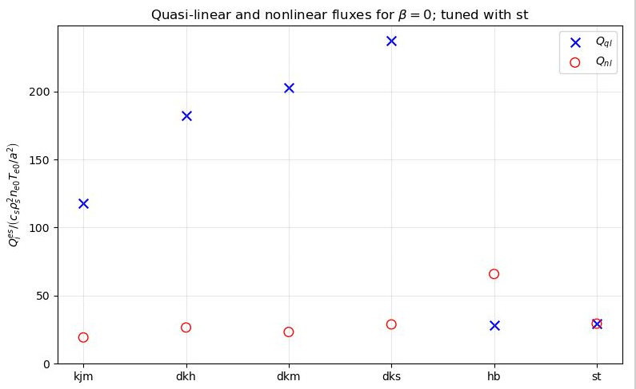
Initial value runs at $β=0$
Quasi-linear model tuned to st-configuration gives moderate prediction of the flux for the hb configuration
Very poor fit for W7-X configurations

Slide 10

Initial value runs at $β=0:$ Conclusions
Transport in stellarators is strongly dependent on device geometry and configuration
Mirror ratio may be equally as important as magnetic shear magnitude in determining QL reliability
Standard QL model breaks when used across different stellarators

Slide 11
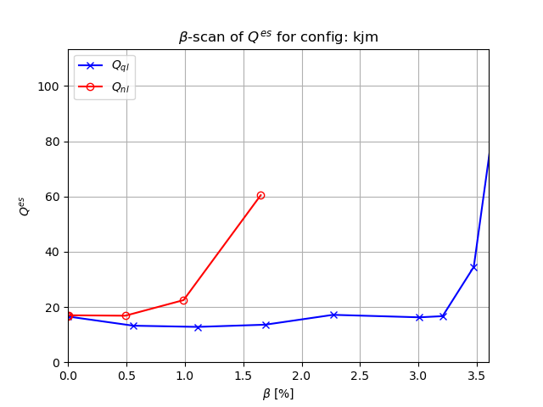
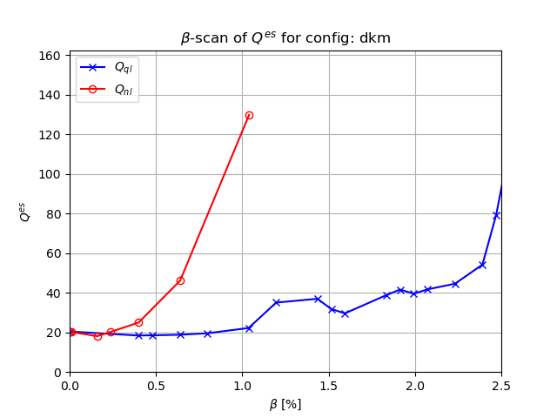

Initial value runs: $β$-scans for W7-X
High mirror ratio, iMHD-optimized
Low mirror ratio; medium shear

Slide 12
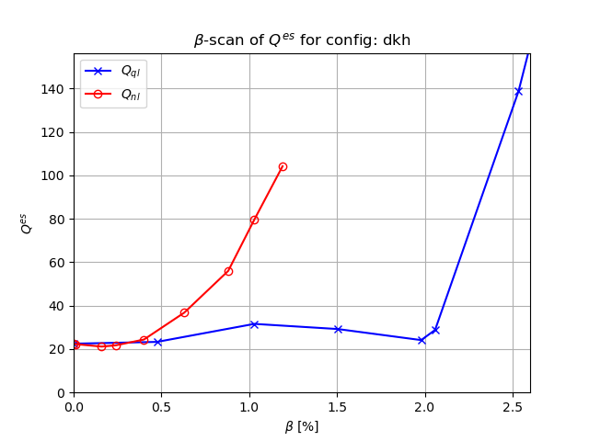
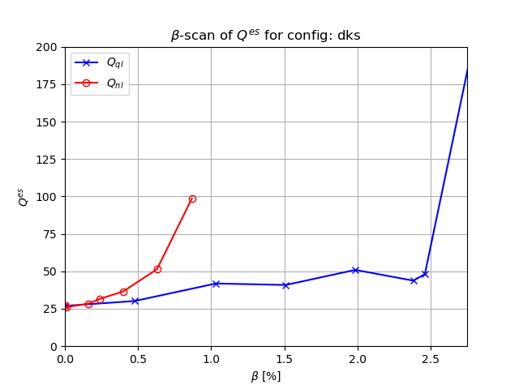
Initial value runs: $β$-scans for W7-X
Low mirror ratio; low shear
Low mirror ratio; high shear

Slide 13
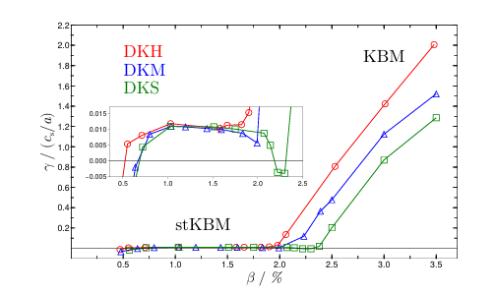

Initial value runs: $β$-scans for W7-X Conclusions
BUT: Acceptable predictive capabilities of this QL-model for W7-X at most up to $β≈0.5\%$
BUT: Acceptable predictive capabilities of this QL-model for W7-X at most up to 𝛽≈0.5%
Better fit for low shear configuration
Agrees well with stKBM threshold, compare Mulholland, submitted to NF
Qualitatively quasilinear models capture fluxes correctly

Slide 14
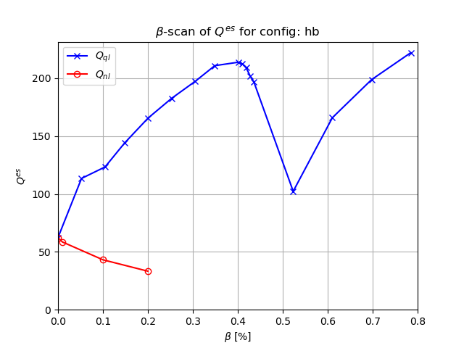

Initial value runs: $β$-scans for H-J
Clearly nonlinearly dominated flux: enhancement of zonal flows with $β$
Clearly nonlinearly dominated flux: enhancement of zonal flows with 𝛽
Opposite result to W7-X configurations
Not just stKBM but also other nonlinear effects can break quasilinear models

Slide 15
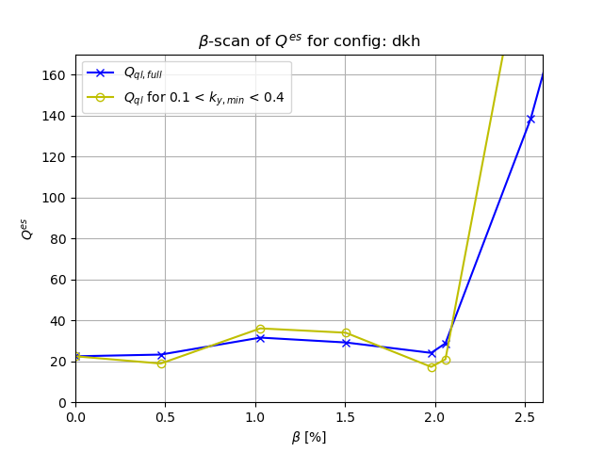
Moving towards eigenvalue runs
Most flux at small ky: do eigenvalue runs in this part of the spectrum

Slide 16
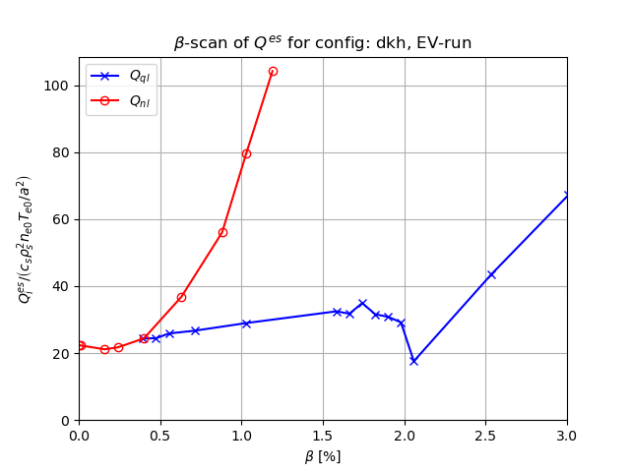
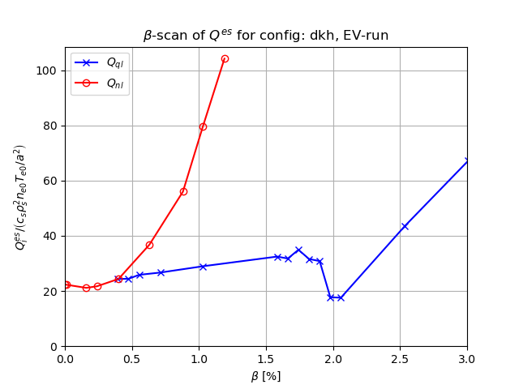

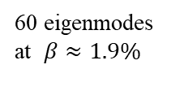
Work in progress: Quasilinear model for EV-runs
60 eigenmodes at $β≈1.9\%$
Calculated flux is sensitive to exact eigenmode spectrum
Subdominant modes are crucial!
40 eigenmodes at $β≈1.9\%$

Slide 17
Summary
Across W7-X configurations QL models may be acceptable though not to great precision
Across H-J configurations and across machines standard QL modelling is not valid
Confirming stKBM story: high $β$ is not captured by QL models
Confirming stKBM story: high 𝛽 is not captured by QL models
This work: still finish EV-model; possibly add KEY data
Longer term: see whether triplet correlation time can fix QL models

Slide 18
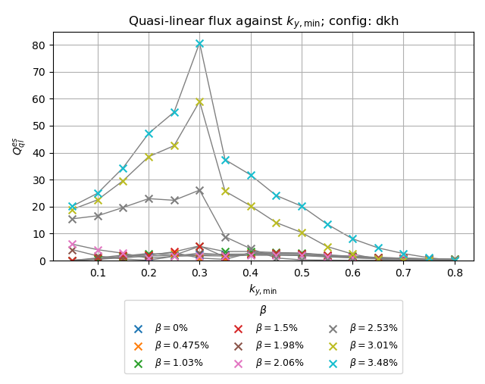
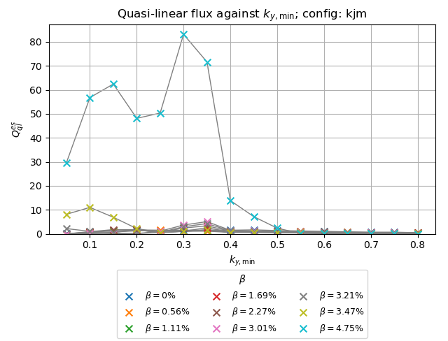
Scan over ky at different betas

