Slide 1
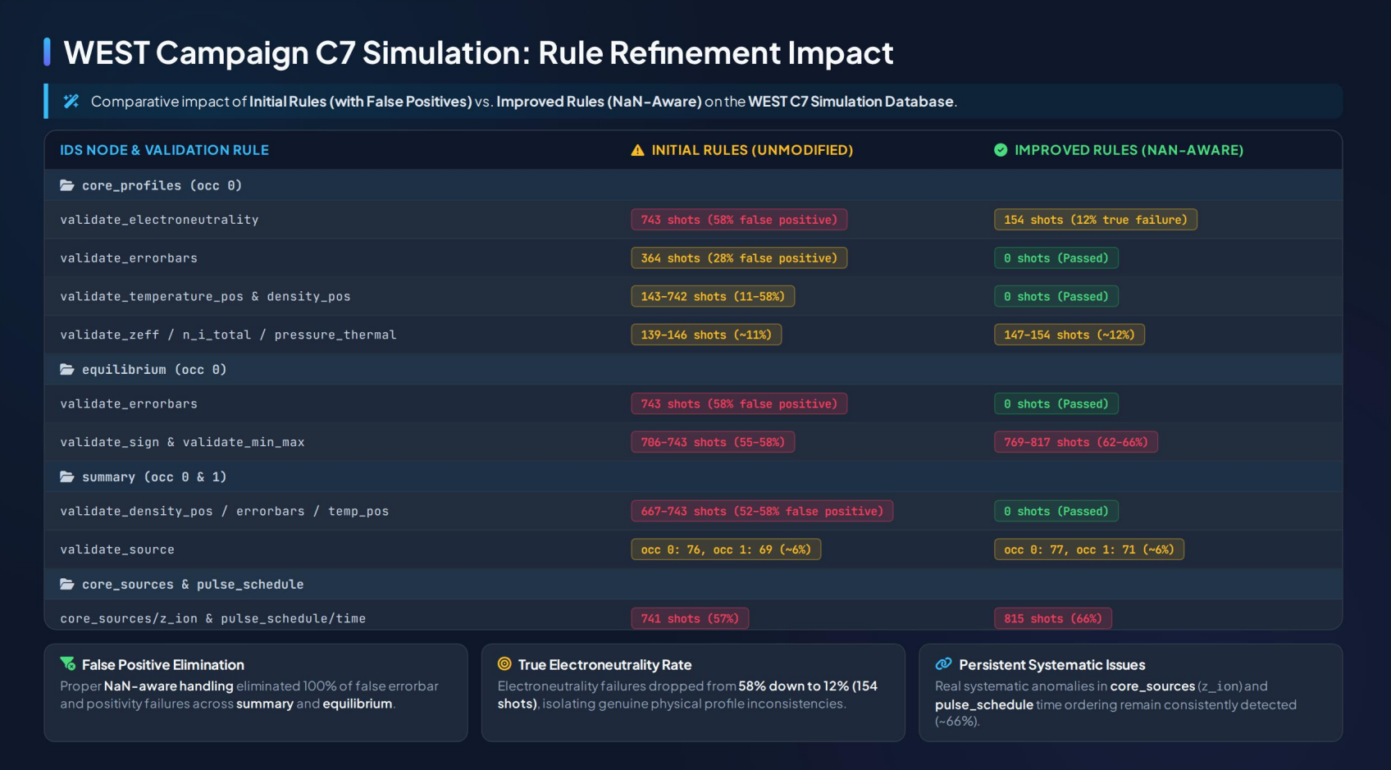
))

Slide 2
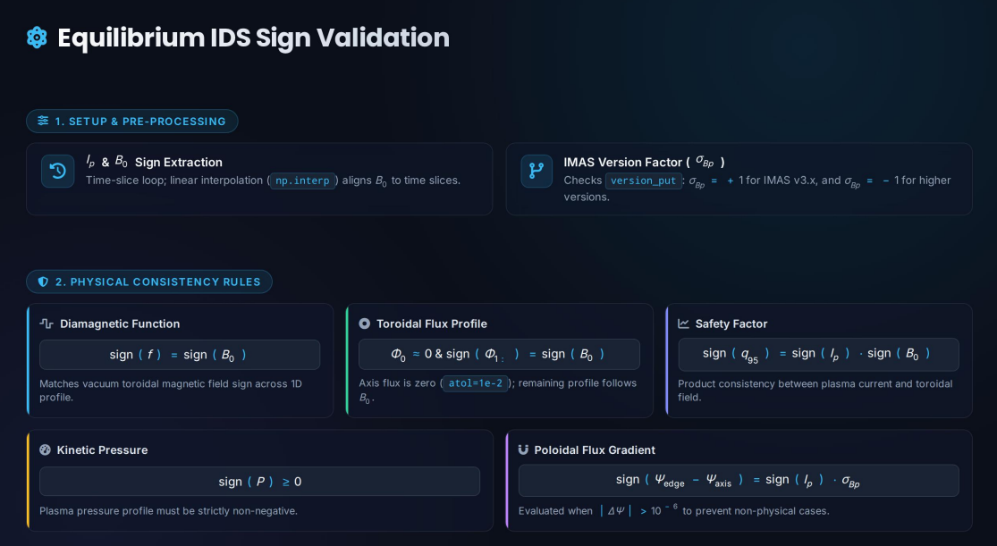
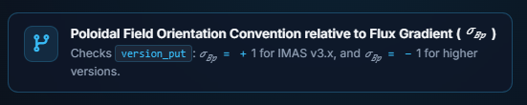

Slide 4

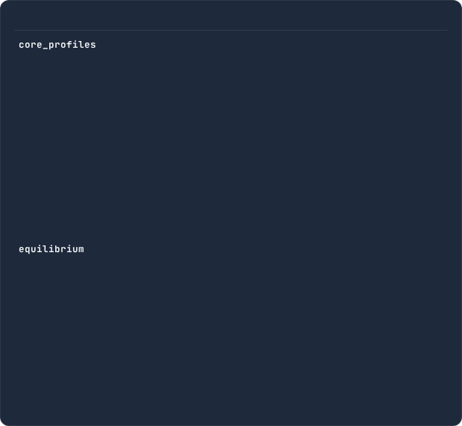
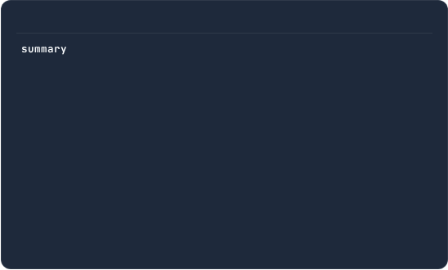
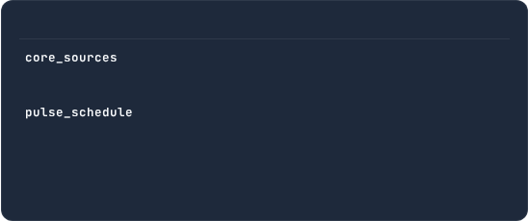
WEST Campaign C7 (Simulation) using initial validation rules
Global summary of unsatisfied validation rules for WEST C7 Experimental pulses showing impacted shots per occurrence.
Profiles and Equilibrium
Summary
(occ 0)
(occ 0 to 1)
validate_electroneutrality
validate_errorbars
validate_errorbars
validate_temperature_positive
validate_zeff
validate_density_positive
validate_n_i_total_over_n_e
validate_source
validate_pressure_thermal_electron...
validate_increasing_time
validate_temperature_positive
validate_z_ion
validate_density_positive
(occ 0)
validate_errorbars
Other
validate_min_max
(occ 0)
validate_sign
validate_z_ion
(occ 0)
validate_increasing_time
1290 analyzed shots
(135 analysis have timed out)

Slide 5

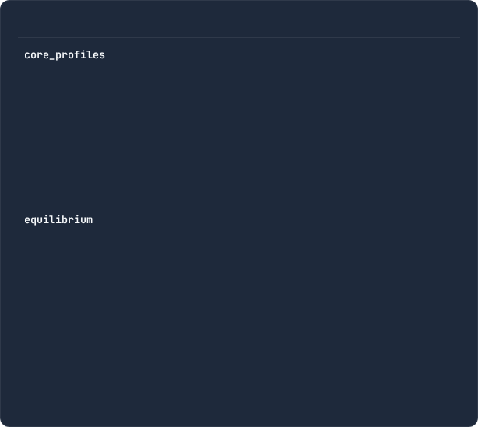
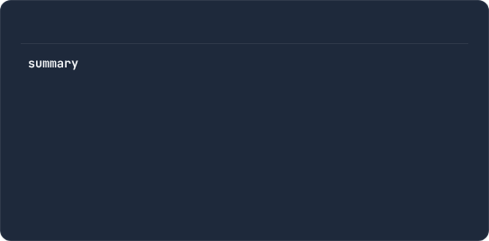
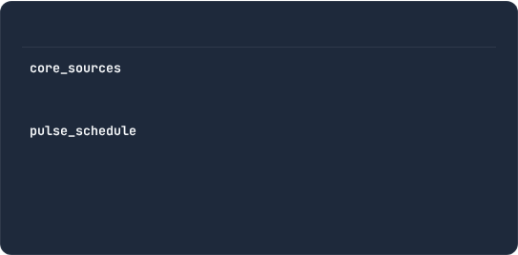
WEST Campaign C7 (Simulation) using patched validation rules
Global summary of unsatisfied validation rules for WEST C7 Simulation runs showing impacted shots per occurrence.
Profiles and Equilibrium
Summary
(occ 0)
(occ 0 to 1)
validate_electroneutrality
validate_source
validate_n_i_total_over_n_e
validate_increasing_time
validate_pressure_thermal_electron...
validate_z_ion
validate_zeff
(occ 0)
validate_sign
Other
validate_min_max
(occ 0)
validate_z_ion
(occ 0)
validate_increasing_time
1235 analyzed shots
(191 analysis have timed out)

