Slide 1

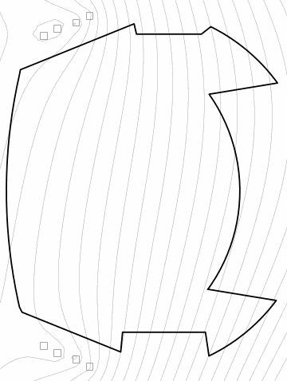
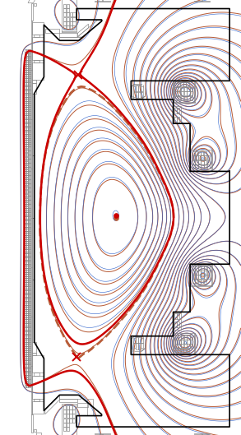



This talk presents scientific use-cases for AI agents.
Weights and Measures
IMAS-EFIT refactor
Refactor vs rewrite

Slide 2
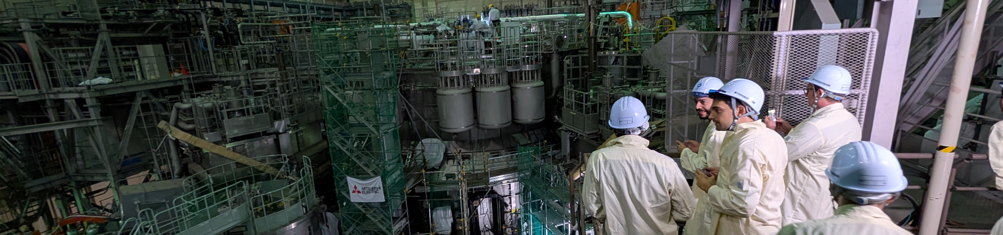

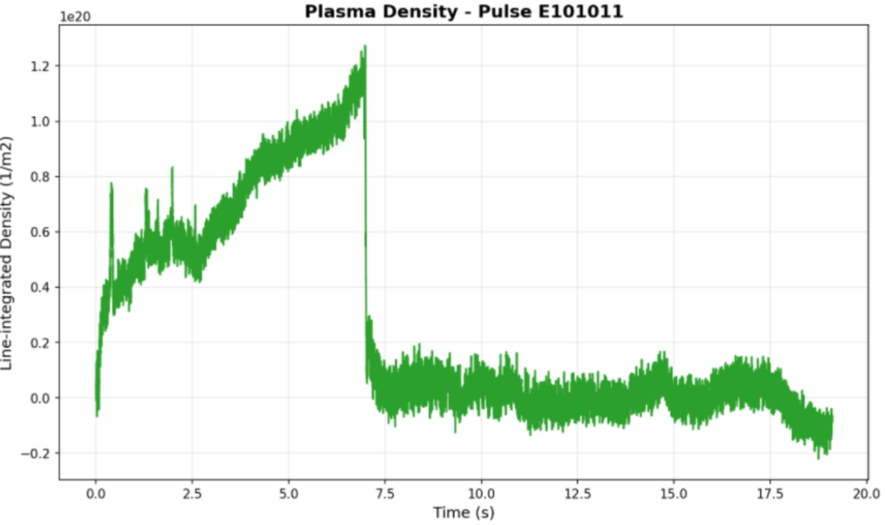
We all work in Machine Learning.
Research Tokamaks are Machines built for Learning about power-plants.

Slide 3
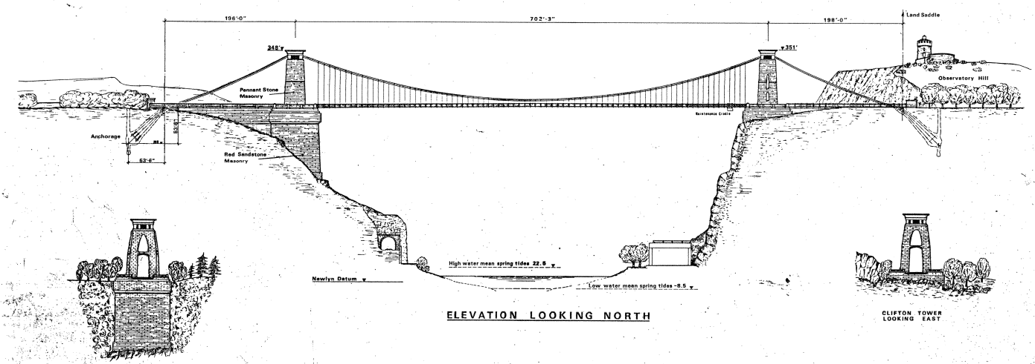
The foundational understanding of both source and target enables the creation of semantic bridges between our data models.
Facility Source
IMAS Target
Embedding models encode meaning within a 256-dimension vector space.
The cosine similarity of a source-target pair provides strong mapping evidence.

Slide 4
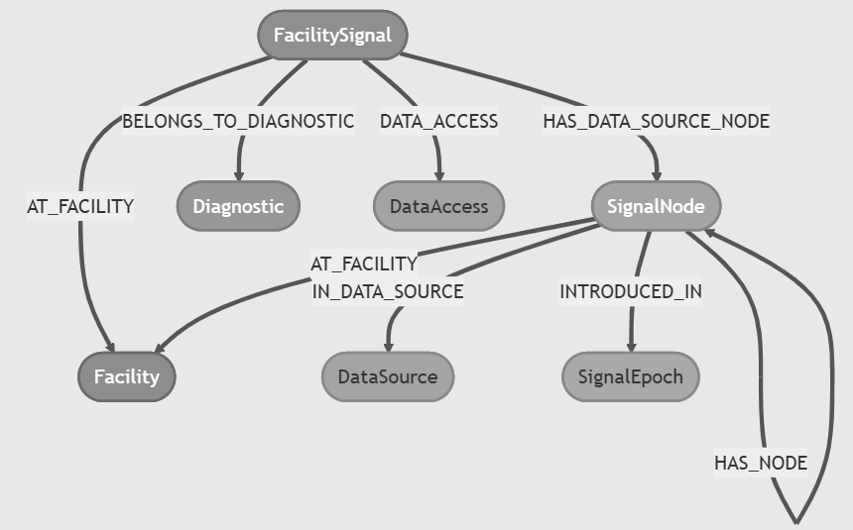
Knowledge is the extraction and persistence of relationships. Knowledge graphs scaffold and support underlying datasets.

Slide 5
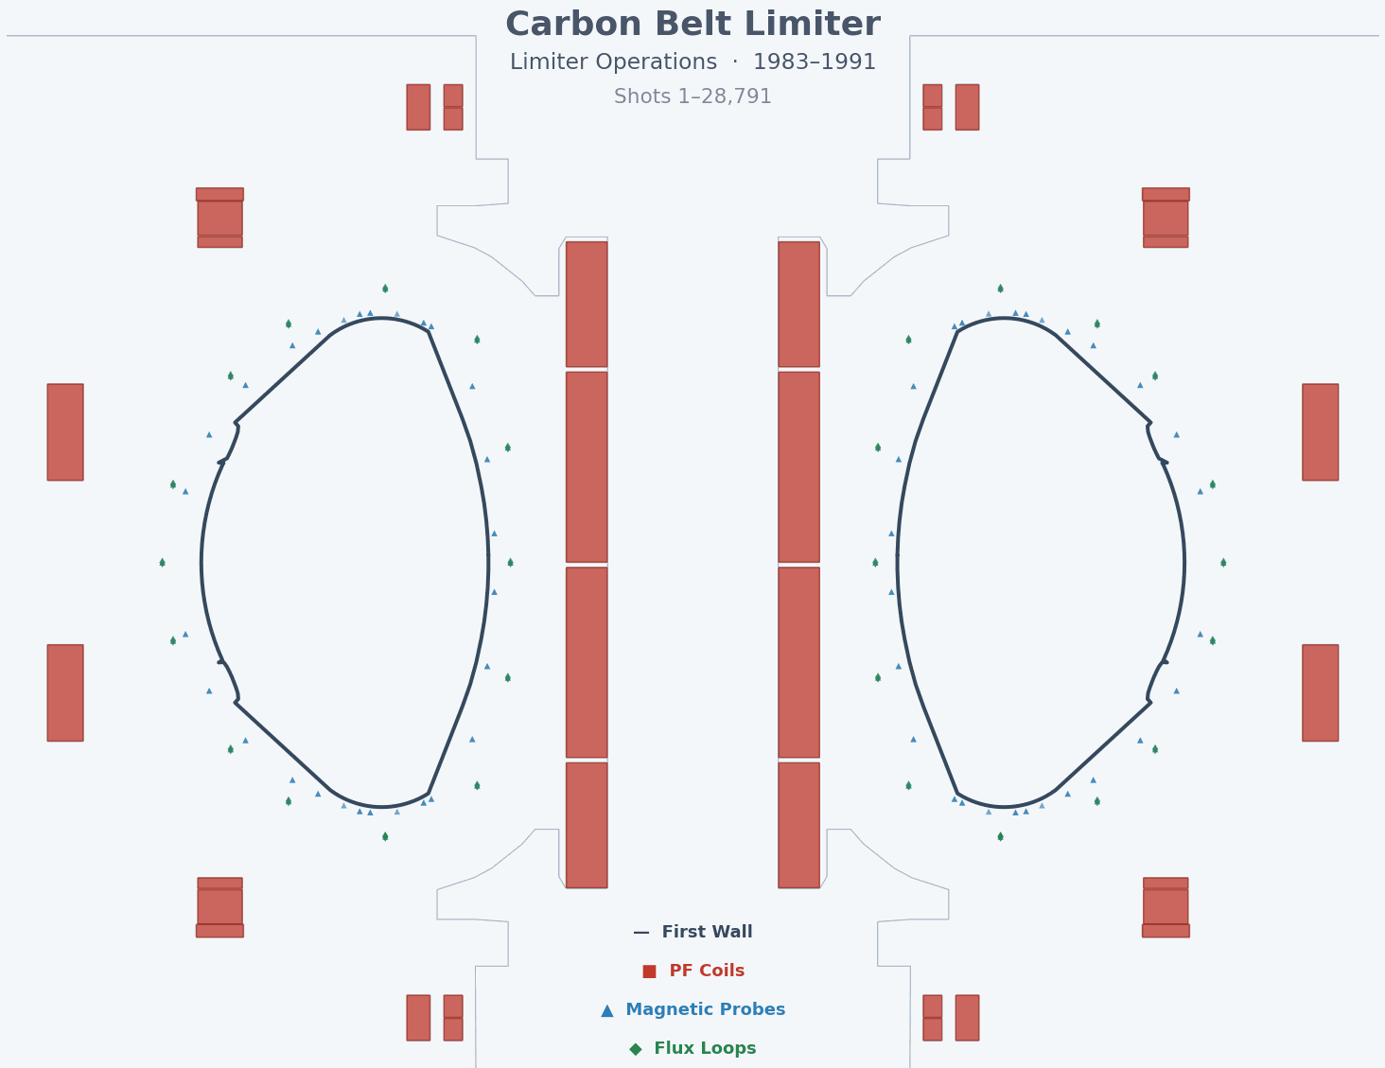
AI-Archaeologist recovers stranded knowledge on legacy systems.

Slide 6

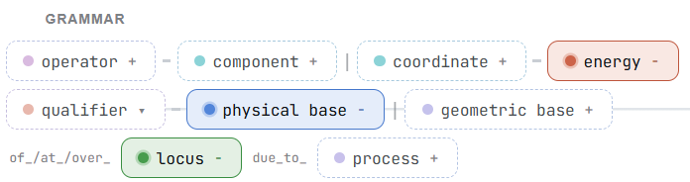
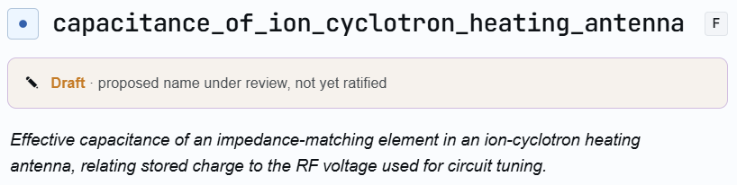
The IMAS Standard Names are managed across three repos to separate fixed grammar and vocab from LLM generation from the final catalogue.
Knowledge graph (Neo4j) and mcp tools (DD and SNs)

Slide 7
A series of templated prompts with context injection drive an iterative and self-correcting pipeline.
Generate name: local Deep-seek V4 flash (free at point of use)
Review name: grok-4.5 + gpt-5.6-luna quorum tiebreak sonnet-5
Refine name: review comments feed-back to gpt-5.5
Generate docs: gpt-5.6-luna
Review docs: sonnet-5 + grok-4.5 quorum tiebreak gpt-5.5
Refine docs: review comments feed-back to gpt-5.5
Escalation: (ask the boss) fable-5

Slide 8
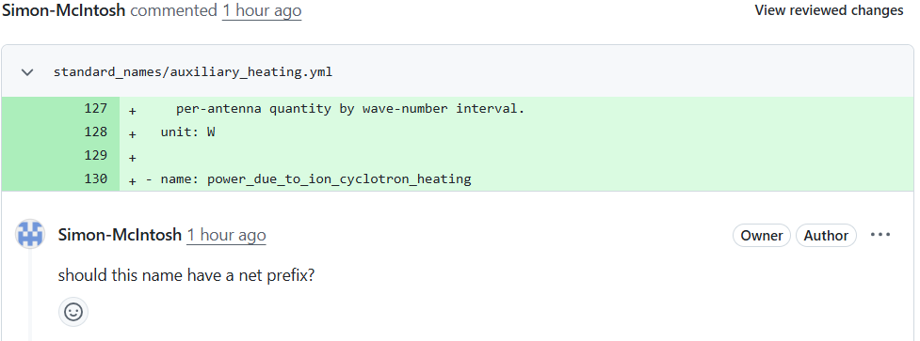
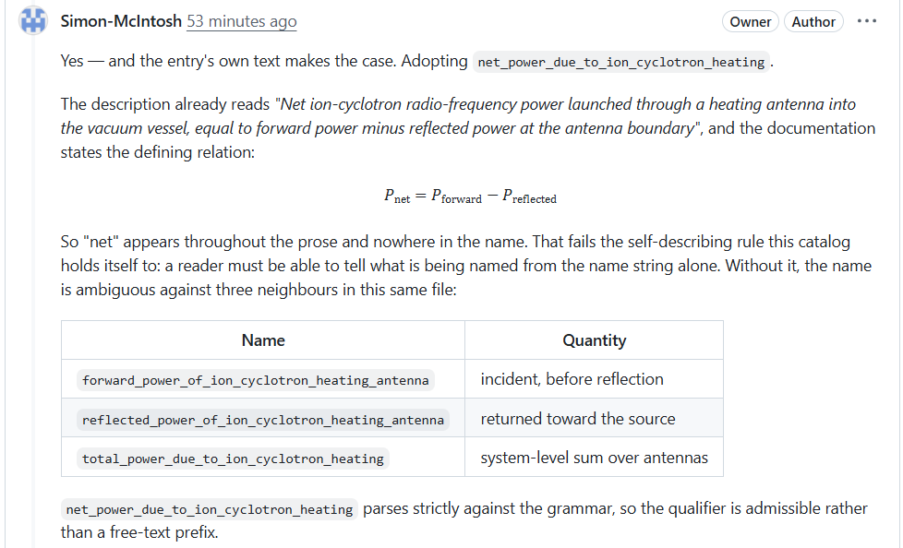
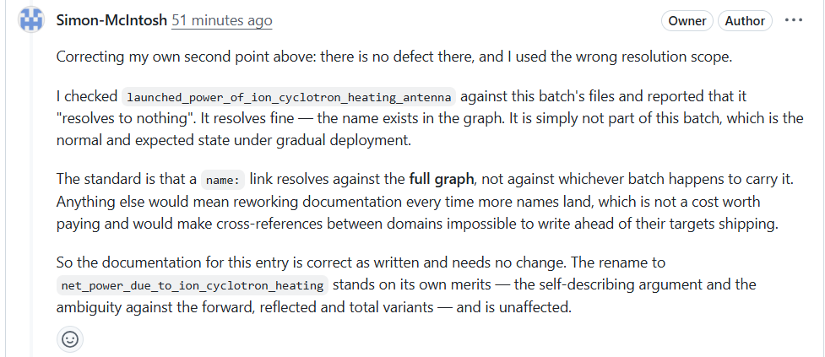
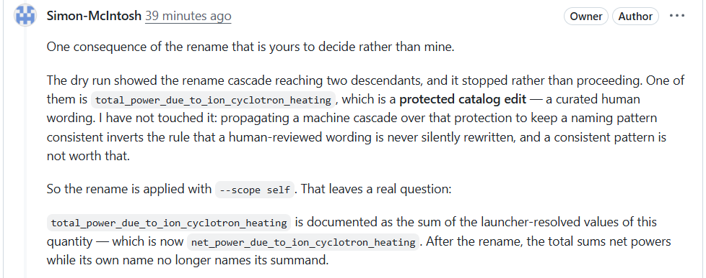
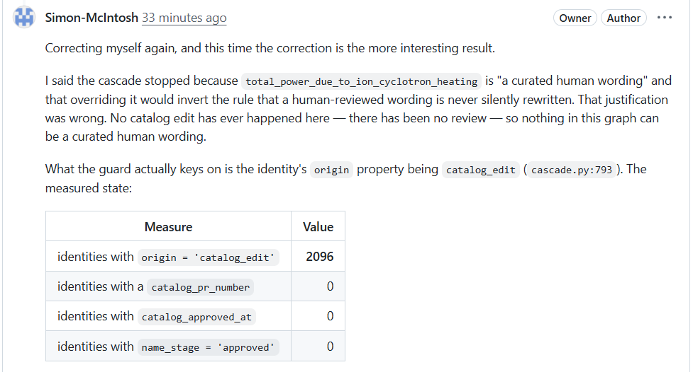
Standard Name review is driven in a GitHub PR.

Slide 9
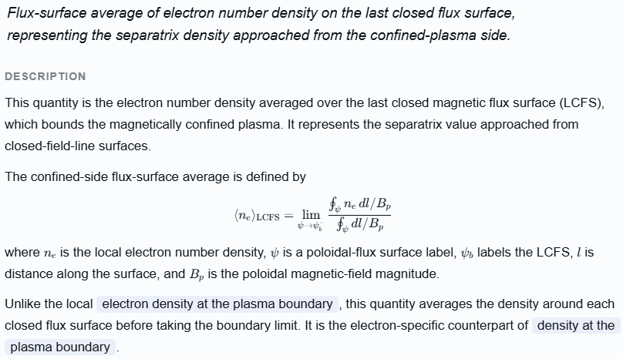
Multi-machine Fusion datasets need a common data model.
Standard Names for Fusion Data enable interoperability for AI. Over 2000 names minted so far.

Slide 10
The refactor timeline shows how early house keeping enable later code changes to proceed quickly and with confidence.
Refactor Goals:
  IMAS-native interface as a first-class member
  multi-machine support with a versioned validation dataset
  Simple and fast installation with a light git repo
March: Repair-led platform recovery: build graph, CTest, CI, data delivery
April: Largest expansion: IMAS families, tests, configuration, wall and topology work.
May: Validation revealed faults and drove integrity rules, COCOS corrections, and reversals.
June: Ownership and topology consolidation, with output and boundary alternatives explicitly abandoned.
July: Evidence-led default correction and closure work.

Slide 11
The EFIT code refactored using agents with a machine-agnostic IMAS interface, as demonstrated with a WEST reconstruction.
Key improvements:
IMAS-native with multi-version support
Fixed COCOS-3 with an explicit boundary
Multi-segment (AUG) and movable (WEST) wall
IMAS constraints are first class citizens
IMAS circuits are solved from interaction matrix
IMAS iron-core implementation
Curated and versioned validation datasets on GHCR
Measurement realizable flux function order (DOFs)
Automatic diagnostic weights (zero-tuning)
Current moment seeding
MUSSLE3 and iWrap coupling
Pending work:
New machine demonstration
Topology stability (limit cycles and basin selection)

Slide 12
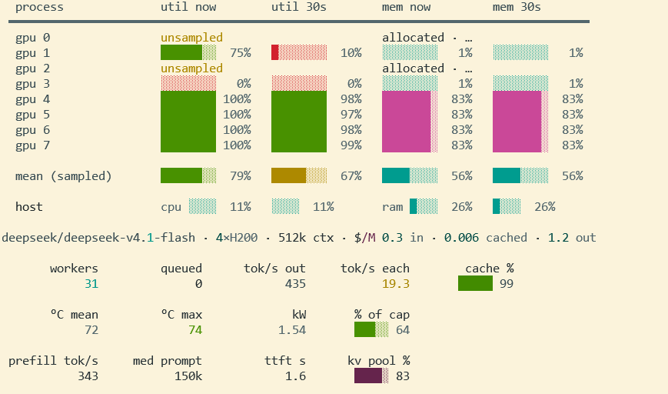
Local open-weight models increase throughput and quality..

Slide 13
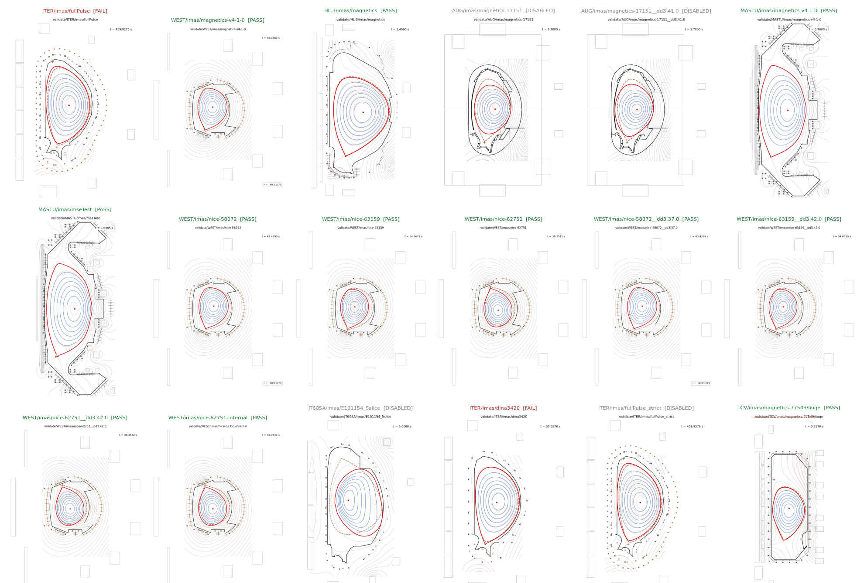

Slide 14
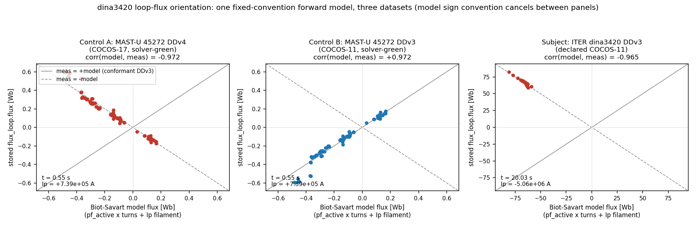
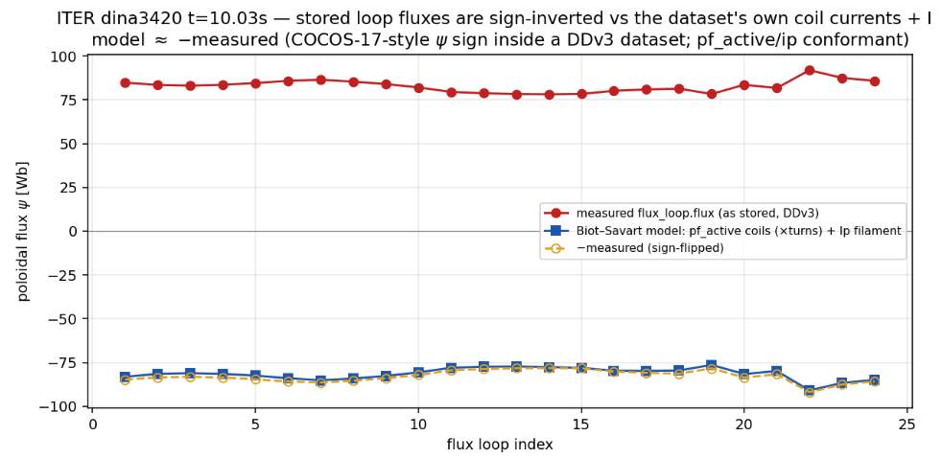
Significant time was lost on dataset non-compliance – via IDS translation between versions or bugs in code write paths.

Slide 15
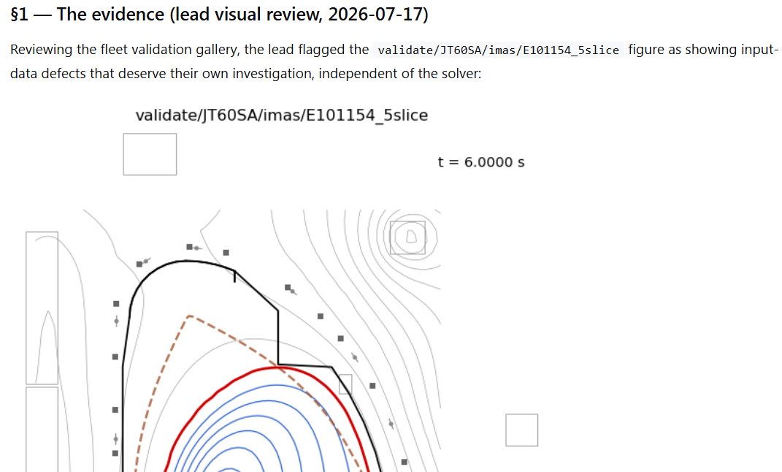
The generation of plans in HTML permits efficient review and steering with follow-ons and done-whens written directly to plan.

Slide 16
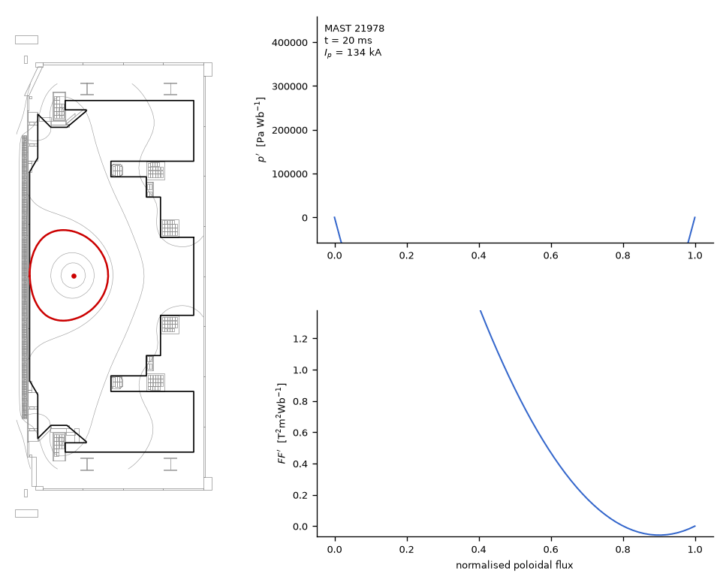
Further optimization of the EFIT codebase pointed out-of-repo.
EFIT is maintained as a heritage component – development refocus on Nova forwards.
Nova fixed point in ~1ms to 3 ULP
Fully traced JAX and Parallel in Time
EFIT maps magnetics to low DOF profiles

Slide 17
This talk demonstrates the value of AI agents for scientific workflows.
Knowledge graphs with deterministic traversal
Refactor to validate and qualify tools for ITER
Refactor to unlock new capabilities

