Slide 1

Code Management Area
Monitoring Meeting 2026
Area Coordinator: Gloria Falchetto
CEA/IRFM

Slide 2
WPSA Code Management Area
https://wiki.euro-fusion.org/wiki/WPSA:_Code_Management_and_Simulation
Scope
Develop and verify a suite of tools and codes for the Scientific Exploitation of JT-60SA, including operation-oriented tools (control-room analysis, control tools),
synthetic diagnostics (implemented under ENH), simulation workflows preparing the subsequent validation or benchmarking within Exp. Team (WPTE)
Out of scope: exploitation (use for analysis or experiment design by a non-developer)
Objectives in 2026
Training for users on :
Pulse Design Simulator July in Naka; December in Cadarache tbd
EC waves tools
ATEP (Advanced Transport workflow for Energetic Particles)
MHD stability chain (sensitivity of the MHD unstable spectra to variations on the q-profile)

Slide 3
WPSA CM Tasks and deliverables 2026
Deliverable ID | Deliverable title | Deliverable Description | Deliverable Owner | Benef. | PM
SA-SE.CM.OP.01-T009-D001 | PDS optimised and applied to JT-60SA hybrid scenario | Application of PDS to JT-60SA hybrid scenario. Profiling and computing time optimization. Integrate and test the JT-60SA controllers, if/when agreed with QST. | E Joffrin Artaud Faugeras Mattei Di Grazia Frattolillo | CEA ENEA EPFL | 2 2 0,5
SA-SE.CM.OP.06-T004-D001 | Tools in support of OP-2 magnets operation | - Update of the magnet THEA models (settings and code consolidation) in preparation of OP 2. - Validation and consolidation of software tool (ANN-based) aimed at TFQDV signal retrieving, correction and transmission to TF interlock system. | Q Le Coz Bonne De Marzi Fiamozzi | CEA ENEA | 1 1
SA-SE.CM.OP.07-T002-D001 | Consolidation of EC HCD and ECE modelling tools | Consolidation of EC HCD and ECE modelling tools (GRAY and SPECE) for use in the control room. Implementation of input data interface and testing on Naka server. | L Figini Tsironis | ENEA NCSRD | 1 1
SA-SE.CM.OP.08-T001-D001 | Magnetic control tool demonstrated on a relevant scenario_ENEA | Development of integrated tools for control design and demonstration on an agreed scenario | G De Tommasi F Fiorenza | ENEA | 2
SA-SE.CM.OP.08-T001-D002 | Magnetic control tool demonstrated on a relevant scenario_EPFL | Automated profile fitting tool on LIUQE or QST equilibrium implemented in Naka server. | A Mele O Sauter | EPFL | 1.5
SA-SE.CM.OP.09-T001-D001 | Data analysis tools adapted to OP-2 | Intrashot data visualization and analysis tools to be used in control room adapted for OP-2 to be used in control room. Including tools for MHD analysis and detection - test and validate on available data. | E Giovannozzi E Alessi | ENEA CNR | 2 1

Slide 4
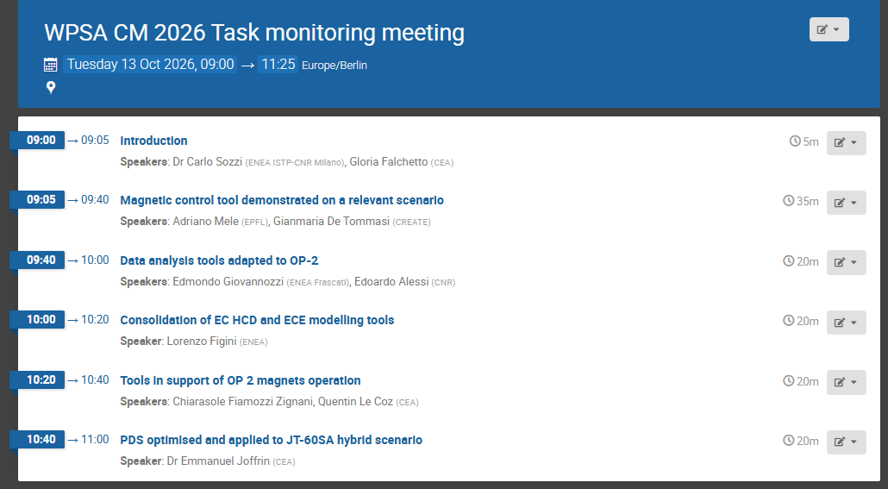
AGENDA Monitoring Meeting of SA.CM 2026 Tasks

