Slide 1
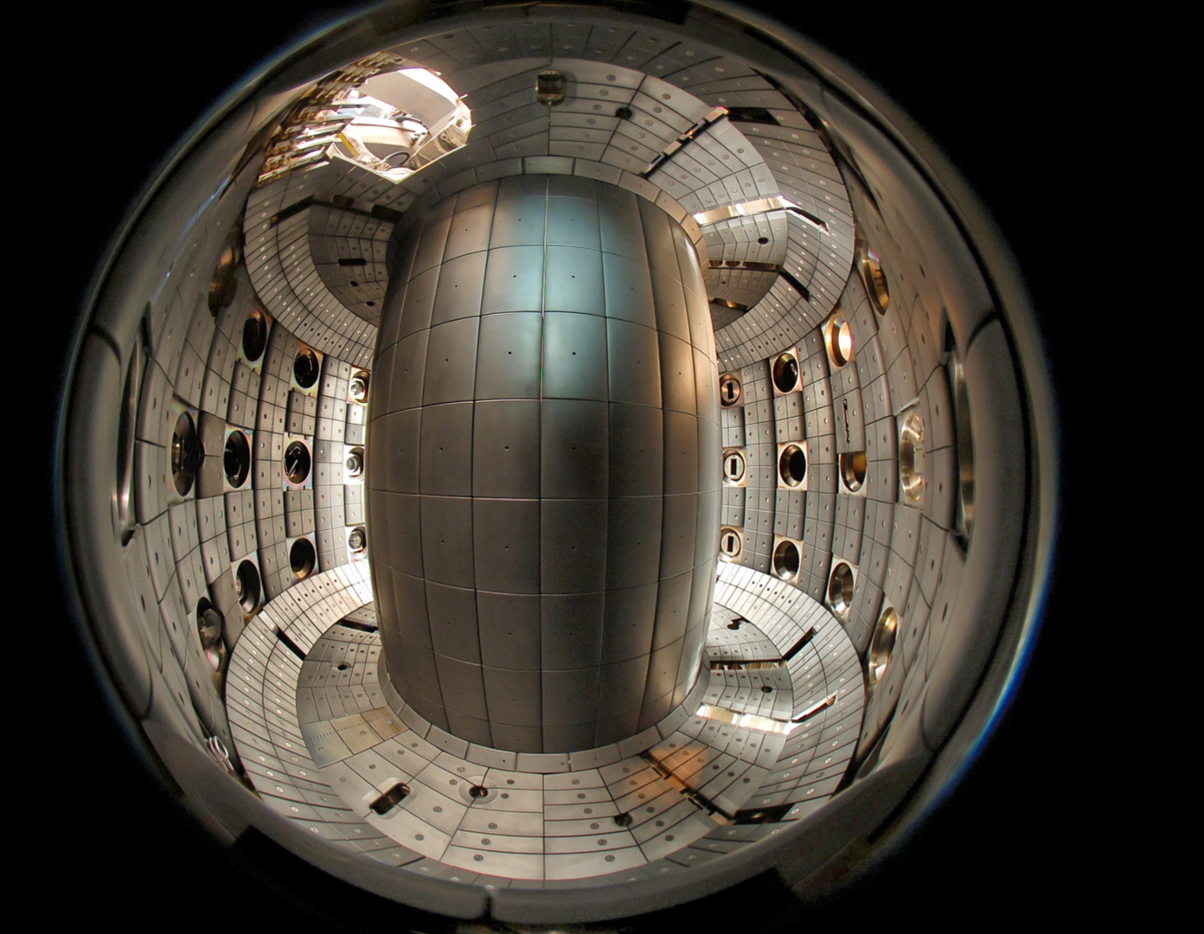
Magnetic control activities for JT-60SA
A. Mele,
D. Frattolillo, O. Sauter, S. Van Mulders, D. Perales Rio
Ecole Polytechnique Federale de Lausanne (EPFL), Swiss Plasma Center (SPC), CH-1015 Lausanne, Switzerland

Slide 2
Overview
Deliverable description:
Test of equilibrium reconstruction methods (LIUQE, CARONTE) on relevant scenarios.
Integration with closed-loop simulations (MEQ, MECS). The work will be carried out in collaboration with the team at CREATE.
IDS interface for LIUQE inputs/outputs.
Automated profile fitting tool on LIUQE or QST equilibrium implemented in Naka server.

Slide 3
Equilibrium reconstruction methods
LIUQE equilibrium reconstruction code:
code configured for JT-60SA OP1 & OP2 geometries
  geometry + probes location stored in dedicated .json files
  native interface to CREATE data also available
Direct interface towards routines for straightforward data retrieval also implemented and installed on nakasvr26
  LIUQE offline version released for general use under
/home/SharedFolder/d260047/liuqe_public
C version of the liutslx stepper function generated
  sub-ms execution time per step (on a Dell laptop) with mex version called from matlab, compatible with real-time execution
  installation on secondary processing unit under discussion

Slide 4
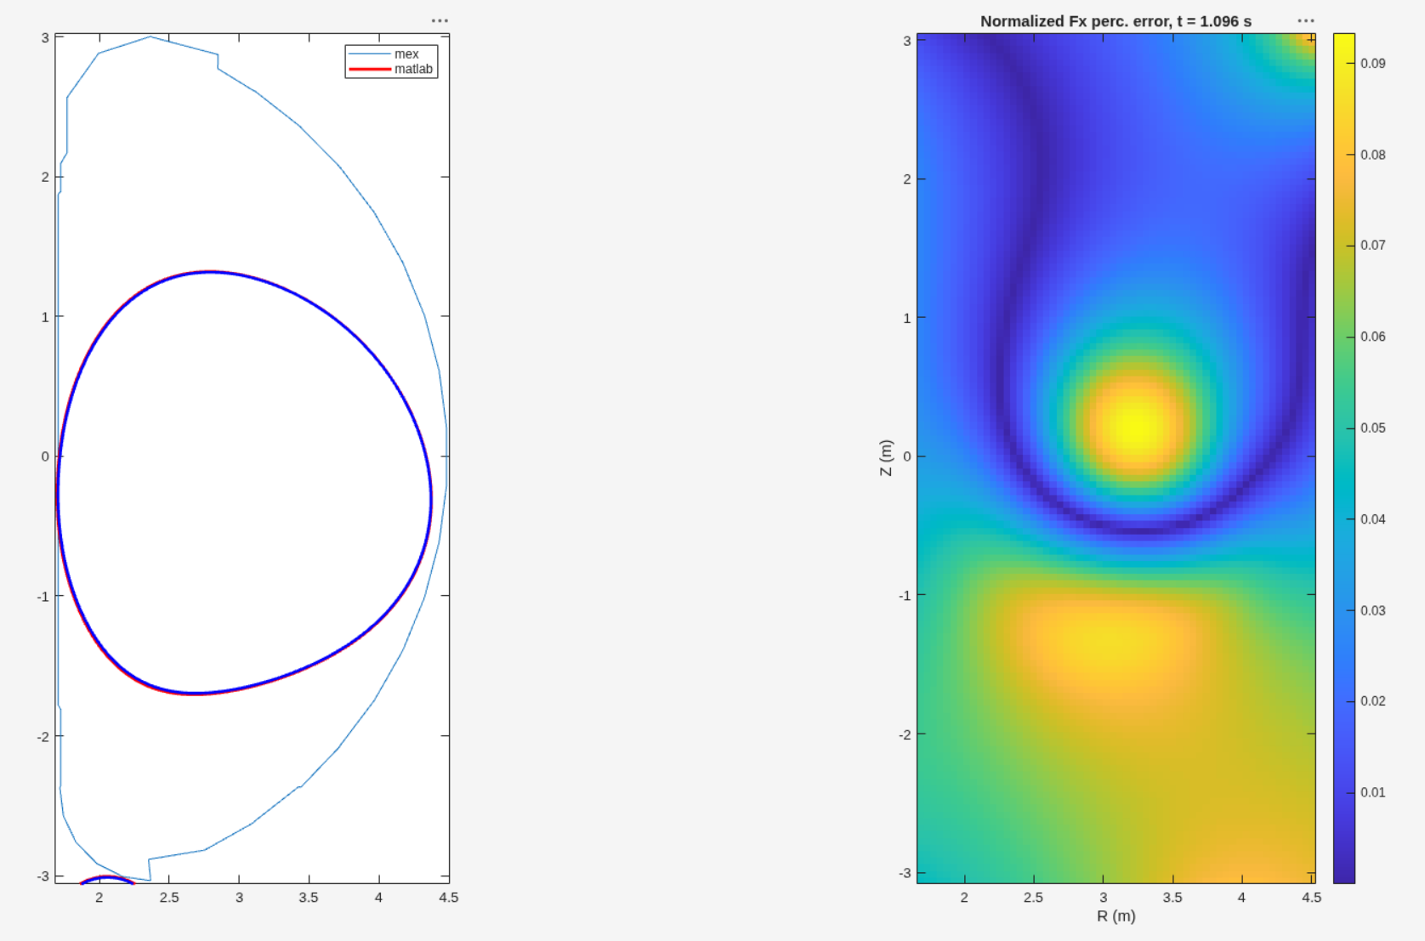
Equilibrium reconstruction methods

Slide 5
Equilibrium reconstruction methods
CARONTE reconstruction method:
CARONTE is currently being benchmarked against LIUQE on a database of TCV discharges
It has also been tested in real-time discharges on TCV
More details from CREATE team

Slide 6
Simulation tools
After LIUQE, the whole MEQ suite is being adapted to JT-60SA
  FBT for scenario design
  FGS for static GS equilibria
  FGE for nonlinear evolutive simulations
  FGEL for linearization/growth rate estimation
The suite has been used to study NT scenarios feasibility
  FBT: current and voltage feedforwards generation
  FGE: closed-loop simulation with “basic” magnetic controllers
  FGEL: growth rate validation and Best Achievable Performance analysis
    D. Frattolillo, SOFT26 poster

Slide 7
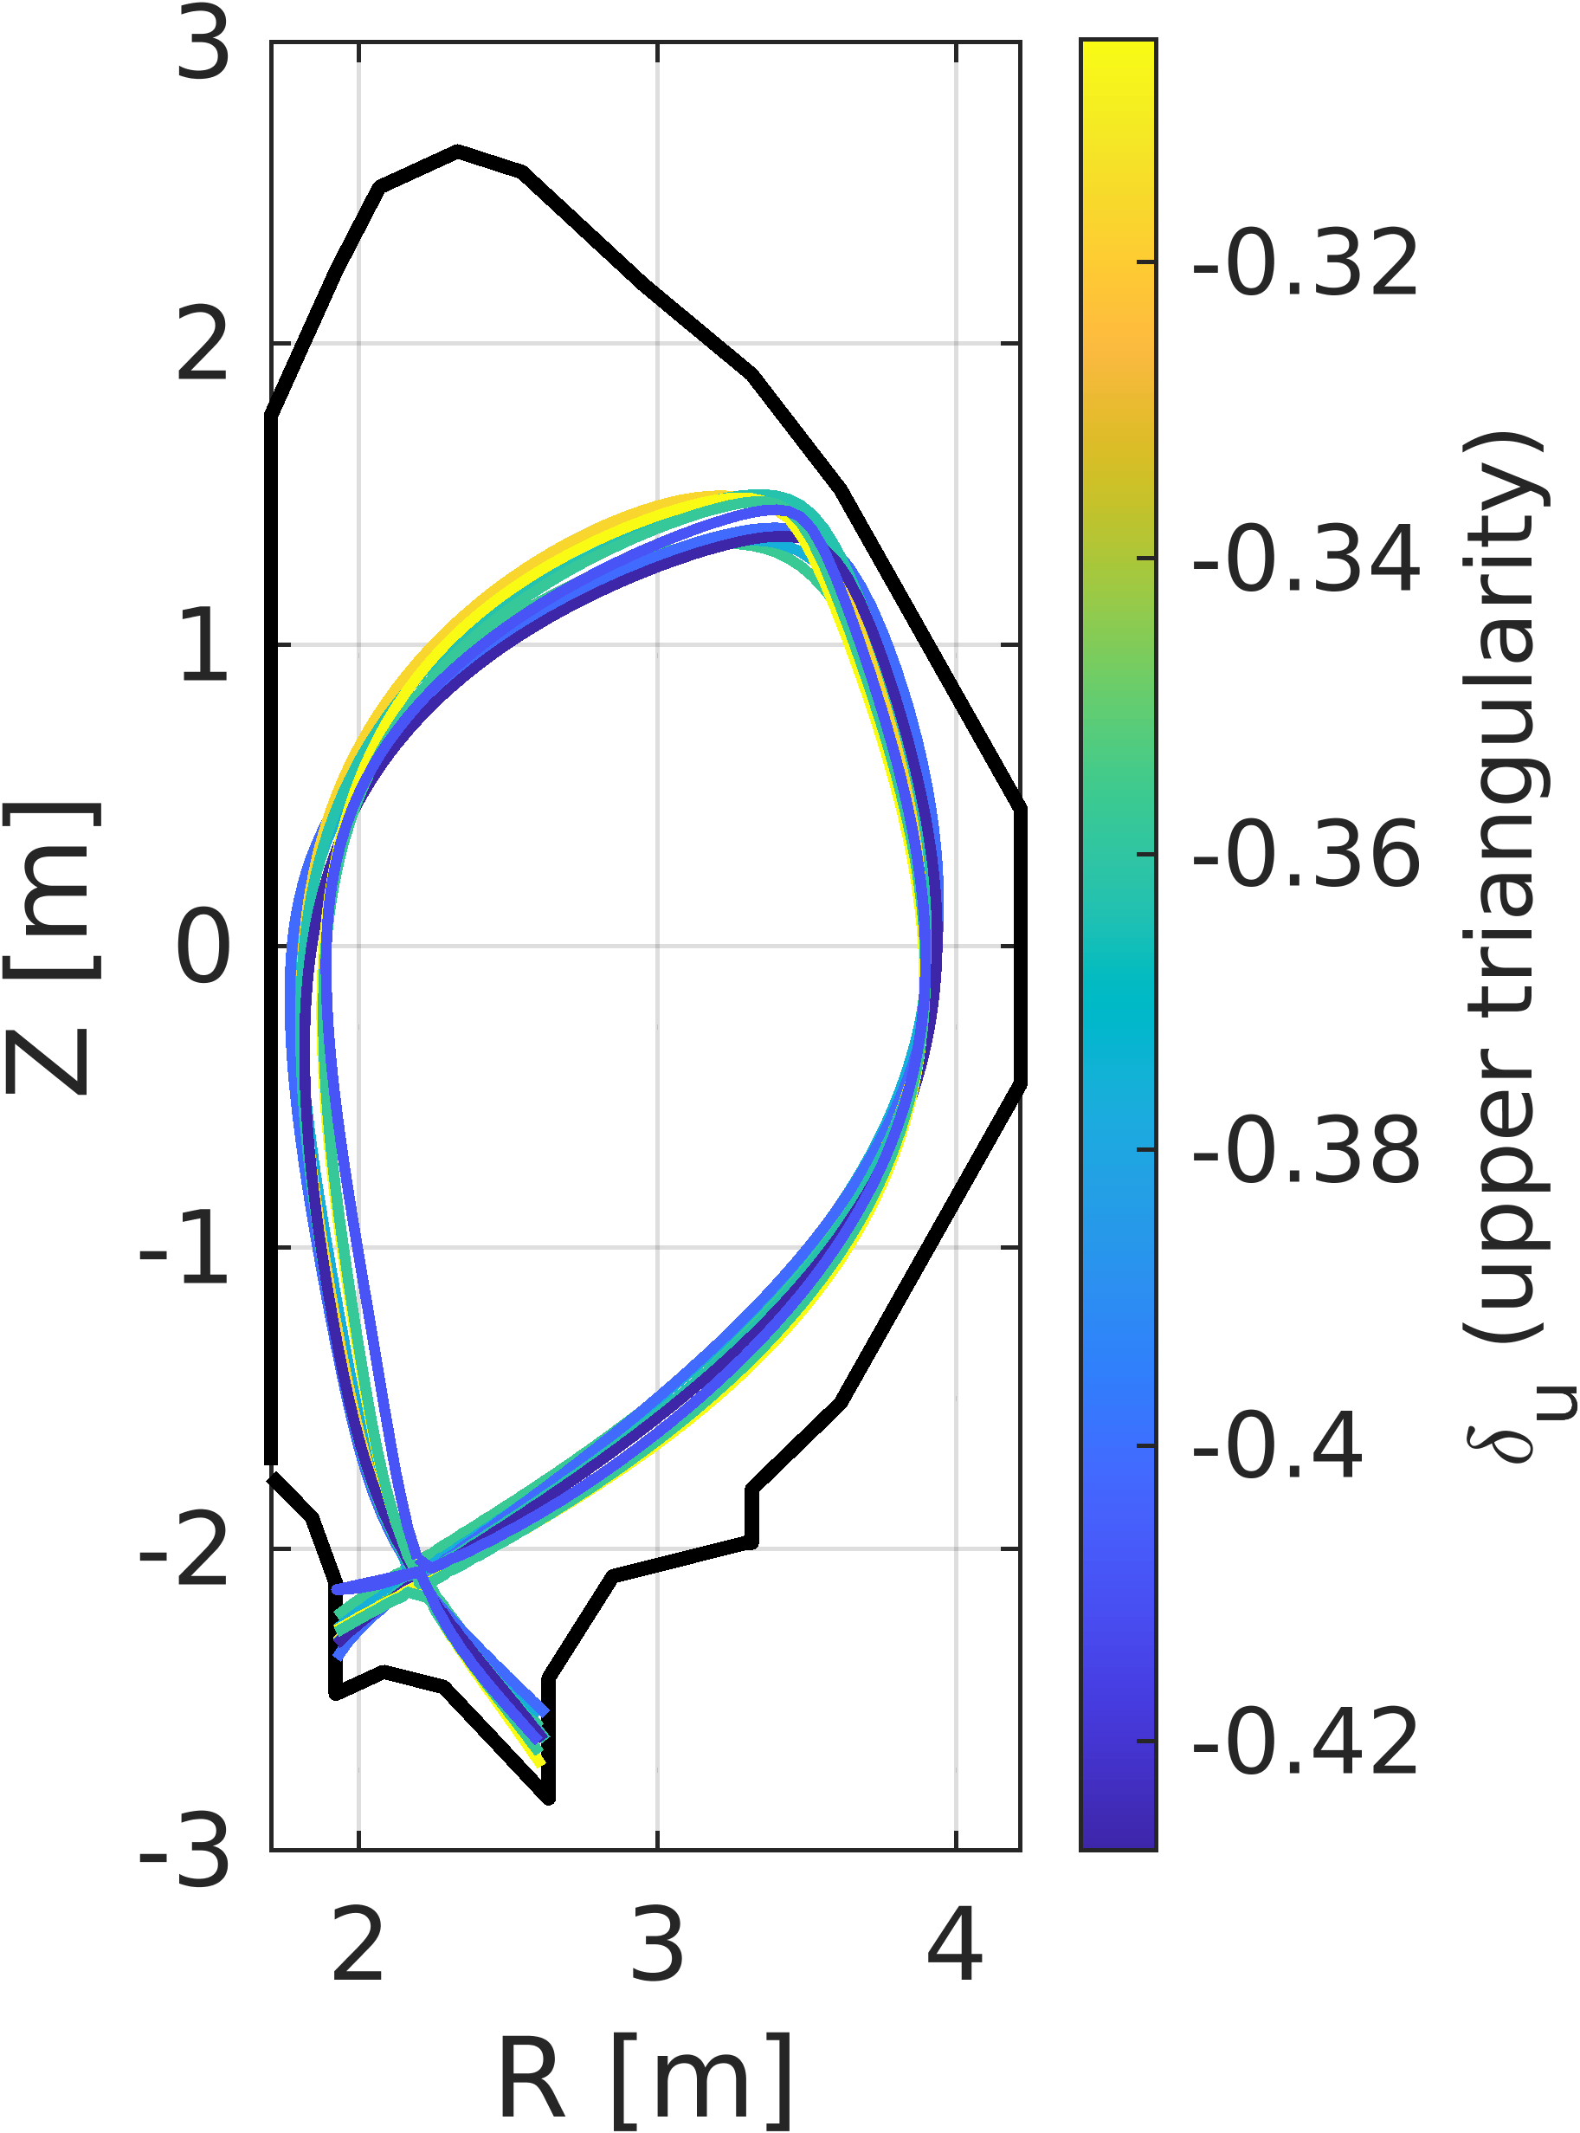
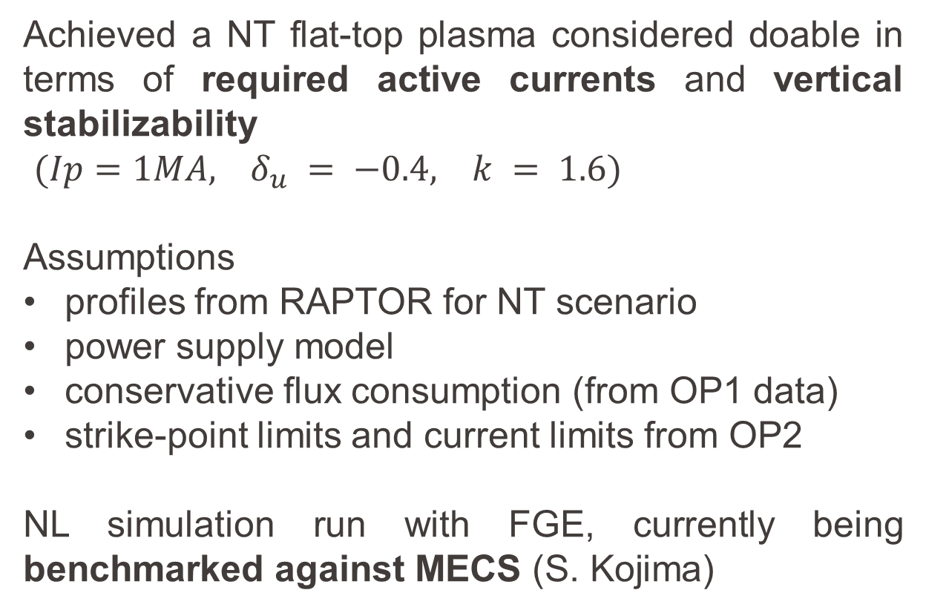
Simulation tools
Achieved a NT flat-top plasma considered doable in terms of required active currents and vertical stabilizability
$(Ip=1MA, δ_{u} = −0.4, k = 1.6)$
Assumptions
profiles from RAPTOR for NT scenario
power supply model
conservative flux consumption (from OP1 data)
strike-point limits and current limits from OP2
NL simulation run with FGE, currently being benchmarked against MECS (S. Kojima)

Slide 8
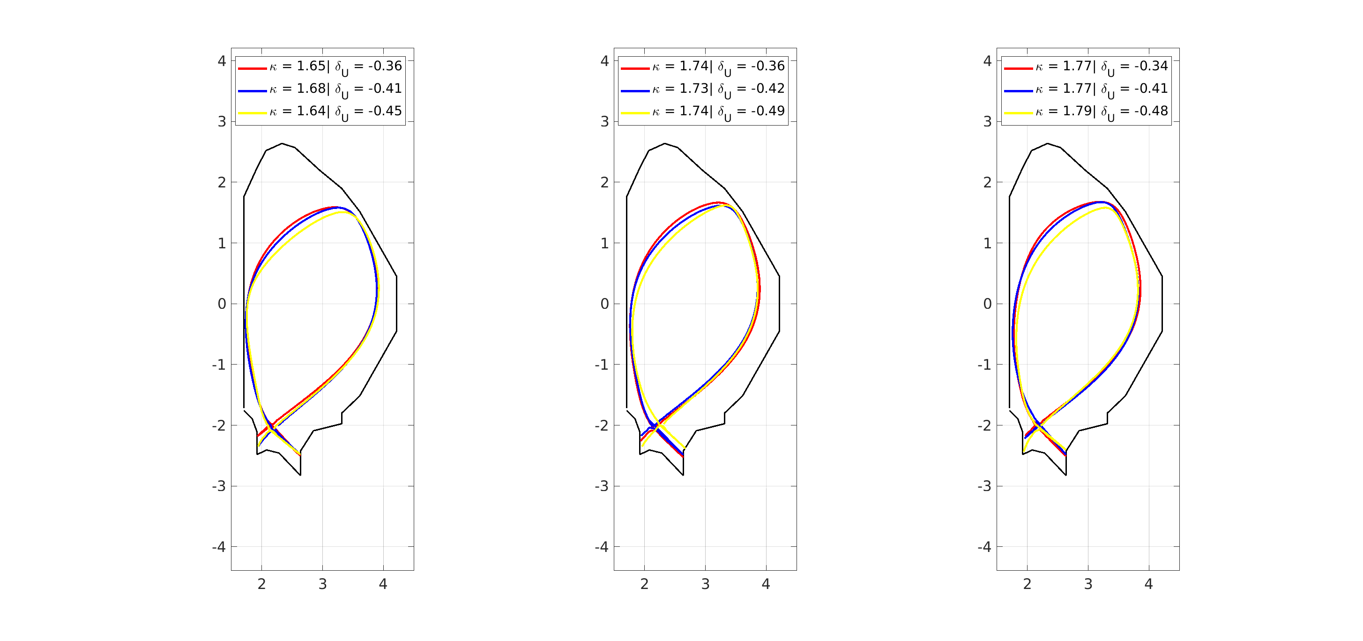
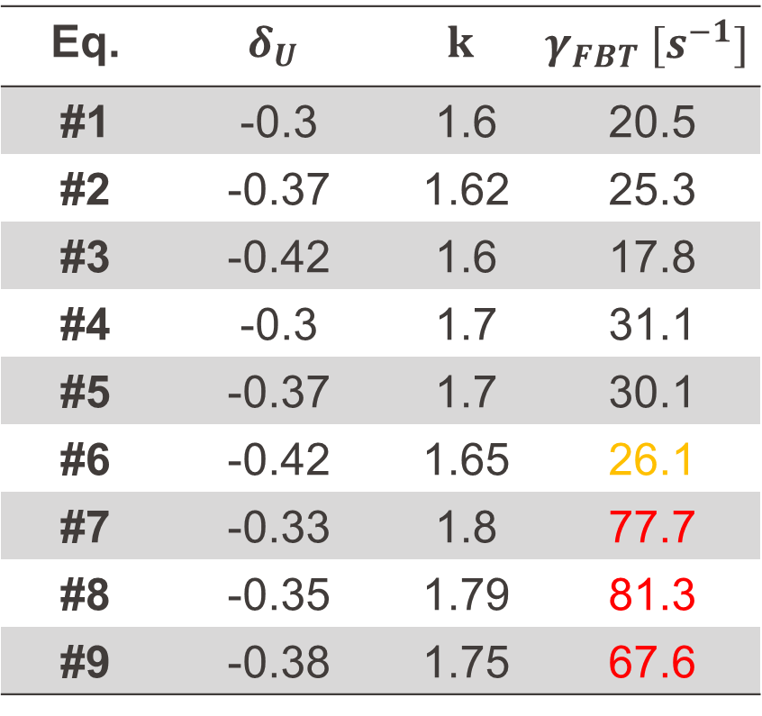
Simulation tools
9 equilibria produced using FBT/FGS (with RAPTOR profiles)
Eq. | $$δ_{U}$$ | $$k$$ | $$γ_{FBT} [s^{−1}]$$
#1 | -0.3 | 1.6 | 20.5
#2 | -0.37 | 1.62 | 25.3
#3 | -0.42 | 1.6 | 17.8
#4 | -0.3 | 1.7 | 31.1
#5 | -0.37 | 1.7 | 30.1
#6 | -0.42 | 1.65 | 26.1
#7 | -0.33 | 1.8 | 77.7
#8 | -0.35 | 1.79 | 81.3
#9 | -0.38 | 1.75 | 67.6

Slide 9
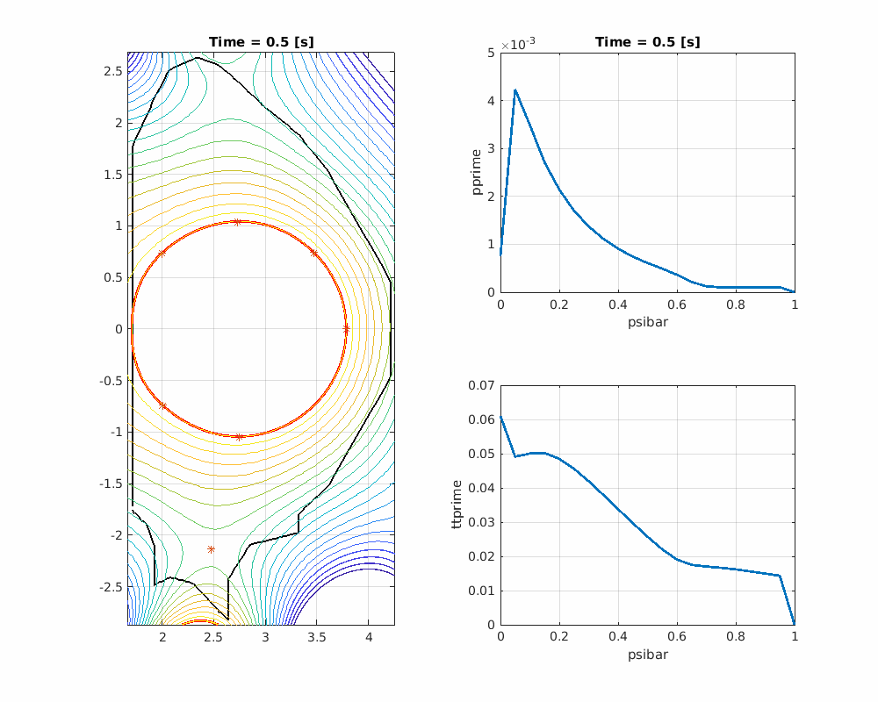
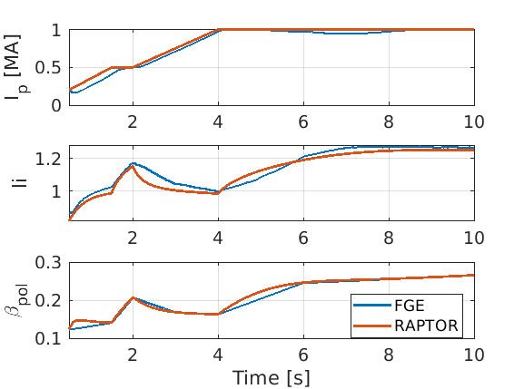
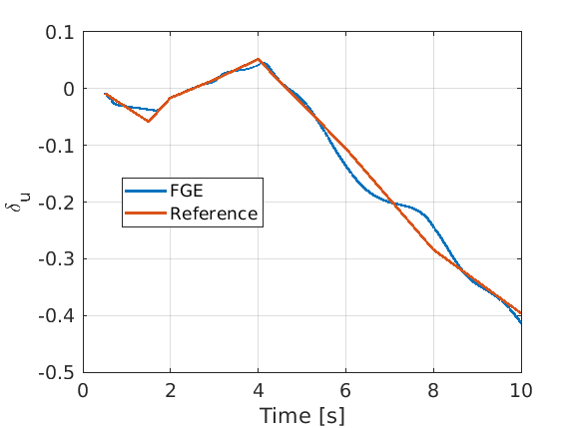
Simulation tools
FGE nonlinear simulation of scenario #3 (ramp-up similar to OP1)

Slide 10
Pending points
MEQ IDS interface is work in progress
prototype exists already (F. Carpanese, M. Marin, V. Bocharev)
needs testing and commissioning for JT60-SA
Profile fitting and RT-RAPTOR (also on secondary unit) under discussion
O. Sauter just came back from Naka – waiting for updates ☺
offline runs already available and coupled with magnetic simulation tools (see previous slides)

Slide 11
Backup

Slide 12
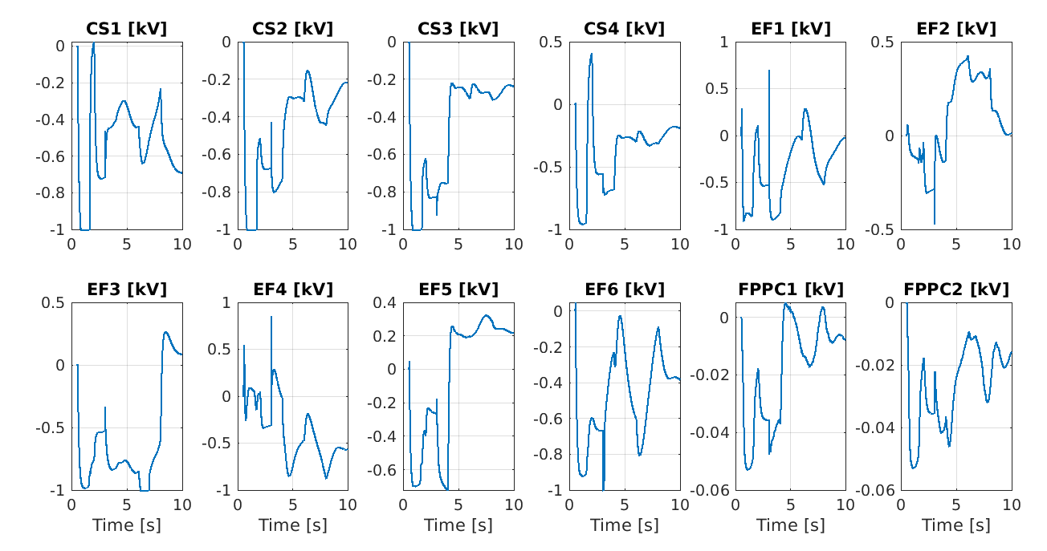
Simulation tools
FGE nonlinear simulation of scenario #3

Slide 13
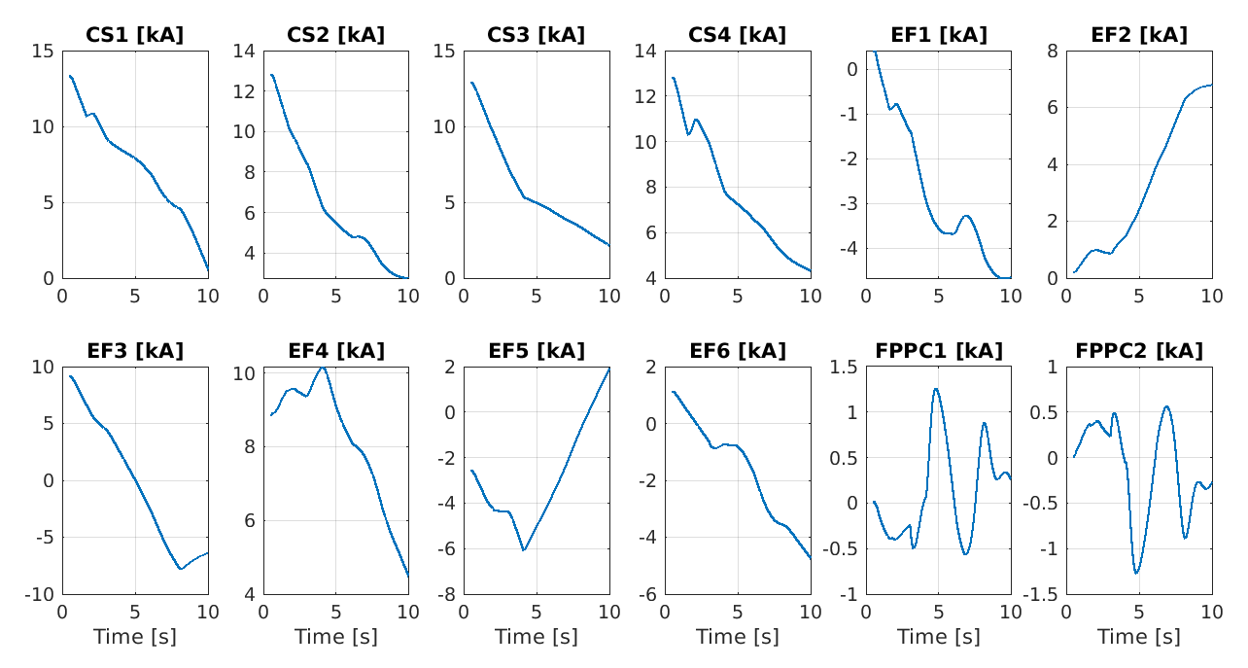
Simulation tools
FGE nonlinear simulation of scenario #3

