Slide 1

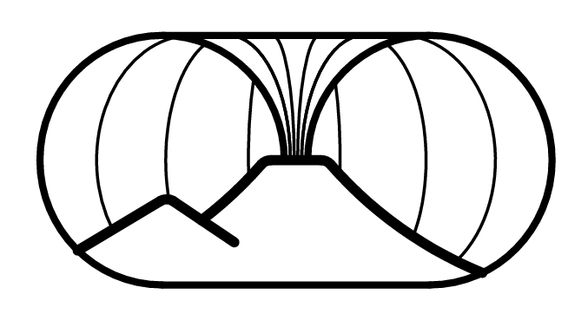
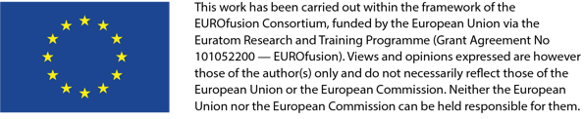

WPSA – Code Management Area
Monitoring Meeting
Magnetic Control Tool Demonstrated on Relevant Scenarios
G. De Tommasi, L. di Grazia, F. Fiorenza, M. Mattei, A. Pironti, C. Vitone
D. Frattolillo, A. Mele
G. Cseh, T. Szepesi
S. Kojima, S. Inoue

Slide 2
Outline
Summary of control design activity
Further validation of OP1 CREATE linear model using EDICAM
CARONTE deployment for Op2
Workplan 2027 (proposal)

Slide 3

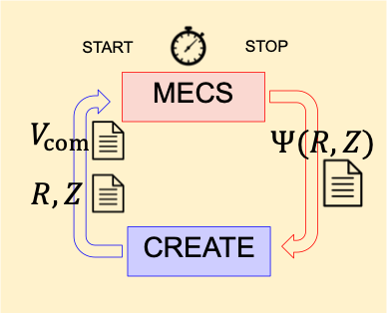
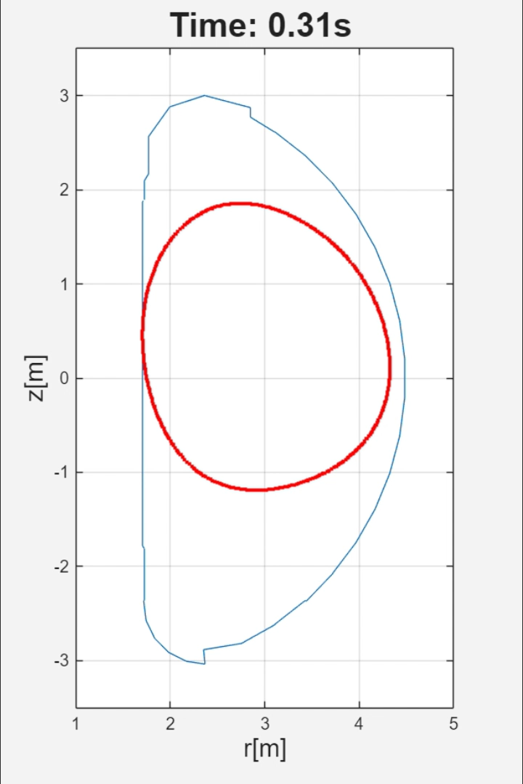
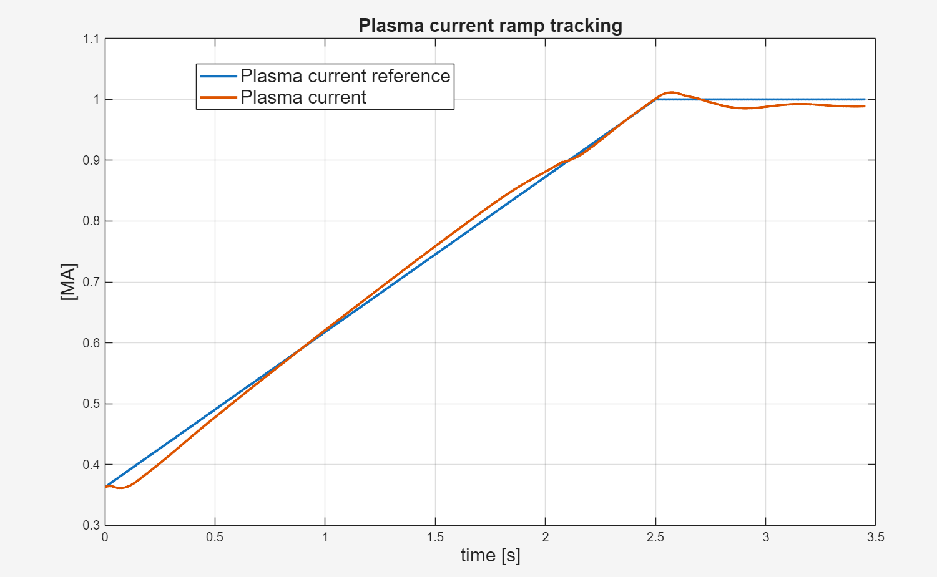
What we achieved last time
MECS interface to test external controllers → now it works both in Matlab & python (needed during the transition from nakasvr23 to nakasvr26!)
At the last Monitoring Meeting → RZIp controller designed using CREATE linearized models & tested on MECS
Exploiting feedforward currents we were able to achieve a 1MA diverted plasma! ☺
However shape control of diverted plasma was not working properly… ☹

Slide 4
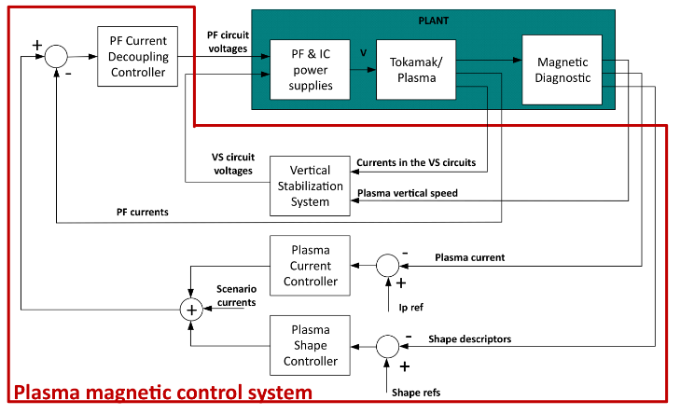
Shape control architecture
The shape control architecture is the following…
The shape control provides current references to a low-level PF current controller
In absence of in-vessel coils EF3-4 are used for vertical stabilization

Slide 5
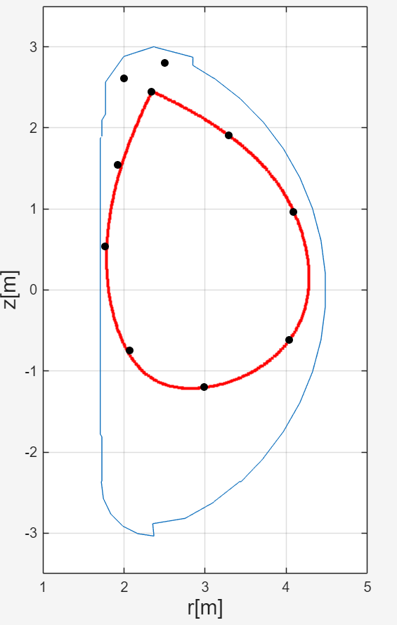
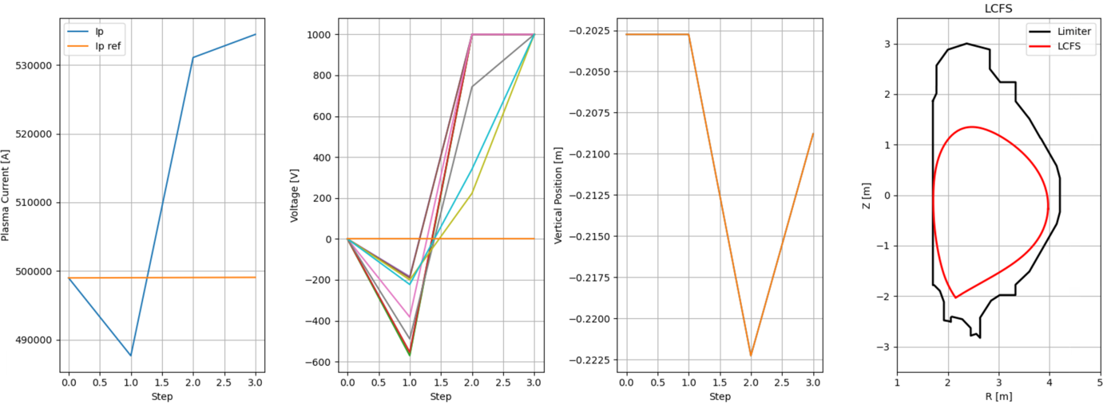
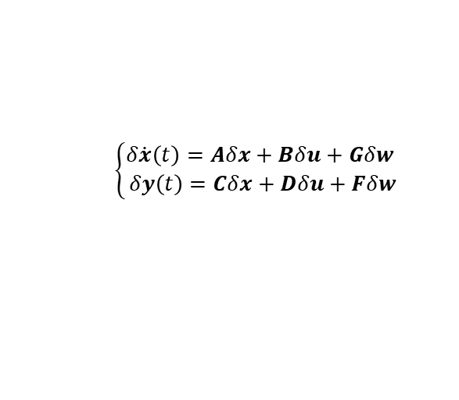

Recent activities on control
Problem: Diverted plasma shape control was not working
Solution: Linearization of the MECS diverted equilibrium with CREATE-NL and redesign of the XSC-like controller
MECS Equilibrium
CREATE linearized model
$$\left\{\begin{aligned}δ\dot{x}\left(t\right)=Aδx+Bδu+Gδw \\ δy\left(t\right)=Cδx+Dδu+Fδw\end{aligned}\right.$$
XSC-like shape control
Interface already running for OP2 configuration. Same design procedure envisaged for OP2 scenario
$${I_{ref}^{XSC}(s)=E_{shape}(s)C}^{†}PID(s)$$

Slide 6
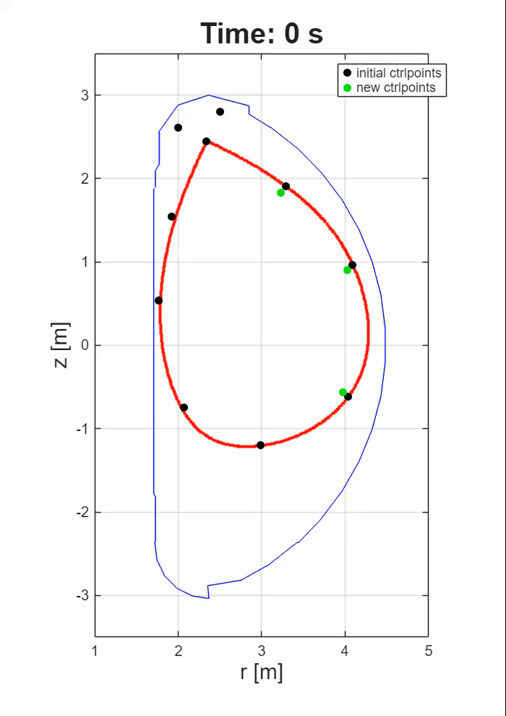
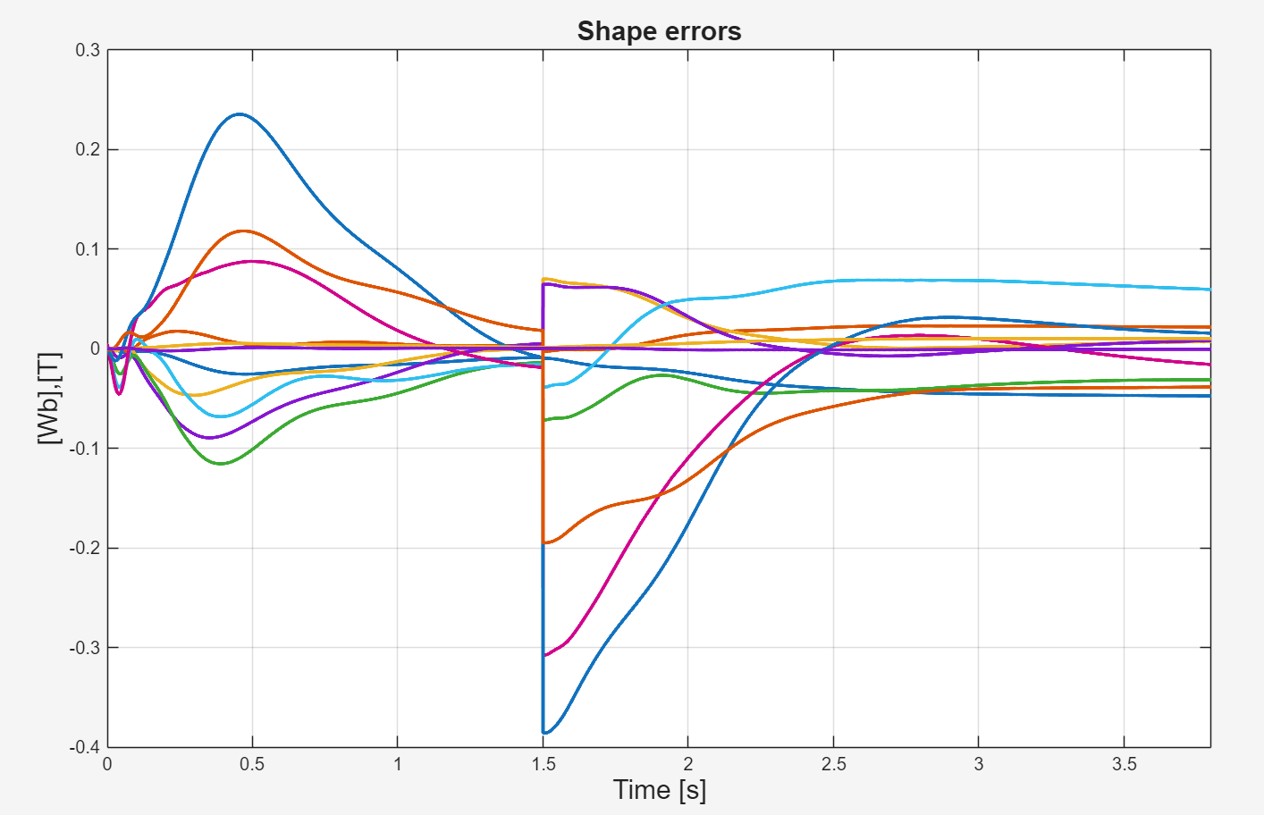
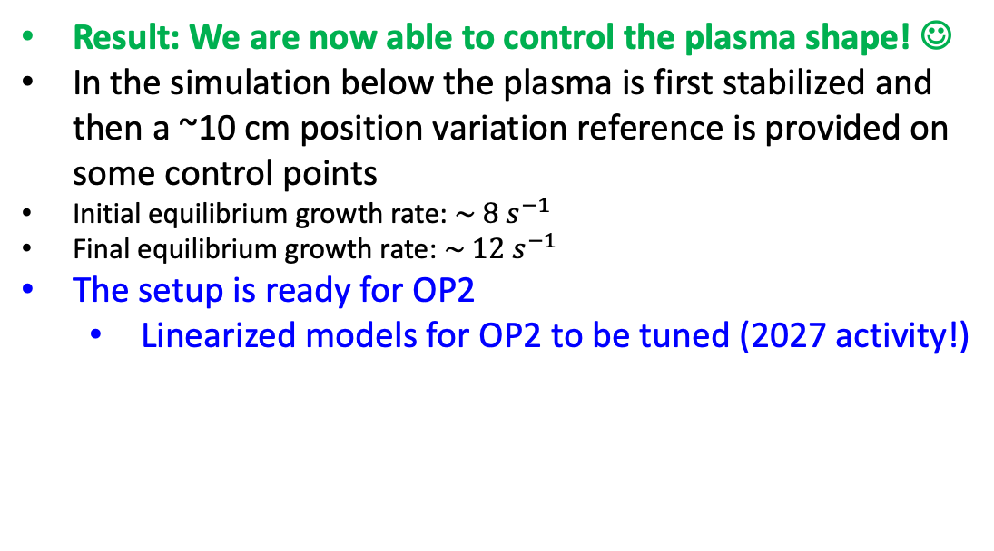
Recent activities on control
Result: We are now able to control the plasma shape! ☺
In the simulation below the plasma is first stabilized and then a ~10 cm position variation reference is provided on some control points
Initial equilibrium growth rate: $\sim 8 s^{−1}$
Final equilibrium growth rate: $\sim 12 s^{−1}$
The setup is ready for OP2
  Linearized models for OP2 to be tuned (2027 activity!)

Slide 7
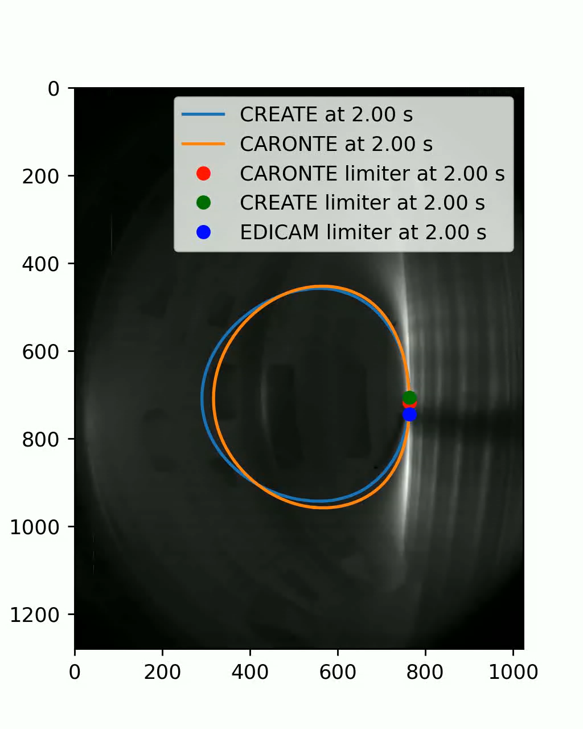
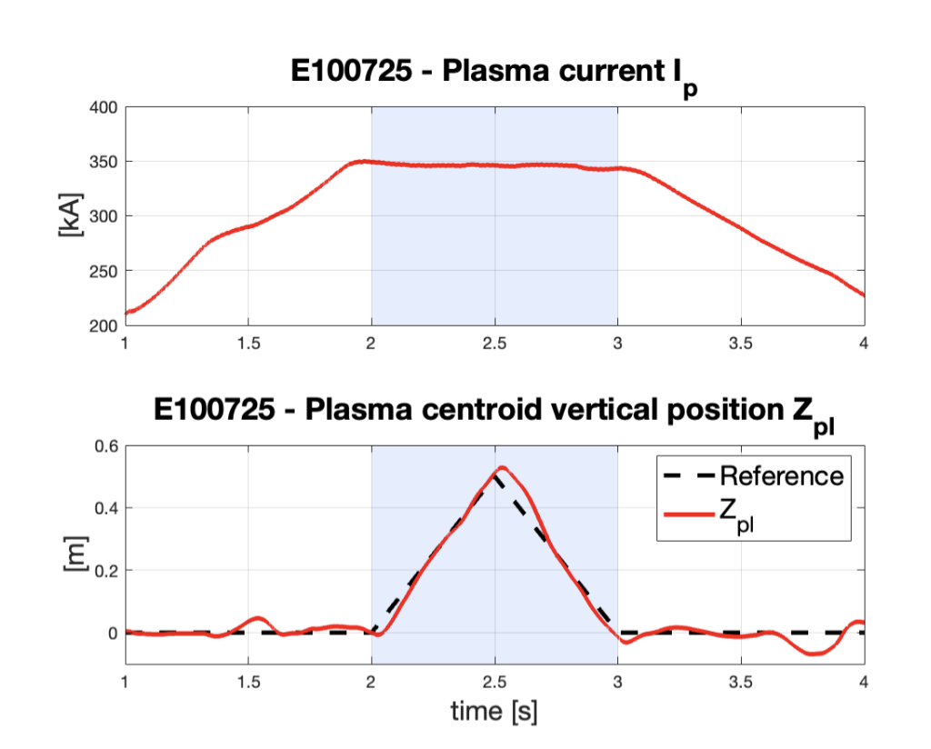
Further validation of OP1 CREATE models using EDICAM
CREATE control-oriented linearized model validated for challenging scenarios
Relatively large vertical movement → ~40 % of the plasma minor radius
limiter configuration where coupling between the plasma and the passive structures is strongly affected by the plasma position
relatively low I_{p} → the eddy currents variation is about ~10 % of I_{p}
Presented at SOFT’26
FED paper under preparation

Slide 8
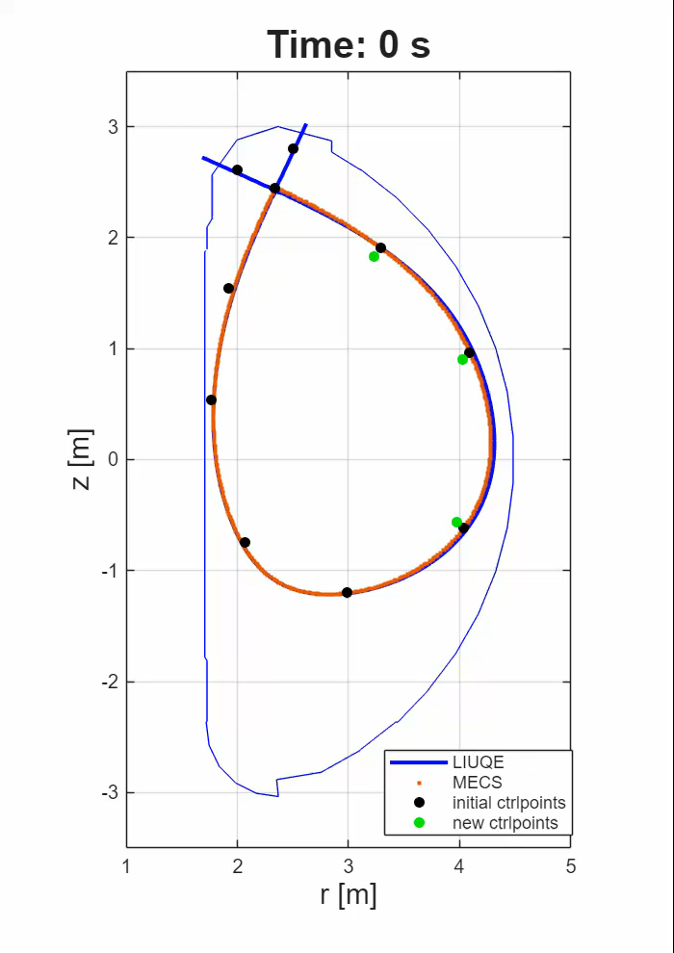


With EPFL colleagues
LIUQE integrated in the MECS workflow (in July 2026, thanks to Adriano & Domenico!)
The Isoflux shape controller tested also with LIUQE flux estimations (starting from MECS magnetic measurements)
MECS
CREATE
LIUQE

Slide 9
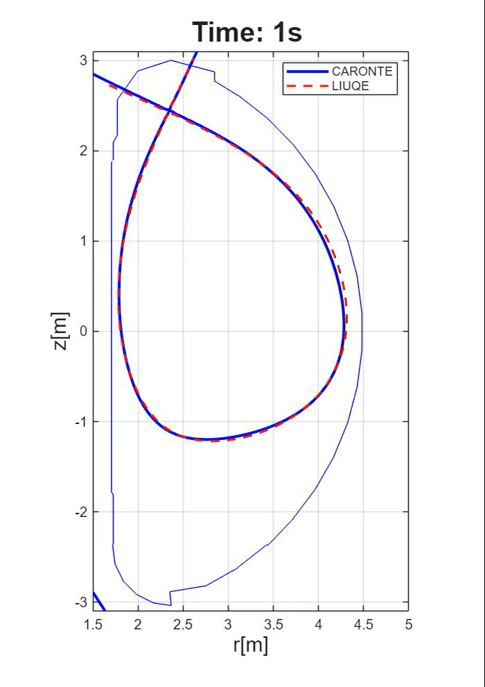
CARONTE: data-driven plasma boundary reconstruction
NN-based CARONTE fast boundary reconstruction benchmarked against LIUQE and MECS (July 2026)
The reconstruction shows overall good agreement between the two codes ☺
Agreed with QST that both LIUQE and CARONTE will be deployed on the Secondary Process Chain for OP2

Slide 10
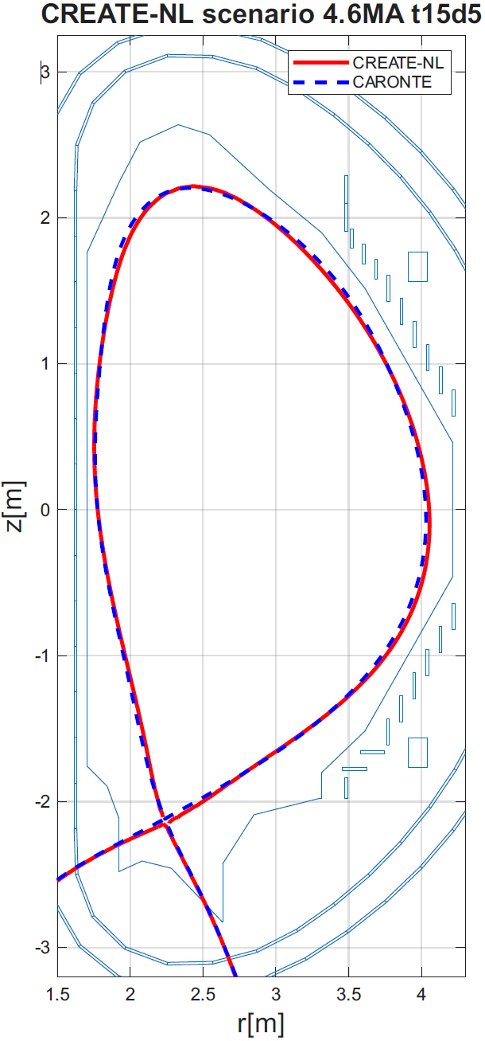
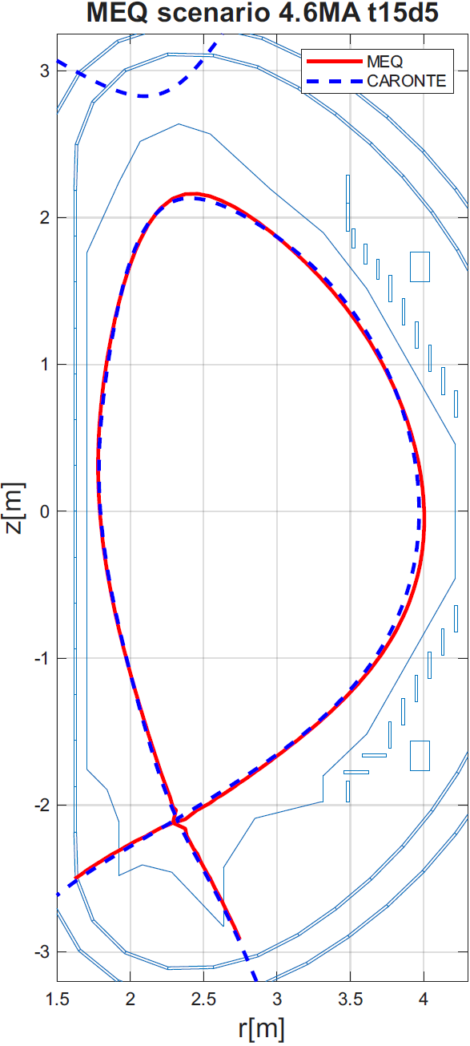
CARONTE for OP2
Preliminary results (October 2026)
Algorithm tuning has started by exploiting both CREATE-NL and MEQ (LIUQE) equilibria of a baseline 4.6 MA scenario (which are slightly different)
The algorithm is tuned exploiting CREATE-NL and then validated on MEQ

Slide 11
2027 Workplan
Campaign of validation of CREATE linear models for OP2 (in view of the control task to be executed in OP3!)
Envisaged resources needed for 2027
  onsite participation to OP2 envisaged (missions)
  Homework
  …are there PMs left? ☺

