Slide 1
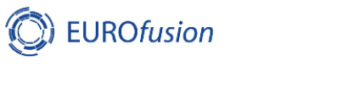
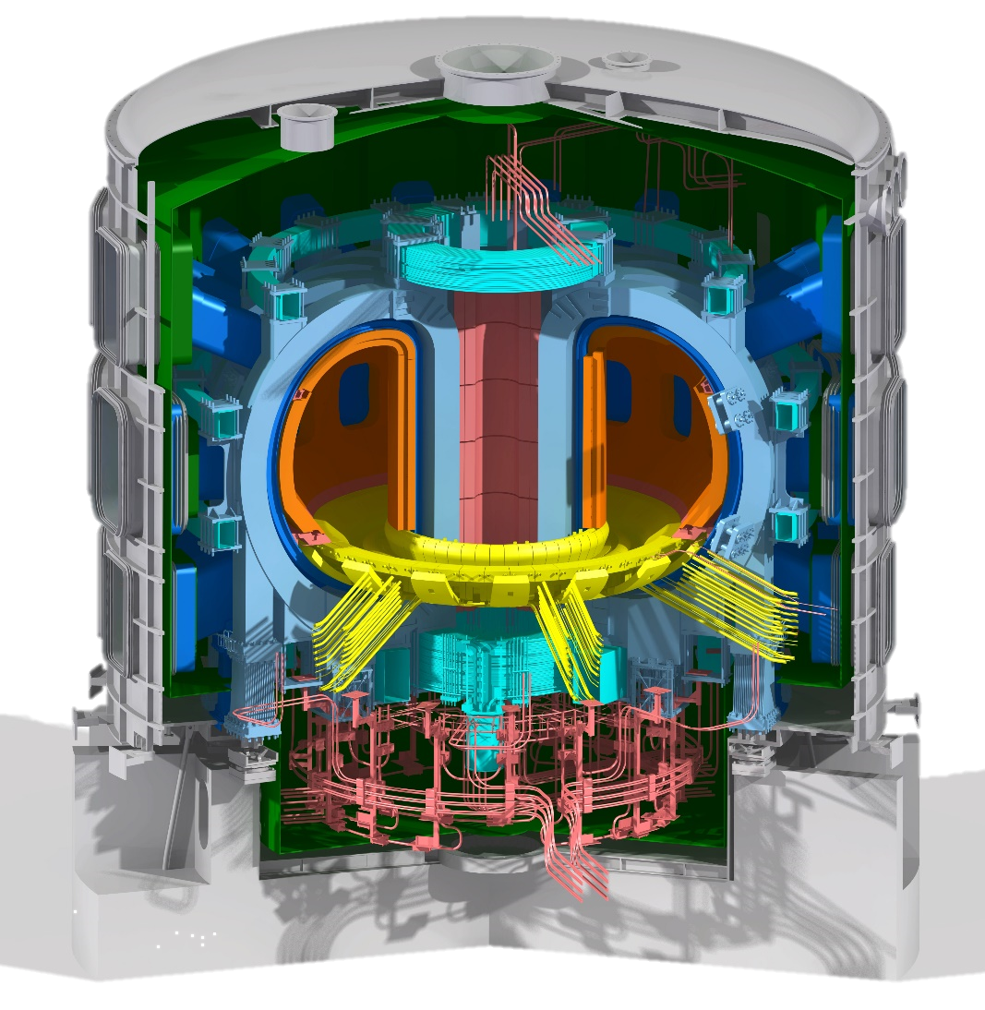

PDS optimised and applied to JT-60SA hybrid scenario
E. Joffrin, D. Frattollilo, J.F. Artaud, M. Mattei
C. Boulbe, B. Faugeras

Slide 2
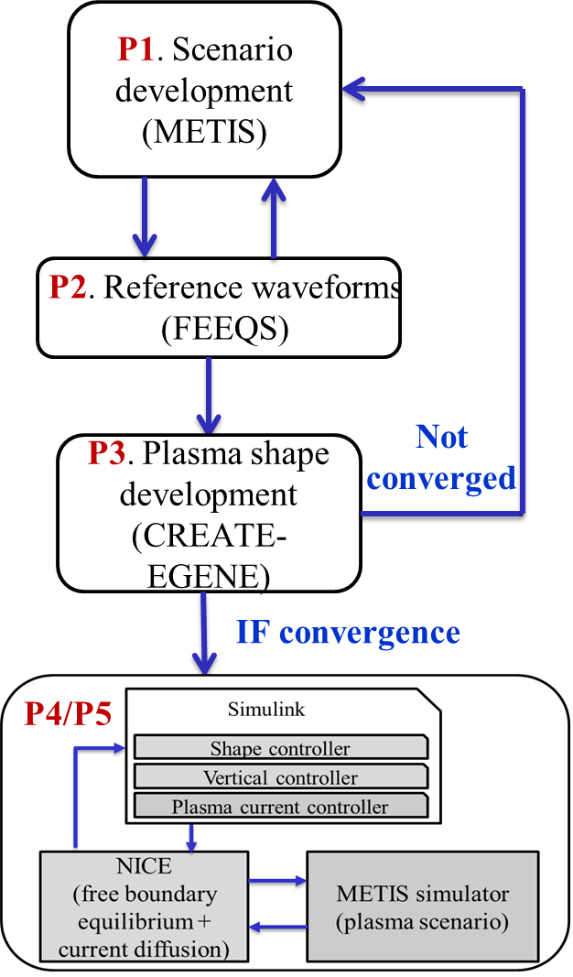
First introduction of the PDS to members of the Experiment Team of JT-60SA
Meeting of the ET in July in Naka (20 EU participants plus QST)
Presentation made in 2 sessions (thanks to Domenico):
  First day: presentation of the modules of the PDS: METIS, FEEQS, EGENE, …
  Second day: live demonstration of the PDS
  (the test included demonstrations on the EU gateway, unfortunately the access was not reliable during the session.
  ➔ Several people (EU and QST of the assistance expressed their interest in learning/using the simulator.
Status of the simulator on the gateway
➔ The 4.6MA case now runs again on the gateway and the issues experienced in July (sign on the flux) are now solved. Paper for this case submitted to FED.

Slide 3
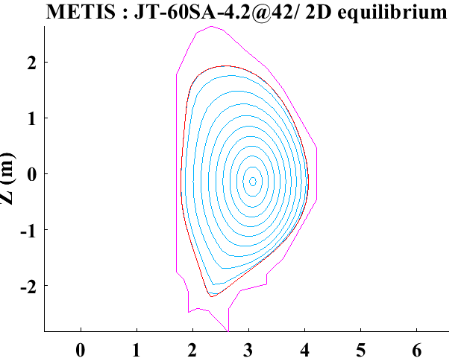
Next steps
Analysis with the simulator a new case: the hybrid scenario at 3.5MA or 2.7MA
Start from the existing work (scenario 4.2) + documentation:
Steps METIS + FEEQS run ➔ EGENE ➔ test the simulator with the existing controller ➔ check whether they need tuning
Scenario 4.2 2.25T / 3.5MA or 2.7MA
Existing shape
NBI=23MW & ECCD=7MW
Ne=7. 10¹⁹ m⁻³
Tested with FEEQS as well

Slide 4
The hybrid scenario in JT-60SA (scenario 4.2 at 3.5MA)
Derived from V. Ostuna et al., 2021
With ECRH=7MW and NBI=23MW, 100s duration, 66% non-inductive
4
3
ECCD
A
NBI
M
2
Boot
Ohm
1
Ip (//B)
0
30
W
20
ECRH
M
NBI
10
Ohm
Rad
3
-
2
Vloop
,
-
li 0D
,
V
1
li ref
betap (th)
0
betap (tot)
0
20
40
60
80
100
120
time (s)
An other version at 2.7 MW may be useful as well

Slide 5
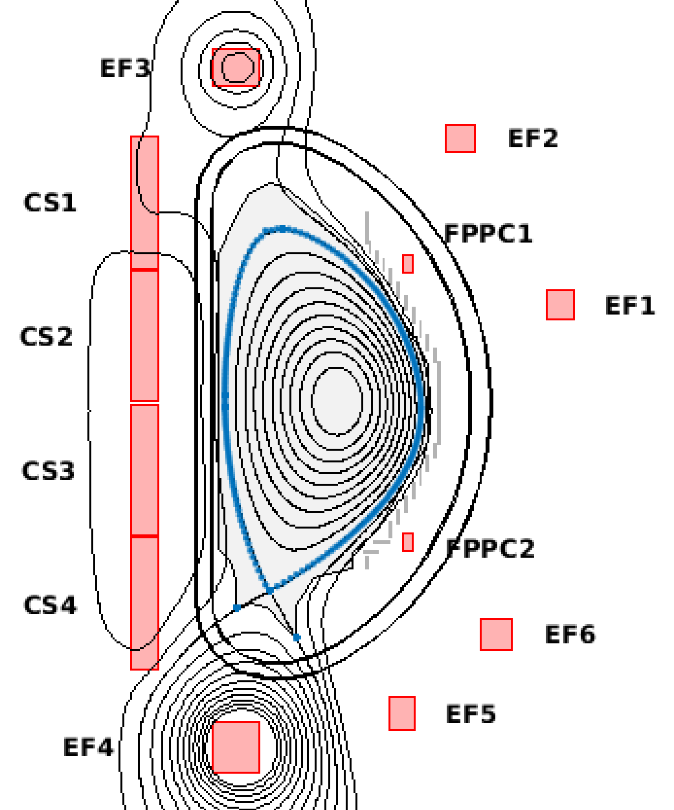
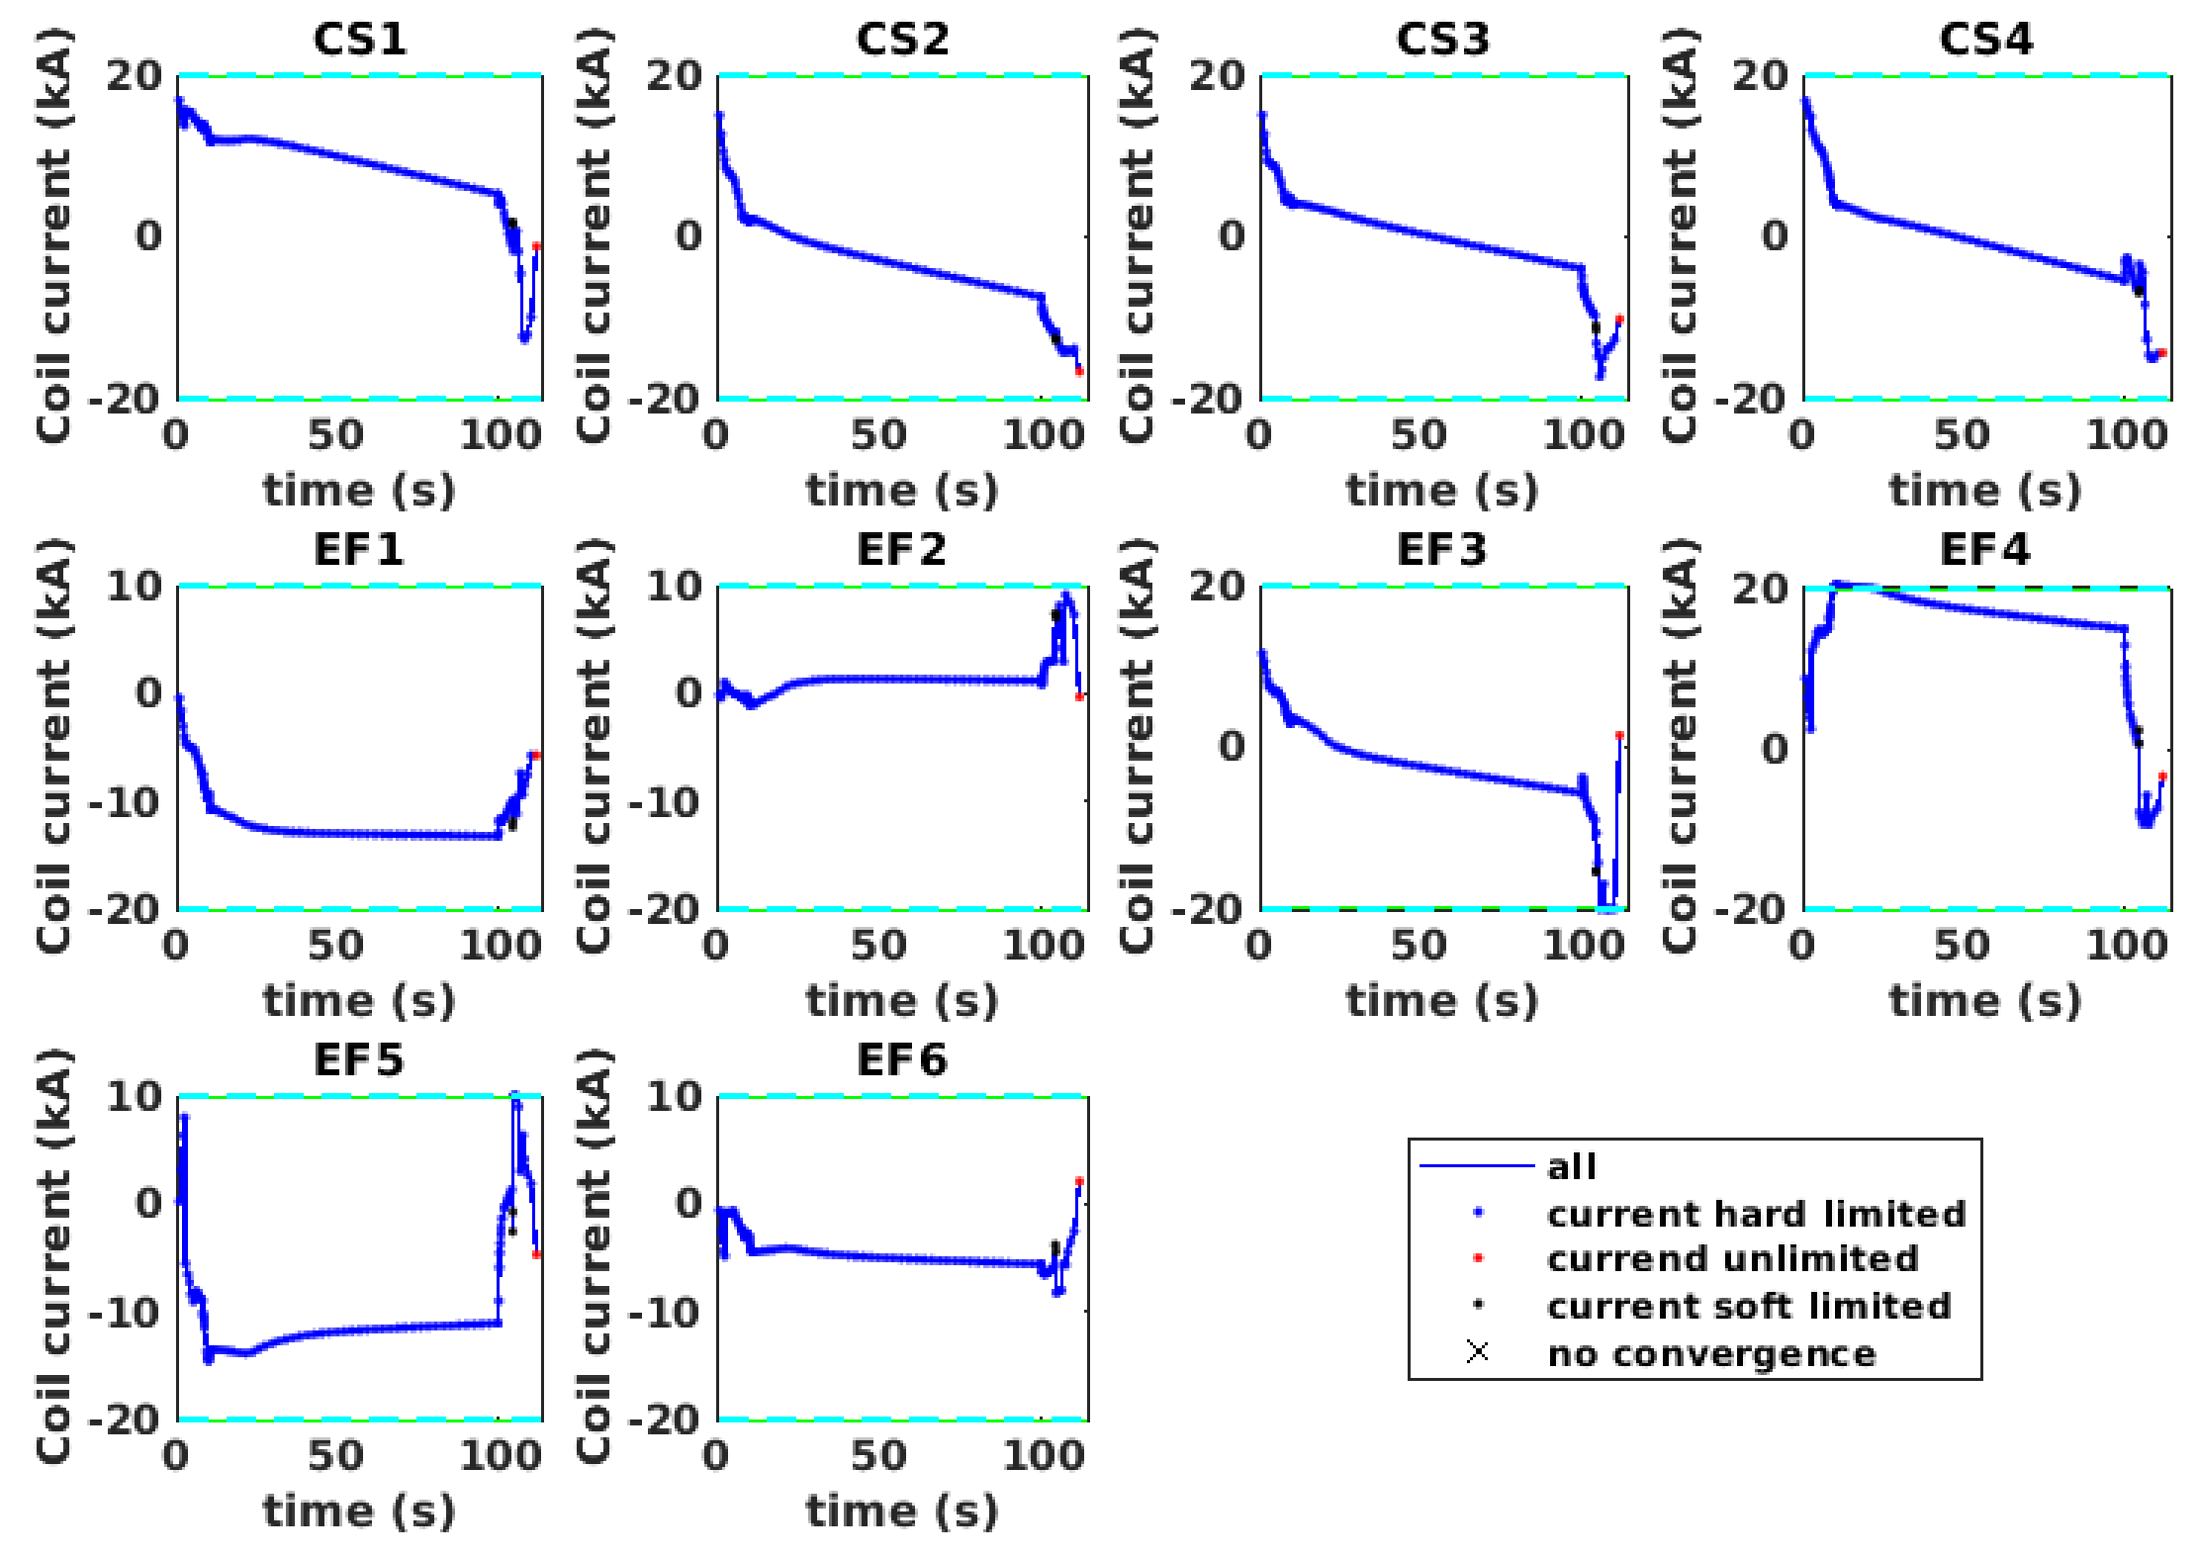
FEEQS output: coil currents

Slide 6
PDS training week
Points for the future training (one week in Cadarache.
Given the delay of JT-60SA is it proposed to hold this training in the begining of 2027
A first agenda and proposed organisation has been already discussed with WPSA PL.
The access to the gateway has to be ensured in advance and issues addressed to the hotline (G. Falchetto): https://ticket.eufus.eu/index.php:
Following the demonstration sessions in Naka several people have expressed their interest in this training.
Content: formal courses about METIS, FEEQS, EGENE and the controllers set-up.
Established case: scenario 2 (4.6MA) ; Development case: scenario 4.2 (3.5MA or 2.7MA)
  A Doodle to be prepared and sent to all potential participants: proposed week is the week of the 18th of January (tbd: logistic)
  The maximum number of participants should be agreed.
  The tutors time and efforts needs also to be secured (Domenico, Jean-François, Max, …)
  Follow-up !

Slide 7
Agenda
From 9 to 16 :30 each day | Content
Monday | Introduction to JT-60SA device Introduction to the simulator (modules, numeric, etc …) Introduction to the controllers Methodology for running the simulator, suite of codes.
Tuesday | List of exercises for the week. Practical exercises with the different modules of the simulator separately and creation of the scenario (METIS, FEEQS, EGENE). Manipulation of the controllers (CREATE)
Wednesday | Run the full simulator with the controller on parts of the scenario and test controller design. Scenario 2 and scenario 4-2
Thursday | Run the full simulator with the controller on parts of the full scenario (current ramp-up/down, flat top)
Friday | Finalize the full scenario run with its controllers. Debriefing and wrap-up

