Slide 1


SA-SE.CM.OP.07-T002:
EC HCD and ECE modelling tools
WPSA Code Management 2026 tasks – Kick-off Meeting
L. Figini¹, M. Guerini Rocco^{1,2}, C. Tsironis³
¹Institute for Plasma Science and Technology – CNR Milan, Italy (ENEA)
²Università degli Studi di Milano – Bicocca, Italy (ENEA)
³National Technical University of Athens, Greece (NCSRD)

Slide 2
Task description
The task aims at providing simulation software for EC waves (ECH&CD, ECE → GRAY, SPECE), both to prepare plasma operation and to analyze experimental results, modelling:
The EC HCD optical system
The ECE diagnostic antennas configuration
The interaction of EC waves with the plasma
Deliverable D001: Consolidation of EC HCD and ECE modelling tools
Consolidation of EC HCD and ECE modelling tools (GRAY and SPECE) for use in the control room
Implementation of input data interface
Testing on Naka server

Slide 3
Status at the last meeting
Simulation tools installed at the Naka server
  GRAY, for EC Heating and Current Drive (H&CD) computation
  SPECE, for Electron Cyclotron Emission (ECE) diagnostics data analysis
CLI interface
  Parameters configuration
  Run code
Python module (GRAY)
  Input/output data import as NumPy struct arrays
  Script for input/output data visualization
JT-60SA EC launcher optical model
  Integrated Commissioning / OP1 (no mirrors)
  Complete EC launcher (full optical system) at 110 and 138 GHz
ECE Computation added to GRAY (experimental)
$ gray -c inputs/gray.ini -g raytracing.nrayr=1 -g raytracing.ipass=1 -g antenna.fghz=82 -g antenna.iox=MODE_O -v
$ python
>>> import gray
>>> d = gray.read_table(filename)
>>> type(d)
<class 'numpy.ndarray’>
$ gray-visual -h
usage: gray_visual [-h] [--kind {raytracing,beam,profiles,inputs} [{raytracing,beam,profiles,inputs} ...]] [--outfile FILE]
[--interactive] [--legend | --no-legend]
inputs outputs

Slide 4
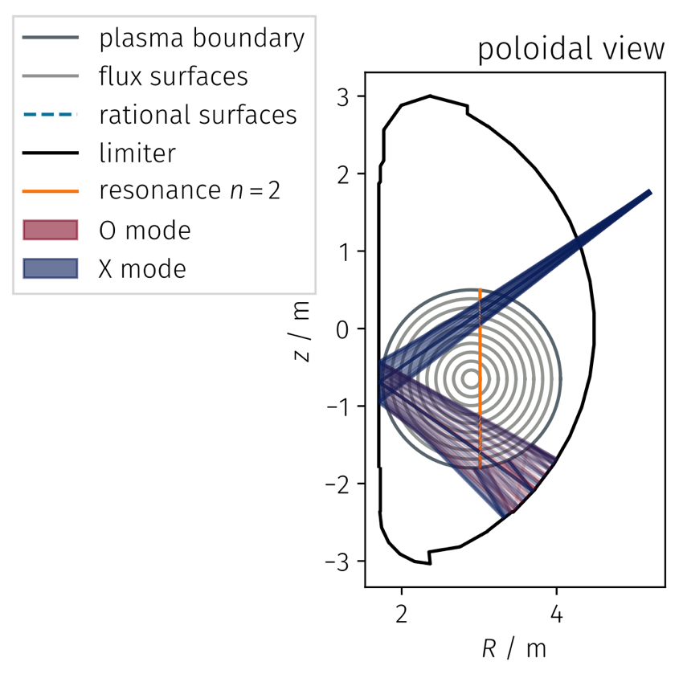
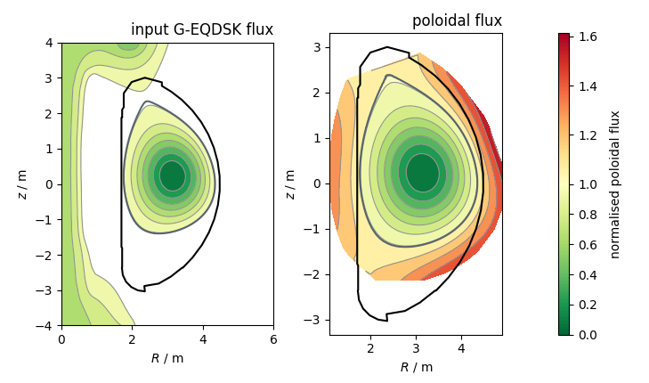
Results visualization examples
$ gray-visual –kind raytracing . .
$ gray-visual –kind inputs . .
#1154 at t=6s
dummy startup scenario
ECE Computation in GRAY
$ gray -c inputs/gray.ini -v -t all
[0007771] [main] [info] using GRAY INI config
...
[0171681] [gray_core:gray_main] [info] partial results:
[0171691] [gray_core:gray_main] [info] final step: n=11501 (s, ct, Sr)=230.0
[0171696] [gray_core:gray_main] [info] optical depth: τ_min=12.04 τ_max=12.04
[0171700] [gray_core:gray_main] [info] absoption: P=1.00 MW
[0171702] [gray_core:gray_main] [info] current drive: I=2.46 kA
[0171705] [gray_core:gray_main] [info] emission: T=11.0 keV
...

Slide 5
Work plan for 2026
Guided/automated input data preparation
  Magnetic equilibrium
  Kinetic profiles (T_{e}, n_{e}, Z_{eff})
  EC launcher configuration
  Inverse mapping ρ → launcher angles
ECE specifications for synthetic diagnostics
  Line of sight
  Measured frequency range
  Antenna pattern
Interface for ECE data visualization
Codes verification/validation on IC/OP1 data
Training material (documentation, tutorials)

Slide 6
Work plan for 2026
Guided/automated input data preparation …
  Magnetic equilibrium ✓
  Kinetic profiles (T_{e}, n_{e}, Z_{eff}) ✗
  EC launcher configuration ✓
  Inverse mapping ρ → launcher angles ✗
ECE specifications for synthetic diagnostics ✓
  Line of sight ✓
  Measured frequency range ✓
  Antenna pattern ✓
Interface for ECE data visualization ✗
Codes verification/validation on IC/OP1 data ✗
Training material (documentation, tutorials) …
Partial progress
On-site participation (with tutorials) reprogrammed: July → November ‘26

Slide 7
Input data
Guided/automated input data preparation
  Magnetic equilibrium ✓
  Kinetic profiles (T_{e}, n_{e}, Z_{eff}) ✗
  EC launcher configuration ✓
  Inverse mapping ρ → launcher angles ✗
ECE specifications for synthetic diagnostics
  Line of sight
  Measured frequency range
  Antenna pattern
Interface for ECE data visualization
Codes verification/validation on IC/OP1 data
Training material (documentation, tutorials)
Magnetic equilibrium ✓
Script to get EQDSK from SELENE
Planned integration with LIUQE
Kinetic profiles ✓
No automation yet
Must be set up manually
EC launcher configuration ✓
Available for IC/OP1 and OP2 configs
82 GHz to be verified
Inverse mapping ρ → launcher angles ✗
On the TODO list
$ ./get-eqdsk.sh
Usage: get-eqdsk.sh SHOT TIME [OPTIONS]

Slide 8
ECE characteristics
Line of sight ✓
Radial view
At machine midplane: Z=0
Radial position unspecified. Arbitrarily set at R=4.5m
Frequency range ✓
67-99 GHz or 90-137 GHz
N_{f} = 64
Configured to model the full range
65-140 GHz
Antenna pattern ✓
FWHM = 10 cm at plasma center
Focusing optics. Focus location to be clarified (low impact)
Guided/automated input data preparation
  Magnetic equilibrium
  Kinetic profiles (T_{e}, n_{e}, Z_{eff})
  EC launcher configuration
  Inverse mapping ρ → launcher angles
ECE specifications for synthetic diagnostics
  Line of sight ✓
  Measured frequency range ✓
  Antenna pattern ✓
Interface for ECE data visualization
Codes verification/validation on IC/OP1 data
Training material (documentation, tutorials)

Slide 9
ECE visualization / Validation on JT-60SA
Guided/automated input data preparation
  Magnetic equilibrium
  Kinetic profiles (T_{e}, n_{e}, Z_{eff})
  EC launcher configuration
  Inverse mapping ρ → launcher angles
ECE specifications for synthetic diagnostics
  Line of sight
  Measured frequency range
  Antenna pattern
Interface for ECE data visualization ✗
Codes verification/validation on IC/OP1 data ✗
Training material (documentation, tutorials)
Activity delayed

Slide 10
Documentation and training
Guided/automated input data preparation
  Magnetic equilibrium
  Kinetic profiles (T_{e}, n_{e}, Z_{eff})
  EC launcher configuration
  Inverse mapping ρ → launcher angles
ECE specifications for synthetic diagnostics
  Line of sight
  Measured frequency range
  Antenna pattern
Interface for ECE data visualization
Codes verification/validation on IC/OP1 data
Training material (documentation, tutorials) …
Material being collected at:
Installation and usage instructions
Input/output description
Test cases
  IC discharge
  Dummy EC-assisted startup configuration
  2.25T and 1.72T scenarios from research plan
~d250022/Public/gray-tutorial

Slide 11
Next schedule
Oct-Nov
Finalize documentation & tutorials
Nov
Testing on IC/OP1 data
Provide tutorials (Analysis and Modelling Week)
ECE antenna focusing
Nov-Dec
Interface for ECE data visualization
Dec
Automated kinetic profiles retrieval
Dec+
Equilibrium retrieval from LIUQE
Inverse mapping ρ → launcher angles

Slide 12
EC H&CD – GRAY
Propagation, absorption and current drive of Gaussian beams with general astigmatism (non-orthogonal optical systems) in axisymmetric plasmas
Quasi-optical ray-tracing
  accurate description of the near field region z/z_{R} ≲ 1
  requires λ << w << L
Linear plasma response
Cold-plasma approximation for propagation
Fully-relativistic formulation for wave absorption
Momentum-conserving collisions in CD calculation
Current development version updated with a new IMAS interface
Kinetic profiles
T_{e}, n_{e}, Z_{eff}
Magnetic equilibrium
B(R, z)
Injected EC beam
x₀, k, λ, w, R_{c}
GRAY
First wall shape
R_{w}, z_{w}
Beam path
x(s)
Shine-through & multi-pass absorption
H&CD profiles
dP/dV, J_{CD}

Slide 13
ECE – SPECE
Forward modelling of ECE spectra for diagnostics with arbitrary line of sight and astigmatic antenna pattern in tokamak plasmas with thermal or non-thermal electron distributions
Geometrical optics ray-tracing
  requires λ << L
Linear plasma response
Cold-plasma approximation for propagation
Fully-relativistic formulation and
Multi-Maxwellian distribution model for absorption and emission
Fast multi-reflection model for optically thin conditions
Simple model for T_{e} perturbation by NTMs
Partially ported in IMAS
Kinetic profiles
T_{e}, n_{e}
Magnetic equilibrium
B(R, z)
ECE antenna / detector
x₀, k₀, w₀, f_{i}
SPECE
NTM islands width/phase
w_{NTM}, φ_{NTM}
Electrons distribution function
ECE spectrum T_{rad}(f)
Velocity space analysis
Radiation path
x(s)
Localization & resolution
<x>(f), dx(f)

