Slide 1

WPSA – 2026 monitoring meeting
Tools development in support of OP 2 magnets operation
WPSA Monitoring Meeting – 13 October 13, 2026
ENEA - Chiarasole FIAMOZZI ZIGNANI, Gianluca DE MARZI
CEA - François BONNE, Quentin LE COZ

Slide 2
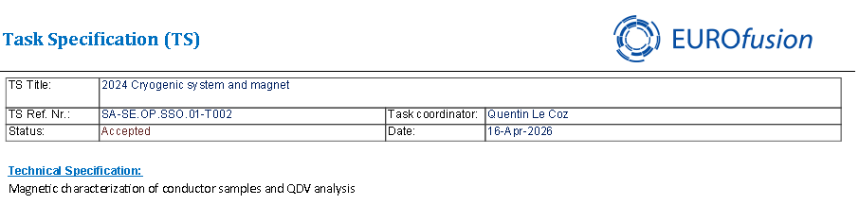
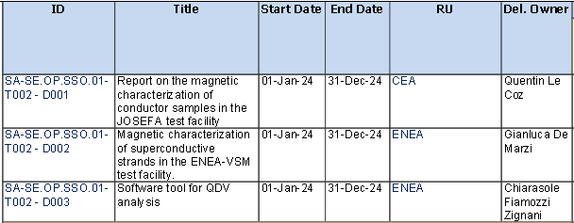
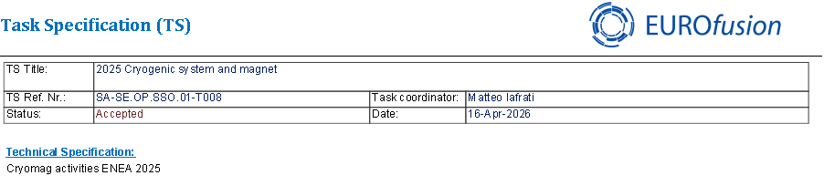
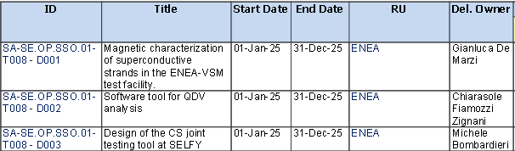
Task Specifications: 2024 & 2025
2024
2024 and 2025 activities completed → deliverable uploaded and approved
2025
SA-SE.CM.OP.06-T003-D001 «Simcryogenics model development for JT-60SA operation” (Francois Bonne)
Developed tools include:
J_{c} parameterization and assessment of hysteresis loss in CEA experiments
Th simulations of EF coils
TF QDV data retrieval and manipulation
Symcryogenics: global FSD of the loop 2 magnets EF + CS
SA-SE.OP.SSO.01-T007 “2025 Cryogenic models” (Francois Bonne)

Slide 3
Task Specifications - 2026
Tools development in support of OP 2 magnets operation.
Update of the magnet THEA models (settings and code consolidation) in preparation of OP 2.
In order to improve the accuracy and reliability of THEA simulations, the J_{c} laws will be consolidated and cross-checked. Also, the updated friction factor correlations will be implemented in the models. The resulting J_{c}(B,T,ε) parameterization will be implemented in the THEA software, to update and consolidate the thermo-electro-magnetic models. The updated models, including the refined parameterization of the critical surface, will be used in quench simulations under different operational scenarios to assess hot-spot temperatures and thermal margins, related to OP 2.
Based on the 2025 activities where the expected behaviour of magnets of loop 2 (PFs) were calculated in case of global FSD at 20 kA current, we will calculate the profile of power that is going to be extracted by the bath. The deliverable will include comparison with loop 1 FSD to have a better understanding of what to expect from the bath/refrigerator point of view in the PF FSD case.
The TFQDV signal processing activities will be devoted to the validation and the consolidation of software tool (ANN-based) aimed at TFQDV signal retrieval, correction and transmission to TF interlock system.
2 PM shared between 2 institutes (1 PM each): CEA (F. Bonne, Q. Le Coz), ENEA (G. De Marzi, C. Fiamozzi Zignani)

Slide 4
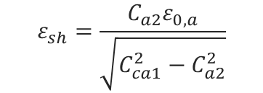

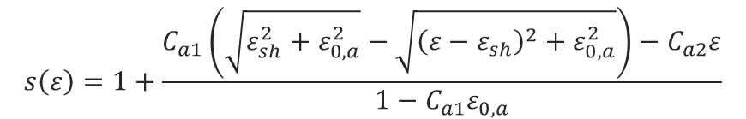

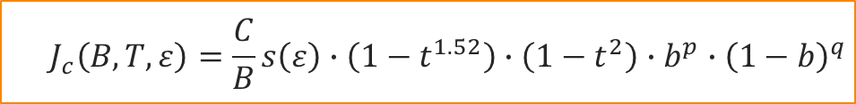


Parameterization of Nb₃Sn Critical Surface
J_{c} parametrization:
Consolidated and cross-checked the J_{c} parametrization, with the aim to establish a common framework between CEA and ENEA codes
The sign of ε_{m} has changed to reflect the fact that it is a tensile strain
The implementation of T_{c}(B,ε) avoids field dependence to prevent circular definition.
Introduced a low field cut-off in the Jc formulation
$$J_{c}\left(B,T,ε\right)=\frac{C}{B}s\left(ε\right)∙\left(1−t^{1.52}\right)∙\left(1−t^{2}\right)∙b^{p}∙{\left(1−b\right)}^{q}$$
$$b=\frac{B}{B_{c2}\left(ε,T\right)}$$
$$B_{c2}\left(T,ε\right)=B_{c20}∙s\left(ε\right)∙\left(1−t^{1.52}\right)$$
$$T_{c}\left(B,ε\right)=T_{c0}∙{\left[s\left(ε\right)\right]}^{\frac{1}{3}}$$
$$t=\frac{T}{T_{c}\left(ε\right)}$$
Parameter | Value |  | Units
 | Old (2025) | New
C | 35.0 | 35.0 | kAT/mm²
B_{c20} | 30.7 | 30.7 | T
T_{c0} | 16.8 | 16.8 | K
p | 0.5 | 0.5 | -
q | 2 | 2 | -
C_{a1} | 47.6 | 47.6 | -
C_{a2} | 6.4 | 6.4 | -
ε_{0,a} | 0.273 | 0.273 | %
ε_{m} | -0.33 | +0.33 | %
$$s\left(ε\right)=1+\frac{C_{a1}\left(\sqrt{ε_{sh}^{2}+ε_{0,a}^{2}}−\sqrt{{\left(ε−ε_{sh}\right)}^{2}+ε_{0,a}^{2}}\right)−C_{a2}ε}{1−C_{a1}ε_{0,a}}$$
$$ε_{sh}=\frac{C_{a2}ε_{0,a}}{\sqrt{C_{ca1}^{2}−C_{a2}^{2}}}$$
$$ε=ε_{a}−ε_{m}$$

Slide 5
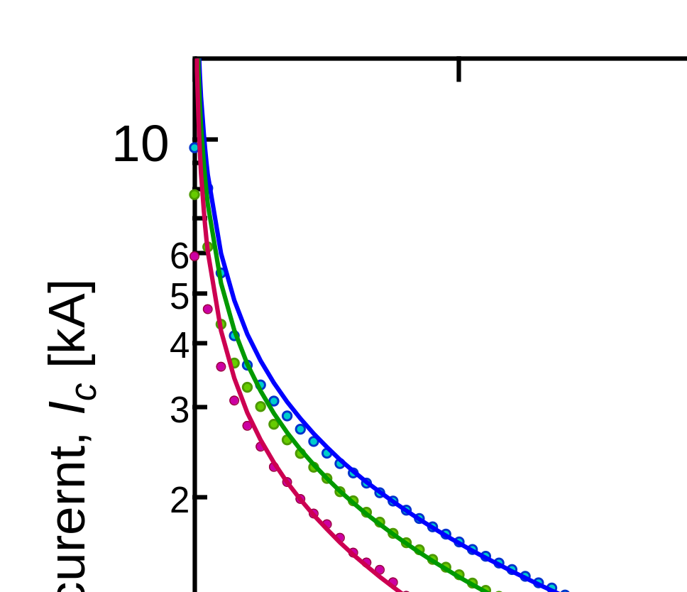
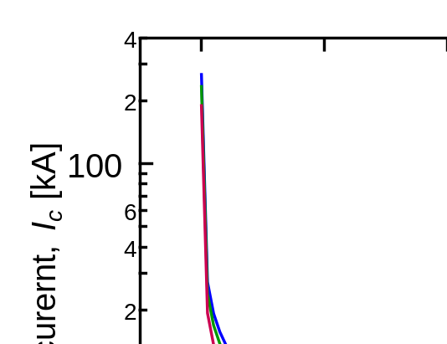
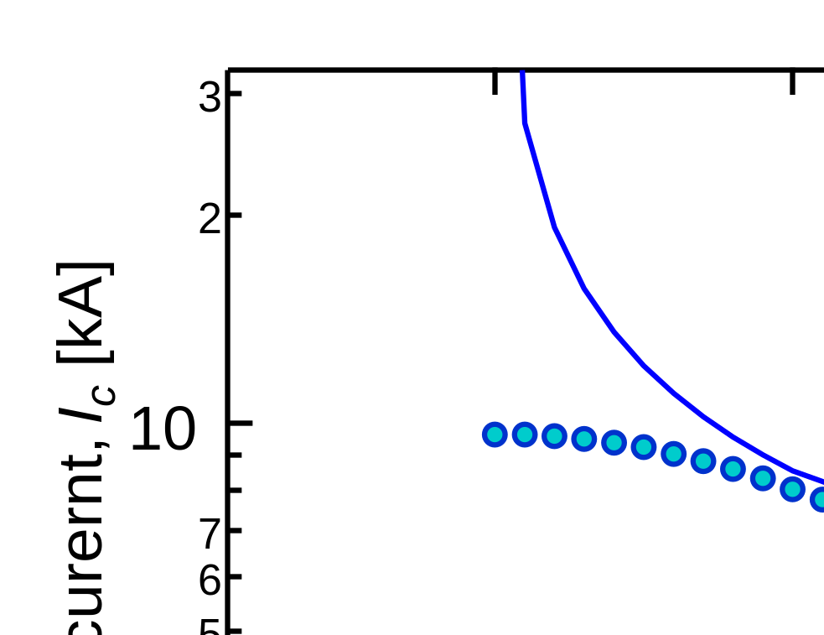
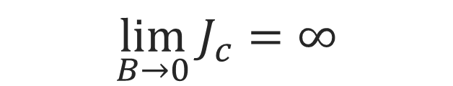
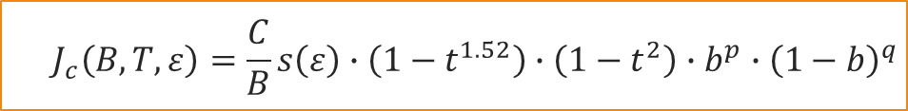
Cut-off in Low-Field J_{c} Scaling Law
$$J_{c}\left(B,T,ε\right)=\frac{C}{B}s\left(ε\right)∙\left(1−t^{1.52}\right)∙\left(1−t^{2}\right)∙b^{p}∙{\left(1−b\right)}^{q}$$
$$\lim_{B→0}{J_{c}}=∞$$
To avoid divergence, a low field cut-off has been introduced
I_{cut-off, 4.2 K} = 9.6 kA @ 80 mT

Slide 6
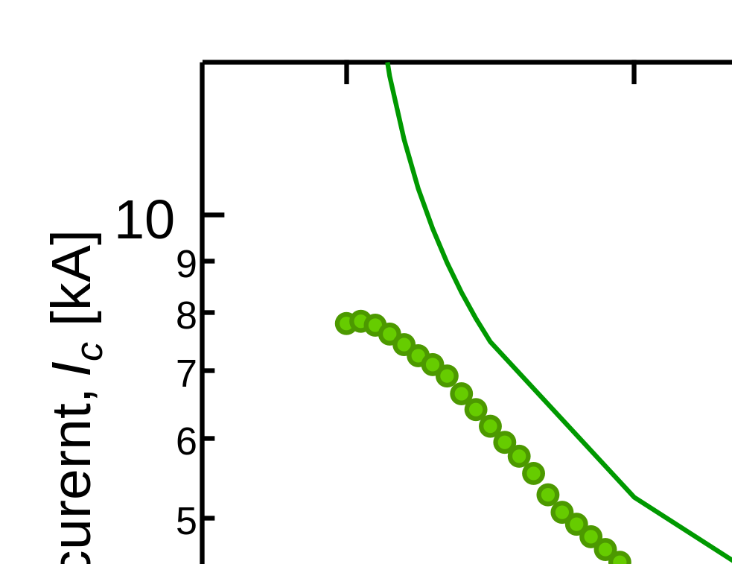
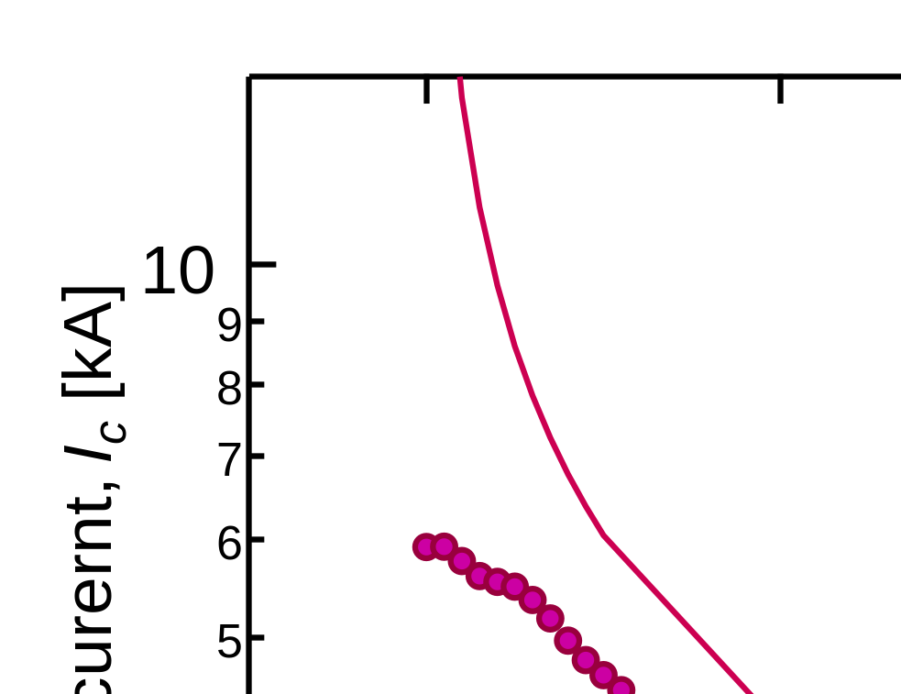
Update on 2026 task activities
$$J_{c}\left(B,T,ε\right)=\frac{C}{B}s\left(ε\right)∙\left(1−t^{1.52}\right)∙\left(1−t^{2}\right)∙b^{p}∙{\left(1−b\right)}^{q}$$
$$\lim_{B→0}{J_{c}}=∞$$
To avoid divergence, a low field cut-off has been introduced
I_{cut-off, 4.2 K} = 9.6 kA @ 80 mT
I_{cut-off, 6 K} = 7.8 kA @ 90 mT
I_{cut-off, 8 K} = 5.9 kA @ 100 mT

Slide 7
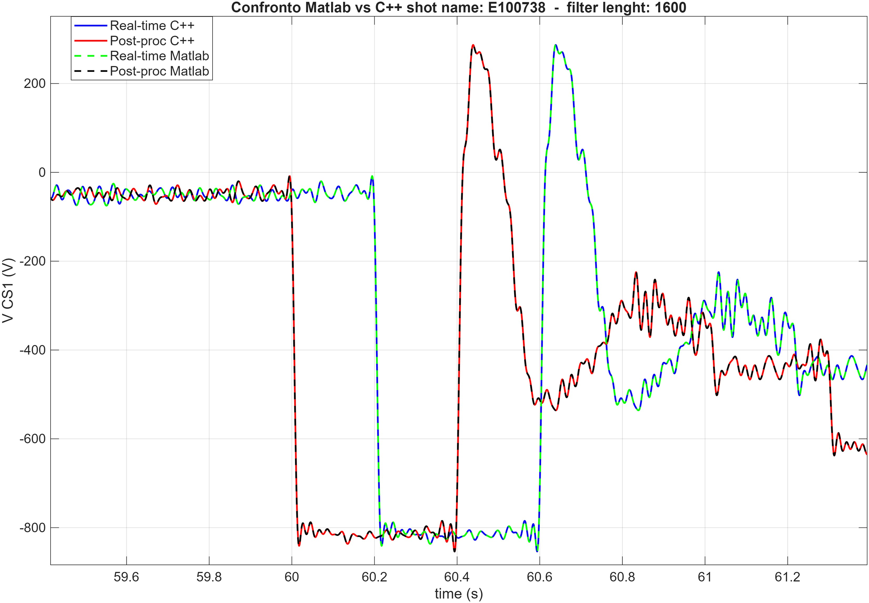
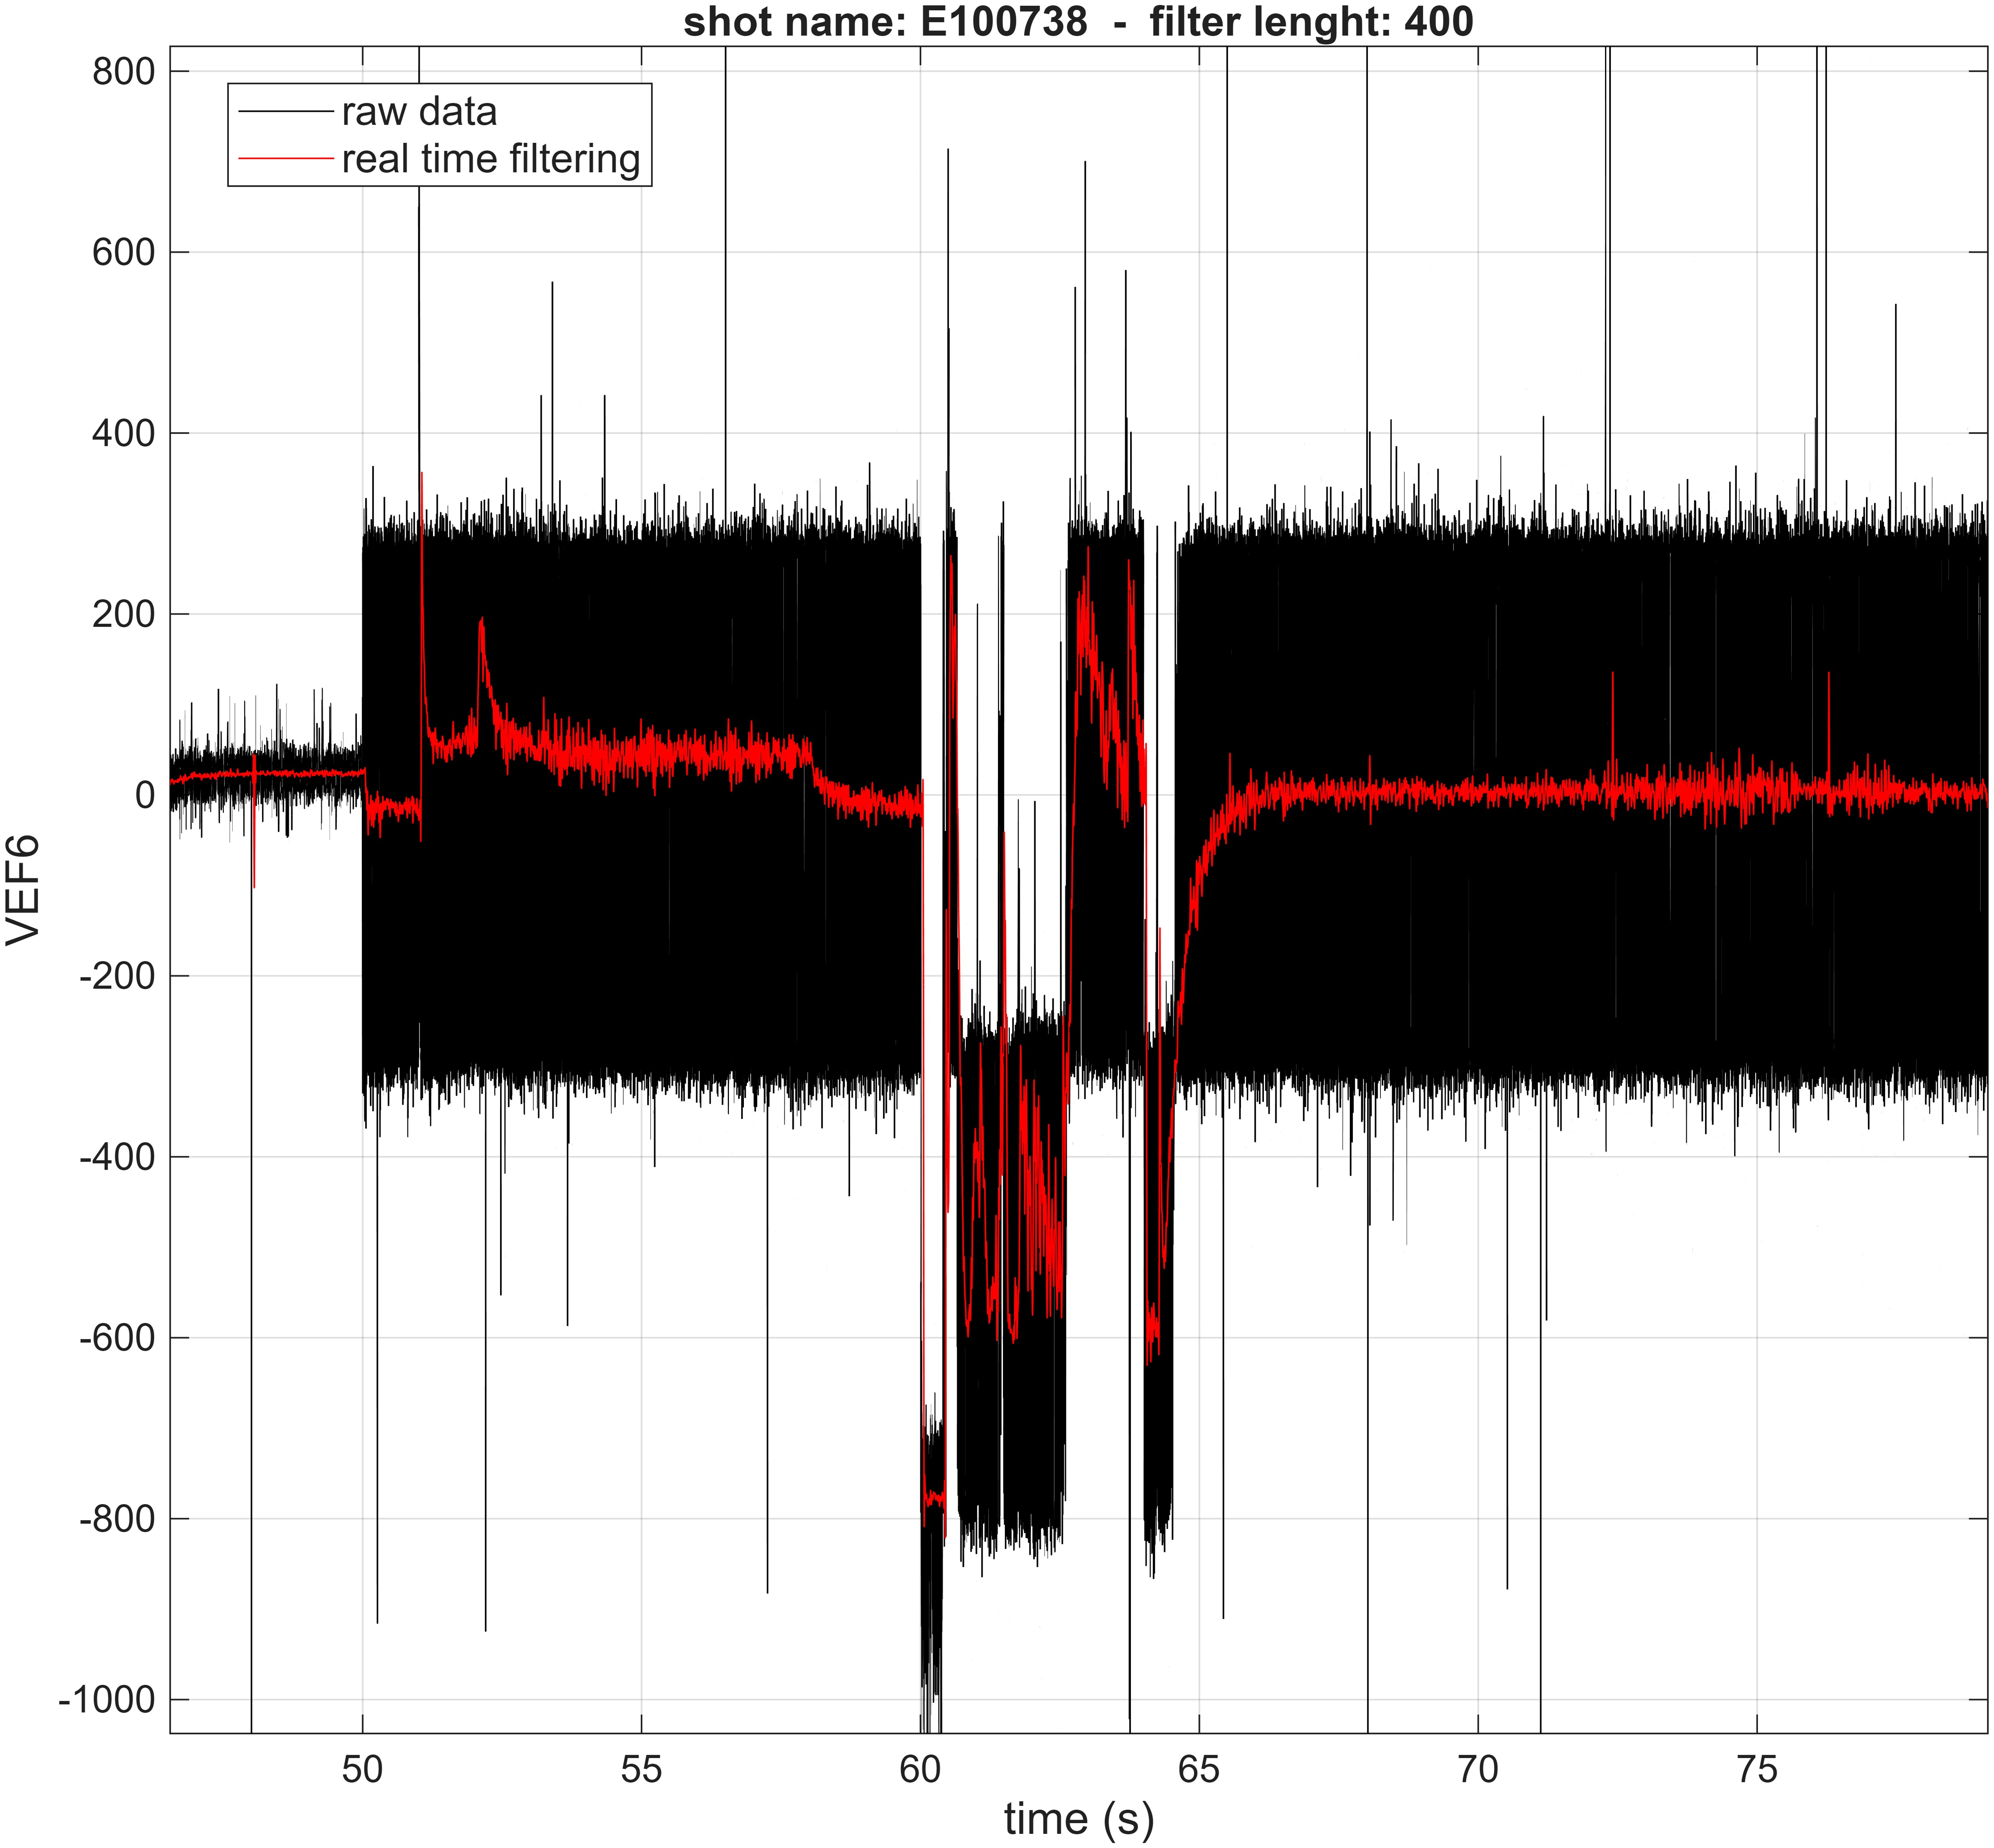
Update on TFQDV activities
The TFQDV signal processing activities has been devoted to the validation and the consolidation of software tool (ANN-based) aimed at TFQDV signal retrieval, correction and transmission to TF interlock system.
TFQDV signal processing activities
Real-time filtering achieved both in Matlab and C++
All U_{PF} filtered

Slide 8
The TFQDV signal processing activities
devoted to the validation and the consolidation of software tool (ANN-based) aimed at TFQDV signal retrieval, correction and transmission to TF interlock system
During Integrated Commissioning held in 2021 and 2023, it was observed that during PF current transients, a spurious transient signal was generated on the TF quench detection voltage (TFQDV) channels, that could be misinterpreted as a TF quench event → as the persistent risk of false-positive quench detection could penalize operation schedules, a dedicated mitigation strategy was implemented:
A software-based approach was chosen to correct in real-time the TFQDV signal through a correlation with a reference signal, for instance the PF coils control voltage (U_{PF}).

Slide 9
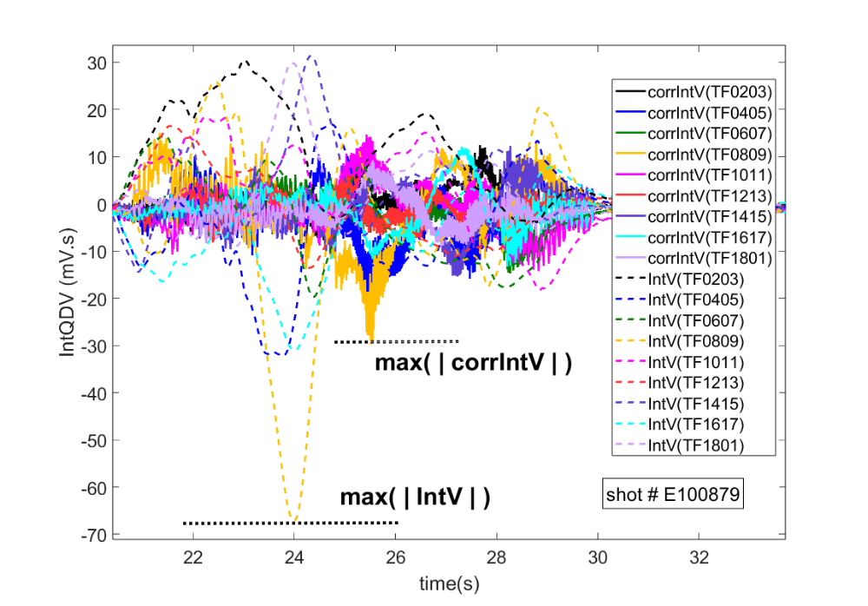
Two methods were pursued:
A purely linear correlation between TFQDV and U_{PF} processed signals, using a direct transfer matrix → Unique Matrix (UM) approach
An Artificial Neuron Network (ANN)-based approach to dynamically correlate TFQDV and U_{PF} to improve fitting fidelity → ANN approach
Key concepts:
The quench identification criterion is based on a 1 second integration of the nine integrated TFQDV (intV) voltage channels
metric that reflects the correction performance, associated with the mitigation of false positive detection risk: Peak Attenuation Ratio (R_{PA}) and is defined as R_{PA}=max(|corrIntV|) / max(|IntV|) where the two components are identified as shown in Figure

Slide 10
The UM method:
demonstrates the ability to mitigate spurious IntV peaks, with 85% rate of shots showing lower maximum after correction. However, it remains limited as only about 20% of the shots exhibited an intV peak decreased by more than 25%, and the best correction rate is 38%
ANN approach:
    single inner layer architecture
    The considered ANN architecture is Multy Layer Perceptron (MLP) implemented in C++ environment with settings as follows:
    nb of input / hidden layers / output neurons: 100 /80 /9
    Learning rate: h=0.01; momentum coefficient: a=0.1
    Number of total epochs: 40000
C++ Real-time filtering
the mathematical relationship that the ANN will approximate is of the type:
intV^{j}(t)=f(V_{PF}^{i}(t-0.1s), V_{PF}^{i}(t-0.2s), …, V_{PF}^{i}(t-1s))
with i=1,…,10 indexing the 10 PF coils, and j=1,…9 indexing the 9 channels of the intV signals.
7 runs → selected to maximize the diversity of current patterns
substantial improvement with 80% of shots having peaks mitigated by more than 25%, and obtaining lower average R_{PA}

Slide 11
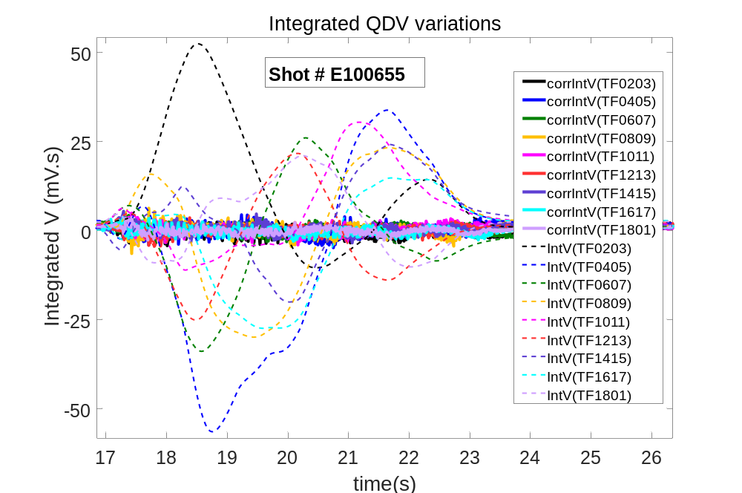
    .
    four inner layers architecture
    explored different MLP architectures by considering four hidden layers (4‑HL) for which the number of neurons are 128, 64, 32 and 16.
    The activation function was changed from Sigmoid to LeakyReLU, for the hidden layers neurons, and a linear function for the output layer. The network was trained using Adam optimizer with a learning rate of 10⁻⁴ and the reduced number of training epochs was fixed to 3000
This approach was developed using the open source PyTorch framework
A refined setting of the MLP configuration applied on selected OP1 shots was shown to reduce the quench identification signal peak by almost 70 % in average, and by almost 90% for the best cases.
These results are highly encouraging, and the applied method will be further optimized
Integrated TFQDV curves before and after correction

Slide 12
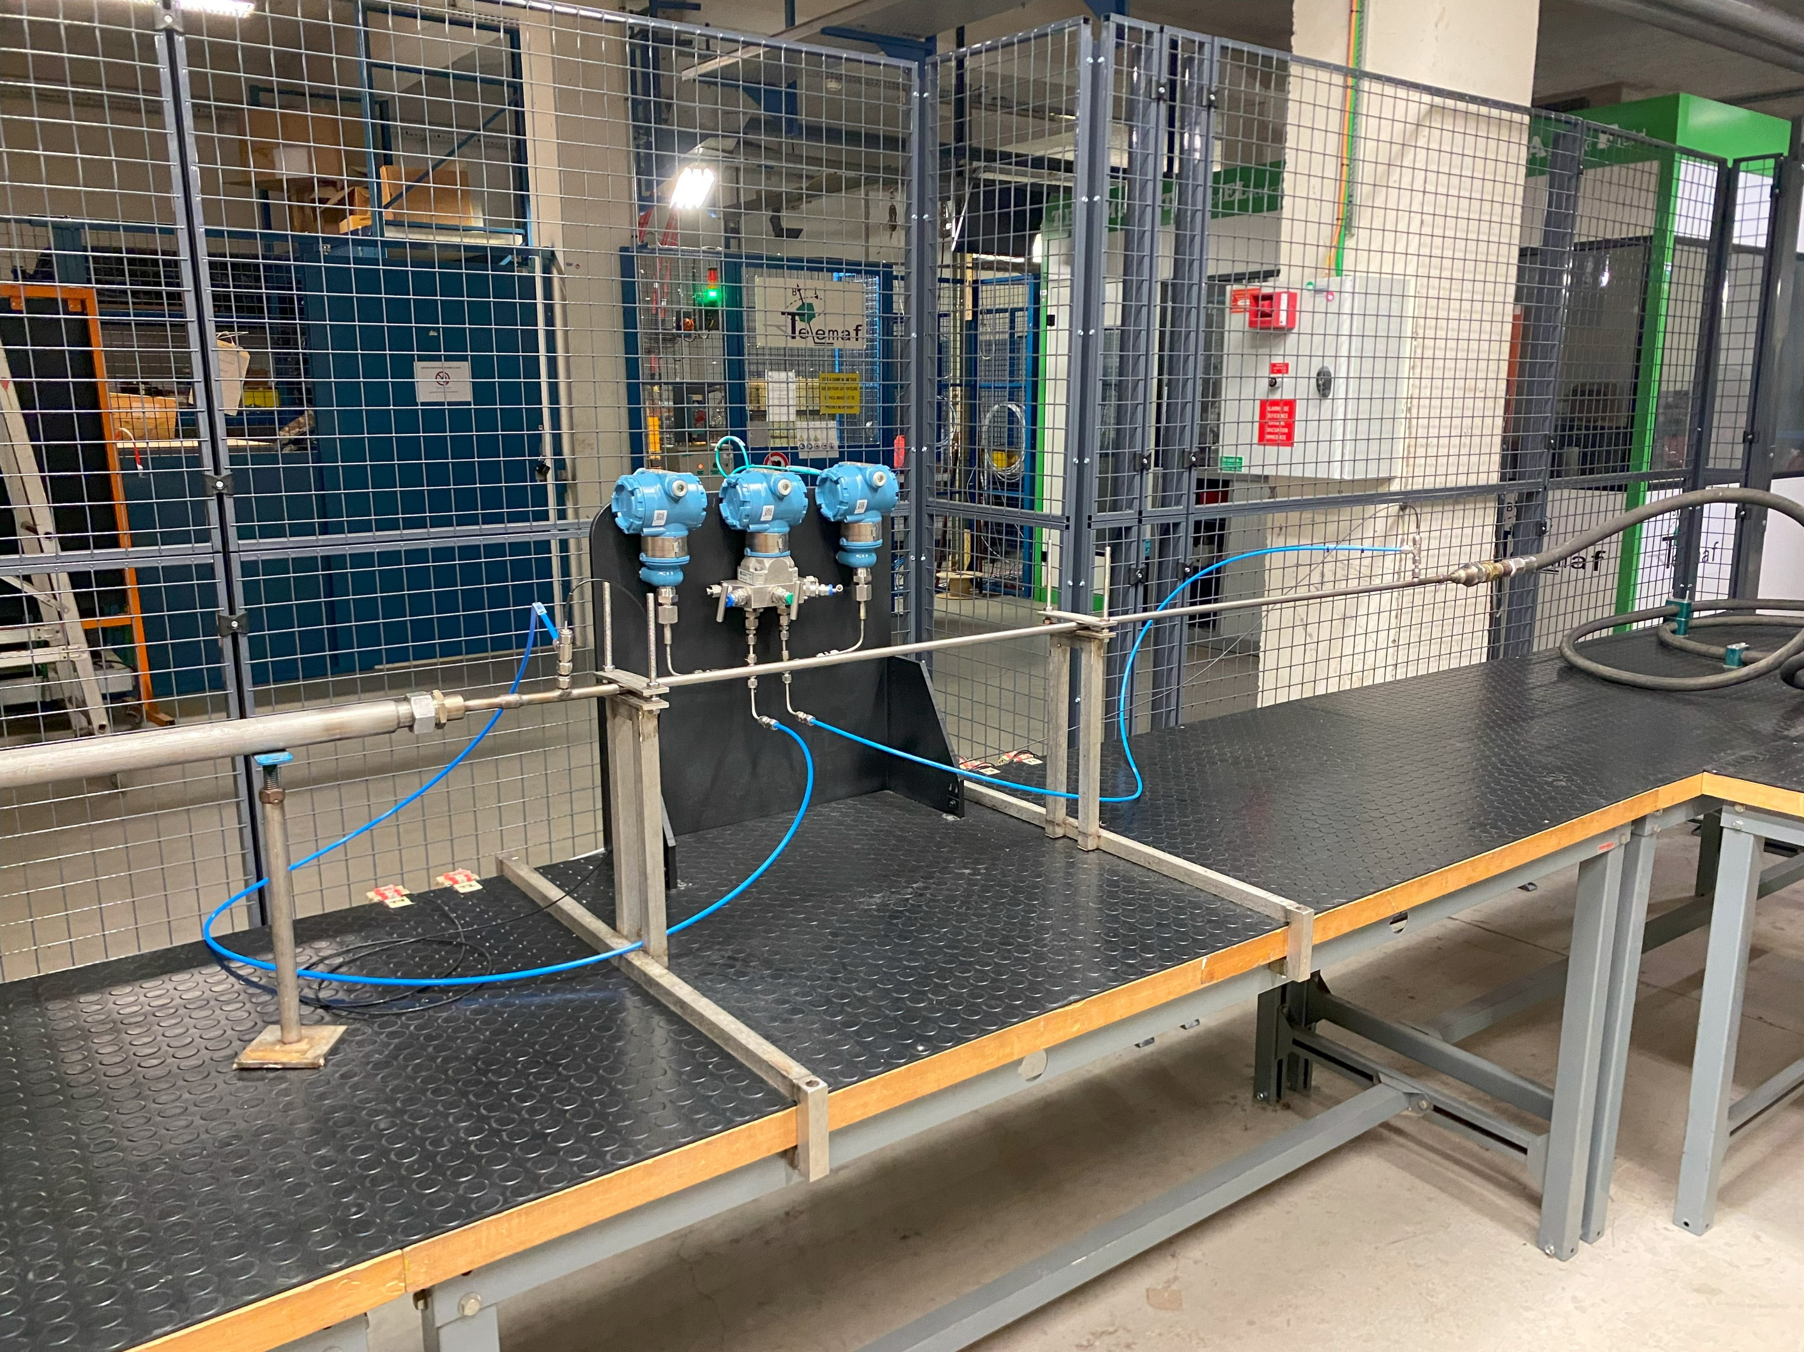
Othello test
Othello test facility at CEA.
Hydraulic characterization of conductor sample with gaseous nitrogen flow.
Pressure drop measurement to evaluate the friction factor.
3 CICC samples to be tested (EF-L, EF-H and CS) plus the central spiral.

Slide 13
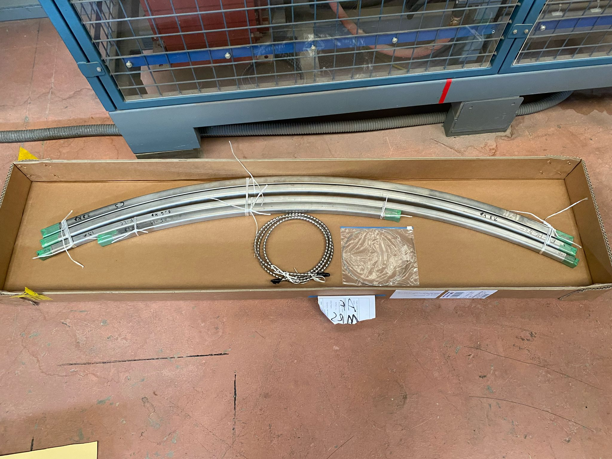
Conductor samples
Bundle (spiral blocked):
  EF-L, EF-H, CS → August 2025
Full conductor (bundle + spiral)
  EF-L → November 2025
  EF-H → March 2026
  CS → not done (difficulty to remove the spiral plug)
Spiral alone (same for all the conductors) → May 2026

Slide 14
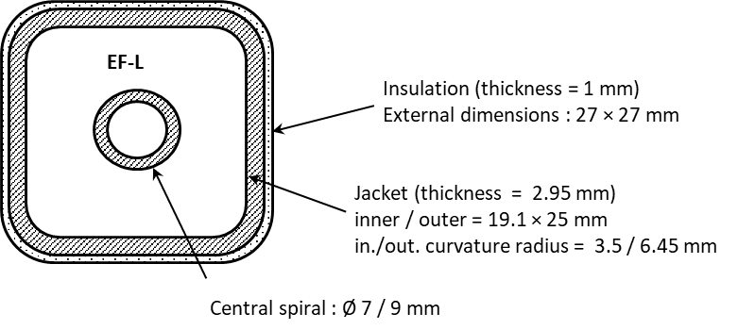

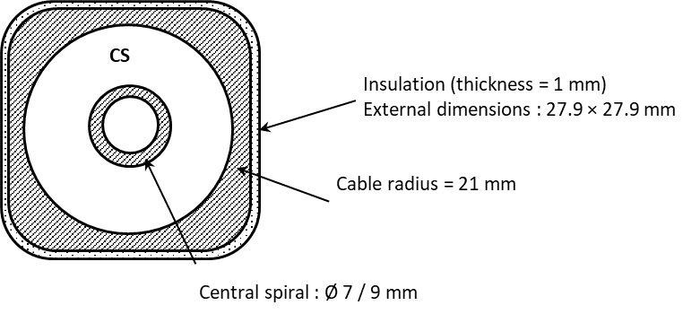


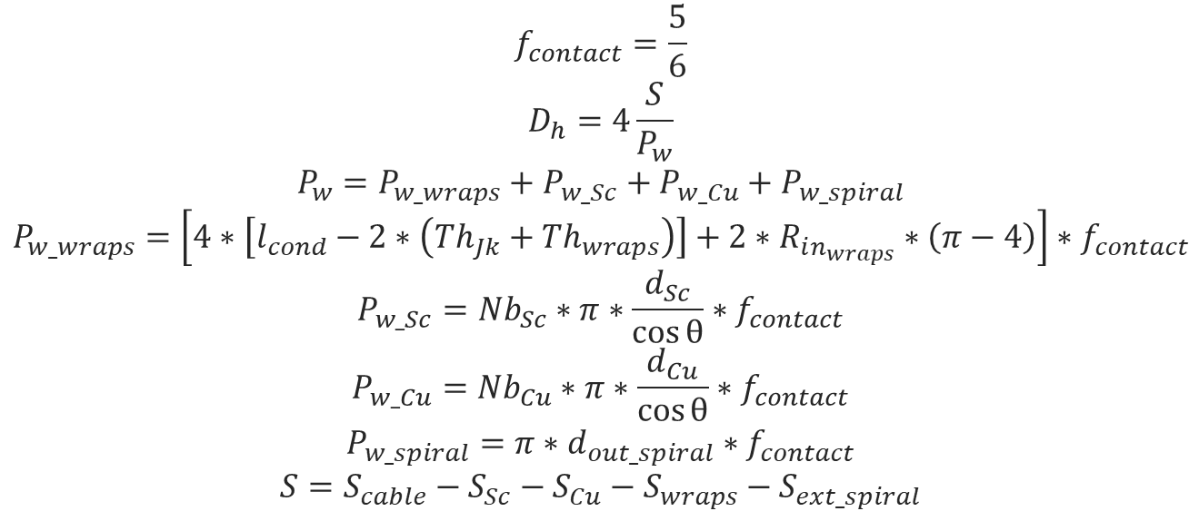
Hydraulic geometrical parameters
$$∆P=\frac{1}{2}ρv^{2}f\frac{L}{D_{h}}$$
$$f=2 ∆P\frac{D_{h}}{L}\frac{ρS^{2}}{ṁ^{2}}$$
Reduction of the wetted perimeter by a factor of 5/6 accounting for the inter-strand contact.
$$f_{contact}=\frac{5}{6}$$
$$D_{h}=4\frac{S}{P_{w}}$$
$$P_{w}=P_{w_wraps}+P_{w_Sc}+P_{w_Cu}+P_{w_spiral}$$
$$P_{w_wraps}=\left[4∗\left[l_{cond}−2∗\left({Th}_{Jk}+{Th}_{wraps}\right)\right]+2∗R_{in_{wraps}}∗\left(π−4\right)\right]∗f_{contact}$$
$$P_{w_Sc}={Nb}_{Sc}∗π∗\frac{d_{Sc}}{\cos{θ}}∗f_{contact}$$
$$P_{w_Cu}={Nb}_{Cu}∗π∗\frac{d_{Cu}}{\cos{θ}}∗f_{contact}$$
$$P_{w_spiral}=π∗d_{out_spiral}∗f_{contact}$$
$$S=S_{cable}−S_{Sc}−S_{Cu}−S_{wraps}−S_{ext_spiral}$$
 | Bundle - EF-H | Bundle - EF-L | Bundle - CS | Spiral
D_{h} [m] | 5.01E-04 | 4.90E-04 | 4.82E-04 | 0.009
S [m²] | 1.37E-04 | 9.88E-05 | 9.61E-05 | 6.3617E-05
The hydraulic diameter of the spiral is chosen as the outer diameter.

Slide 15
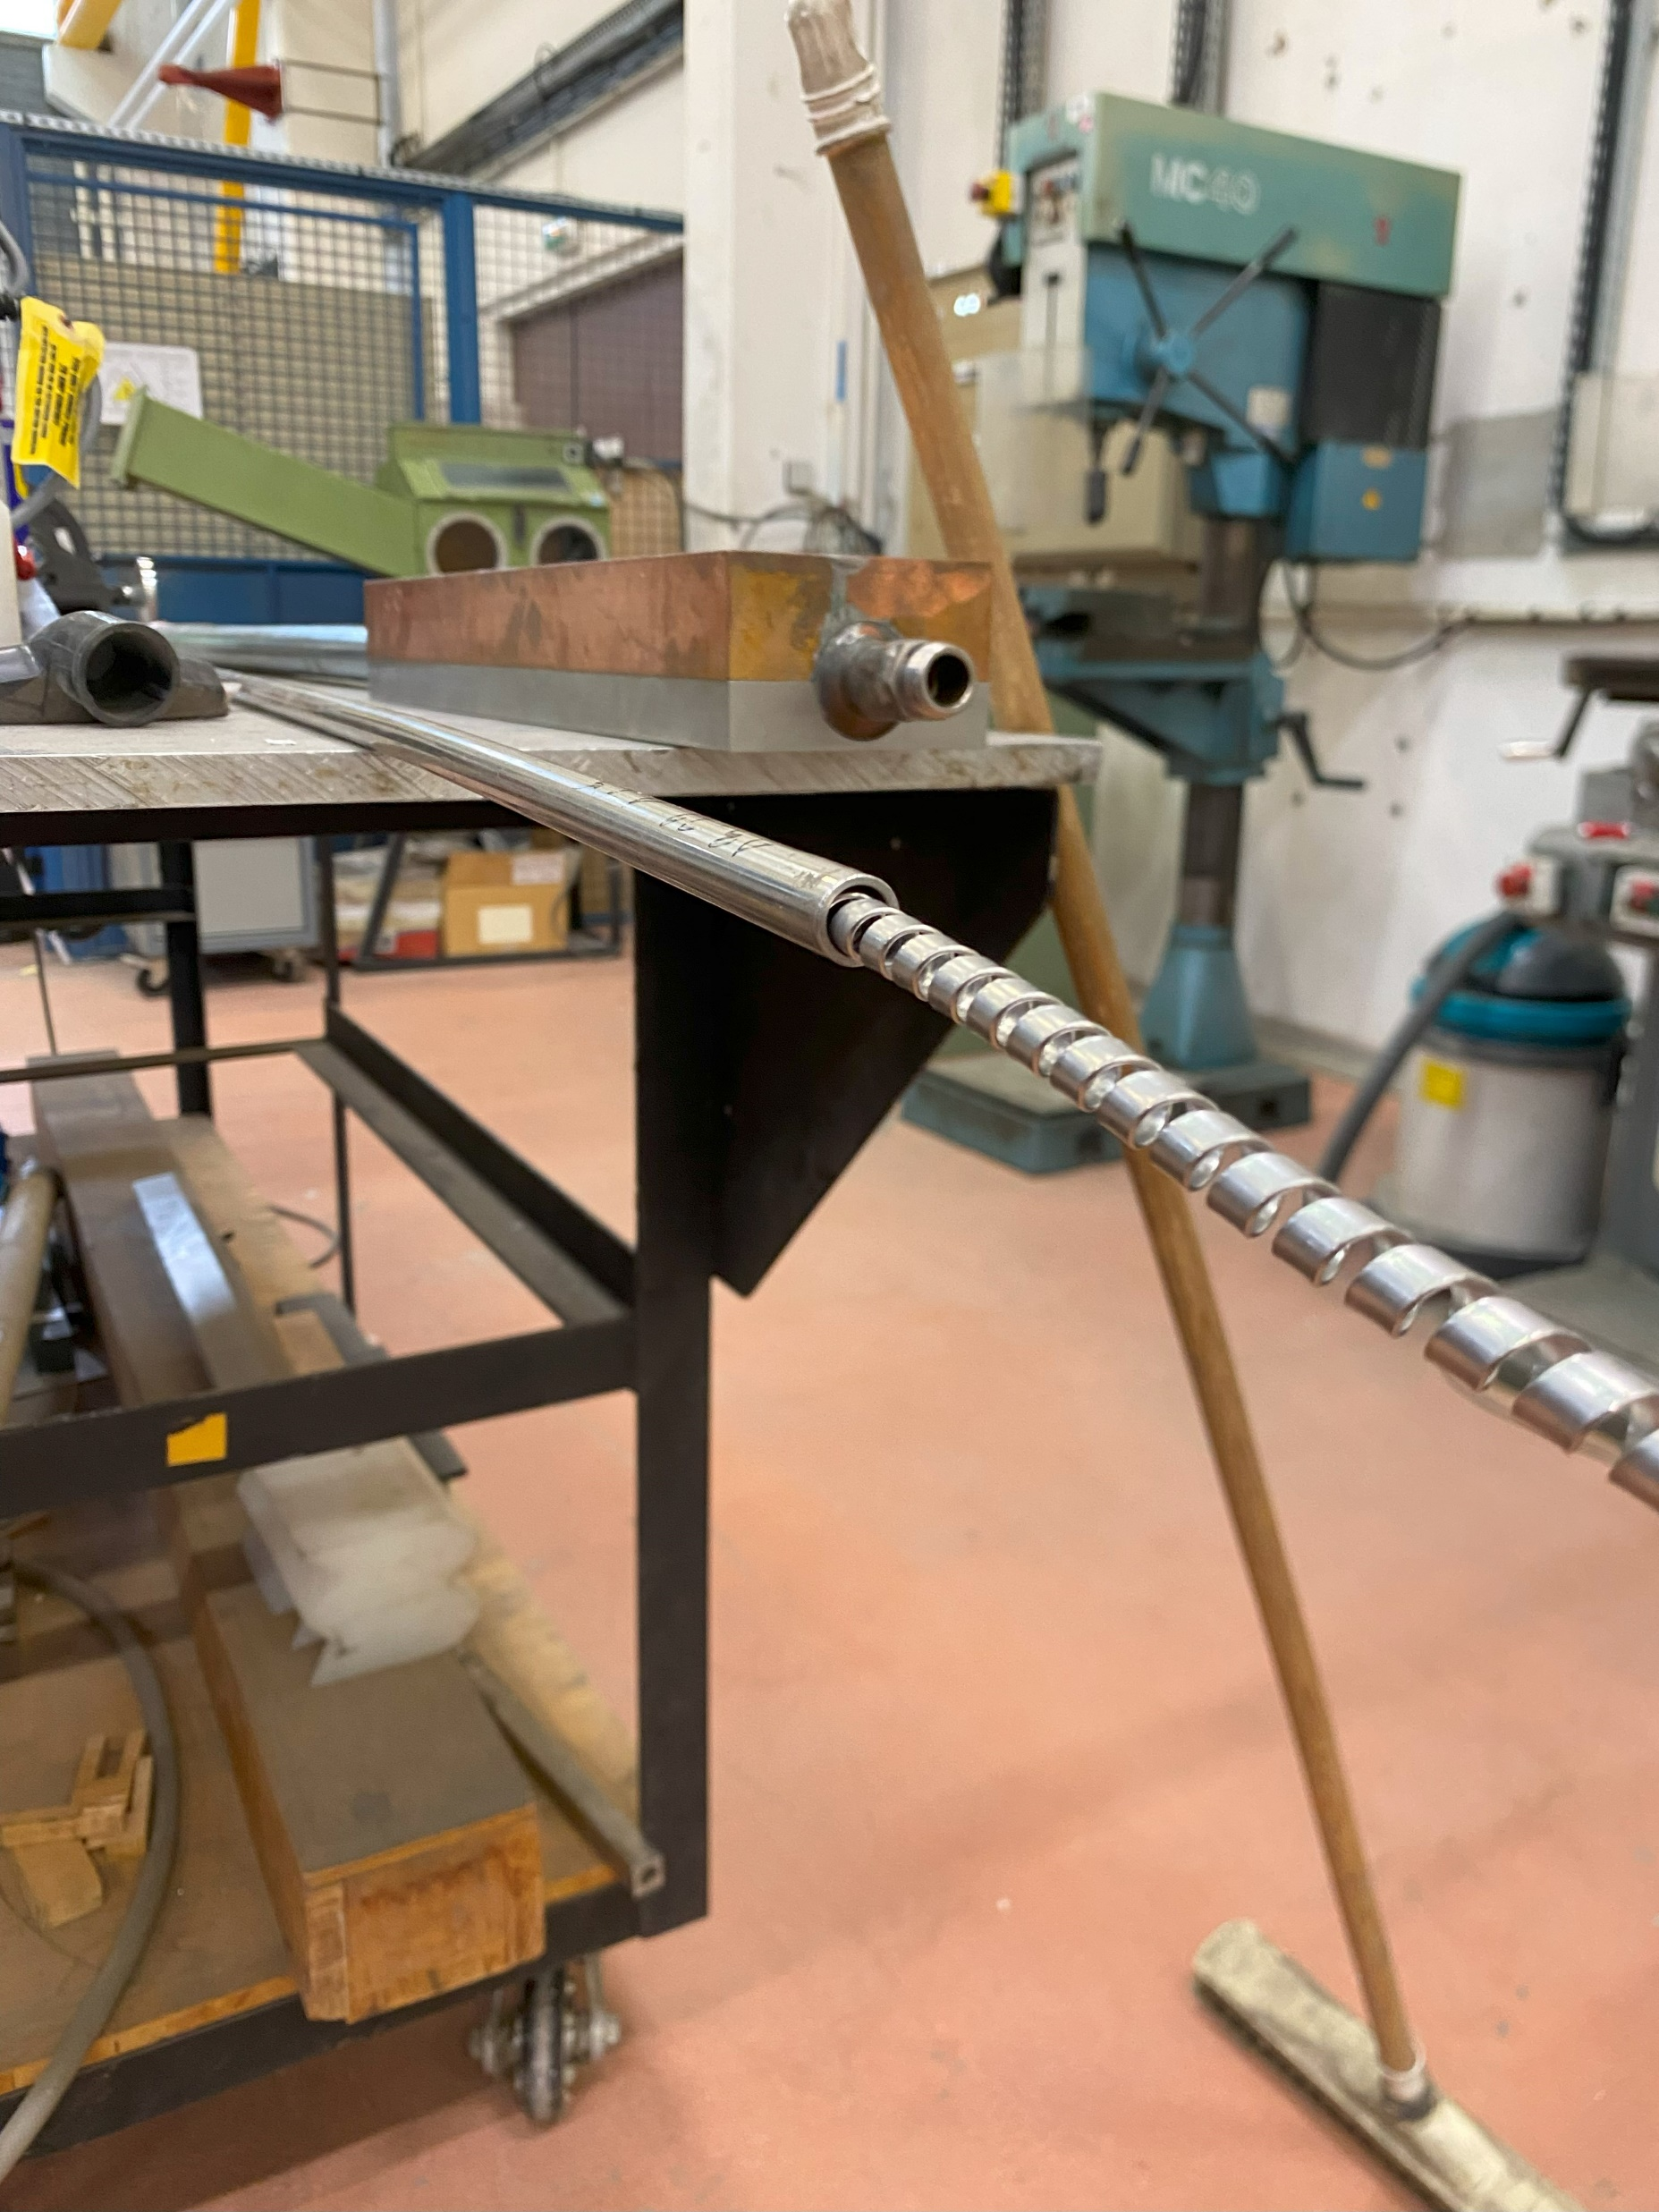
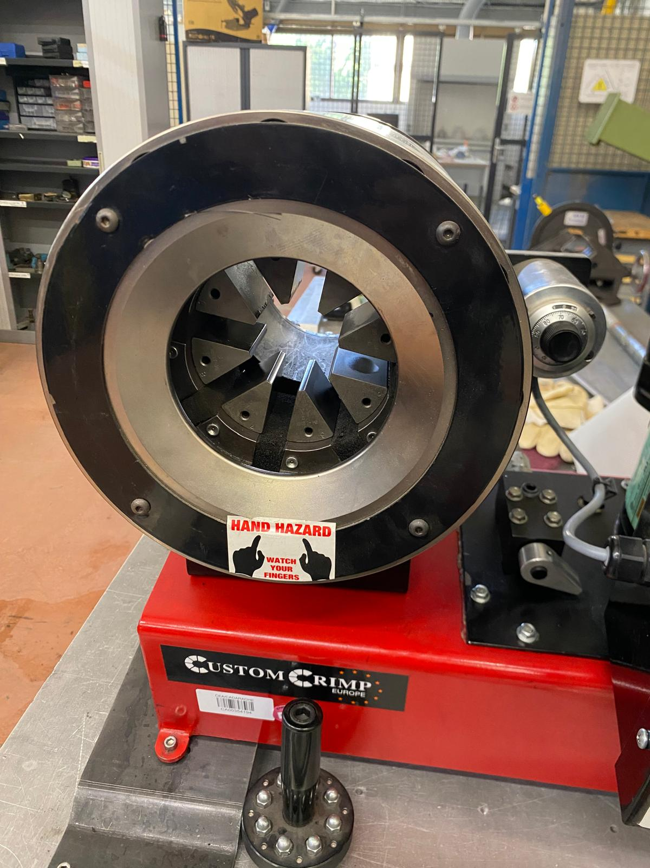
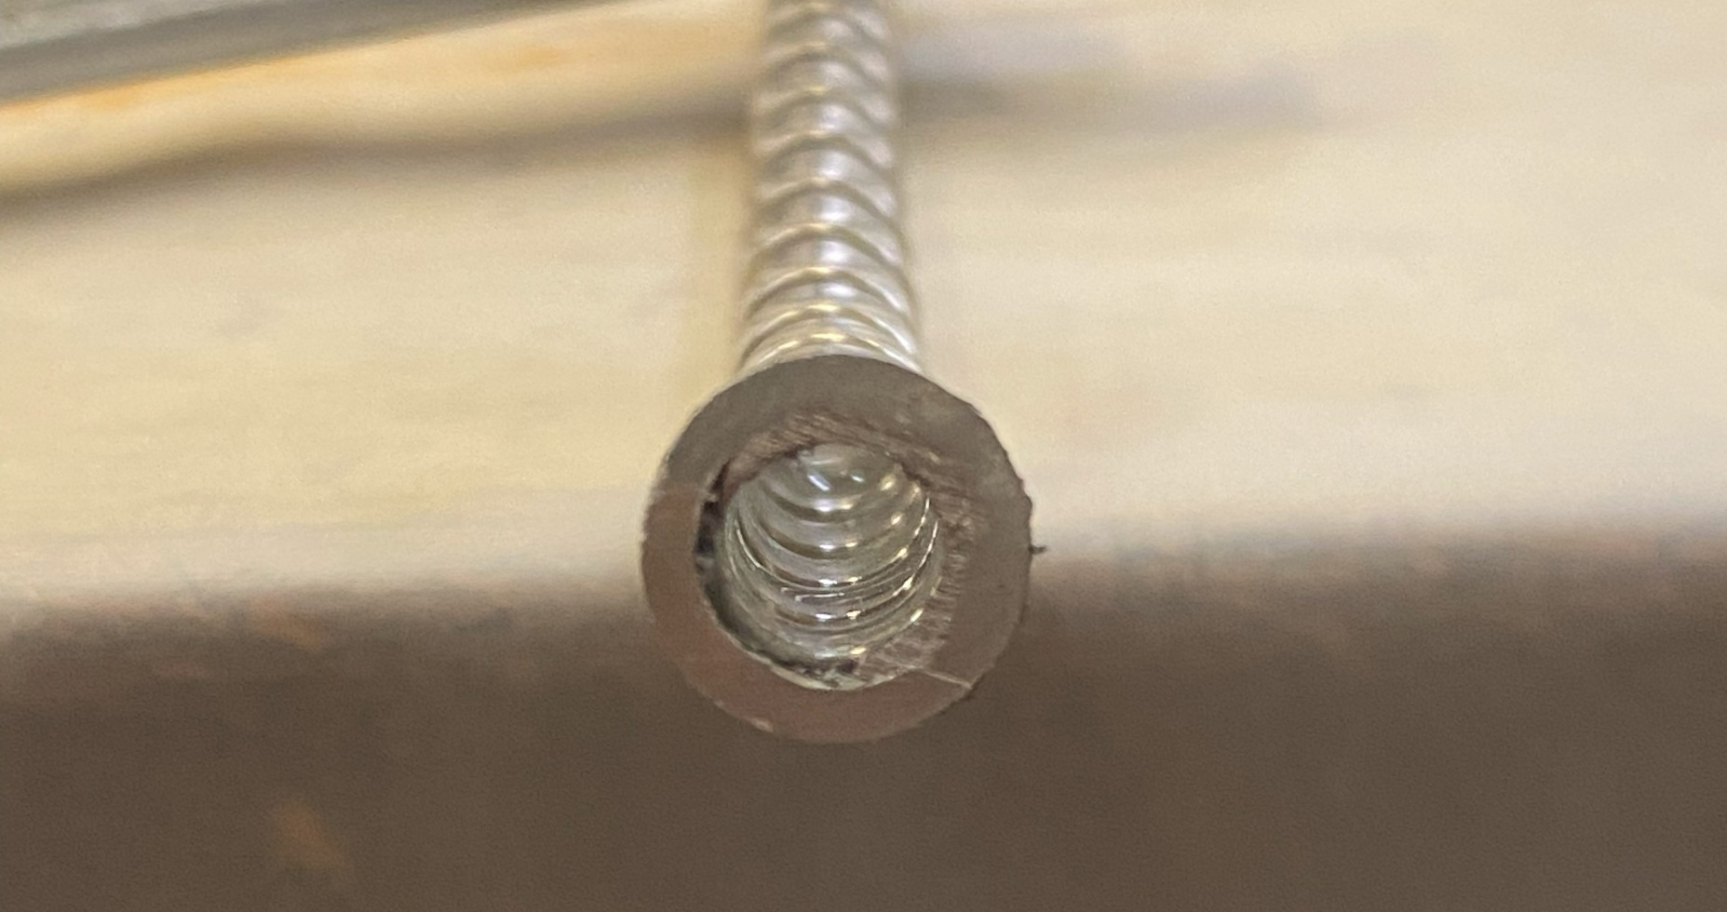
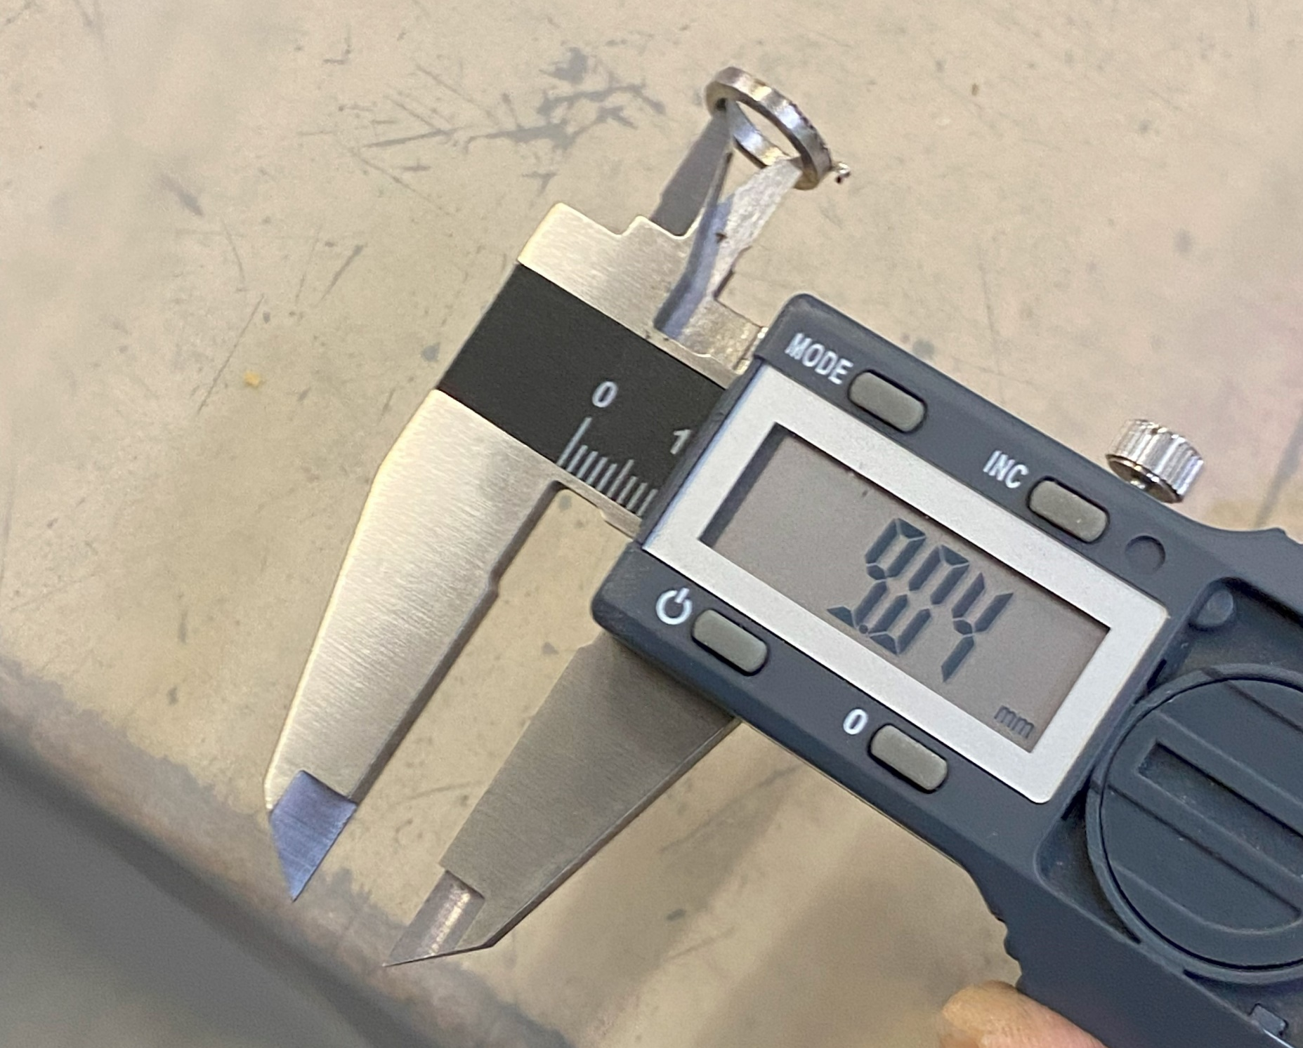
Othello test – Spiral
Outer diameter of the spiral: 9 mm
Initial inner diameter of the tube: 10.42 mm
Tube crimped on the spiral

Slide 16

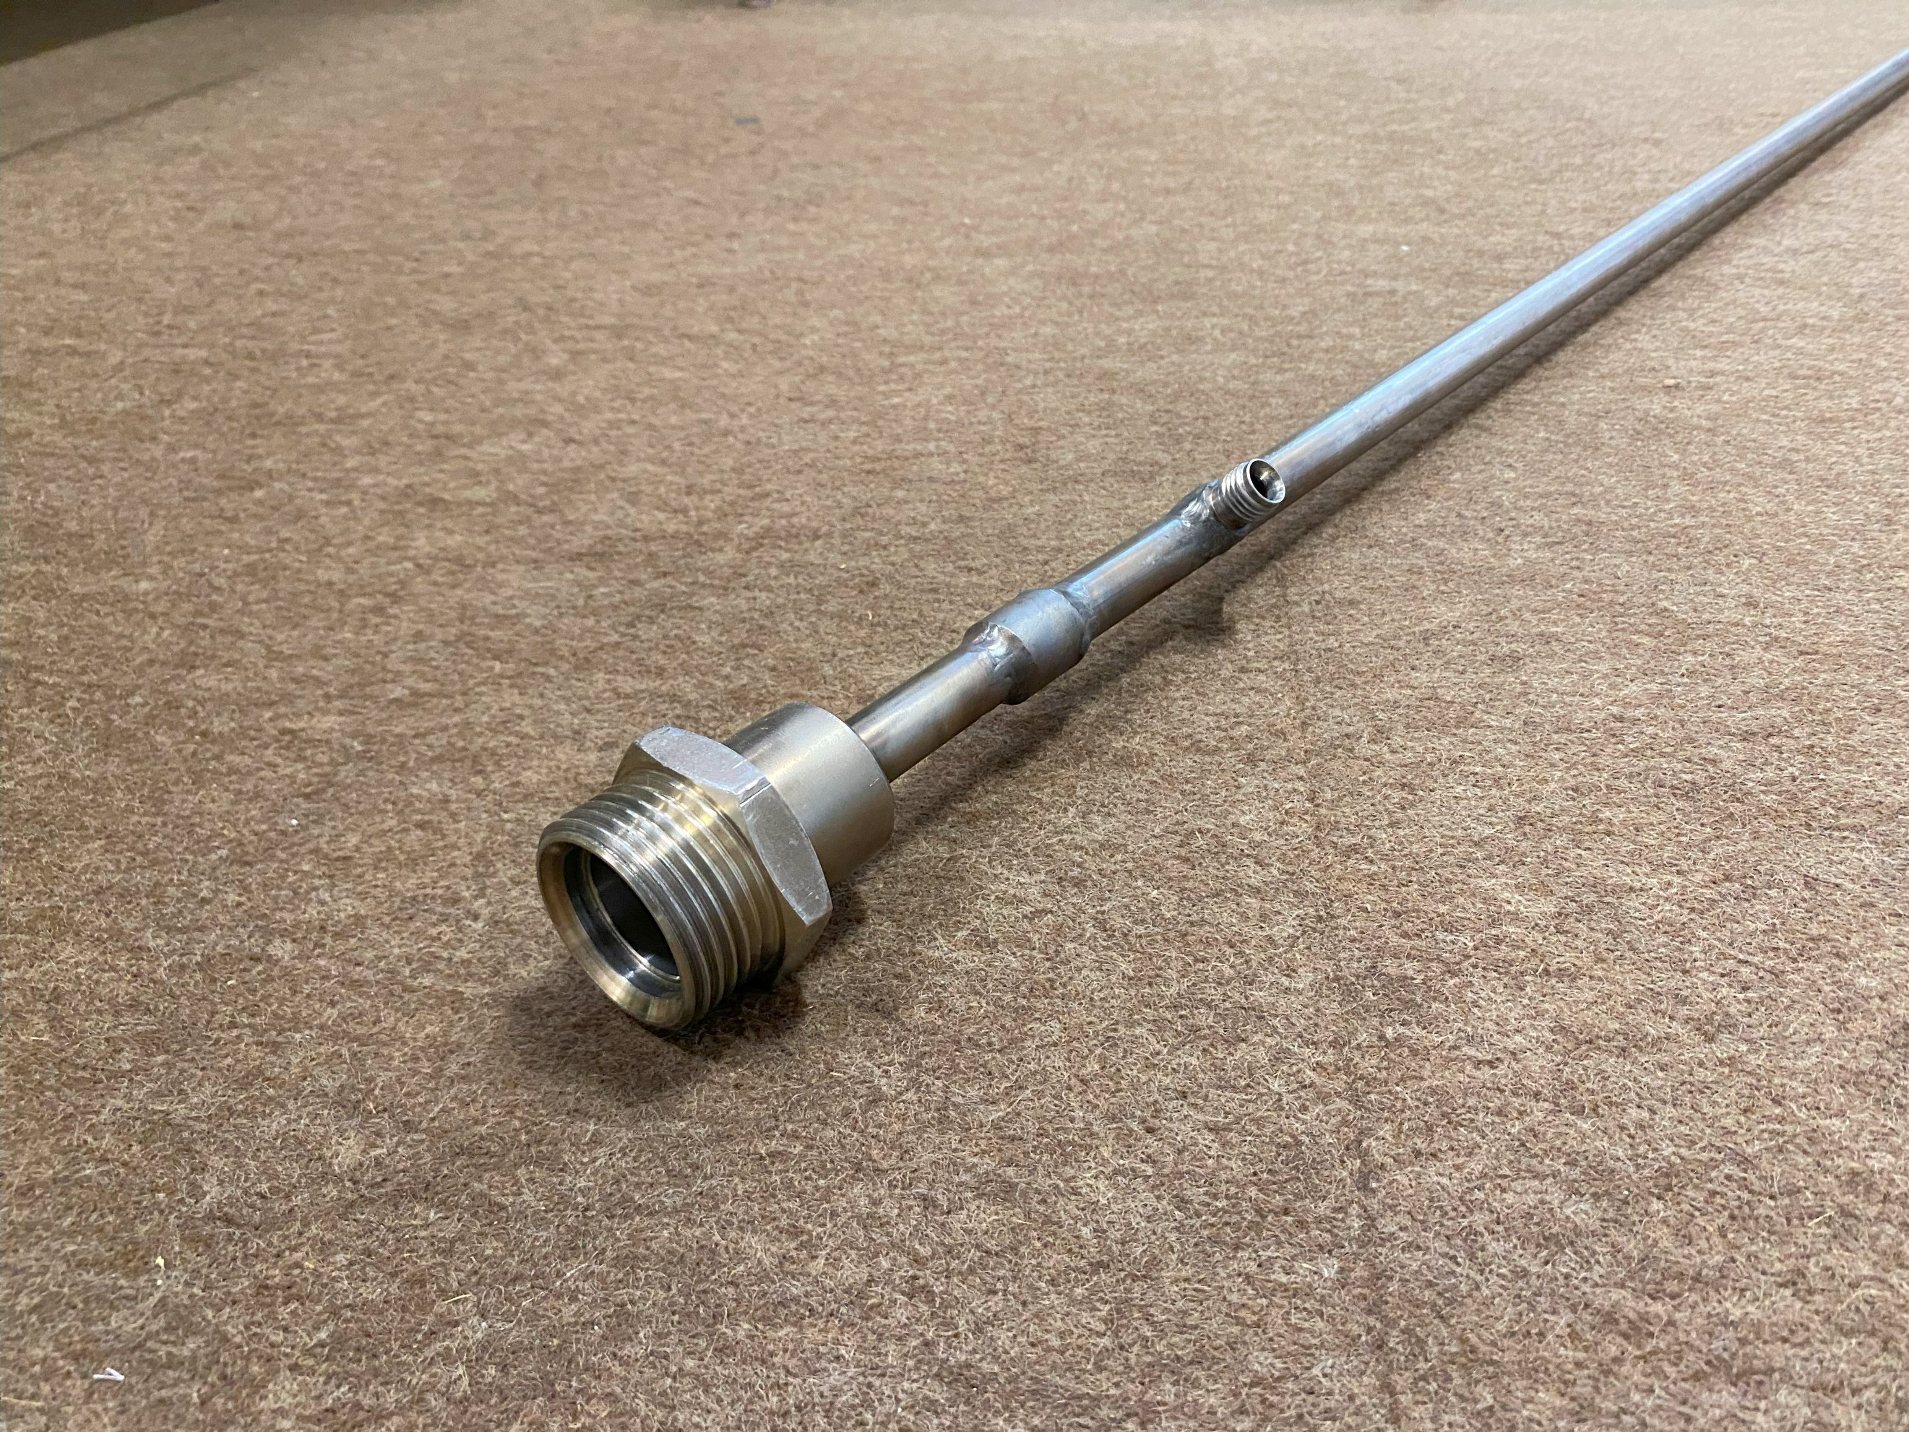
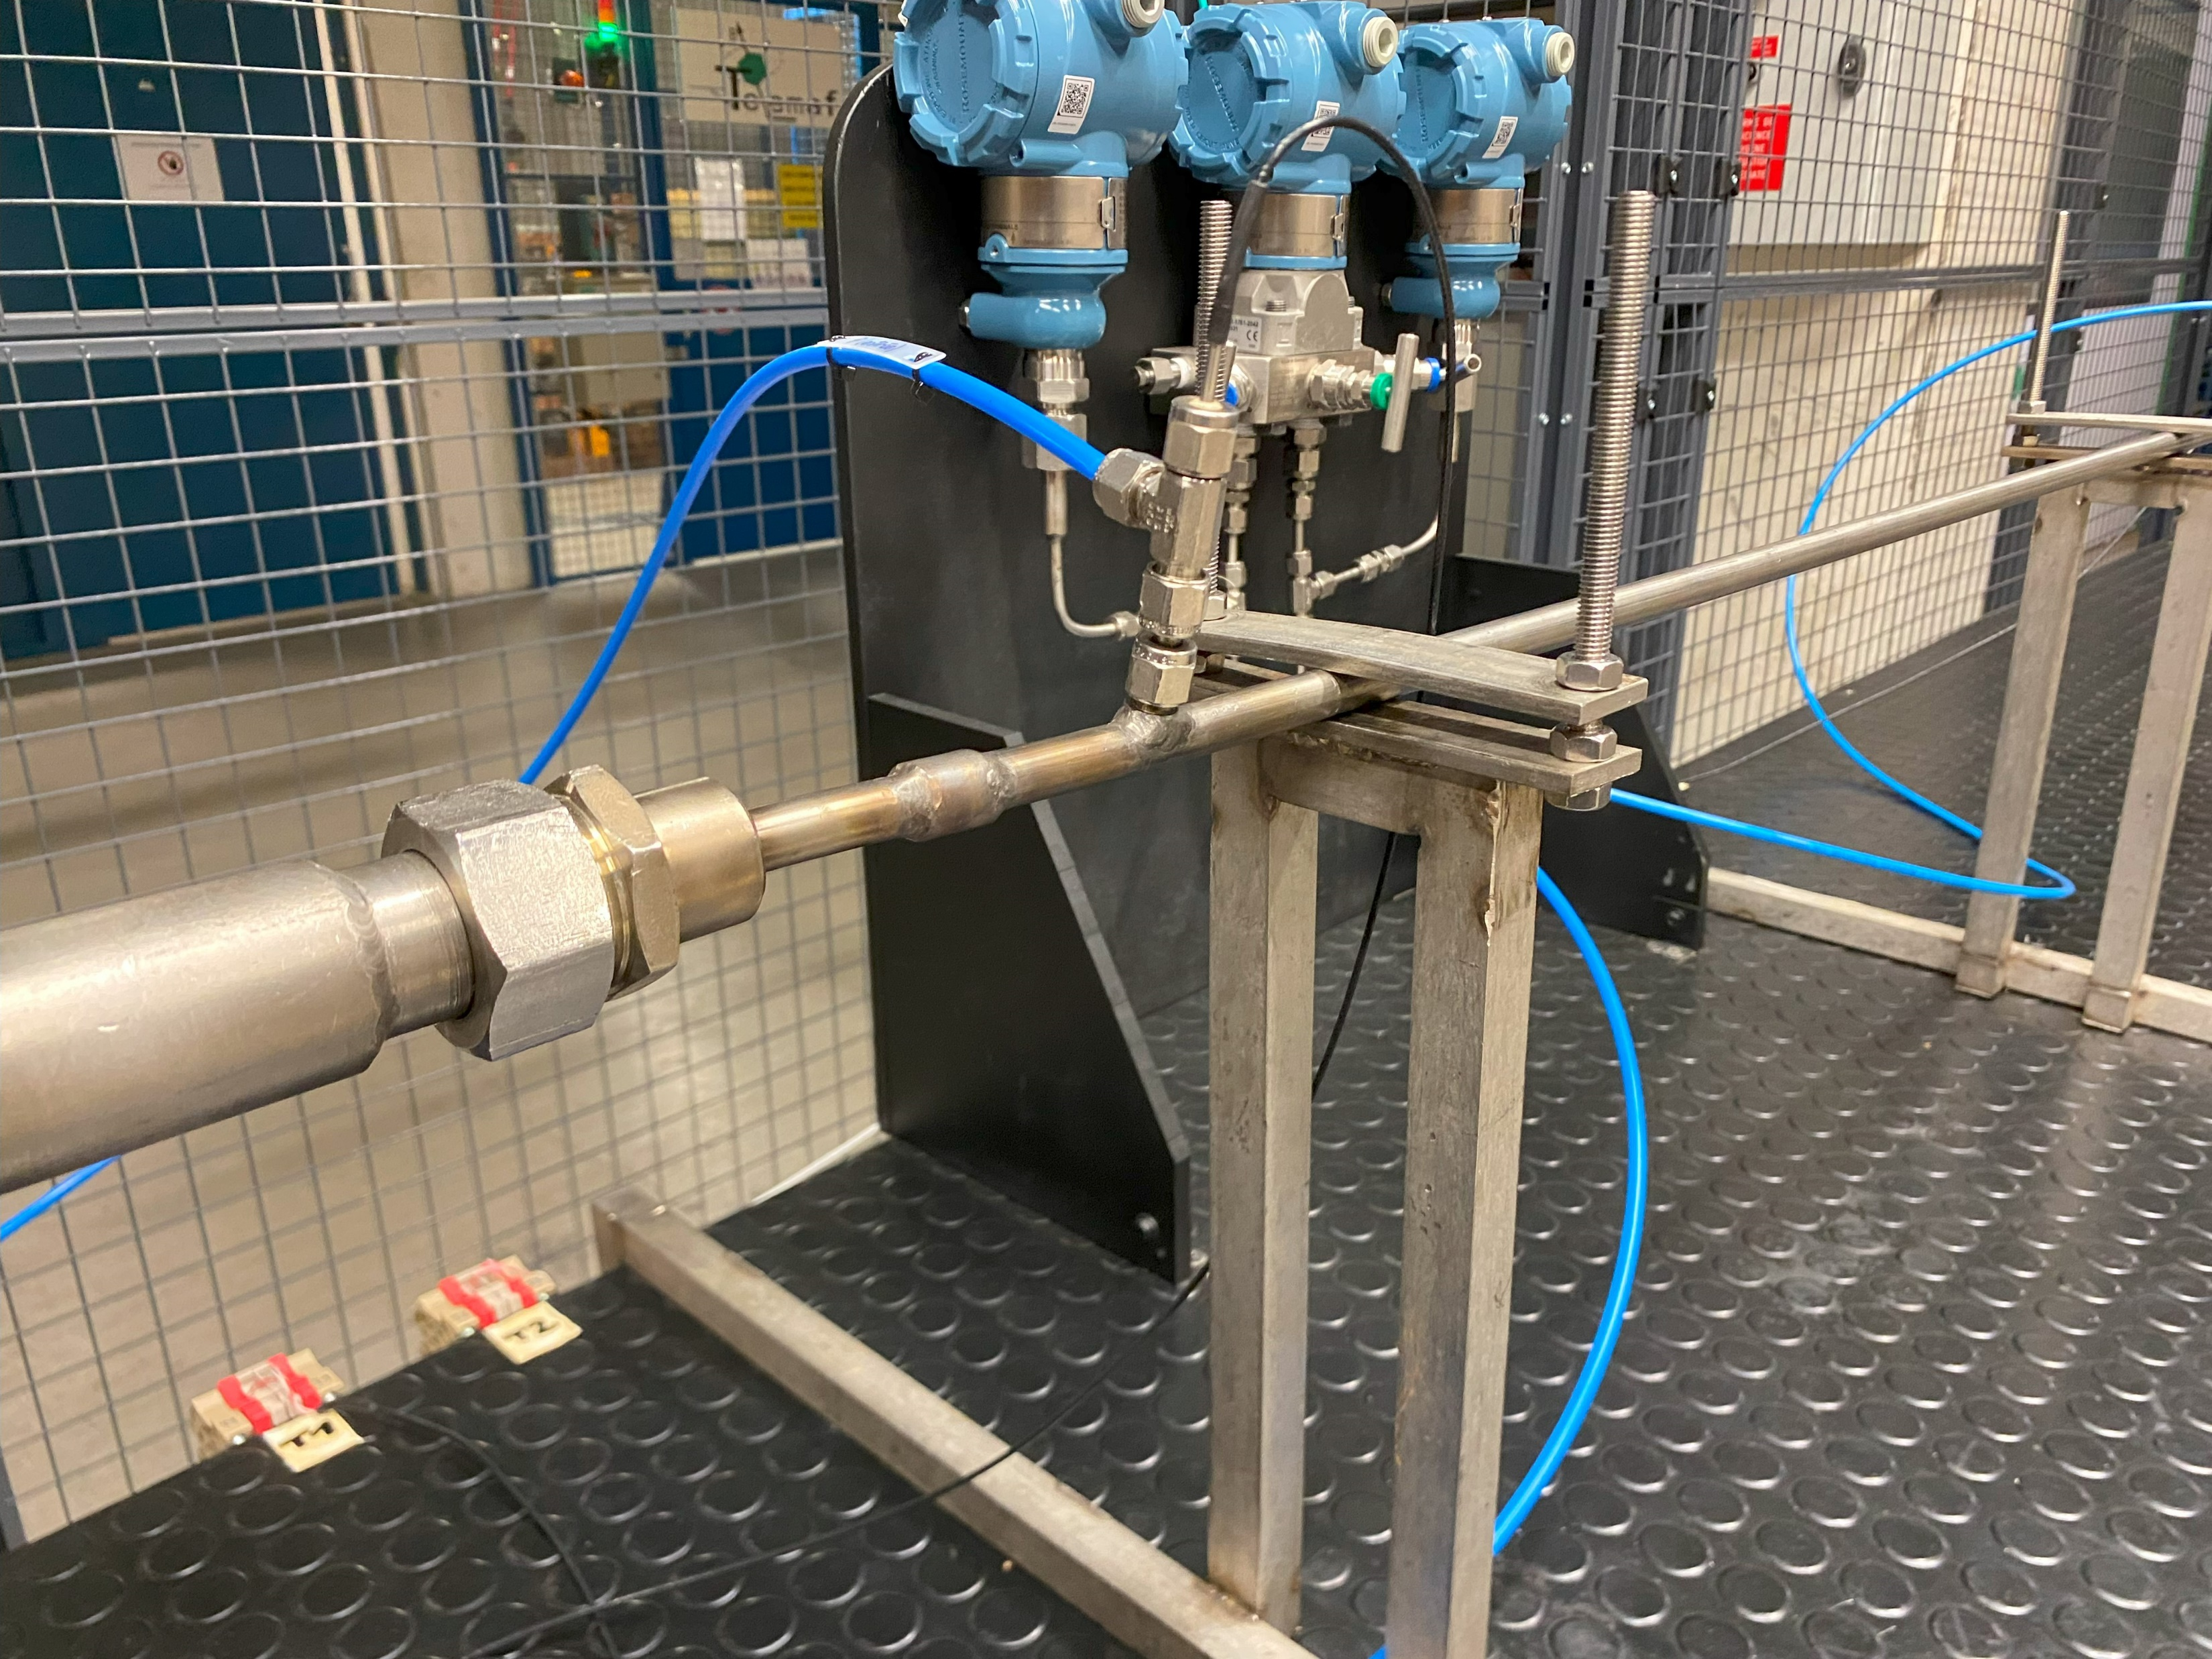
Othello test – Spiral
1.5 m
Length between pressure taps: 1.5 m

Slide 17
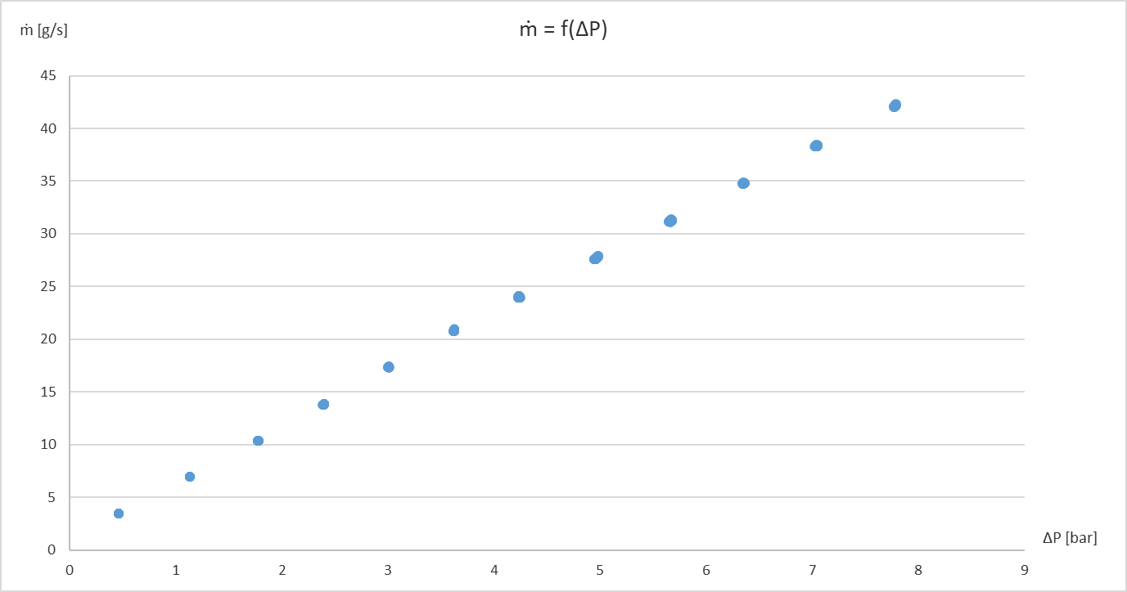
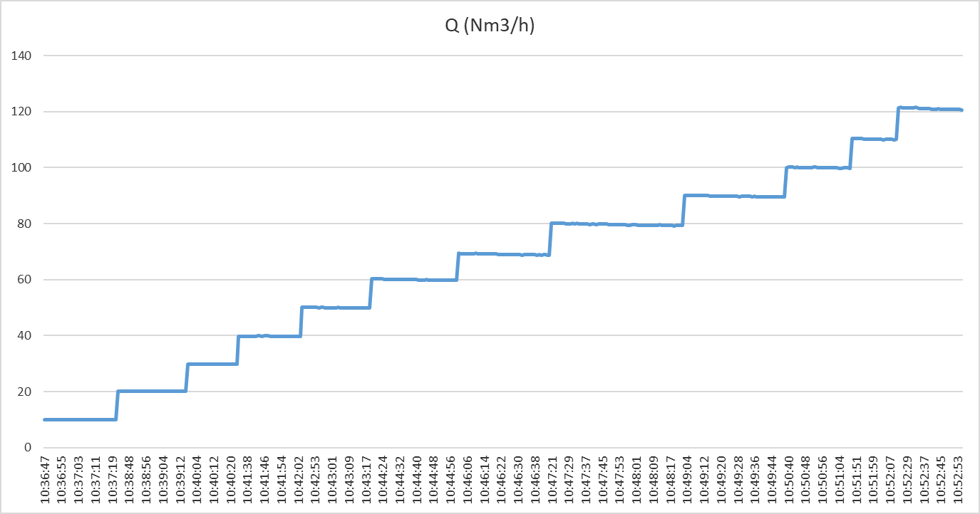
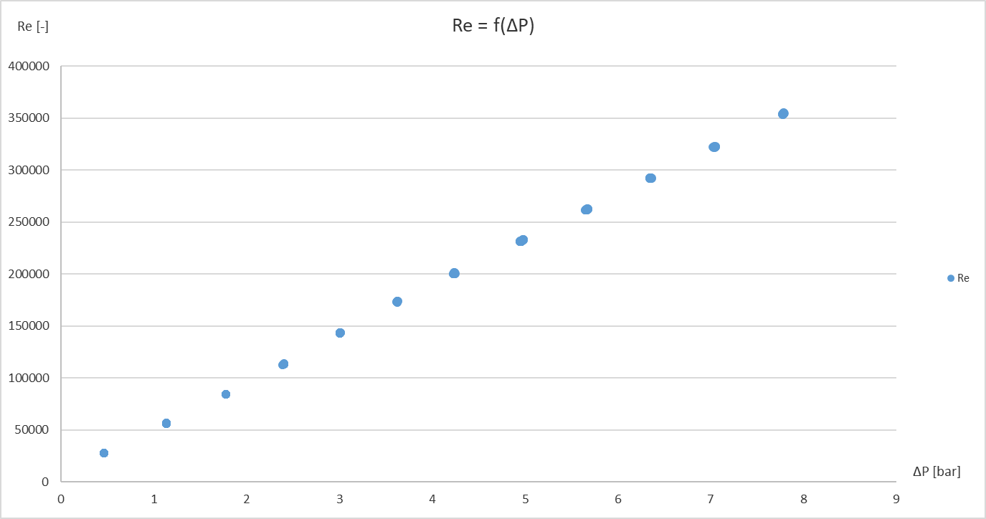
Othello test – Spiral
Reynolds number ~ Re = [ 28000 ; 350000 ]

Slide 18
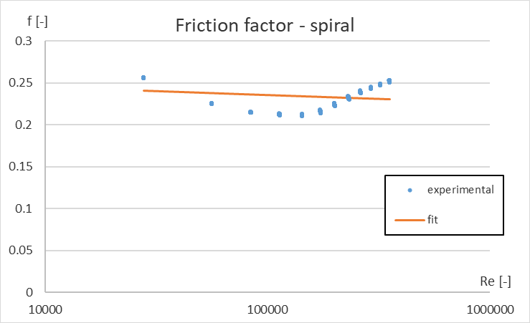
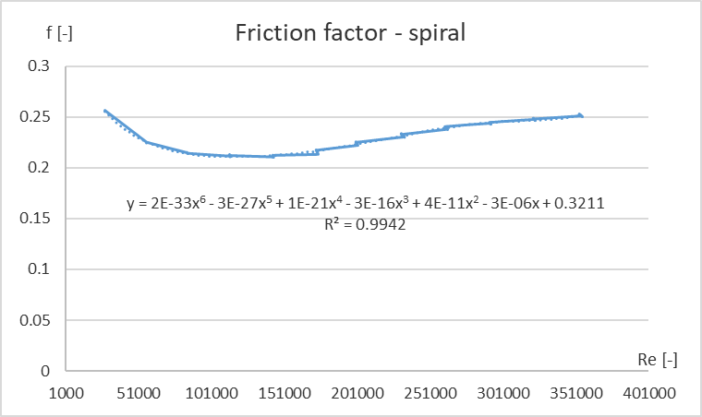
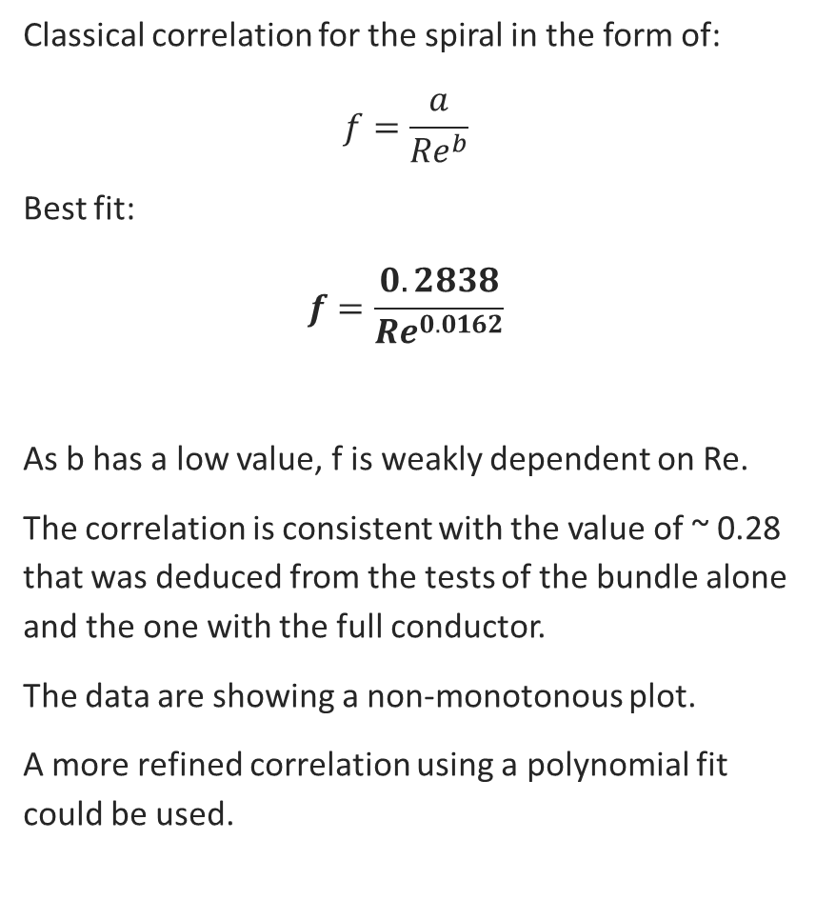
Othello test – Spiral
Classical correlation for the spiral in the form of:
$$f=\frac{a}{{Re}^{b}}$$
Best fit:
$$f=\frac{0.2838}{{Re}^{0.0162}}$$
As b has a low value, f is weakly dependent on Re.
The correlation is consistent with the value of ~ 0.28 that was deduced from the tests of the bundle alone and the one with the full conductor.
The data are showing a non-monotonous plot.
A more refined correlation using a polynomial fit could be used.
Reynolds number in operating conditions ~ 120000 (EF-H) – 150000 (EF-L)

Slide 19
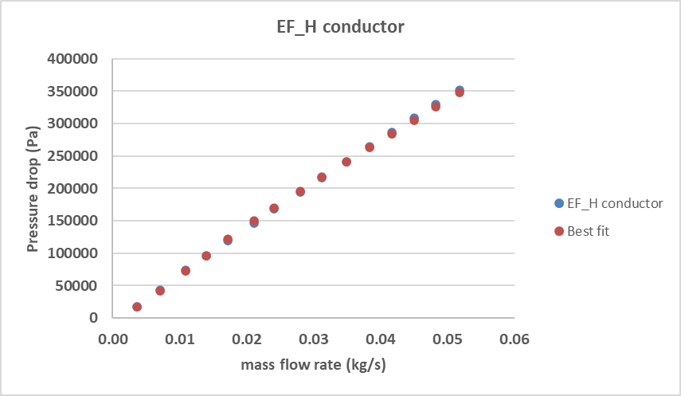
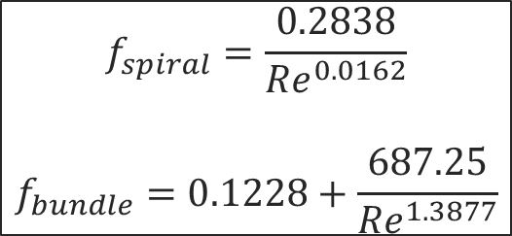
Othello test – EF-H
Best fit for the full conductor:
$$f_{spiral}=\frac{0.2838}{{Re}^{0.0162}}$$
$$f_{bundle}=0.1228+\frac{687.25}{{Re}^{1.3877}}$$

Slide 20
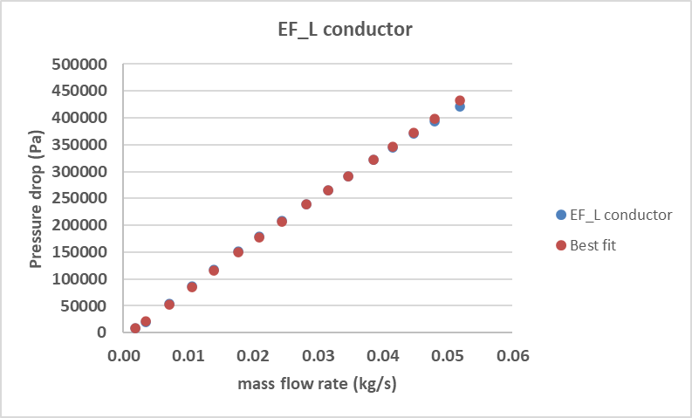
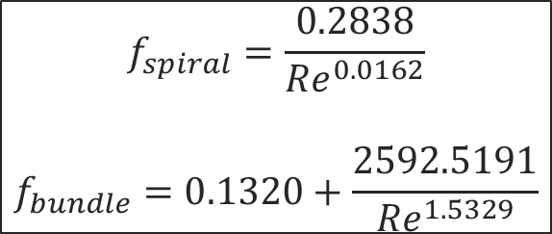
Othello test – EF-L
Best fit for the full conductor:
$$f_{spiral}=\frac{0.2838}{{Re}^{0.0162}}$$
$$f_{bundle}=0.1320+\frac{2592.5191}{{Re}^{1.5329}}$$

Slide 21
Conclusion of Othello activities
Test of the full conductors (bundle + spiral) for EF-H, EF-L and CS;
Unplugging of 2 of the 3 conductors (EF-L and EF-H), CS too difficult to unblock (deformation of the spiral);
Test of the central spiral alone.
Results consistent with the 2011 CEA test campaign (JL. Marechal);
Comparison with experimental data from the tokamak operation is on-going;
The numerical models (THEA) are being updated with the new correlations and used on different scenario (operation, quench events, cool-downs…).

Slide 22
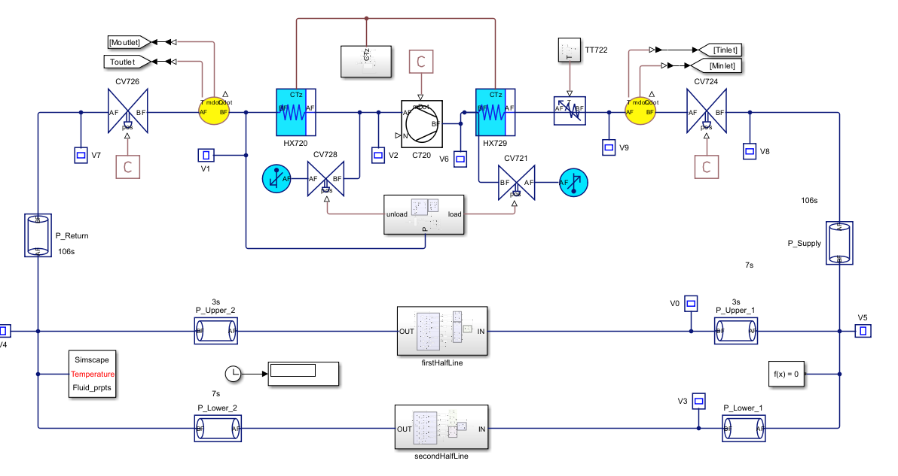
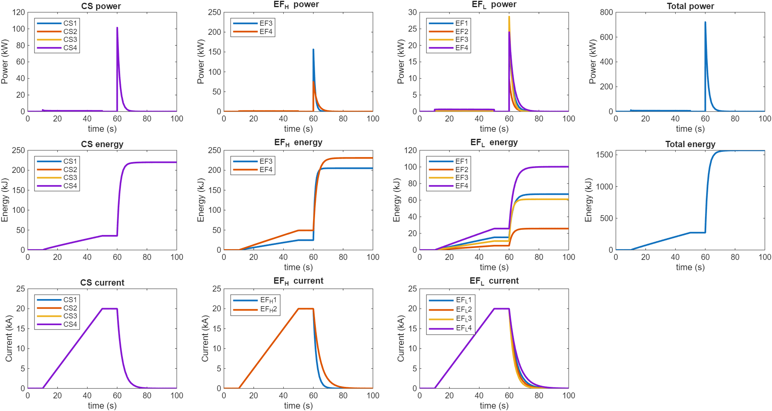
Update on 2026 task activities
Simcryogenics modeling of loop 2 : energy assessment and bath behavior
The global FSD of the loop 2 magnets EF + CS has been performed in 2025. Final checks will be done to verify that the energy deposited on the magnets in case of FSD in matching other code, and the behavior of the thermal buffer will be predicted.
Simcryogenics modeling of loop 2
Power, energy and current in case of PF magnet FSD

Slide 23
2027 Work Plan
On-site participation to OP2 envisaged (missions)
PMs for J_{c} vs strain measurements at ENEA

Slide 24
Thanks for your attention

