Slide 1


SA-EN.FE.11-T004-D002: Neutron Spectrum Reconstruction and Activation Foils studies
Enhancements Progress Meeting 23 October 2026
Katarzyna Mikszuta-Michalik
IPPLM
Email: katarzyna.Mikszuta@ifpilm.pl

Slide 2
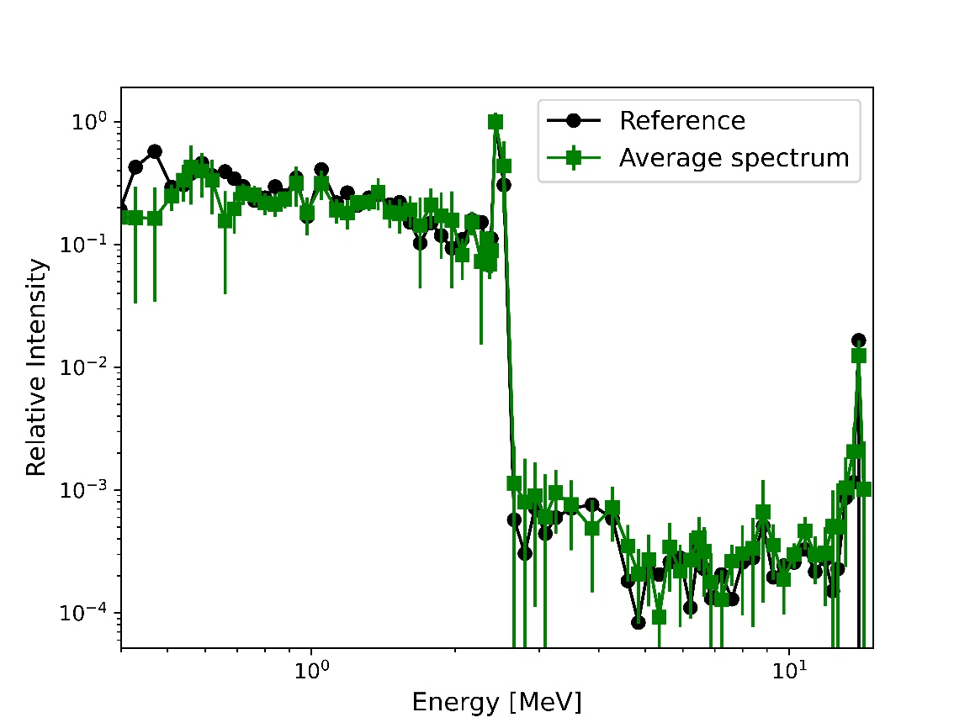
Neutron spectrum reconstruction based on neutron activation measurement
  General objectives:
  Expansion of the neutron activation scope from neutron yield monitoring to spectral studies that can be used for MCNP model validation, cross-comparison with other neutron diagnostics, and fusion physics studies
Preliminary analysis done in 2025:
Preparation of a methodology based on four methods:
  Tikhonov Regularization (TR)
  Minimum Fisher Information (MFI)
  Maximum Entropy (ME)
  Maximum Likelihood (ML)
for validation of the neutronics models of JT-60SA by comparing simulated neutron spectra with spectra reconstructed from neutron activation measurements.
Demonstration of the methodology’s potential and identification of areas for improvement (without reproduction of real conditions)
Mean uncertainty:
24% ± 20%
References:
K. Mikszuta-Michalik, R. Miklaszewski (2024). Reconstruction of neutron spectrum emitted by portable 14 MeV neutron generator by a combination of different methods. Fusion Engineering and Design, 199, 114129.
K. Mikszuta-Michalik, R. Miklaszewski, M. Gierlik, et al. (2021). Application of the different deconvolution methods to the neutron spectrum reconstruction from activation measurement. Fusion Engineering and Design, 173, 112934.
K. Mikszuta-Michalik, A. Cubi, M. Fabbri, M.D. Giacomo (2026) A feasibility study of neutron spectrum reconstruction using synthetic activation data for JT-60SA. Plasma Physics and Controlled Fusion. 68 105001.
Mean uncertainty for the full spectrum: 41% ± 44%

Slide 3
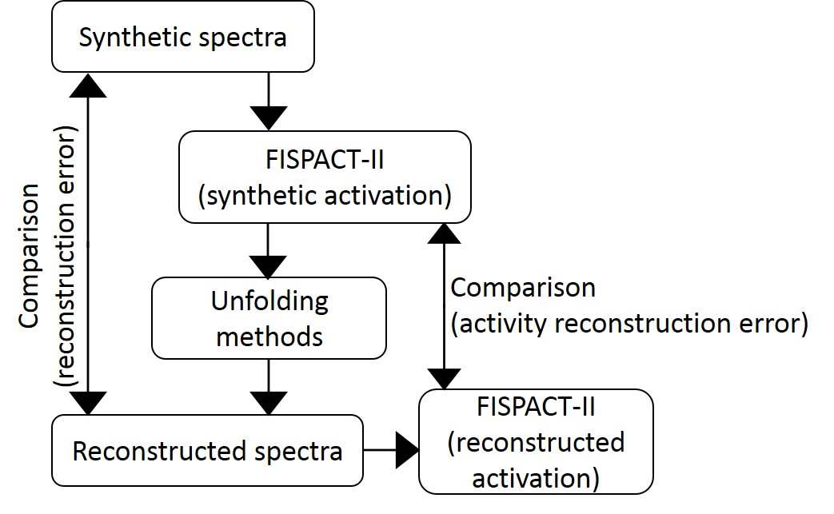
Neutron spectrum reconstruction based on neutron activation measurement – continuation in 2026
Activities:
Preparation of the tools optimized for analysis on JT-60SA
  Preparation of the tool that allows for including the irradiation sequence to the analysis
  Optimization of a new approach for spectrum reconstruction by dividing the spectrum into energy regions, with reconstruction parameters optimized independently for each part.
Comparison of the results for continuous irradiation and irradiation sequence
Irradiation conditions:
Total yield: 1.3·10¹⁷ n/s
Irradiation sequence: (60 s + 1800 s cooling time) x 5
Location: P10 port
Synthetic activity from FISPACT-II:
Foil​ | Reaction​ | Activity [Bq/g] | Uncertainty [%]
Al | Al-27(n,a) Na-24​ | 6.29E+02 | 9.44
Ti​ | Ti-48(n,p)Sc-48​ | 4.62E+01 | 8.21
Ni​ | Ni-58(n,2n)Ni-57​ | 1.31E+01 | 12.89
 | Ni-58(n,d)Co-57 | 2.33E+00 | 11.03
In​ | In-115(n,n')In-115m​ | 7.05E+04 | 9.03
Co | Co-59(n,p)Fe-59​ | 1.90E+00 | 9.10
 | Co-59(n,2n)Co-58m​ | 1.50E+03 | 5.39
Nb​ | Nb-93(n,2n)Nb-92m​ | 4.31E+01 | 15.94

Slide 4
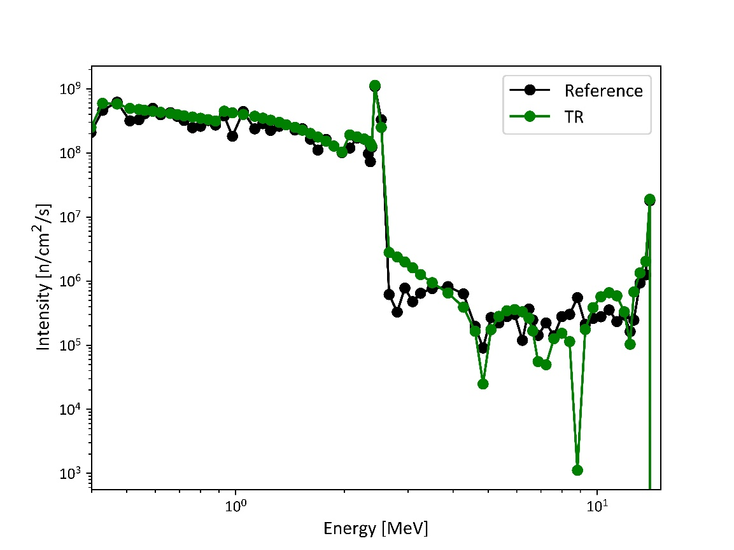
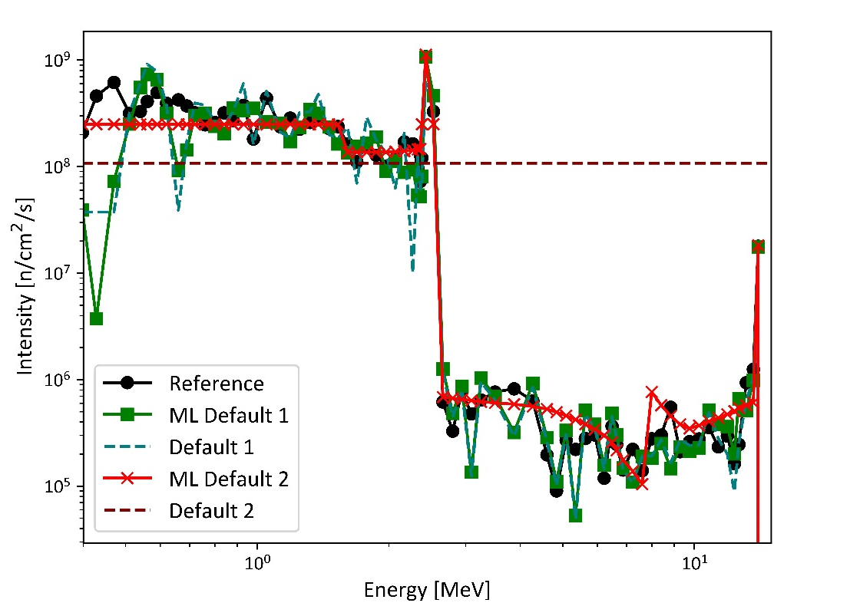
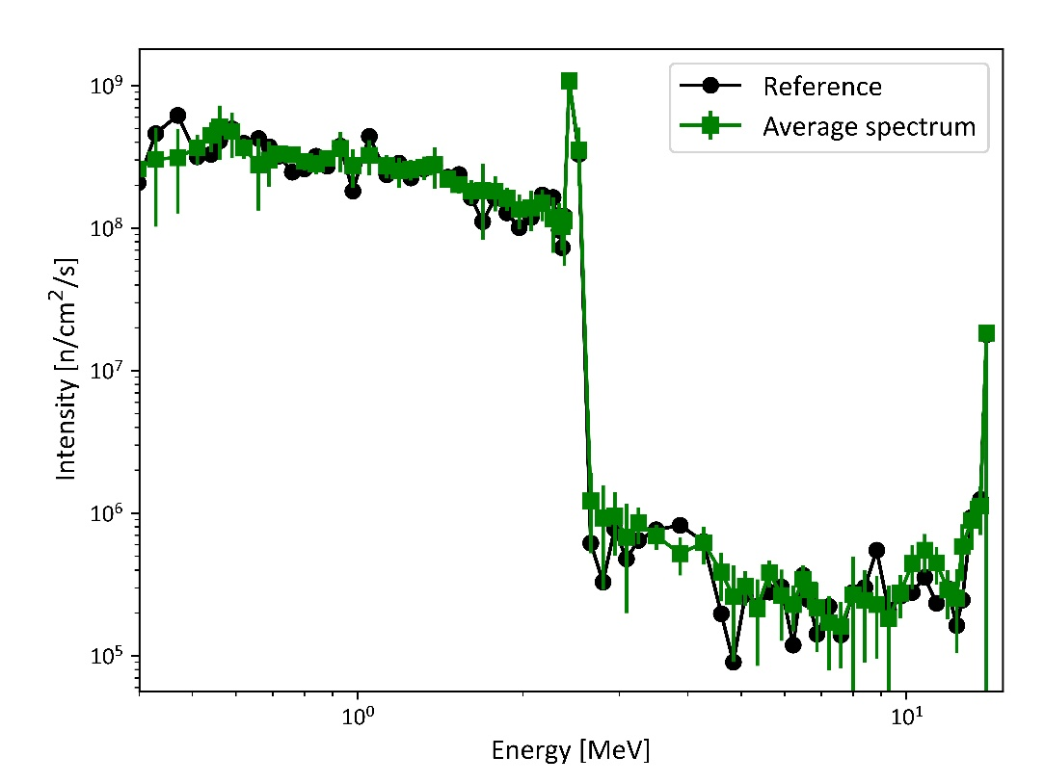
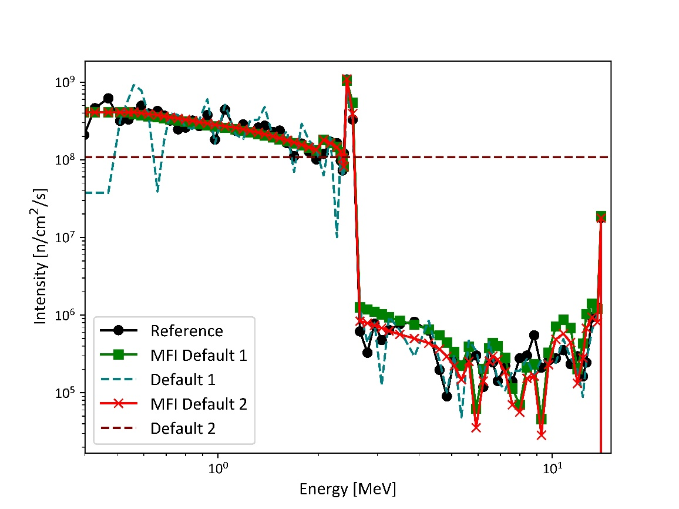
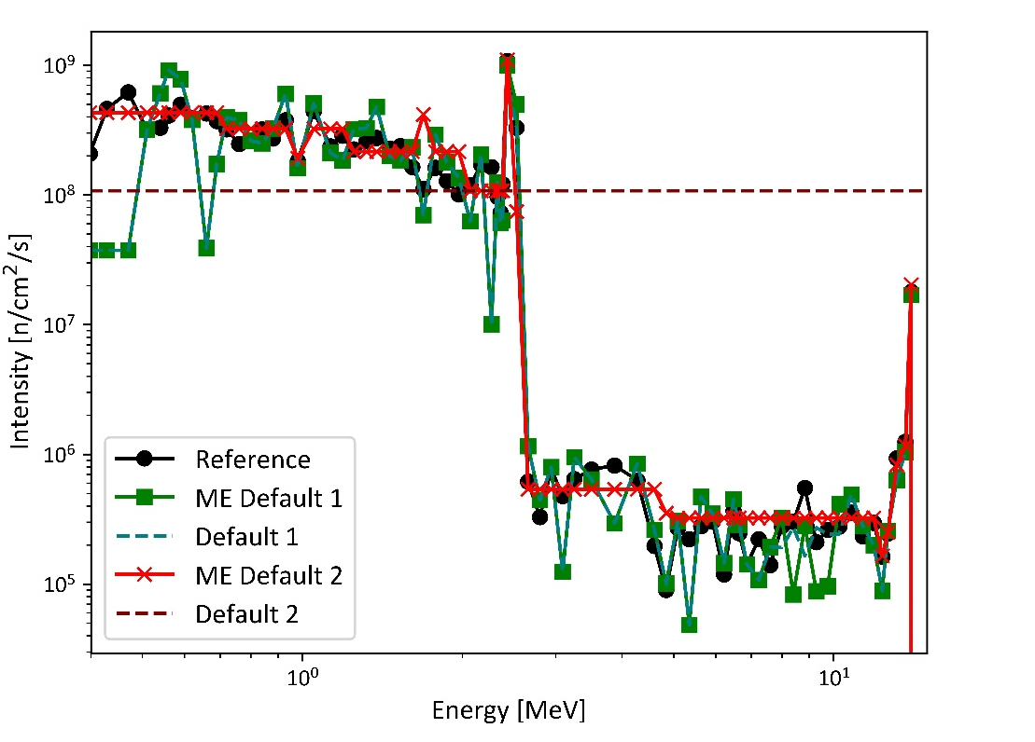
Neutron spectrum reconstruction based on neutron activation measurement – continuation in 2026

Slide 5
Neutron spectrum reconstruction based on neutron activation measurement – continuation in 2026
Comparison of the results for continuous irradiation and irradiation sequence
Ratio of the activity obtained for continuous irradiation versus an irradiation sequence: 1.03 – 2.2
Previous result
Errors | TR | MFI I | MFI II | ML I | ML II | ME I | ME II | Average
2.43 MeV | 19% | 23% | 22% | 0% | 15% | 29% | 11% | 3%
14 MeV | 78% | 26% | 28% | 1% | 0% | 5% | 21% | 22%
High intensity part 0.4 - 2.5 MeV | 22% | 24% | 22% | 38% | 45% | 43% | 54% | 24%
Standard deviation | 20% | 16% | 19% | 30% | 43% | 31% | 78% | 20%
Full spectrum | 124% | 53% | 40% | 35% | 46% | 39% | 60% | 41%
Standard deviation | 195% | 100% | 49% | 28% | 47% | 28% | 77% | 44%
Optimized methodology
Errors | TR | MFI I | MFI II | ML I | ML II | ME I | ME II | Average
2.43 MeV | 5% | 3% | 1% | 1% | 4% | 8% | 2% | 0%
14 MeV | 5% | 5% | 1% | 1% | 2% | 5% | 14% | 3%
High intensity part 0.4 - 2.5 MeV | 26% | 23% | 22% | 36% | 27% | 44% | 33% | 20%
Standard deviation | 28% | 20% | 19% | 27% | 24% | 31% | 48% | 15%
Full spectrum | 55% | 53% | 37% | 38% | 46% | 39% | 38% | 31%
Standard deviation | 89% | 73% | 40% | 31% | 64% | 28% | 55% | 37%

Slide 6
Neutron spectrum reconstruction based on neutron activation measurement – plan for 2027
Activities planned for 2026 completed – report in preparation
Planned activities:
Pre-experimental analysis with the foils to be used during the upcoming OP2 campaign
Objective:
Optimization of the spectrum binning
Optimization of reconstruction parameters for the specific cases
Uncertainty evaluation
Required inputs:
foils: Co, Ta, Y, Ni – list of threshold reactions need to be analyzed
Irradiation sequence: Sequence with neutron flux levels to be established in collaboration with the F4E neutronics group
Foils position: 2-3 can be selected

