Slide 1
Tangential phase-contrast imaging diagnostic
for JT-60SA
S. Coda¹ , K. Tanaka² , M. Noël¹
¹EPFL-SPC, ²NIFS WPSA Enhancements Progress meeting, 23.10.2026

Slide 2
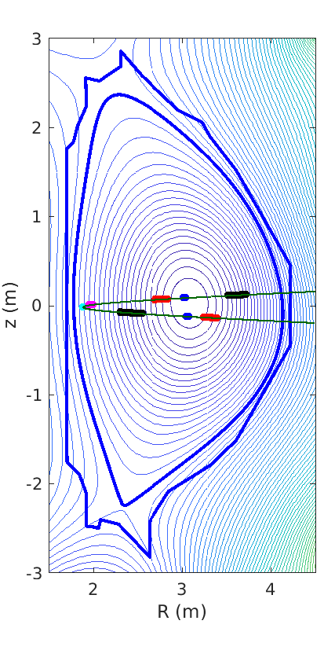
Phase-contrast imaging on JT-60SA
CO₂-laser based transmission diagnostic
Will provide localized density fluctuation measurements across the minor radius and in all plasma regimes
  δn/n~10⁻⁵, 0.06<kρ_{i}<12 (ITG/TEM/ETG)
  high spatial resolution in the center and at the edge (very favorable configuration on JT-60SA)
Europe/NIFS collaboration and cost split
S. Coda et al, Nucl. Fusion 61, 106022 (2021), DOI:10.1088/1741-4326/ac2081

Slide 3
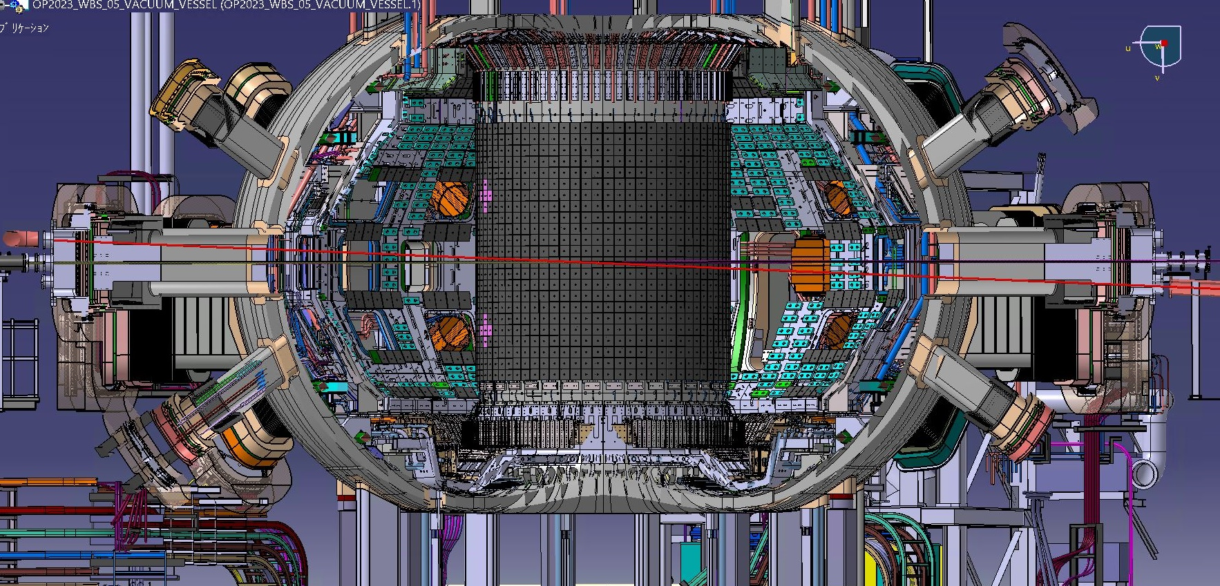
Optical-path design
P01H
CO2
PCI
CO2
YAG
P08H
PCI
P01H
CO2
YAG
PCI
YAG
P08H
3

Slide 4
Current status and planning
Procurement Agreement signed last year.
NIFS is providing 3 detectors and associated acquisition modules from NIFS TPCI. It has procured new radiation shielding and a LN2 filling station. The latter has proven insufficient upon testing and is currently being redesigned.
Optics (2 ZnSe windows and 10 mirrors) and optical supports from the laser room to a point before the beam expander (before entering the torus) have been procured and fabricated by EPFL-SPC and are ready to install (final shipment being organized now). Installation planned for 9-20 November.
The remainder of the system is to be installed in ME2, with component design at a mature stage.

Slide 5
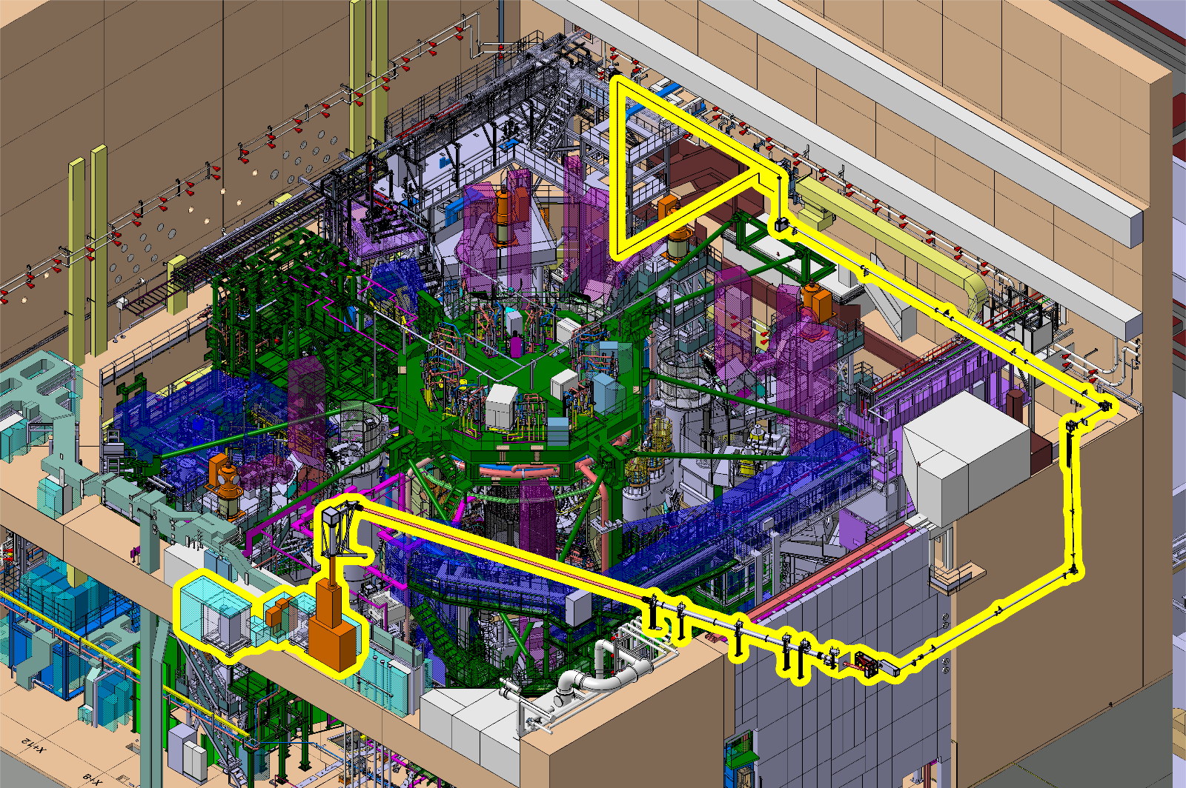
Optical path layout
ME1
ME2

Slide 6
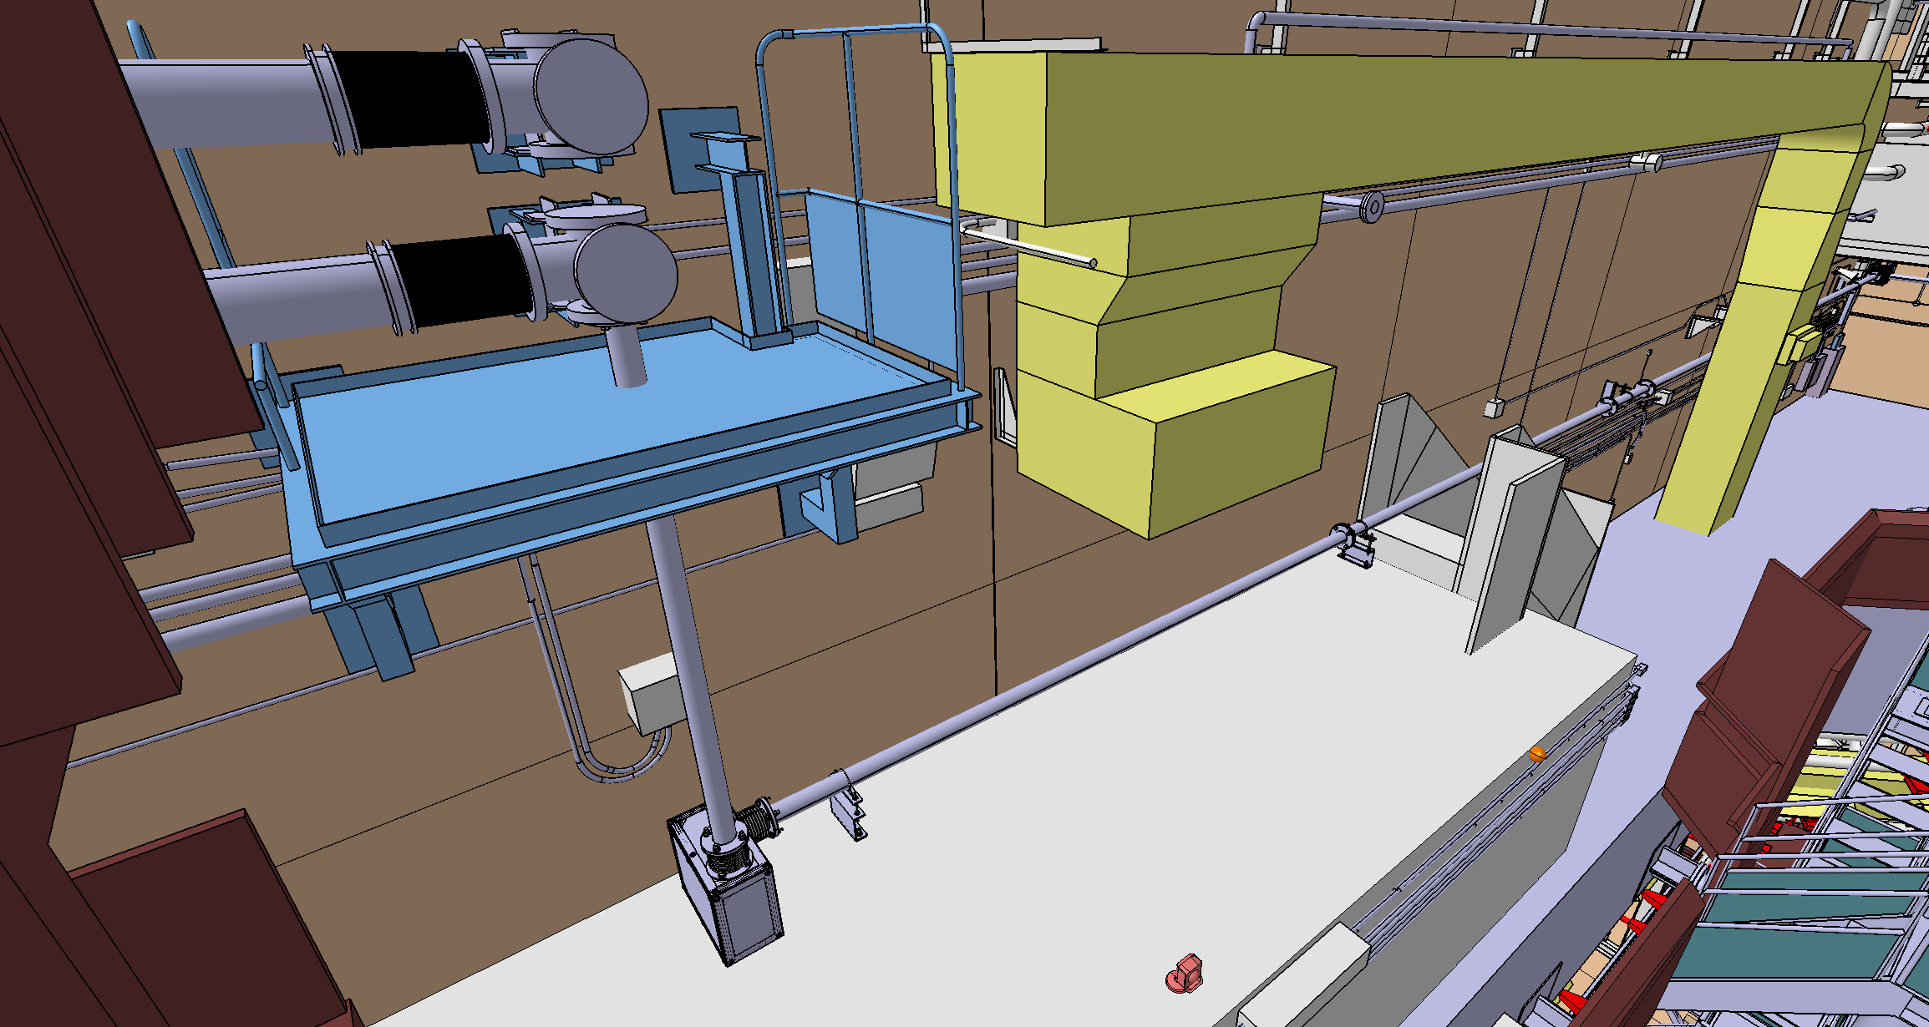
Beam trajectory: mirror supports

Slide 7
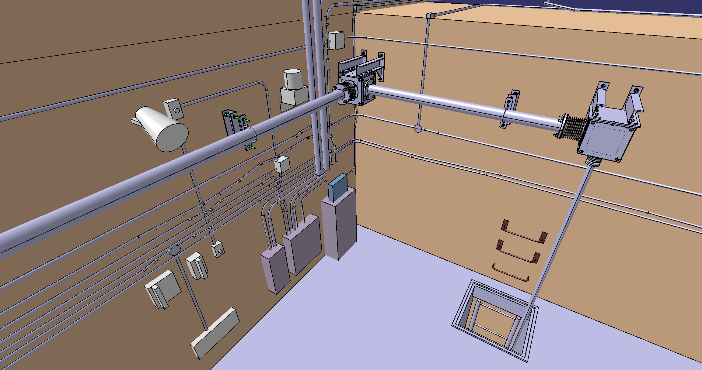
Beam trajectory: mirror supports

Slide 8
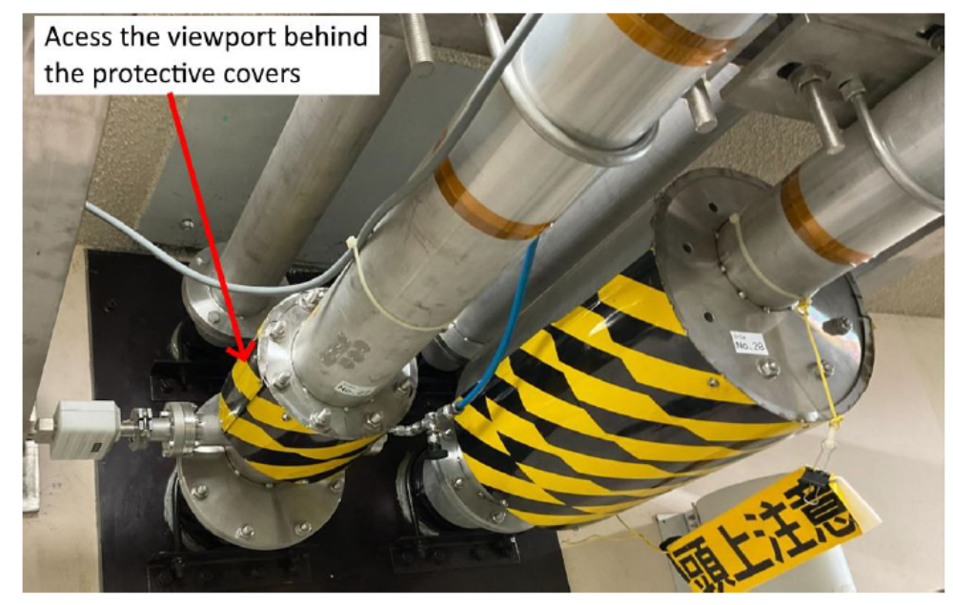
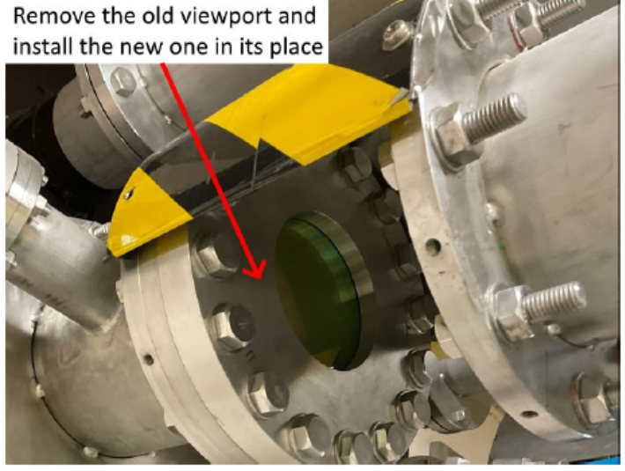
Elements of installation procedure
Replacement of two ZnSe windows isolating laser room from torus hall

Slide 9
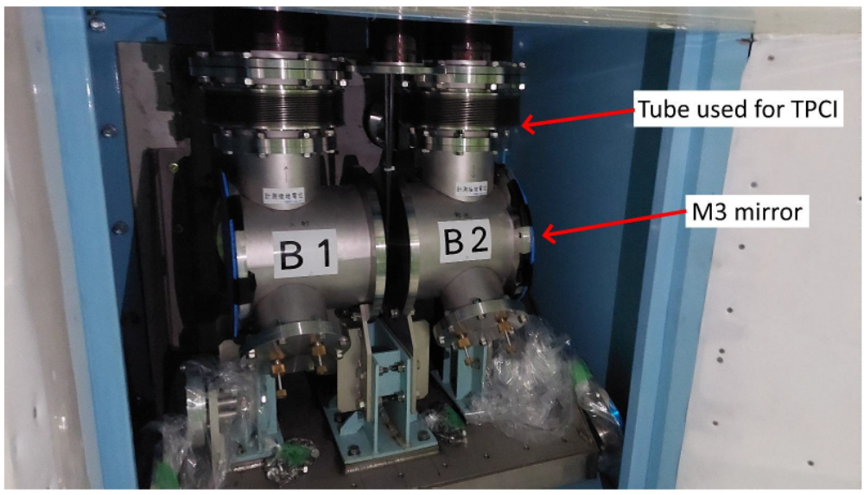
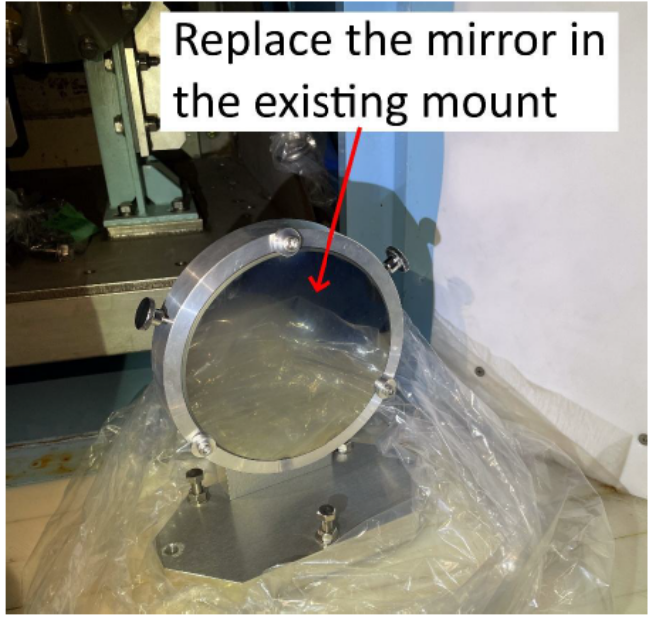
Elements of installation procedure
Replacement of old mirrors in existing mounts and boxes

Slide 10
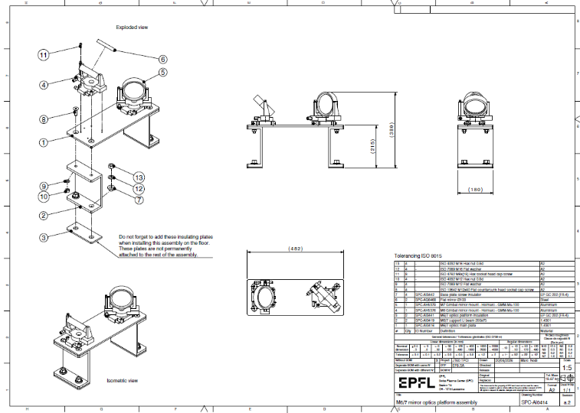
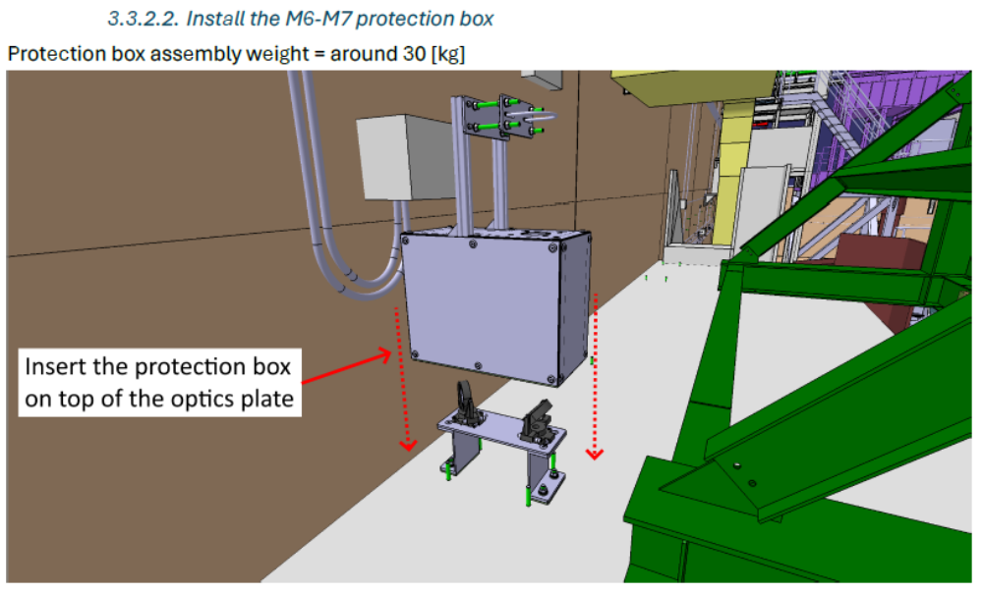
Elements of installation procedure
New mirror mounts and boxes

Slide 11
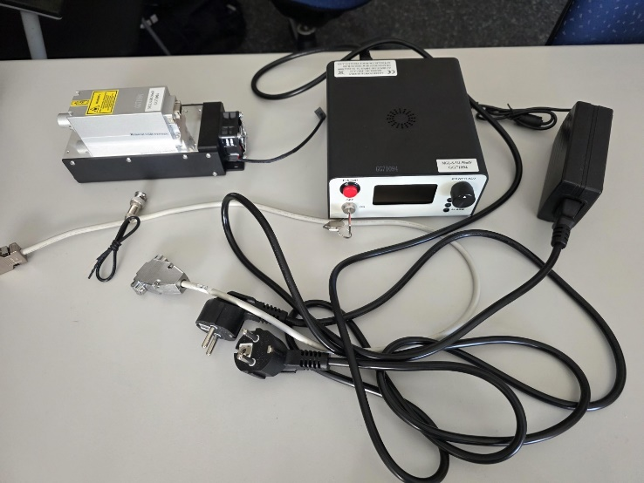
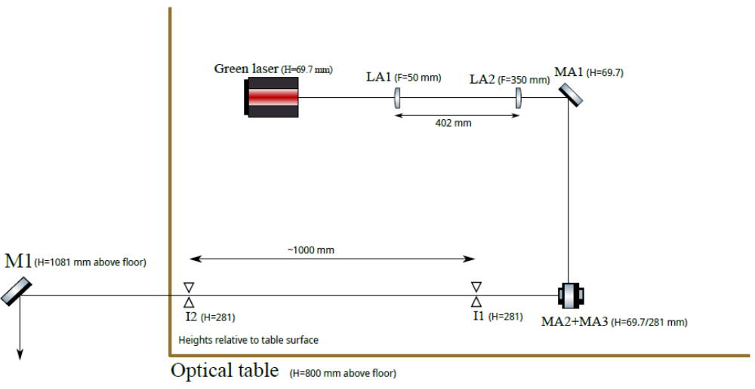
Initial alignment with visible laser
Irises will permit alignment of final CO₂ laser system

Slide 12
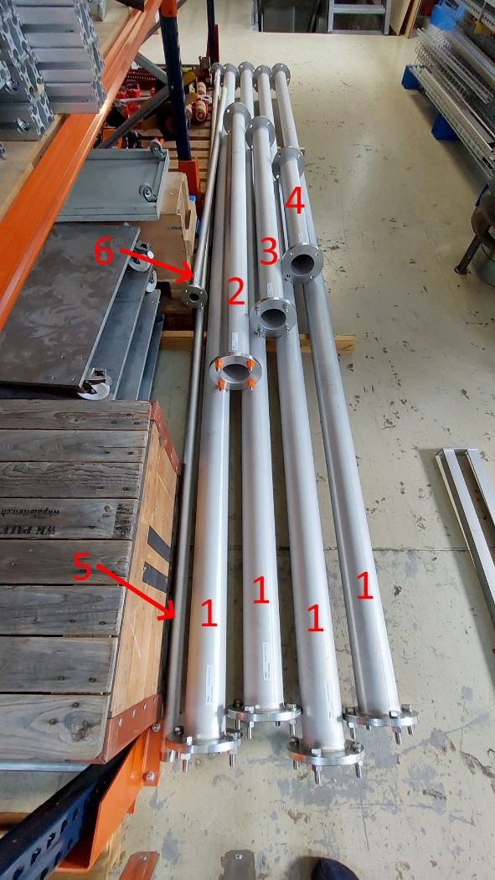
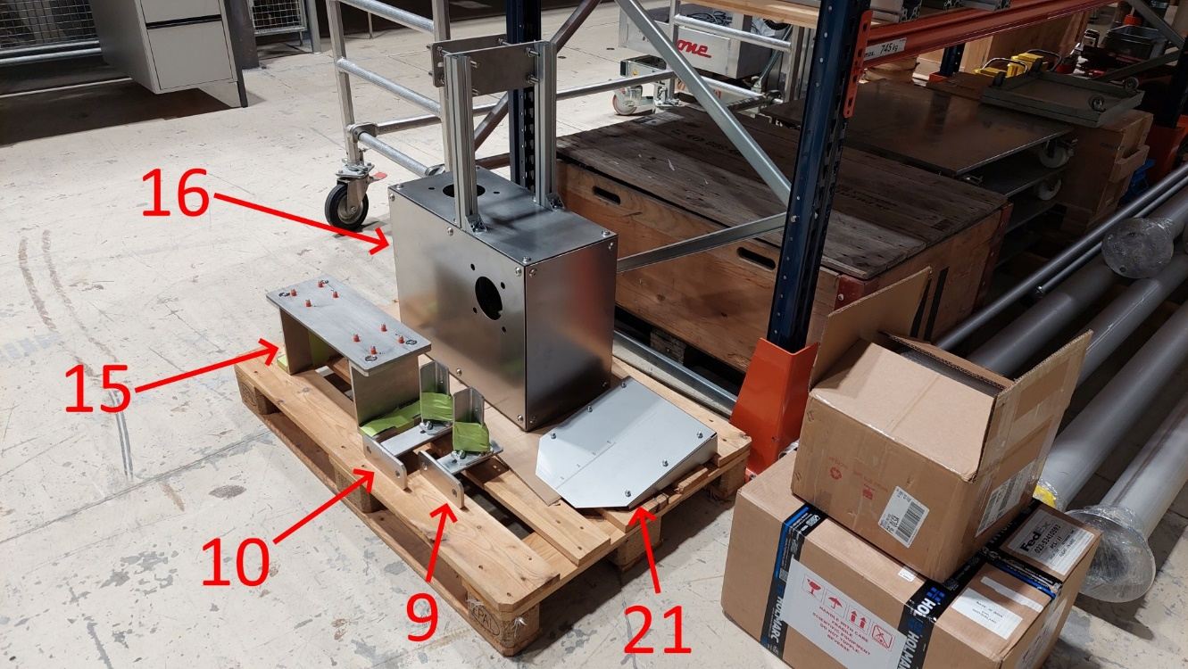
Items ready to ship at EPFL

Slide 13
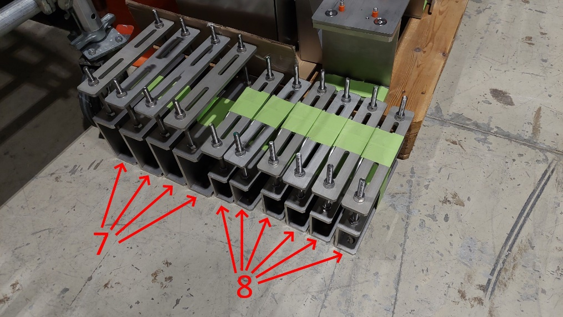
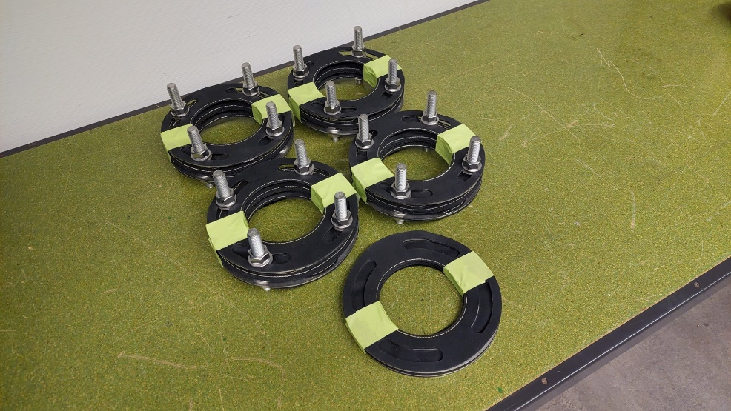
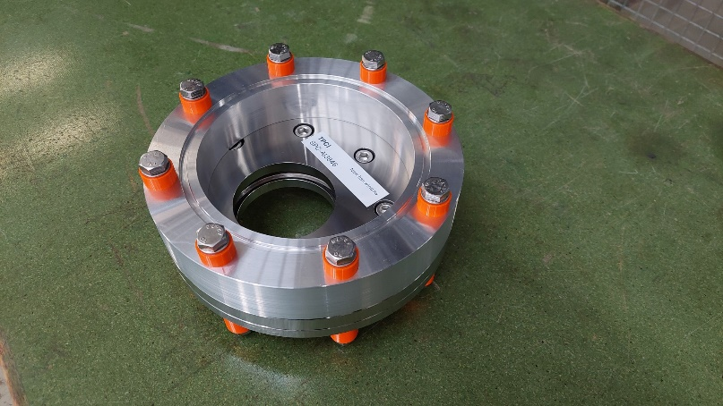
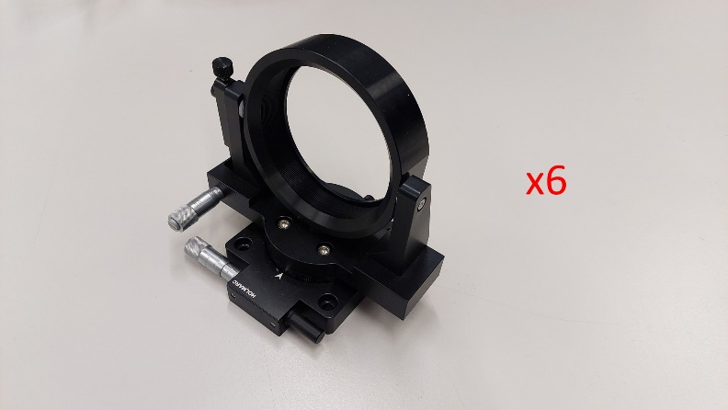
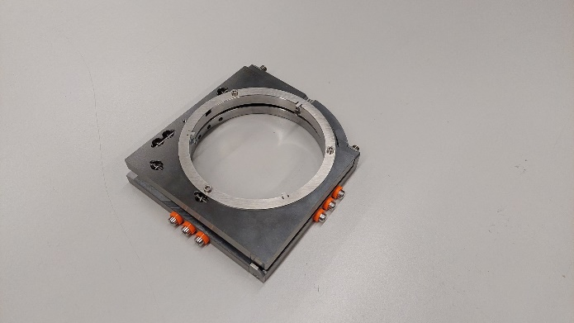
Items ready to ship at EPFL

Slide 14
Calendar for 2026 and 2027
ME1 installations planned for November 2026.
Completion of design and remaining procurements and shipments planned during OP1.
Complete installation planned for ME2.
Scientific exploitation to begin in OP2.

Slide 15
Outstanding needs
The physics personnel is highly insufficient. A dedicated full-time scientist (typically a postdoc) would be needed for debugging and scientific exploitation. Funding for this is currently unavailable.
Personnel from QST and NIFS may pick up the slack – this is unclear at the moment. But this would limit the European involvement undesirably, and the quality of the results would be uncertain.

Slide 16
additional slides

Slide 17
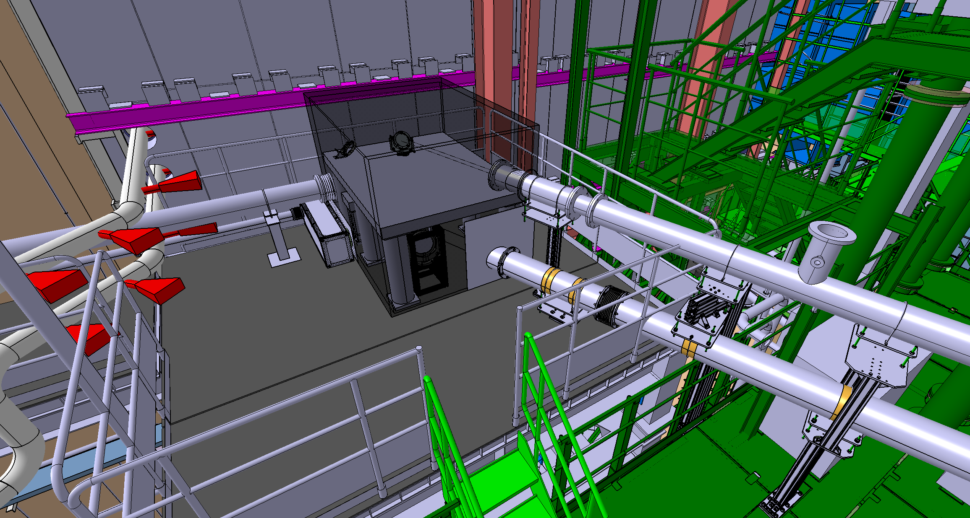
Beam expander under optical table

Slide 18
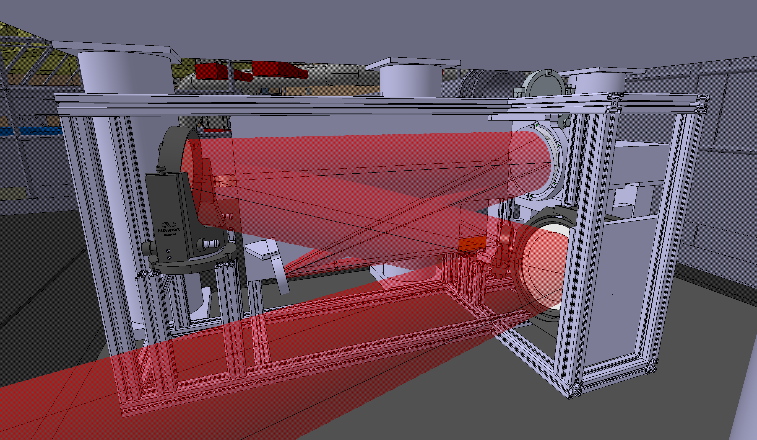
Beam expander under optical table

Slide 19
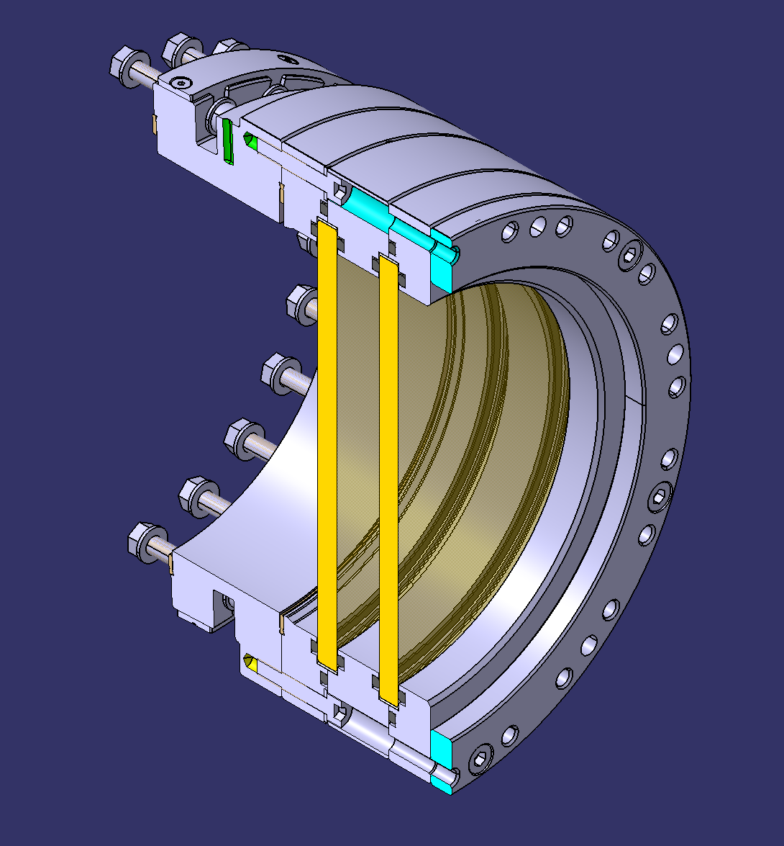
Entry window assembly

Slide 20
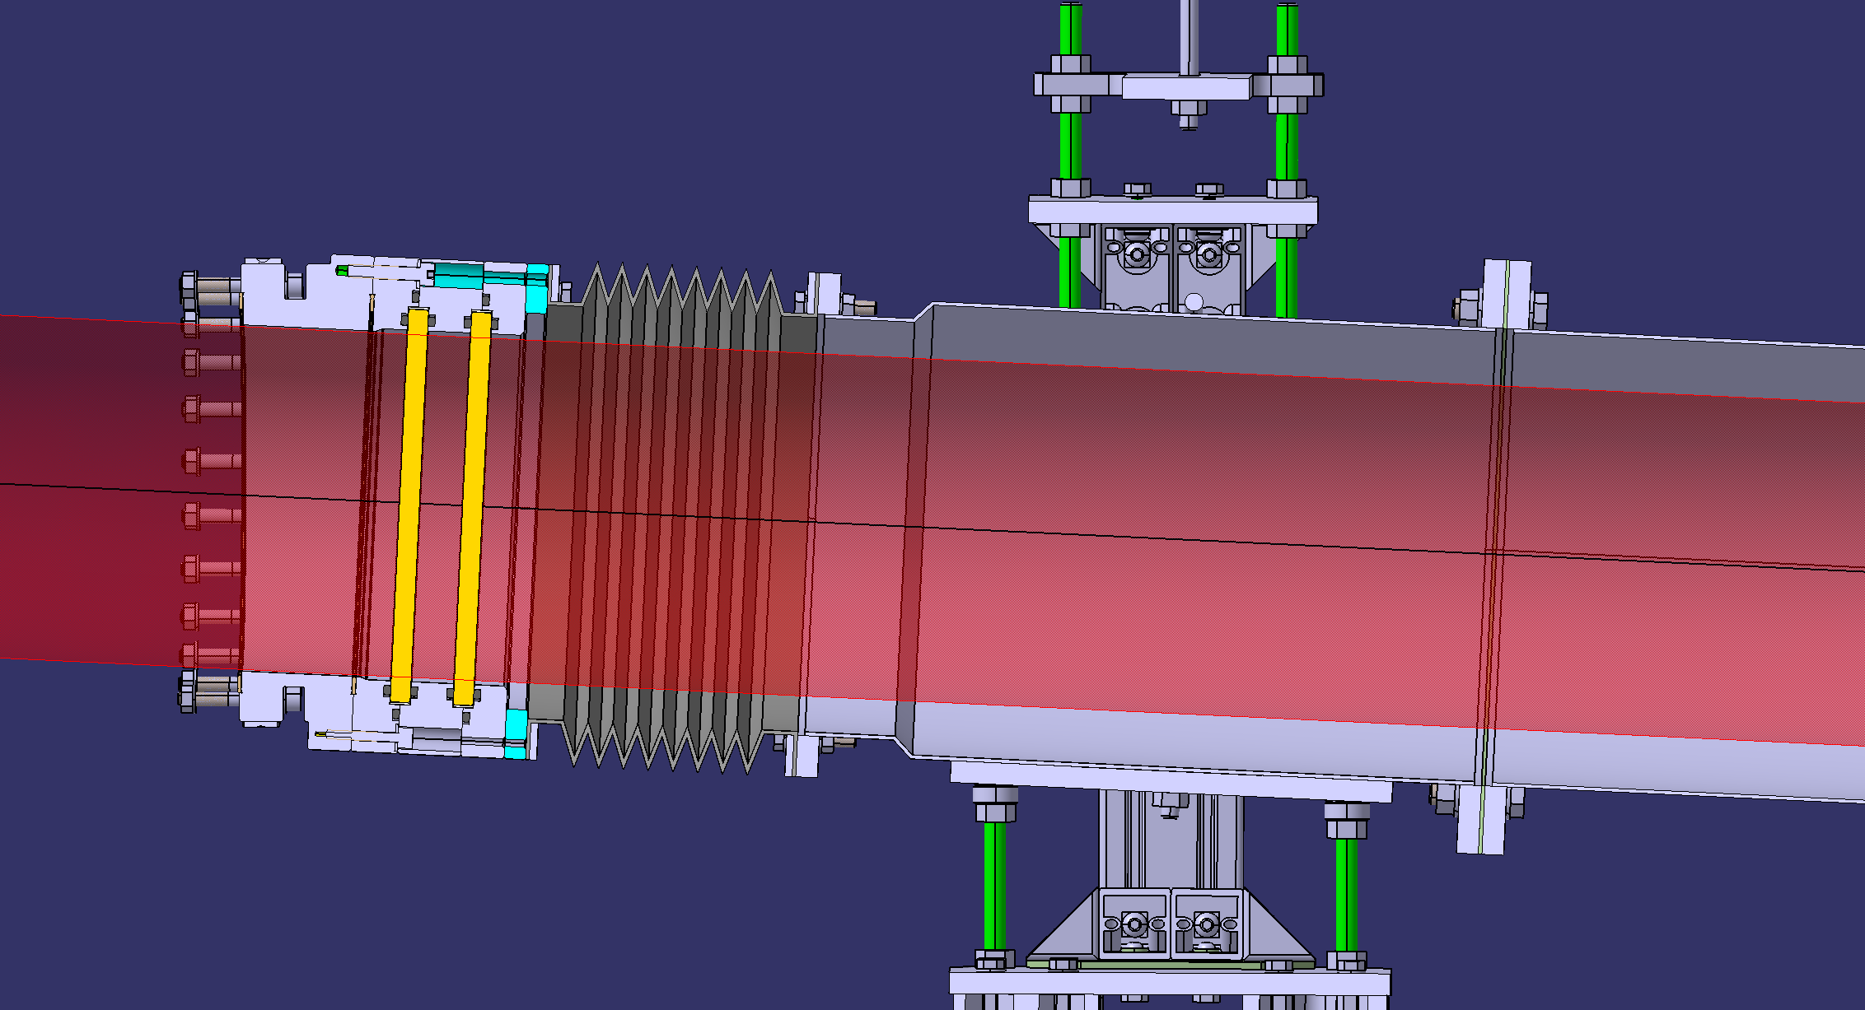
Entry window assembly

