Slide 1

Current status of the PLS for JT60-SA CAD simplification and the MCNP model
Enhancements Progress Meeting, Oct 23rd, 2026
B. Bieńkowska, S. Akbaş
Logo

Slide 2
Pellet Launching System (PLS)
designed to enhance plasma performance and support advanced fusion research,
produces and accelerates frozen hydrogen or deuterium pellets, which are injected into the plasma to provide efficient fuelling and to control Edge Localised Modes (ELMs),
uses a centrifuge-based accelerator, allowing pellets to reach speeds of up to 600 m/s before entering the plasma.

Slide 3
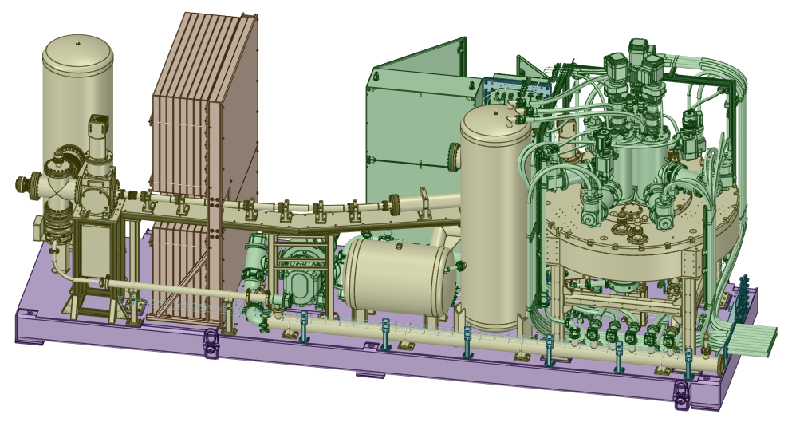
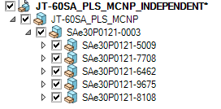
The original PLS CAD model
F4E provided the original CAD model of the PLS.
A complex CAD model consists of 7633 solids in 5 main subcomponents.

Slide 4
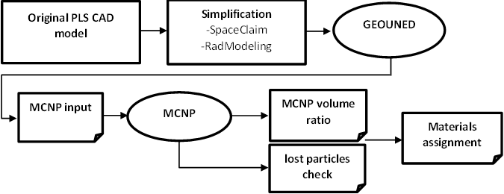
The goal of the task
This task aimed to prepare a neutronic model in support of F4E
1st step: the simplification of the components using ANSYS SpaceClaim with Rad
Modelling collection of scripts developed and shared by F4E
2nd step: conversion to MCNP using the GEOUNED tool
3rd step: lost particles check and stochastic volume calculation for comparison with
the original volumes
4th step: materials assignment

Slide 5
CAD simplification
Simplifying the model involves removing rounds, welds, chamfers, smaller screws, washers, etc, and also the replacement of splines and tori with surfaces allowed by MCNP.
The details and features smaller than 10 cm are removed because they do not affect radiation transport.
To preserve the volume of the original CAD model, the volumes of the removed bodies can be added to the adjacent component (the bigger one).
The volume deviation of the component has to be lower than 1%.
The developed by F4E Rad Modelling collection of scripts aids in the pre-processing of an MCNP model,
Due to the complexity, the CAD simplification was performed on every main component separately.

Slide 6
Bill of Materials
Construction material specifications remained incomplete and ambiguous for an extended period, slightly extending the overall project timeline.
A complete and component-specific material definition was finally established.
The finalized material data enabled further geometry simplifications.
Smaller features were merged into larger components.
The overall number of geometric bodies was reduced, improving model efficiency.

Slide 7
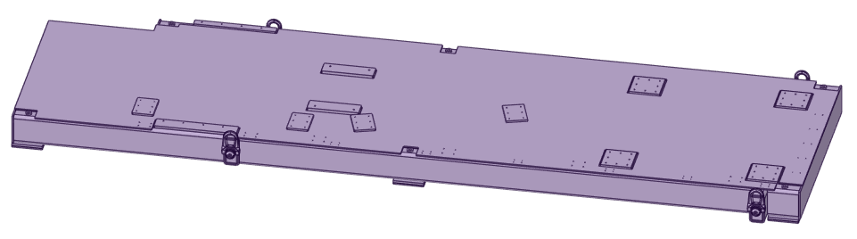
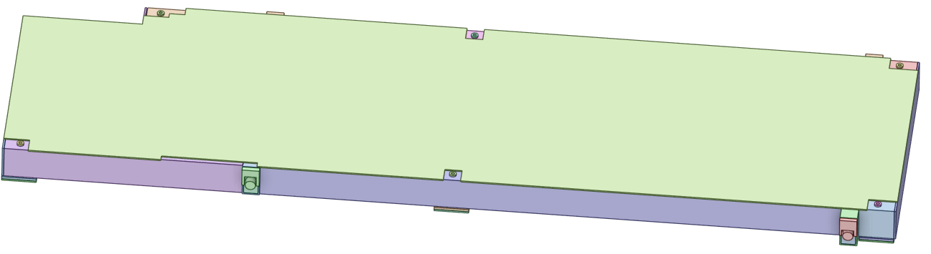
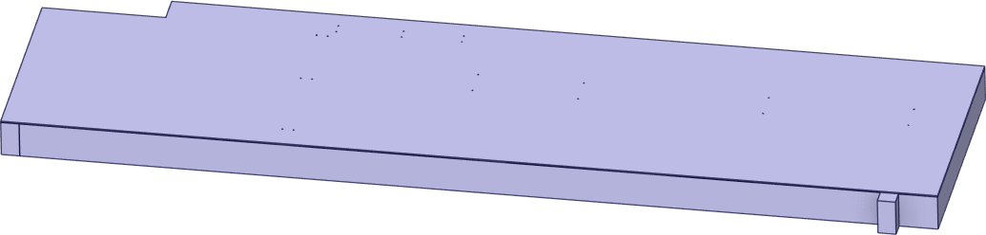
SAe30P0121-5009
Original 78 solids
Intermediate 54 solids
Final 20 solids

Slide 8
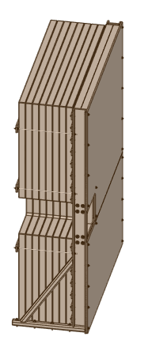
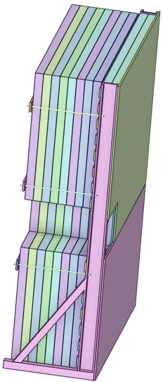
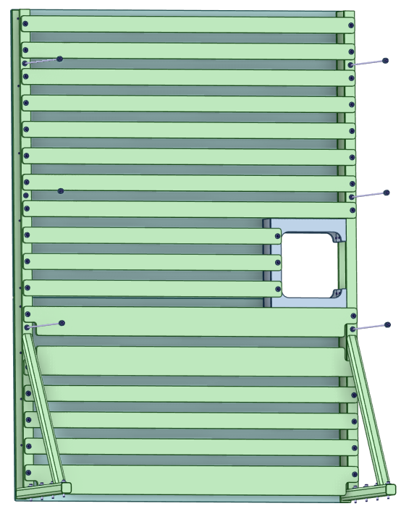
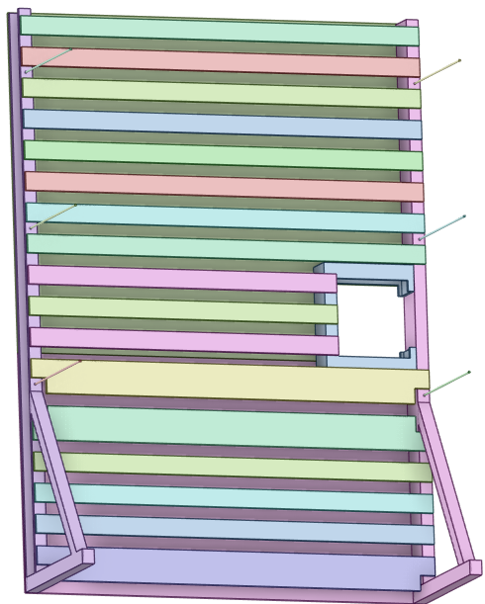
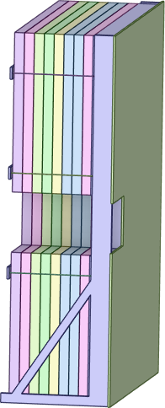
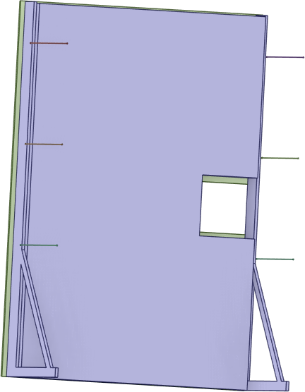
SAe30P0121-7708
Original 249 solids
Intermediate 41 solids
Final 21 solids

Slide 9
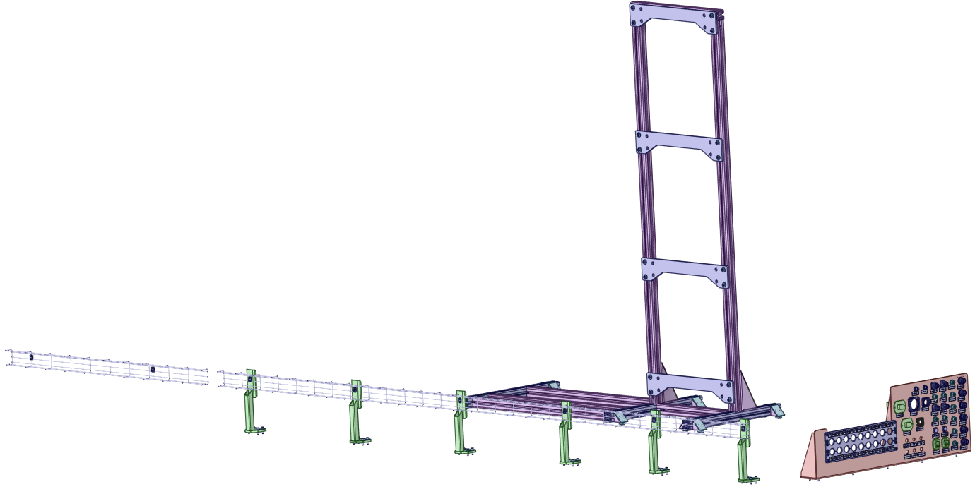
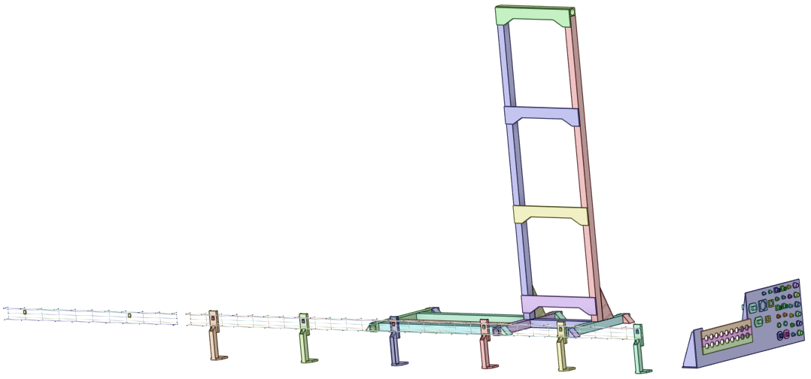
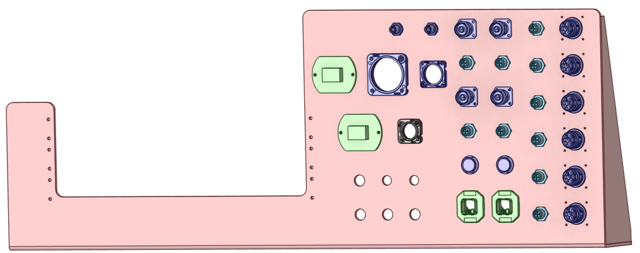
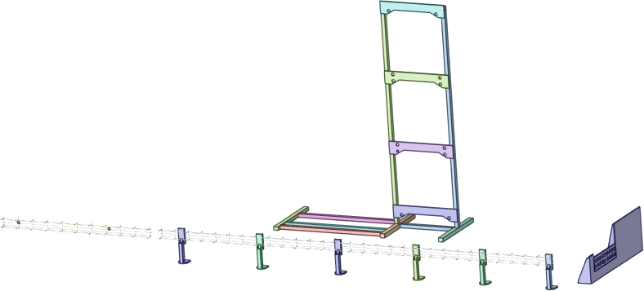
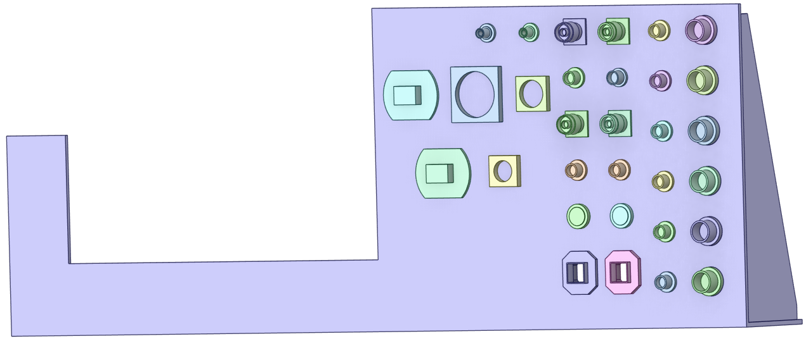
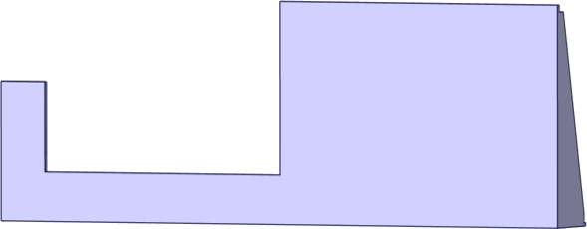
SAe30P0121-6462
Original 494 solids
Intermediate 94 solids
Final 79 solids

Slide 10
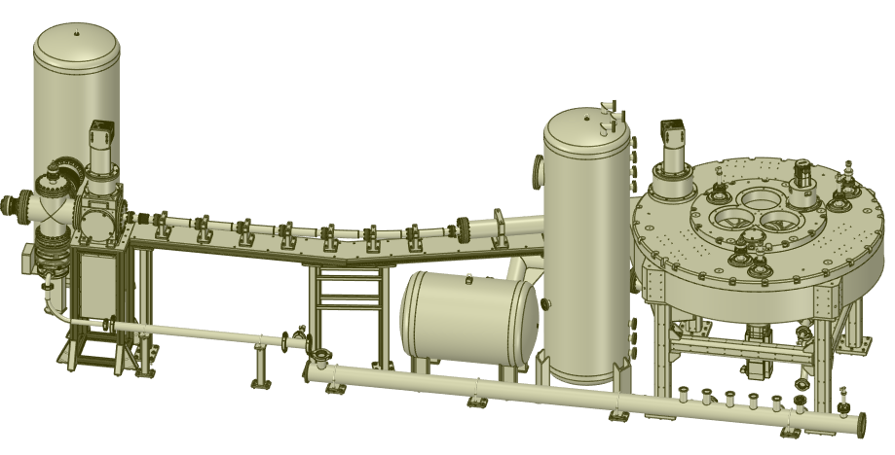
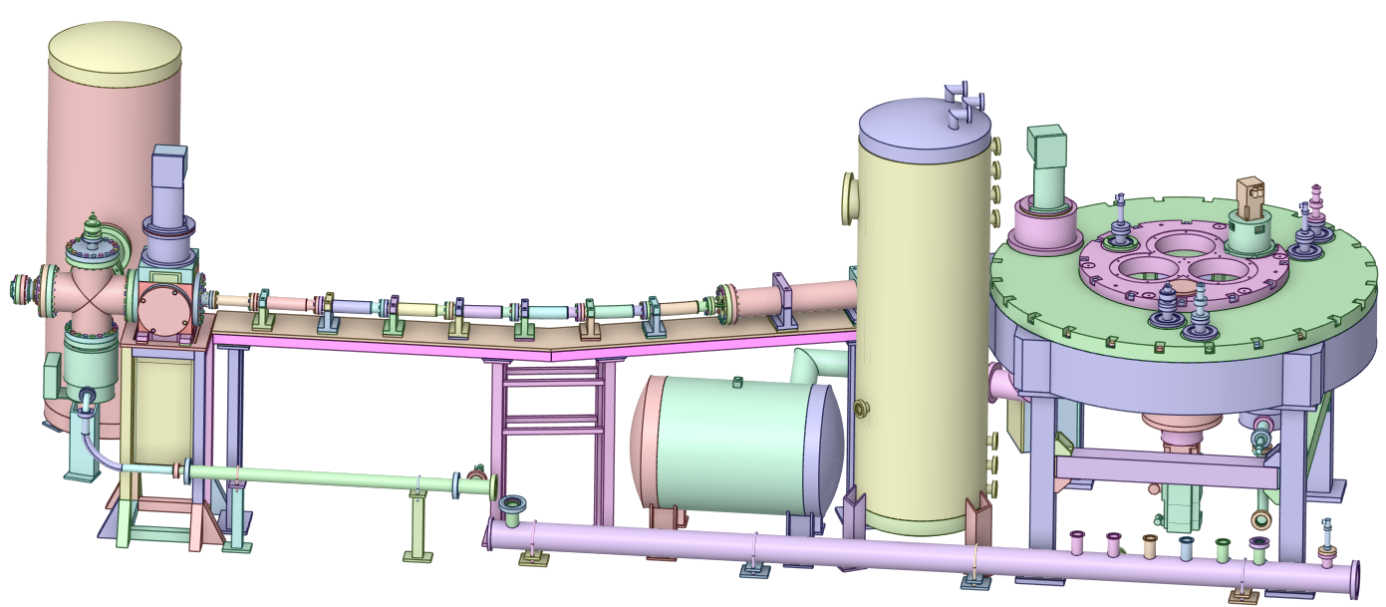
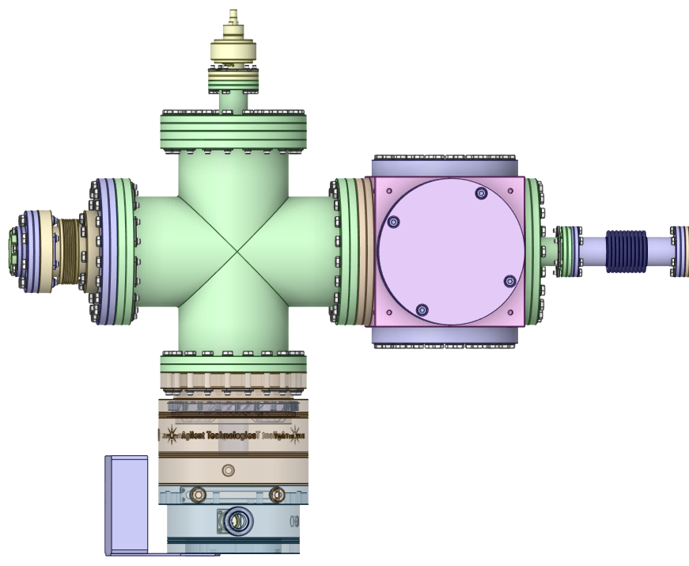
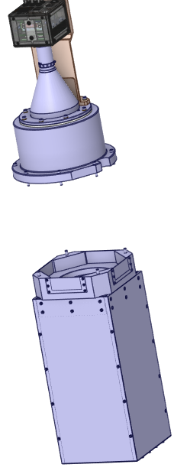
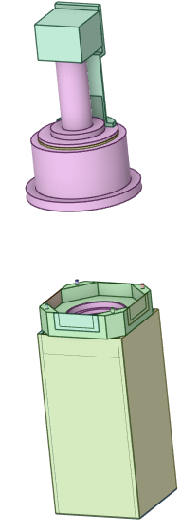
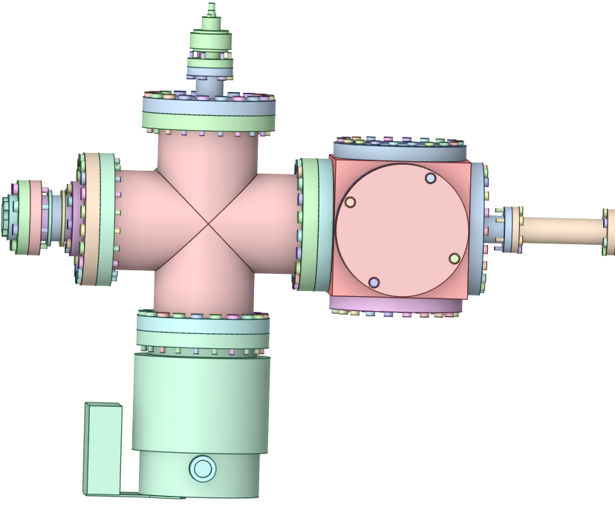
SAe30P0121-9675
Original 3501 solids
Intermediate 893 solids

Slide 11
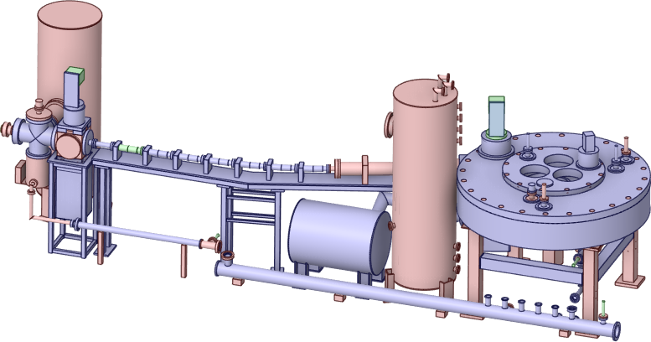
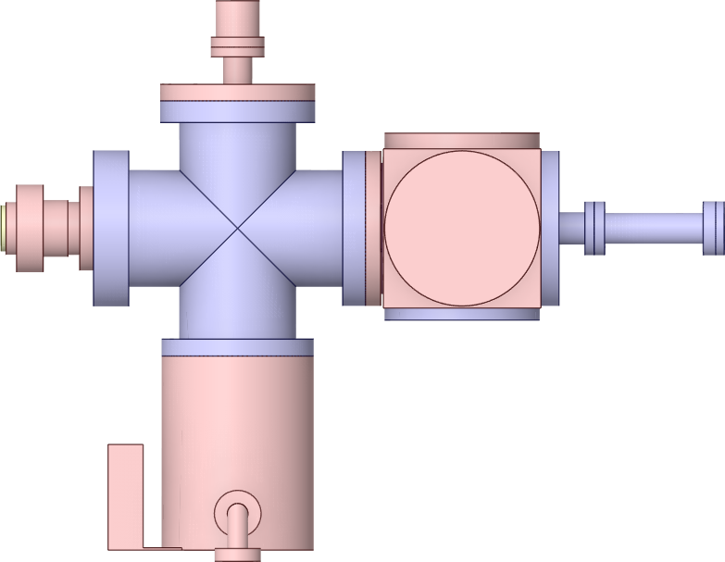
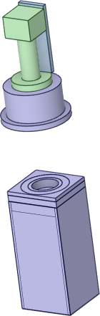
SAe30P0121-6462
Intermediate 893 solids
Final 480 solids
11

Slide 12
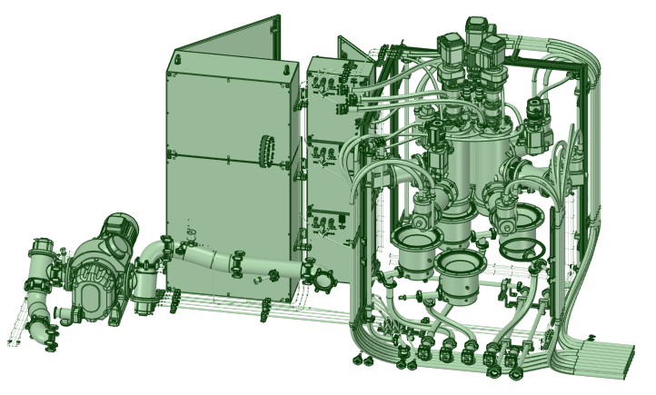
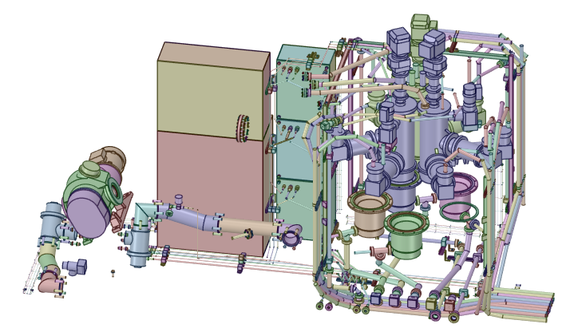
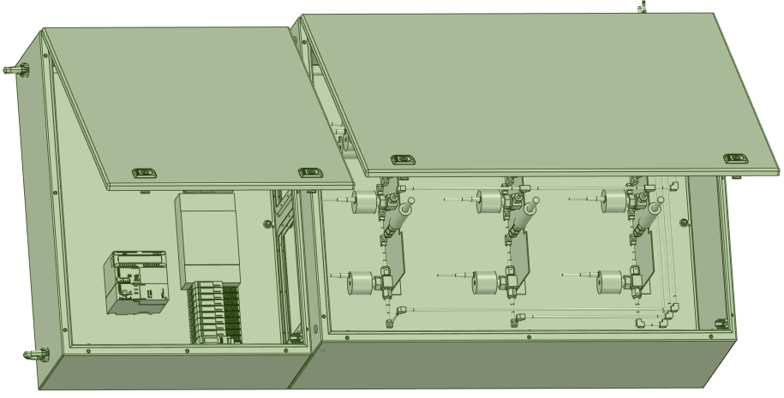
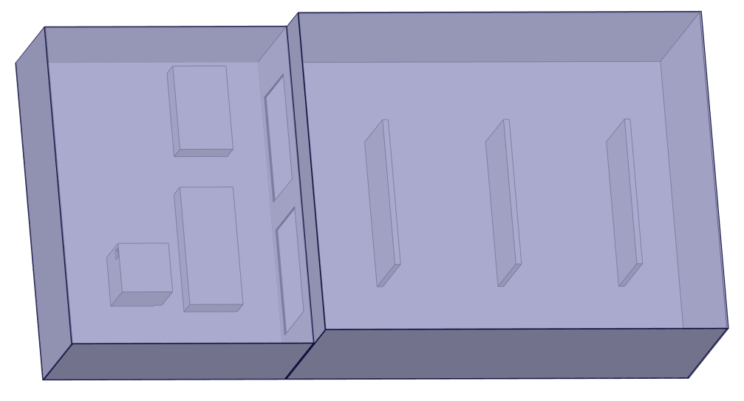
SAe30P0121-8108
Original 3311 solids
Partially simplified 1835 solids

Slide 13
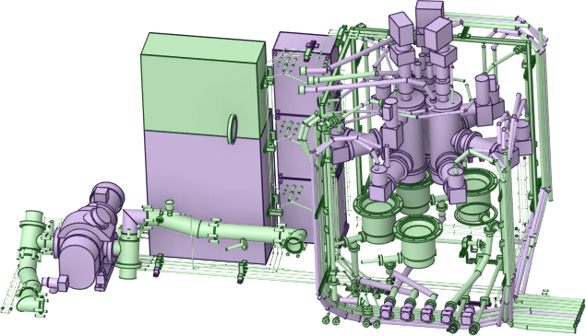
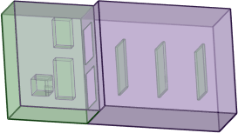
Intermediate 1835 solids
Final 1183 solids

Slide 14
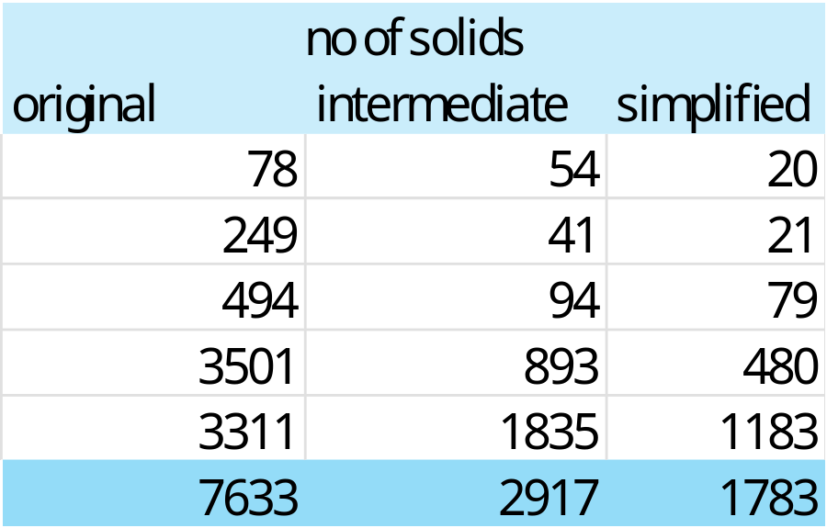
Summary
The simplification is finished,
The original number of solids is 7633,
The final number of solids is 1783,
To do:
  The elimination of the last errors,
  The stochastic volume calculation,
  The materials assignment,
  The report.

Slide 15
F4E neutronic workshop
🗓 F4E Neutronics Workshop: Tools and Best Practices for Industry and Labs
📅 18–20 November 2026
📍 Fusion For Energy, Barcelona, Spain
The main sessions will include:
F4E Guidelines — Neutronics Quality Procedures and Best Practices
Tools Workshop — a complete workflow example featuring RadModeling, GEOUNED, Gitronics, F4Enix and a unique MCNP Visualization scheme
Neutronics Tools Panel Discussion — Challenges, Choices, and What's Next

Slide 16
Thank you for your attention

