Slide 1

Progress on the engineering design of European Doppler Reflectometer for JT60-SA
EUROfusion Revision Meeting, 23 October 2026
E. de la Luna (Project Leader) on behalf of the CIEMAT JT-60SA/DR
S. Cabrera, D. Carralero,T. Estrada, A. Fernández, J. Martínez and L. Ríos

Slide 2
Outline: progress since the last Review Meeeting
Engineering analysis (thermal, EM, seismic) of the in-vessel support structure
Validation and optimisation of the in-vessel optical design
Selection of a possible path for the ex-vessel waveguides, including space requirements
Next steps (2026-2027)
Instrumentation + control + ADCs
2 Reflectometers (V & W band)
In-vessel components
Ex-vessel transmission line
(from fundamental to oversized waveguides, mitre bends, combiners& splitters, mechanical supports…..)
Front-end
(V band)
Splitter
TX
X-mode
Antenna
+
Optical assembly +
Steering mirror
TX (O-mode)
Front-end
(W band)
O-mode
Reflectometer control
RX
Combiner
Plasma
TX (X-mode)
RX
Back-end
(V & W band)
ADCs
RX
Steering mechanism control
Vacuum windows
V band (50-75 GHz), W band (75-110 GHz)

Slide 3
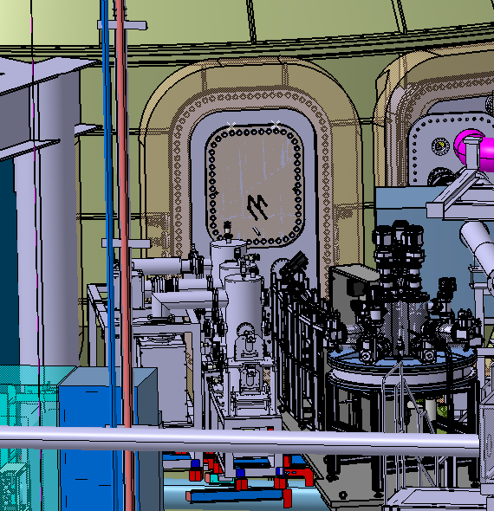
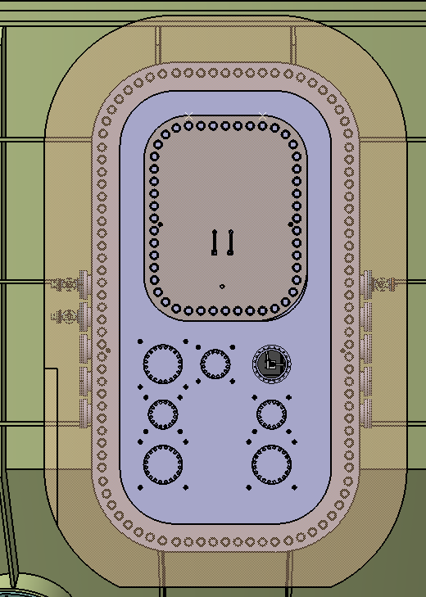
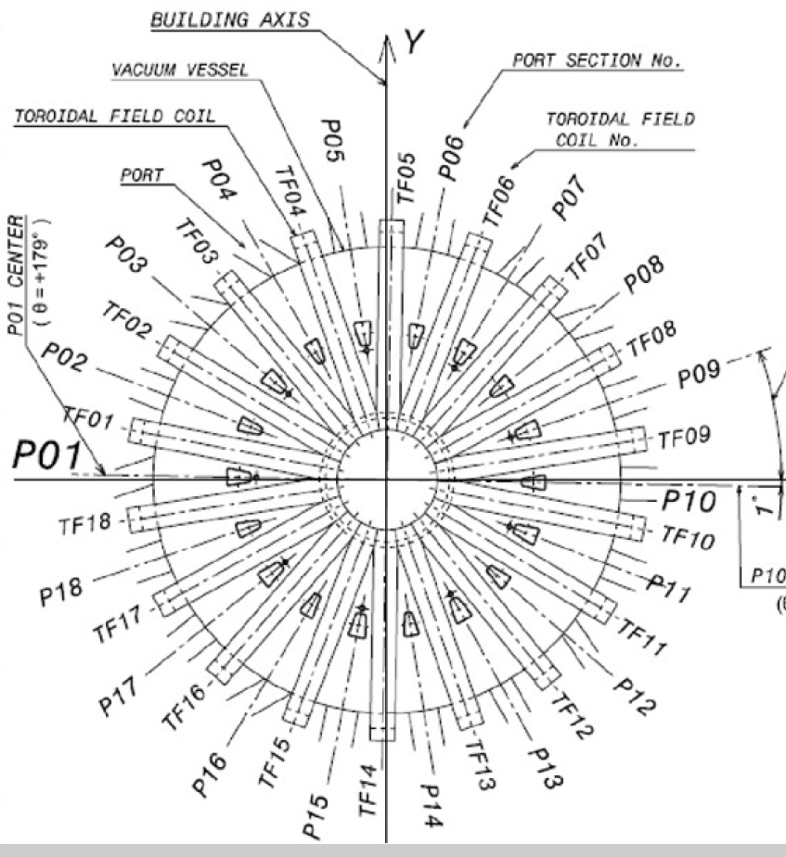
EU Doppler Reflectometer
European DR is intended to be installed in EP09 upper flange (~ 860 x 1084mm)
Port shared with Pellet injector and TESPEL
It uses a port that will be used for access to the vessel
EP09 (Upper flange)
Pellet Injector
TESPEL

Slide 4
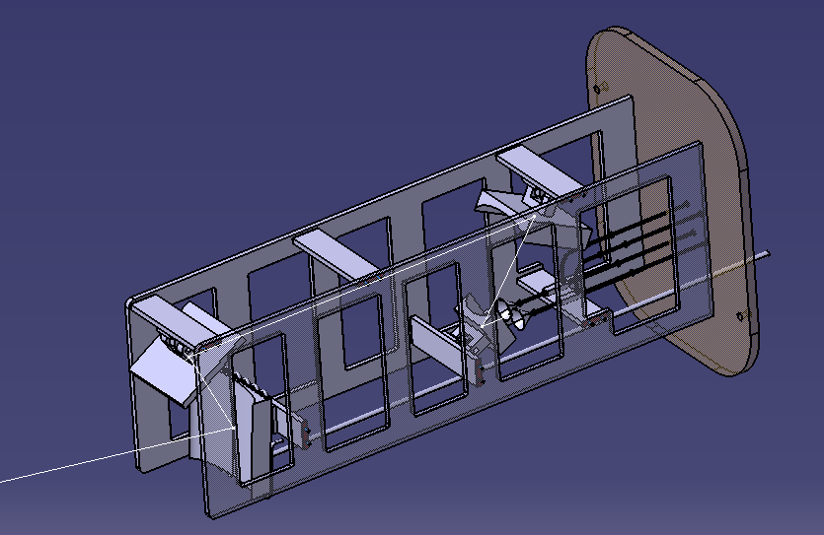
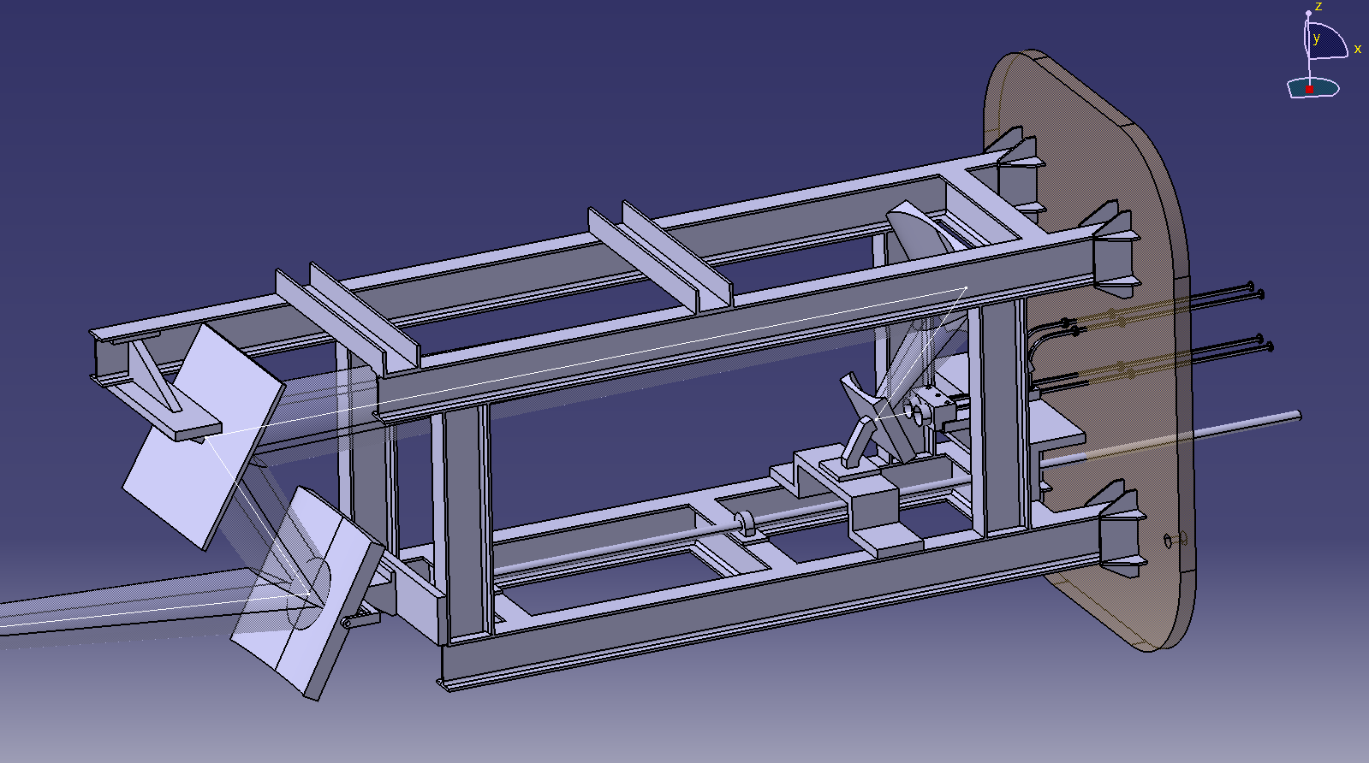
Engineering design (in-vessel): progress since Review Meeting July2025
EP09 is used for access to the vacuum vessel: ​
DR uses a “port-plug-like” design allowing fully extraction (based on the W7-X design)
Preliminary engineering analysis:
    Thermal analysis: to evaluate water-cooling needs.
    EM analysis: eddy currents caused by major disruption
    Mechanical analysis: structural viability
  New design proposal
Initial design (July/2025)
Current design (Oct/2026)

Slide 5
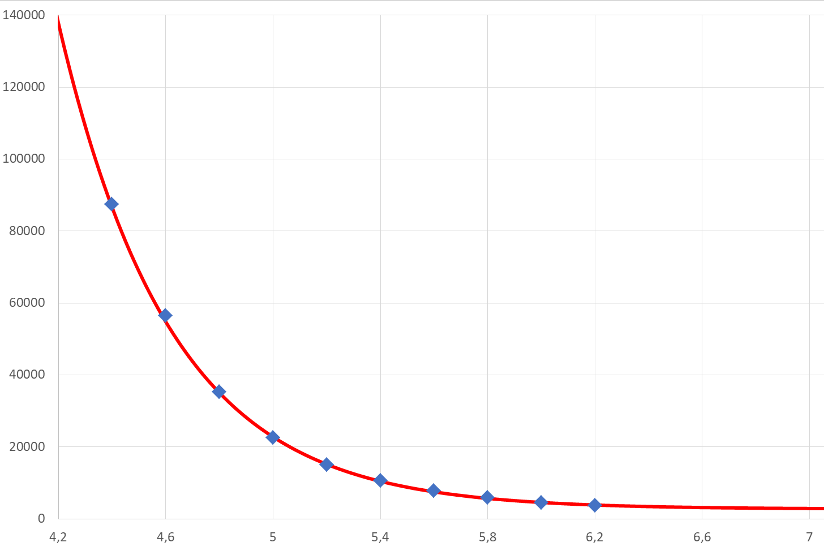
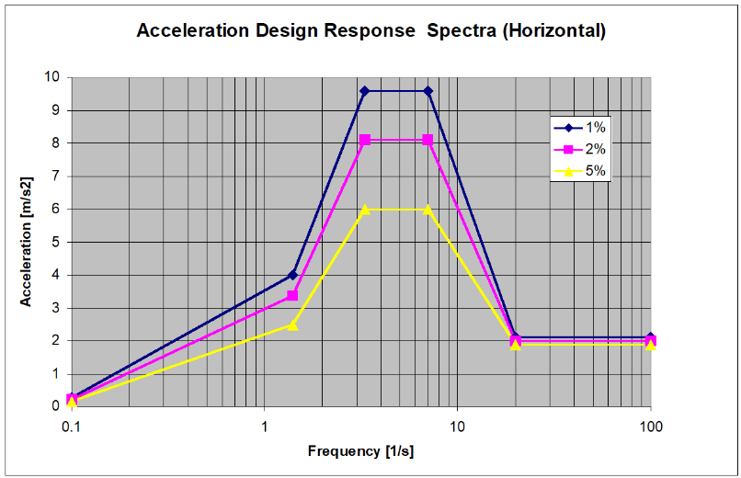
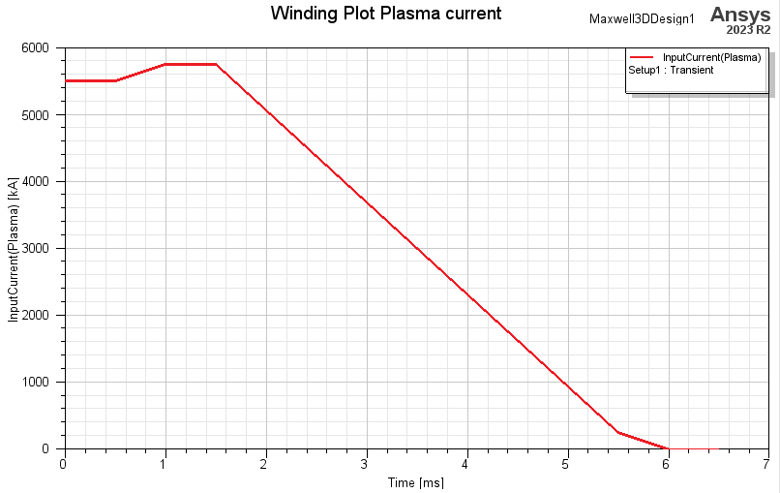
  Load definition
Load definition taken from PID 222UJY
  Thermal loads:
    - Decay of perpendicular radiative heat flux
    - Ex-vessel ambient = 25ºC
    - Port walls at 50ºC
  Seismic loads
  EM loads
    - Plasma current quench in 4 ms
Heat flux (W/m²)
Radial distance (m)
Engineering analysis process
  Thermal/EM loads used for the analysis of the initial support structure
  Results from the analysis applied to redesign the support structure
  Thermal/seismic/ELM analysis repeated to validate the new support structure
Plasma current (kA)
Time (s)

Slide 6
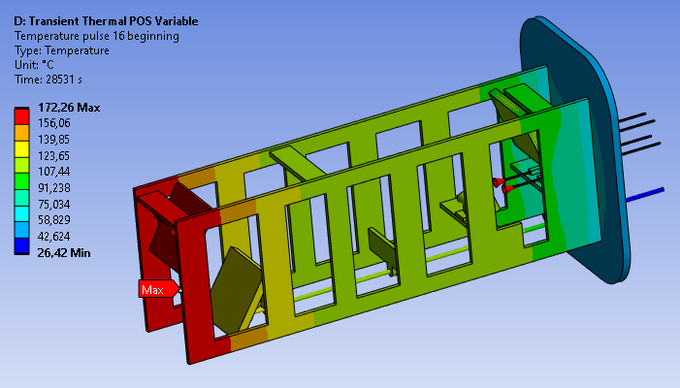
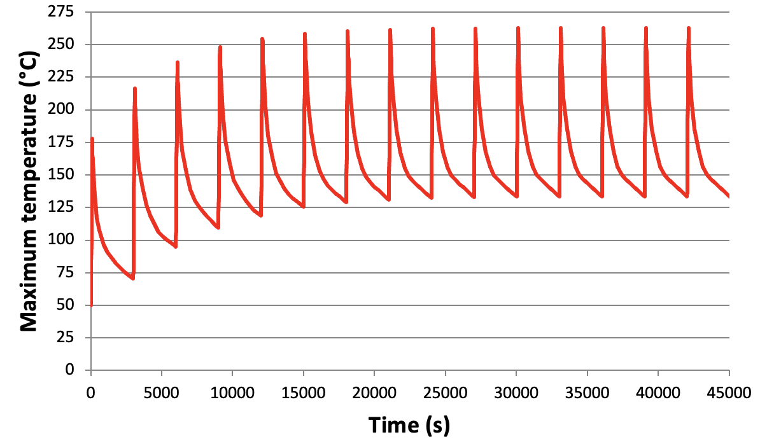
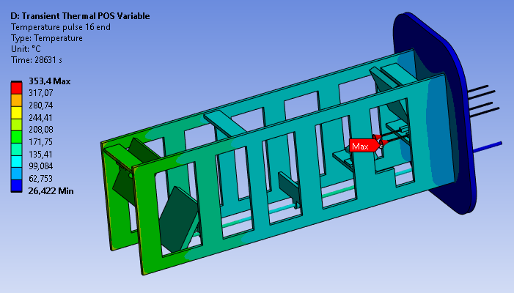
Preliminary thermal analisis
100 s pulse - 2900 s of cooling down
Maximum temperature stabilised after 8-10 pulses
  Mirror 3 (closer to plasma):
    150ºC at the beginning of pulse no. 11
    230ºC at the end of pulse no. 11
  Horns: hottest points
    160ºC at the beginning of pulse no. 11
    350ºC at the end of pulse no. 11
    Low mass and high area
    Heat evacuation must be improved

Slide 7
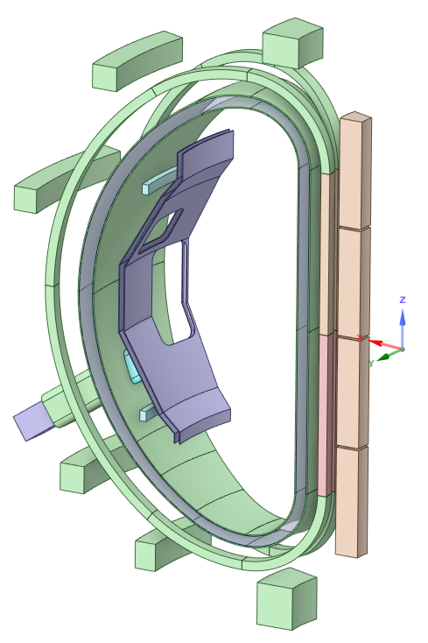
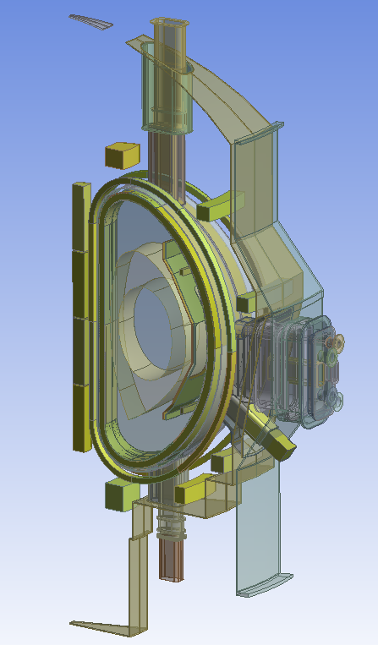
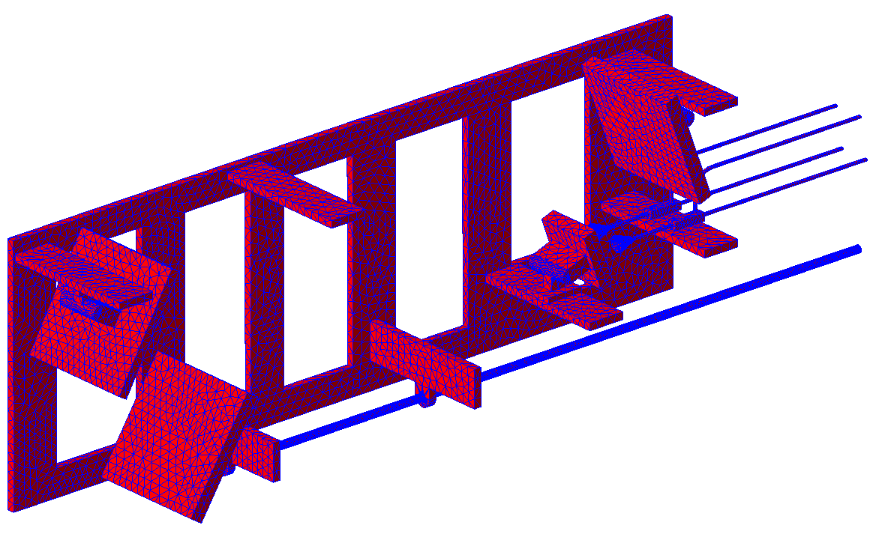
  Preliminary EM analysis model
40º model includes two complete TFC
VV modelled as the inner shell
Stabilising plate (SP), made of two shells + cryostat and port extension
Doppler reflectometer (initial design)
Materials (PID):
  - SP, VV, port extension and DR in SS 316L
  - Cryostat in SS 304

Slide 8
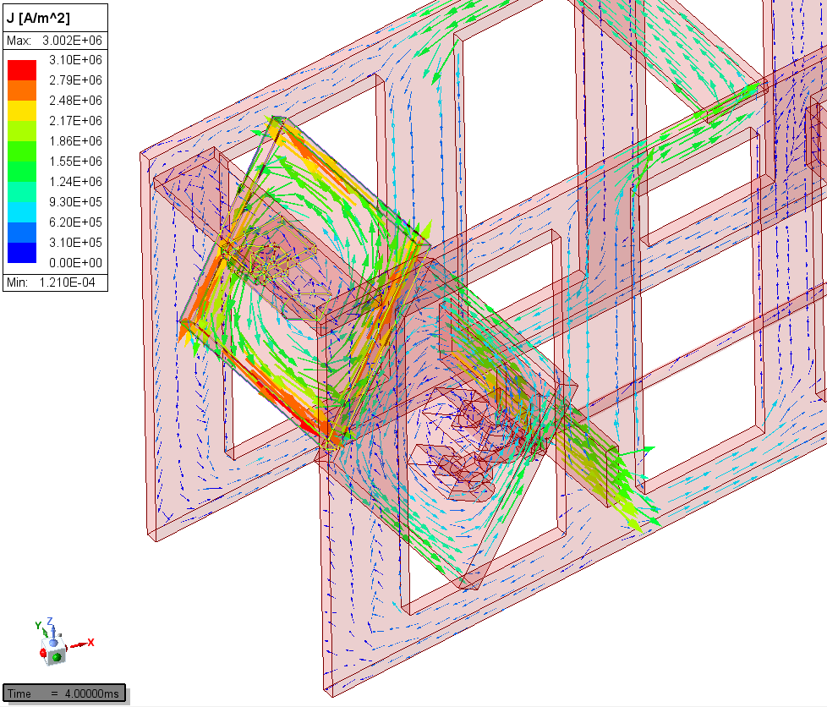
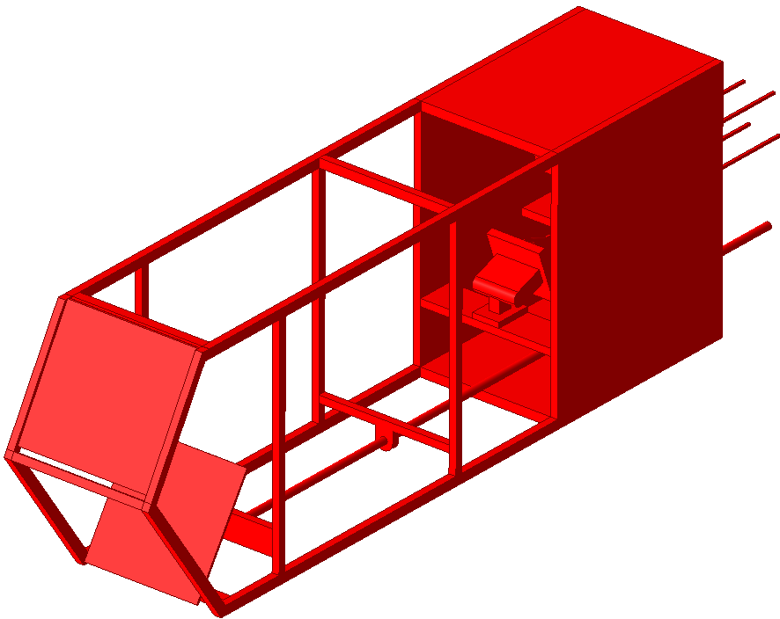
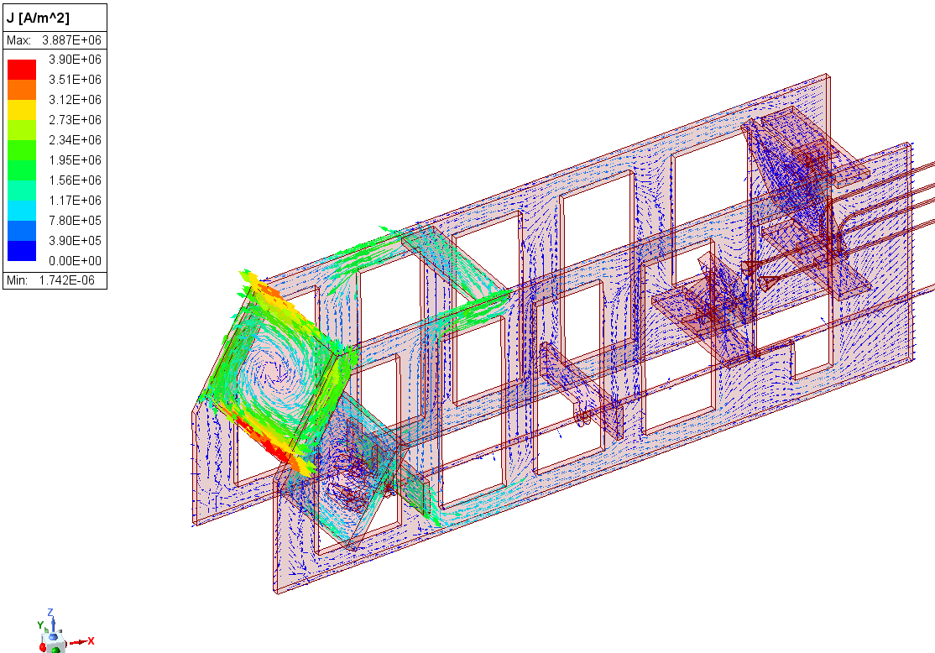
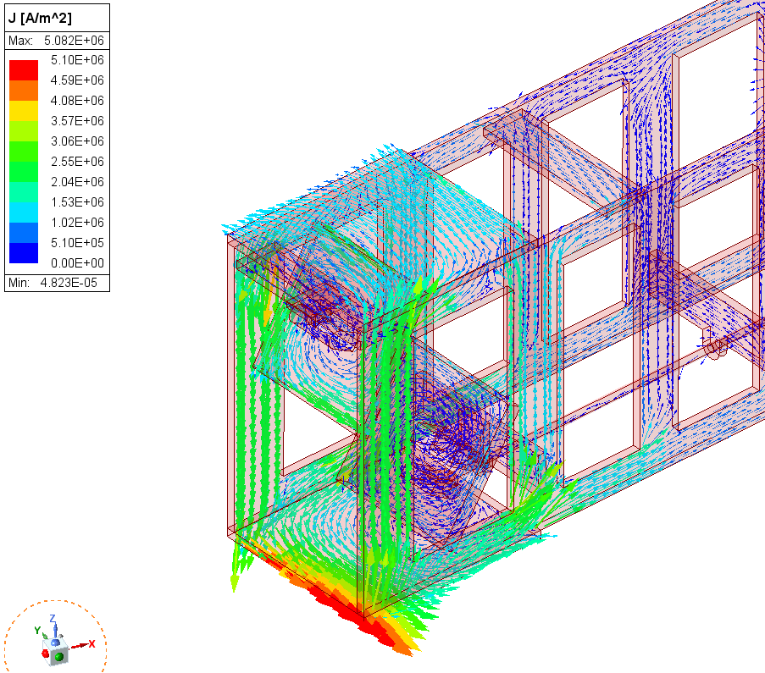
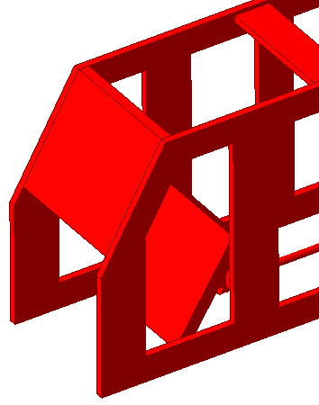
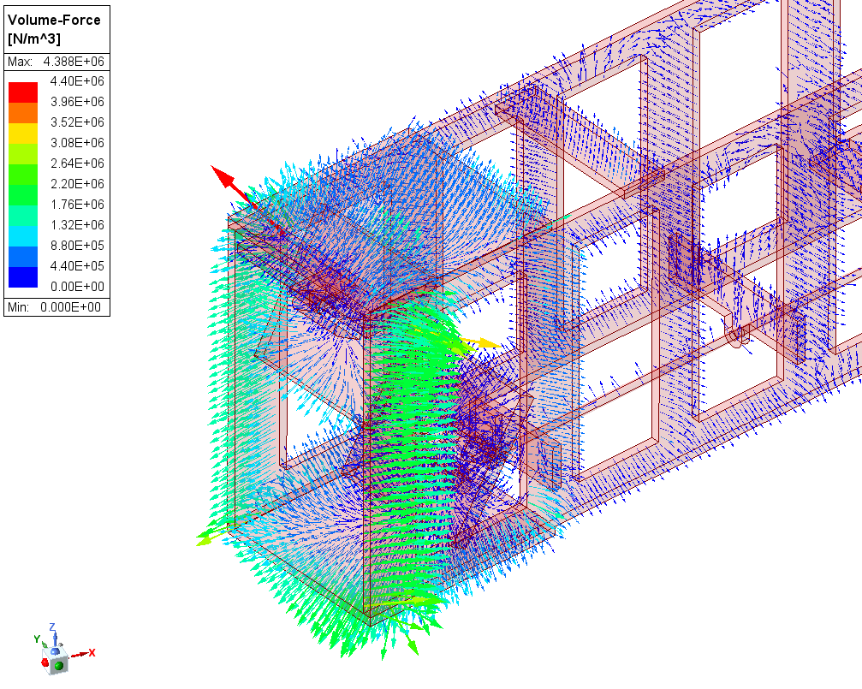
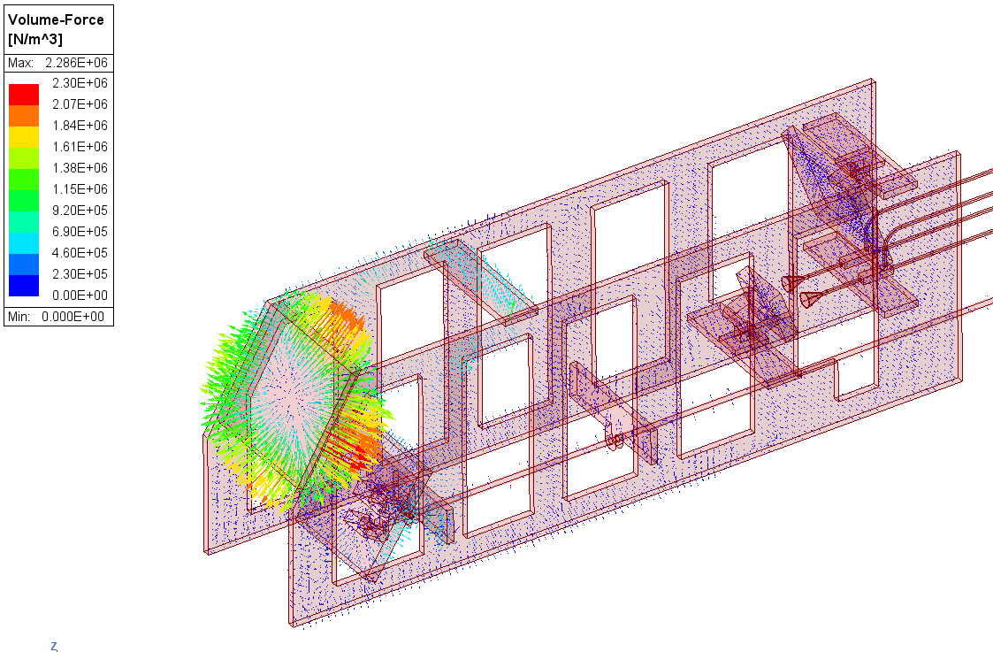
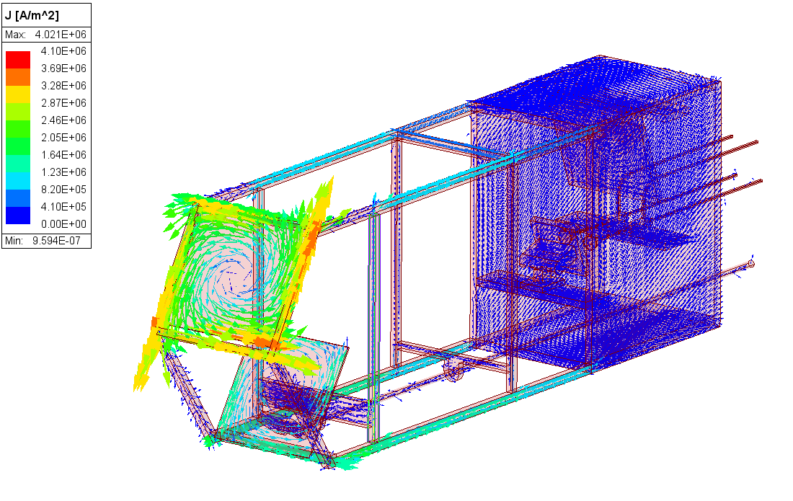
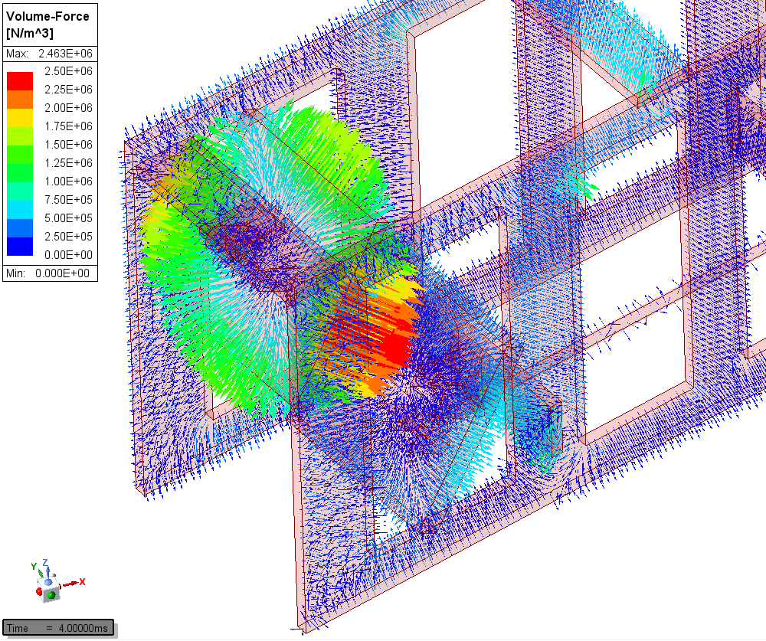
  Preliminary EM Analysis results
Step 1: ELM analysis to validate the initial design
Force ~ 1 kN, mainly transversal
    M3 ~ 300 N
    M4 ~ 150 N
  Big currents and forces on the mirror closer to the plasma
A set of modifications was analysed to minimise the loads:
  Frontal shielding of the mirror to redirect the currents through the structure -> Similar forces, more current
  Shielding plates (more material and more current path for loops)
  Including the mirror in the structure (less material, fewer closed loops)
  Light bar design (less material, bars around M3 to absorb currents)
    Force ~ 400 N (M3: 132 N & M4: 24 N)

Slide 9
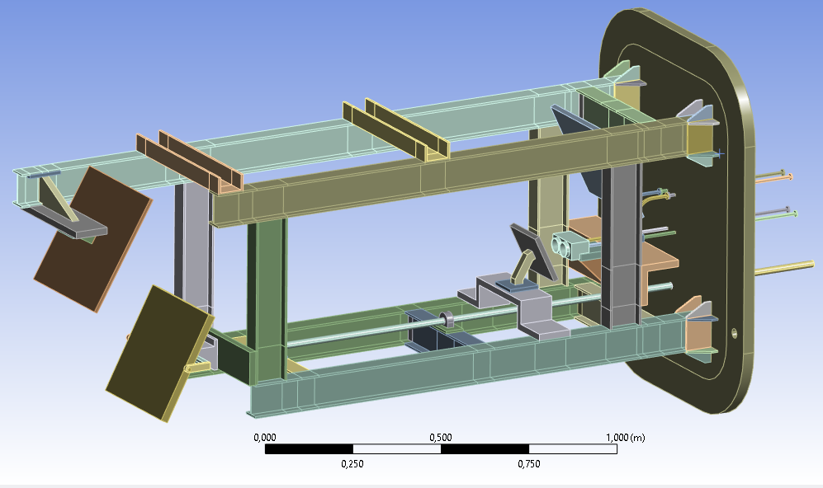
New DR design proposal for in-vessel components
Step 2: re-design the support structure based on preliminary EM/thermal analysis
Based on standard IPE100 beams
Lighter: 168 kg vs 395 kg
(+ 237 kg of closure plate)
Centre of gravity closer to closure plate
Asymmetric design in the frontal part to avoid current loops
Lower reactions on cryostat

Slide 10
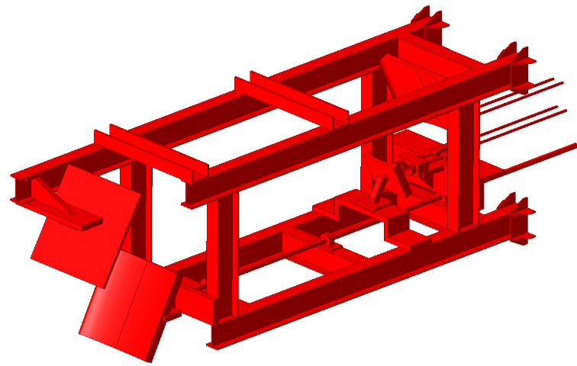
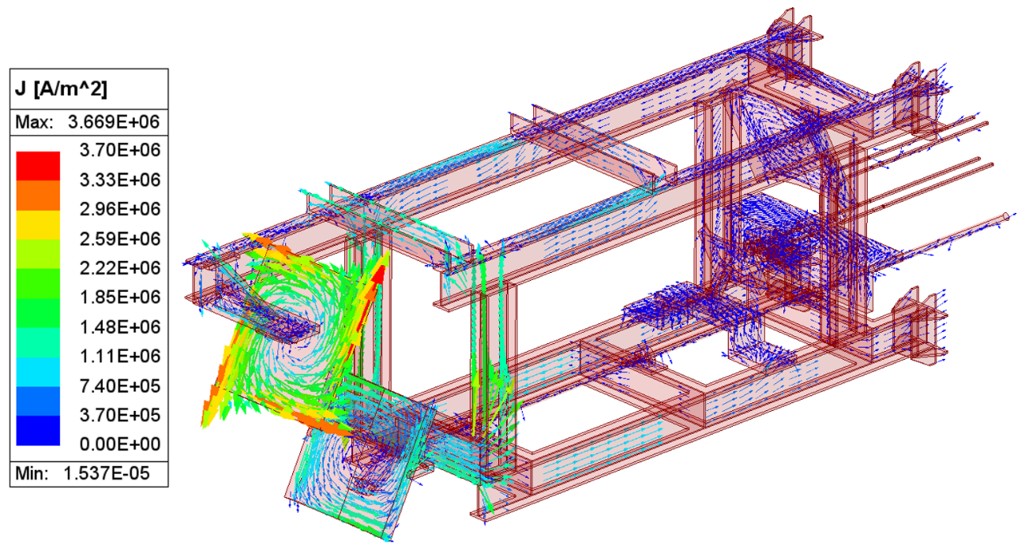
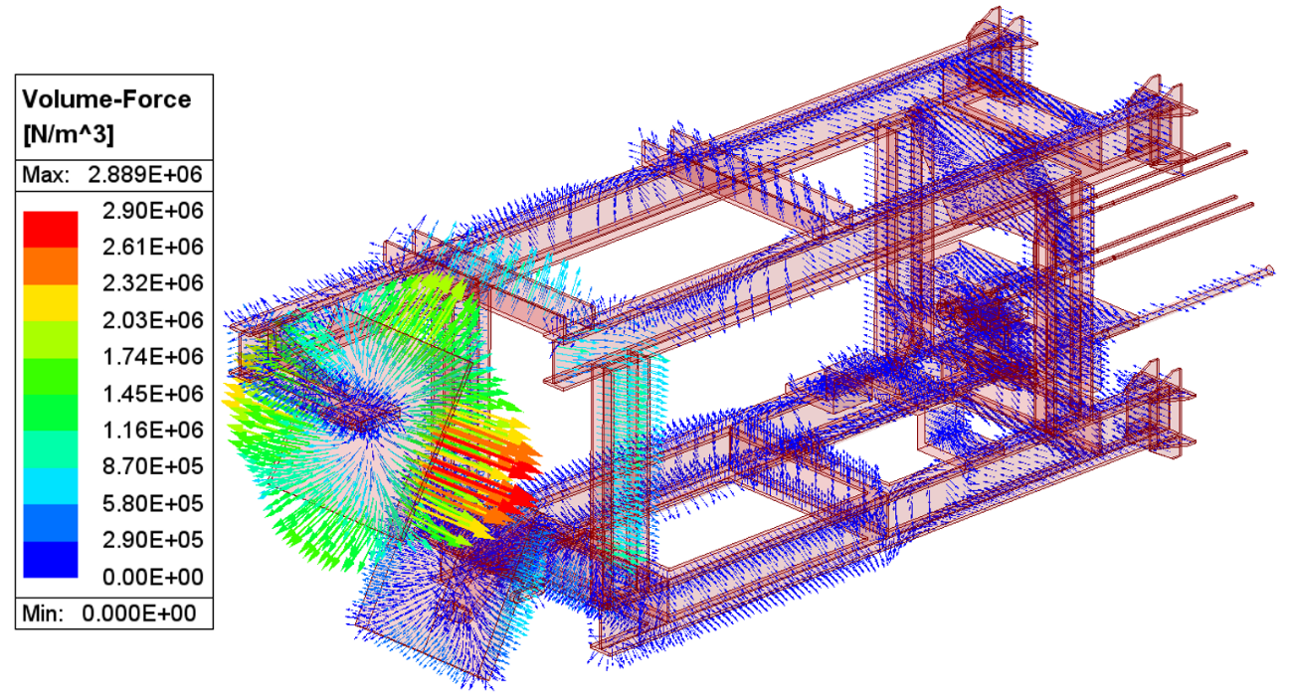
Validation of the updated DR design (selection of results)
Step 3: Repeat EM, thermal, and seismic analysis to validate the updated in-vessel design
EM analysis: Include the update support structure + an increase in the size of mirrors 3 and 4
Force: 488 N, in M3= 187 N, in M4 = 92 N.
The structural rigidity of mirror 3 needs to be increased

Slide 11
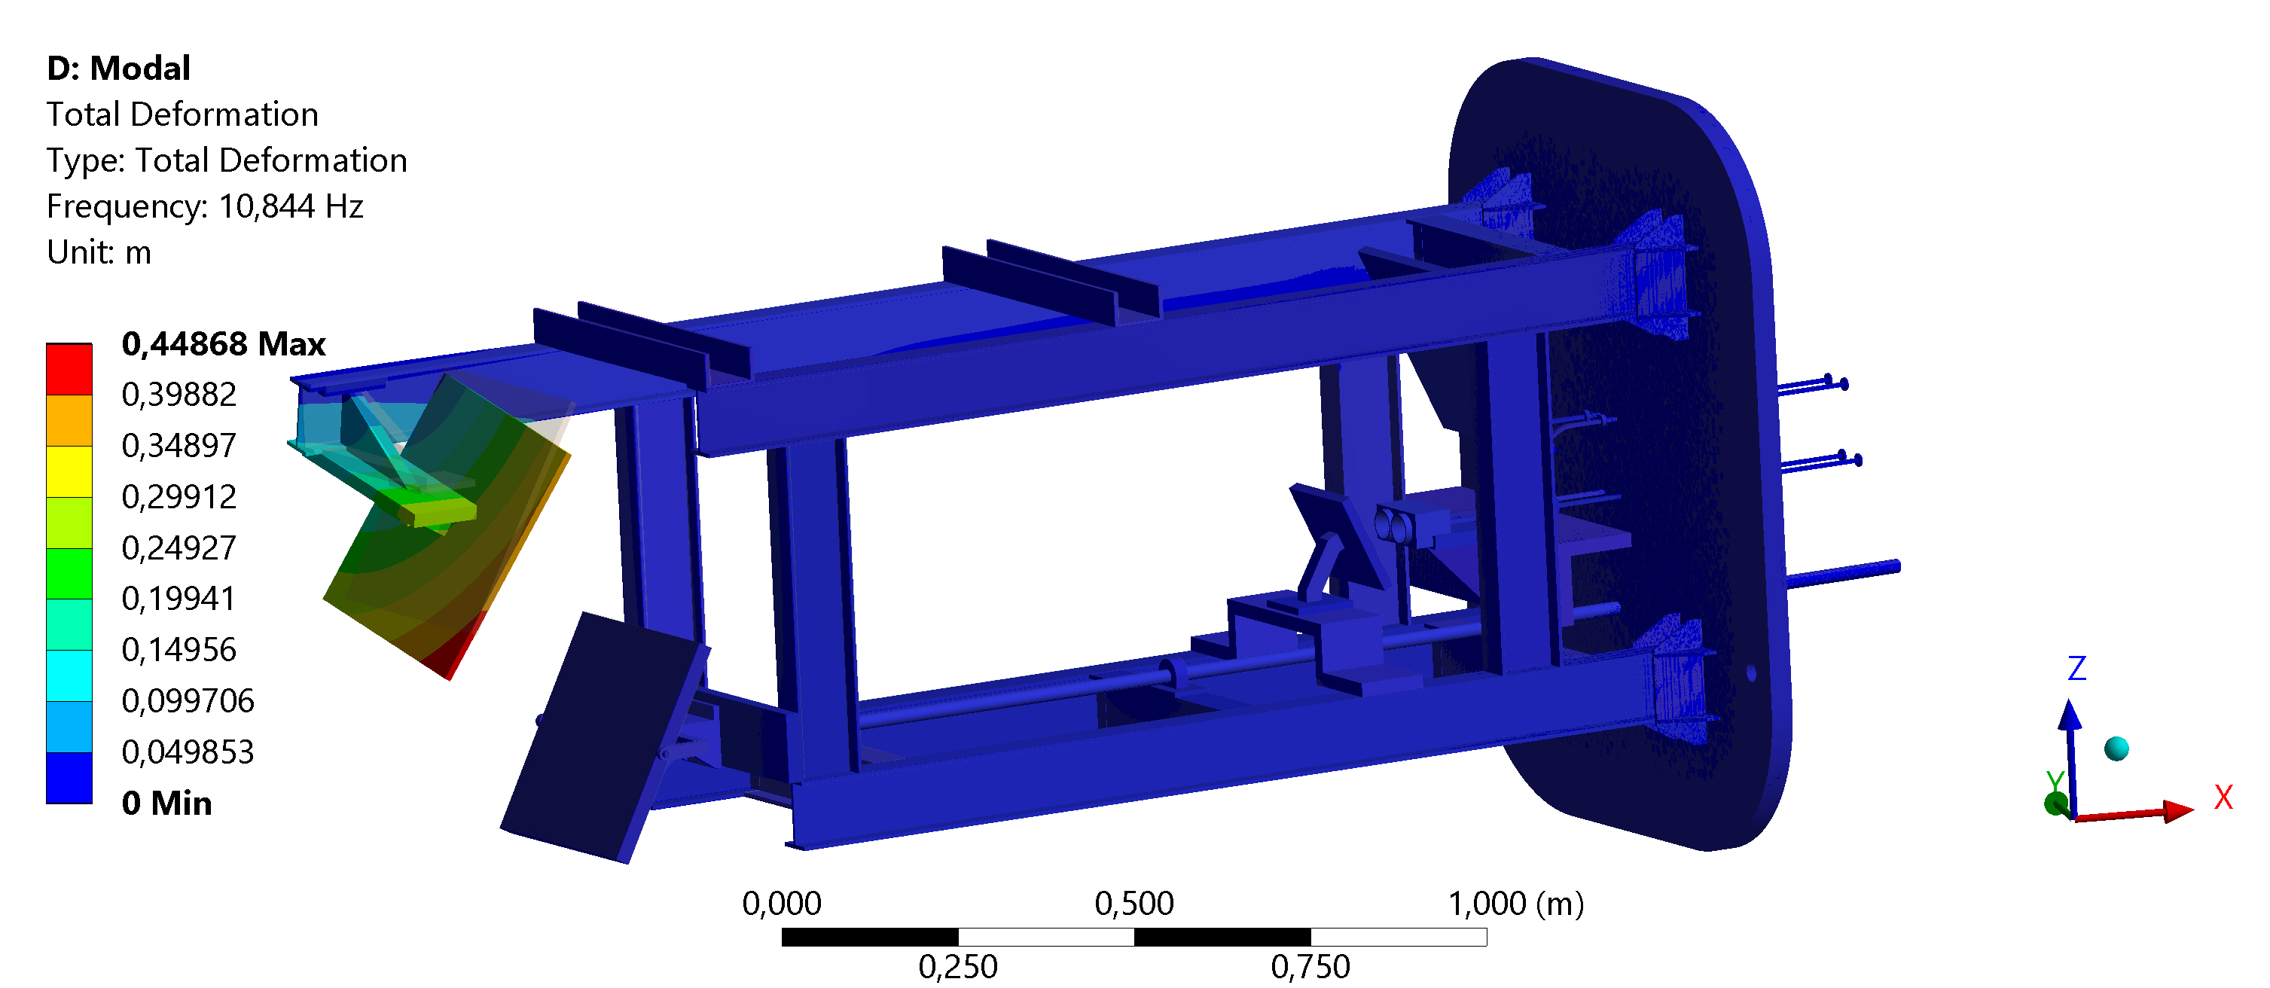
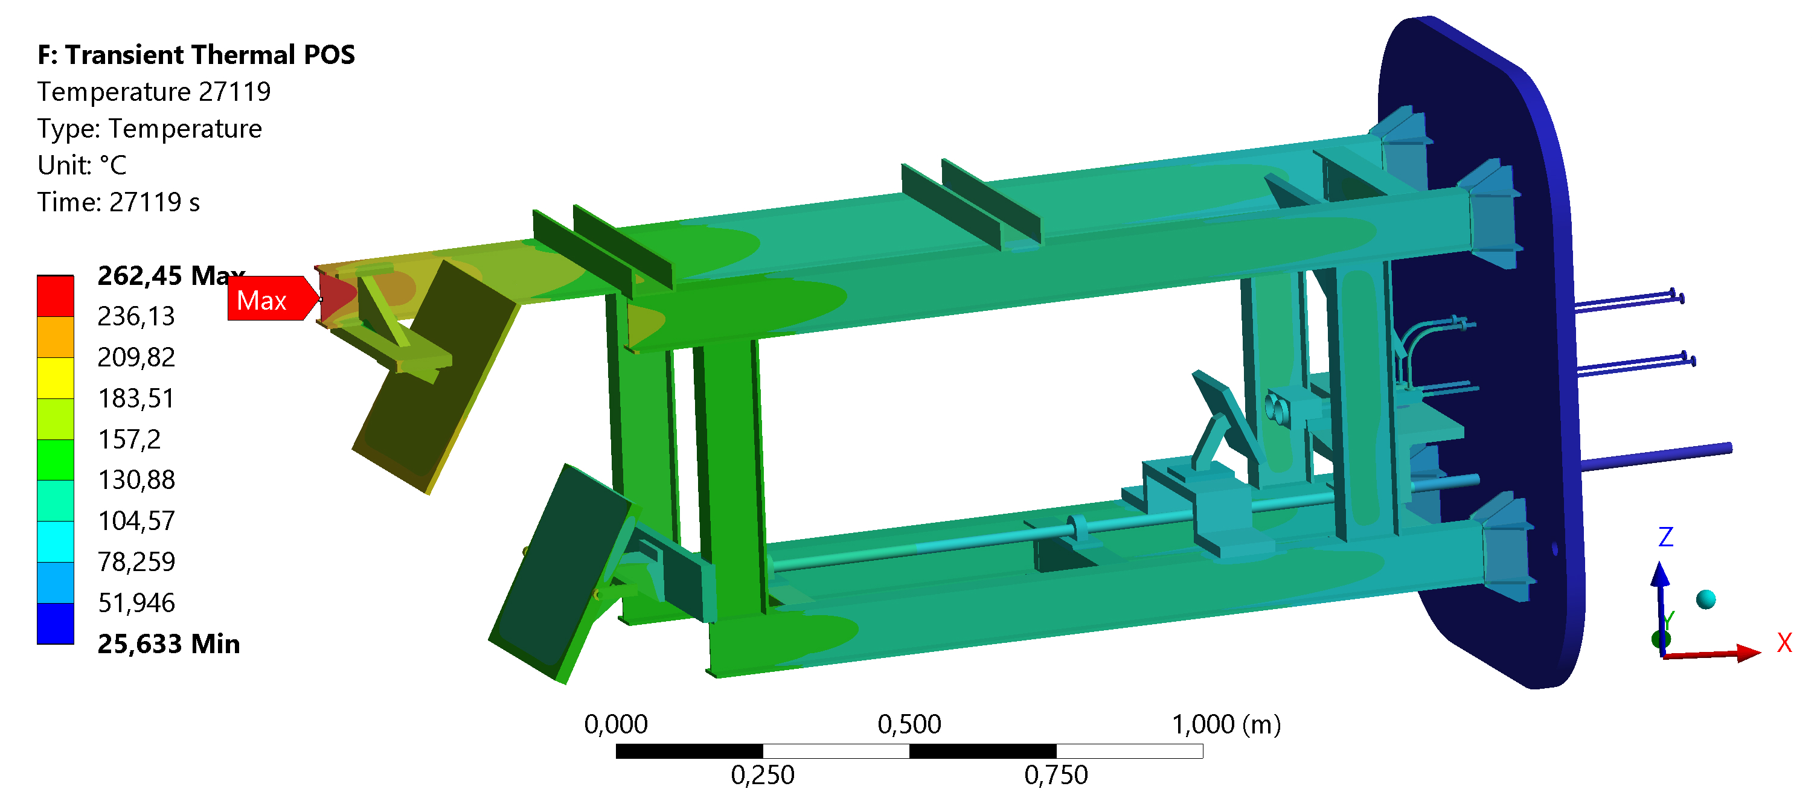
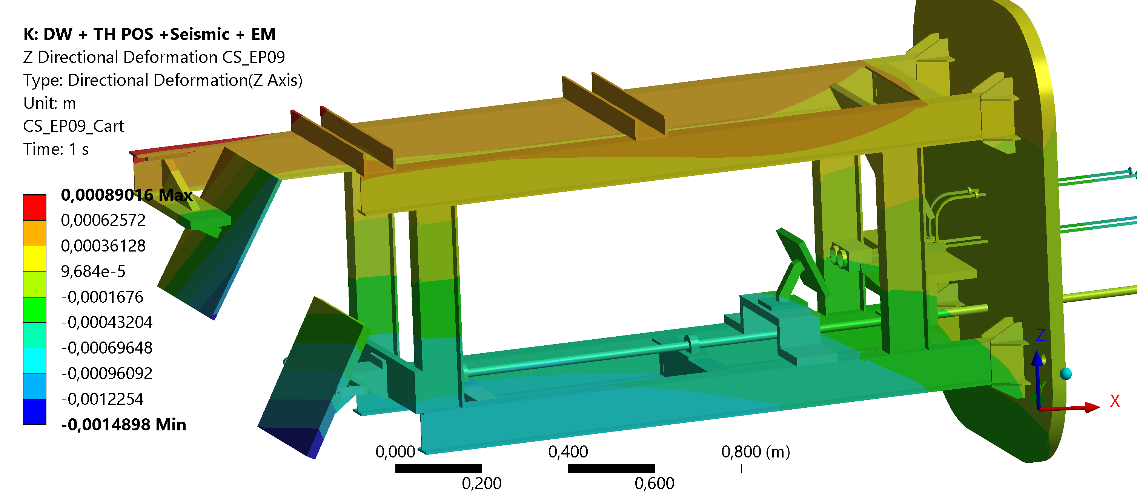
Validation of the updated DR design (selection of results)
Modal analysis:
Total deformations first natural freq (10.8 Hz)
First frequency beyond ZPA
(Zero peak acceleration)
Thermal analysis (includes improved heat evacuation for the antennas)
Thermal analysis + Dead Weight + Seismic
Antennas~72 ºC (max. value)
Mirror-3~170ºC (max. value)
Deformations in the Z direction <0.5 mm

Slide 12
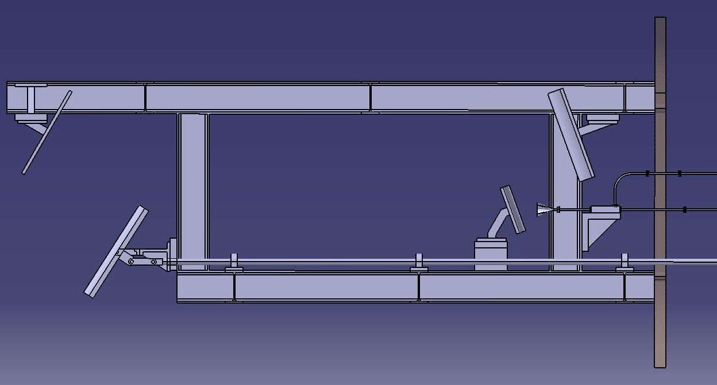
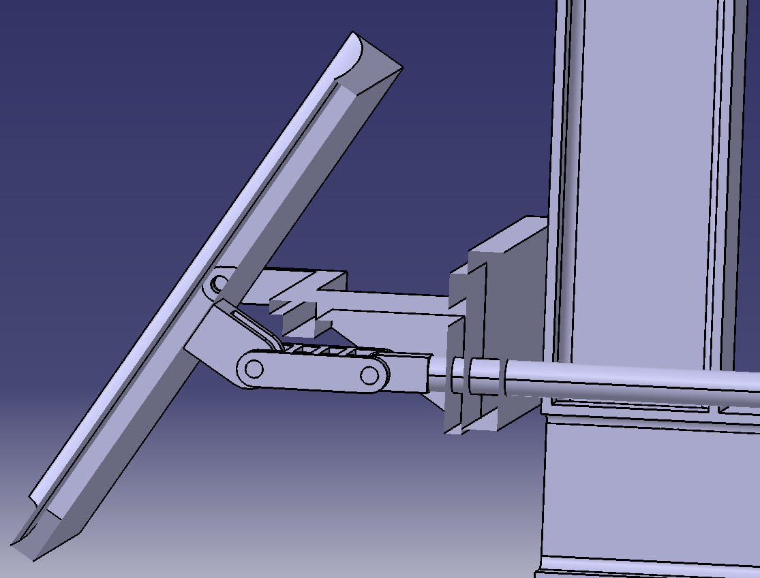
DR steerable mirror mechanism – conceptual design
Bellows for rod-closure plate vaccum interface
Same concept used in one of W7-X DR steering mirror mechanism
Bellows for vacuum interface of long rod with EP9 closure plate
Linear actuator moved by a piezoelectric motor
  Long cylindrical rod actuated by a piezoelectric motor
  Small rod with 2 articulated joints as an interface with the mirror
Self-lubricating, radiation-resistant material (e.g. Si3N4 ceramic) for:
  Cylindrical bushings allowing sliding of long rod supports
  Spherical or cylindrical bearings for small rod articulated joints
NEXT STEP: final engineering design, including mirror position control
Long rod
Spherical or cylindral bearings
Small rod
Long rod

Slide 13
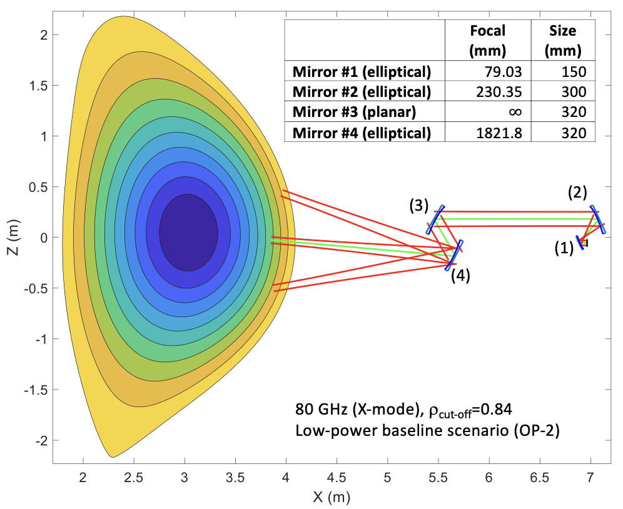
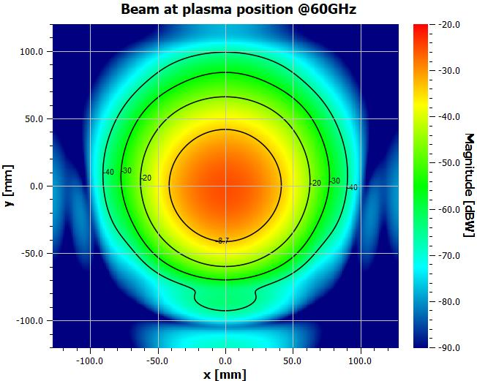
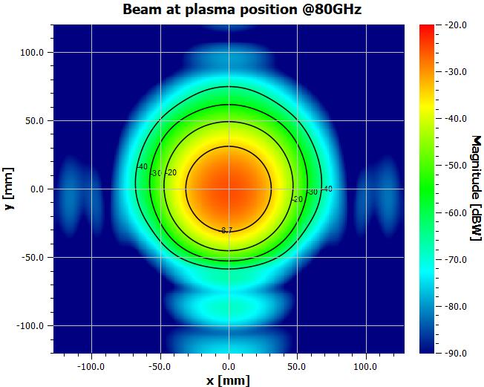
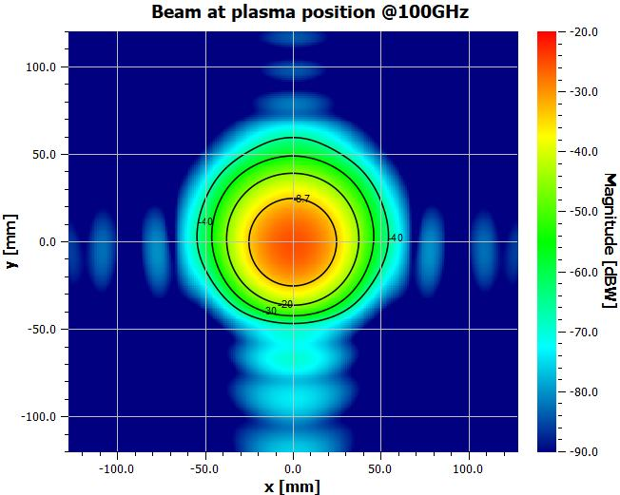
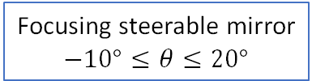
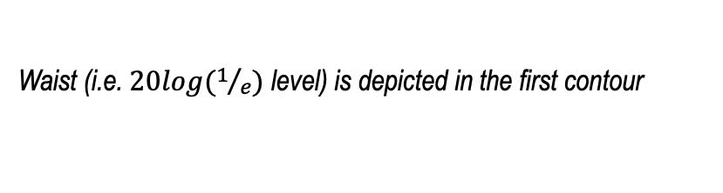
Optical design: progress since Review Meeting July2025
Gaussian beam telescope &
frequency-independent optics
Validation/optimization of the optical design using GRASP in collaboration with A. Simonetto and P. Platania (ongoing since September 2026):
  multi-beam optics typically requires large mirrors
  space constraints impose a limit on mirror size
Initial design
Beam waist in the plasma
Waist (i.e. $20log⁡(1/e)$ level) is depicted in the first contour
60 GHz 80 GHz 100 GHz
Focusing steerable mirror
$$−10°≤θ≤20°$$
First results show excellent agreement with the optical design
Work is ongoing: minor adjustments to mirrors (1) and (2) may be required following the optimisation process
Notes:
GRAPS is the industry-standard software tool used for the design, analysis, and optimisation of large reflector and quasi-optical systems
It models scattering and propagation of radio frequency (RF) radiation to compute near-field and far-field radiation patterns in large reflector systems

Slide 14
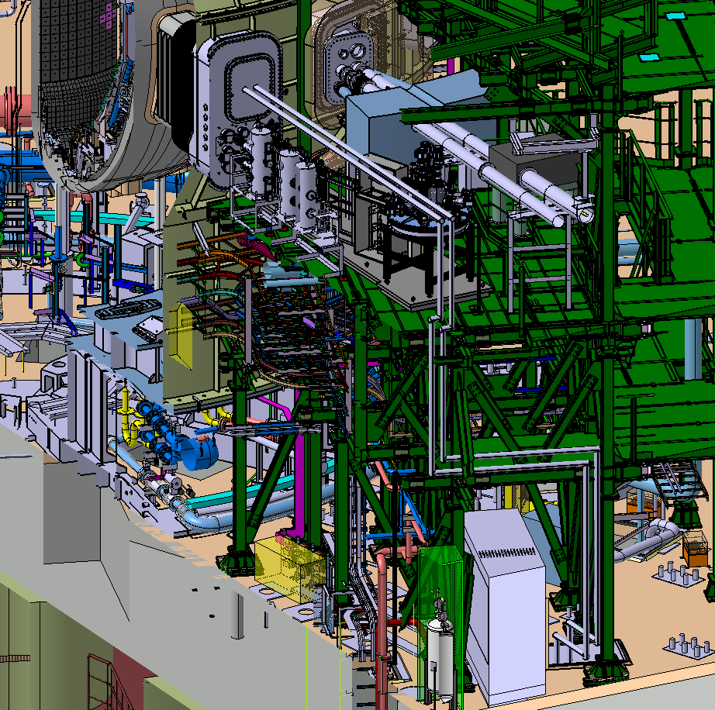
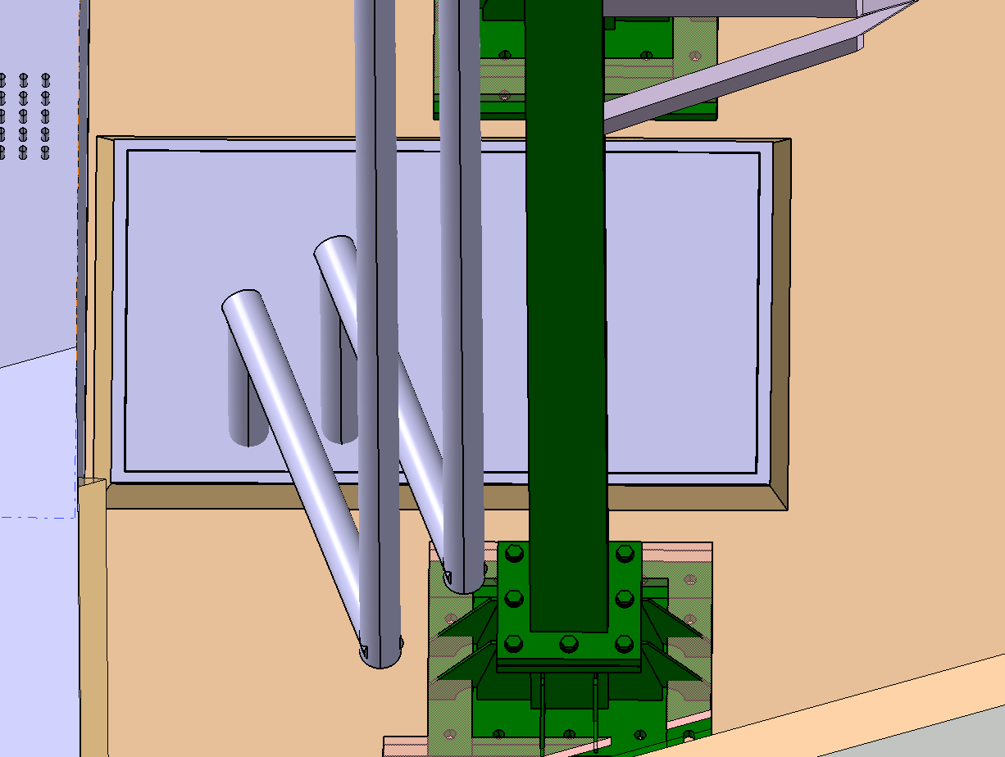
Ex-vessel transmission path: progress since Review Meeting July2025
Preliminary analysis to define the ex-vessel waveguide (WG) path up to the basement
  using actual corrugated waveguide dimensions (D = 92.7 mm [1]) and flanges
  minimising the number of 90° bends
  WG path selected to facilitate the installation of support modules
Designing waveguide access to the PIG room is complex due to the lack of information in the CAD model
Hatch A-11
directly to the basement
Length: 32 m, including 5 extra meters after reaching the basement
Number of 90º bends: 8
[1] Large corrugated waveguides. Can be smaller (D=63.5 mm or 31.75 mm)

Slide 15
Next steps
Finalise Annex B (2026), which is nearly complete, covering:
  On-site and off-site testing requirements for the DR system
  Vacuum window requirements and testing (at CIEMAT)
  Closure plate vacuum tests to be defined (test facility in Seville?)
  Space requirements for the instrumentation, control and data acquisition
Define instrumentation specifications, nearly complete (2026)
Organise Design Review Meeting (DRM) with QST (Nov/Dec 2026)
Consolidate the optical-thermal-structural design (in-vessel) after the DRM (2027)
  Finalise the optiminisation/validation of the optical design
  Finalise mechanical design, including changes to the optical layout
  Finalise the last mirror steering mechanism (steering range, precision, actuator concept)
  Final validation and analyses
Design of the ex-vessel transmission path layout, including support structures (2027)
  Pending the decision on the location of the instrumentation

Slide 16
Thanks for your attention!
Questions?

Slide 17
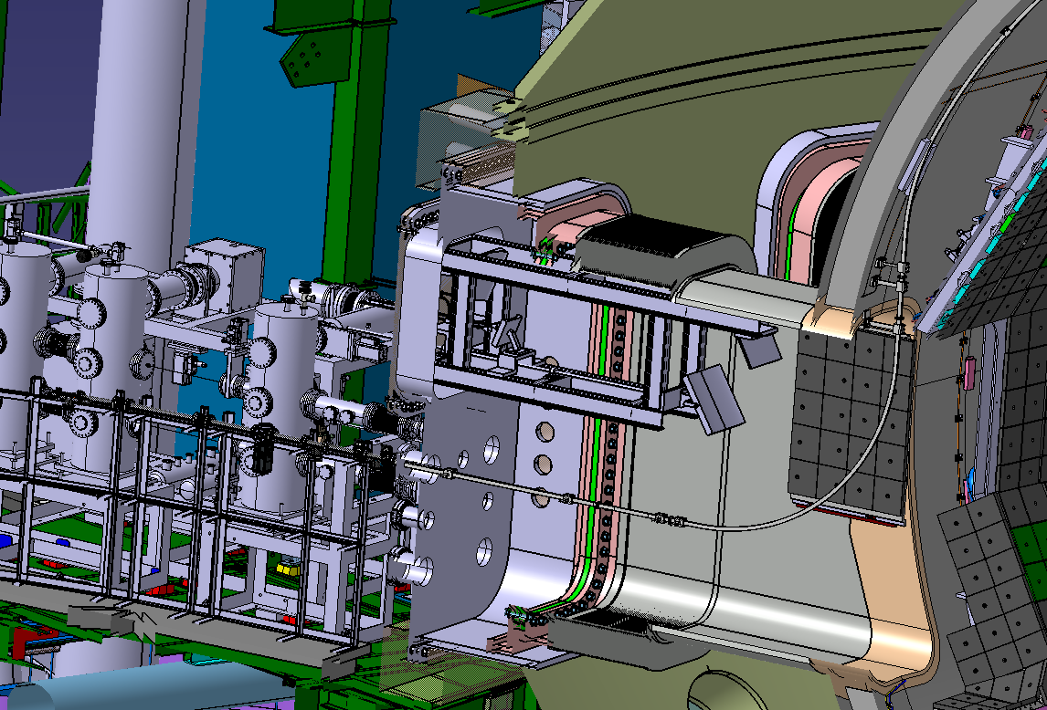
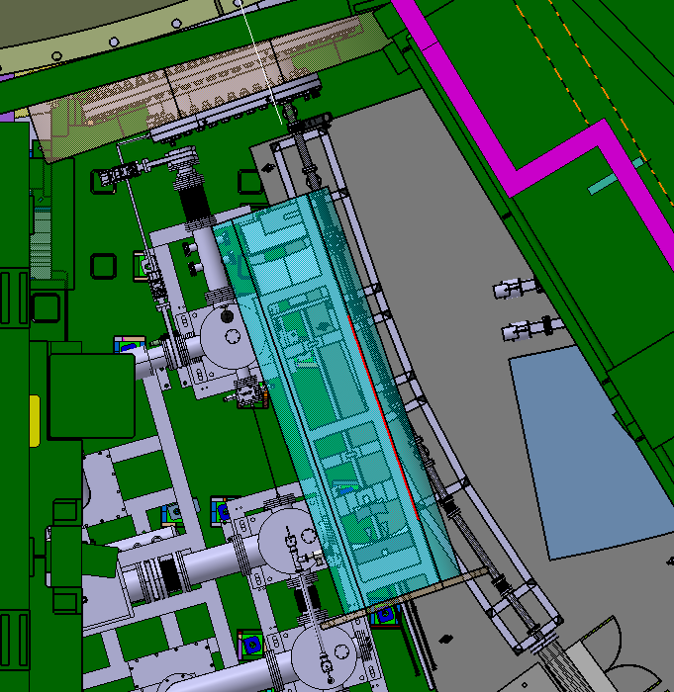
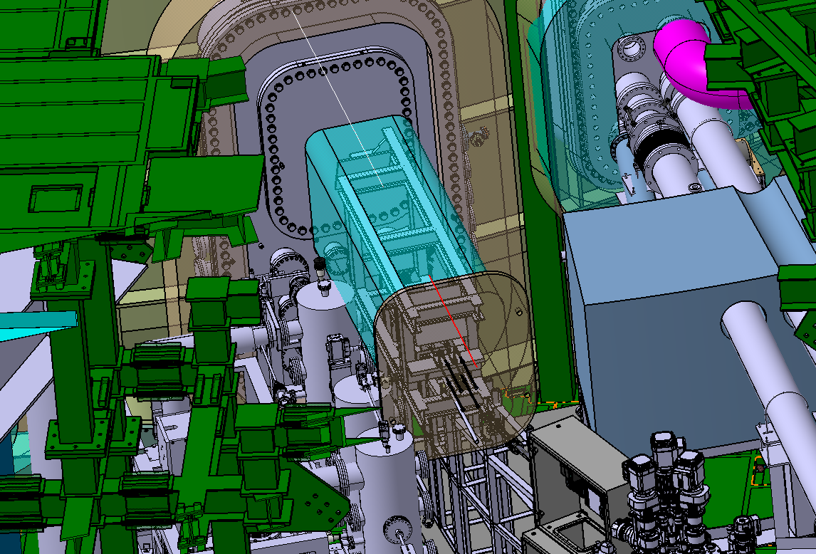
Extraction sequence: initial contacts with QST (June/2026)
Side view of in-vessel components inside EP09
Interference with Pellet Injector and TESPEL
Upper extraction possible (common stage beam needs to be removed)
16

Slide 18
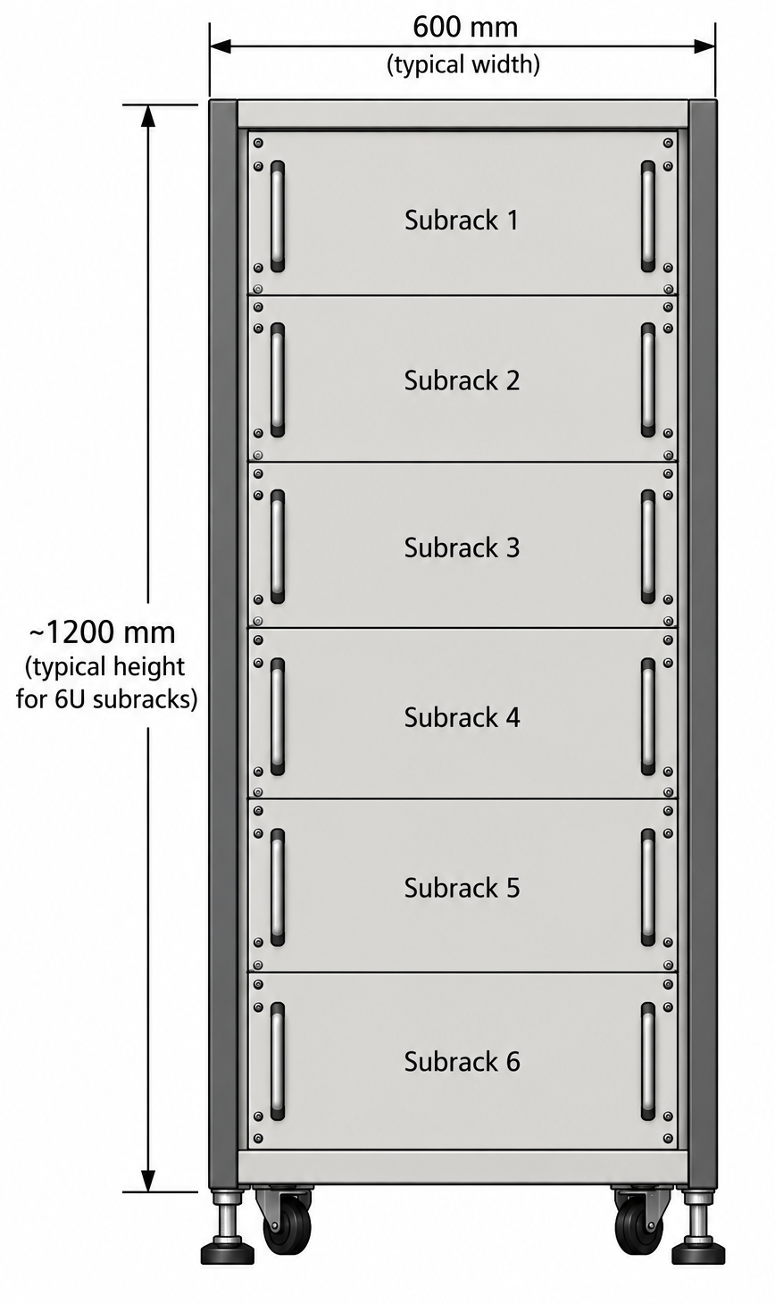
Instrumentation space requirements for DR system
Full rack needed for the DR system: 6 subracks + additional space on top of the rack for the installation of the RF components + QO boxes (combiner/de-combiner) to connect to the ex-vessel waveguides
Subracks required:
Instrumentation Reflectometer 1 (W Band)
Delay line Reflectometer 1 (W Band)
Instrumentation Reflectometer 2 (V Band)
Delay line Reflectometer 2 (V Band)
Instrumentation control (O/X polarisation, frequency sweeps, last mirror movement,…)
Acquisition system

