Slide 1
Opening & overview of project status
TSVV3 annual workshop 2026
P. Tamain
CEA, IRFM

Slide 2
Call for ACH support requests
  Call for ACH support requests in 2027 is out - deadline: 30/10/2026
  No change in form w/r to last year
  Like last year, unclear through which channel the answer should be given: direct from code developers or through TSVV projects
    I suggest to compile them and send them through TSVV-B as I believe these will be given higher priority than isolated requests
  We should try to synch: max. 2 to 3 ppy of support total -> ~8pm per code max
    Please discuss with ACH contacts to determine needs and workplan
    Send first draft to me by October 16th
    Dedicated Zoom mid-October (21st?) if needed

Slide 3
Call for HPC time in cycle 11 (03/2027-12/2027)
  Call for HPC time cycle 11 is out - deadline: 13/11/2026
  No change in form w/r to last year
  Important note: time period of cycle 11 for the moment limited to 01/03/2027 – 31/12/2027
    Extension into 2028 will depend on future of EUROfusion (linear extension will be granted)
  I’ll send instructions by e-mail as usual, but here are already a few guide lines:
    Total request in cycle 10 was 1 M node.h on CPU => *10/12 * 1/4 ~ 200k node.h per code
    Start from last year’s proposal and make changes there directly
    Send first draft to me by October 23rd

Slide 4
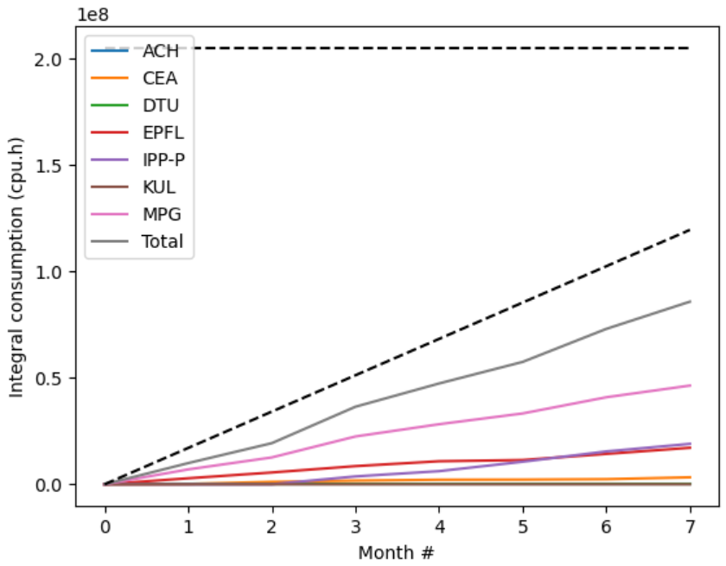
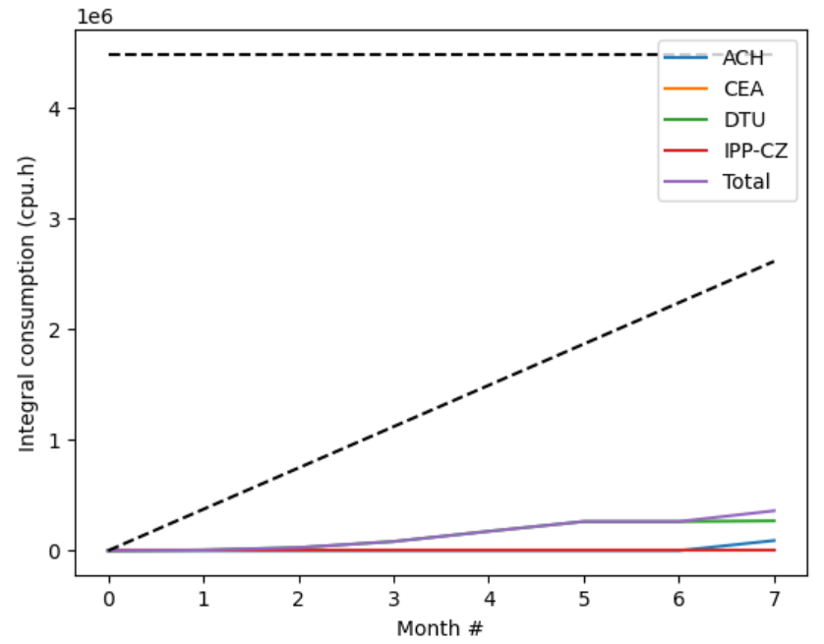
Pitagora usage
CPU
GPU
~70% of target
~14% of target

Slide 5
Context and purpose of meeting
TSVV-3
TSVV-B
2021
2022 - 2025
2026 - 2027
2028 - ??
You are here
  Context:
    approaching mid-TSVV-B milestone: need review and (if needed) re-assessment of 2027 objectives
    WP-TM to report at Project Board: request to report on 2026 achievments and 2027 plans by October 28th
    EUROfusion actively discussing future beyond 2028: request by WP-TM to brainstorm on longer term directions
  Objectives:
    Promote scientific exchange
    Assess status of progress and deliverables for 2026
    Re-assess priorities (further compression almost certain) for 2027
    Start discussion on vision beyond 2028

Slide 6
Practical information
  Meeting room: we will change from this afternoon => David for details
  Workshop dinner on Thursday evening?

Slide 7
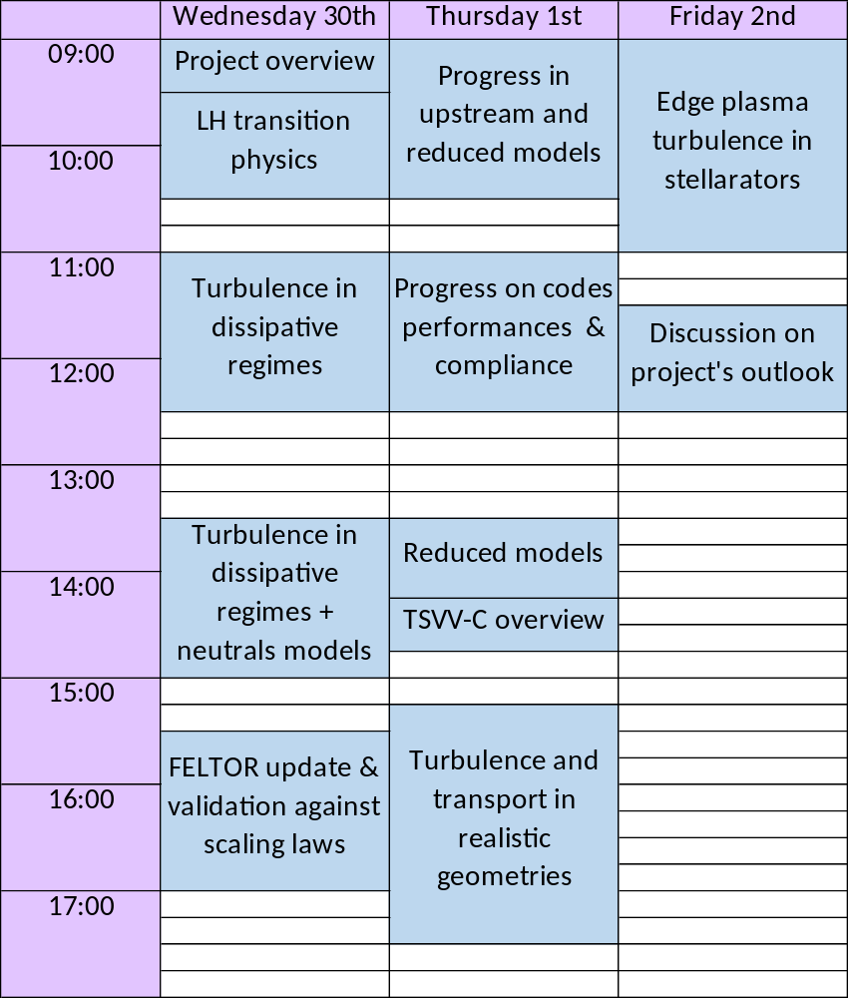
Agenda
Meeting page available on Indico: https://indico.euro-fusion.org/event/4187/
Please upload there presentations

Slide 8
Task 1: edge plasma turbulence and heat exhaust in dissipative regimes
 | Description | What? | Who? | When?
D1.1 | Assessment of impact of baffles on turbulence and plasma conditions in high-density regime in TCV | Report / presentation / paper | CEA, EPFL | 2026
D1.2 | Analysis of turbulence and transport in detached regime in the frame of the TCV-X23 experiments | Report / presentation / paper | CEA, EPFL, MPG, DTU, KUL | 2027
D1.3 | First evaluation light impurity turbulent transport in 3D edge turbulence simulation | Report / presentation / paper | CEA, EPFL | 2027
D1.4 | Demonstrate capability to model D-T plasmas both for mean-field and turbulence applications | Report / presentation / paper | CEA, DTU | 2027
~?
✓?
✓
?
  D1.1: work done by Louis, probably not as much as hoped but could be sufficient. Anything else planned?
  D1.2: work already completed with GBS and SOLEDGE3X. More detailed analysis planned? Other codes?
  D1.3: Patrick’s PSI contribution probably enough to consider as « achieved ». But much more could be done
  D1.4: not aware of whether any effort was started or not (nothing on SOLEDGE3X side yet), need to be discussed

Slide 9

Task 2: edge plasma turbulence in improved confinement regimes
 | Description | What? | Who? | When?
D2.1 | Evaluate the role of electromagnetic turbulence from low to high beta conditions | Report / presentation / paper | CEA | 2026
D2.2 | Simulation and analysis of edge plasma turbulence in QCE regime | Report / presentation / paper | MPG | 2026
D2.3 | Analysis of near SOL transport in L-mode and H-mode conditions in TCV and AUG | Report / presentation / paper | CEA, EPFL, MPG | 2027
✓
✓
  D2.1: at risk due to change in resources (Raffael leaving)
  D2.2: completed with Kaiyu’s work
  D2.3: Wladimir’s and Brenno’s studies already validate the deliverable. Any plan to go further? SOLEDGE3X effort on-going with Michele L., not clear if edge barrier can be obtained yet

Slide 10

Task 3: edge turbulence and PWI in complex geometries
 | Description | What? | Who? | When?
D3.1 | Numerical investigation of turbulence in MAST-U and comparison to experiments | Report / presentation / paper | DTU | 2026
D3.2 | Evaluation of plasma conditions along the WEST wall during start-up and ramp-up | Report / presentation / paper | CEA | 2026
D3.3 | Analysis of impact of divertor leg length and flux expansion on turbulence in TCV | Report / presentation / paper | EPFL | 2027
D3.4 | Study of heat exhaust in Advanced Divertor Configurations in the new AUG upper divertor | Report / presentation / paper | MPG | 2027
✓?
✓
  D3.1: paper of Synne partly fulfil the deliverable, but no comparison to experiments yet. On-going work?
  D3.2: achieved with Ivan’s paper
  D3.3: work on-going (Sergio), status to be review this meeting
  D3.4: work on-going, to be reported by Wladimir this meeting

Slide 11
Task 4: edge plasma transport and turbulence in stellarators
 | Description | What? | Who? | When?
D4.1 | GRILLIX code with support for island divertor configurations | Code + report / PhD | MPG | 2026
D4.2 | FELTOR code with support for non-axisymmetric equilibria (DTU) | Code | DTU | 2027
D4.3 | Analysis of edge plasma turbulence in medium sized stellarators (e.g., W7-AS, HSX or LHD) and comparison to experimental trends (EPFL, MPG) | Report / presentation / paper | EPFL, MPG | 2027
D4.4 | Full-scale simulation of W7-X in island divertor geometry and comparison with experimental data (MPG) | Report / presentation / paper | MPG | 2027
?
?
  D4.1: work on-going (Andreas & Barnabas), exact status to be discussed this meeting
  D4.2: status of work to be discuss at this meeting (Matthias’ presentation)
  D4.3: status of work to be discuss at this meeting (Zeno and Andreas’ presentations)
  D4.4: status of work to be discuss at this meeting (Zeno and Andreas’ presentations)

Slide 12
Task 5: validation of models and codes against scaling laws
 | Description | What? | Who? | When?
D5.1 | Investigate the dependence of the SOL width on key parameters in edge turbulence simulations in L-mode | Report / presentation / paper | CEA, MPG | 2027
D5.2 | Investigate the dependence on key parameters of the SOL width imbedded/implied by the RANS model(s) in L-mode | Report / presentation / paper | KUL | 2027
✓?
?
  D5.1: PSI contribution of Hugo can count as deliverable on SOLEDGE3X side. Work still on-going to go further (presentation this meeting). Not sure of situation on GRILLIX’s side.
  D5.2: status of work to be discuss at this meeting (Wouter’s presentation)

Slide 13
Task 6: developments towards higher fidelity fluid simulations (1)
 | Description | What? | Who? | When?
D6.1 | Implement full Horsten fluid neutrals model, including boundary conditions, in SOLEDGE3X | Code | CEA, KUL | 2026
D6.2 | Couple another edge turbulence code to EIRENE or KINDNES, likely starting with GRILLIX | Code | CEA, DTU, EPFL, MPG | 2026
D6.3 | KINDNES kinetic neutrals module compatible with flexible wall geometry | Code | EPFL | 2026
D6.4 | Sheath boundary conditions for 4-moment gyro-fluid model | Model | IPP.CR, DTU | 2026
D6.5 | SOLEDGE-HDG edge fluid code with capability to model impurity physics + report on progress with drifts implementation | Code + report | CEA | 2027
?
?
  D6.1: work on-going, might extend in early 2027 though. To be discussed (Bridget’s presentation)
  D6.2: some work had been kicked-off, but current status unclear. Discussion planned this meeting.
  D6.3: work on-going, to be reported in Davide’s presentation.
  D6.4: not sure of status of this task, to be discussed
  D6.5: aware of some progress with impurities. Update expected with Ivan’s presentation.

Slide 14
Task 6: developments towards higher fidelity fluid simulations (2)
 | Description | What? | Who? | When?
D6.6 | STYX-EIRENE package usable in 3D in turbulence simulations and in time-dependent mode | Code | CEA | 2027
D6.7 | Couple synthetic emission diagnostics and Doppler back-scattering to TSVV-B codes with IMAS interface | Codes | CEA, DTU | 2027
D6.8 | Updated RANS model description applicable to SOL in variety of L-mode regimes | Report / presentation / paper | KUL | 2027
D6.9 | Sheath boundary conditions across reactor relevant range of collisionalities, for arbitrary plasma mix | Model | IPP.CR | 2027
?
  D6.6: deliverable partially achieved (2D EIRENE in 3D plasma). Work will resume end of 2026 (Diego and new PhD student).
  D6.7: tightly linked to IMASification effort. Some delays but effort resumed with ACH. Dedicated discussion planned.
  D6.8: not sure of exact status and how far this matches the expected deliverable. Update expected with Olivier’s presentation.
  D6.9: update expected with David’s presentation.

Slide 15
Task 7: numerical developments towards improved accuracy or perf.
 | Description | What? | Who? | When?
D7.1 | Implement KINDNESS kinetic neutral solver in GPU-compatible version of GBS | Code | EPFL | 2026
D7.2 | Report on progress of numerical methods for FCI to handle complex wall geometries beyond the immersed boundary approach | Report / PhD / paper | MPG | 2027
D7.3 | Port full turbulence model of GRILLIX and SOLEDGE3X to GPU | Code | CEA, MPG | 2027
D7.4 | Report on attempt at extending the HDG discretization method to handle 3D edge plasma a simulations | Report / presentation / paper | CEA | 2027
D7.5 | Test of scalability of FELTOR to large number of GPUs and implementation of high priority recommendations | Code + report | DTU | 2027
?
  D7.1: work on-going. Delivery by end of year? Update in Davide’s presentation this meeting.
  D7.2: work on-going. Update expected in Andreas’ presentation.
  D7.3: work on-going. Update for SOLEDGE3X will be given by Matthieu, update for GRILLIX by Andreas.
  D7.4: work on-going with recent progress. Update expected in Marcello’s presentation.
  D7.5: work on-going with ACH, should be reported in Matthias’ presentation.

Slide 16
Task 8: compliance with EUROfusion standard software specifications
 | Description | What? | Who? | When?
D8.1 | Python post-treatment routines to export data from all contributing codes in IMAS format using library developed in TSVV-3 | Code | All | 2026
D8.2 | TSVV-B codes compliant with priority 2 criteria of EUROfusion standard software recommendations (exception: priority 1 criteria for SOLEDGE-HDG) | Codes and environment | All | 2027
D8.3 | Individual or collective training for new users of TSVV-B codes on request from WPs or individual collaborators | Training sessions | All | 2027
~?
?
✓?
  D8.1: achieved for SOLEDGE3X, GRILLIX and GBS (to be confirmed). FELTOR status unclear.
  D8.2: status of all codes probably not up-to-date. Discussion planned to get an update.
  D8.3: at least one new GRILLIX user trained outside IPP. SOLEDGE3X training made in the US in June. Deliverable can be considered as achieved. Interested in updates and plans though.

