Slide 1
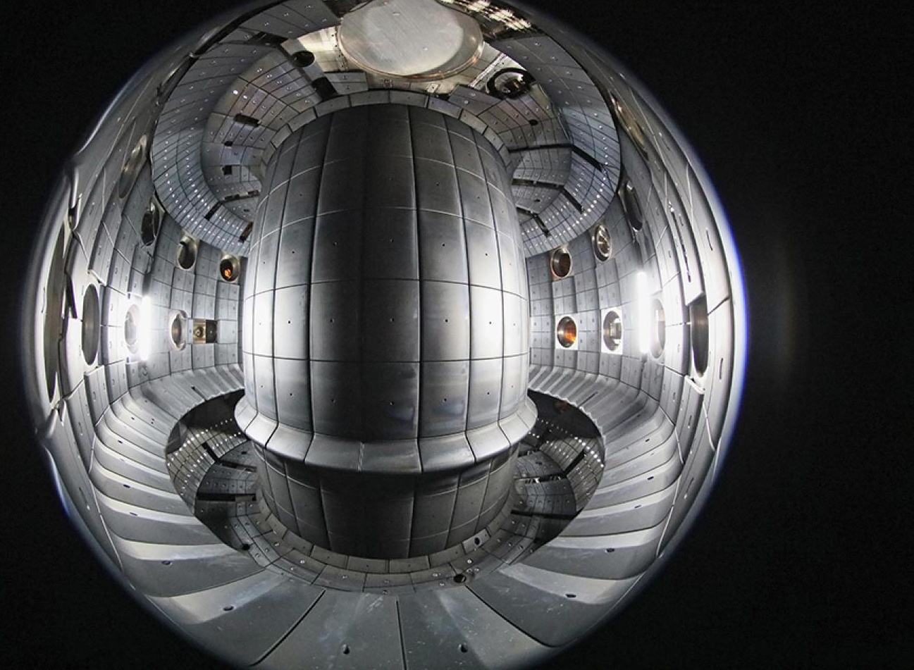
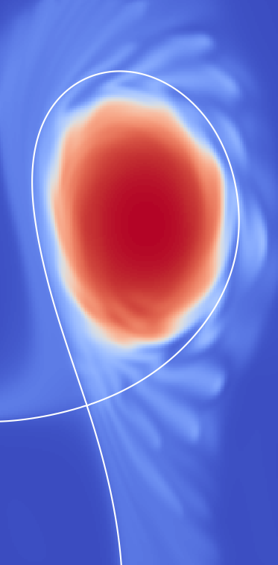
Effect of divertor leg length on transport in the boundary plasma of TCV
Sergio García Herreros, Davide Galassi, the GBS team, Christian Theiler and Paolo Ricci
TSVV-B Annual Workshop
1/10/2026

Slide 2
1. Introduction
TSVV-B workshop Prague

Slide 3
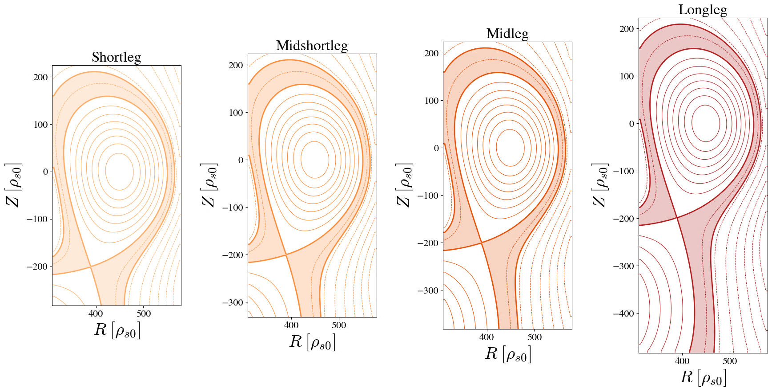
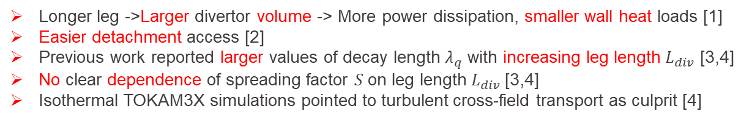
Previous work and motivation
Longer leg ->Larger divertor volume -> More power dissipation, smaller wall heat loads [1]
Easier detachment access [2]
Previous work reported larger values of decay length $λ_{q}$ with increasing leg length $L_{div}$ [3,4]
No clear dependence of spreading factor $S$ on leg length $L_{div}$[3,4]
Isothermal TOKAM3X simulations pointed to turbulent cross-field transport as culprit [4]
TSVV-B workshop Prague
Difficult to isolate the role of transport in these studies and data samples are limited
The aim of this work is to isolate and further study the contribution of transport to these benefits on a larger experimental database
Support from GBS turbulence simulations
[1] V. A. Soukhanovskii, PPCF, 59, 2017.
[2] H. Reimerdes et al, NF, 57, 2017.
[3] R. Maurizio et al, NF, 58, 2017.
[4] A. Gallo et al, PPCF, 60, 2018

Slide 4
2. Effect on transport
TSVV-B workshop Prague

Slide 5
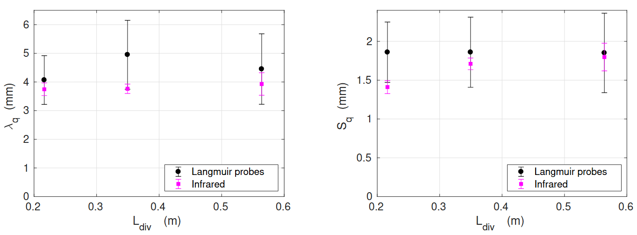
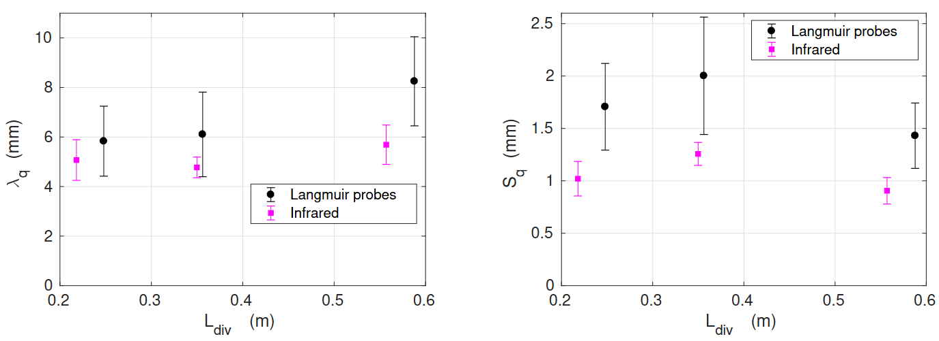
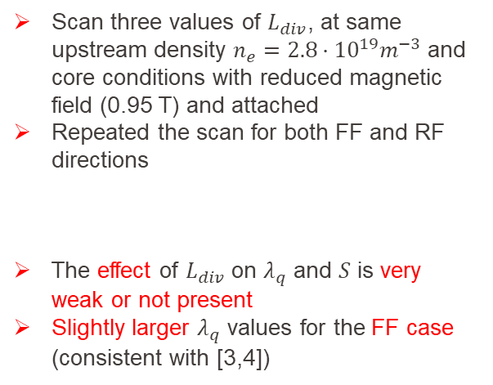
Reduced field, attached, leg length scans
RF
Scan three values of $L_{div}$, at same upstream density $n_{e}=2.8·{10}^{19}m^{−3}$ and core conditions with reduced magnetic field (0.95 T) and attached
Repeated the scan for both FF and RF directions
The effect of $L_{div}$ on $λ_{q}$ and $S$ is very weak or not present
Slightly larger $λ_{q}$ values for the FF case (consistent with [3,4])
TSVV-B workshop Prague
FF
[3] R. Maurizio et al, NF, 58, 2017
[4] A. Gallo et al, PPCF, 60, 2018

Slide 6
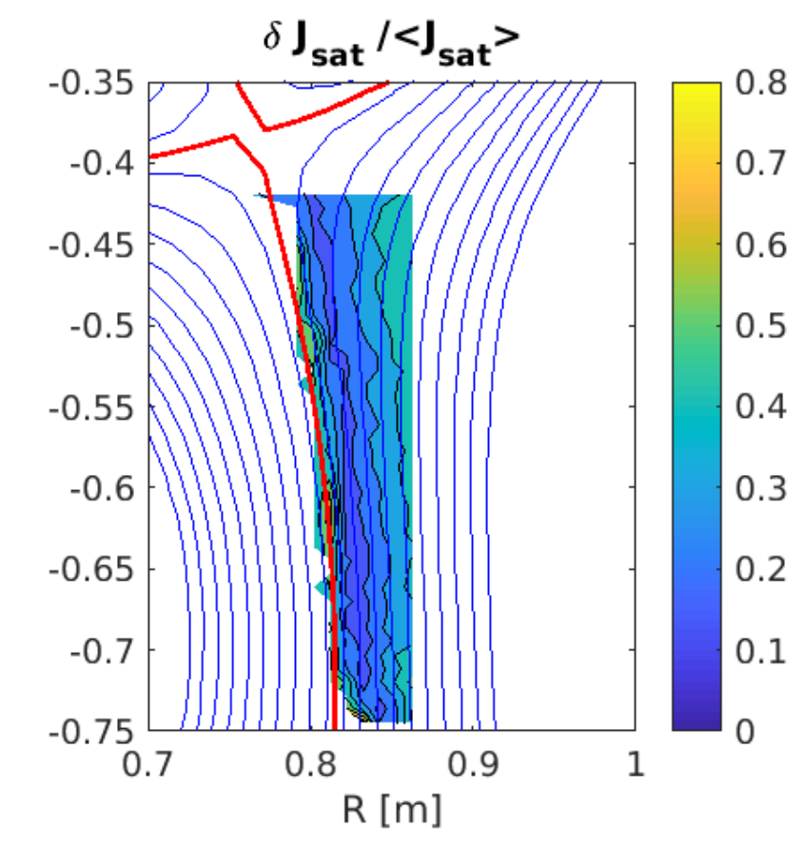
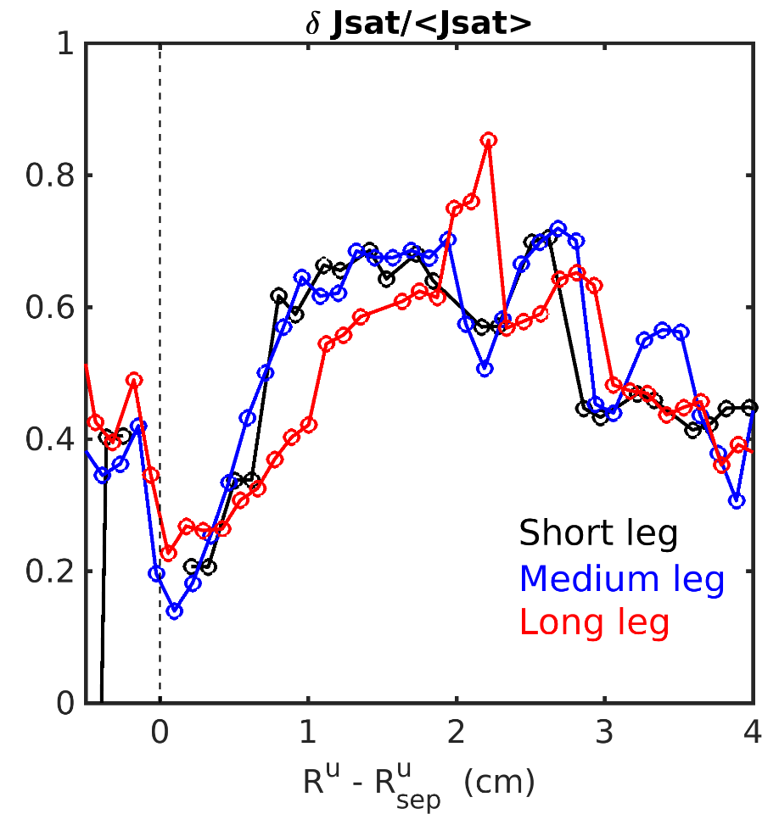
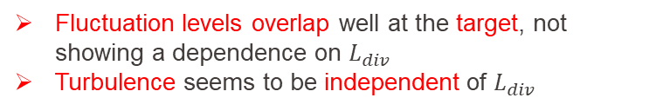
Reduced field, attached, leg length scans
Fluctuation levels overlap well at the target, not showing a dependence on $L_{div}$
Turbulence seems to be independent of $L_{div}$
RDPA data shows fluctuations are field aligned with a small radial increase
TSVV-B workshop Prague

Slide 7
3. Database study
TSVV-B workshop Prague

Slide 8
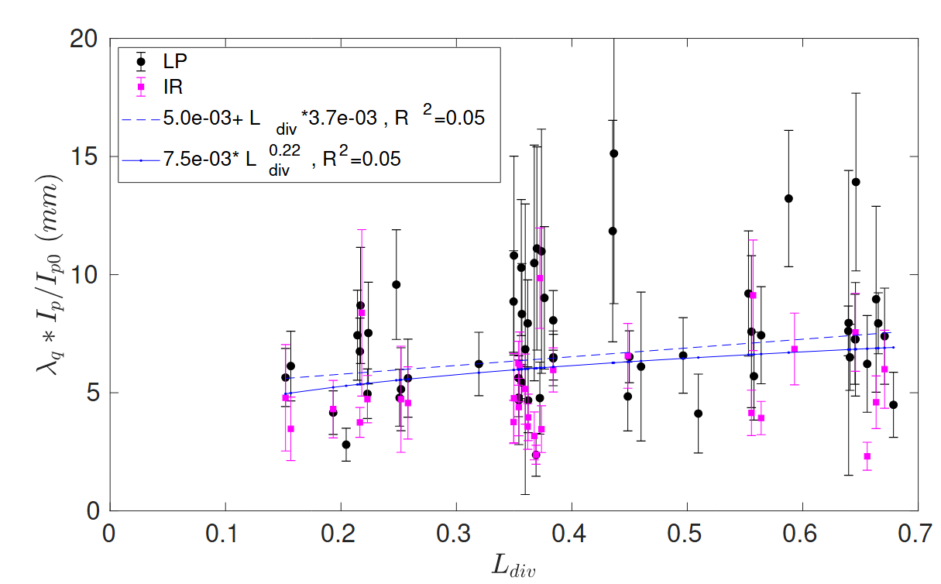
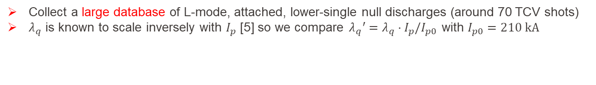
Database results
Collect a large database of L-mode, attached, lower-single null discharges (around 70 TCV shots)
$λ_{q}$ is known to scale inversely with $I_{p}$ [5] so we compare$λ_{q}′=λ_{q}·I_{p}/I_{p0}$ with $I_{p0}=210 kA$
TSVV-B workshop Prague
$L^{0.22} vs L^{0.35−0.45}$ [3] , $m=3.7·{10}^{−3} vs m=1.2·{10}^{−2}$ [4]. Roughly $L_{div}+30 cm$ -> $λ_{q}+ 1 mm$
The effect of $L_{div}$ on $λ_{q}$ is much weaker than in literature further supporting a weak transport
[3] R. Maurizio et al, NF, 58, 2017
[4] A. Gallo et al, PPCF, 60, 2018
[5] T. Eich et al, NF, 53, 2013

Slide 9
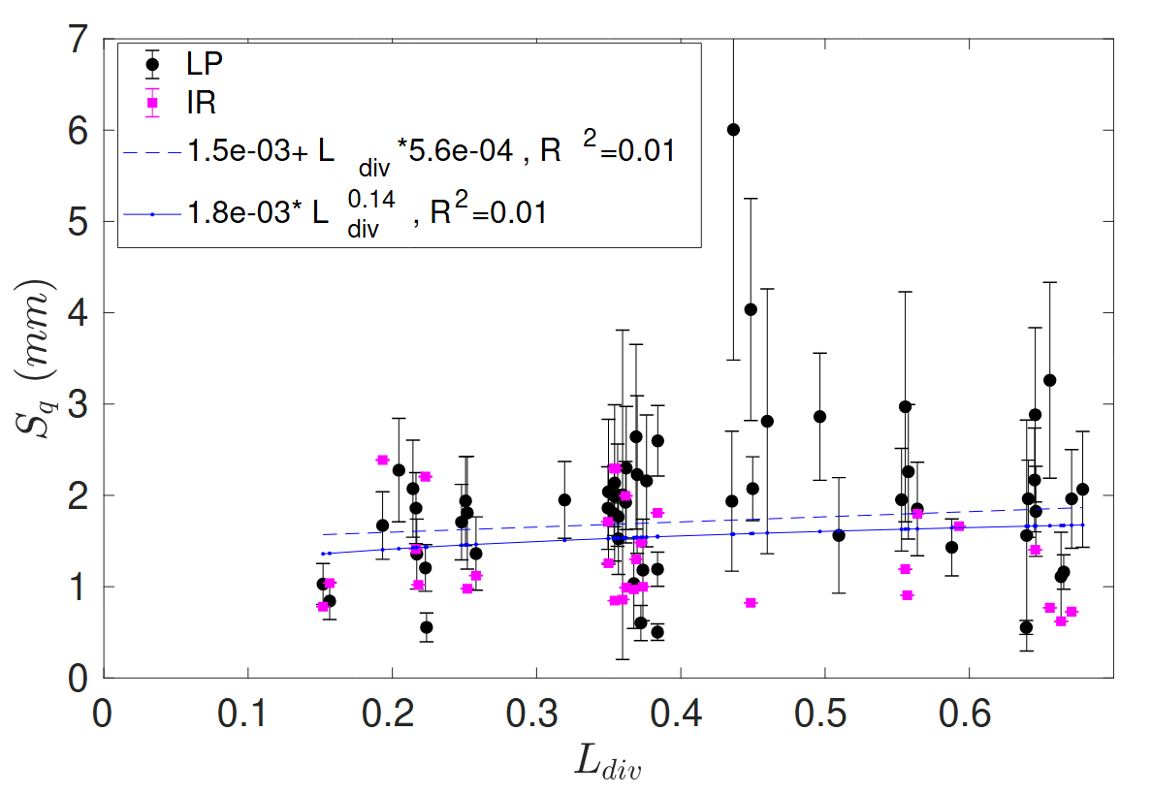

Database results
The effect of $L_{div}$ on $S$ is very weak, as expected from the literature [3, 4]
TSVV-B workshop Prague
[3] R. Maurizio et al, NF, 58, 2017
[4] A. Gallo et al, PPCF, 60, 2018

Slide 10
4. Simulation results
TSVV-B workshop Prague

Slide 11
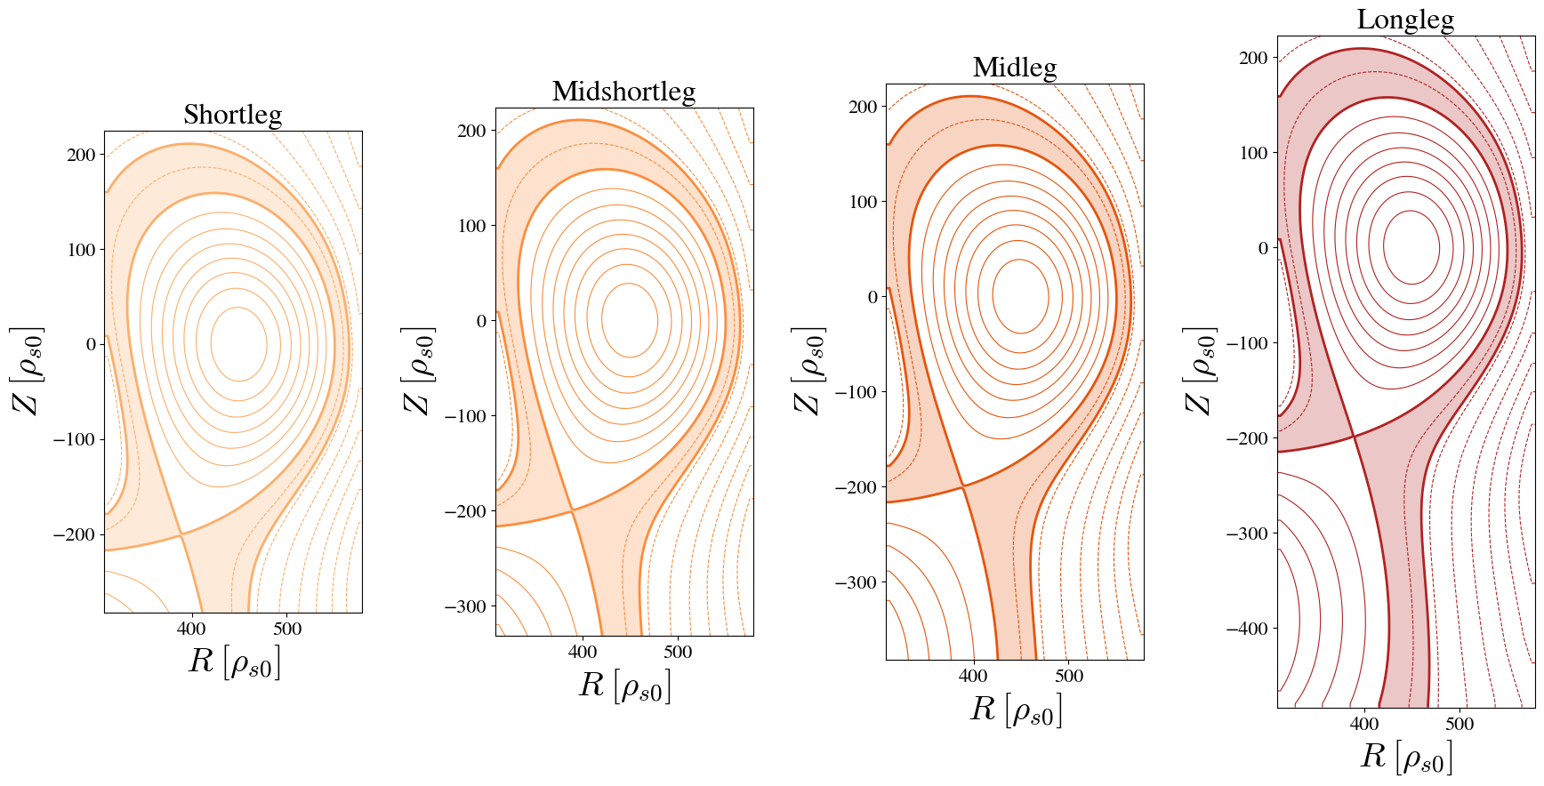
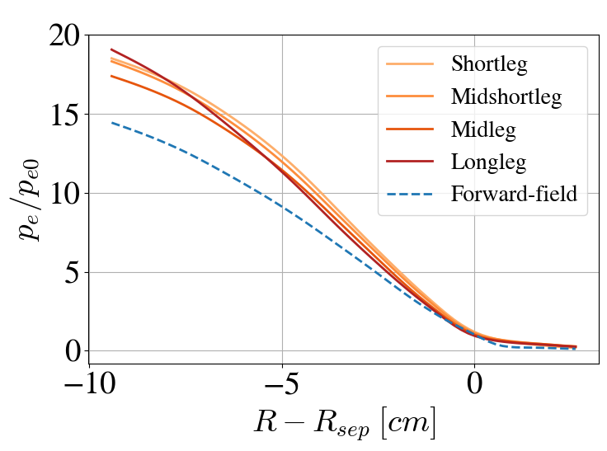
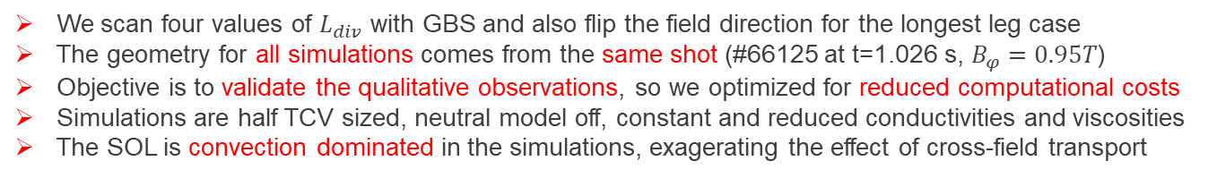
Reduced field, attached, leg length and field scans
We scan four values of $L_{div}$ with GBS and also flip the field direction for the longest leg case
The geometry for all simulations comes from the same shot (#66125 at t=1.026 s, $B_{φ}=0.95T$)
Objective is to validate the qualitative observations, so we optimized for reduced computational costs
Simulations are half TCV sized, neutral model off, constant and reduced conductivities and viscosities
The SOL is convection dominated in the simulations, exagerating the effect of cross-field transport
TSVV-B workshop Prague

Slide 12
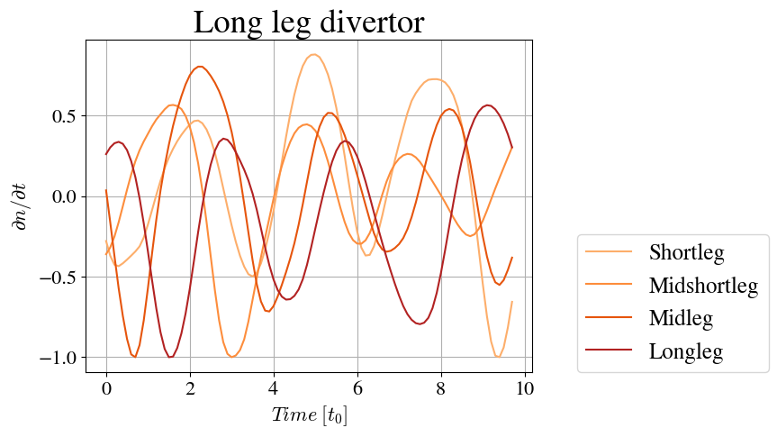
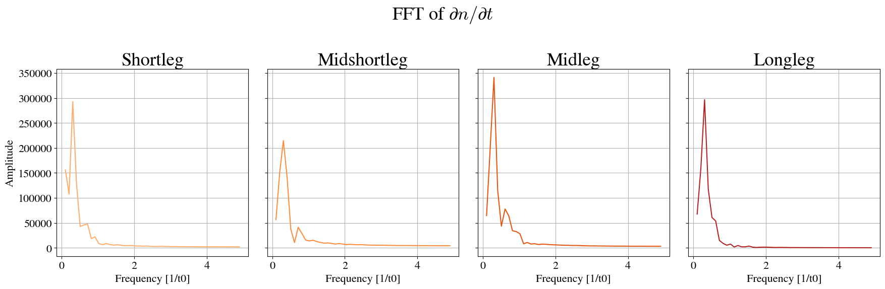
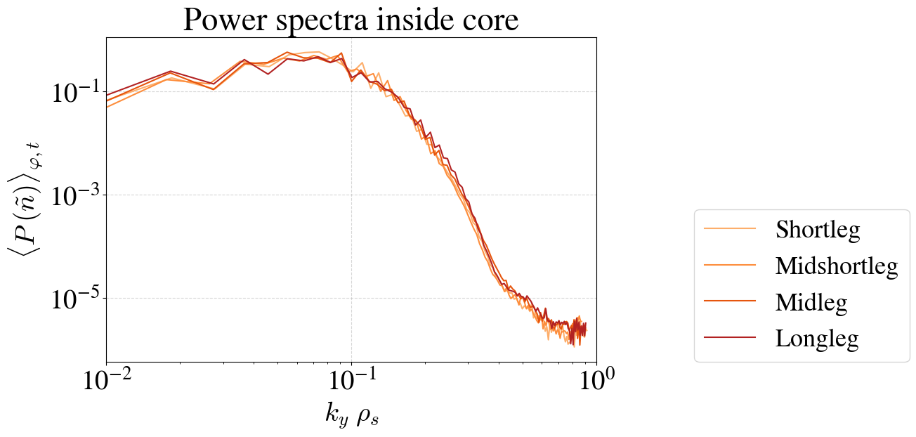
What kind of modes do we have?
TSVV-B workshop Prague
The fluctuations in the time trace of core density look very similar and the Fourier analysis confirms it
The power spectra of fluctuations in the core and in the SOL overlaps very well between simulations
Very similar turbulent behavior

Slide 13
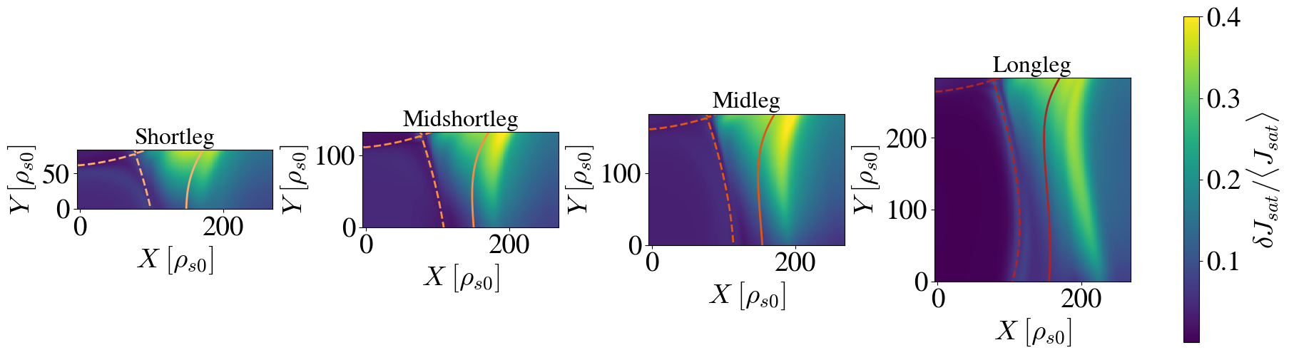
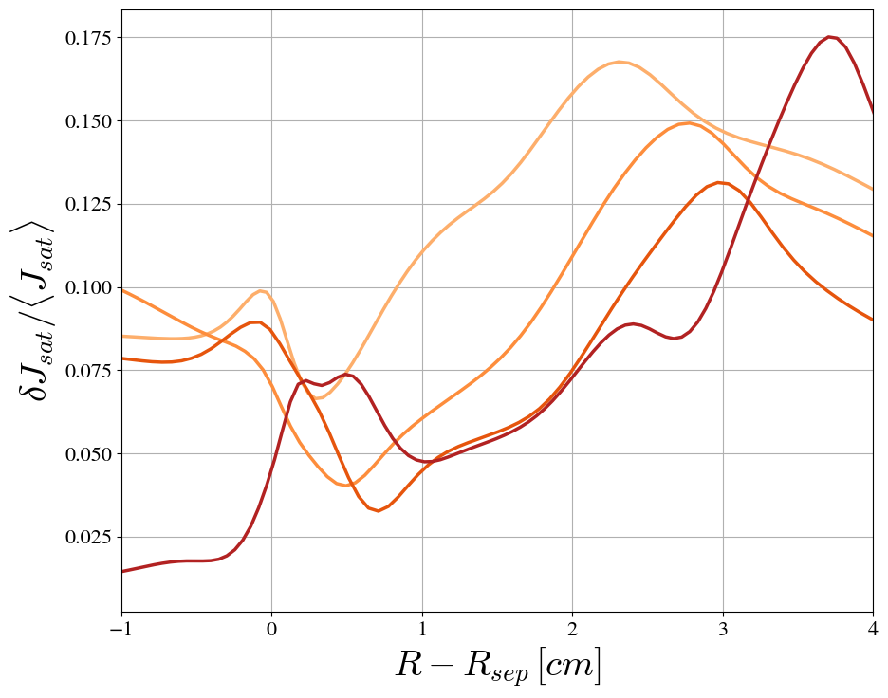
How do the fluctuation levels compare with experiments?
Similar qualitative picture: field aligned fluctuations with small radial increase
Fluctuation levels at the target overlap quite well
GBS underestimates the fluctuation levels, but captures both trends quite well
Fluctuations at the target
TSVV-B workshop Prague

Slide 14
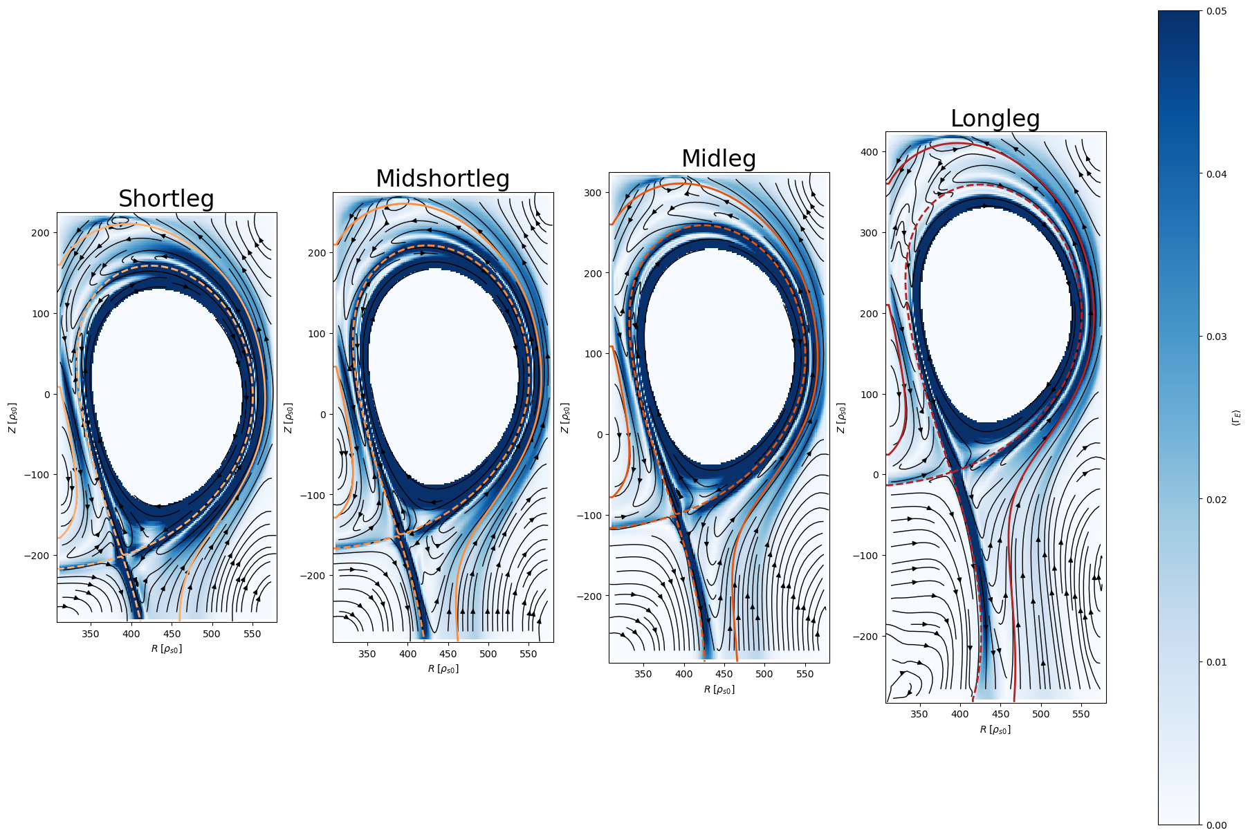

Analysis of the particle fluxes
$$\left\langle Γ_{E×B}\right\rangle$$
The ExB flow pattern is very similar and seems to extend downwards when given more space
Important difference: with longer leg, the convection cell moves radially outwards, contributing to the outward displacement of profiles at the target
TSVV-B workshop Prague

Slide 15
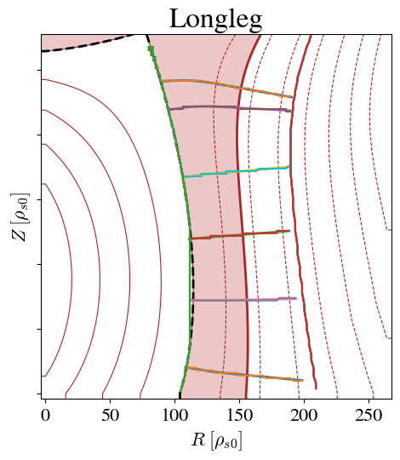
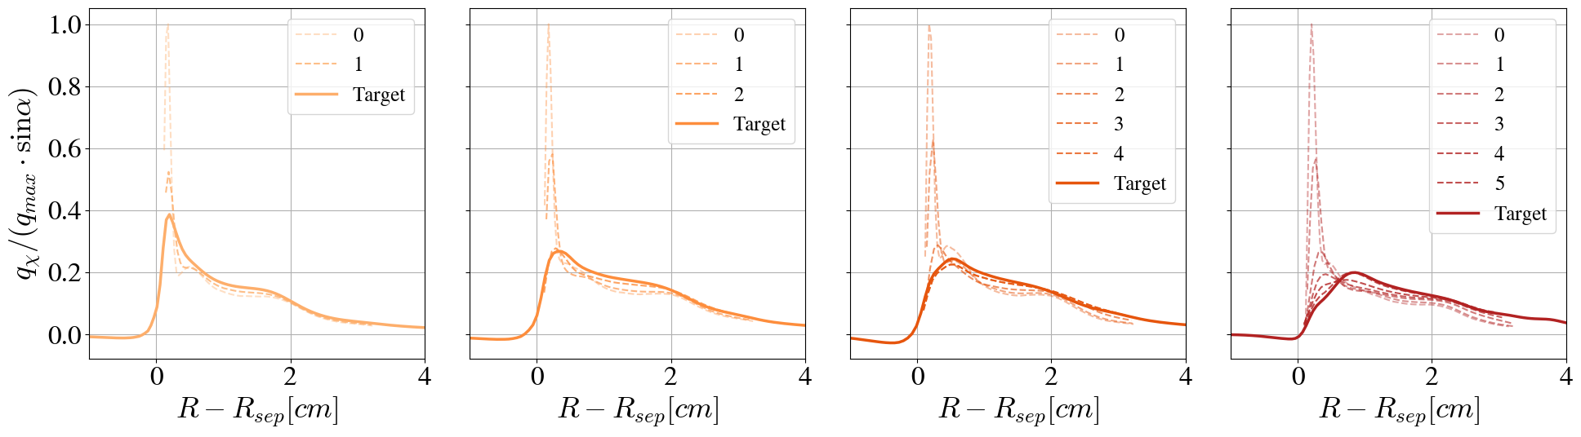

Analysis of the heat flux profile
Looking at different positions along the leg we can see the evolution of the heat flux profile
Being convection dominated the flow pattern widens the profile and shifts it radially outwards
0
TSVV-B workshop Prague
1
2
$$q_{∥}/q_{max}$$
3
4
5

Slide 16
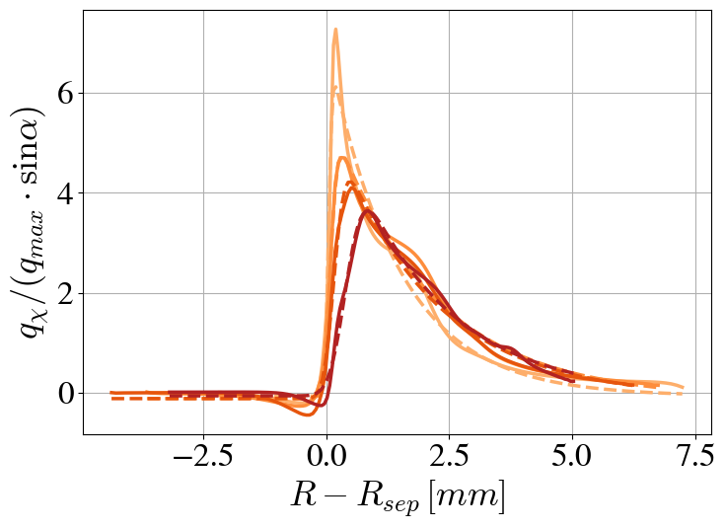
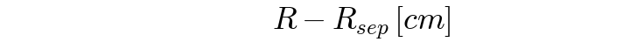
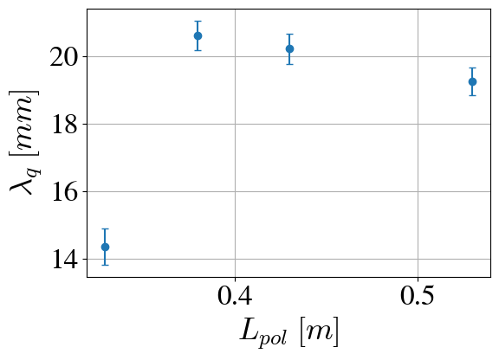
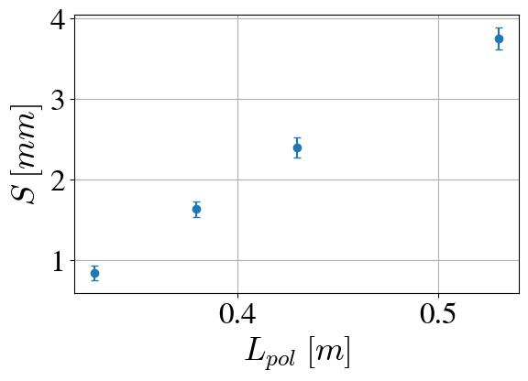

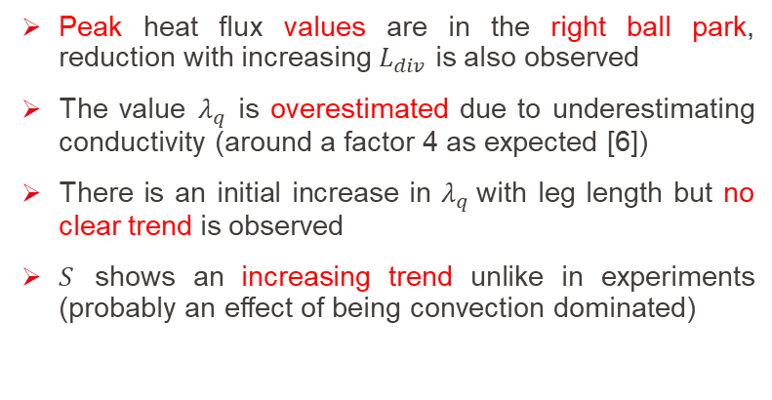
Analysis of the heat flux at the target
Target parallel heat flux
Peak heat flux values are in the right ball park, reduction with increasing $L_{div}$ is also observed
The value $λ_{q}$ is overestimated due to underestimating conductivity (around a factor 4 as expected [6])
There is an initial increase in $λ_{q}$with leg length but no clear trend is observed
$S$ shows an increasing trend unlike in experiments (probably an effect of being convection dominated)
$$q_{∥} \left[MW/m^{2}\right]$$
TSVV-B workshop Prague
[6] D. S. de Oliveira et al, NF, 62, 2022.

Slide 17
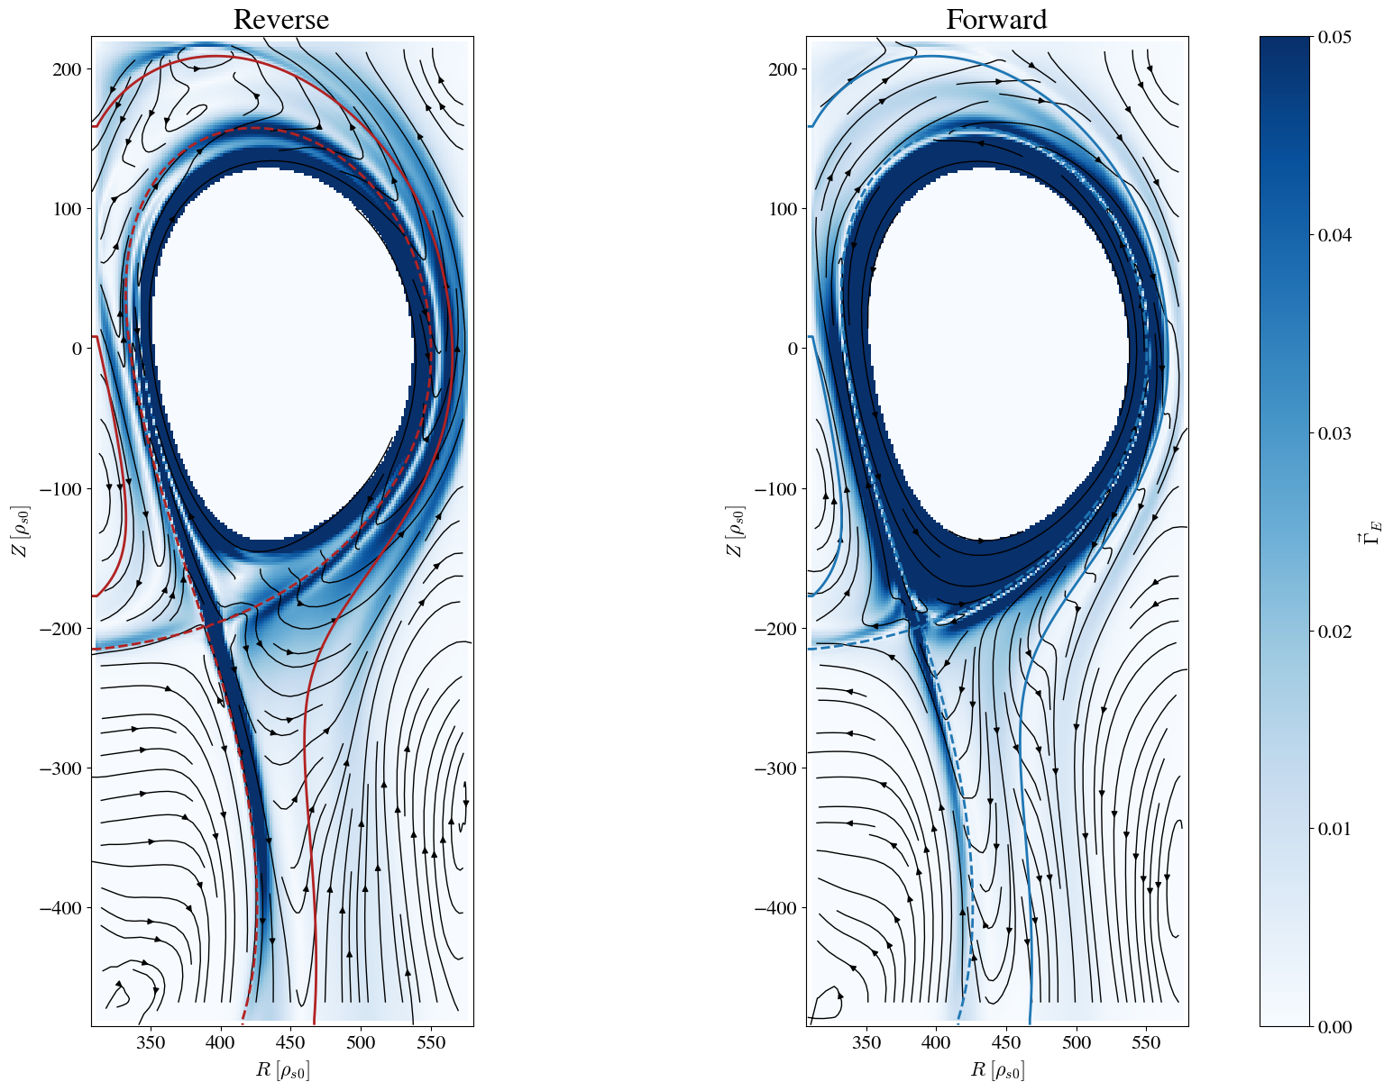

Analysis of the particle fluxes RF vs FF
$$\left\langle Γ_{E×B}\right\rangle$$
The ExB flow pattern changes significantly
Turbulent ExB pointed radially outwards in both cases
The average ExB convective cell flips with field direction
Forward field shows a divergent flow pattern along the leg
RF
FF
TSVV-B workshop Prague

Slide 18
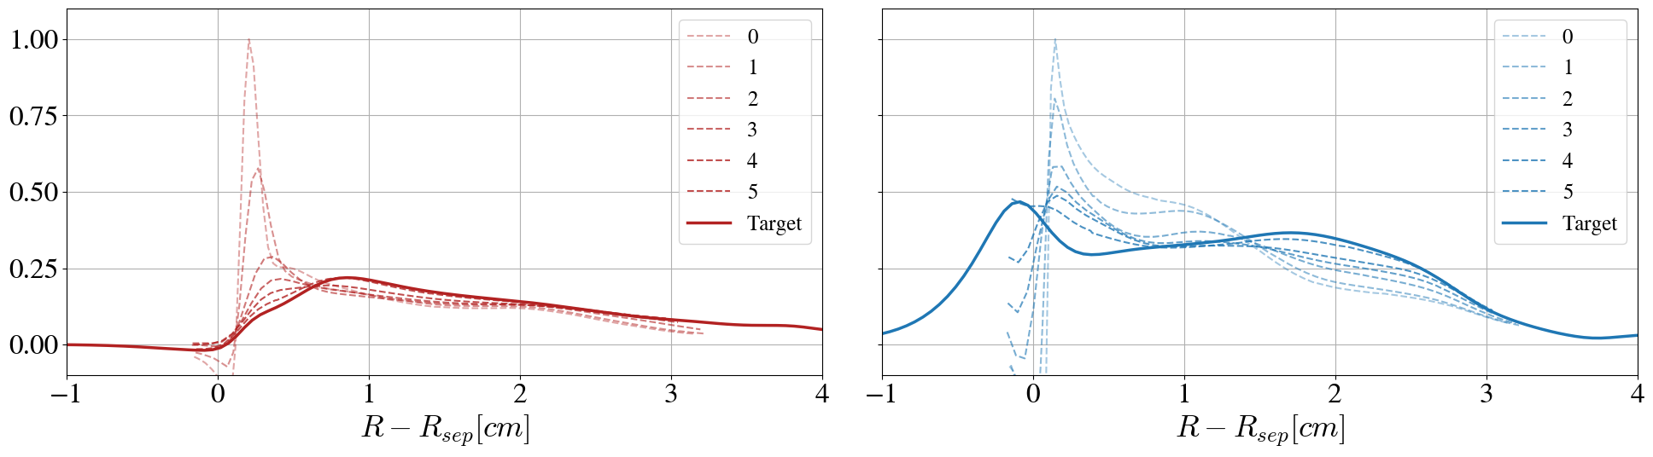
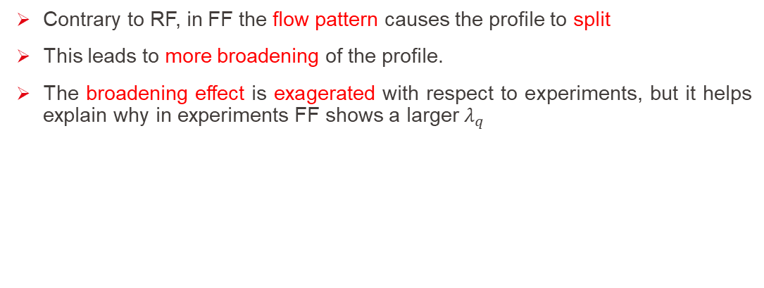

Analysis of the heat flux profile
Contrary to RF, in FF the flow pattern causes the profile to split
This leads to more broadening of the profile.
The broadening effect is exagerated with respect to experiments, but it helps explain why in experiments FF shows a larger $λ_{q}$
TSVV-B workshop Prague
$$q_{∥}/q_{max}$$

Slide 19
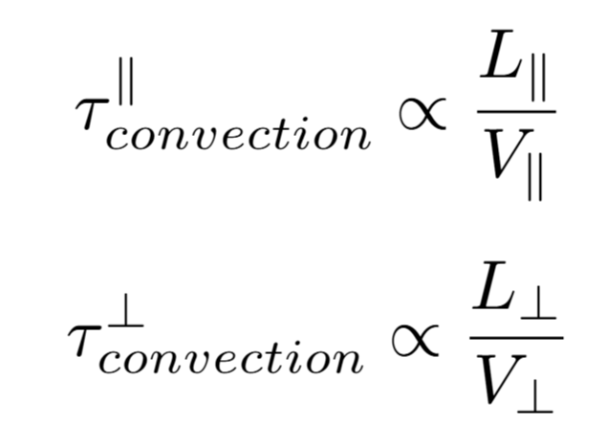

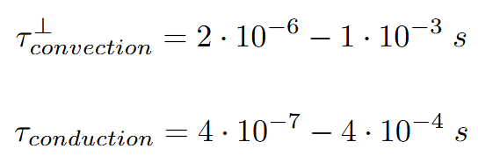
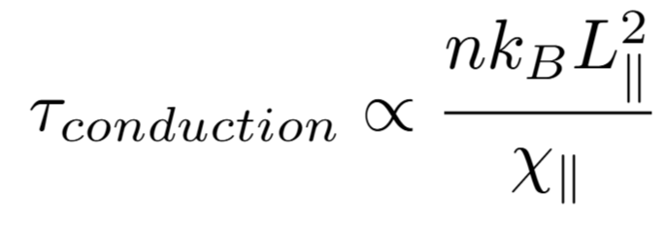

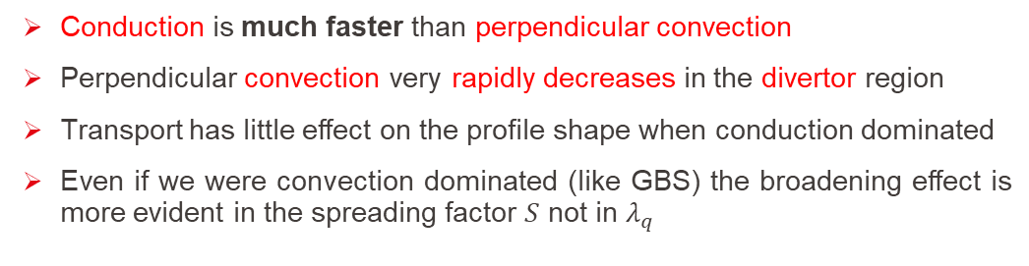


Simplified picture
Conduction is much faster than perpendicular convection
Perpendicular convection very rapidly decreases in the divertor region
Transport has little effect on the profile shape when conduction dominated
Even if we were convection dominated (like GBS) the broadening effect is more evident in the spreading factor $S$ not in $λ_{q}$
TSVV-B workshop Prague
Convection $∥$
Convection $⊥$
Conduction $∥$

Slide 20
5. Conclusions
TSVV-B workshop Prague

Slide 21
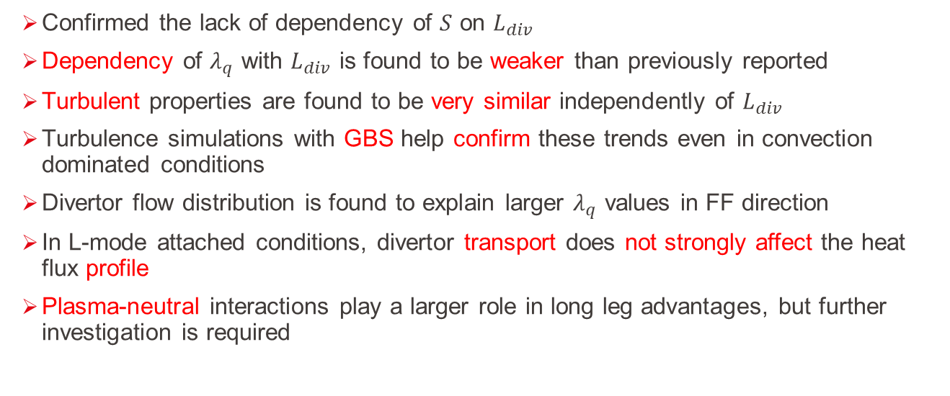
Conclusions
Confirmed the lack of dependency of $S$ on $L_{div}$
Dependency of $λ_{q}$ with $L_{div}$ is found to be weaker than previously reported
Turbulent properties are found to be very similar independently of $L_{div}$
Turbulence simulations with GBS help confirm these trends even in convection dominated conditions
Divertor flow distribution is found to explain larger $λ_{q}$ values in FF direction
In L-mode attached conditions, divertor transport does not strongly affect the heat flux profile
Plasma-neutral interactions play a larger role in long leg advantages, but further investigation is required
TSVV-B workshop Prague

Slide 22
Backup slides
TSVV-B workshop Prague

Slide 23


Rescaled parallel energy flux
Define total poloidal energy flux
$$q_{χ}=\left[\left(\frac{1}{2}m_{i}V_{∥i}+\frac{5}{2}p_{i}\right)\left(V_{E}+V_{di}+V_{∥i}\right) +\left(\frac{1}{2}m_{e}V_{∥e}+\frac{5}{2}p_{e}\right)\left(V_{E}+V_{de}+V_{∥e}\right) − χ_{∥i} ∇_{∥} T_{i} b− − χ_{∥e} ∇_{∥} T_{e} b\right]· e_{χ}$$
$$e_{χ}=e_{φ}×∇ψ$$
TSVV-B workshop Prague
Rescale into a ‘parallel energy flux’ using the grazing angle
$$q_{∥}=q_{χ}/sinα$$

