Slide 1
Impurities in the ETS-6
Thomas Jonsson

Slide 2
Status and questions
Present status:
Presently impurities are not working – we cannot even use static impurities.
Impurities refers to ions with multiple ionisation states.
Denis and Irena has worked on the developing impurities tools for over a year.
This development has now been merged with the develop branch of ets-core.
Testing has started, but it’s not yet ready to be released.
Questions to be discussed:
How to set up impurities in ets_init?
How predict the impurity temperature – consequences for energy conservation?
How to implement the Lackner scheme?

Slide 3
How to evolve the impurity temperature?
Impurity temperatures are not predicted in the ETS-6. How should they evolve?
Option 1: Static temperature.
Option 2: Interpretative temperature.
Option 3: Pressure-like average of main-ion temperatures; $T_{z}={\sum_{i}{n_{i}T_{i}}}/{\sum_{i}{n_{i}}}$
Option 4: Collision-like average of main-ion temperatures; $T_{z}={\sum_{i}{Z_{i}^{2}n_{i}T_{i}}}/{\sum_{i}{Z_{i}^{2}n_{i}}}$
Energy is not conserved when…
we modifying the impurity temperature to follow main ions,
we transfer collisional power from impurities, without a reaction in the impurity temperatures,
but it is not a big problem for trace impurity.

Slide 4
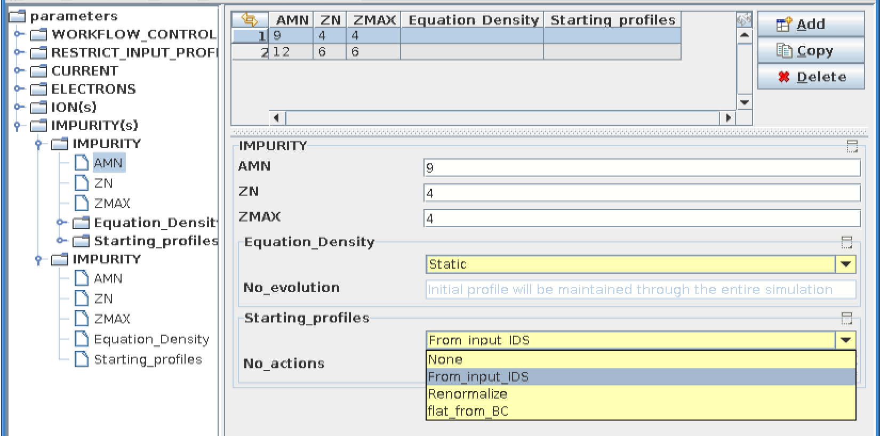
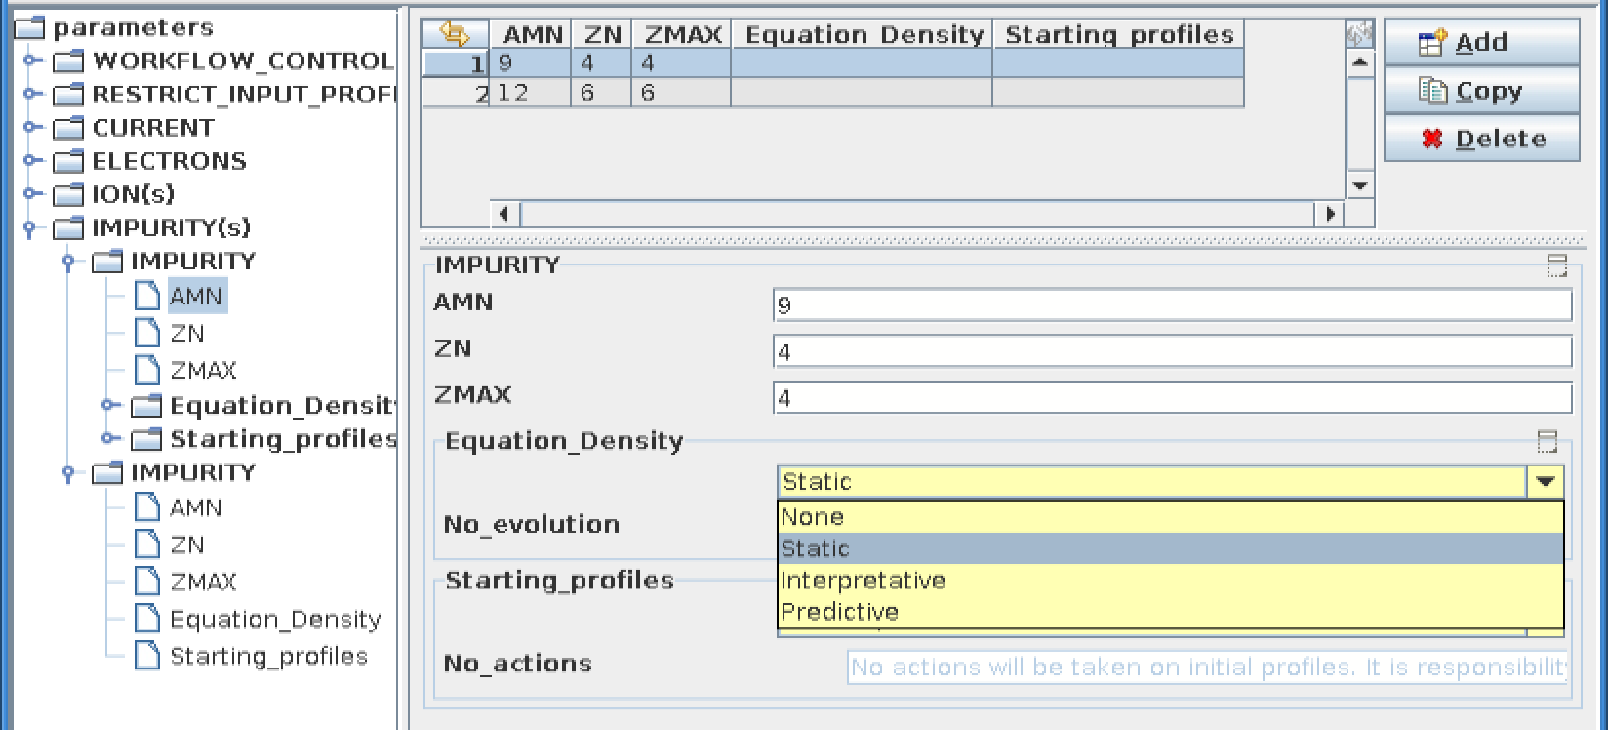
ETS-init: present CodeParameters for impurities

Slide 5
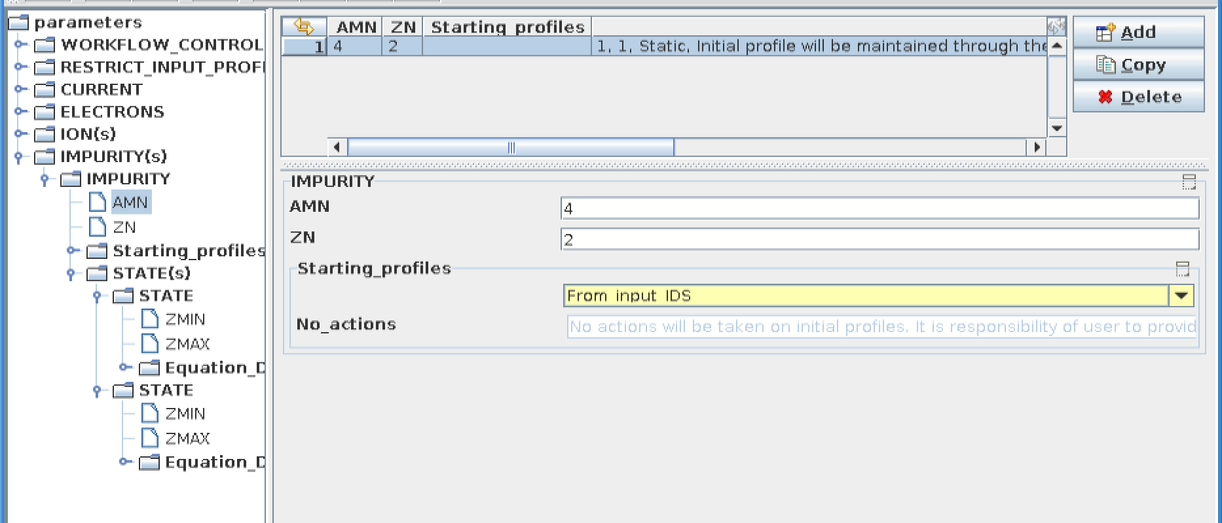
ETS-init: proposed CodeParameters for impurities

Slide 6
What is the Lackner scheme?
Consider the densities of Helium ions; $n_{He}^{+1}\left(t\right)$and $n_{He}^{+2}\left(t\right)$ where the evolution equations read $\frac{d}{dt}n_{He}^{+j}\left(t\right)=ℇ\left[n_{He}^{+1}\left(t\right),n_{He}^{+2}\left(t\right)\right]$ where $ℇ$ is non-linear evolution operator, describing among other things atomic processes inducing transitions between the two Helium states.
The Lackner scheme is an explicit scheme to evolve these densities $t→t+dt$. For Helium it reads
Step 1: Take a half step and start with the highest charge state
1a) $n_{He}^{+2}\left(t+dt/2\right)=n_{He}^{+2}\left(t\right)+ℇ\left[n_{He}^{+2}\left(t\right),n_{He}^{+1}\left(t\right)\right] dt/2$ 1b) $n_{He}^{+1}\left(t+dt/2\right)=n_{He}^{+1}\left(t\right)+ℇ\left[n_{He}^{+1}\left(t\right),n_{He}^{+2}\left(t+dt/2\right)\right] dt/2$
Step 2: Take a half step and start with the lowest charge state
2a) $n_{He}^{+1}\left(t+dt\right)=n_{He}^{+1}\left(t\right)+ℇ\left[n_{He}^{+1}\left(t+dt/2\right),n_{He}^{+2}\left(t+dt/2\right)\right] dt/2$
2b) $n_{He}^{+2}\left(t+dt\right)=n_{He}^{+2}\left(t\right)+ℇ\left[n_{He}^{+2}\left(t+dt\right),n_{He}^{+1}\left(t+dt/2\right)\right] dt/2$

Slide 7
Lackner scheme and atomic rates in an external actor
The Lackner scheme requires that the atomic rates found in $ℇ$ are evaluate four time; before each of the steps 1a, 1b, 2a, 2b.
But the plan is to evaluate atomic rates only once in an external actor!
Are these two ideas really compatible? How do we proceed?
ANSWER from David Coster (summarised by Thomas): From the source terms for ionisation and recombination the rates can be calculated in the solver be dividing by the relevant densities. Since the rates do not depend on the ion densities the Lackner scheme can be evaluated using these rates. However, the top priority should be to get something working. The implementation of the Lackner scheme is a later concern.

