Slide 1
Recent progress on electrons outside the SOL
Indications for in situ flux surface measurements
C. Killer @ TG Scenario, 21.09.2020

Slide 2
Recap: indications for electron population far outside the SOL
20181002.46
occurring in pure ECRH plasmas with P_{ECRH}/n_{dl} > 1 (for P_{ECRH} in MW and n_{dl} in 10¹⁹m⁻²)
negative floating potentials seen be probes (where it should be zero, since n_{i}=0)
hot spots on walls, probes, … (at positions that are not expected to receive heat loads)
see also:
Physics meeting 20.11.2019
TG scenario 16.03.2020
[video: Aleix Puig Sitjes]

Slide 3
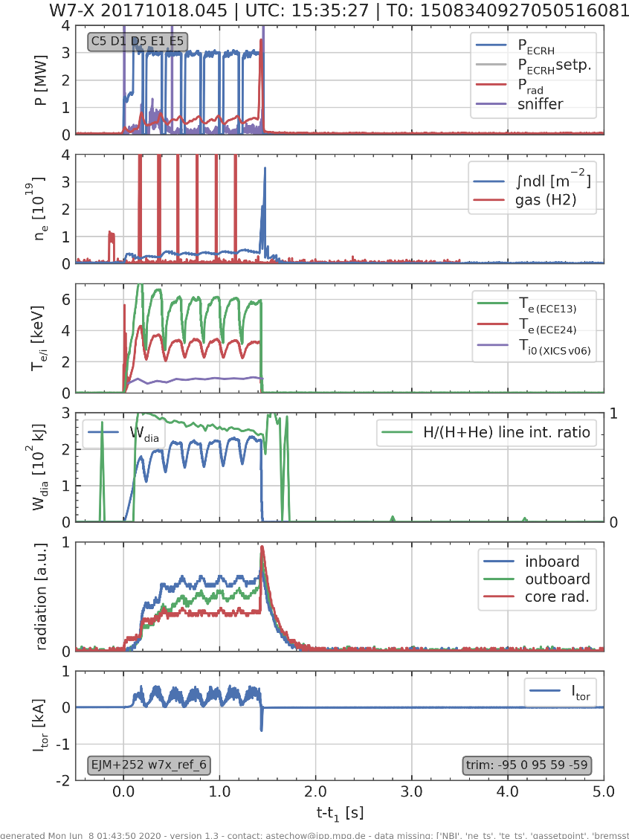
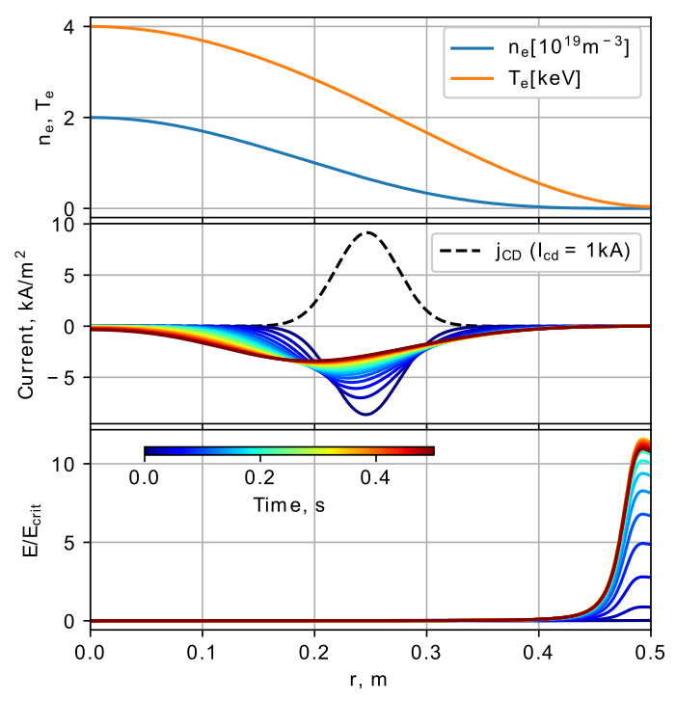
some progress
over-critical electric field for runaway acceleration can appear transiently at the plasma edge → Pavel Aleynikov
identified more possible incidents in badly covered early OP1.2a programs
radiation collapses due to MPM plunges with excess heat loads far outside the expected SOL

Slide 4
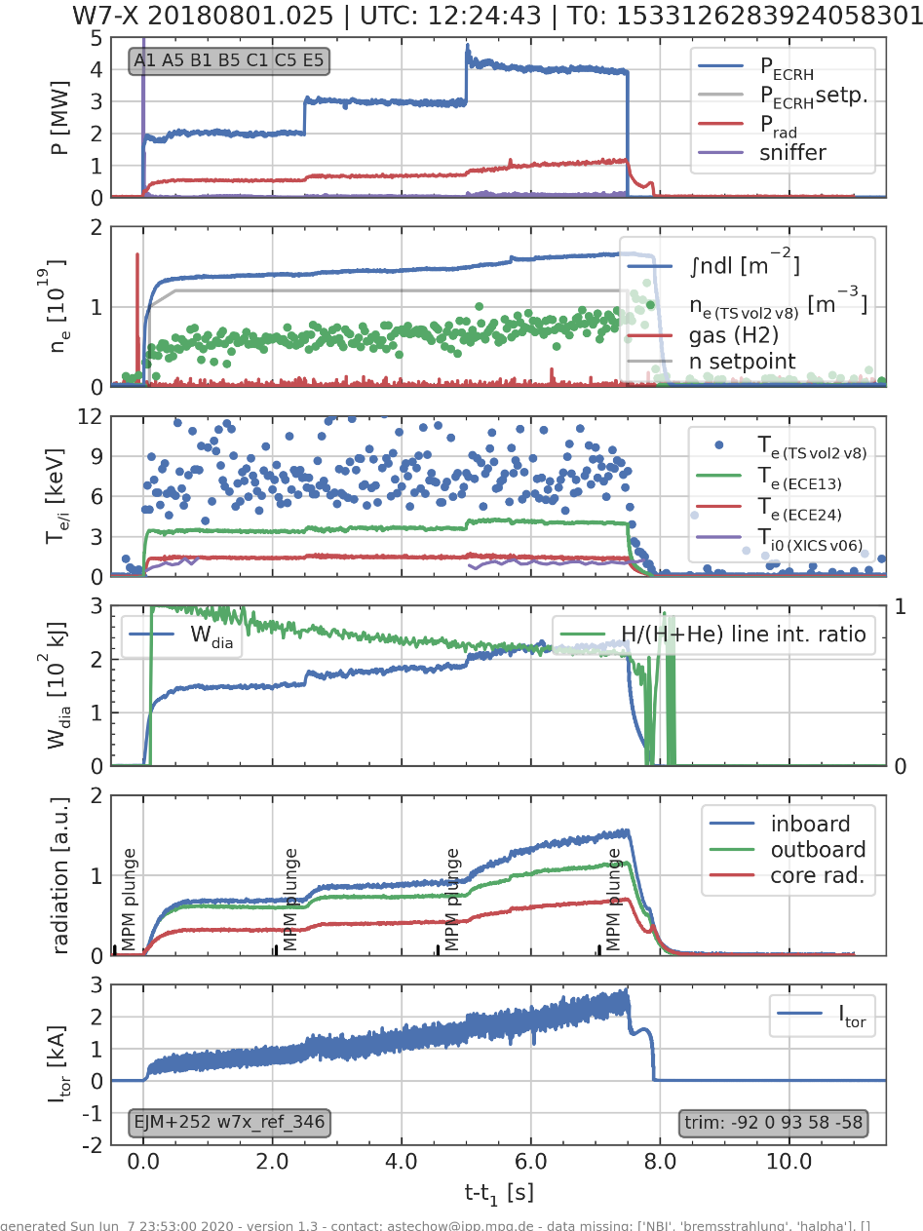
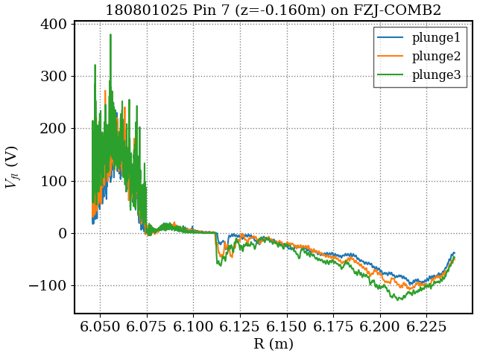
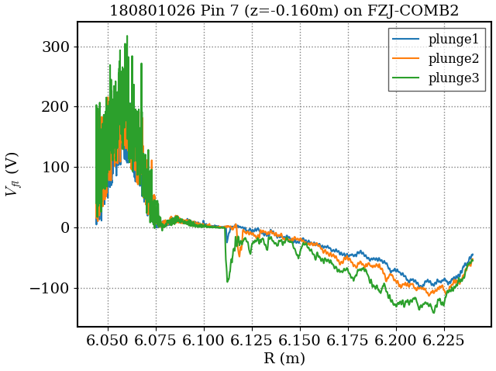
Video data might provide more insight
New interesting set of programs identified:
20180801.24-33 (pre-boronization characterization, low density)
negative V_{fl} outside plasma → indication for electrons

Slide 5
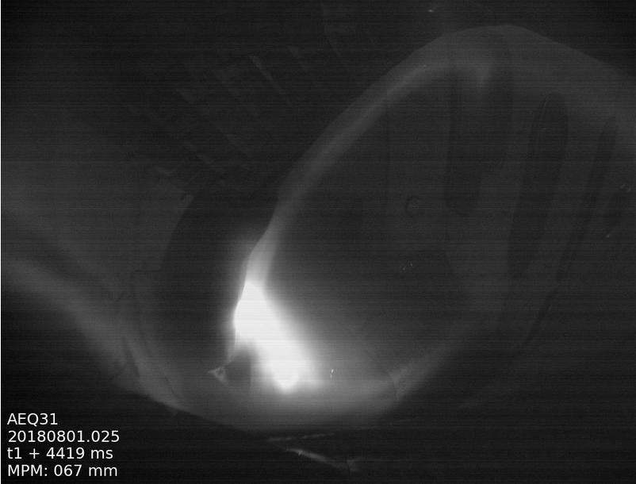
20180801.25, video AEQ31

Slide 6
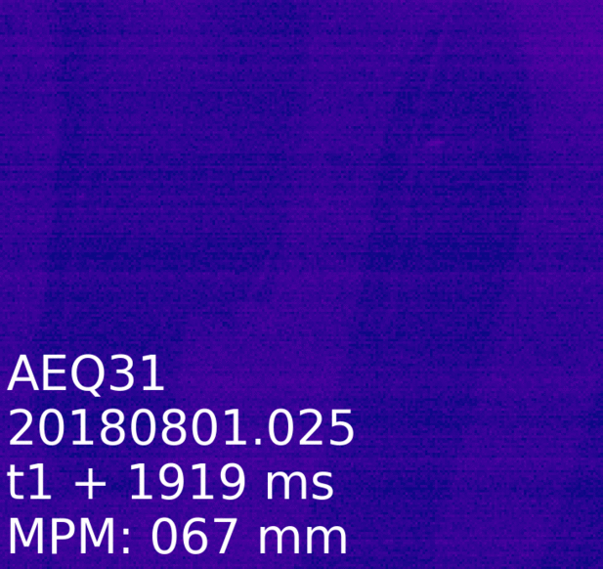
20180801.25, video AEQ31 close-up of MPM
sharp, bright stripe
diffuse, dim stripe
“edge of the plasma”

Slide 7
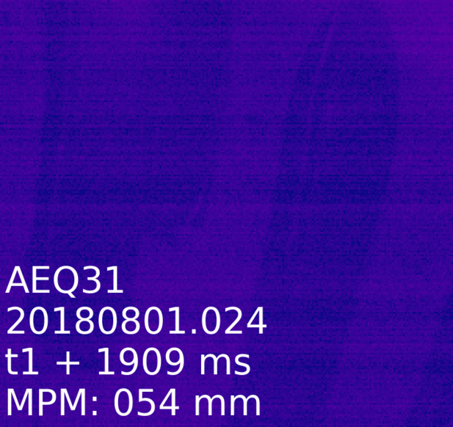
20180801.24, video AEQ31 close-up of MPM
sharp, bright stripe
diffuse, dim stripe
“edge of the plasma”

Slide 8
20180801.26, video AEQ31 close-up of MPM
sharp, bright stripe
diffuse, dim stripe
“edge of the plasma”

Slide 9
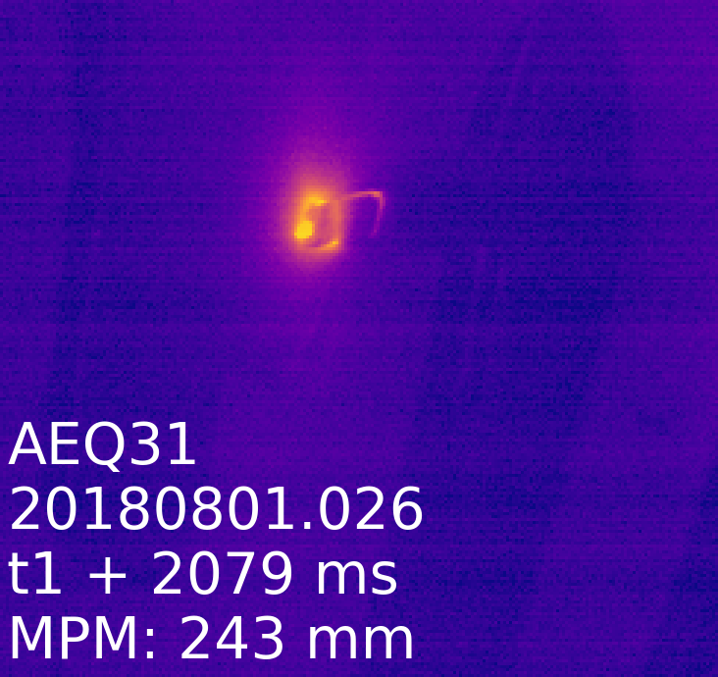
20180801.26, video AEQ31 close-up of MPM
correlation of features to the magnetic topology?
sharp, bright stripe
diffuse, dim stripe
R≈6.10m
R≈6.17m
“edge of the plasma”
estimation of feature position from
video images
MPM position, probe geometry
R≈6.07m

Slide 10
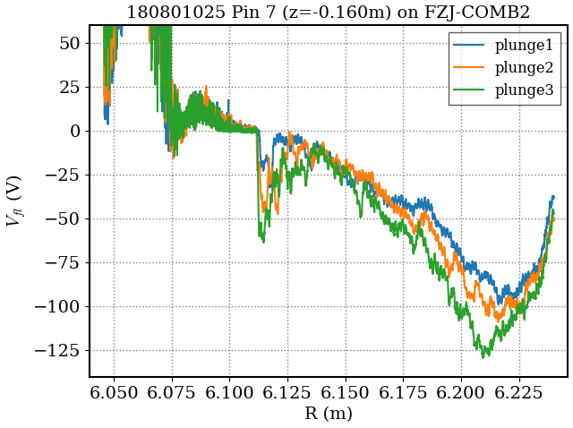
Are the video features seen in the probe data?
on this day: only 2 floating pins worked (issue with MPM interface)
sharp negative spike in V_{fl} might correlate with sharp stripe

Slide 11
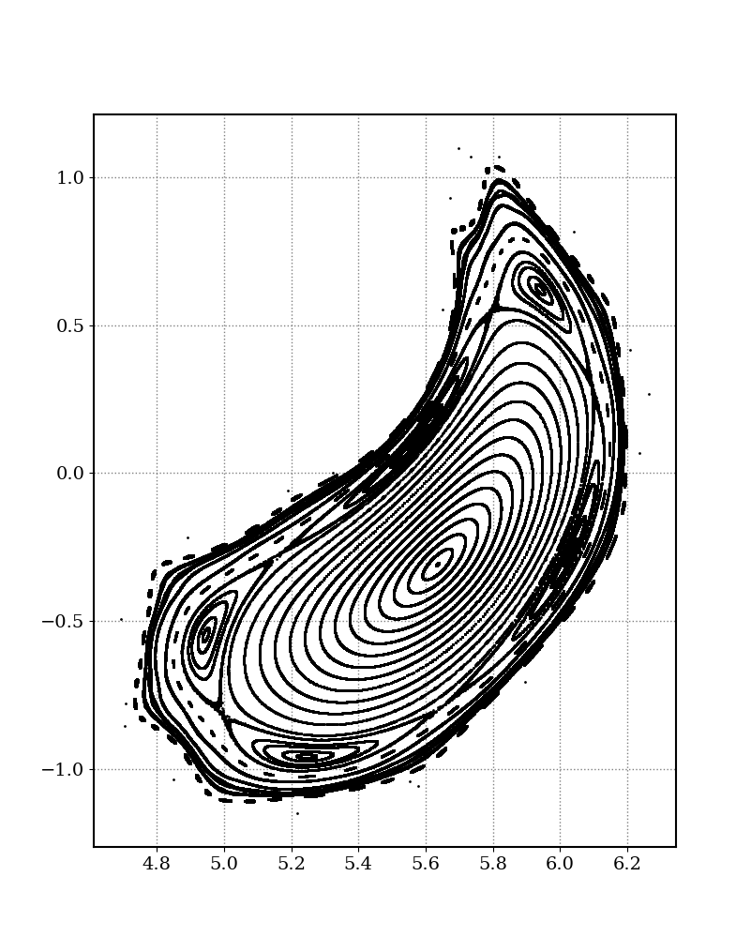
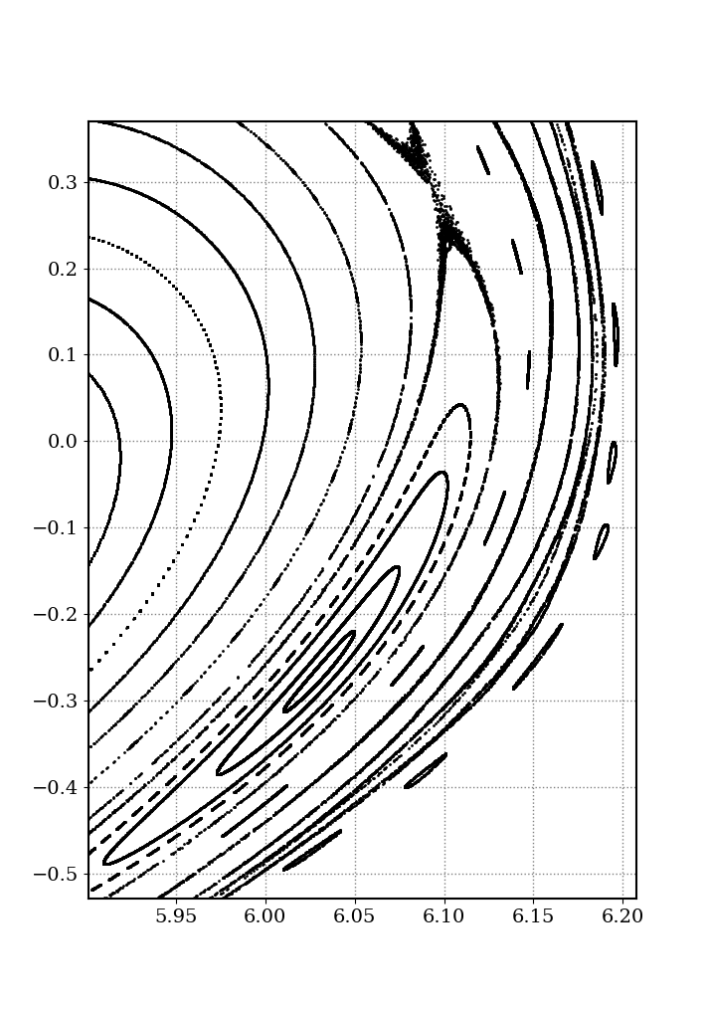
Position of features in the magnetic topology
2
sharp, bright stripe
diffuse, dim stripe
“edge of the plasma”
3
1
5/5 island
island separatrix R=6.10m
2
1
3
10/9 island , R~6.20m (not visible here)
enter long L_{c} region
R=6.07-6.08m
this is where we typically see the T_{e} maximum

Slide 12
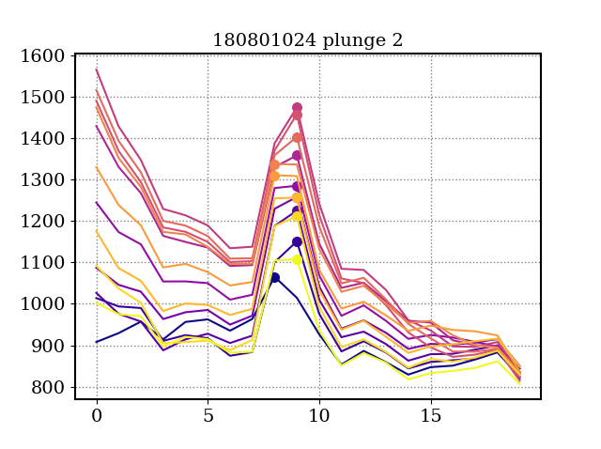
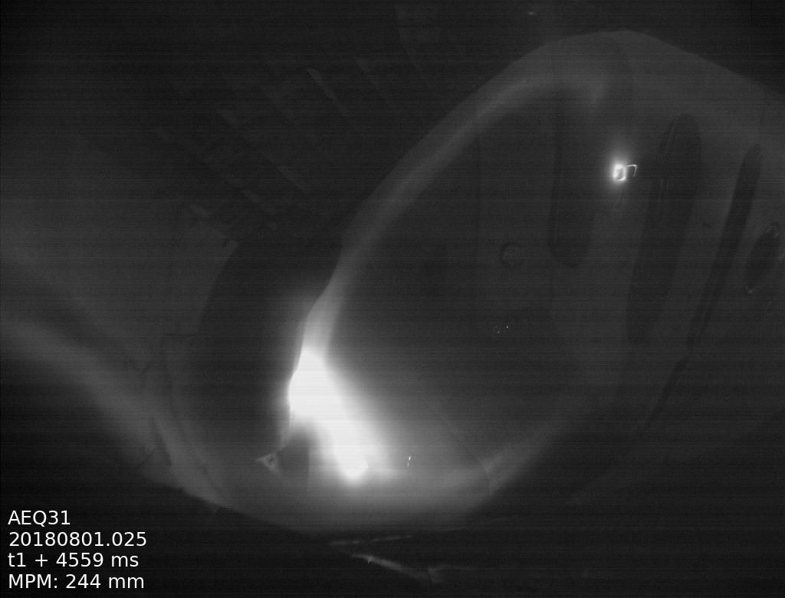
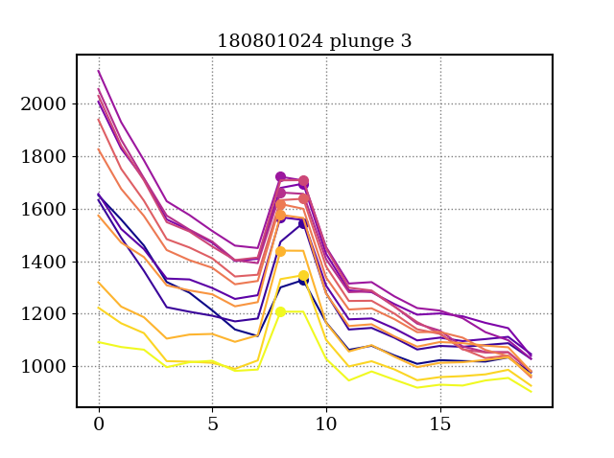
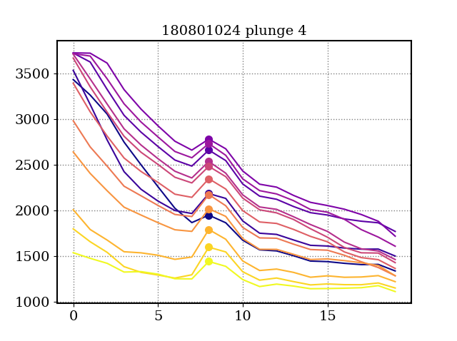
tracking the stripe (the presumable 5/5 separatrix)
stripe moves radially inwards at ≈ 0.5 px / kA
conversion at MPM in AEQ31: 1px ≈ 2.5mm (no significant projection error since viewing angle onto MPM side is 25°)
this might be an in situ flux surface measurement (!?)
island chain shifts inwards by ≈ 1mm per kA (?)
analyzing the light intensity along this line
color code: images of plunge
I_{p}=0.8kA
peak at 9px
light intensity
px horizontal
I_{p}=1.6kA
peak at 8.5px
I_{p}=2.8kA
peak at 8px

Slide 13
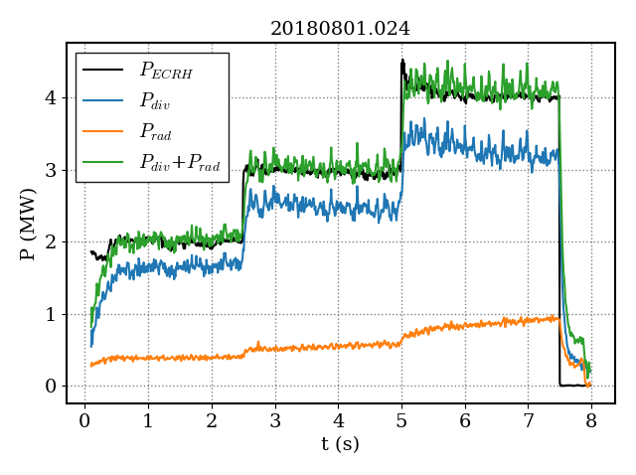
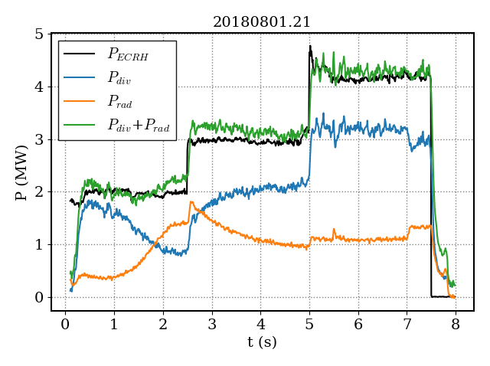
Is the power balance affected by electrons?
no significant additional loss channel indicated (within the uncertainties of P_{rad} and P_{div})

Slide 14
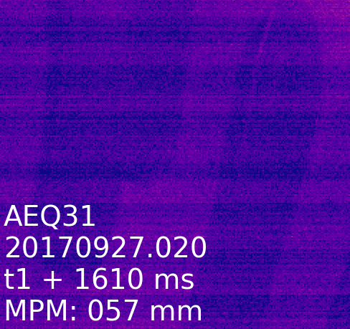
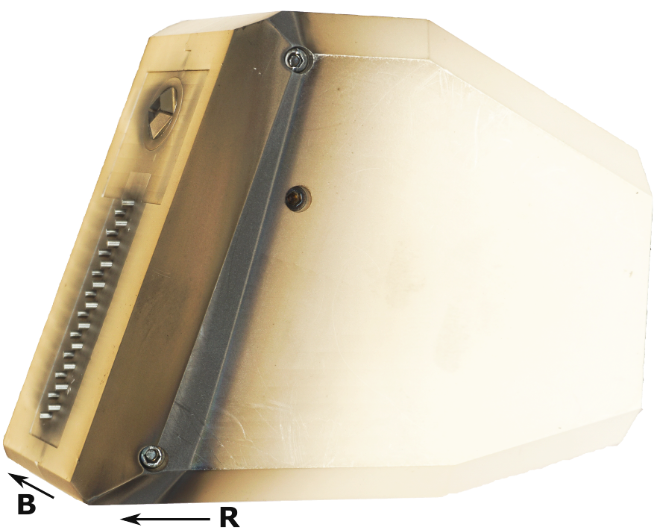
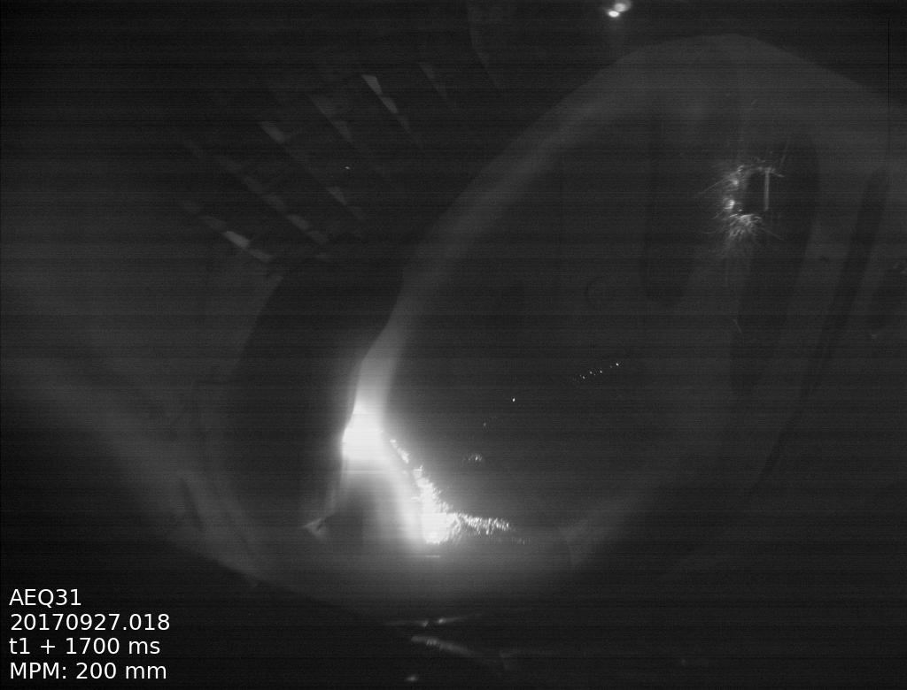
Similar (and clearer) observations with IPP-FLUC1 in OP1.2a
R≈6.10m
R≈6.16m
horizontal px

Slide 15
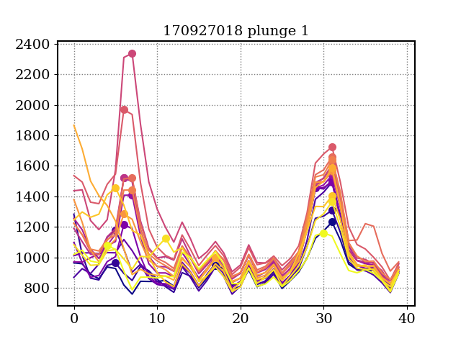
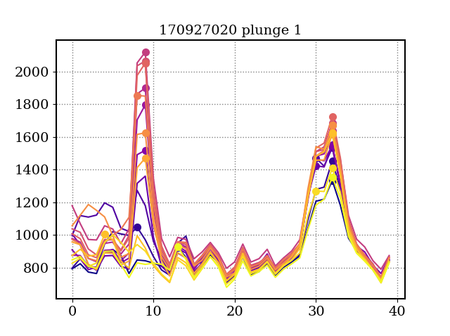
Update: also with IPP-FLUC1
color code: different images during plunge
R≈6.10m
R≈6.16m
I_{pc}=-700A
light intensity
stripes move radially out for I_{pc}=0A
≈4mm for left stripe
≈2.5mm for right stripe
horizontal px
I_{pc}=0A
light intensity
horizontal px

Slide 16
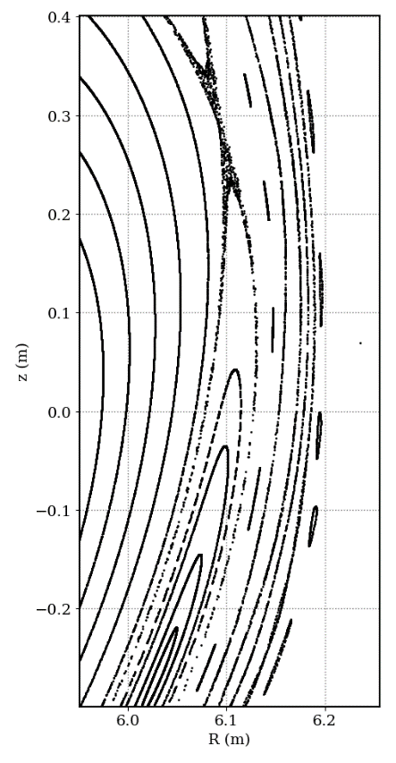
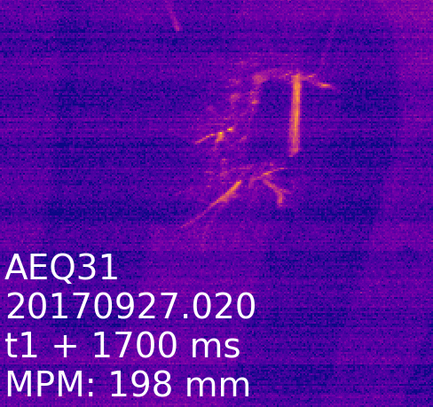
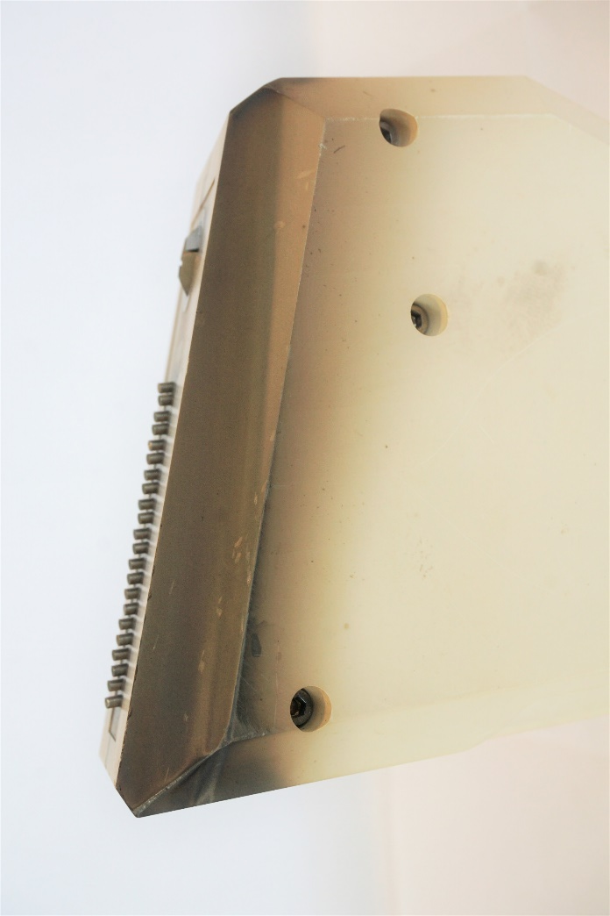
absolute position determination using probe head features
holes for probe head assembly
center screw: typically stripe at d_{mpm}=240mm → R=6.105m at z=-0.153m (R_{sep} at 6.100m)
top screw: typically stripe at d_{mpm}=230mm → R=6.115m at z=-0.123m (R_{sep} at 6.108m)

Slide 17
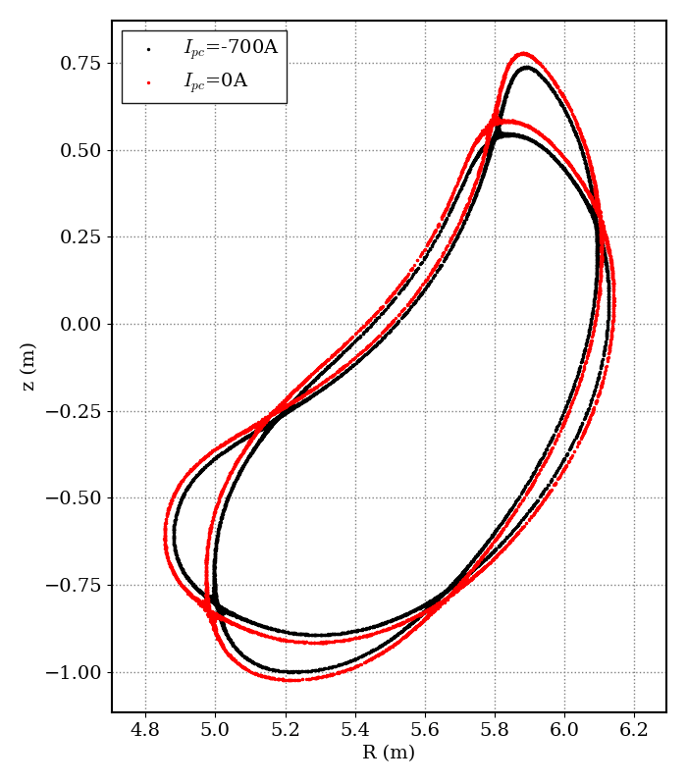
Checking plausibility of separatrix shift
field line tracing
separatrix moves outwards (-700A → 0A) by 15mm (along MPM path)
experiment
bright stripe moves outwards (-700A → 0A) by ≤ 5mm (also indicated by probe head “holes”)
why this mis-match? perhaps bright stripe ≠ separatrix ?

Slide 18
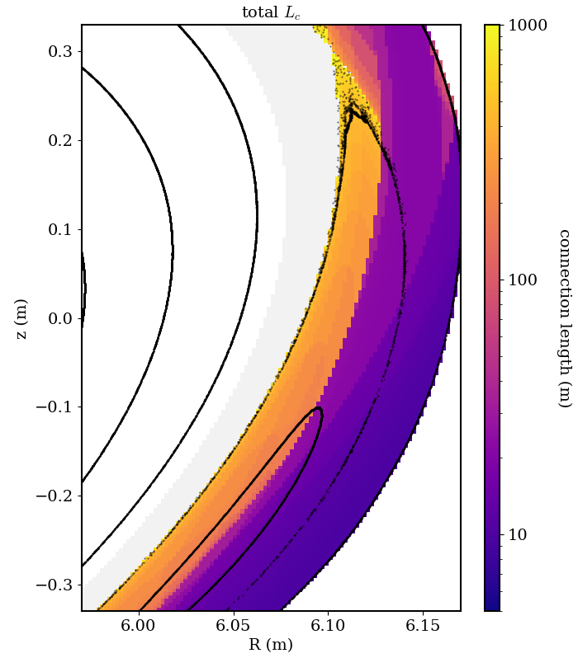
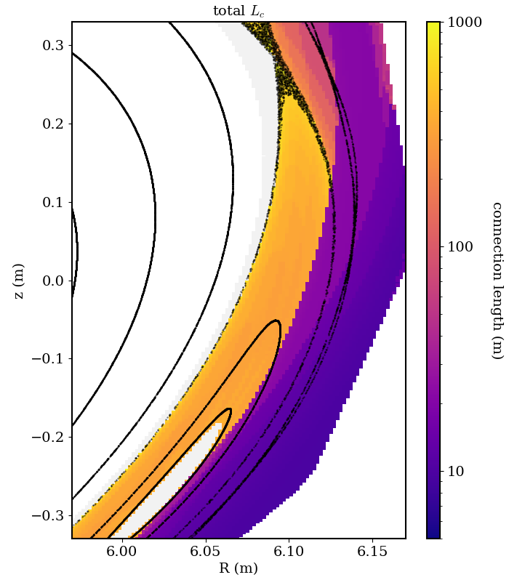
sanity check, role of connection length
why do we see flux surfaces at all, when L_{c} ≈ 10m ?
20170927.20
I_{pc}=0A
20170927.18
I_{pc}=-700A
stripe position
L_{c} ≈ 10m
stripe position
L_{c} ≈ 10m

Slide 19
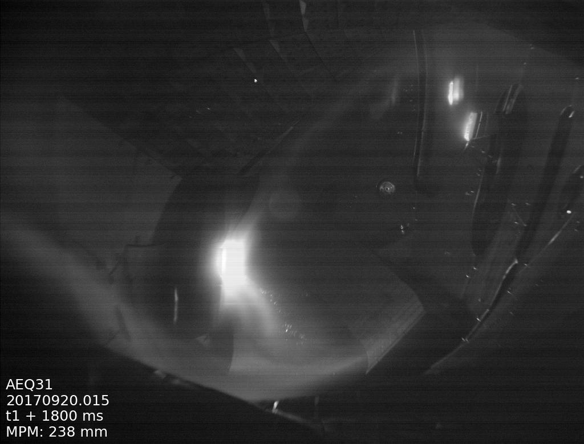
configuration space for stripe imprint on probe head
high mirror configuration
MPM probe
with stripe
big hot spot
trim coil scan in high mirror configuration (20./26.09.2017 , compass scans)
28 programs with stripe seen on probe
stripe position is identical in all 28 programs → not affected by trim coil setup
many small hot spots
Stripe covers center screw at d_{mpm}=240mm (on average)
screw is at 86mm ahead of R0 → R_{stripe}=6.105m

Slide 20
Conclusion
indications for electron population outside the plasma in low density experiments
potentially harmful for machine safety → impact on scenario development: avoid low density
visible light stripe on MPM probe head, seeming to originate from the plasma
position and shape of stripe suggest that this might be the 5/5 separatrix → accidental in situ flux surface measurement?
position of stripe changes with plasma current and I_{pc} in qualitative agreement with expectations
but:
electrons on flux surfaces are not really expected there since L_{c} ≈ 10m,
no reaction of “flux surface” to trim coil scan
any ideas?

Slide 21
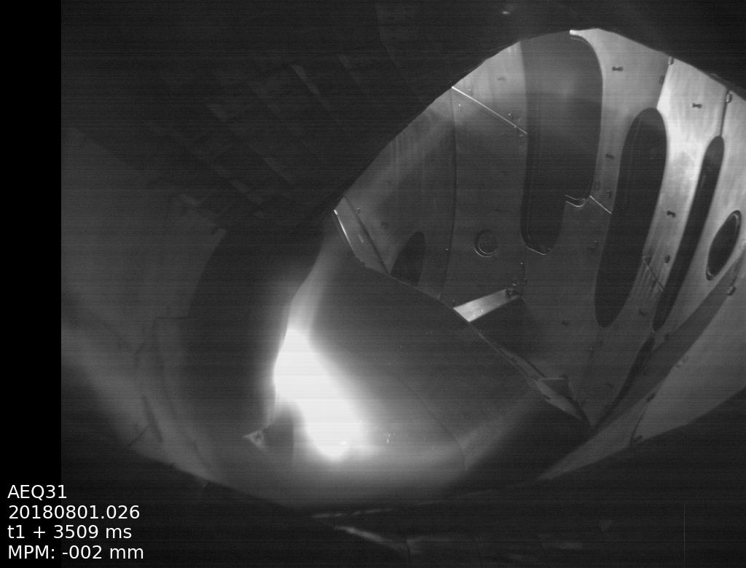
for reference: orientation of the video image AEQ31

Slide 22
projection error from viewing geometry
PV
u_{mpm}=[ 0.9297 , 0.3683 , -0.005 ]
u_{aeq31}=[ -0.060 , -0.988 , 0.142 ]
estimated conversion px – mm at MPM: 1px=2.5mm
→ projection error along MPM plunge ≈1/cos(25°) ≈10%
top view onto M4
MPM
25°
AEQ31

Slide 23
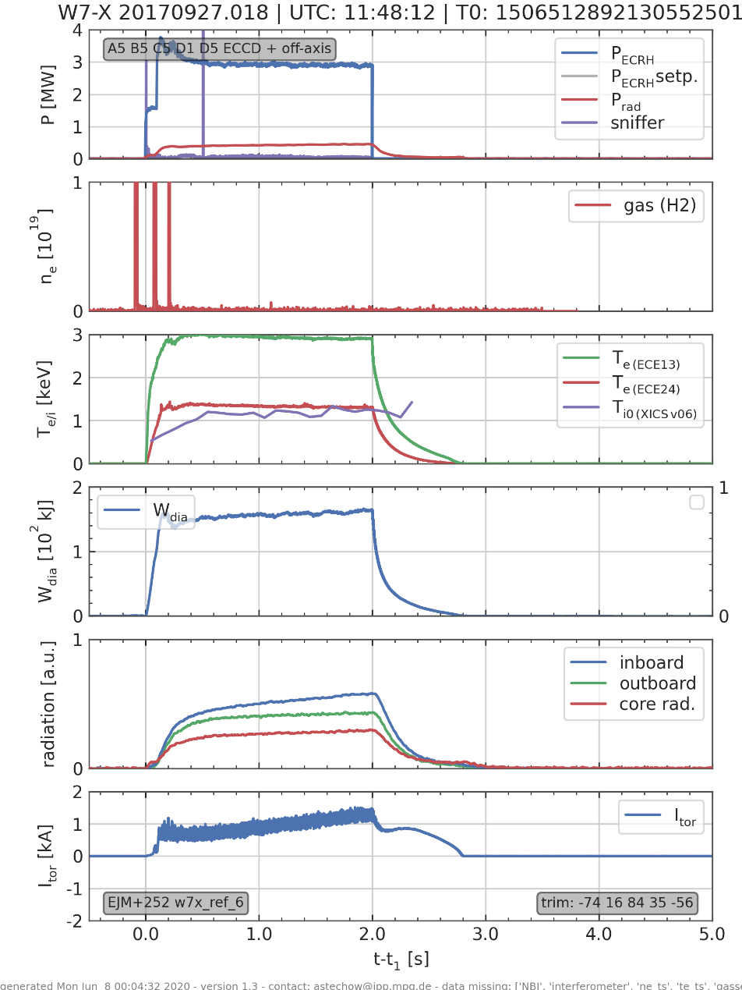
bad diagnostic coverage for many programs of interest

