Slide 1
WEST roadmap toward wall protection using infrared viewing systems
R. Mitteau & West GP3 team

Slide 2
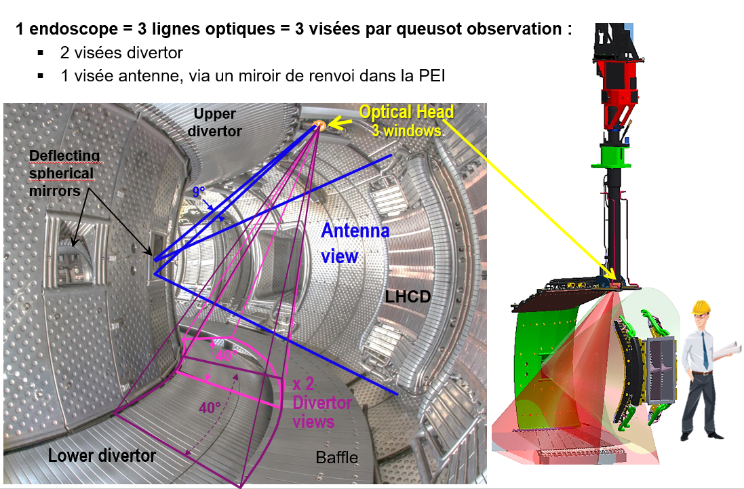
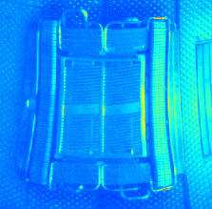
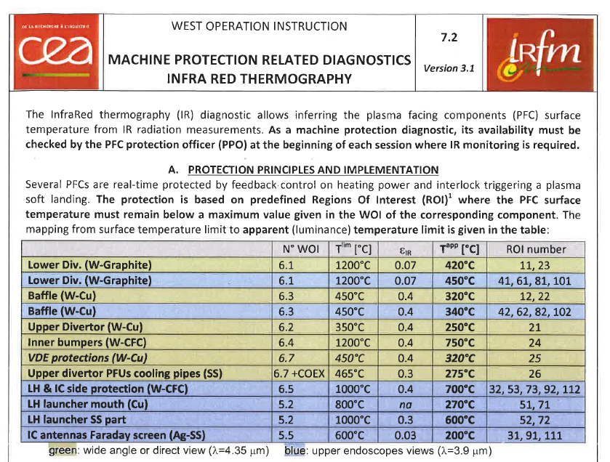
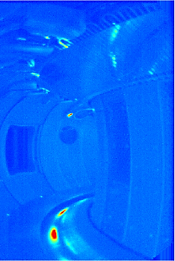
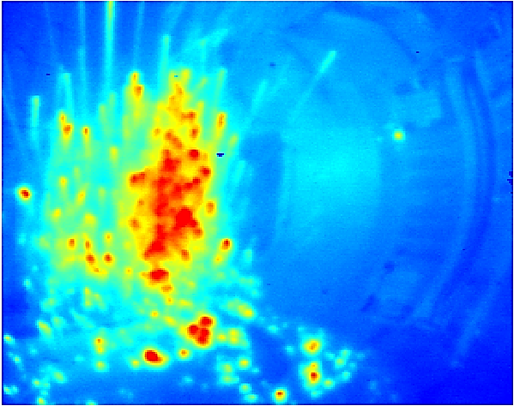
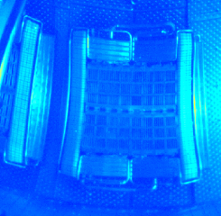
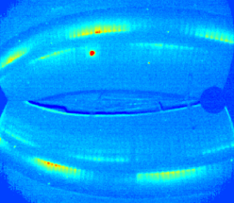
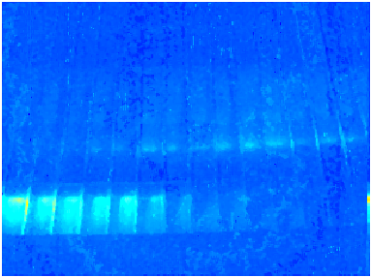
West Infrared diagnostic and wall monitoring
10+ lines of sight and IR cameras monitoring WEST wall in real time
Double role
1 - Wall monitoring & protection
2 - Diagnostic for science
Operational domain → WOI
(West Operating Instruction)

Slide 3
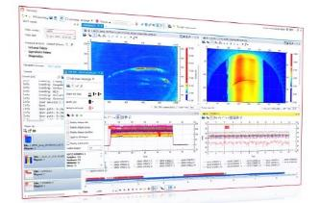
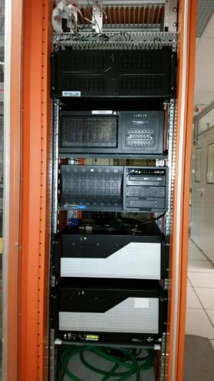
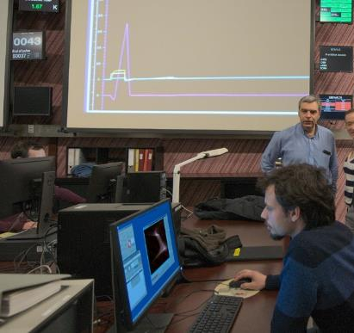
Two approaches toward wall monitoring
Automatized system
Real time (= video, duty cycle 20 ms)
DWMS cubicle – data pre-processing inside customized cameras (FPGA)
Write data as it comes on shared memory network 'dolphin'
Human expertise
Hot spot surveillance in between pulses
PPO roaster (PFC Protection Officer)
support - scripts + automated analysis tools
PFC effective temperatures are read by PCS
for feedback control
through pre-defined
actuators
(Note, also hard wired plasma stop)
Severity – urgency assessment
Decision making before following pulse -
Knowledge database

Slide 4
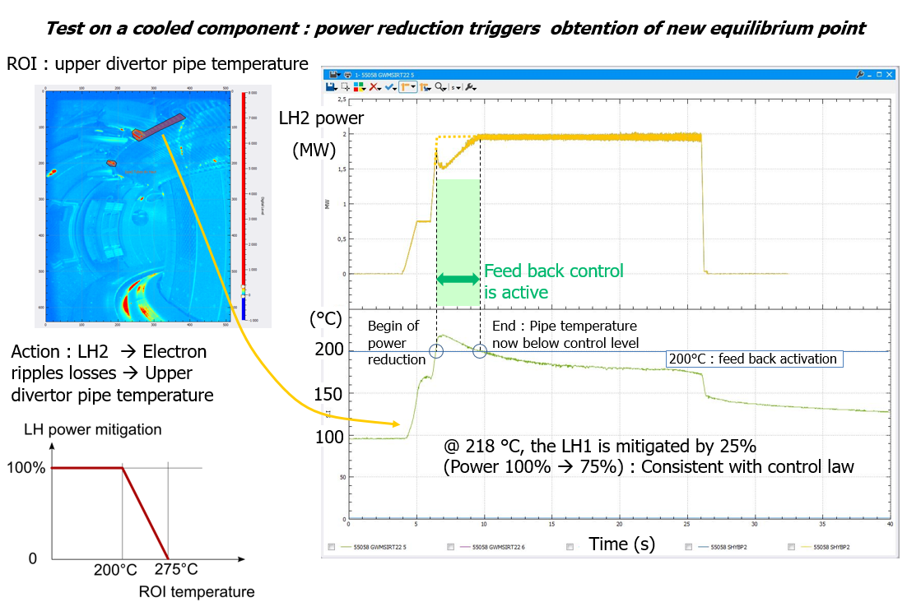
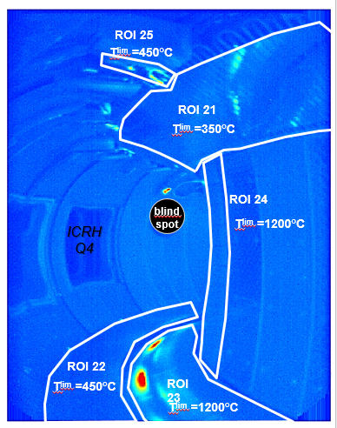
Automatized system
Security based on predefined Regions of Interest (ROI)
Settings + qualification in 2019 (C4 campaign)
Limitations
  Ufos, photonic reflections supra-thermal emission – Risk of wrong safety triggers
  Frequent manual ROI position re-adjustment required , possible human error
  Limited decisional intelligence

Slide 5
Human expertise
IR video are analysed after the discharge.
Existing knowledge, known hot spots, …
Decision making : session leader, engineer in charge, scientific coordinator – program tuning.
Weekly IR experts coordination meeting, knowledge sharing, review of current wall hot spots status
Workload become exceedingly large excessive when experimental program runs well (10 videos to be analysed in about 10 minutes)
Some concerns with hot spots revealed only the following days
About 10 experts have slightly different practices (severity rating, ….)
Correlation to other noticeable event (add. power, density change…)
Hot spot Decision making Cycle
Decision / action
Alert SL-SC
New / Known
…
Etc, etc…
Hot spot detection
Localisation → a strong guide to expertise
Severity grading

Slide 6
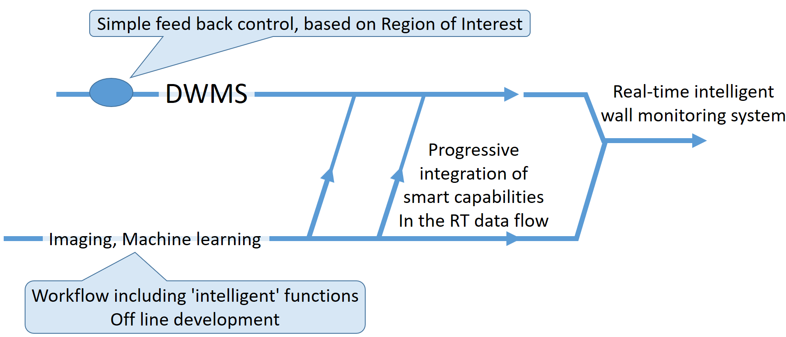
Intelligence needed into automatized system
Able to detect "false" hot spots
  Most moving spots are UFOs – can be classified without further action
  Some moving hot spots aren't UFOs ---- plunging probe --- expertise needed
  Capacity to arbitrate true / false hot spots
Monitoring "mild spots" which can be precursor to severe incident
  Critical heat flux on a cooled component
  Tile bonding progressive degradation
  Coating delamination
Add expert knowledge from PFC protection officers to automatized control

Slide 7
Long term goal
Based mainly on IR images from the IR viewing diagnostic, but able to use data from other diagnostic systems (Spectrometry, bolometry, heating systems, magnetic data …)
Managing two feedback control loops :
  1/ Plasma discharge loop, integration with Plasma Control System
  2/ In between plasma, monitoring cross discharge event (tile delamination spanning over successive plasma discharges)
Using imaging techniques (computer vision) toward hot spot Detection-segmentation-classification
Using 'a-priori' knowledge of scene : components, materials, thermal behaviour,
Making use of the quantitative infrared data : this is not only about imaging, the measure (radiance, temperature) contains meaningful information
Using expert systems, artificial intelligence for hot spot classification, estimate severity and criticality levels, and deciding about fast (within discharge) of slow (discharge to discharge) management.
Able to mix all this multiple data, manage information : big data, data fusion techniques
All that, in (video) real time (20 - 100 ms).
(longer term – integration with synthetic diagnostic – inverse methods toward parameter estimation)

Slide 8
Progressive approach to complexity
But can't either set aside any challenge from the start
Can't tackle all challenges at the same time
Task complexity axis
Act (feedback control)
Expertise (classification)
Segment hot spots (contour)
Detect hot spots
No time constraint
Divertor vertical view (3 to 5 event classes)
Work flow btw pulses
(~10 minutes)
Antenna views (6 to 9 classes)
RT workflow (~20ms)
Tangential wide angle (>10)
Time complexity axis
Scene complexity axis

Slide 9
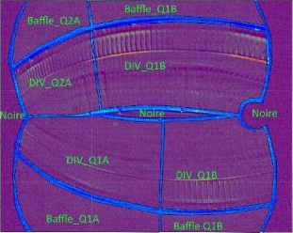
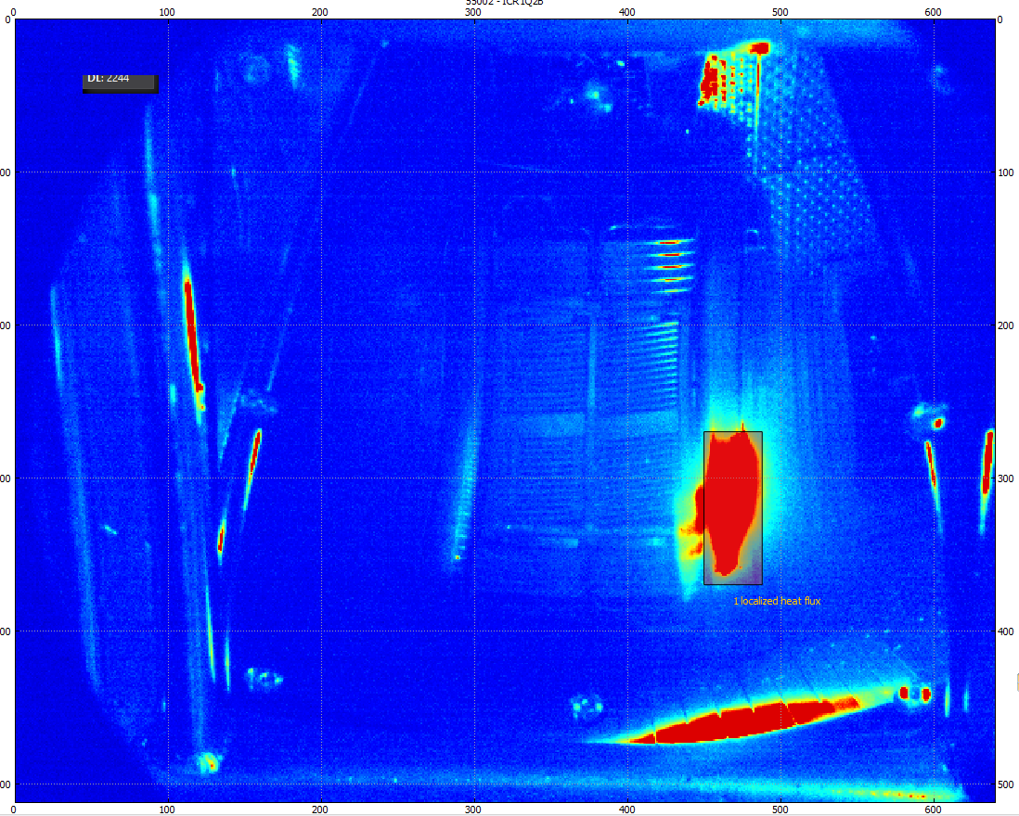
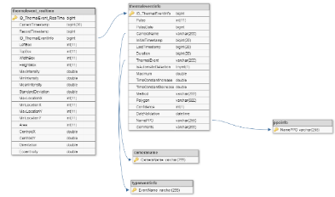
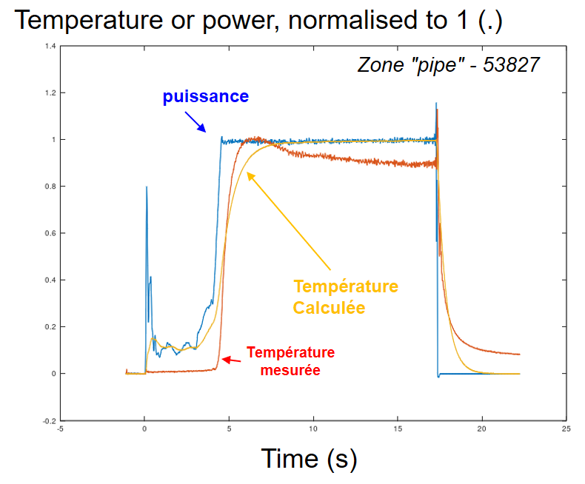
Data pipeline
West experiment database
IR movies
Other data
Mapping
Pipeline : detection - segmentation
Thermal event database
Thermal parameter estimation (Tstab, dT/dt)
Analyse, classification

Slide 10
Imaging and signal processing activities related to thermal event management
Pure imaging (computer vision)
Hot spot Detection, segmentation, instance detection
Thermal evaluation : signal processing, thermal time constant evaluation, Scaling laws, parameter estimation
Thermal event database
Data sorting
Data Field management, add-ons, pipeline management
"Synthetic" diagnostic : Calculate thermal scene as seen by viewing diagnostic, from first principles (CAD models, temperature distribution, diagnostic optical model)
Includes : image mapping
Rough mapping
Fine mapping
IR diagnostic
Data accuracy, calibration
… emissivity evaluation
Actuators, safety management, feed-back control, operating instructions
Knowledge management, expert system, artificial intelligence, machine learning

Slide 11
Deming virtuous circle
First : make a full pipeline work
Improve thermal event database : more fields, more pipelines
Client
feedback
Improve hot spot detection, segmentation…
Improve classification, decision, branching to actuators…
Then, take each stage, work at improve it
Improve data management, history…

Slide 12
Milestones
Milestone
A thermal event database
Assisted feed of thermal event data base
Using a priori knowledge of components
(rough mapping)
Current status
Adding thermal parameter to aid classification
Automatized feed of thermal event database
Incomplete list
Milestone
Using synthetic diagnostic data
"long term goal"

Slide 13
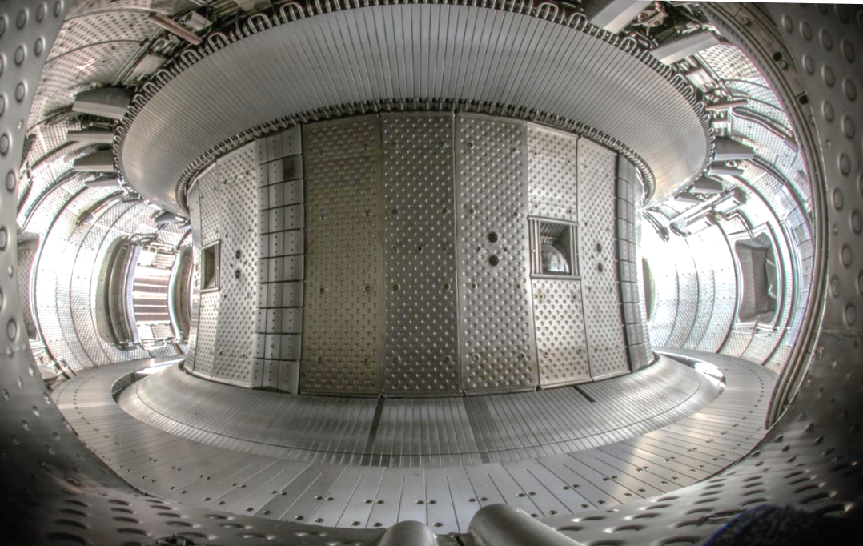
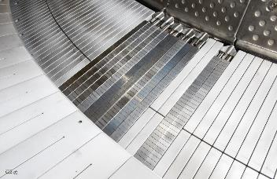
West configuration
WEST in May 2018
Upper divertor
W (15µm)/CuCrZr
VDE/ripple protection
W (15µm)/CuCrZr
Vessel Protection panels
Stainless steel
Vessel Protection panels
Stainless steel
Outer bumpers
W (80µm)/Mo(80µm) /CFC (reused)
Inner bumpers
W (12µm)/CFC (reused)
Lower divertor
W (12µm)/Graphite
Baffle
W (15µm)/CuCrZr
Test sector
with ITER-like
Plasma Facing Units (W MBs)

Slide 14
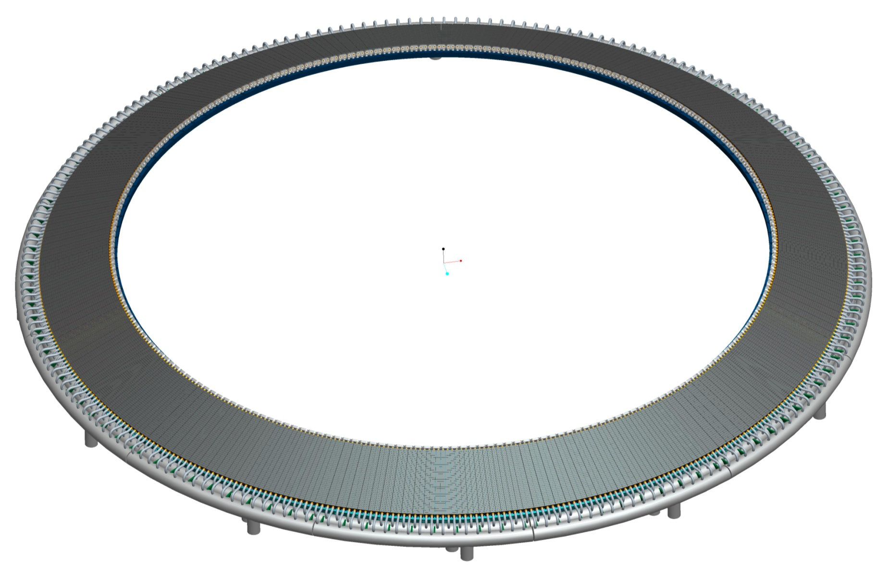
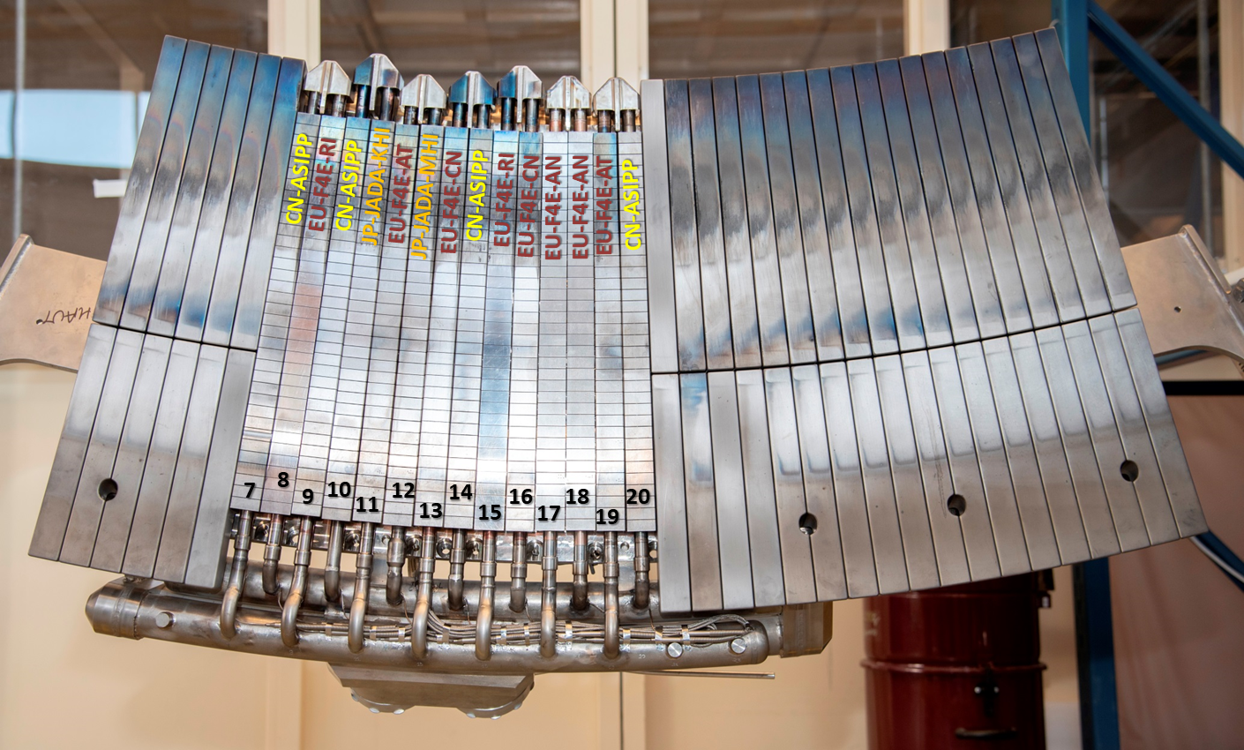
2019 → 2020
2019 – 12 cooled PFUs
The rest is graphite (W-coated)
2020 – all cooled divertor
** plus a couple other important improvements (heating systems, diagnostics …) not detailed here + Conditioning – powder dropper

Slide 15
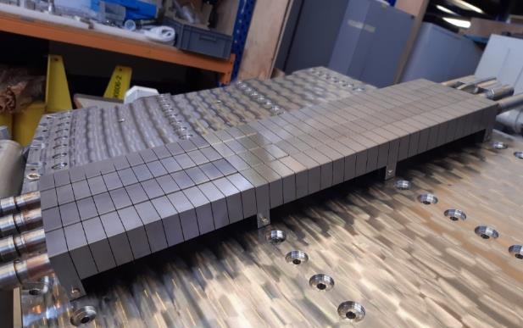
Divertor procurement status
Manufacturing of the 456 ITER grade PFUs ongoing
  4 prototypes received in August 2019
  Full delivery expected in Spring 2020
Preparation for WEST phase 2 starting
International call for modelling and experimental proposals : February 2020
WEPM3, 5-6 May 2020, Aix en Provence
WEST GB7, May 15, 2020
Phase II PFU prototypes showing ITER beveling

Slide 16
Experimental timeline for Phase II
First campaign with actively cooled tungsten lower divertor Oct.-Dec. 2020
C5 in Oct.-Dec. 2020 (1 month of commissioning without plasma in Sept. 2020)
2 campaigns of 3 months per year afterwards
Typical campaign breakdown
  4 weeks of plasma commissioning
  8 weeks of experiments
  Maintenance on Monday
  Operation in 2 shifts on Wednesday and Thursday
  6 experimental sessions per week
  60 experimental sessions per year (+36 contingency)
3 months shutdowns
  Necessary for regulatory controls
  Compatible with PFC change and RF antenna operation
Horizon Europe (FP9)

Slide 17
Conclusion
West WMS Roadmap is defined
Manage WMS roadmap complexity
  Milestone are defined : supports dialog with stake holders
  While allowing sufficient work management flexibility
Resources & Planning
  Flexibility needed – resource controlled
  A lot of opportunities…
Experimental campaign C5 being prepared

