Slide 1
Camera Integration at W7-X
Axel Winter
for the W7-X CoDaC Team

Slide 2
Overview
Camera Integration @ W7-X
  Integration of Camera Systems – Hardware
  Integration of Camera Systems – Software
Upgrades to Central Software Systems for real-time control
Outlook and Conclusion

Slide 3
Camera Integration
Challenges in design of imaging systems for plasma diagnostics
  Plasma diagnostics - monitor plasma temperature, density, radiative properties, divertor/first-wall protection
  Dozens of cameras
  1-8 Mpx @ 50-50k FPS
  Throughput may exceed 8 Gb/s per camera
  Scalability and high reliability
  good synchronization accuracy
Call for a highly versatile solution:
  Identical framegrabber hard- and software for all cameras
  Cost-effective, scalable solution, widely used
  Good abstraction from camera interface with one software API for all cameras to facilitate integration
  Collaboration with DMCS (Markowski Group), based on their prototype work for ITER

Slide 4
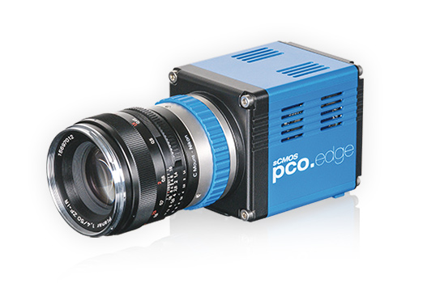
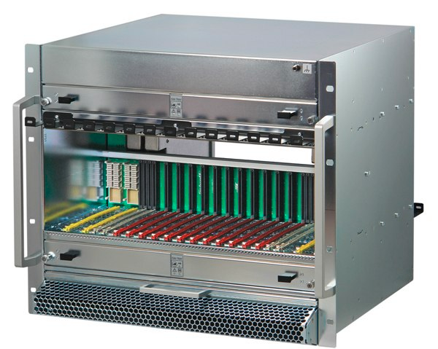
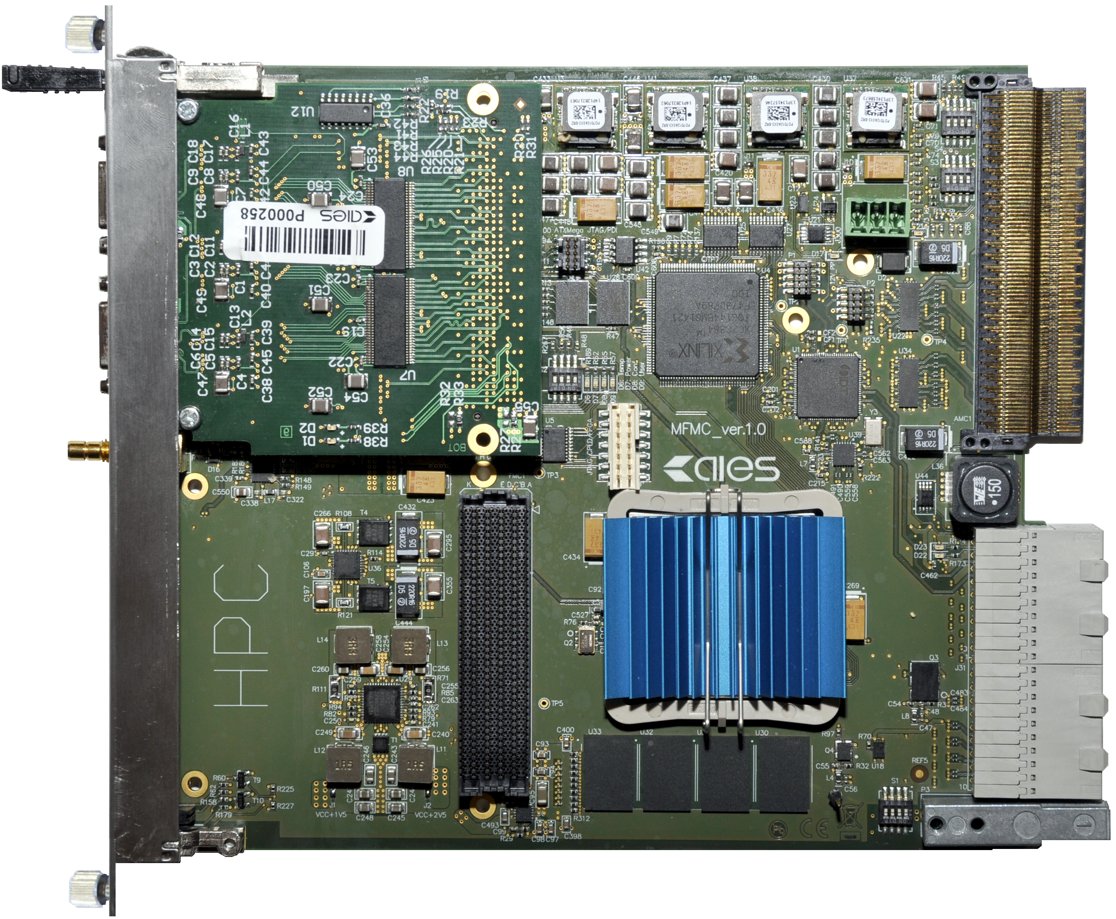
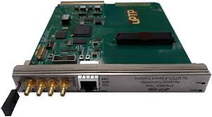
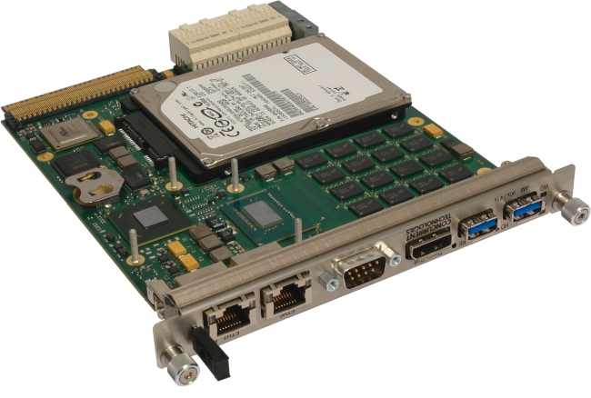
Highly generic interface required
Image Acquisition and Processing with MTCA.4 – Initial Solution
Micro Telecommunication Computing Architecture:
High RAMI (Reliability, Availability, Maintainability and Inspectability)
Extensions for precision timing and synchronization
Intelligent Platform Management
Good price to performance ratio
Additional PCIe extender enables use of standard PC with higher throughput
8-32 Gbps
MTCA.4 12-slot
Chassis
32 Gbps
Frame
Grabber
32 Gbps
32 Gbps
Courtesy D. Mankowski, DMCS Univ. Lodz
Timing module
CPU

Slide 5
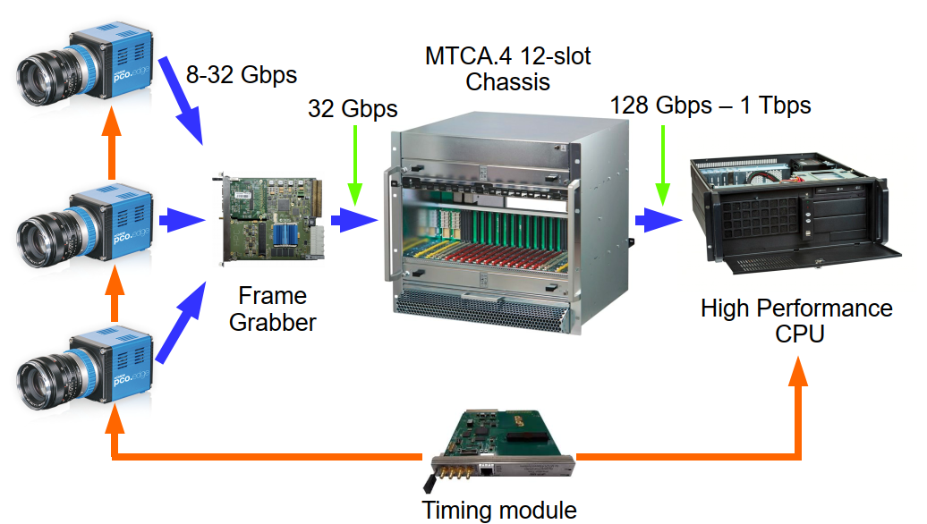
High-Performance Solution possible
High-speed connection to external CPU/GPU possible
Segregating MTCA backplane allows for up to 4 PCIe root complexes to be used

Slide 6
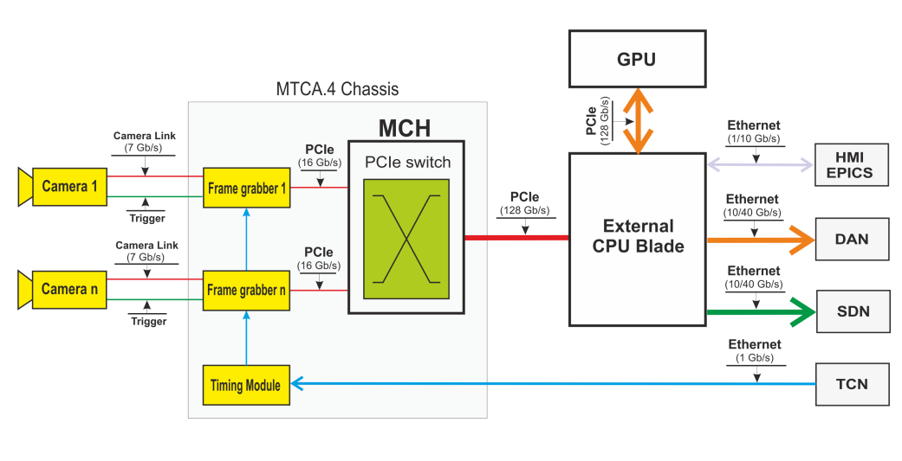
Image Acquisition using external CPU

Slide 7
MFG4 - Frame Grabber Card for MTCA.4
Cost-effective solution for high-performance image acquisition systems
Designed as FMC carrier module (HPC and LPC) with FMC extension modules:
  Camera Link (Base, Full, Ext-Full), CoaXPress
  (Camera Link HS, IEEE1394, GigEVision)
  Universal IO module
  Firmware support for selected protocols
Provides all resources for data acquisition and control systems (FPGA processing power, SDRAM, clocks distribution, trigger and interlock signals)
Based on Xilinx Artix 7 (XC7A200T) FPGA
RTM Zone 3 connector (D1.2 Digital Class)
Courtesy D. Mankowski, DMCS Univ. Lodz

Slide 8
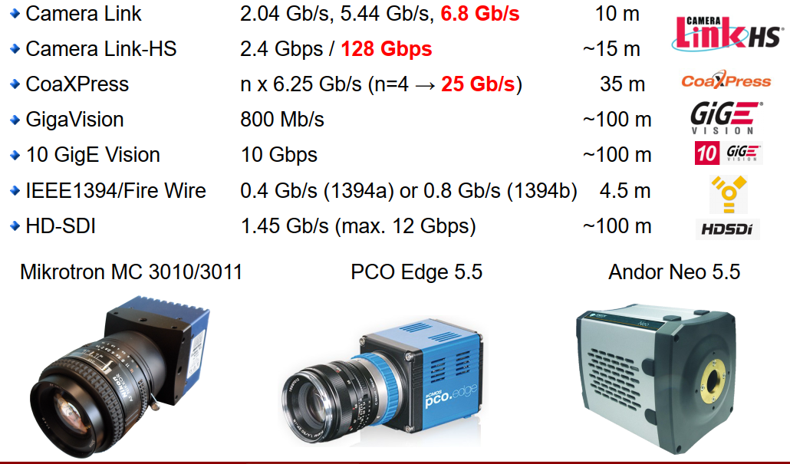
A whole zoo of camera standards available

Slide 9
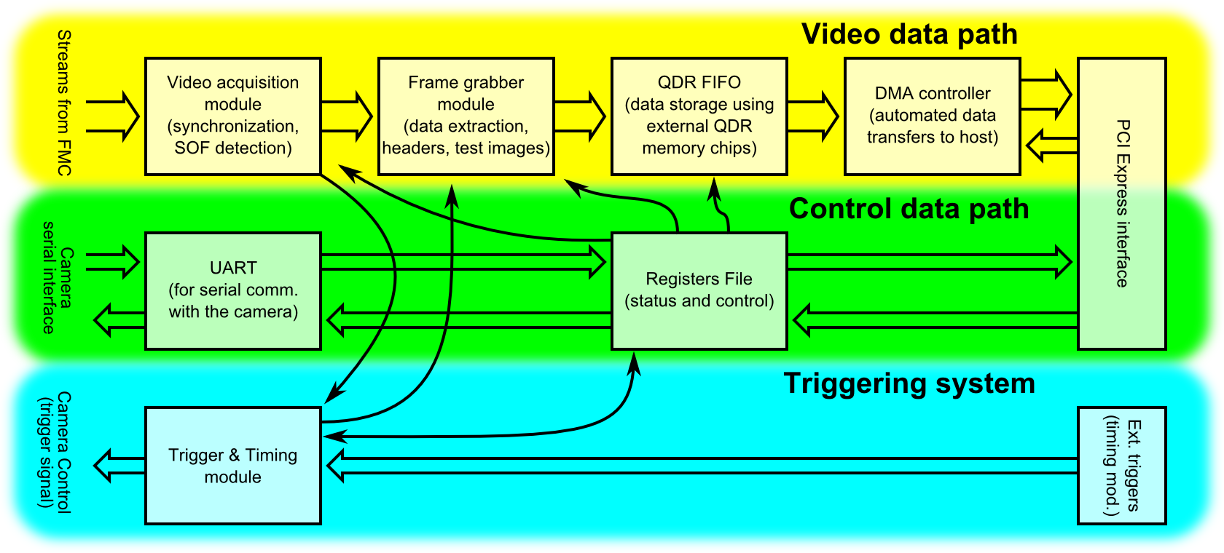
Image Acquisition System - Firmware
Three paths for image, camera control and triggering
Allows acquiring image from CL camera
Powerful DMA over PCIe
AXI Stream interface to CL receiver
Image Acquisition and Processing Firmware
Courtesy D. Mankowski, DMCS Univ. Lodz

Slide 10
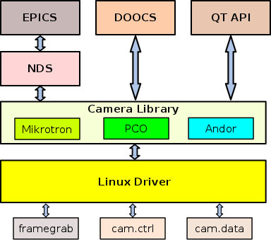
Image Acquisition System - Software
API for EPICS, DOOCS, QT and W7-X SegmentControl
Library for a number of cameras, e.g.:
  Microtron, PCO Edge, Andor
  Raptor Cygnet, IRCAM Caleo*, Hercules*
will be extended to all standard W7-X cameras
Support for Cameralink, CameraLink HS, GigEVision*, Firewire
Available nodes:
  Frame Grabber, Camera control, Camera image
Linux driver with support for GPUDirect*
GenICam* support
HMI panels in QT
Courtesy D. Mankowski, DMCS Univ. Lodz
* planned

Slide 11
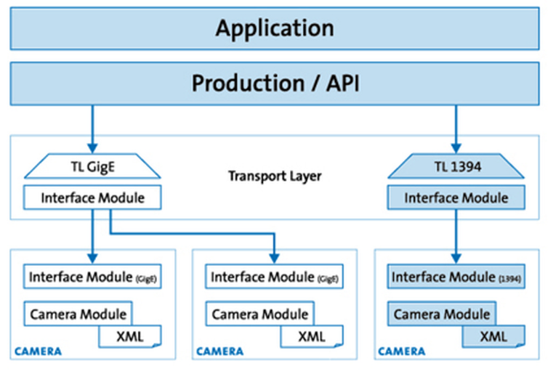
Future plans – GeniCam Implementation
Baseline MTCA system will be available for key diagnostics for OP 2.0
Full compatibility with GenICam Standard (expected end of 2021)
Driven by about 150 companies (e.g. Basler, NI, Pleora, e2v)
Result: Any GenICam compatible camera will work out of the box with W7-X hardware and any software SDK will work as API is static
The goal of GenICamTM (Generic Interface for Cameras) is to provide a generic programming interface for all kinds of devices (mainly cameras), no matter what interface technology (GigE Vision, USB3 Vision, CoaXPress, Camera Link HS, Camera Link etc.) they are using or what features they are implementing. The result is that the application programming interface (API) will be identical regardless of interface technology.
See https://www.emva.org/standards-technology/genicam/

Slide 12
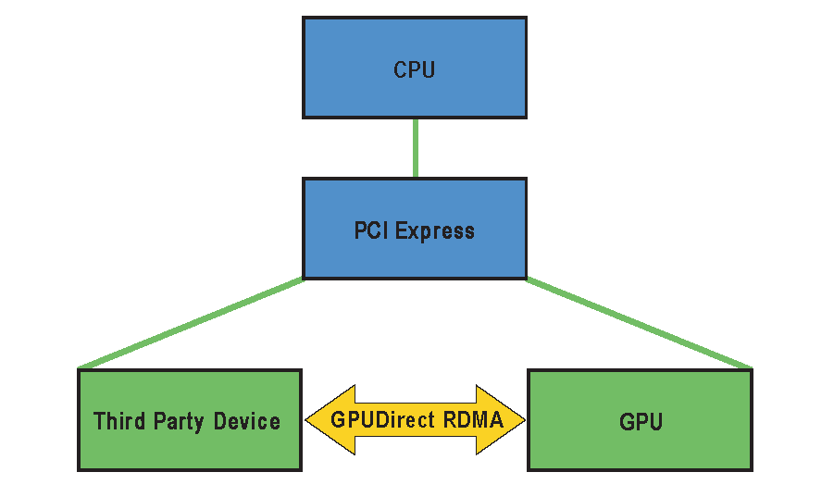
Future plans – GPUDirect
GPUs get more and more important in real-time processing, but exhibit non-deterministic behavior at the µS-level due to memory copies in/out of GPUs
Speed bottleneck for large amounts of data is the IO of the GPU
GPUdirect RDMA reduces jitter of transfer to (almost) zero and transfer time by a factor of 2 by establishing direct transfer between device (e.g. camera framegrabber) and GPU memory bypassing CPU and system memory.
Developed by NVIDIA and obviously limited to their performance line of GPUs
Planned for 2022

Slide 13
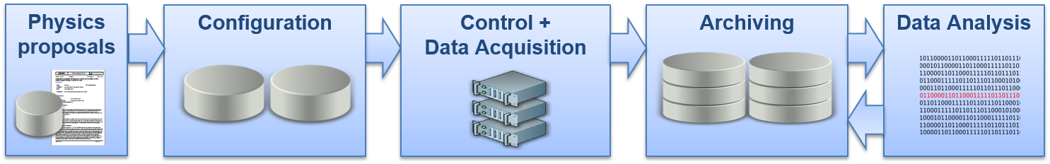

CoDaC software tasks
Safety system
Slow control system (operational management)
Fast control system (segment operation)
Safety PLC
PLCs
PCs
Cycle time: <500ms
Cycle time: <200ms
Cycle time: <100ms
(FastControlStations)

Slide 14
W7-X control and data acquisition system
ControlStations
Fast control system (segment operation)
FastControlStations
Mainly for control purposes
VxWorks bases realtime systems
CoDaStations
Mainly for data acquisition purposes
Java-based non-realtime systems
PCs

Slide 15
CoDaC Software Stack
Two fundamental components for DAQ:
CoDa-Station – non real-time JAVA-based framework for archiving
  Powerful framework for configuration, timing and data archiving aimed at large data throughput
  Makes use of W7-X timing system for 10ns accurate triggers, event propagation etc.
Fast Control Station (FCS) – real-time framework for deterministic data processing
  C/C++ based framework running on RT Linux (as of 2020)
  Highly deterministic scheduler : data in, data out and process method. Everything else done safely before/after RT phase plus all necessary interfaces to W7-X infrastructure
  Will –over time- allow plasma control @ W7-X
  Makes use of W7-X timing system for 10ns accurate triggers, event propagation etc.
Concurrent data access module to allow running both frameworks on a multi-core architecture

Slide 16
FCS enhancements
The FCS framework is the basis for all real-time control at W7-X
Enhancements are in progress (full availability post OP 2.1) to open framework up for an easier use of non-CoDaC collaborators
  test bed which allows compiling and testing of individual algorithm modules (already available in an alpha version)
  Robustness and hardening of the framework to deal with non-expert users
  Documentation to enable easier use by non-experts
Final vision is to allow people to compile working algorithm modules without CoDaC assistance which are then tested and benckmarked and finally deployed in the FCS infrastructure running W7-X
All of this will take place during the next few years and intermittent solutions are being put in place for software for OP2
FCS deployment will provide availability to many diagnostic inputs and control outputs around the machine (heating and fuelling, interlock system, a selected set of diagnostics) –> Possibility of sophisticated plasma control at W7-X.

Slide 17
Talking about control and protection
What is real-time for control ? – „Real-time systems must guarantee response within specified time constraints” very different to the definition for simulations “simulation's clock runs at the same speed as a real clock”
That means acquisition, transport, calculation and actuation must fulfil RT requirements for the process chain to be applicable to control and/or protection
Plasma Control and protection post challenging requirements on algorithms and infrastructure
  Algorithm determinism – nothing is worse than old data (so NO recursive algorithms)
  Infrastructure determinism – nothing with garbage collection will ever work deterministically (Java, Python, etc). No interrupts at OS layer (NO WINDOWS, no standard Linux)
  Real-time network
  Speed – must be fast enough to enable desired result

Slide 18
Outlook and Conclusion
Integration of the various demanded camera types for OP2 quite challenging, since new overall concept needed to be found as well as major software components reworked.
We managed, and a very promising integration concept has been found and is currently being finalized with a proof-of-concept available by end of March
All forms of processing are available and readily scalable: FPGA, GPU and CPU
FCS software was migrated to RT Linux (conditio sine qua non) and will be enhanced over time to facilitate collaboration with external contributors of algorithms allowing for more refined plasma control at W7-X.
But all this is just the beginning: Now comes the challenge of developing, benchmarking and finally robustly implementing the protection algorithms. A lot of work for the CoDaC team and our E4 colleagues.
For Data Processing and storage challenges and options see next talk…

