Slide 1
Data processing of images / videos @ W7-X
Simon Dumke
for the W7-X CoDaC Software Team

Slide 2
Agenda
Real Time IR image processing
Scaling and PFC protection
Compression
Challenges

Slide 3
Real Time IR image processing
DataMonitor
High Performance PC
(RT Linux)
Monitoring
CoDaStation
Archiving Java API
W7-X Archive
IR Camera
CameraLink
MTCA Frame-Grabber
Shared Access
FastControlStation
Cam DAQ Module
TTE Module
NUC Module
GPU
Thermal Event Detection Module

Slide 4
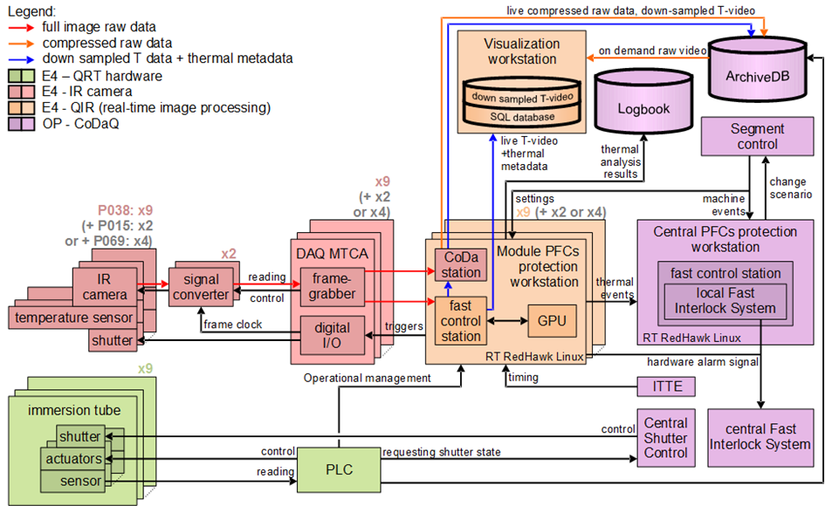
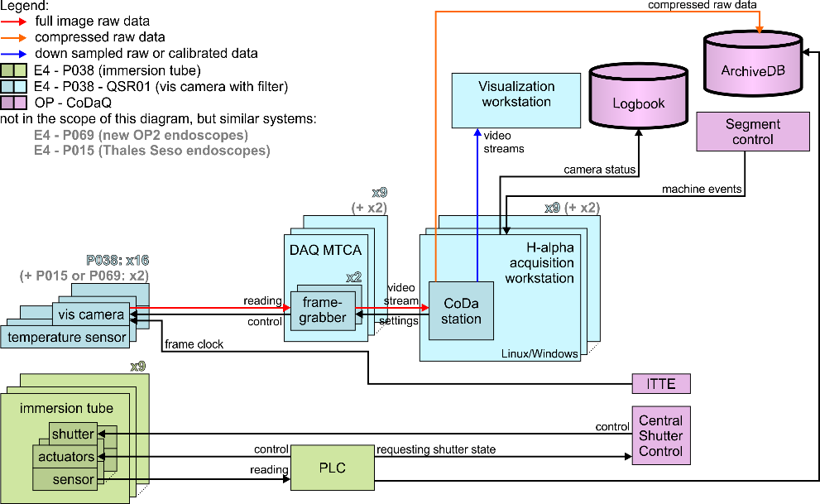
Scaling and PFC protection
8x EDICAMs
…
Network Bandwidth & Archive Storage

Slide 5
Compression
Lossy
Visually Lossless
Numerically lossless

Slide 6
Compression
Generic Stream Compressors: | BZIP2 | GZIP | XZ | ZSTD
Intra Frame Compressors: | HUFFYUV | JPEG Family | FFVHUFF | FFV1
Inter Frame Compressors: | H264 (x264) | H265 (x265) | AV1 | VP9 Dirac
16 bit support
Compression efficiency
Compression speed
Required resources

Slide 7
Compression
H264/265
JPEG XL (upcoming)
Pro
Very high compression efficiency
Con
Limited 16 bit support
Very, very, verry resource hungry
Shady patent situation
Pro
>16 bit support
Moderate resource usage
Upcoming Open Standard
Con
Lower compression efficiency

Slide 8
Compression
1,6 GByte
8bpp
H265
HEVC
16bpp
…
…
- CUDA Encoding ($$)
256 MByte
…
…
In-compressible
…
8bpp
Bit
Packing
…
…
…
- CPU “Encoding“
786 MByte
…
3,1 GByte
(2,4 GByte)
786 MByte

Slide 9
Challenges
Can‘t someone else do it?!!?
Yes! The Garbage man can!

Slide 10
Challenges
Compressors use patterns / assumptions for data reduction
White / Random Noise is incompressible
White / Random Noise does not contain any information
Pure Noise is Pure Waste
Of Network Bandwidth
Of Archive Storage
Of Computing Power

Slide 11
Challenges - full 12 bit
Fourier Transforms
Pixel value distribution over 400 Frames
Single Frame
400 Frame Mean

Slide 12
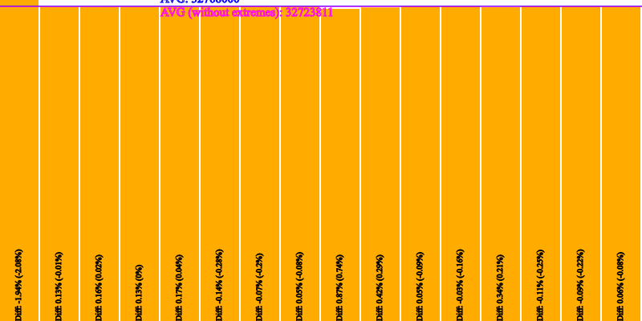
Challenges - lowest 4 bits
Fourier Transforms
Pixel value distribution over 400 Frames
Single Frame
400 Frame Mean

Slide 13
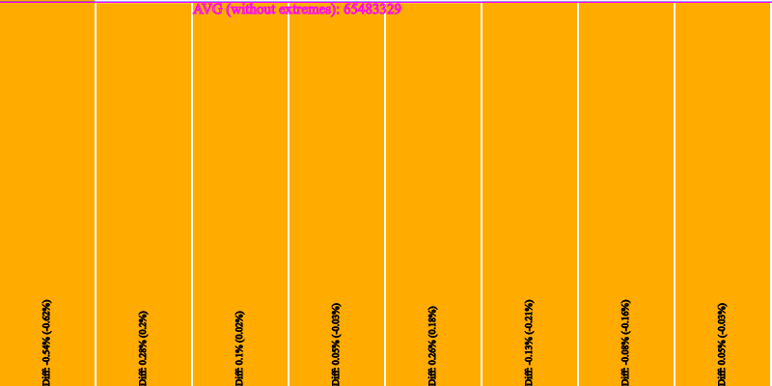
Challenges - lowest 3 bits
Fourier Transforms
Pixel value distribution over 400 Frames
Single Frame
400 Frame Mean

Slide 14
Challenges - lowest 2 bits
Fourier Transforms
Pixel value distribution over 400 Frames
Single Frame
400 Frame Mean

Slide 15
Challenges - Conclusion
Please think about dropping waste
and come talk to us! ☺

Slide 16
Thank you!

