Slide 1
New hardware and software for EDICAM
Tamás Szepesi
G. Cseh, G. Kocsis, T. Szabolics,
S. Zoletnik

Slide 2
Introduction
Why new hardware was needed?
The present hardware is outdated
PCs are 6-8 years old (used since OP1.0 and before)
receiver (FPGA) card is 15 years old
Aims with the new hardware
compatible with present firmware
significant improvement wrt. the old one
→ capacity for future firmware development
reasonable cost
long support (manufacturer)
T. Szepesi | Image processing meeting | Greifswald | 26.02.2020. | Page 2

Slide 3
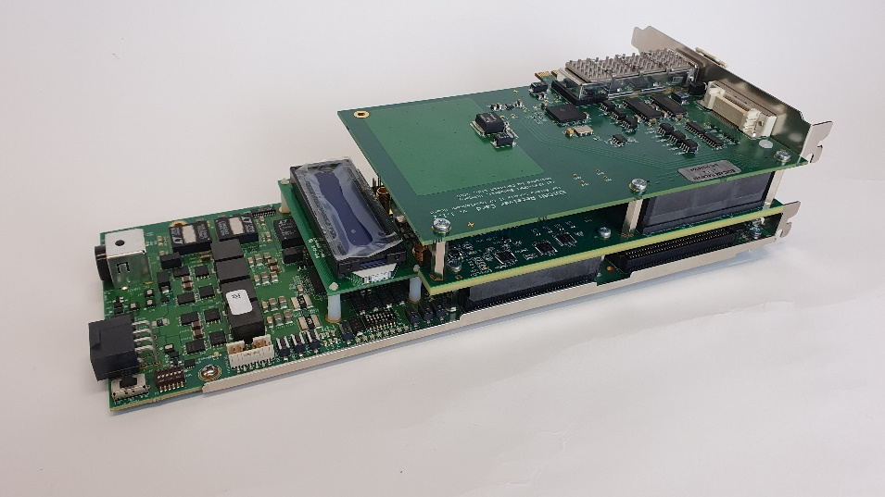
New hardware
Intel (Altera) Arria10 GX FPGA card
Most recent FPGA in the Arria series
new
old
 | Arria10 GX | Stratix II GX
Price | 4500 EUR | 3500 EUR
Logic Elements | 1,150,000 | 90,960
Adaptive Logic Module | 427,200 | 36,384
T. Szepesi | Image processing meeting | Greifswald | 26.02.2020. | Page 3

Slide 4
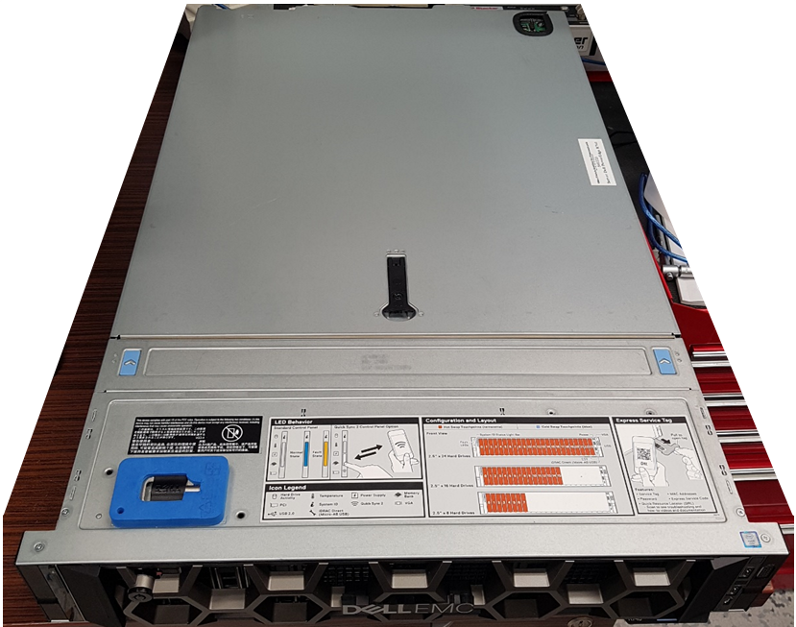
New hardware
Intel (Altera) Arria10 GX FPGA card
Most recent FPGA in the Arria series
we can use the old I/O add-on card
firmware porting is reasonable effort
New PC: CoDaC high performace computer
10 Gbps and 1 Gbps Ethernet
fast SSD for data stream
powerful CPU
T. Szepesi | Image processing meeting | Greifswald | 26.02.2020. | Page 4

Slide 5
Driver, API, software
Utilizing experience with the existing EDICAM system
Old system: all ROI data is bit-continuous in PC memory
New system: allocated memory is separated for each ROI
allows more sophisticated streaming and storage
→ writing of small frames (128x64) in batches (e.g. 10 frames)
0 MB
500 MB
ROI | #1 | #2 | #3 | #2 | #3 | #2 | #3 | #1
0 MB
500 MB
ROI #1
ROI #2
…
ROI #n
T. Szepesi | Image processing meeting | Greifswald | 26.02.2020. | Page 5

Slide 6
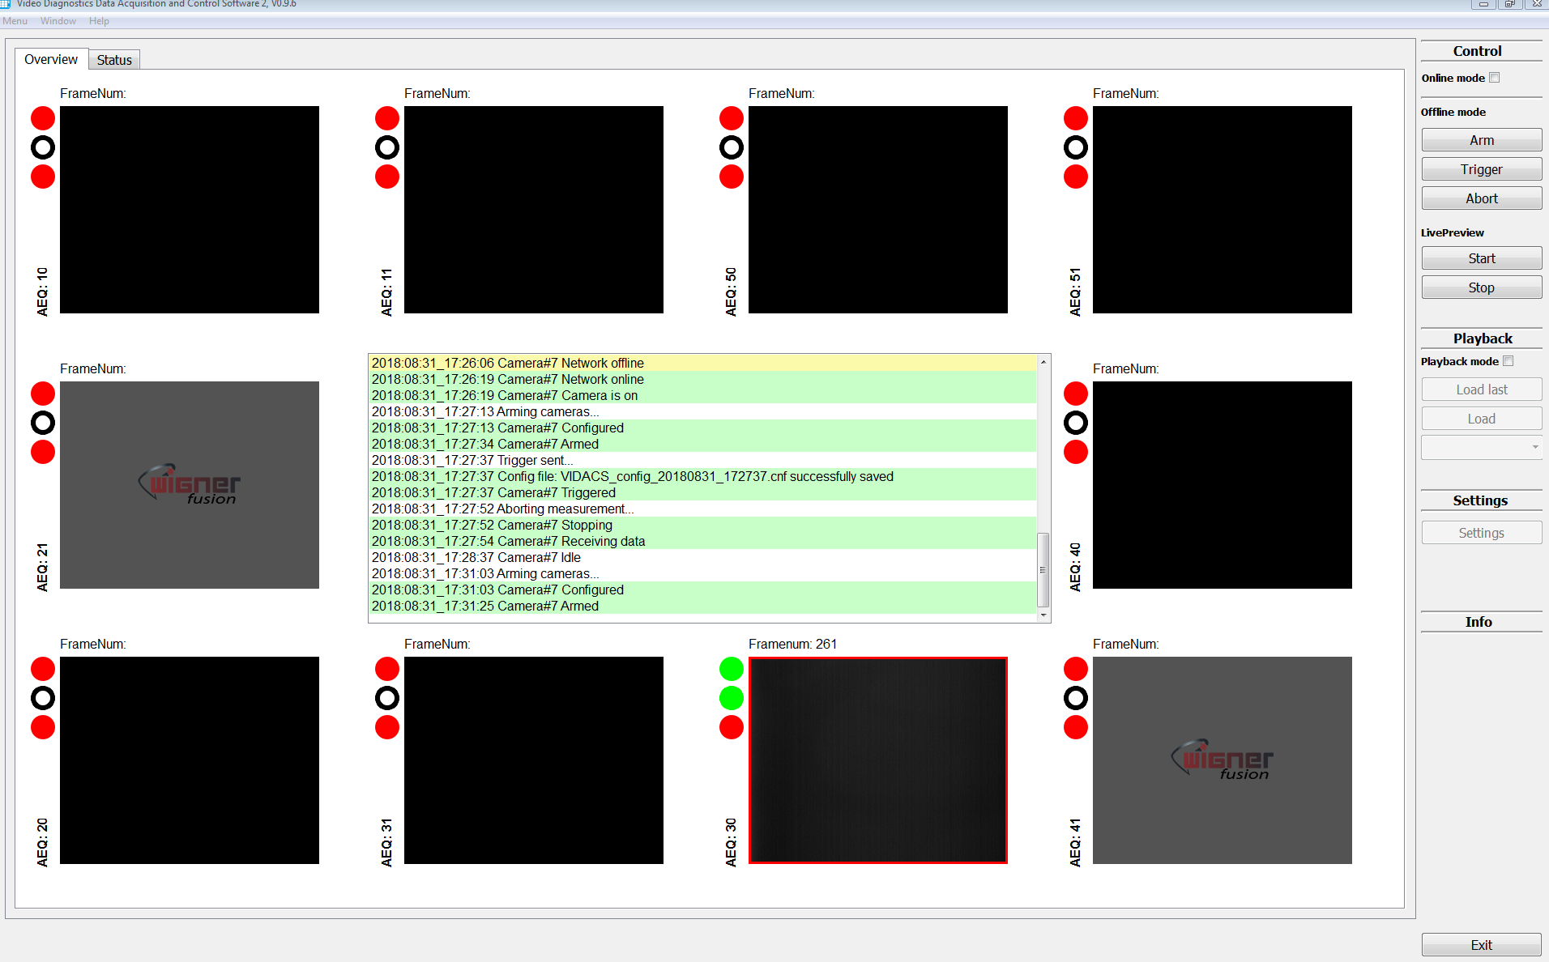
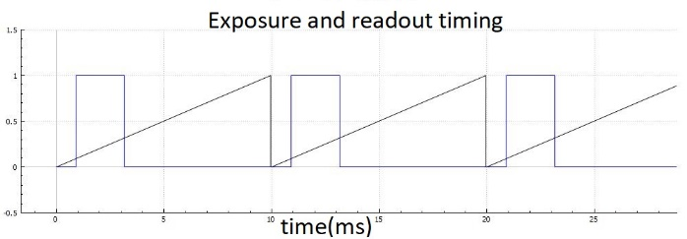
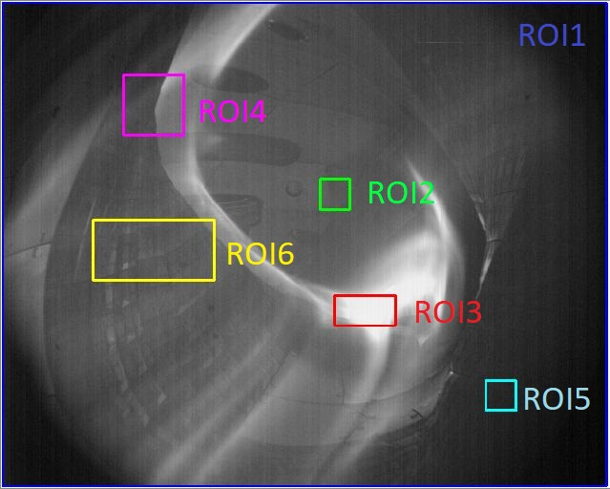
Driver, API, software
Re-writing of control software from scratch
EDIDAQ 2.0 and VIDACS 2.0
get rid of unhealthy solutions resulting from extensive patching
optimize code efficiency, better stability
T. Szepesi | Image processing meeting | Greifswald | 26.02.2020. | Page 6

Slide 7
Driver, API, software
Control, interaction with W7-X
Guideline: everything stays as in OP1.2
TTE unit: arm, start, stop
streaming video data real-time to Archive via coda station
→ remove limitations?
max. 100 fps full frame → increase to 200 (400) fps?
only 1 stream / camera → increase to 6 streams (smaller)?
no GeRi
GenICAM will be considered
T. Szepesi | Image processing meeting | Greifswald | 26.02.2020. | Page 7

Slide 8
Driver, API, software
Control, interaction with W7-X
Real-time data processing, event detection
two-level image processing in EDICAM
integrate into the same system as IR
BUT: we support ITER-relevant solutions
major aims
→ hot-spot (PWI) detection
→ plasma size monitoring (detachment)
T. Szepesi | Image processing meeting | Greifswald | 26.02.2020. | Page 8

Slide 9
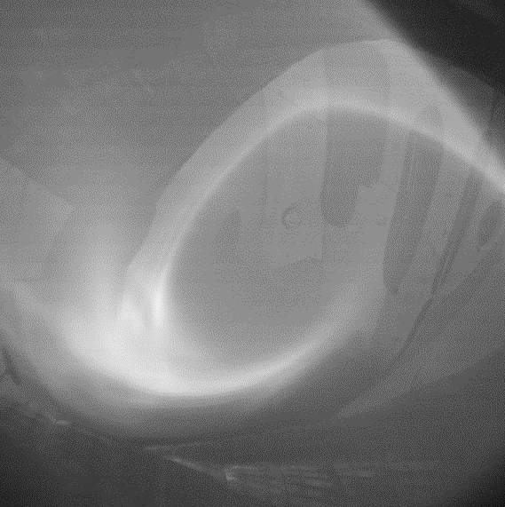
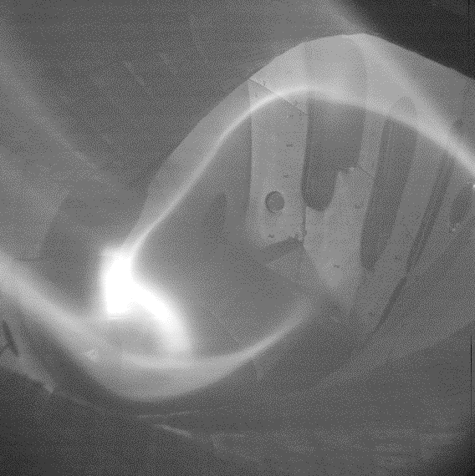
Two-level image processing
Possible uses
Hot-spot detection
need to define the proper algorithm → student topic
→ any ideas (for visible cameras)?
classification
two-way communication with other systems
→ ROI start/stop
UFOs? Moving, appearing, vanishing
Pattern recognition
plasma radius, even magnetic config!
EJM
FTM
T. Szepesi | Image processing meeting | Greifswald | 25.02.2020. | Page 9

Slide 10
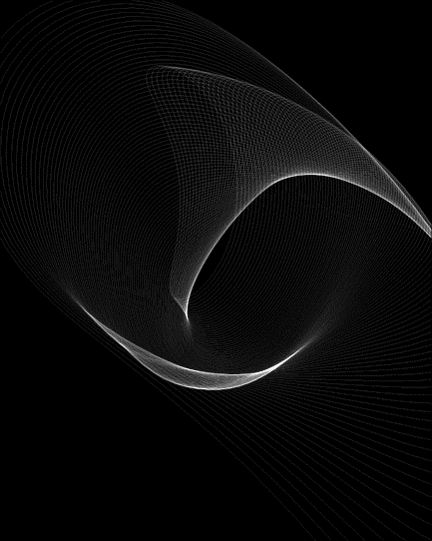
Two-level image processing
An example: plasma radius
The problem
3D geometry, camera image = integration along LOSs (pixels)
T. Szepesi | Image processing meeting | Greifswald | 25.02.2020. | Page 10

Slide 11
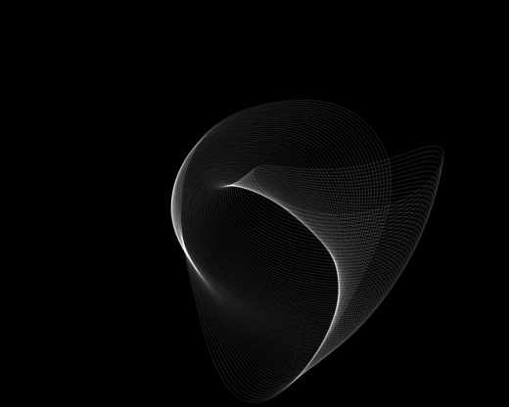
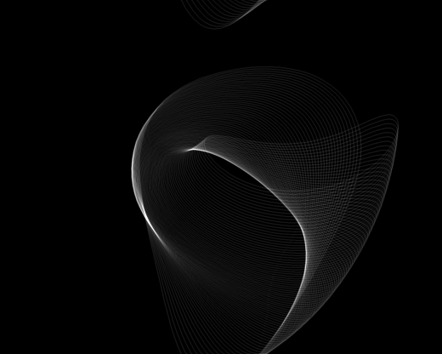
Two-level image processing
An example: plasma radius
(A possible) solution of the problem
generate synthetic images and compare them to measurement
T. Szepesi | Image processing meeting | Greifswald | 25.02.2020. | Page 11

Slide 12
Two-level image processing
An example: plasma radius
(A possible) solution of the problem
generate synthetic images and compare them to measurement
BUT
→ only works for a given magnetic configuration
→ need to generate field line tracing, synthetic images for all configs.
→ this a large database
→ the method is not the fastest ↔ real-time application?
→ the divertor light emission corrupts the algorithm
still need to find a solution
T. Szepesi | Image processing meeting | Greifswald | 25.02.2020. | Page 12

Slide 13
Thank you!
T. Szepesi | Image processing meeting | Greifswald | 26.02.2020. | Page 13

