Slide 1
Infrared Reflections Modeling
at WEST, ASDEX-U and W7-X
MH. Aumeunier¹, J.Gerardin¹, C. Talatizi¹, R. Mitteau¹, P. Drewelow², Y. Gao², M.Jakubowski², A.Herrmman³, M.Faitsch³, M. Ben Yaala⁴, L. Marot⁴
¹ CEA Cadarache, 13108 Saint Paul-Lez-Durance, France
² Max-Planck-Institut für Plasmaphysiks, 17491 Greifswald
³ Max-Planck-Institut für Plasmaphysiks, D-85748 Garching
⁴Department of Physics, University of Basel, Klingelbergstrasse 82, 4056 Basel, Switzerland
EUROfusion Meeting on Image Processing and Artificial Intelligence, 25.02-26.02 2020 Greifswald

Slide 2
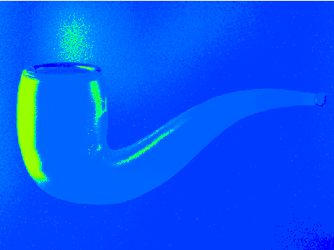
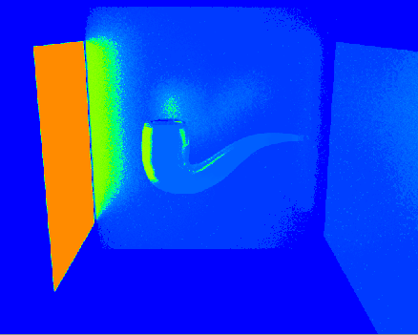
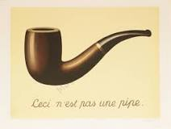
The issue of IR measurement
The analysis of thermography measurement is difficult (often qualitative) and can lead to false interpretation
SPEOS CAAV5 © CEA
BB 100°C
R.Magritte « The Treachery of Images»
This is not a real hot pipe
SPEOS CAAV5 © CEA
Simulated IR image
The quantitative thermography is not a direct problem. Achievement of the desired precision requires a perfect understanding of all “sources” phenomena (surrounding environment) up to the transfer function of instrument

Slide 3
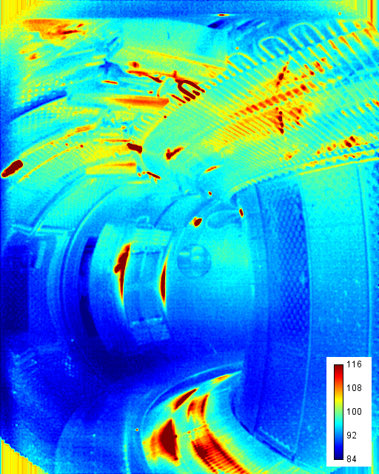
IR Synthetic Diagnostic for helping image analysis
WEST experimental image
Aim: predict & understand the impact of low and variable emissivity and reflections on PFCs surface temperature measurement
Different levels of analysis
Qualitative purposes:
Discriminate reflections from hot target
Identify the origin of reflections (primary hot sources)
Quantitative analysis
(3) Recover true surface temperature solving the emissivity inaccuracy & reflection contribution
Reflection ?
Hot Target ?
IR synthetic diagnostic applied to Tore Supra, JET, ITER devices
for improving IR image interpretation & anticipating measure accuracy
➔ Currently benchmarked with WEST, ASDEX-U, W7-x experiments

Slide 4
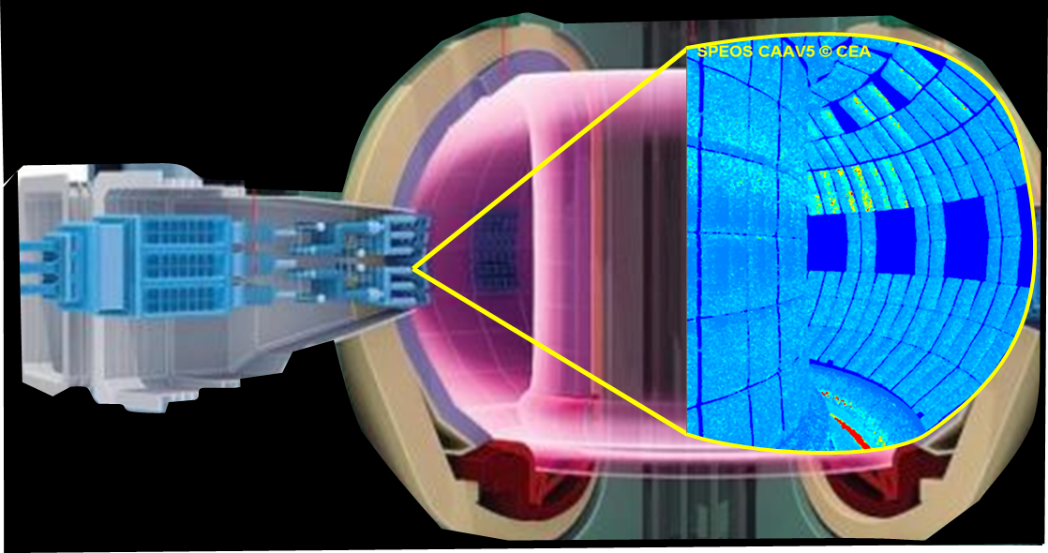
A “digital twin” approach
IR synthetic diagnostic: an end-to-end simulation aiming to model all physical phenomenon involved in the IR measurement chain: from source to optical response of instrument
1
IR Source Modeling
Modeling of plasma heat loads deposited on PFCs (main IR source)
Modeling of resulting 3D temperature field
Synthetic IR images
2
Materials Thermal-radiative Modeling
Emissivity model
Reflectivity Model
3
ITER Wide Angle Viewing Sytem
Optics Modeling
Camera model
Optical Transfer Function
Light propagation in 3D model based on Monte Carlo Ray Tracing (MCRT) code
(ANSYS-SPEOS CAAV5) getting all radiations of thermal scene

Slide 5
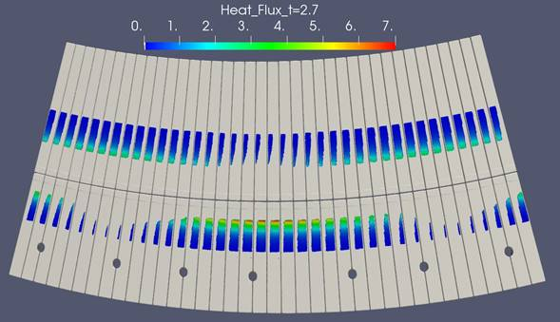
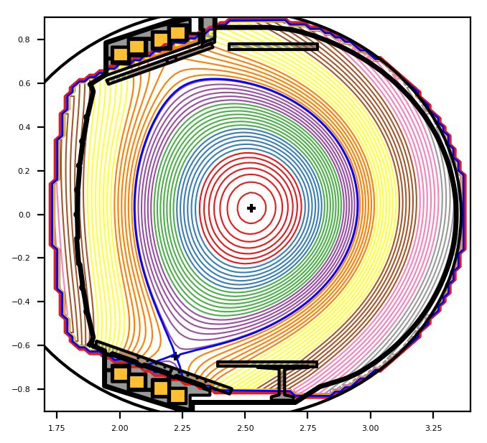
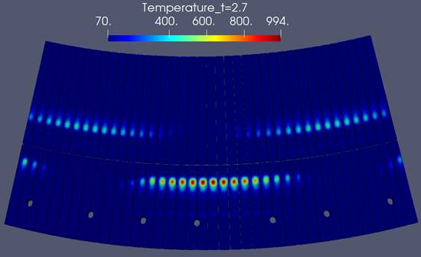
Prediction of true surface temperature on WEST lower divertor
Pulse Configuration (#53694)
3D deposited heat flux on divertor computed from field line ray tracing code based on optical approximation (parallel transport only)
Ptot=3,75 MW injected (assuming 40% conducted)
λq = 5mm; Ratio inner-outer : 0.33/0.67
3D Heat Flux
Magnetic Equilibrium at 3.05s
Wetted area
1/3
2/3
PFCFLUX output
3D surface T° computed from fast thermal reduced model (Modal Identification Method) including 3d heat diffusion learnt from Ansys calculation
3D surface temperature
MIM output

Slide 6
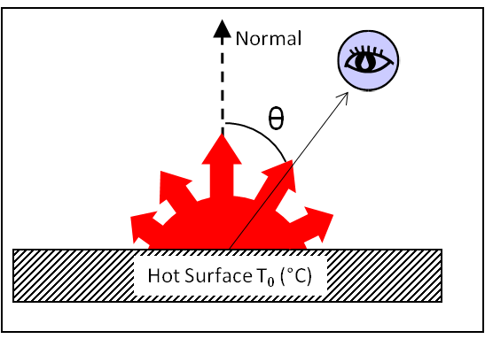
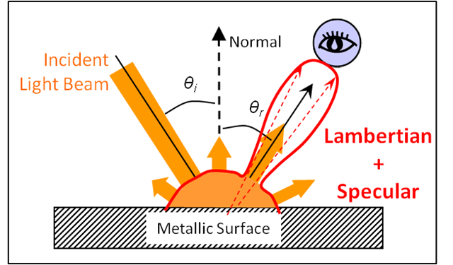
Modeling of materials thermal-radiative properties
2 physical models to describe how photon is emitted and reflected …
Emissivity Model
Reflectivity Model
Spectral Directional Emissivity
ε_{λ}'(λ,θ_{o},T)
Bidirectional Reflectivity Distribution Function (BRDF)
$ρ_{λ}^{′′}$(λ,θ_{i},θ_{o} φ_{i}, φ _{o} ,T)
$$ɛ_{λ}^{n}\left(T\right)$$
$${ɛ′}_{λ}\left(\text{λ}\text{,}\text{θ}\text{o},T\right)=1−ρ_{λ}^{′⋂}\left(\text{λ}\text{,}\text{θ}\text{o} ,T\right)$$
Directional hemispherical reflectance

Slide 7
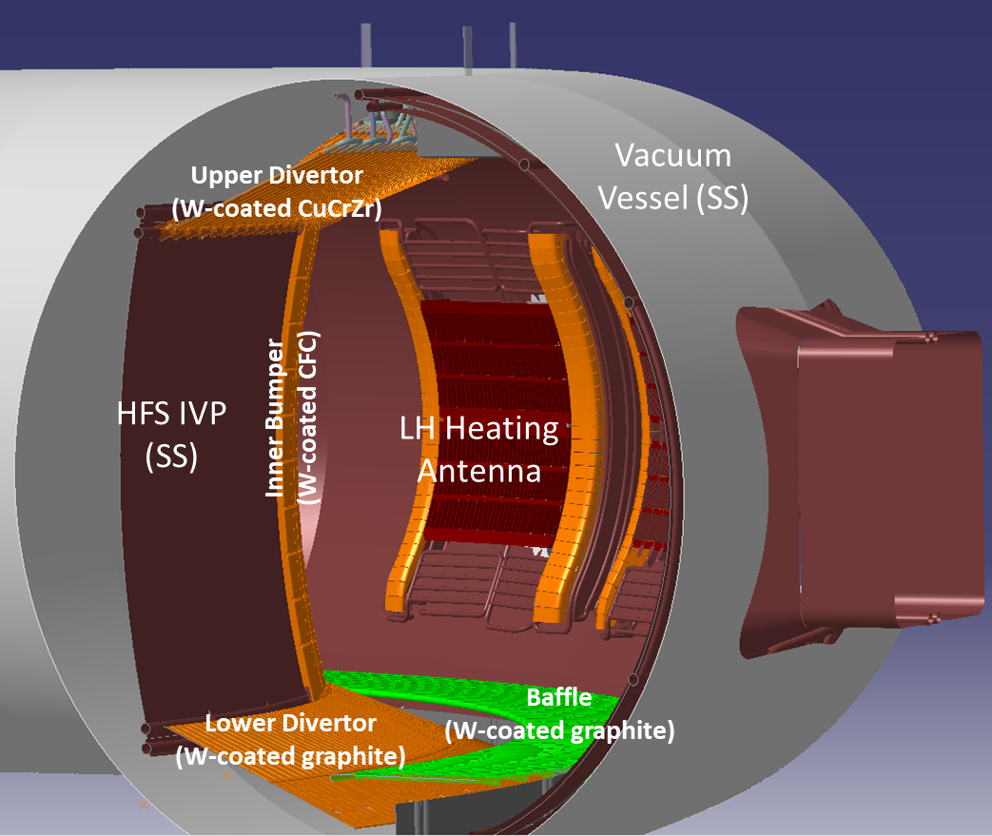
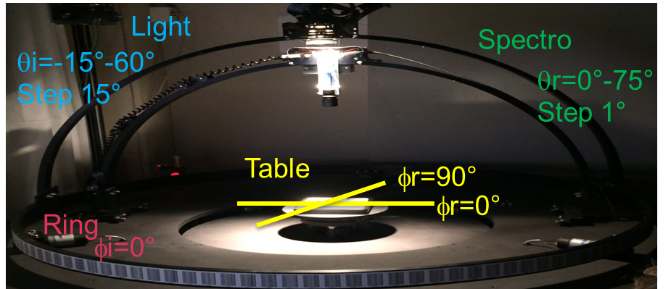
WEST Thermal scene Modeling
Mainly metallic materials with W-coating
2 reflectance models considered:
Diffuse reflectance (or Lambertian reflectance)
Highly specular reflectance roughly fitting with W-sample measurement in laboratory
Measure of Bidirectional Reflectance W-samples in VIS & NIR at ambient T° (Basel University)
Reflectivity follows a gauss distribution with increasing intensity at higher incident angle
Quasi-specular reflectance of W sample with specular lobe of small angular width: from 3° to 6° wrt roughness
Isotropic BDRF ( same behavior at φ_{R}=0° or 90°)

Slide 8
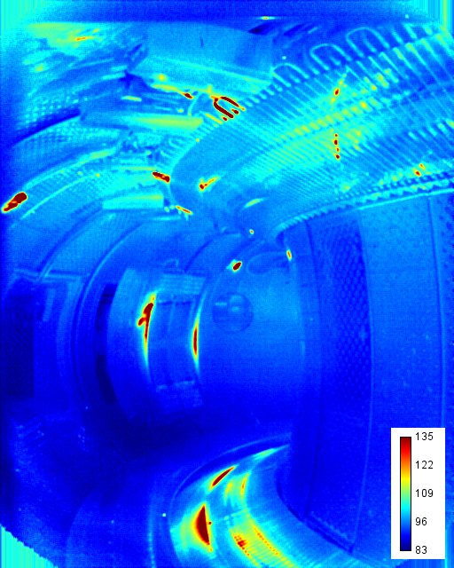
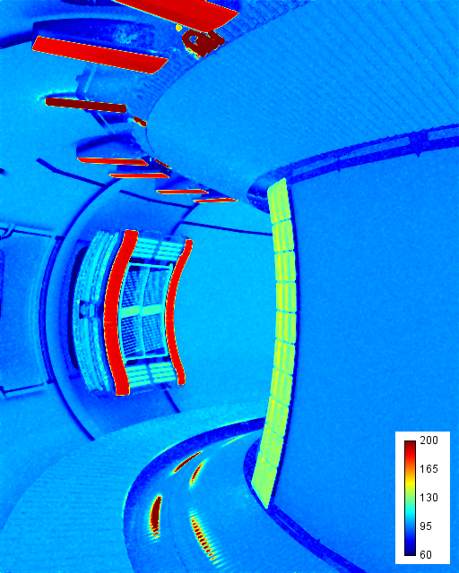
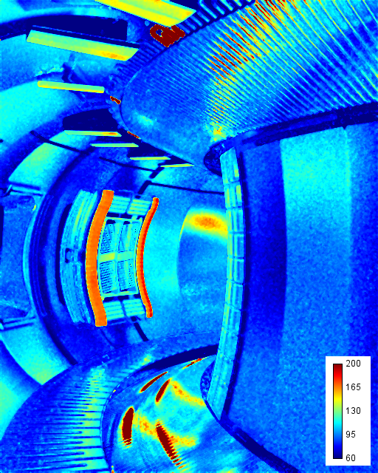
Specular Reflectance models on WEST wall surface fits roughly with experimental images… in accordance with BRDF measure
Experimental IR Image
Simulated IR image
Case with all diffuse surface
Case with high specular surface
simulated from W-sample measurement
WEST Pulse #55210
Brightness T° Map
Brightness T° Map
Brightness T° Map

Slide 9
Simulation helps to discriminate reflection features from thermal events
Experimental IR Image
#Pulse 55210 @ 7s(Ip=500 kA, 4.4MW LH + 0.7MW FCI)
Simulated IR Image
Brightness T° Map
Brightness T° Map
Hot pipes
Hot pipes
Reflections from FCI outbord
Reflection from Q4 & Q5 low divertor
Reflections
Reflection
Reflection from Q3 low divertor
Reflection
Hot spot
Reflection from FCI outboard
Strike Point Splitting (not modeled)
Reflection from FCI outboard
Reflection
ANSYS SPEOS CAA © CEA
ANSYS SPEOS CAA © CEA

Slide 10
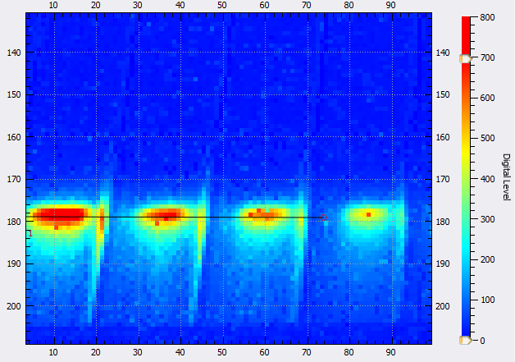
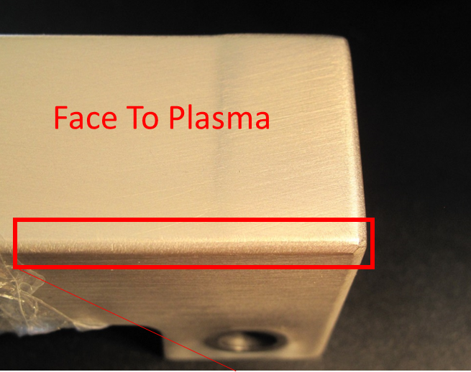
IR synthetic diagnostics helps to understand unexpected light pattern on WEST PFU fillet
Issue : Unexpected light pattern along the fillet of WEST PFU (trailing edge) observed on several IR cameras
WEST experimental IR image (zoom of equatorial camera in Q2A)
IR modeling proves that light pattern on PFU fillet is
NOT a thermal event
NOT a reflection feature
DUE TO an unpredicted and variable thermo-radiative properties of WEST PFU… and especially due to the angular-dependent emissivity model which can change with the surface state (between PFU fillet vs top face)
WEST synthetic image
WEST PFU (W-coating)
Fillet

Slide 11
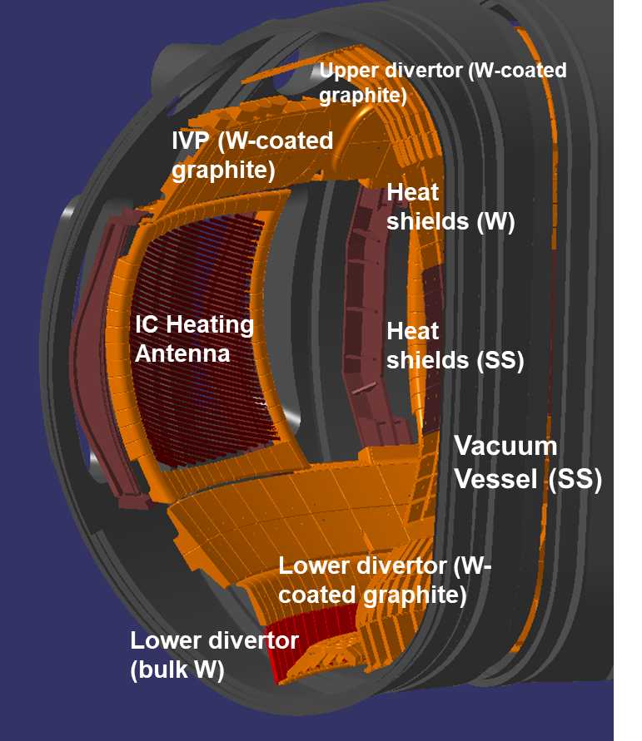
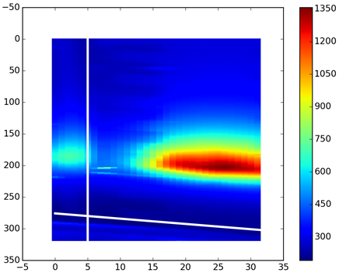
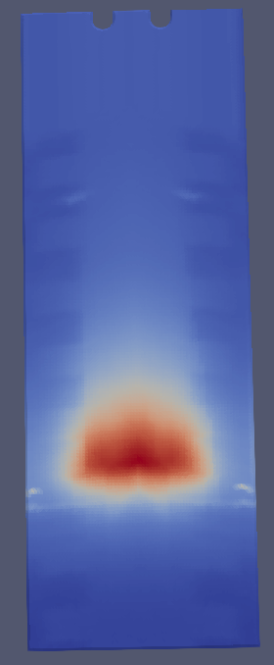
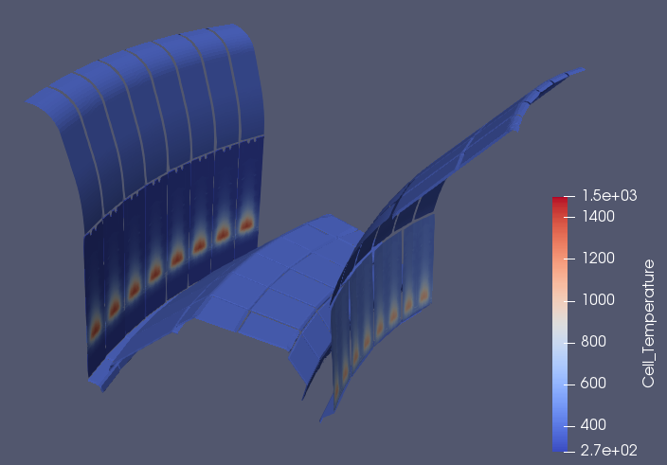
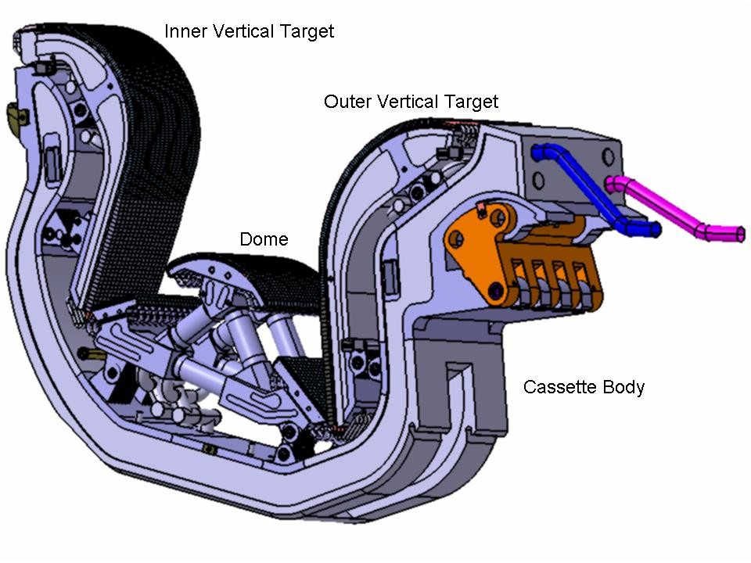
ASDEX-U Thermal Scene Modeling
Materials Properties Assumptions
3D Temperature Field
Projection mapping of experimental image on 3d geometry to establish the 3D temperature field of divertor used as input of photonic simulation
2D experimental image
(outer divertor target)
Recovered 3D T° distribution on one bulk tile
Fully metallic device
Closed divertor geometry similar to ITER divertor more favourable to reflections (between targets facing each others)
3D T° Field used as input of photonic model
ITER divertor (iter.org)

Slide 12
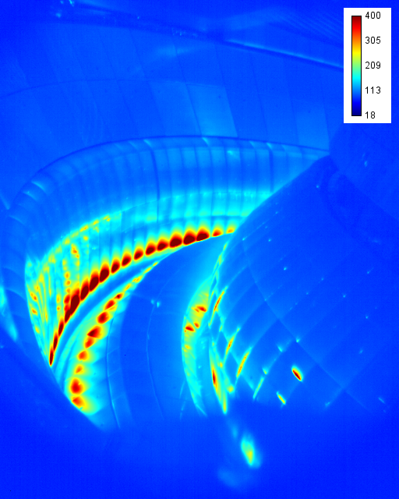
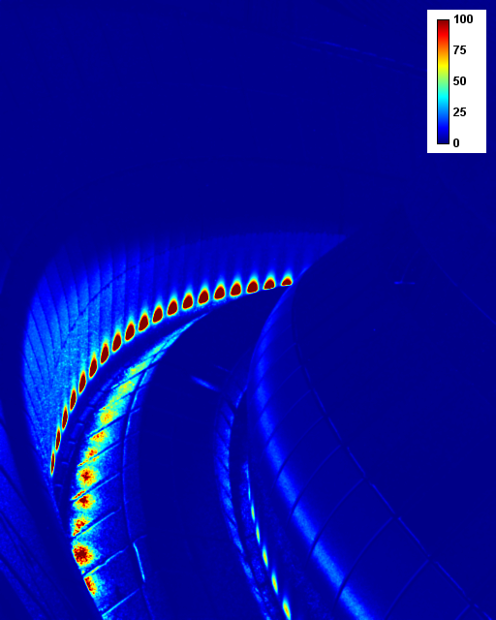
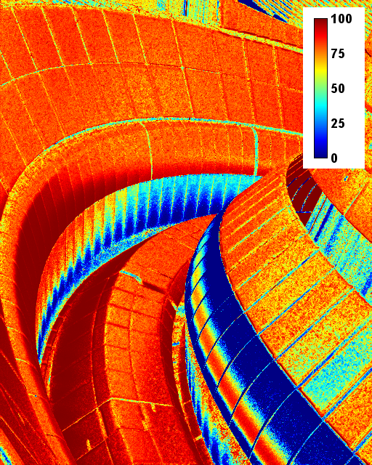
ASDEX-U first results (ongoing work)
Experimental Image
Simulated Image
(high specular reflectance materials)
Reflection Map
= Reflected Flux / Total Flux
#Pulse 32858 , MWIR camera (sector 9)
Reflections from outer target (secondary reflections)
Lower divertor
2
Outer target
2
Lower divertor
Reflections from outer target
1
3
1
4
Real hot target ?
Reflections from outer target (primary reflections)
3
Inner target
4
Reflections from inner target
Main reflections reproduced on dome, on lower divertor (colder area)
Thermal modeling used as input of MCRT is still a work in progress (strike point fitting, tiles misalignment)
Under investigation: light pattern along the fillet of inner divertor (a change of emission model as observed in WEST or real deposited heat flux, both ?)

Slide 13
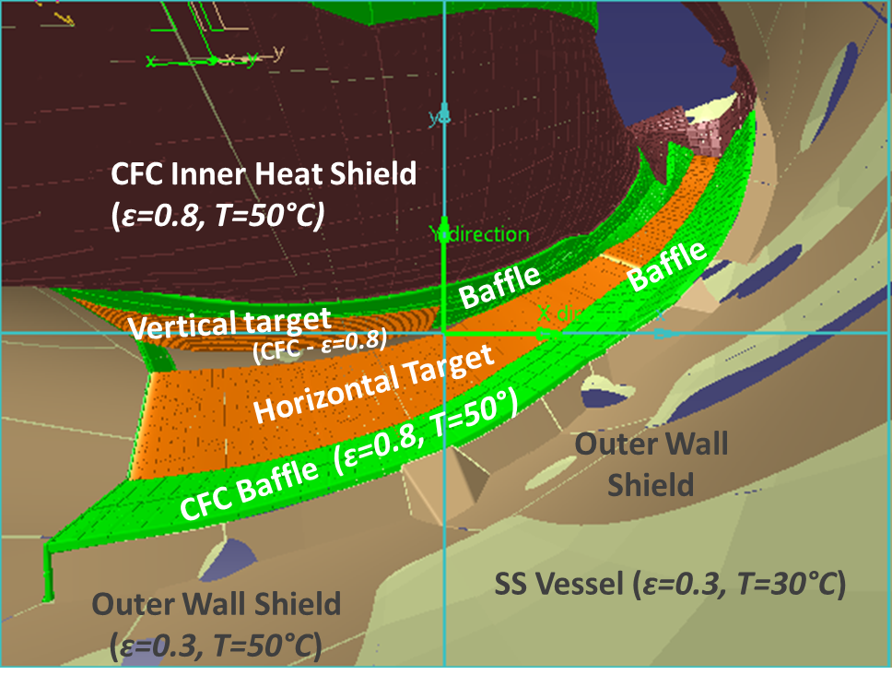
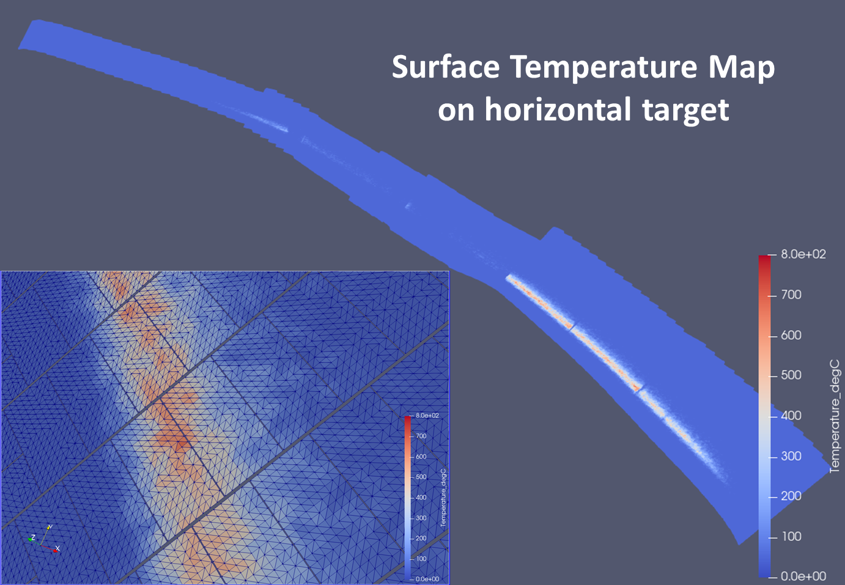
W7-X Thermal Scene Modeling
Materials Properties Assumptions (OP1.2)
3D Temperature Field (used as input of MCRT)
Surface heat loads assessed on divertor island for a standard plasma scenario from field line ray tracing code [Y.Gao & al., Nuclear Fusion, 59 (6), 066007 (2019)]
Resulting surface T° computed from 1D thermal model (semi-infinite wall)
Uniform temperature assumed for the remaining in-vessel components
Major components in carbon graphite characterized by lambertian emission (ɛ~0.8) and diffuse reflectance
Stainless steel for outer wall shield and vacuum vessel characterized by low Lambertian emission (ɛ~0.3) and high specular reflectance

Slide 14
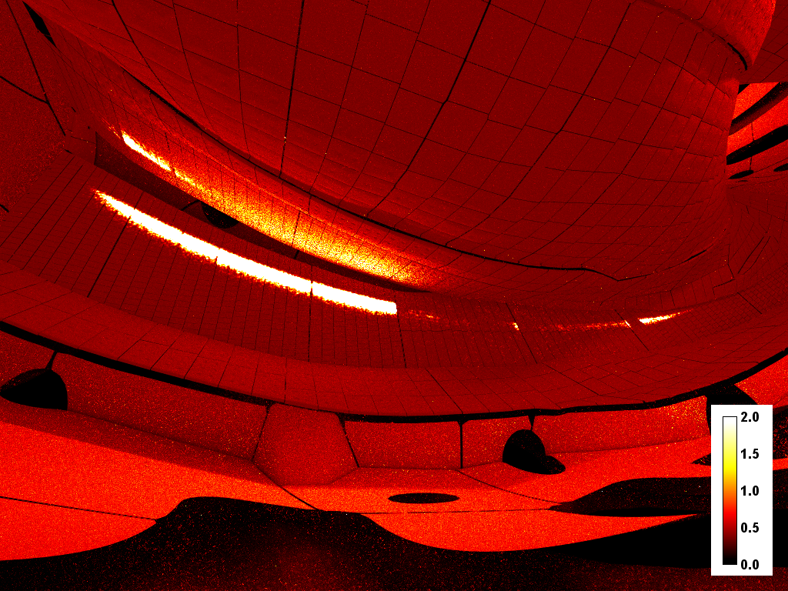
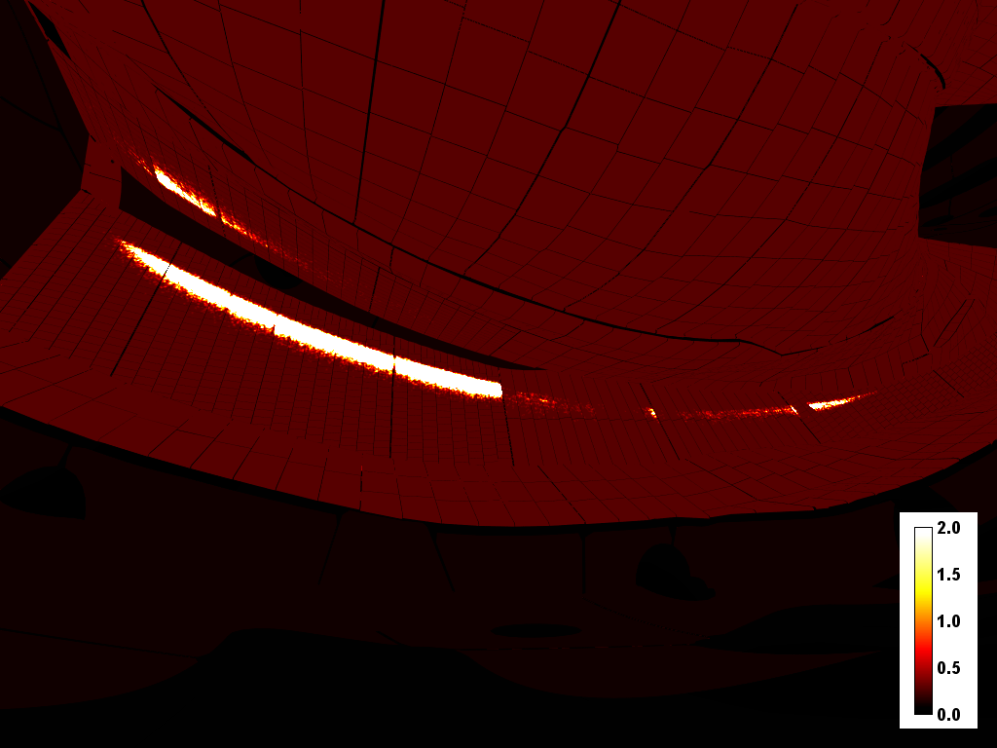
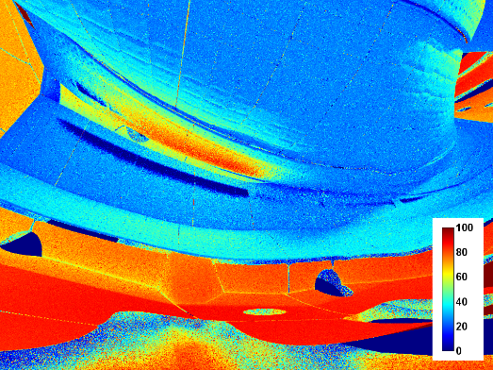
W7-X first results (ongoing work)
Experimental Image (20180724_018_AEF20)
Simulated Image (with reflections)
Simulated Image (free-reflections)
Heat flux patterns
Heat flux patterns
Reflections coming from lower H-target
Reflections
Lower H-target
Lower baffle
Outer Shield
W/m²/sr
Reflection Map = Reflected Flux / Total Flux
ANSYS-SPEOS 2019 © CEA
Identification of main reflection patterns and their origin
>50% of reflected flux on CFC lower V-target (of which 50% coming from lower H target) causing a temperature error of 140% on the coldest target at 50°C (120°C measured)
~75 % of reflected flux on SS outer shield at 50°C (of which 50% coming from lower H target) causing a temperature error of 100%
~30-40% of reflected flux on CFC lower baffle at 50°C (of which 25% coming from upper H-target ) causing a temperature error of 30% (15°C)
Next steps:
Adjustment of thermal radiative properties and camera model (e.g. distortions modeling)
Application to camera used for OP2

Slide 15
Conclusions
IR synthetic diagnostic is a confident and useful tool to improve our understanding of IR images
BUT parameters used as input need to be used with caution and consolidated, especially thermal-radiative properties of materials
➔ Tricky task since multi-parametric model and with some parameters which impact the results in the same way (e.g. emissivity value & angular distribution of materials)
IR synthetic diagnostic application
Currently used for helping IR interpretation at WEST, ASDEX-U and W7-X: discriminating reflections features to real thermal events, understanding & finding the origin of unexpected light pattern ➔ consolidate the PFCs monitoring in all reflective & radiative environment
To be used for quantitative measurement (thesis under going): development of inverse method based on radiometry model to retrieve the true surface t° by solving reflections contribution and inaccurate emissivity, in case of all diffuse surface (first results in ISFNT paper 2019, C.Talatizi)
Outlook: Synthetic data base to be used in learning phase for pattern recognition algorithm ?

