Slide 1
Inferring component thermal parameters from the data stream coming from the infrared viewing diagnostic
February 25th, 2020
Raphael MITTEAU

Slide 2
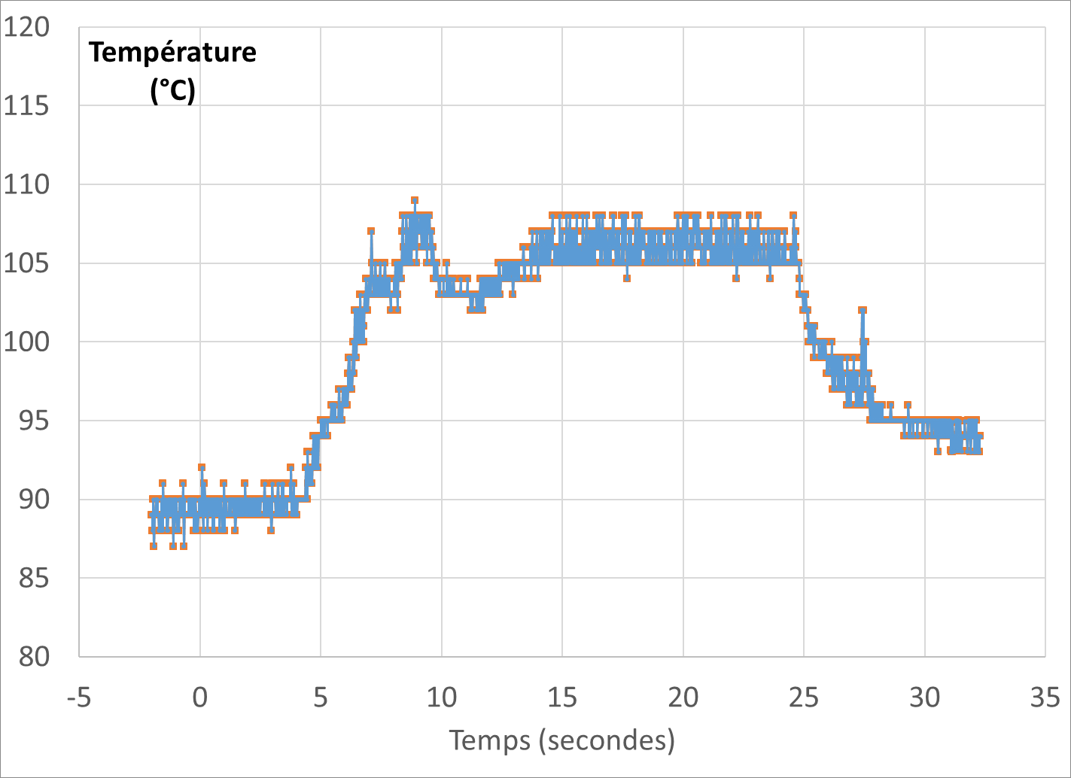
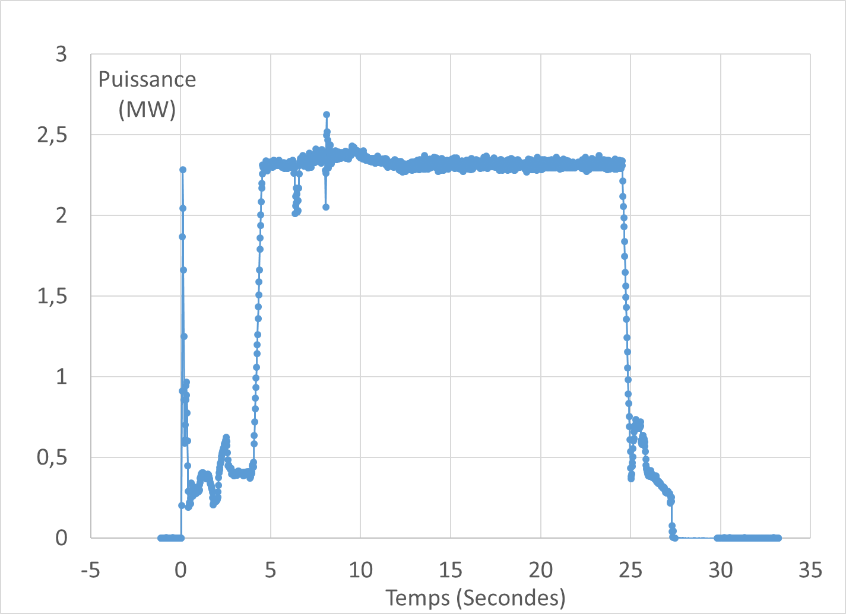
What kind of thermal parameters can be inferred from the temperature time trace ?
Measures available from diagnostic systems :
Surface temperature (time evolution) of a given spot. Including some assumptions regarding emissivity, reflectivity etc…
Total power P_{tot} (time evolution)… but usually not the local power density q_{deposited}
Can relevant thermal parameters of a hot spot be inferred (= deducted) from the temperature history ?
Material health (good, bad, armour delamination)
Presence / absence of co-deposit
Component being well cooled or thermally insulated
All these information's are relevant for decision-making toward wall monitoring

Slide 3
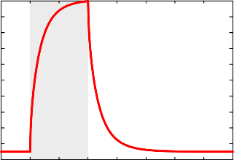
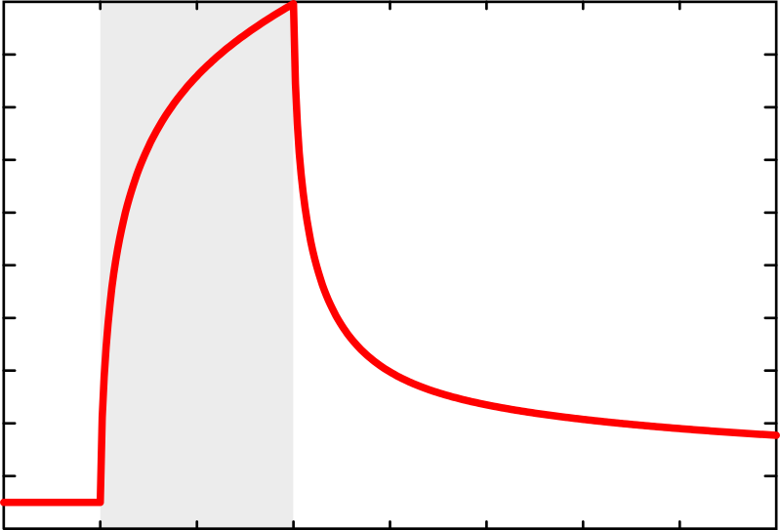
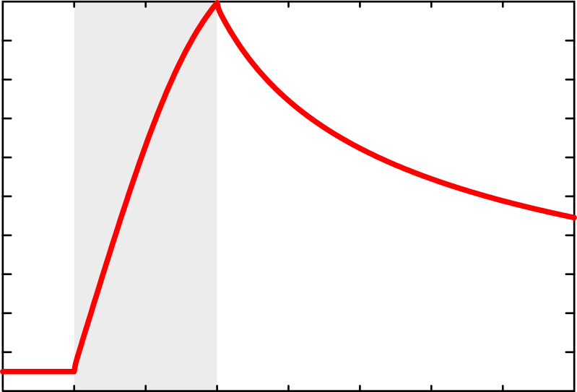
4 thermal behaviours, all up to 1000°C
Power on
1000
Feed forward modelling
500
0
1000
Temperature (°C)
500
4 thermal behaviours, all calibrated on a prescribed temperature rise of 950°C (from 50 °C to 1000 °C)
All do corresponds to simulated thermal models of possible plasma facing components
The power deposition lasts 10 seconds, from 5 to 15 seconds
The heat flux density is unknown
1000
0
500
0
1000
off
500
Time (s)
0
10
20
30
40

Slide 4
Qualitative human expertise
1000
Heating and cooling ramps are quasi-symmetrical
+ good match to exponential behaviour
Probably a well cooled component
500
0
1000
Temperature (°C)
Heating and cooling are quasi-symmetrical
Fast response to Heaviside power steps : low capacity material – Look likes a co-deposited layer
500
1000
0
500
Poor up-down symmetry. Slow return to base temperature : visible effect of radiation cooling
0
1000
Poor up-down symmetry. Slow ramp-up plus very slow return to base temperature
→ thermal capacity being filled, radiation cooling
500
Time (s)
0
10
20
30
40

Slide 5
Unveiling local power density
1000
500
8.9 MW/m²
0
1000
While identical max temp 1000°C, quite different power densities
Temperature : a poor indication of actual heat load
Temperature (°C)
500
1.7 MW/m²
1000
0
500
3.9 MW/m²
0
1000
500
0.5 MW/m²
Time (s)
0
10
20
30
40

Slide 6
Unveiling thermal model
1000
8.9 MW/m²
W macrobloc with top heat load and blackbody cooling
500
0
1000
Temperature (°C)
Same as above with addition of low adherence deposit
500
1.7 MW/m²
1000
0
3.9 MW/m²
500
10 mm
Thick plate with local heating
0
1000
0.5 MW/m²
500
1 mm
Thin plate with uniform heating
0
10
20
30
40

Slide 7
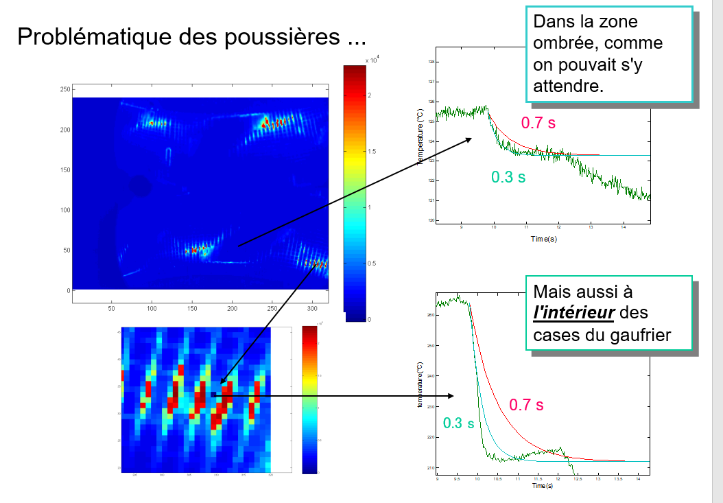
Provisional conclusions & Statement of work
The temperature itself is of little use for knowing component status, the local heat flux density being unknown
Valuable knowledge about component status is present in the thermal dynamics of a hot spot
Numerical algorithms to be developed, to reveal that hidden data
Historical method : search the 'thermal time constant' (τ)
Expected τ = 0.7 second
Measured τ= 0.3 second
Difference attributed to thin deposited layer

Slide 8
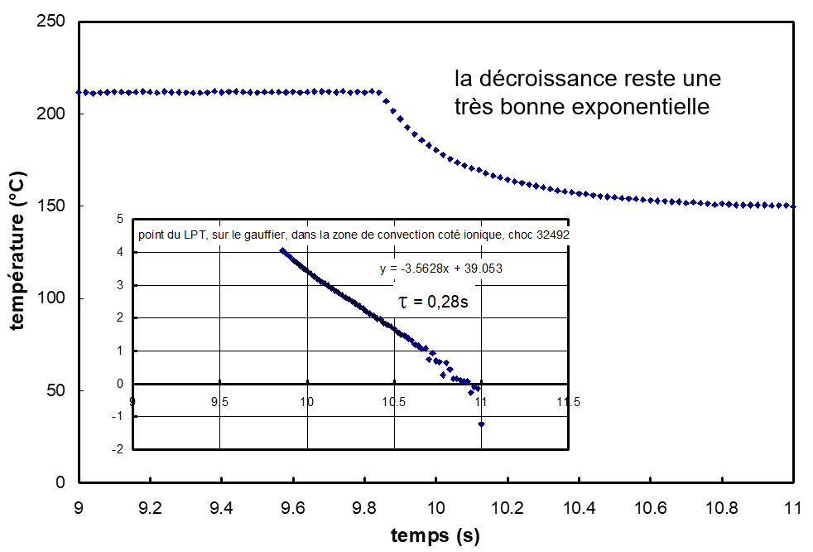
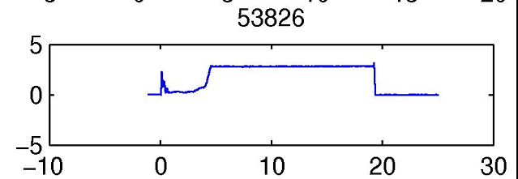
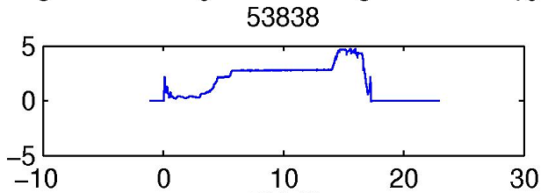
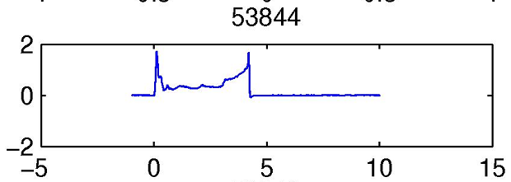
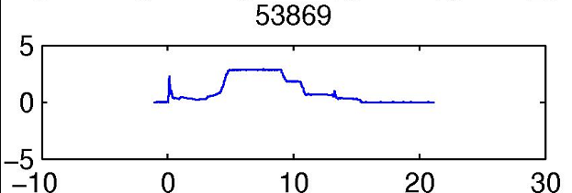
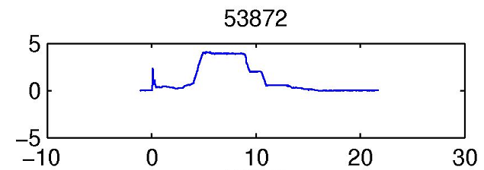
Estimating the thermal time constant of PFCs
Power
The usual method : hunt for power time evolution with abrupt change and long enough plateaux before and after the change
Needed : a method allowing to estimate t on most plasma discharges
Ramped power
No power plateau
Time
Power time profile for a typical selection of WEST plasma discharges of C3B btw #53800 et #53950
At WEST, less than 10% of the plasma discharges are like this

Slide 9
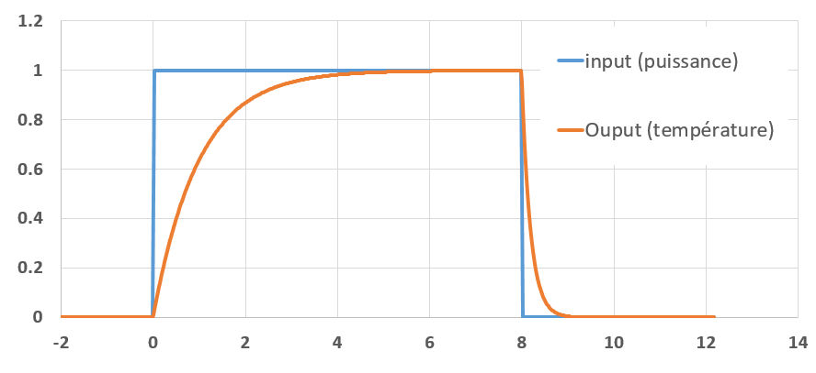
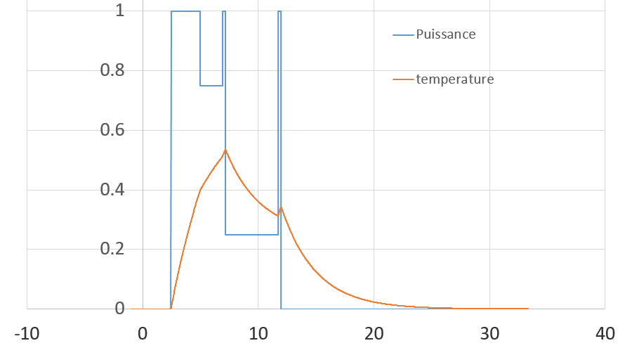
Temperature history identification with Proportional control law
Order(i)
Result(i)
Example with τ_{up} = 1 second and τ_{down} = 0.2 second
Process
action(i+1) = G x (Ri – Oi)
8 seconds heating
Non-Heaviside function

Slide 10
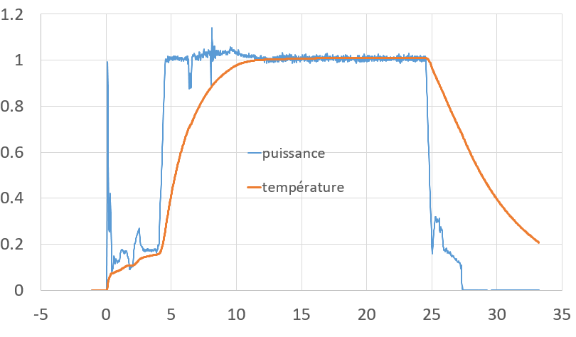
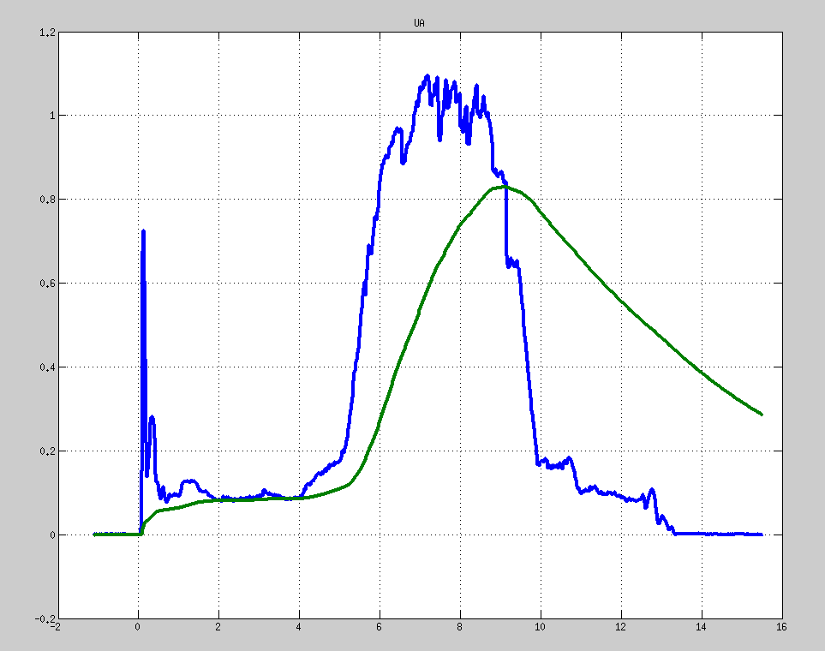
Proportional Control – real power time history
Simple time history
Unsteady time history
Power time profile (normalised to 1)
Power time profile (normalised to 1)
Calculated Temperature, using tau_up = 2 seconds and tau_down = 5 seconds
Calculated Temperature, using tau_up = 2 seconds and tau_down = 5 seconds

Slide 11
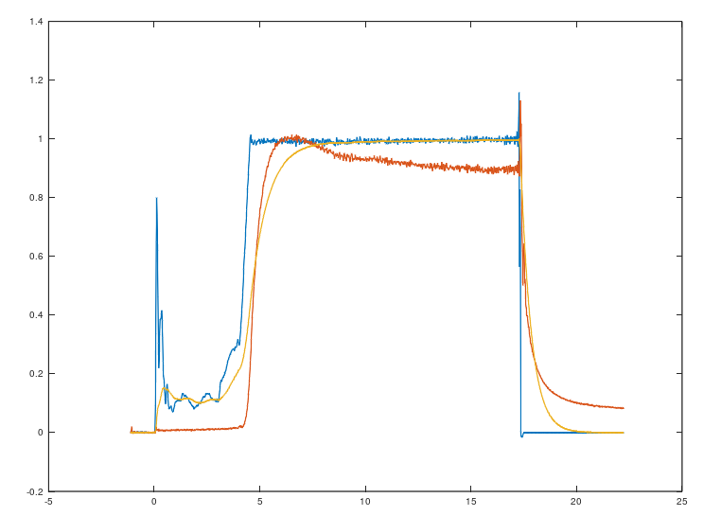
Optimisation toward best fit by comparison to temperature history
Define cost function Temperature
Minimisation algorithm
Temperature or power, normalised to 1 (.)
Zone "pipe" - 53827
Power
Calculated
Temperature
Script output :
τ_{up} = 0.8 s
τ_{down} = 0.5 s
Measured
Temperature
Time (s)

Slide 12
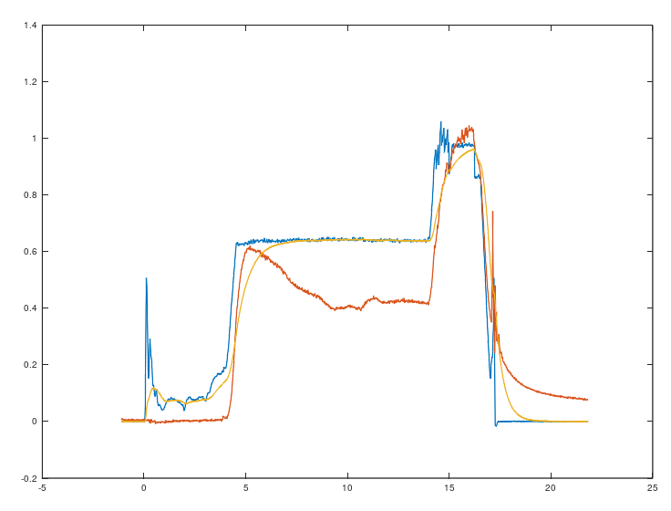
Stability of the identification technique
Same hot spot, another discharge
Zone "pipe" - 53816
Power
10-20% accuracy
Calculated Temperature
Measured Temperature

Slide 13
Large use on C3 campaign
Results (→ next slides )
Strengths / weaknesses (→ next slides )

Slide 14
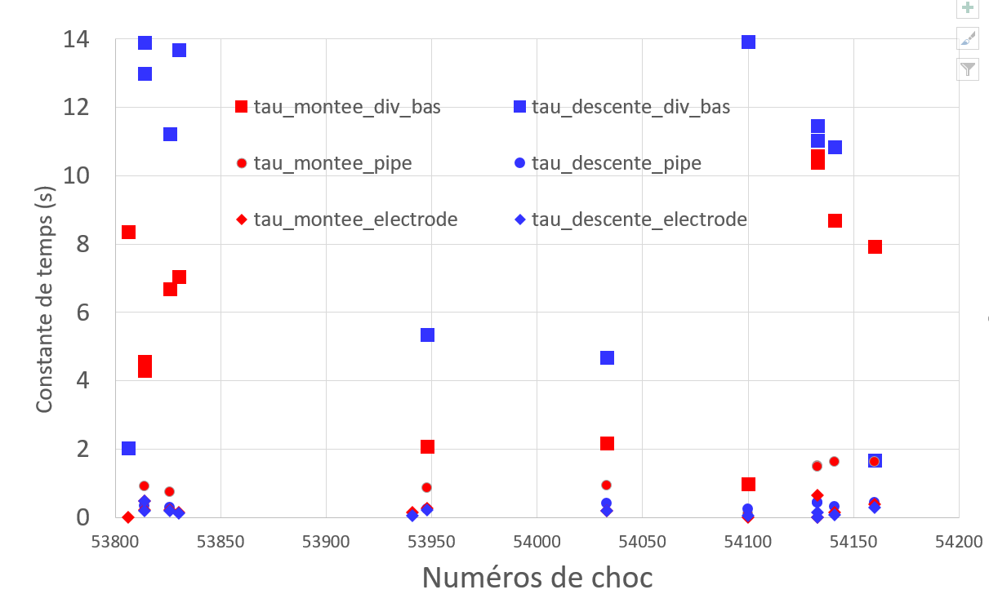
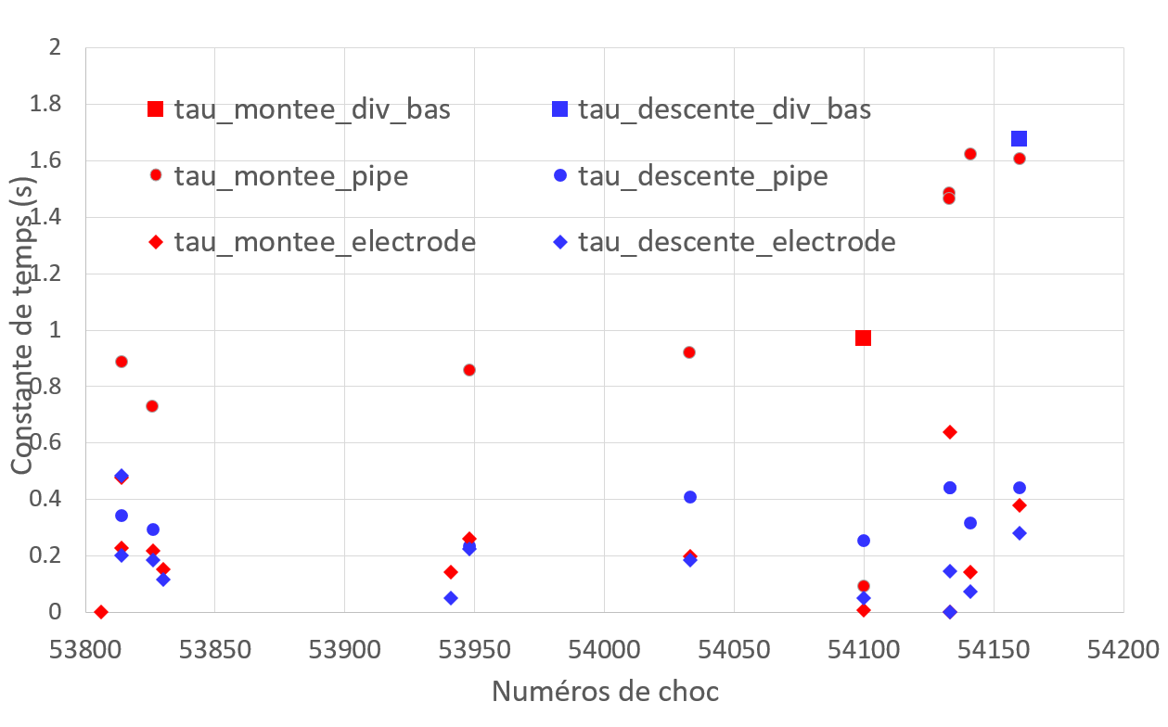
3 hot spots: div_bas (=inertiel), pipe (= cooled), electrode (=codeposit)
Scale [0 – 14] seconds
Scale [ 0 – 2] secondes
Algorithm stability (no crash → good)
Some difference btw tau_up and tau_down
Visible fast & slow components
More steadiness needed → discussed next slide

Slide 15
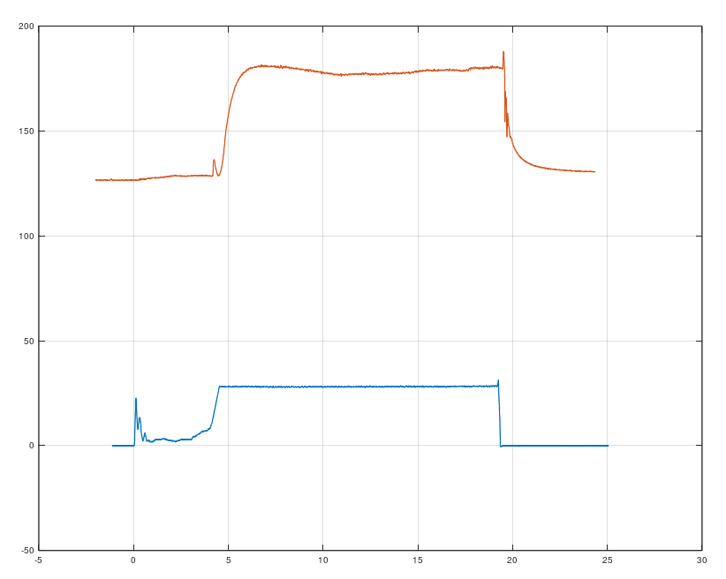
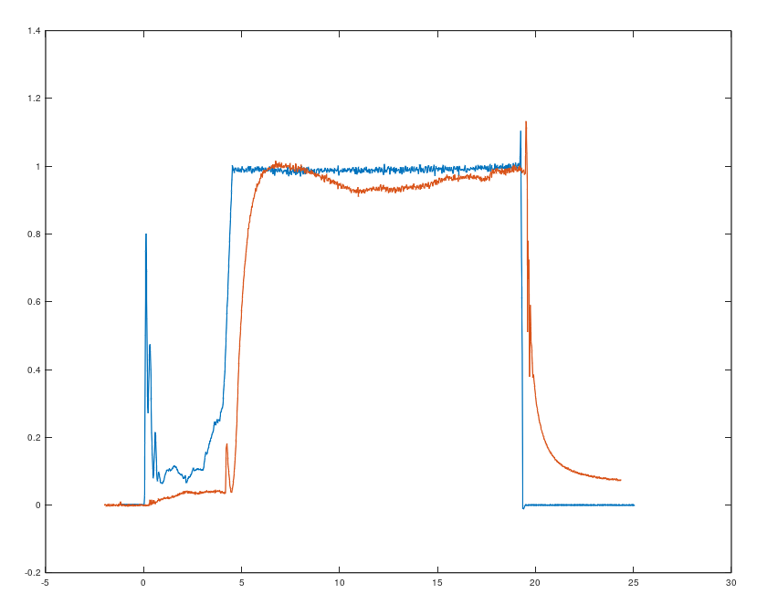
Normalisation
Min – max normalisation to be improved toward more stable estimates
Requires normalised signals = "min-max normalised"
Power shall be between 0 and 1
Temperature shall be btw 0 and 1
200°C
UA
Temperature
1.0
100°C
10 MW
0.8
0.6
Power x 10
5 MW
0.4
0°C
0
0.2
Zone "pipe" 53826
0.
0
10s
20s
0
10s
20s
Time
Time

Slide 16
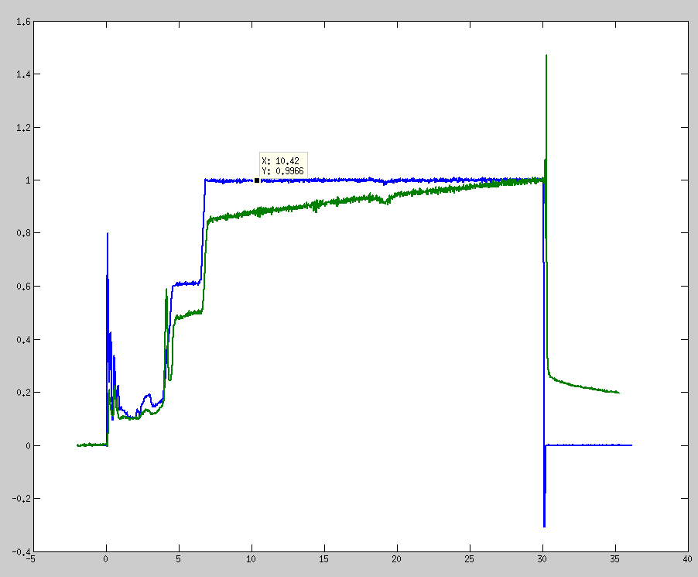
Issue 1 : temperature drift
Probable cause : Photonic background increase – or progressive increase of an inertial component coinciding cartesian reflexion
Power
Temperature
Final temperature plateau hotter than initial
t_begin
t_end
Possible correction of the temperature time profile with affine law btw t_begin and t_end – doable, but shall seek/keep justification
Correction – or no correction ?
Sometimes meaningfull – sometime not.

Slide 17
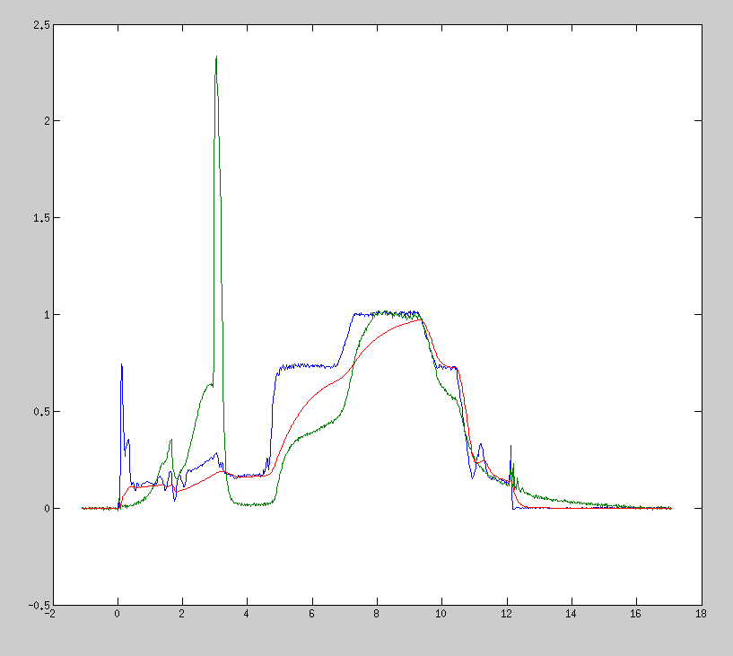
Issue 2 – Non proportional plateaus Power Temperature
Zone "pipe" for #53897
Ratio T_stable / P_stable changes
Possible effect of rad power, power deposition mechanism ….
Ratio T / P = 1 (par définition, plateau max de la normalisation)
Ratio T / P = 0.5
T / P = 0.8
This variation perturbs temperature reconstruction from power time trace
Maybe work shall be done for each discharge phase separately – phase 1, phase 2 , phase 3

Slide 18
Conclusion
A algorithm based on proportional control rule is efficient for estimating the thermal time constant, even for plasma discharges having a power-time profile having no plateau
Very basic algorithm, can be implemented in any language (matlab, excel, python, C, whatever)
Consolidation work still to be done (exception handling, etc…)
More work shall be done toward increasing robustness, in presence of signal perturbations (parasitic signal, non-proportional plateaus)
Quality data signal helps getting good (= stable) estimates

