Slide 1
Quasi real-time image processing for EDICAM
FPGA-based real-time processing
Present capabilities
Limitations
Two-level image processing
Scheme
Possible uses
An example: Plasma radius
Tamás Szepesi
G. Cseh, G. Kocsis, T. Szabolics,
S. Zoletnik

Slide 2
FPGA-based real-time image processing
Present capabilities
The flow of data from sensor to PC
10 Gbps transciever
Sensor
IPCU
PC memory
All data is streamed through the IPCU
possibility to process the data on-the-fly
→ also: e.g. median filter, luma correction etc.
reaction time in the microsecond range (after the arrival of the fame)
actions → can modify camera operation
this processing is hard real-time
T. Szepesi | Image processing meeting | Greifswald | 25.02.2020. | Page 2

Slide 3
FPGA-based real-time image processing
Present capabilities
Events – from real-time image processing
min/max/average pixel intensity exceeds a pre-defined threshold
Events – other
elapsed time (after camera start)
external TTL (level or change)
Actions
start / stop ROI readout
external TTL (level change / control)
activate moving ROI
T. Szepesi | Image processing meeting | Greifswald | 25.02.2020. | Page 3

Slide 4
FPGA-based real-time image processing
Limitations of the present system
FPGA – VHDL programming
complex, not user friendly (for a physicist…)
camera control (hardware) – not ideal environment for data processing
available image processing algorithms very limited
interactions with other systems only via TTL (4 channels)
Need for another, higher-level data processing layer!
T. Szepesi | Image processing meeting | Greifswald | 25.02.2020. | Page 4

Slide 5
Two-level image processing
Scheme
Basic idea: all data is available in the PC memory
memory is used as a ring buffer, separated for each ROI
even for highest data rate, frames are available for ca. 500 ms
→ allow access to memory for another software
→ communicate with EDIDAQ for memory status
10 Gbps transciever
Sensor
IPCU
PC memory
0 MB
500 MB
ROI #1
ROI #2
…
ROI #n
T. Szepesi | Image processing meeting | Greifswald | 25.02.2020. | Page 5

Slide 6
Two-level image processing
Aim: create a system that can be used in other experiments (e.g. ITER)
One possibility: EDIDAQ + MARTe
MARTe in several fusion experiments for r-t data processing & control
→ JET, COMPASS, ISTTOK, FTU, RFX
Maybe better: EDIDAQ + ThermaVIP@MARTe
MARTe could be integrated with ThermaVIP
T. Szepesi | Image processing meeting | Greifswald | 25.02.2020. | Page 6

Slide 7
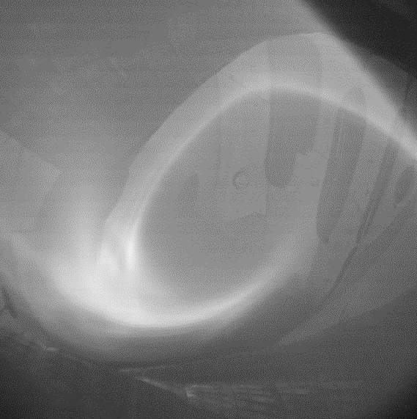
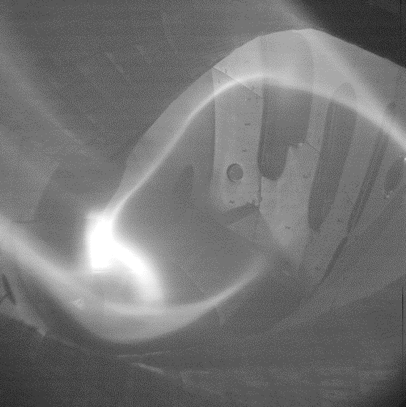
Two-level image processing
Possible uses
Hot-spot detection
need to define the proper algorithm → student topic
→ any ideas (for visible cameras)?
classification
two-way communication with other systems
→ ROI start/stop
UFOs? Moving, appearing, vanishing
Pattern recognition
plasma radius, even magnetic config!
EJM
FTM
T. Szepesi | Image processing meeting | Greifswald | 25.02.2020. | Page 7

Slide 8
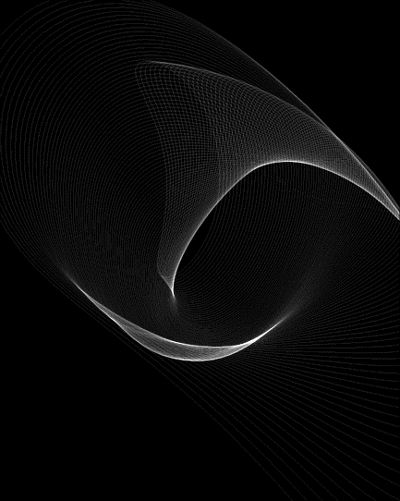
Two-level image processing
An example: plasma radius
The problem
3D geometry, camera image = integration along LOSs (pixels)
T. Szepesi | Image processing meeting | Greifswald | 25.02.2020. | Page 8

Slide 9
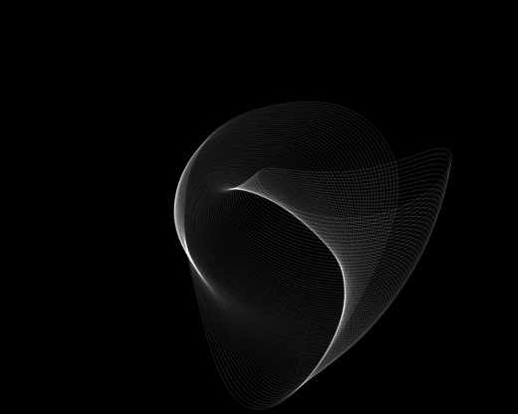
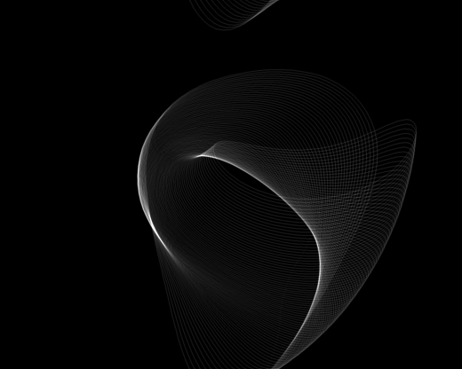
Two-level image processing
An example: plasma radius
(A possible) solution of the problem
generate synthetic images and compare them to measurement
T. Szepesi | Image processing meeting | Greifswald | 25.02.2020. | Page 9

Slide 10
Two-level image processing
An example: plasma radius
(A possible) solution of the problem
generate synthetic images and compare them to measurement
BUT
→ only works for a given magnetic configuration
→ need to generate field line tracing, synthetic images for all configs.
→ this a large database
→ the method is not the fastest ↔ real-time application?
→ the divertor light emission corrupts the algorithm
still need to find a solution
T. Szepesi | Image processing meeting | Greifswald | 25.02.2020. | Page 10

