Slide 1



Statistical methods and software for image processing
(for turbulence studies)
G. Kocsis¹,
G. Cseh¹, M. Lampert¹, T. Szepesi¹ M. Vécsei¹, S. Zoletnik¹, L. Zsuga¹ and QSV Video Team
¹ Center for Energy Research, Budapest, Hungary
G. Kocsis, Budapest, 20.02.2020

Slide 2
Contents
Plasma visible radiation and video observation
Filaments and cross-correlation images
Quasy-coherent modes and spectrum images
Video data processing in IDL (present solution)
Introduction to Fusion Library of Analysis Programs (FLAP)
Summary
G. Kocsis, Greifswald, 25.02.2020

Slide 3
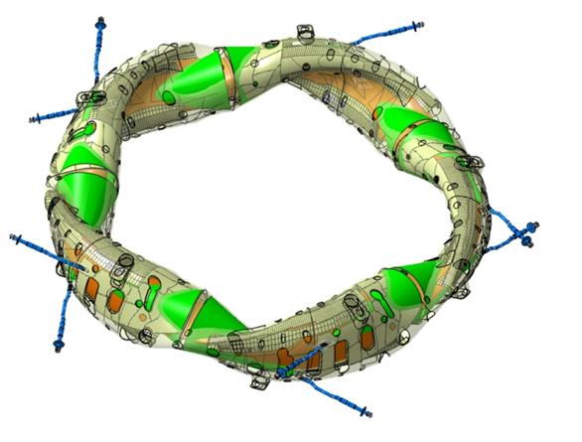
Plasma visible radiation and video observation
Fusion plasma is a volumetric visible light source therefore the reconstruction of the radiation distribution is a challenge if we have limited number of views (which is always the case).
W7-X has a complicated, non axial symmetric 3D magnetic geometry, which makes the reconstruction more difficult.
QSV video diagnostics in OP1:
10 tangential views
8 EDICAMs
400Hz @ 1.3Mpixel
upto 50kHz @ 64x 56 pixels
1 Photron SA5
7.5kHz @ 1Mpixel
upto 1MHz @ 64x64 pixels
AEQ11:
EDICAM
AEQ50:
EDICAM
AEQ51:
EDICAM
AEQ10:
EDICAM
AEQ40:
EDICAM
AEQ21:
Photron
AEQ20:
EDICAM
AEQ31:
EDICAM
AEQ30:
EDICAM +
Phantom (MIT)
G. Kocsis, Greifswald, 25.02.2020

Slide 4
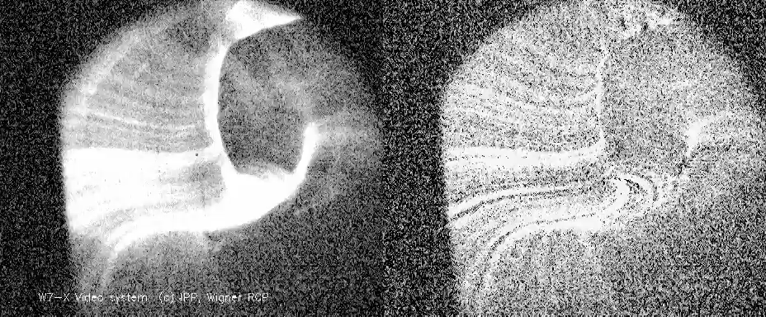
Filaments and cross-correlation images
Fast framing observation:
filamentary structures, elongated along the magnetic field lines
short lifetime (~100µs), intermittent(?) turbulent eddies
statistical methods needed: cross-correlation or conditional averaging
QSV video diagnostics:
raw movie filtered for low frequencies
(below 1kHz)
20171206.031 2631-2638ms, Hydrogen plasma, EJM-252
45khz, C III filter, divertor radiation
G. Kocsis, Greifswald, 25.02.2020

Slide 5
Filaments and cross-correlation images
Intensity distribution
at a given time point:
image
y pixels
Cross-correlation at a
given time lag:
Cross-correlation image
y pixels
x pixels
x pixels
Video stream
Cross-correlation
Time axis
Time lag
y pixels
Reference pixel
y pixels
Correlation calculation
x pixels
x pixels
Intensity distribution averaged over a time interval:
Long exp. image
y pixels
x pixels
G. Kocsis, Greifswald, 25.02.2020

Slide 6
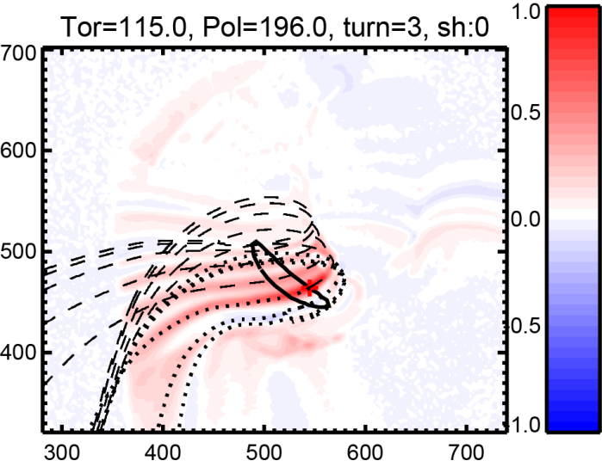
Filaments and cross-correlation images
2D cross-correlation: example in the divertor region, an 5/5 island magnetic surface is used for selecting the reference signal for cross-correlation calculation
„Open” field lines:
high correlation for several toroidal turns
Reference pixel
Magnetic field line started from the reference pixel, a few toroidal turns back and forward
G. Kocsis, Greifswald, 25.02.2020

Slide 7
Quasy-coherent modes and spectrum images
Intensity distribution
at a given time point:
image
y pixels
Power at a given
Frequency:
Power image
y pixels
x pixels
x pixels
Video stream
Spectrum
Time axis
Freq. axis
y pixels
y pixels
Fourier transformation
x pixels
x pixels
Intensity distribution averaged over a time interval:
Long exp. image
Integrated over a
frequency rage:
Band power image
y pixels
y pixels
x pixels
x pixels
G. Kocsis, Greifswald, 25.02.2020

Slide 8
Quasi-coherent modes and spectrum images
In some scenarios a clear quasi-coherent fluctuation is seen at around 1kHz frequency.
Strong light fluctuation ([1.,2.5]kHz) is detected by the camera.
Cross-correlation: no filamentary structure, the radiation fluctuates correlated on almost the whole magnetic surface(?)
Band power image ([1,2.5]kHz)

Slide 9
Video data processing in IDL
Data processing: old school style, IDL library
Available functionality:
video data input (HDF5, tif)
magnetic geometry input (pre-calculated for several magn. geometry stored IDL sav files)
Spatial calibration of the different views (linear projection, parameters stored in a database)
Data filtering with various methods, down sampling (binning)
Correlation, conditional averaging calculations
Processed data are stored in IDL sav files
Various plots stored also in pdf (ps) files
Problem: IDL licence, specific, not for general usage
New general solution (not only for video data but also for other type of diagnostics):
G. Kocsis, Greifswald, 25.02.2020

Slide 10
FLAP
FLAP:
Fusion Library of Analysis Programs
A program suite for processing large multidimensional datasets
Developer team: Sandor Zoletnik, M. Lampert, Miklós Vécsei, Gábor Cseh
G. Kocsis, Greifswald, 25.02.2020

Slide 11
FLAP features in nutshell
FLAP
Python 3.7 + numpy + matplotlib
Data input modules: core FLAP and data access methods are separate
All data are in flap.DataObject:
  N dimensional (complex) data + error + coordinates + other data
  Stored in variable or memory storage area
  Save/load to file
Processing: filter, slicing, APSD (Auto Power Spectral Density) , CPSD (Cross Power Spectral
Density) , CCF (Cross-Correlation Function), conditional averaging, ...
flap.DataObject → processing → flap.DataObject
Optimized numpy processing routines operate along 1 (or multiple) dimensions
→ processing of many signals in one call
Options configurable for processing methods, data source
Plots for 1D, 2D, 3D data objects, slices of objects
Available on GitHub: https://github.com/fusion-flap
G. Kocsis, Greifswald, 25.02.2020

Slide 12
Available data input modules
FLAP
testdata: Generates various test signals and image sequences
w7x_abes: W7-X Alkali BES data (locally stored)
mdsplus: General MDS+ module
w7x_mdsplus: MDS+ for W7-X
w7x_webapi: W7-X web database access (experimental)
nstx_mdsplus: NSTX MDS+ access (experimental)
w7x_camera: W7-X EDICAM and Photron camera data (locally stored, HDF5 file)
apdcam: General APDCAM access
G. Kocsis, Greifswald, 25.02.2020

Slide 13
Data processing methods
FLAP
All processing methods operate on data objects and produce data objects as output.
It is possible to limit processing to intervals:
filter_data: Various scipy filters can be used along one coordinate
detrend: Remove trend with polyfit.
apsd: Auto Power Spectral Density along a coordinate
(e.g. converts Time coordinate to Frequency)
cpsd: Cross Power Spectral Density between all signals in two data objects
(e.g. converts Time coordinate to Frequency)
ccf: Cross Correlation Function between all signals in two data objects
Also multi-dimensional CCF
(e.g. converts Time coordinate to Time lag)
select_intervals: Select intervals in a coordinate either by mouse click or on condition
Output is data object where intervals are described by data and error.
The output data object can be used in slice_data → conditional averaging
arithmetic: +,-,* is implemented between data objects with identical shape and scalars
broadcasting to be implemented soon
G. Kocsis, Greifswald, 25.02.2020

Slide 14
Plotting
FLAP
flap.plot function implements higher level plots on the basis on Matplotlib:
Handles coordinates, errors, ... automatically
Can plot data vs coordinates, coordinates vs coordinates, constant vs coordinate,
one data object vs another, ....
Handles over plotting: as default prevents over plotting data with incompatible units
(can be overridden)
Plot types as present: xy, multi xy, image, contour, anim-image, anim-contour
Default plots: e.g. 3D data object plotted as anim-...
Multiple part plots. (e.g. complex signal is plot as amplitude/phase or real/imaginary)
Plot ID is returned: possible to over plot to any existing (even multi-part) plot.
G. Kocsis, Greifswald, 25.02.2020

Slide 15
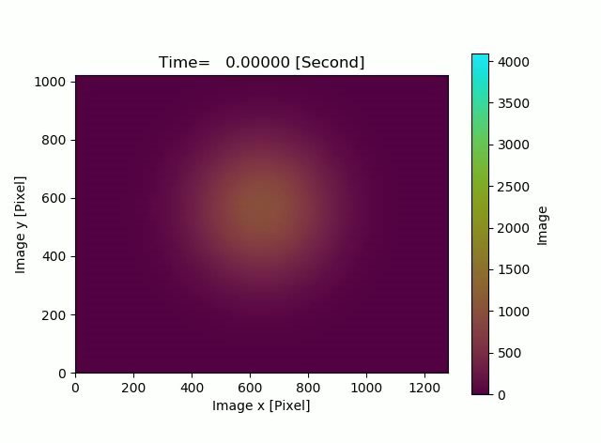
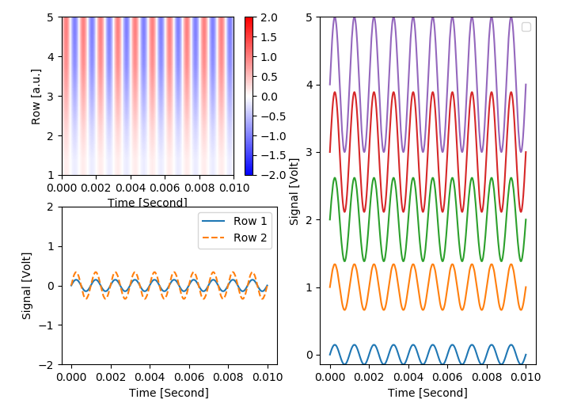
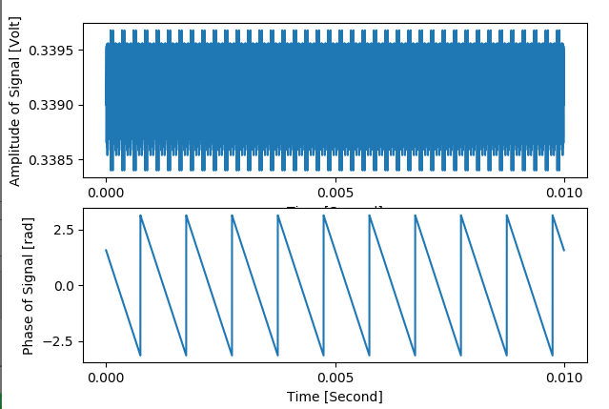
Plotting
FLAP
‘anim-image’ plot of test video data
‘image’ plot
‘multi-xy’ plot
‘xy’ plot
‘xy’ plot from complex data
G. Kocsis, Greifswald, 25.02.2020

Slide 16
Summary
Fusion plasma is a volumetric visible light source therefore the reconstruction of the radiation distribution is a challenge if we have limited number of views (which is always the case.
To study turbulence we need statistical analysis and to calculate multi dimensional:
Auto Power Spectral Density
Cross Power Spectral Density
Cross Correlation Function
Conditional Averaging
Old solution: IDL
New solution: FLAP (python)
package has now good functionality
Considered as beta version
Available on GitHub: https://github.com/fusion-flap
flap_tests.py demonstrates possibilities on test data
Users, collaborators are welcome
G. Kocsis, Greifswald, 25.02.2020

Slide 17
Backup slides
G. Kocsis, Greifswald, 25.02.2020

Slide 18
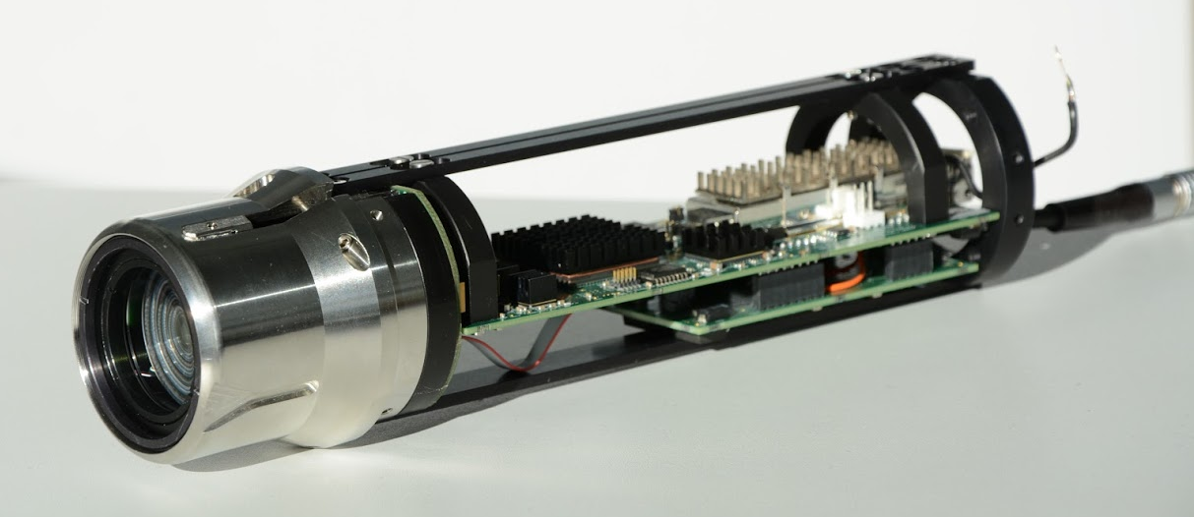
The EDICAM concept: overview diagnostics + event detection + physics investigation
Event Detection Intelligent CAMera
Special 1.3 Mpixel (1280x1024) 12-bit monochrome CMOS camera
  max. frame rate: 400 fps (full frame); 50,000 fps (64x56)
  non-destructive readout → exposure and readout cycles can be decoupled
  magnetic field tolerant (tested upto 3 T and 250 mT/min)
[S. Zoletnik et al, Fus. Eng. Des. 88 (2013) 1405]
Modular design:
camera head + FPGA card
Small
Durable
Image processing
Events
cam.head
FPGA
10 Gbit/s fiber link
QSV Video Diagnostics Team
QSV Video Diagnostic Team
G. Kocsis, Greifswald, 25.02.2020

Slide 19
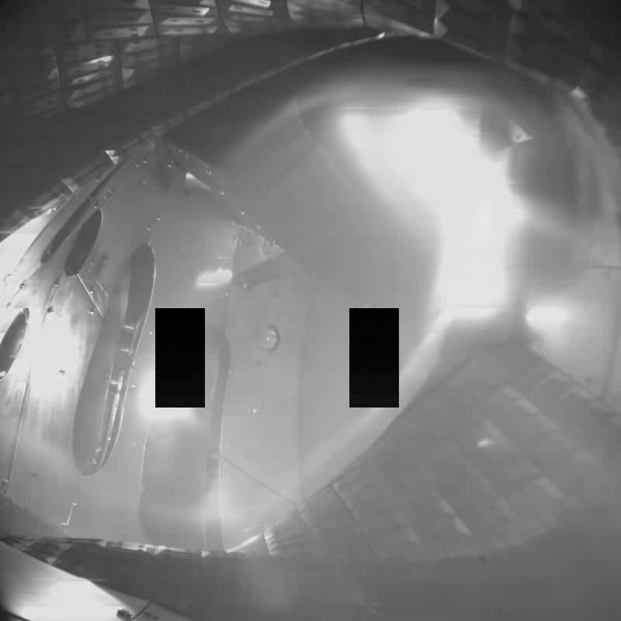
EDICAM application ”science”
Utilization of multiple ROIs in the non-destructive readout mode
the EDICAM system can handle up to 6 ROIs simultaneously ≡ 6 cameras
20171115.039
Helium plasma
Pellet injection
ROI #1: full frame, 100 Hz
Here: still image
ROI #2 and #3:
Small area (160x100), 10 kHz
Pellet penetration is temporally resolved!
Event → only during pellets
expo
reset
NDR readouts
NDR readouts
pixel brightness
Save storage space
Save camera usage
time
G. Kocsis, Greifswald, 25.02.2020

Slide 20
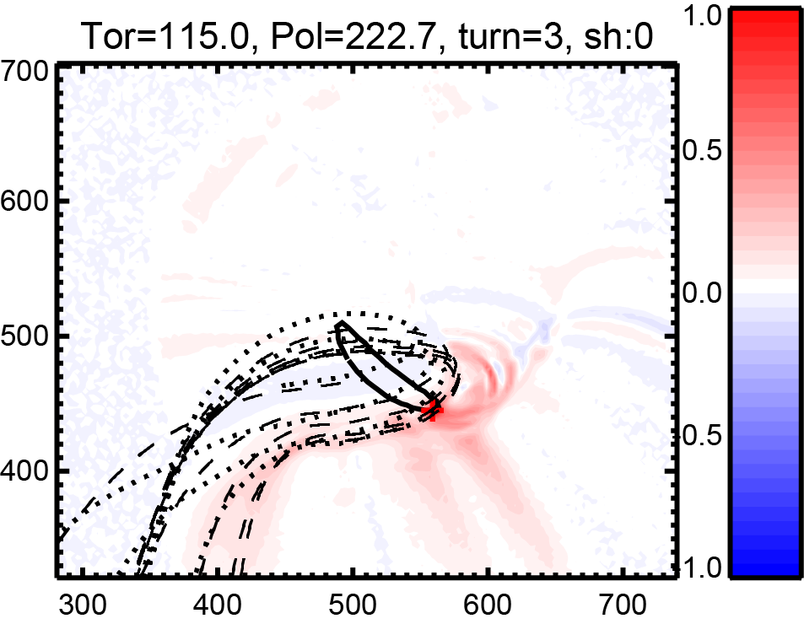
Filaments and cross-correlation images
2D cross-correlation: example in the divertor region, an 5/5 island magnetic surface is used for selecting the reference signal for cross-correlation calculation
„Open” field lines:
high correlation for several toroidal turns
„Connected” field: correlation for one turn
or divertor strikeline
G. Kocsis, Greifswald, 25.02.2020

Slide 21
flap.DataObject
FLAP
All data (experimental, calculated, modeling) are stored in DataObjects
d = flap.DataObject(data=..., error=...)
Data fields:
data: n-dimensional numpy array: integer, float, complex, ...
data_shape: Data array shape (used if no data is present)
error: Optional error values: symmetric (1 array) asymmetric (list of two arrays)
data title: String (e.g. ‘ABES-13’)
data unit: flap.Unit class
name: String (e.g. ‘Signal’)
unit: String (e.g. ‘Volt’)
coordinates: List of flap.Coordinate() objects
Arbitrary number of coordinate values can be assigned to data points:
exp_id: Some kind of experiment ID (shot number, project no..)
data_source: String (e.g. ‘W7X_ABES’)
info: Any other information (Depending on data_source)
history: at present empty for future application

Slide 22
Definitions
signal
Fourier transform
Auto-Power Spectral Density (APSD)
Cross-Power Spectral Density (CPSD)
Coherency
Cross-Covariance
Cross-correlation: normalised cross-covariance

