Slide 1
Towards Plasma Control at W7-X
Long Term Objective and Achievements En Route

Slide 2
Long Term Objective

Slide 3
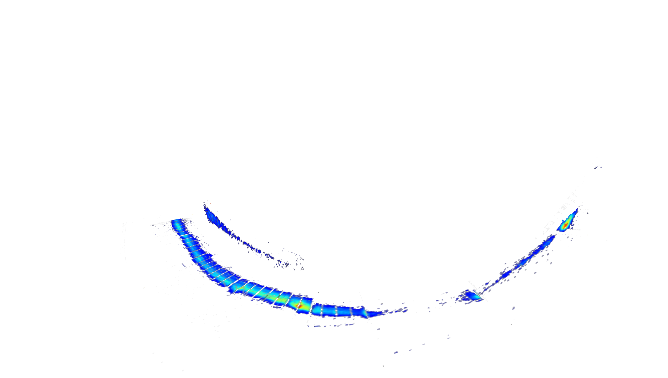
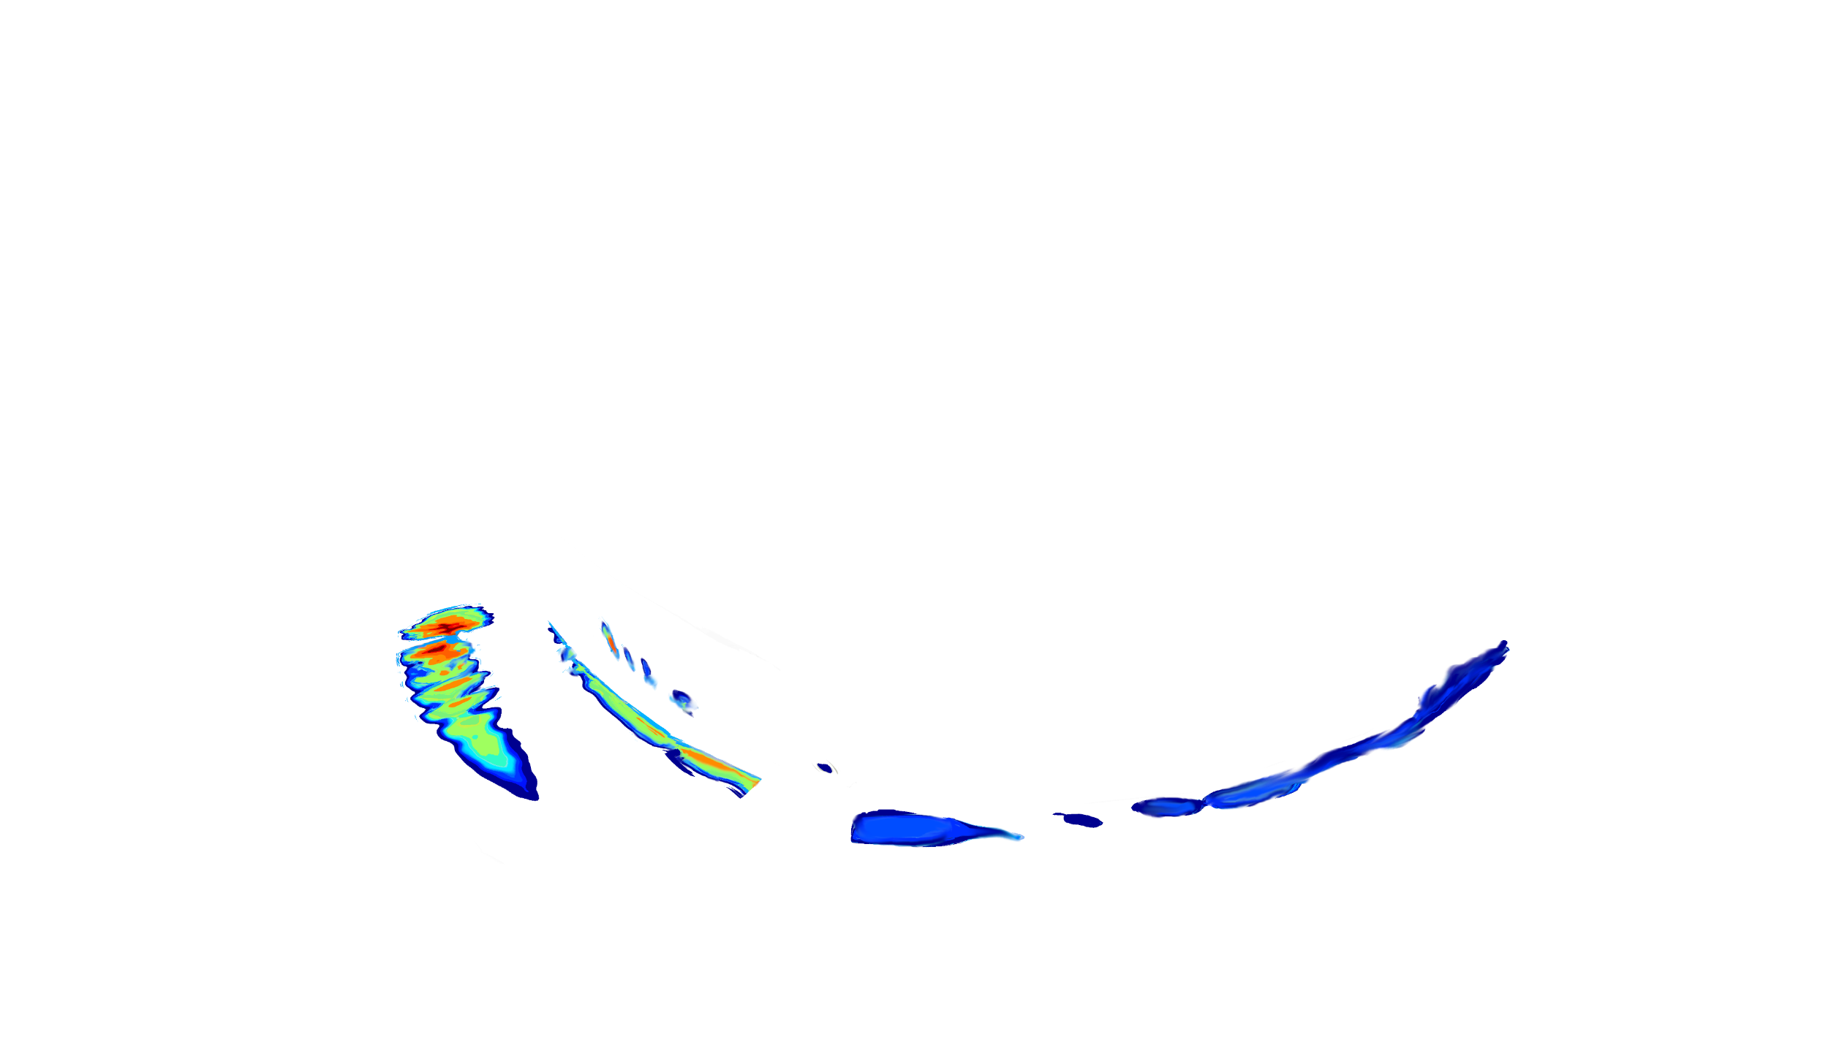
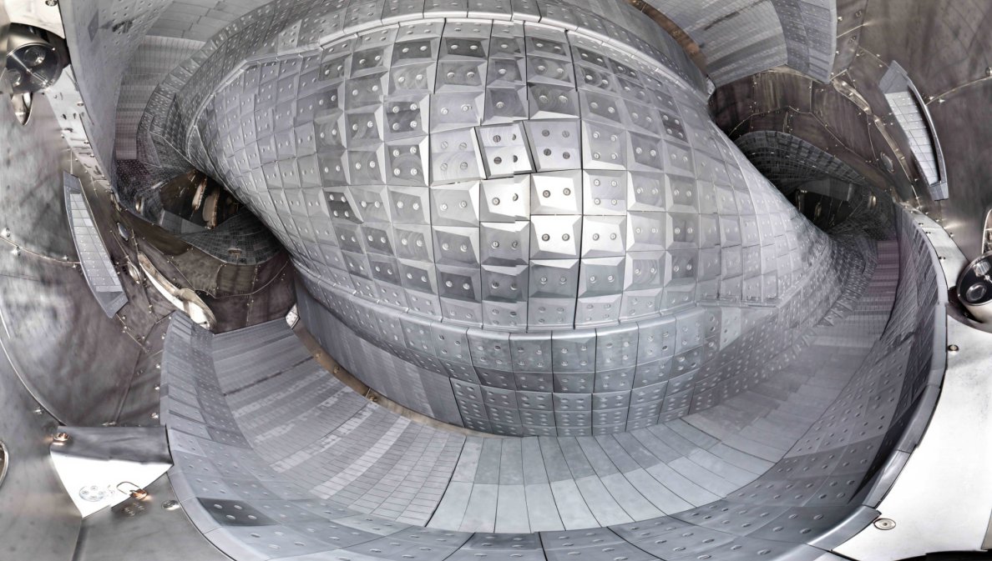
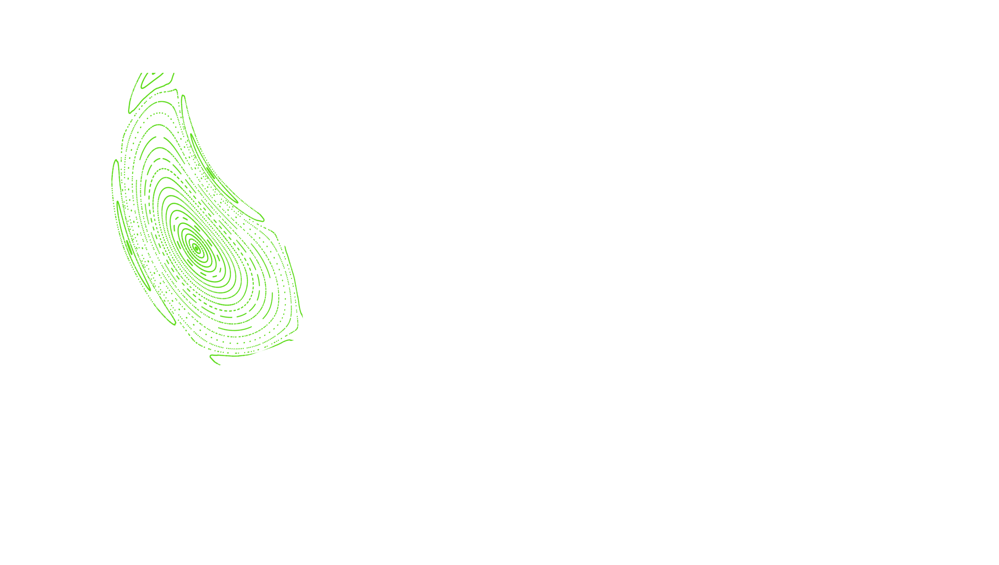
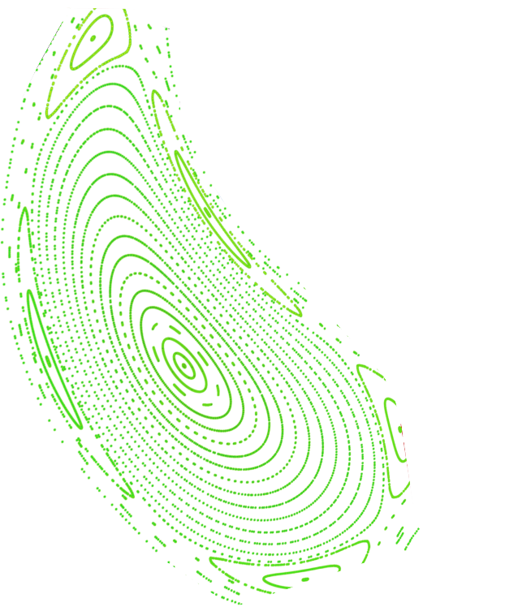

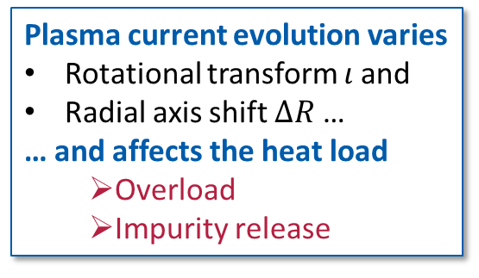
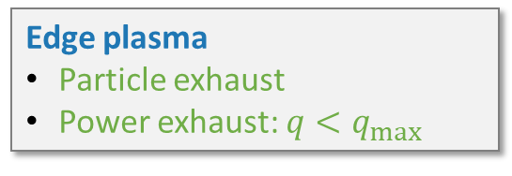
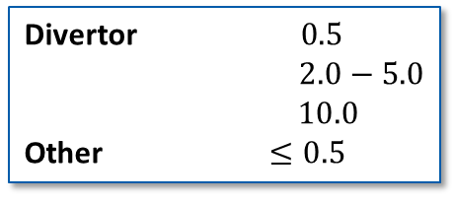

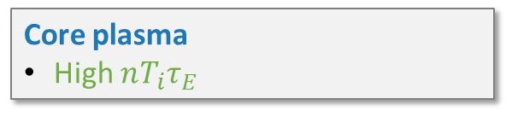
Heat Load Pattern Variation
Core plasma
High $nT_{i}τ_{E}$
Edge plasma
Particle exhaust
Power exhaust: $q<q_{max}$
Plasma current evolution varies
Rotational transform $ι$ and
Radial axis shift $ΔR$ …
… and affects the heat load
  Overload
  Impurity release
Heat load limit $q_{max }$(MW/m²)
Divertor $0.5$
$2.0−5.0$
$10.0$
Other $≤0.5$
Divertor heat load (a.u.)
Notes:
Plasma parameters are generally dynamic
Iota is a function of the toroidal current which – although small in W7-X can have substantial magnitude due to an establishing plasma current
Additionally the radial position of the magnetic axis is a function of density and temperature which can vary throughout the discharge
These parameters strongly affect the PFC heat load which can lead to excessive heat flux and severe damage to the machine
Their influence is especially large since W7-X is a low shear machine and field line-PFC incident angles are shallow

Slide 4
Approaching Overloads with Control Theory
Targets
Actuators
Core plasma
High $nT_{i}τ_{E}$
Coil System:
Control Coils
Planar Coils (Slow)
Sensors
Edge plasma
Particle exhaust
Power exhaust: $q<q_{max}$
Heating / Current Drive:
ECRH / ECCD
Diagnostics:
IR camera system
Magnetic diagnostics
Bolometers
Gas injection:
Fueling
Impurity seeding (N)
Plasma control challenge
“Can we automatically find a trajectory in the operational space of W7-X to ensure the safety of the wall and optimized performance?”
Notes:
There are multiple ways to infere with such overloads
The before introduced coils can be used as actuators to counter plasma dynamic
Also manipulaiton of the heating and fueling including current drive can be used
Sensors are potentially any diagnostics
In the language of control theory these can be grouped as Targets, Actuators, and Sensors

Slide 5
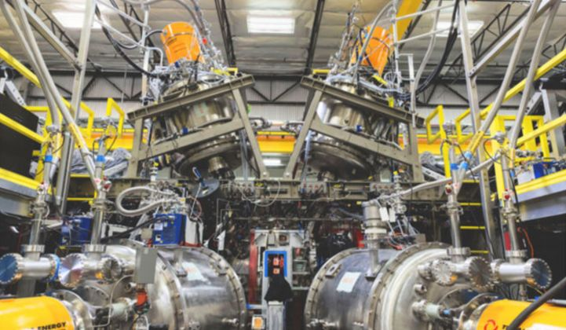
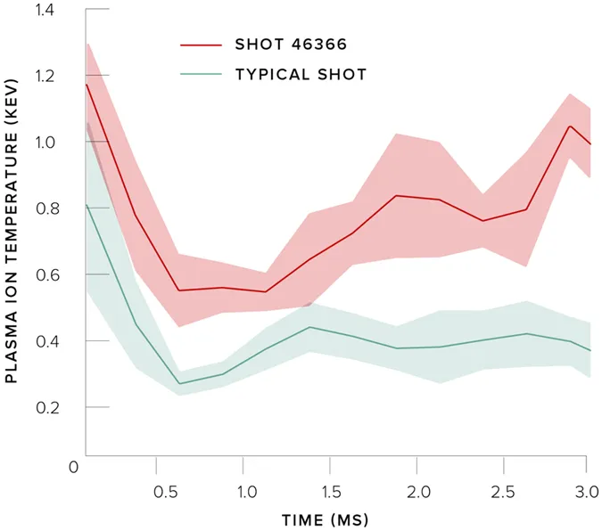
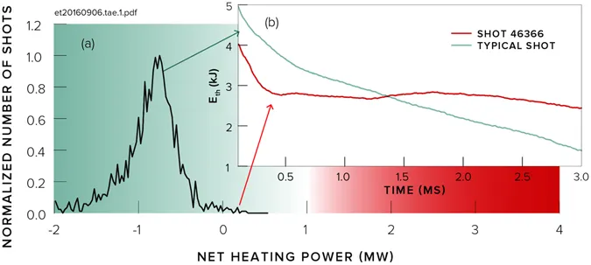
ML in Fusion: Tri-Alpha-Energy & Google
„Optometrist Algorithm“ [Baltz 2017]
  Machine learning tool that aids in optimizing experiment parameters
  Algorithm asks for human advice (Wich discharge is better)
Led to discovery of record confinement regime
  Positive net heating power
  Increased ion temperature and plasma energy

Slide 6
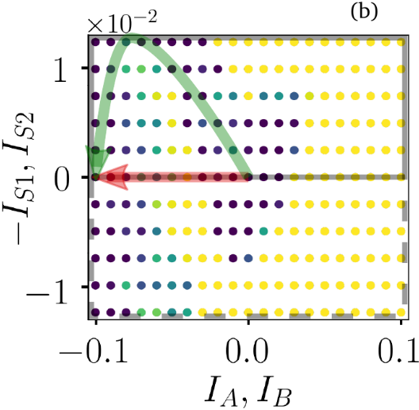
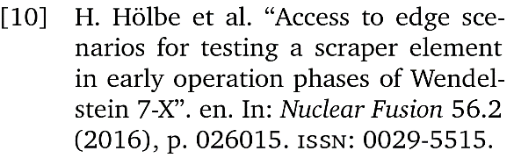


Semi-Manual Plasma Control/Optimization
Scenario to avoid overload arising from $I_{tor}$ evolution by control coil action [Böckenhoff 2019]
Safe plasma evolution trajectory for ramp up by varying $P_{heat}$ and $n$. [Sinha 2019]
Controlling $I_{tor}$ by ECCD [Turkin 2017]
$n$ control with PID feed-back [Krychowiak tbp]
$$I_{S}$$
damage
[Böckenhoff 2019]
Local solutions
(sensible to variation of orthogonal parameters)
Interdependence with other control targets neglegted
Require ground truth e.g. PID
safe
Notes:
Bilder fehlen
Emphasis auf dritter Achse erklären
Bild von sweepspulen
Formel weglassen
Scenario für Kontrolle, Bild RL!!!
This is one instance of rather manual control
=> RL for automation
Avoiding transient PFC overloads by tuning $n$ and $P_{heat}$
Baffle and heat shield overload examinations for identifying critical baffle tiles for safety relevant thermo-couple installation ($P_{conv}$ & $P_{rad}$ FLD + LOWENDEL)

Slide 7
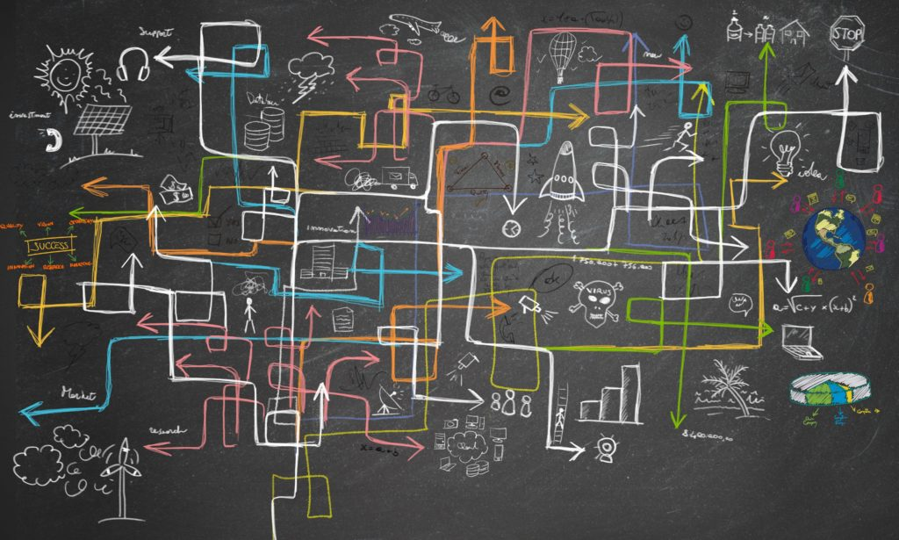
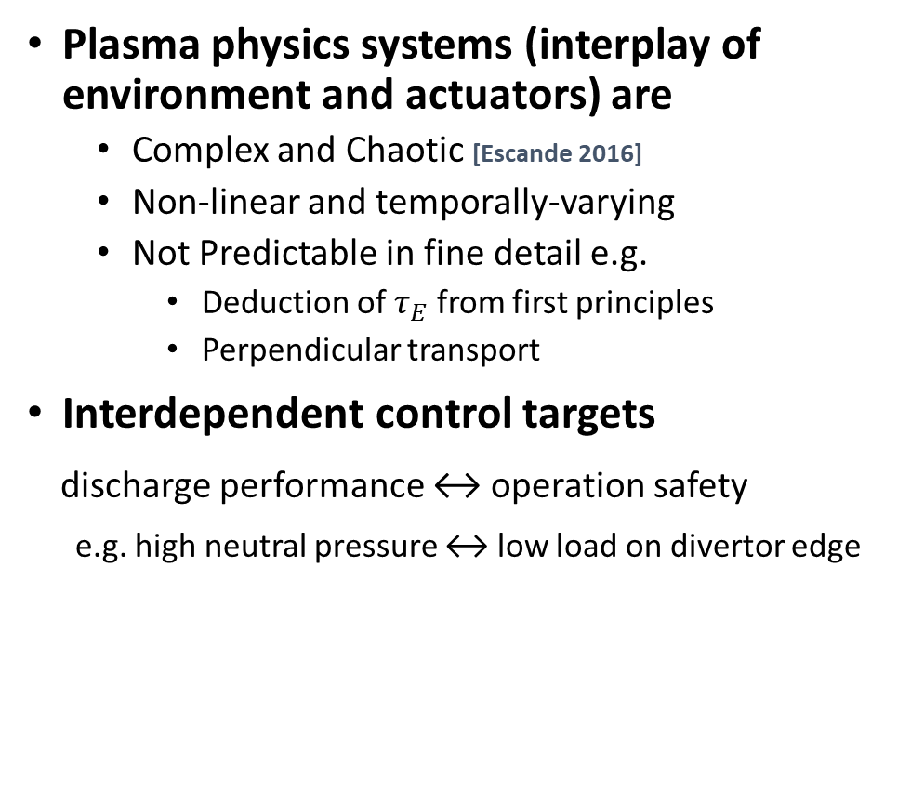
Choice of Control Method
Plasma physics systems (interplay of environment and actuators) are
  Complex and Chaotic [Escande 2016]
  Non-linear and temporally-varying
  Not Predictable in fine detail e.g.
    Deduction of $τ_{E}$ from first principles
    Perpendicular transport
Interdependent control targets
discharge performance ↔ operation safety
e.g. high neutral pressure ↔ low load on divertor edge
Reinforcement learning (RL) suits well here
[Bucci 2019]
Notes:
So which control method should be chosen?
For this we must first characterize our system which is
Chaotic, complex, non-linear and not predictable to the fine detail
As introduced before we have many control targets and some of these targets are interdependent
In this setting reinforcement learning is the right choice.

Slide 8
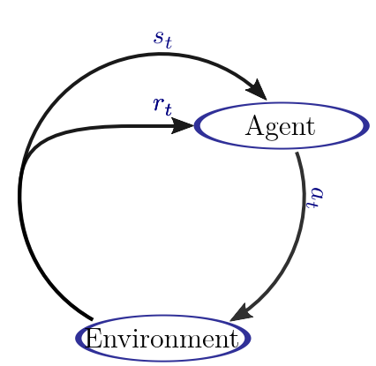
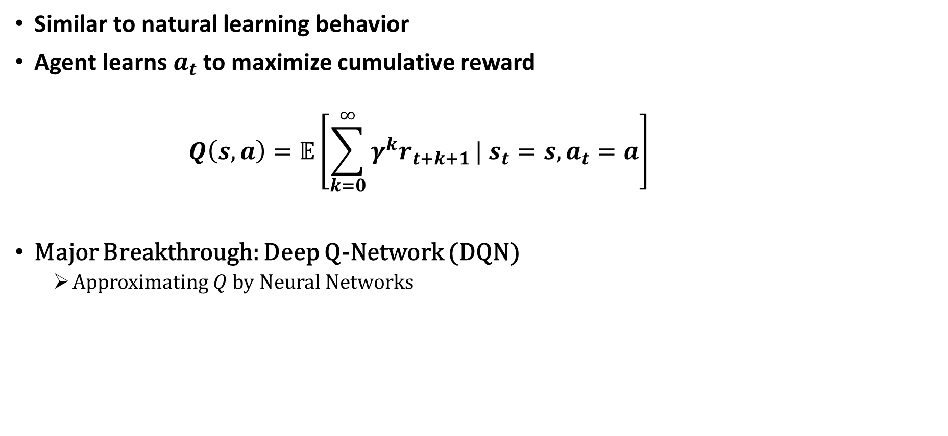
Reinforcement Learning
state
Similar to natural learning behavior
Agent learns $a_{t}$ to maximize cumulative reward
$$Q\left(s, a\right)=𝔼\left[\sum_{k=0}^{∞}{γ^{k}r_{t+k+1}}| s_{t}=s,a_{t}=a\right]$$
Major Breakthrough: Deep Q-Network (DQN)
  Approximating $Q$ by Neural Networks
reward
action
Impact of new knowledge
Short- vs. long-term reward maximization
Notes:
Reinforcement Learning is a learning scheme which is similar to natural learning behavior
The controller is called agent which is an algorithm which observes the state s_t and learns to choose an action a_t to maximize the cumulative reward r_t
A huge breakthrough was the approximation of the cumulative reward by a recursive update rule
The optimal action given an actual state is then given by the argmax of Q
A problem is now, that the state set is usually not finite and Q which is a table of dimension s cross a becomes infinite and must be approximated by a function
Here the breakthrough was to use NNs which we introduce in the following

Slide 9
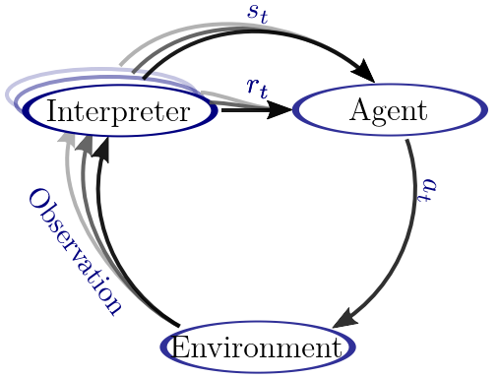
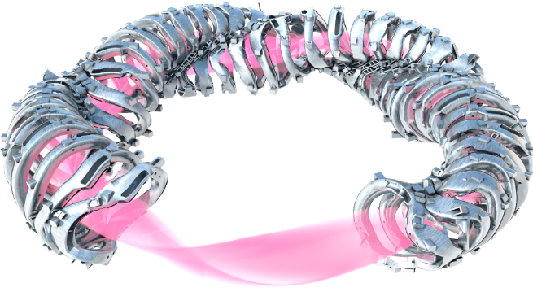
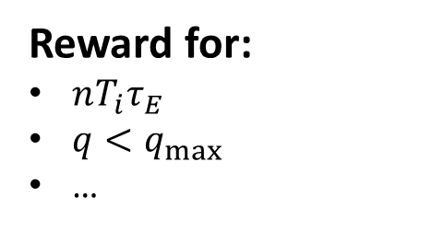



Long Term Objective: Plasma Control with High Level RL
$s_{t}$=High level plasma state
Reduced dimensionality
  Fewer Data required
Lift black box of RL
Robustified RL
Virtual diagnostic
$$=ι, ΔR,n, T,…$$
Sensors:
IR camera system
Magnetic diagnostics
Bolometers
…
Reward for:
$nT_{i}τ_{E}$
$q<q_{max}$
…
First step:
Retrieve reduced state in real time
$s_{t}$=Low level sensors
Large state-space
e.g. ${10}^{6}$ pixel / IR-camera
Curse of dimensionality
Actuators:
Coils
ECRH
Fueling (Gas, Pellet)
…
Notes:
Let’s put RL in the context of W7-X
Actuators and Rewards were introduced beforehand
As sensors basically every diagnostic can be added.
However, if you directly use the low level sensor outputs as state description your state-action space becomes very large and your RL Agent will be very data-inefficient.
Because of that I introduce the interpreter which will build a high-level state from the diagnostics input beforehand.

Slide 10
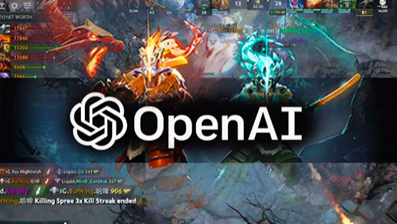
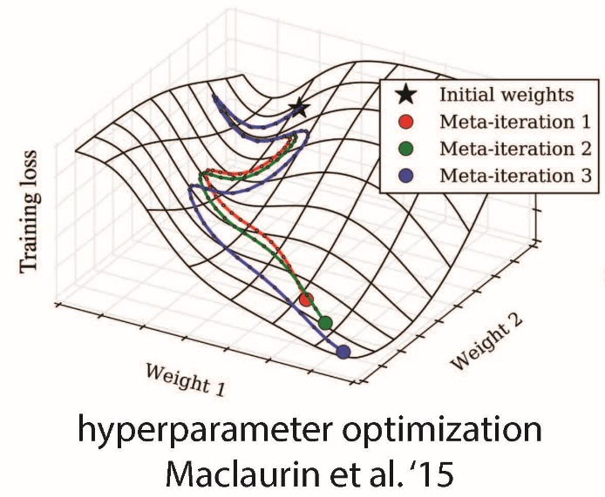

DQN Success Stories
Super-human Performance in
Atari Games [Mnih 2015]
StarCraft II [Vinyals 2017]
Dota2 [Tobin 2017]
Gaining understanding of a system [Heess 2017]
Possible through
Reinforcement learning
Self-play
Enough computation
Simulation = Real world!
Meta Learning

Slide 11
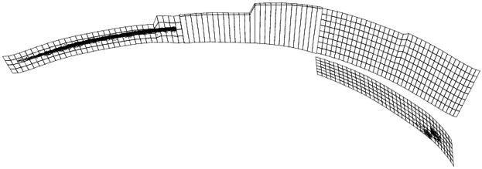
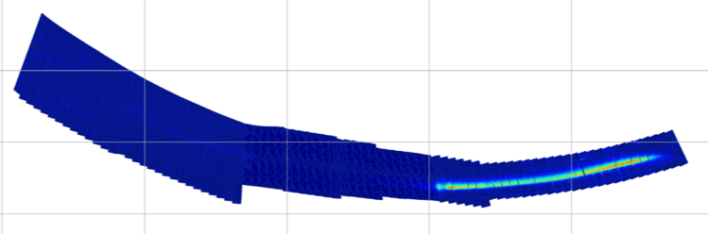
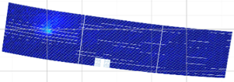
Simulation != Experiment
Compared to the real world, synthetic data is …
  Easy to label
  Less expensive
  Easier to scale
  Not dangerous
  …
Simulation can be qualitatively highly aqurate …
but will mostly qualitatively differ from Experiment
Numerical prediction
Infrared camera image
How can we transfer simulation knowledge to the real world?

Slide 12
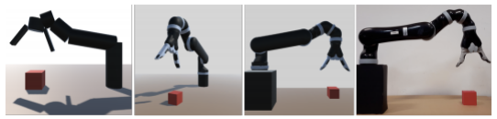
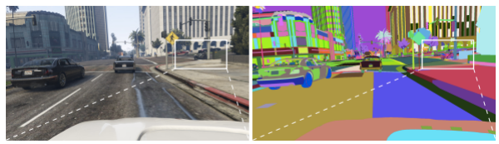
How Can We Transfer Simulation Knowledge to Real Data
Use Realistic Simulated Data
  Carefully match the simulation to the world
  Augment simulated data with real data
  Arbitrarily complicated
  Error prown
Domain Confusion [Tzeng 2014]
Domain Randomization

Slide 13
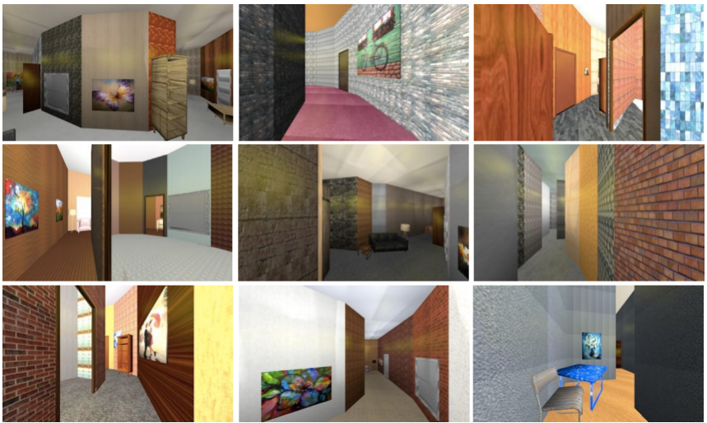
Manual Domain Randomization (MDR)
If the model sees enough simulated variation, the real world may look like just the next simulator
Example: Real Single-Image Flight Without a Single Real Image [arXiv:1611.04201]
  Quadcopter collision avoidance
  ~ 50% of trajectories are collision-free

Slide 14
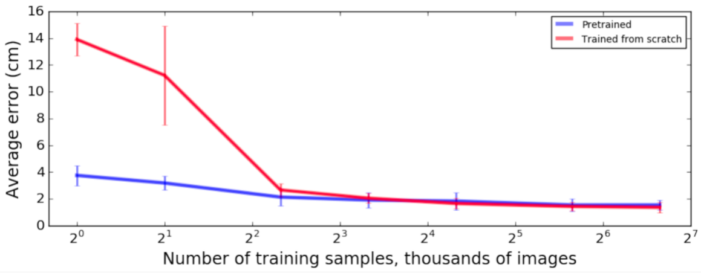
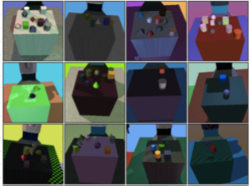
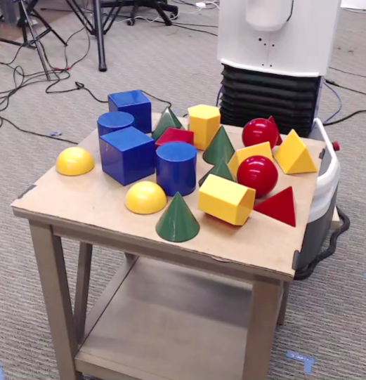
Manual Domain Randomization (MDR)
If the model sees enough simulated variation, the real world may look like just the next simulator
Example: Pose Estimation [Tobin 2017]
Training
Pre-Training is not Necessary
Application

Slide 15
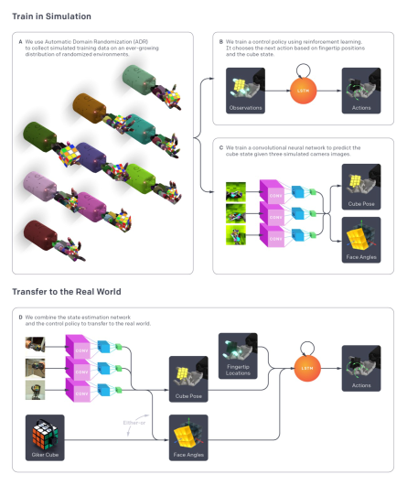

Automatic Domain Randomization (ADR)
Hypothesis:
  Learning with a sufficiently randomized environment leads to meta-learning, i.e. NN learns to rapidly adapt to actual environment
Workflow:
  NN learns to solve problem at start with nonrandomized environement
  At a performance threshold the amount of domain randomization is increased automatically (Entropy maximization)
  Task becomes harder and NN learns to generalize to more randomized environments
Robust Performance
Parameter reconstruction

Slide 16
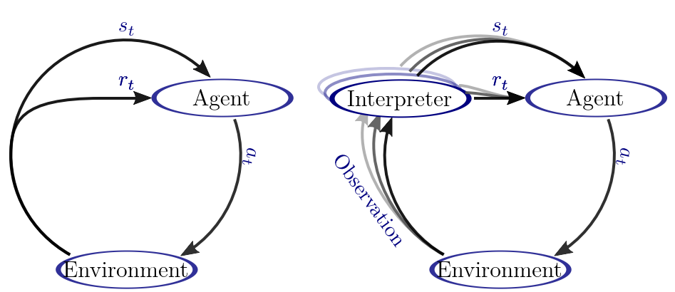
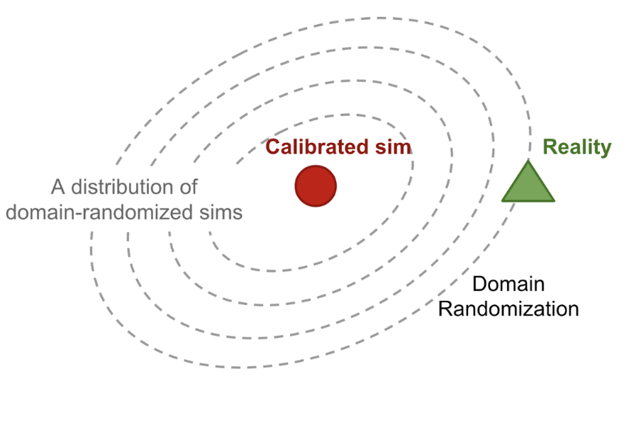
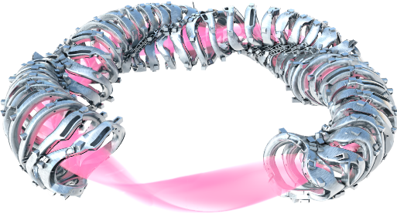
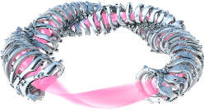
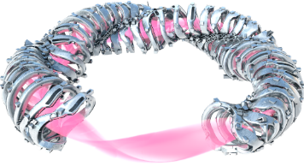
Plasma Control with ADR Requires Simulation Framework
Large amount of simulation data required
Simulation framework
  Very fast codes

Slide 17
Simulation Framework Sketch
DKES
VMEC
NTSS
Extender
EMC3
FLT
Timestep
EIRENE
FLT

Slide 18
Accomplishments and Present Work

Slide 19
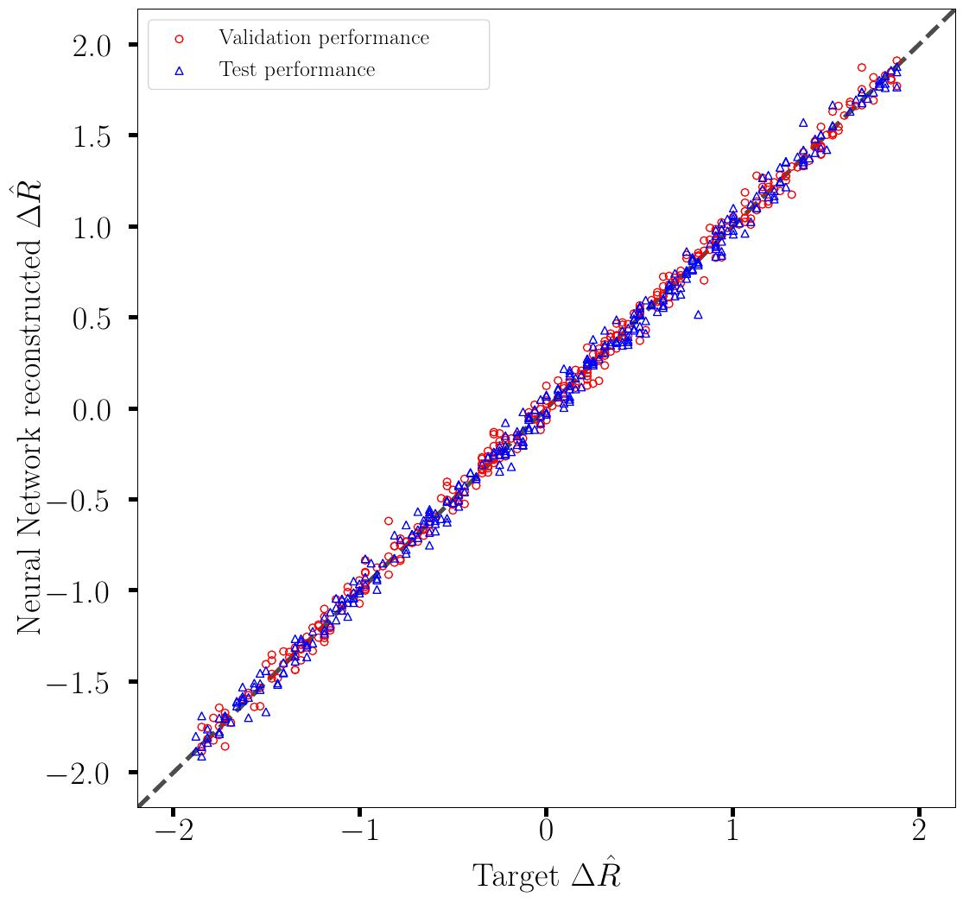
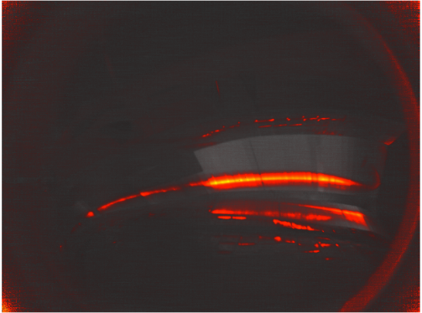
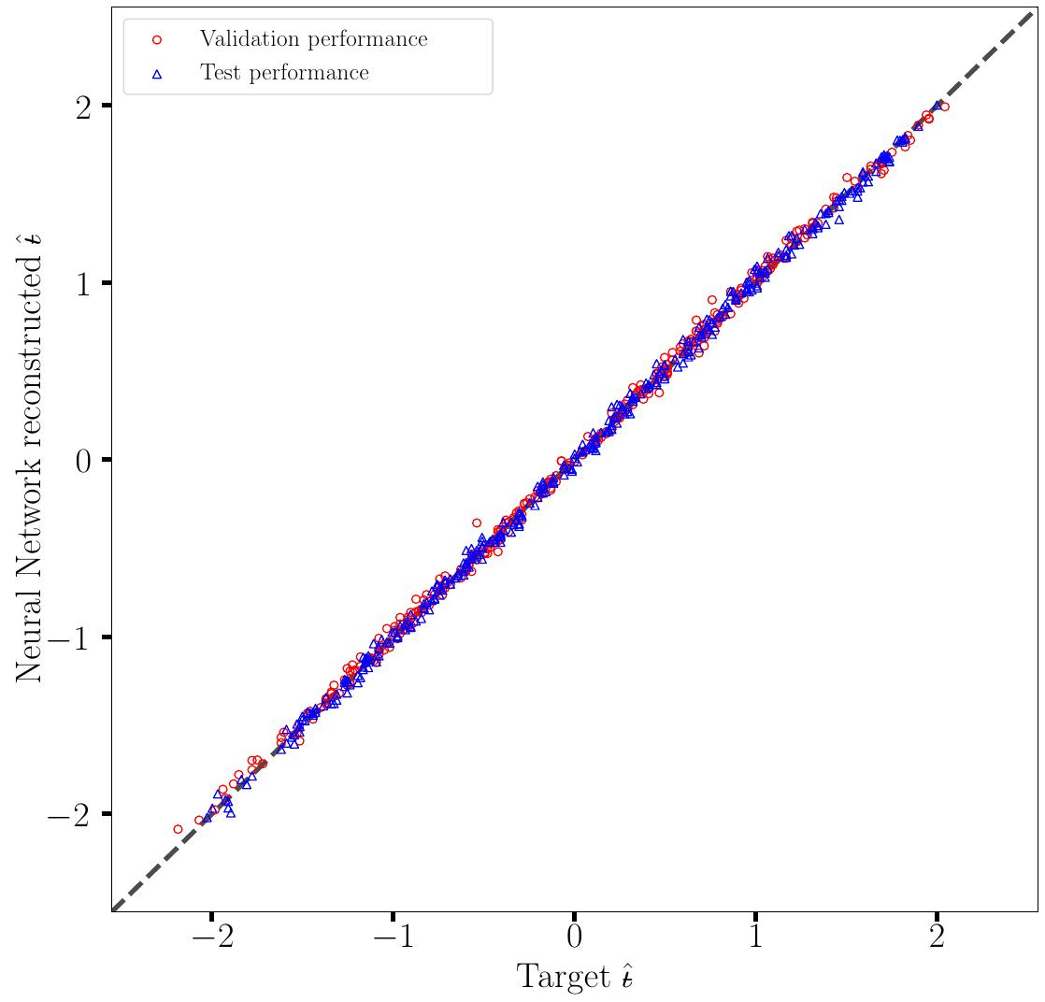
$ι ,ΔR$Regression with Deep Res-Nets
[Böckenhoff & Blatzheim 2018, 2019]
Adding simulation improves performance despite systematic differences

Slide 20






Control coil current regression with CNN
$$I_{tor}(t)$$
$q(t)$ (AEF10)
Shots: 20180815.#
$$I_{S1}(t)$$
CNN
$$I_{S2}(t)$$
$$I_{S1}(t)$$
$$I_{S2}(t)$$
[F. Pisano, B. Cannas, et al., University of Cagliari]
Control coils change island width & phase (also plasma equilibrium effect)
Notes:
CNN = Convolutional Neural Network
The CNN takes as input the strike line image (the heatflux image calculated from AEF10 IR camera) and the toroidal current from the Rogowski coils, and makes a regression in order to infer the control coil currents.
On the right side plots, the temporal evolution of the target (in blue) and output (in red) control coil currents superimposed. The six experiments (from OP1.2b), concatenated on the x-axis, are separated by black dashed vertical lines.

Slide 21
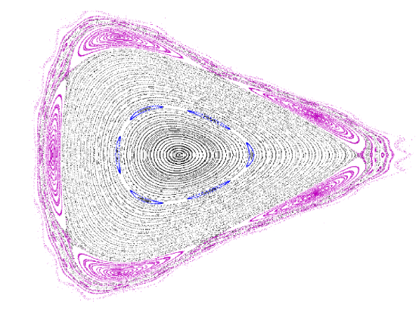
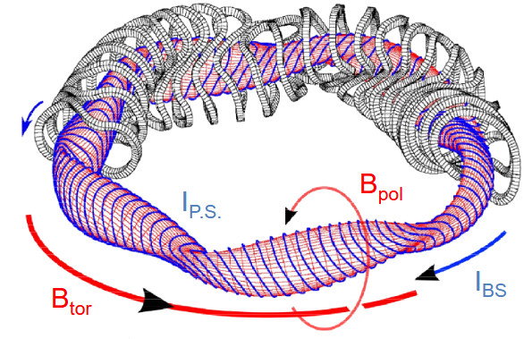
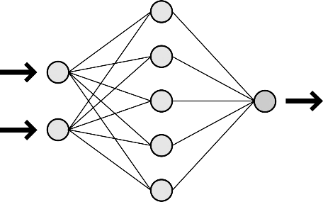


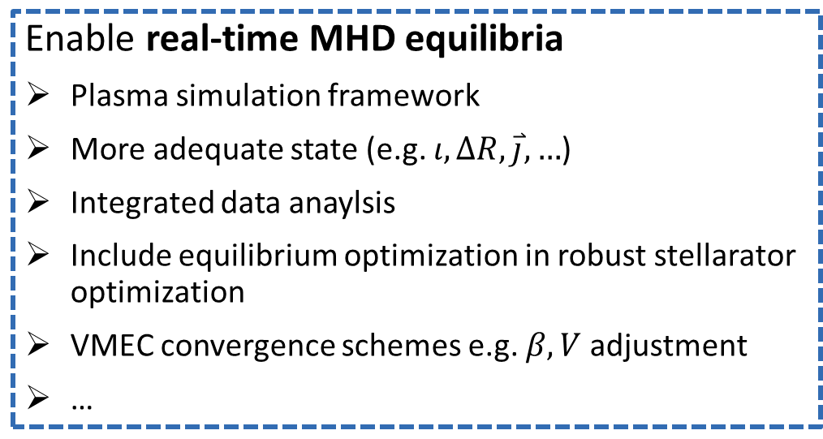
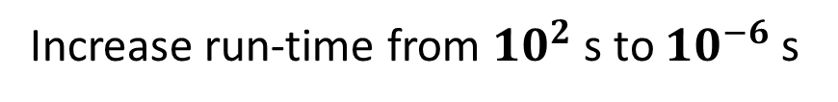
Fast Surrogate: A Supervised Learning Approach
Courtesy Andrea Merlo
Increase run-time from ${10}^{2}$ s to ${10}^{−6}$ s
$$f$$
MHD Equilibrium Code
$$g_{J}$$
Enable real-time MHD equilibria
Plasma simulation framework
More adequate state (e.g. $ι, ΔR, \overset{⃑}{j}, …$)
Integrated data anaylsis
Include equilibrium optimization in robust stellarator optimization
VMEC convergence schemes e.g. $β, V$ adjustment
…
21
Notes:
TODO: Add connection slide
21

Slide 22
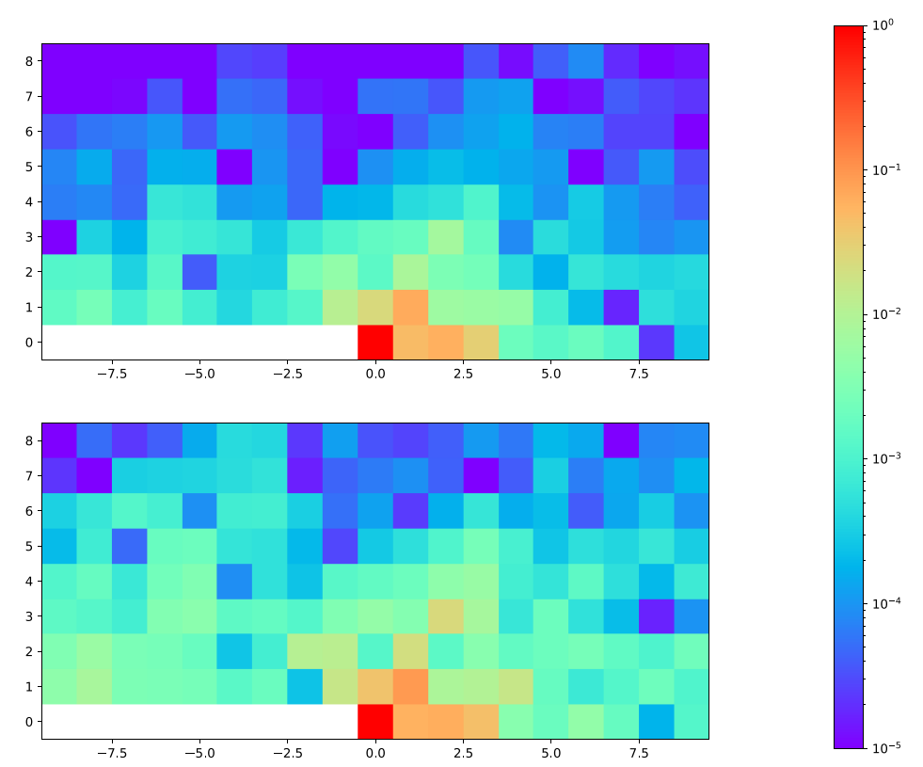














Fast Surrogate: Initial Results
Courtesy Andrea Merlo
VMEC $B_{mn}(ρ^{∗})$ Fourier Coefficients
Predicted Fourier Coefficients
VMEC Input features:
Coil currents Array
Pressure profile
Toroidal current profile
VMEC Runtime parameters:
9 poloidal and toroidal modes $(m,n)$
20 radial grid points ${(ρ}^{∗})$
NN Architecture:
Fully Connected Neural Network (FC-NN)
5 hidden layers with 16 neurons each
R$econstructs B_{mn}(ρ^{∗})$
$$m$$
$$ρ=0.5$$
$$m$$
$$ρ=0.5$$
$$n$$
$$n$$
$$m$$
$$ρ=1.0$$
$$m$$
$$ρ=1.0$$
$$n$$
$$n$$
Even a relatively shallow neural network is able to reproduce features present in the real data.
22
Notes:
22

Slide 23

Summary
Goal: RL with ADR for (holistic) plasma control
Research questions:
  Is ADR suitable for our problem?
  Can we model the environment W7-X with the main dynamics?
  What states should be used?
  Can control be achieved?
Priority:
  Building framework for speeding up required codes with SL techniques
    VMEC / PIES
    Real-time heat load (Cagliari)
    Field line tracer
    EMC3-EIRENE (?)
    …
    Benefit for the whole project (IDA, Stellarator optimization, …)

Slide 24
APPENDIX

Slide 25


Spin-off(s)
damage
safe
20-fold increased simulation speed
(Formalism for) evaluation of PFC integrity
Applied to other analyses already [Sinha 2019, Bonjovi manuscript in preparation]
[Böckenhoff 2019]

Slide 26




Reconstruction of Proxy for Rotational Transform and Radial Shift
$ι, ΔR$= …

Slide 27


OP 1.1 Setup

Slide 28


















Data Set(s)
$ι$ Scan („Config. J“ – Op1.1)
  Sparse Experimental Data:
    Only 6 distinct magnetic configurations
  Same trend but systematic differences in Simulations vs. Experiment
4
Infrared
…
Data Set Size
Synthetic
IR
$$I_{B}$$
$$ι$$
Synthetic
1000
…
FLD Parameters
Notes:
An iota scan was carried out by changing the planar coil current IB.
With 6 different configurations, we got a total of 319 infrared pictures.
Since this is few for the training of a NN, we complement the infrared data set with simulations by field-line-diffusion

Slide 29




Performance Optimization: Mixing
Optimization:
NN Training Set:
Architecture & Preprocessing:
  Convolutional Neural Network (CNN)
Further techniques tested
  Generative Adversarial Networks
  Transfer Learning
Relative error < 5.4%
[Böckenhoff 2018, Blatzheim 2019]
RMSE: 0.007 (~5.4%)

Slide 30

OP 1.2 Setup

Slide 31

NN Input
Divertor mapping
Following physics and engineering constraints
CNN Input
Optimized for MC based simulations
  Factor 20 more training data per time with same statistical significance

Slide 32




Simulated Data Set
$\sim$ 30000 Field Line Diffusion Simulations
$$ΔR$$
$$ι$$

Slide 33






Simulated Data Set
$$P_{conv}=5MW$$

Slide 34


$(ι ,ΔR)$ - Reconstruction
Experiments in NN Depth
and Input Parametrization
Missing (yet):
Application to Experimental Data
[Blatzheim 2019]

Slide 35







Artificial Neural Networks (NNs)
$${\overset{⃑}{w}}_{1}$$
$${\overset{⃑}{w}}_{l}$$
NN = Mathematical representation of networks of neurons in nervous systems
  Approximation of any continuous function to any degree of accuracy [Cybenko 2003]
Supervised Learning: Split data in 3 sets
  Training ($80\%$)
    Propagate input$.$Compare output with target e.g.
    $Ɬ=\frac{1}{2}|output−\text{target}\text{|²}$
    Adjust weights ${\overset{⃑}{w}}_{l}$by back-propagation:
    $Δ{\overset{⃑}{w}}_{l}=λ {\overset{⃑}{∇}}_{{\overset{⃑}{w}}_{l}}Ɬ$
  Validation($10\%$)
    Stop criterion to prevent overfitting
  Test ($10\%$)
    Evaluate performance
Architecture has impact on abstraction power $→$ depth, convolution (CNN), …
Input
Output
$$Ɬ$$
Validation
Test
Training
Validation
Test
Training
epoch
Notes:
Mathematische Perspektive
The network is built from individual neurons who's individual elements have corresponding counterparts in the biological neurons
Inputs x (potentials at dendrites)
Dampened or amplified by individual weights w (length of dendrites)
Are summed (signal supperposition in the cell body)
Non-linearly transformed by the activation function (activation potential in the axon)

