Slide 1
Object detection and segmentation
Chakib BELAFDIL
25 February 2020

Slide 2
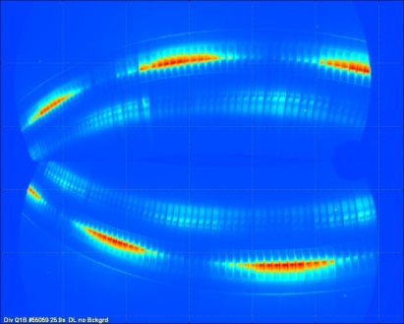
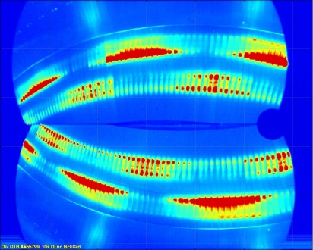
definitions
Inboard strike point
Inboard strike point
Regular plasma contact
Regular plasma contact
Outboard strike point
Outboard strike point
Ion Ripple losses
Ion Ripple losses
Classification:
Assign only one class label based on the dominant object inside it.
Classification and localization:
Assign only one class label to the object in the image and draw a bounding box around it.
Object detection:
Assign multi bounding box per object instance and classify it.
Instance segmentation:
Assign a class label and an instance for each pixel.

Slide 3
The need : detect thermal events
Detect thermal events present in IR films
Localization
Tracking
Classification
Inboard strike point
t
t + 1
Outboard strike point
Ion Ripple losses
ID ThEv | Type | Location | Timestamps | Temperatures | Known
ThEv #1 | Inboard strike point | At location x,y with this contour | From t1 to t2 | Max Mean Etc … | True
ThEv #2 | Reflection | At location x,y with this contour | From t3 to t4 |  | False
Etc….
Report file for each target after each pulse.

Slide 4
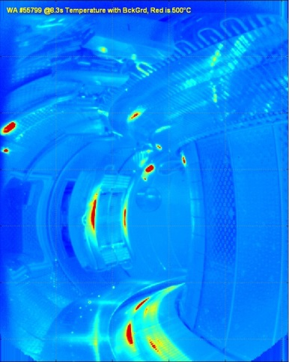

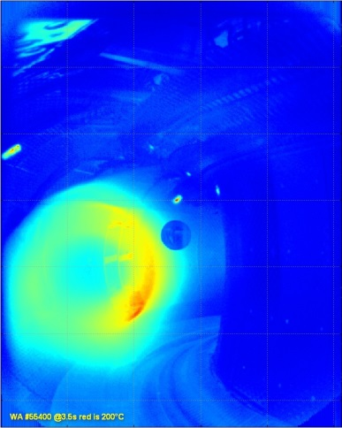
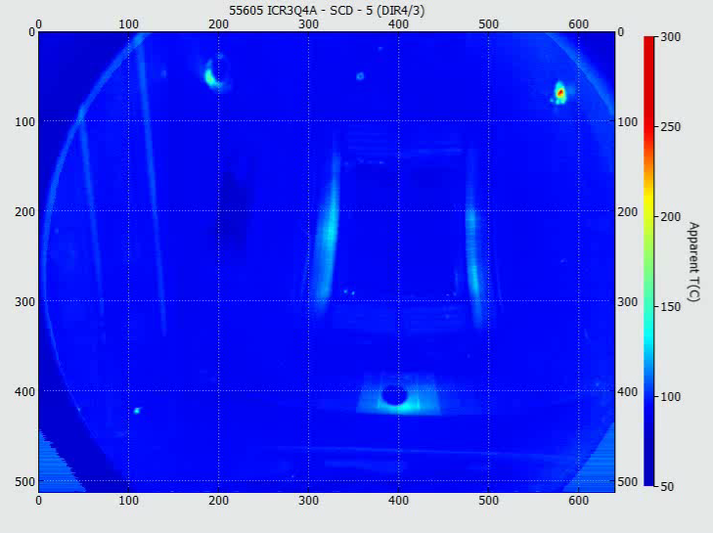
A wide variety of thermal events
Textured pattern: the event is the large contour, the smaller hot spots are less relevant
Many thermal events (ThEv) in the image
Some ThEv close to image maximum intensity, while other important hot spots are just above
background level
ThEv overlap
Some ThEv have stable position, other moving slowly (moveable probe), some move fast (UFOs = dust, flakes)
Some ThEv are some very small (3 pixels)
Some ThEv very large (linear size 1/3 of image, 200 pixels)
Courtesy of Raphaël MITTEAU

Slide 5
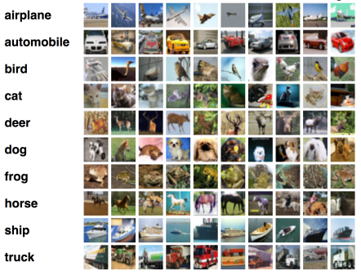
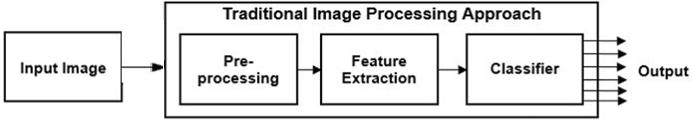


Image classification
Image classification :
Classify an image based on the dominant object inside it
Texture : Haralick, LBP
High-Level : SIFT, HOG, BoVW
Histogram Equalization
Rolling ball algorithm
Blurring
kNN, SVM, Decision Trees, etc.

Slide 6
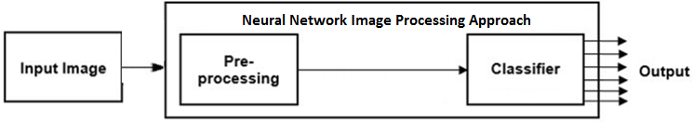
Image classification
Image classification :
Classify an image based on the dominant object inside it
Convolutional Neural Network (CNN)

Slide 7
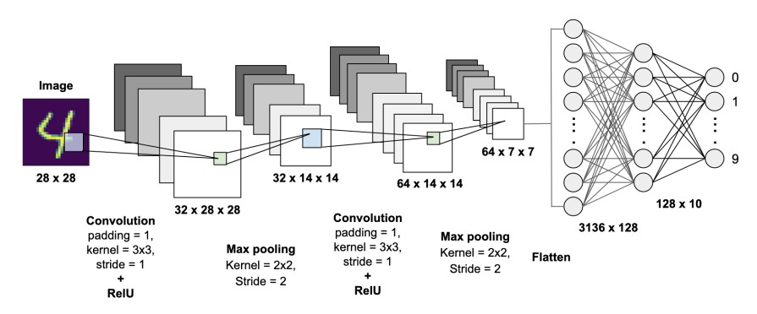
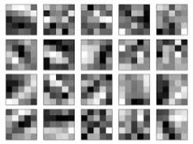
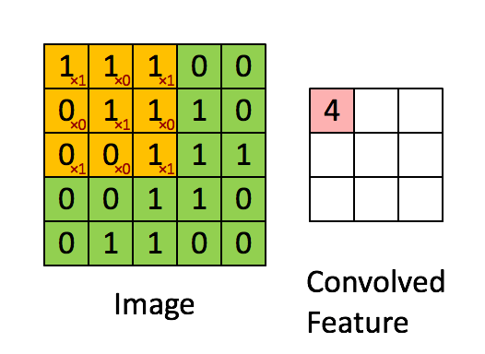
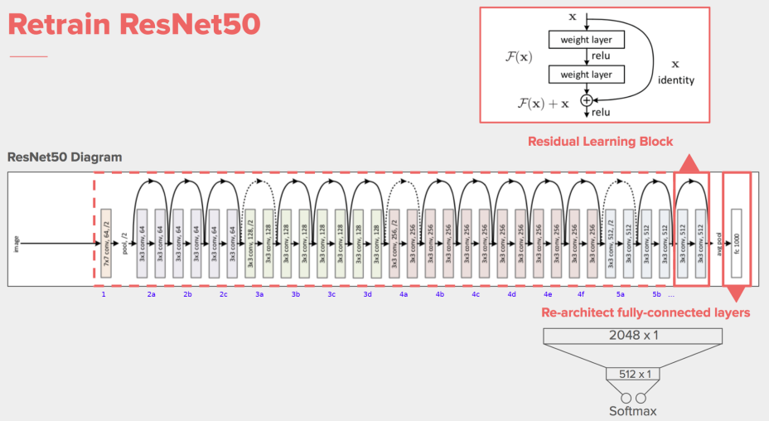
CNN
Kernels

Slide 8
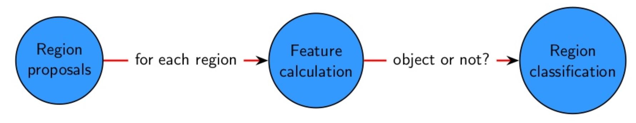
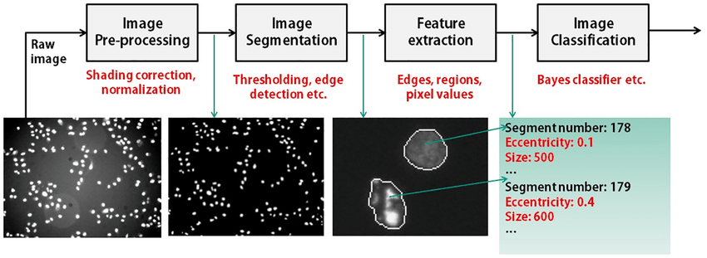
Object detection : traditional approach
Image classification
Sliding window
Thresholding
Selective search
A new Feedback-Based Method for Parameter Adaptation in Image Processing Routines

Slide 9



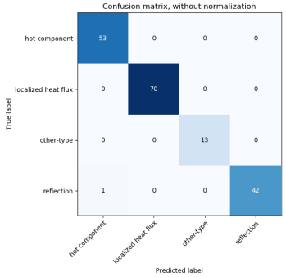


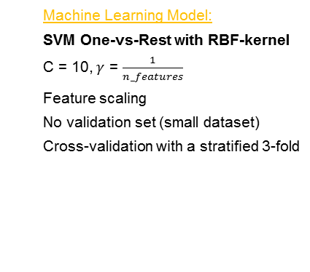
Object detection: traditional approach
ML Model
IR Data preparation
Feature extraction
Prediction
WIDE ANGLE
IR Data Preparation
Segmentation: Sauvola algorithm
$$T\left(i,j\right)=m\left(i,j\right)(1+k\left(\frac{s(i,j)}{R}−1\right))$$
Window size = 17
k = 0.13
Region labeling :
Min Area: 9 pixels
Label connectivity: 8
Tracking :
Max distance : 20 pixels
Min Overlap: 30%
Feature extraction
Temperature : Max
Form criterion : Elongation, Area
Localization : X, Y
Duration: Δt
Machine Learning Model:
SVM One-vs-Rest with RBF-kernel
C = 10, $γ$ = $\frac{1}{n_features}$
Feature scaling
No validation set (small dataset)
Cross-validation with a stratified 3-fold
Improvement needed for the segmentation step
J. Sauvola and M. Pietikainen, “Adaptive document image binarization,” Pattern Recognition 33(2), pp. 225-236, 2000. DOI:10.1016/S0031-3203(99)00055-2
Notes:
179 samples from 4 labels (after data cleaning)
Gathered from the 20 most energetic and powerful pulses

Slide 10
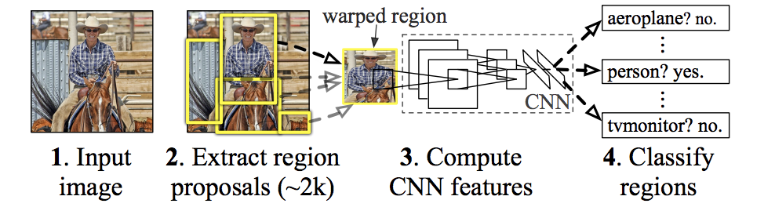
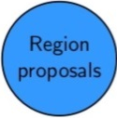
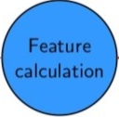

Object detection: DEEP LEARNING approach
R-CNN: Regions with CNN features
Selective search
CNN
SVM
R. Girshick and al. Rich feature hierarchies for accurate object detection and semantic segmentation. Technical Report, UC Berkeley, 2014.

Slide 11
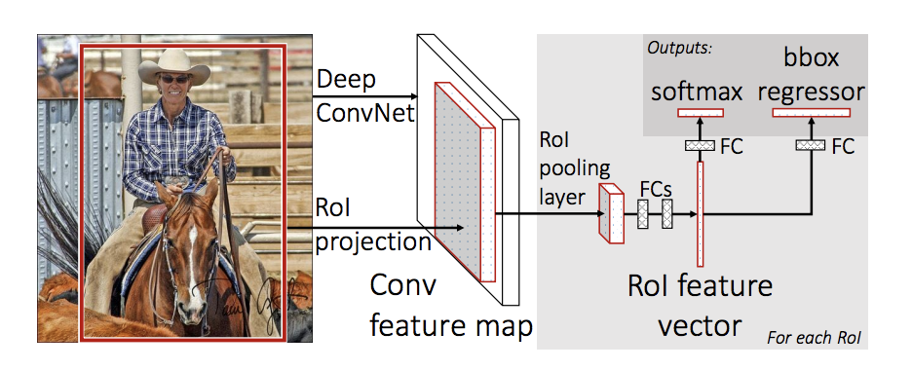
Object detection: DEEP LEARNING approach
Fast R-CNN
CNN
Selective search
FC layers
R. Girshick. Fast R-CNN. Microsoft Research, 2015.

Slide 12
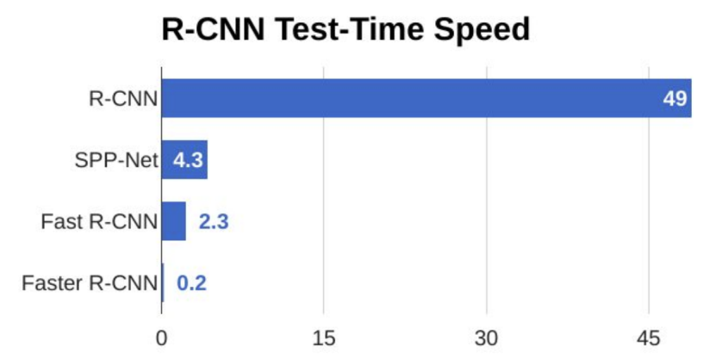
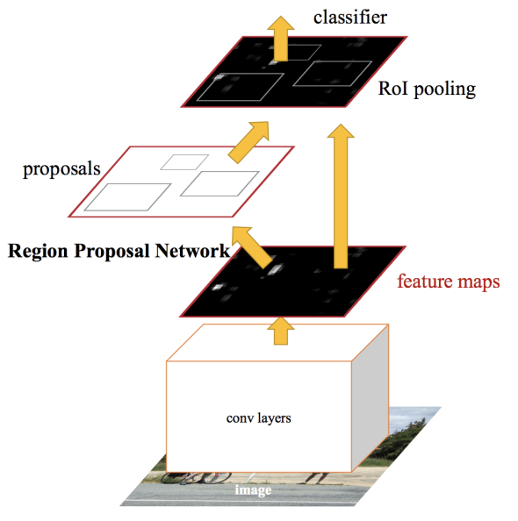
Object detection: DEEP LEARNING approach
Faster R-CNN
FC layers
RPN
CNN
S. Ren and al. Faster R-CNN: Towards Real-Time Object Detection with Region Proposal Networks. 2016.

Slide 13
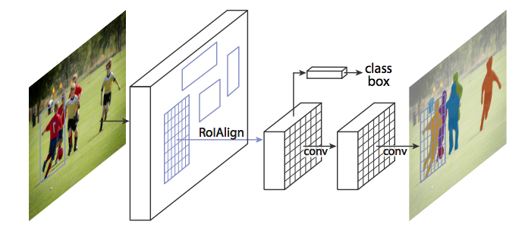
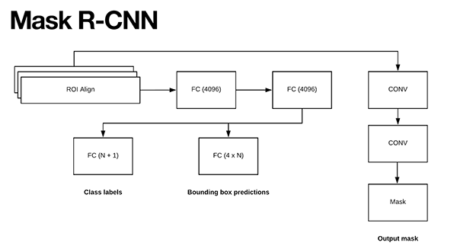
Instance segmentation APPROACH
Mask R-CNN: extending Faster R-CNN from Object Detection to Instance Segmentation
K. He and al. Faster R-CNN: Towards Real-Time Object Detection with Region Proposal Networks. Facebook AI, 2018.

Slide 14
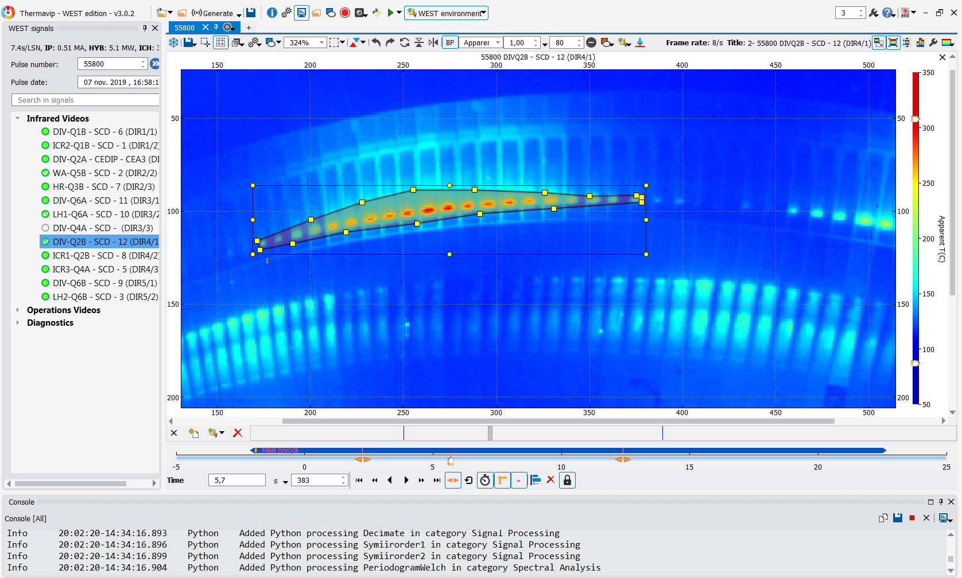
Instance segmentation APPROACH FOR WEST
1st step: Build an annotated dataset
Subset | Train | Validation | Test
#images | 11366 | 4112 | 3740
Target : DIVQ2B
# Pulses: 60 most energetic and powerful pulses
Classes: Outboard strike point and Inboard strike point

Slide 15
Instance segmentation APPROACH FOR WEST
2nd step: Train the model
Code: https://github.com/matterport/Mask_RCNN
Hardware :
Training schedule: Transfer Learning on ResNet50 pre-trained on MS COCO with 40 epochs (20 epochs for head layers + 20 for all layers)
Device/Cluster | CPU/GPU | Duration per image | Total duration per test (~15k images, 40 epochs)
i7-6700K | CPU | ~10s | > 2 months
Talitha – 4 x Intel(R) Xeon(R) Gold 5122 CPU @ 3.60GHz | CPU | ~2.8s | ~20 days
Quadro K6000 | GPU | ~1.4s | >9 days
GTX 1060 | GPU | ~800ms | > 5 days
RTX 2080 Ti | GPU | ~230ms | < 2 days

Slide 16

Instance segmentation APPROACH FOR WEST
3rd step: Monitor learning and check performance

Slide 17
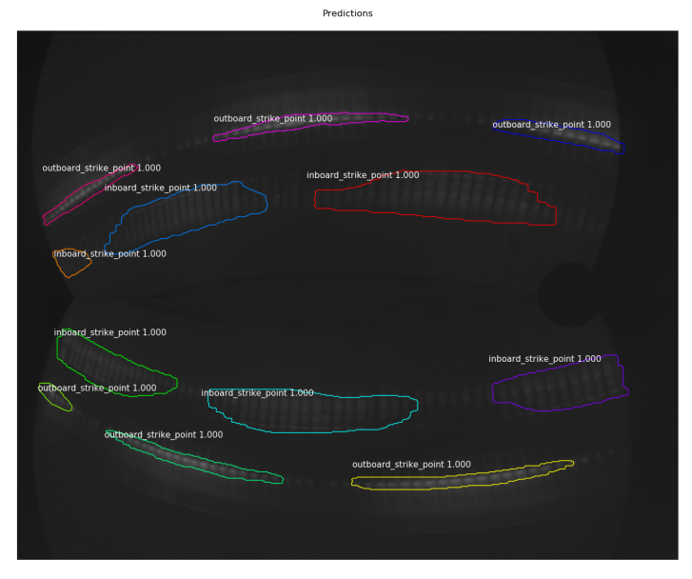
Instance segmentation APPROACH FOR WEST
3rd step: Monitor learning and check performance
Prediction time: ~200ms w/ RTX 2080Ti
For a 1 minute IR film, it would take roughly 10 minutes.

Slide 18
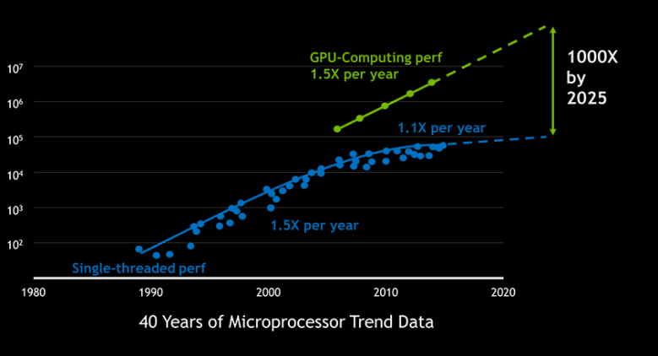
What’s next
From inter-pulse to RT prediction
Source: https://www.nvidia.com/en-gb/about-nvidia/ai-computing/

Slide 19
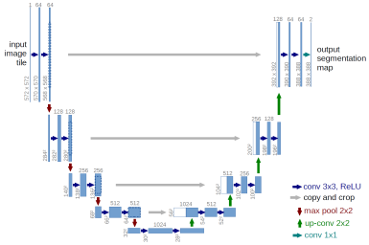
What’s next
Ontology
Inboard strike point
Outboard strike point
UFO
Reflection
Other-type
Unknown
Only raw image data used
Temporal properties are not used:
Mask R-CNN with one label and class
U-Net
O. Ronneberger and al. U-Net: Convolutional Networks for Biomedical Image Segmentation, University of Freiburg, 2015.

Slide 20
DSM
IRFM
Service
Commissariat à l’énergie atomique et aux énergies alternatives
Centre de Cadarache | 13108 Saint Paul Lez Durance Cedex
T. +33 (0)4 42 25 46 59 | F. +33 (0)4 42 25 64 21
  Etablissement public à caractère industriel et commercial | RCS Paris B 775 685 019

