Slide 1




Strike Line Characterization from IR Images at W7-X
﻿EUROfusion Meeting on
Image Processing and Artificial Intelligence
February 25-26, 2020
Greifswald, Germany
F. Pisano, B. Cannas, A. Fanni, G. Sias, Y. Gao, M. Jakubowski, H. Niemann, A. Puig Sitjes and W7-X Team

Slide 2
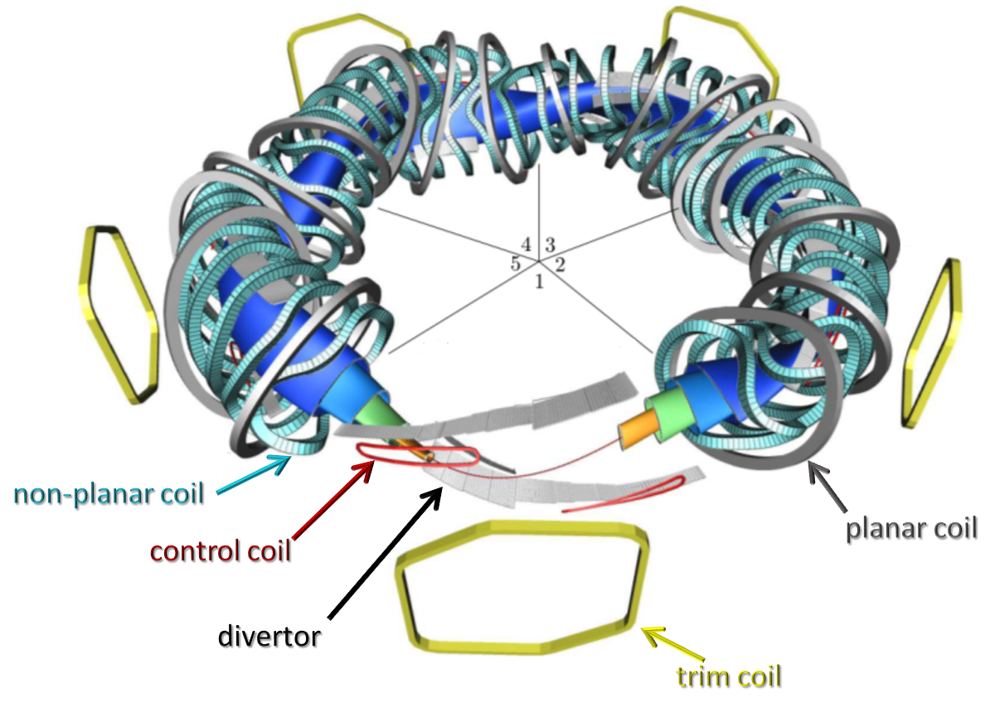
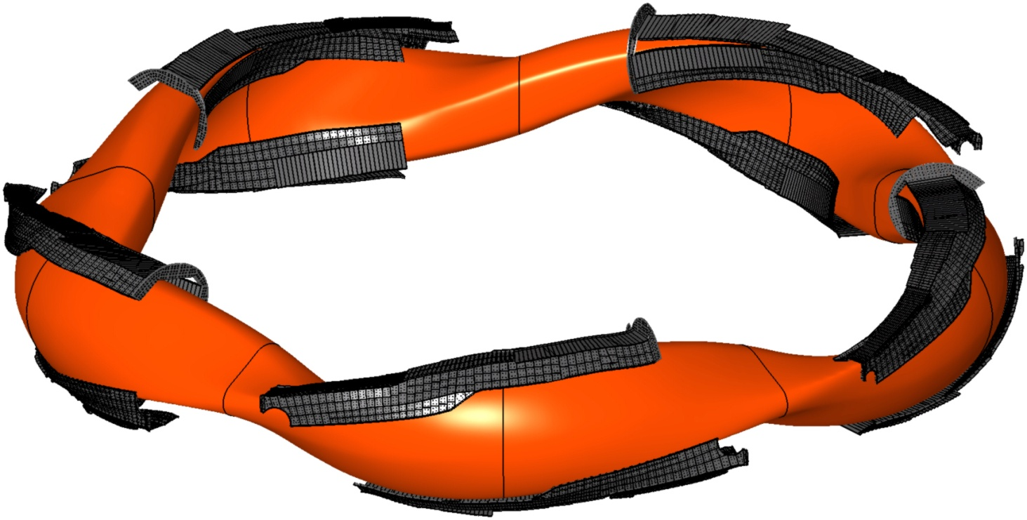
Wendelstein 7-X Stellarator
Optimized stellarator:
5-fold simmetry, 3D shape
Heating power:
10 MW ECRH (30min), 10MW NBI (10s)
10 divertors: 5 lower, 5 upper
upper divertor
targets
OP1.2 (2017-2018) (T.S. Pedersen et al., EPS 2018):
Inertially cooled test divertor
High performance discharge 150MJ: 30s @ 5MW
100s plasmas (2MW): 200 MJ
lower divertor targets
contour of confinement region

Slide 3
Wendelstein 7-X Stellarator
Optimized stellarator:
5-fold simmetry, 3D shape
Heating power:
10 MW ECRH (30min), 10MW NBI (10s)
10 divertors: 5 lower, 5 upper
upper divertor
targets
OP2 (> 2021):
High Heat Flux (HHF) water-cooled divertor
Steady state operation: 30 min
lower divertor targets
contour of confinement region

Slide 4
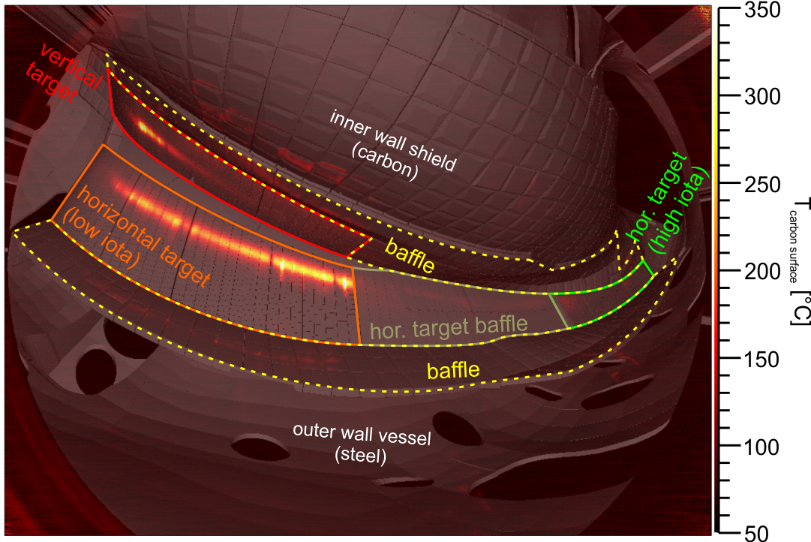
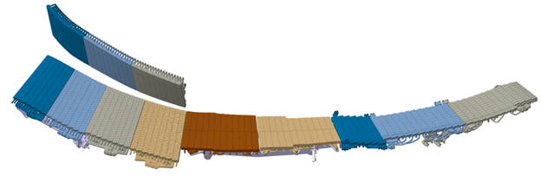
Divertor Strike-Lines
10 IR thermographic systems monitor surface temperature on the 10 divertors
Investigation on heat and particle fluxes, local effects of leading edges and error fields
Regions of highest thermal load → strike lines
A complex interplay of component shape, magnetic field structure, cross- and parallel field transport results in the strike lines observed.
vertical target
M. Jakubowski et al. (2018), Rev. Sci. Instr. 89, 10E116
Courtesy of M. Krause
low-iota target
high-iota target
central low-loaded target

Slide 5
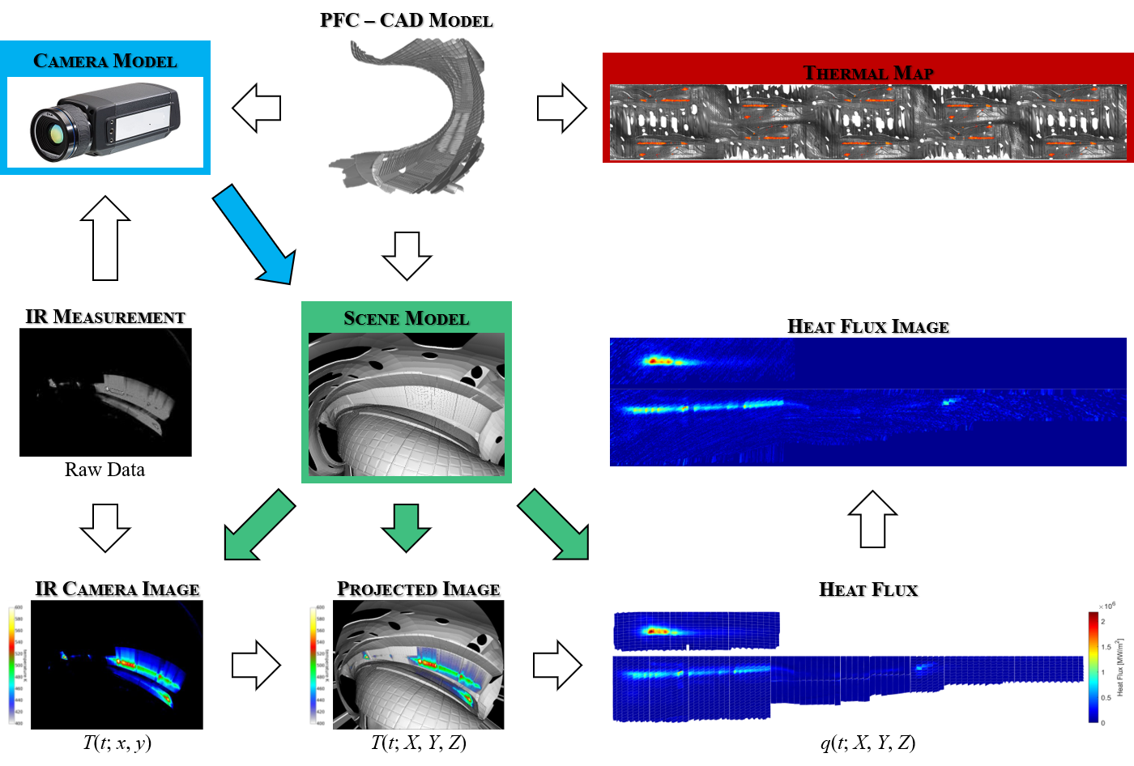
IR System

Slide 6
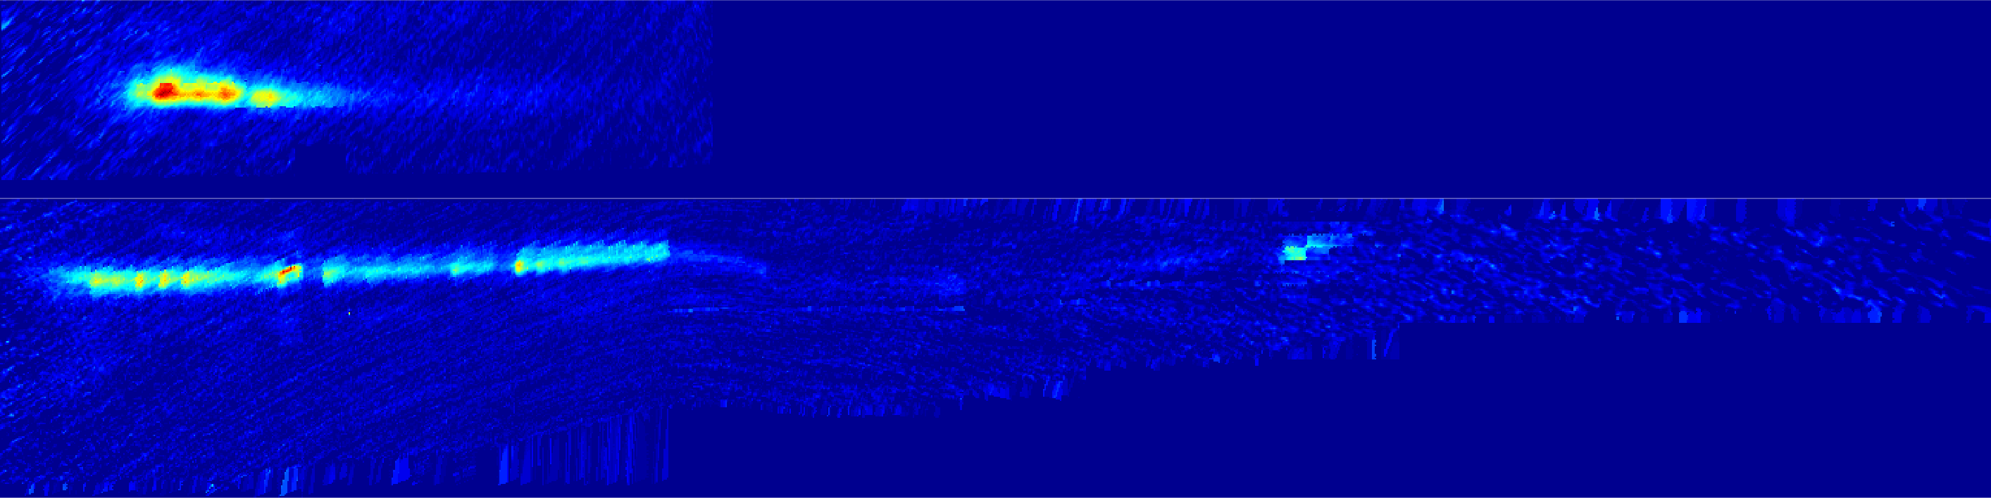
Heat-Flux Image
Vertical Target
1296x324
Low Iota Target
Middle Target
High Iota Target
Horizontal Target

Slide 7
Strike-Line Segmentation
It is important to segment the image,
i.e. isolate the thermal events with respect to image background and noise,
in order to automatically:
- analyse separately the properties of each single thermal event
- implement the proper control strategies in case of dangerous events
Strike-line
Hot spots
Leading edges
...
Other thermal events

Slide 8
Strike-Line Segmentation
It is important to segment the image,
i.e. isolate the thermal events with respect to image background and noise,
in order to automatically:
- analyse separately the properties of each single thermal event
- implement the proper control strategies in case of dangerous events
Strike-line
Hot spots
Leading edges
...
Other thermal events

Slide 9
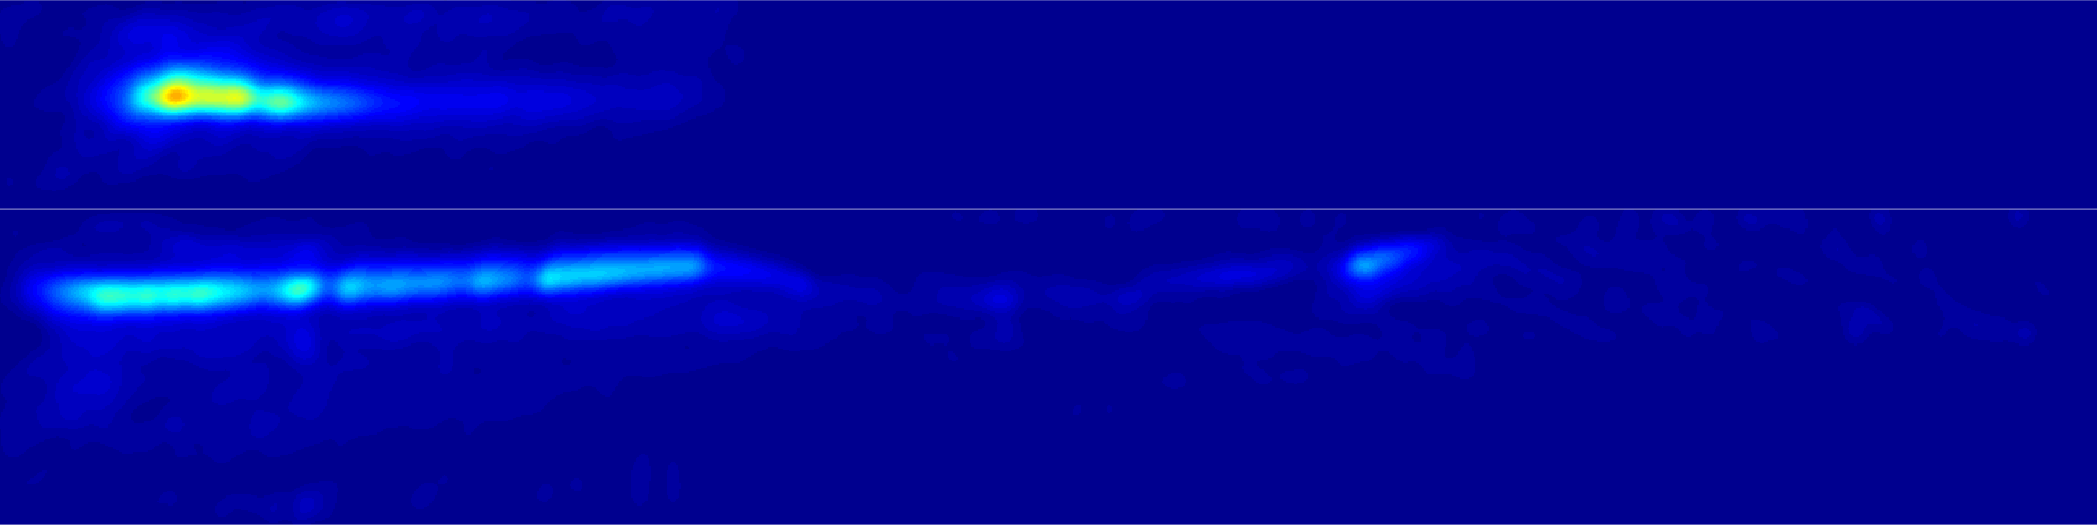
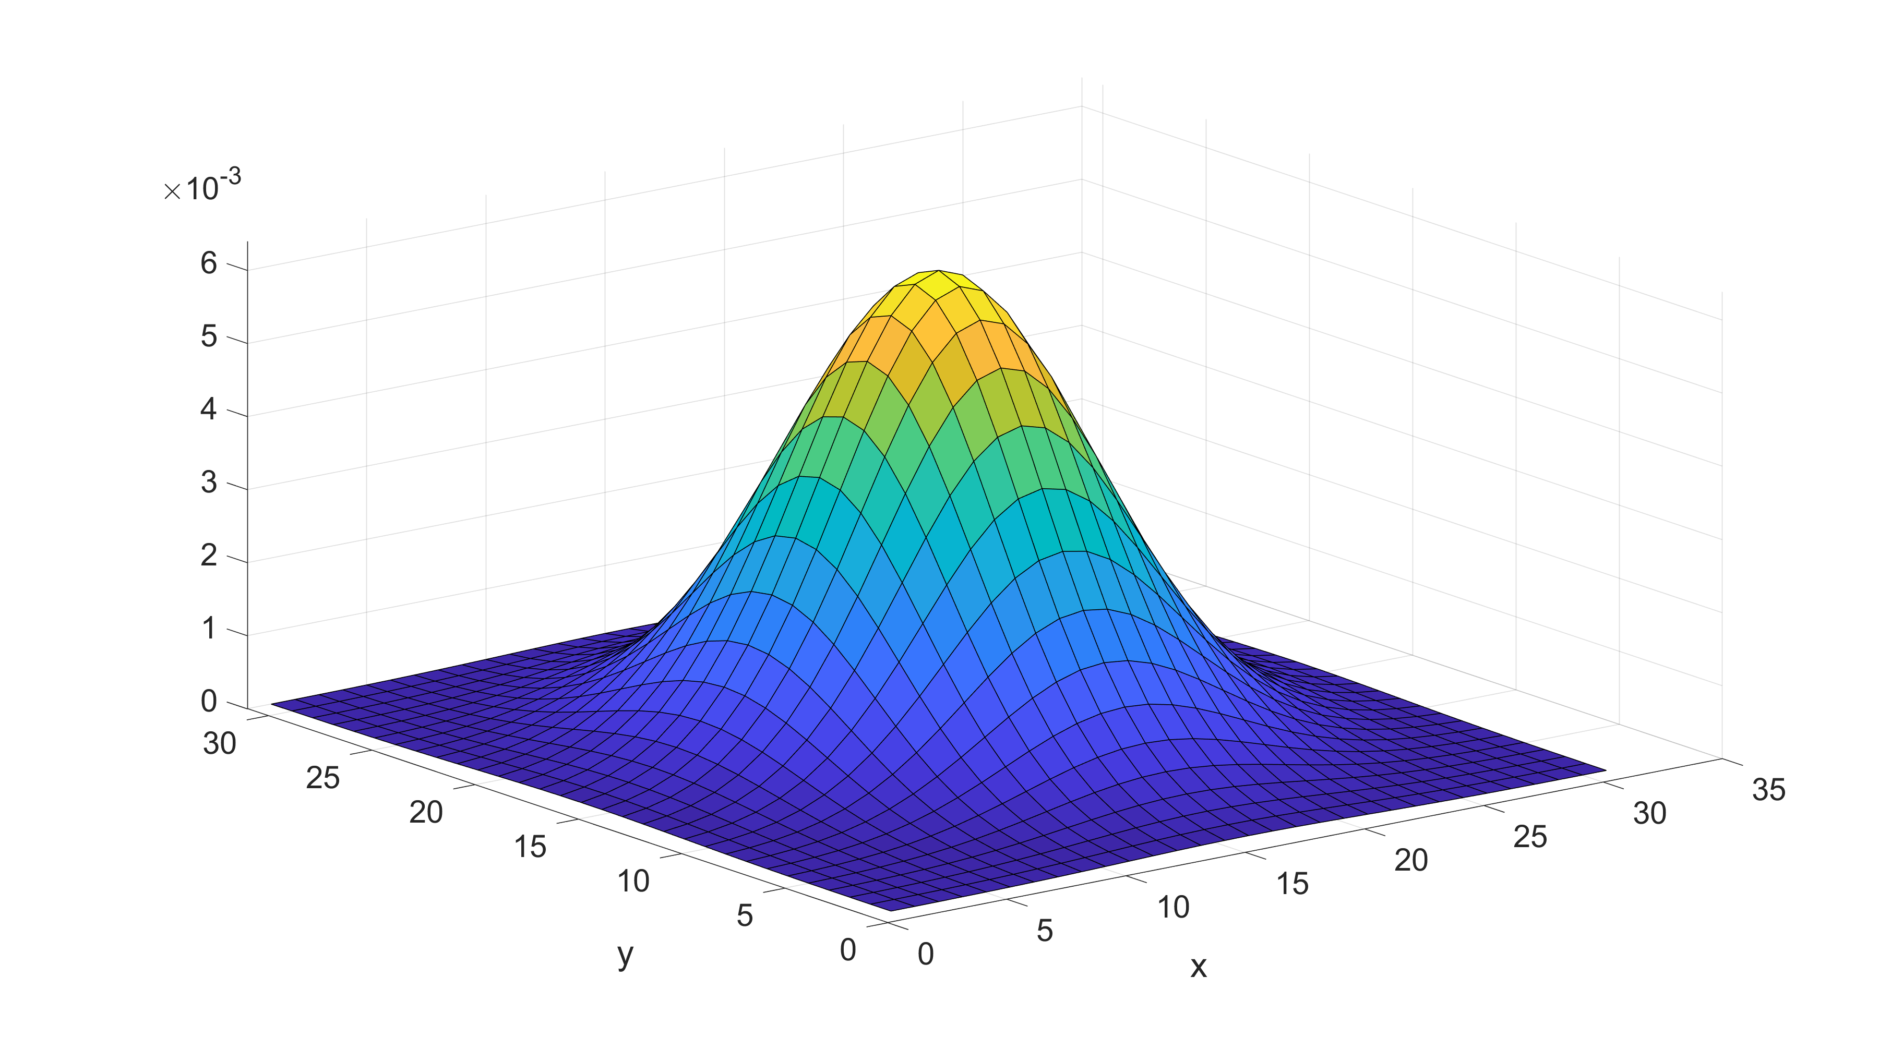
Strike-line Segmentation
As a first attempt of isolating the strike-line and remove the effect of noise, hot spots and leading edges, a spatiotemporal prefiltering is applied to the video.
Prefiltering helps avoiding fragmentation
*
Gaussian spatial filter
size 31x31, σ ≈ 15mm
moving average
time filter, w = 0.03s

Slide 10
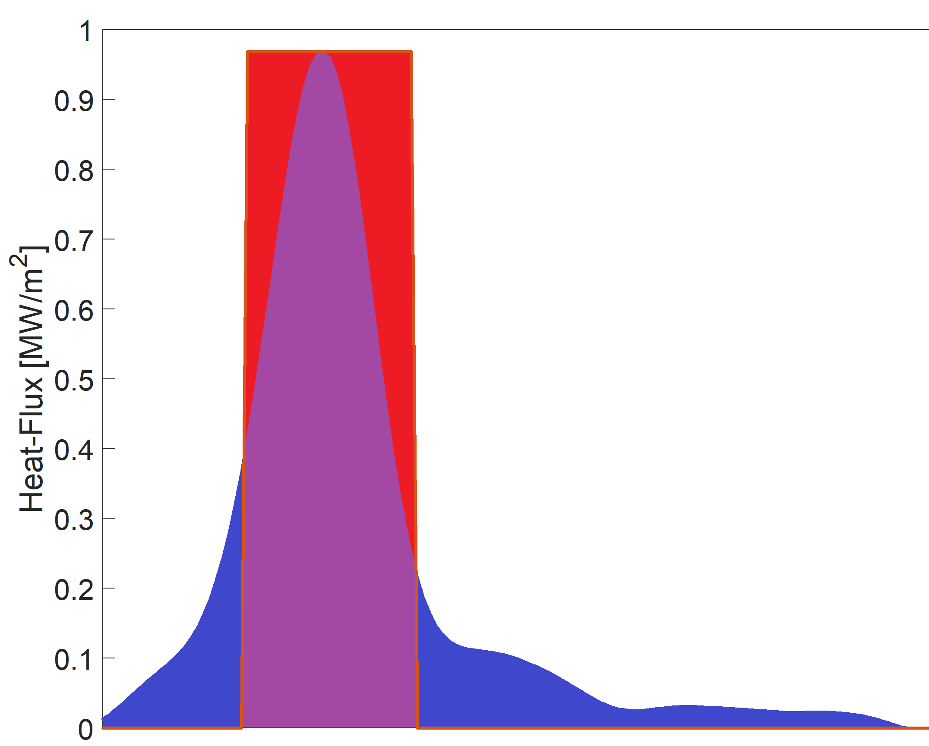
Strike-line Segmentation
For each profile (each vertical line) of the horizontal and vertical divertor target, the strike-line width is estimated, using the formula for the wetted area*, as
Q_{profile} line integrated heat-flux along the profile [MW/m]
q_{max} maximum heat-flux in the profile [MW/m²]
The segmentation is equivalent to consider an
equivalent rectangular profile having:
- heat-flux equal to q_{max}
- line integrated heat-flux equal to Q_{profile}
*M. Jakubowski et al., IAEA FEC 2018
Red area =
Blu area
w
q_{max}
profile width

Slide 11
Strike-line Segmentation
For each profile (each vertical line) of the horizontal and vertical divertor target, the strike-line width is estimated, using the formula for the wetted area*, as
Q_{profile} line integrated heat-flux along the profile [MW/m]
q_{max} maximum heat-flux in the profile [MW/m²]
The asymmetry with respect to the peak position
is estimated on the basis of the ratio between the
line integrated heat-fluxes at both sides of the profile.
*M. Jakubowski et al., IAEA FEC 2018
Red area (L/R) =
Blu area (L/R)
w_{L}
w_{R}
q_{max}
profile width

Slide 12
Strike-line Segmentation
For each profile (each vertical line) of the horizontal and vertical divertor target, the strike-line width is estimated, using the formula for the wetted area*, as
Q_{profile} line integrated heat-flux along the profile [MW/m]
q_{max} maximum heat-flux in the profile [MW/m²]
Applicable only in the case of a single strike-line
for each target!
*Only heat-fluxes greater than 0.15MW/m² are
taken into account.
*M. Jakubowski et al., IAEA FEC 2018
Red area (L/R) =
Blu area (L/R)
w_{L}
w_{R}
q_{max}
profile width

Slide 13
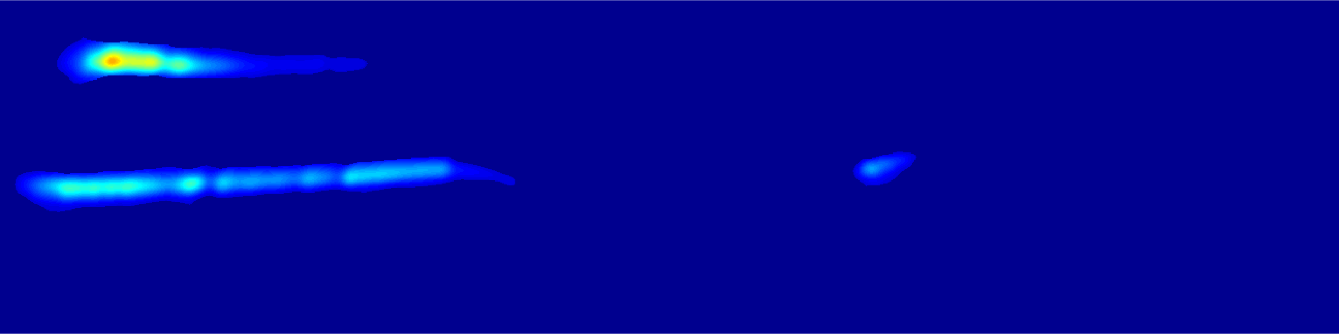
Strike-line Segmentation
example of strike-line segmentation for standard configuration
3 main objects

Slide 14

Strike-Line Segmentation

Slide 15
Strike-Line Characterization
For each object a set of features is calculated
SPATIAL
Area
Perimeter
Centroid Position
Orientation
etc.
THERMAL
Maximum heat-flux
Minimum heat-flux
Mean heat-flux
Median heat-flux
etc.

Slide 16
Strike Line Characterization

Slide 17
Strike Line Characterization

Slide 18


Thanks for Your Attention!
Questions?

Slide 19
Case Study
Strike line control experiments in standard configuration (OP1.2b, XP: 20180816.#)
Experiment | Comments
20180816.010 | Ref. discharge: standard magnetic configuration, P_{ECRH}= 3 MW, n_{e} = 3.5∙10¹⁹ m⁻²
20180816.011 | at 6s, I_{CC} starts ramping up with slope 150A/s in all control coils
20180816.012 | at 6s, I_{CC} starts ramping down with slope -150A/s in all control coils
20180816.014 | at 6s, I_{CC} starts ramping down (up) with slope -150A/s (150A/s) in lower (upper) divertor control coils
20180816.015 | at 6s, I_{CC} starts ramping up (down) with slope 150A/s (-150A/s) in lower (upper) divertor control coils
20180816.016 | at 10s, I_{CC} starts oscillating @5Hz, by gradually increasing the oscillation amplitude to 600A within 5s. Currents in the lower divertors are in antiphase with respect to the currents in the upper divertors.

Slide 20
Case Study
Strike line control experiments in standard configuration (OP1.2b, XP: 20180816.#)
Ramp
down
Ramp
down
AC
Ref
Ramp
up
Ramp
up
010 011 012 014 015 016
Ramp
down
Ramp
down
AC
Ref
Ramp
up
Ramp
up

Slide 21
Case Study
Strike line control experiments in standard configuration (OP1.2b, XP: 20180816.#)
AC
016
AC

