Slide 1
Discussion on AI for machine safety
Imaging Workshop 25-26.02.2020

Slide 2
Applications of AI in this workshop
Pattern recognition
Thermal event detection and classification
Direct and inverse NN
Direct: Simulation software replacement by fast NN (VMEC, Theodor)
Indirect: plasma feature reconstruction from images (CC, iota,…)

Slide 3
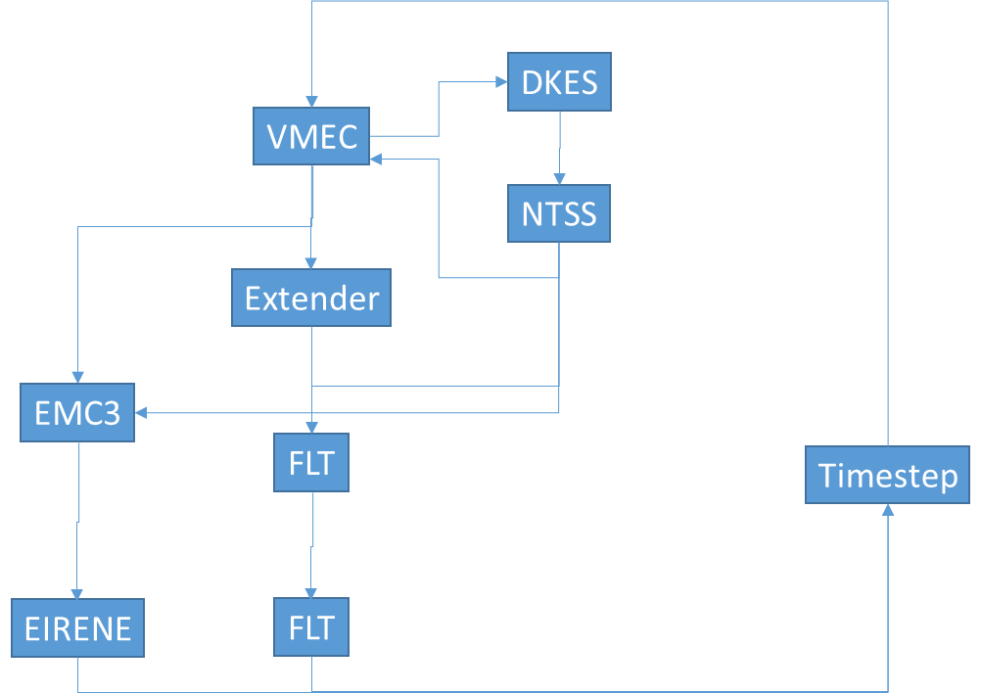
Potential applications
Evaluation of criticality of hot spots by their size and magnitude
Considering thermo-mechanical response of KIP
NN replacing Theodor or FEM
Considering resolution of sensor and optics projected onto KIP
Considering reflections
Acceptance of thermal events
Turn off experiment
Adaptation of actuators
NN replacing models in simulation framework

