Slide 1
Sprint-1 on internal boundaries and hyperdiffusion
Thomas Jonsson
WIMAS-2 Weekly meeting, 23 September 2020

Slide 2
Brief summary
Goal: Implement internal boundary condition and hyperdiffusion
Main result: Both implemented; the internal boundary is well tested, while hyperdiffusion need more testing.
Test case added to the regressions test suite.
Started preparing for core-edge coupling with finite edge region.
Note: solpsz1 sets BCs at rho=1, while PENN fill a finite edge e.g. rho in (0.95 , 1]

Slide 3
Internal boundary or core-edge boundary?
Interpretation: The internal boundary is really a boundary between the core and the edge.
What should we call this boundary?
“internal boundary”
“core-edge boundary”
DECISION: Use “core-edge boundary”, but Alexei warned that we may need to have a separate point for the boundary condition and the core-edge boundary.

Slide 4
Design choices
Decision to redesign the use of transport_solver_numerics
Fill both BCs at axis and edge – implemented!
Previously we only filled the edge BC.
Now, each equation is given a domain; we could set different BCs at axis e.g. zero gradient or zero flux.
Fill both core and edge equation – not implemented.
What does database_profiles fill?
computation_mode=interpretative, then fill profiles in [0, rho_bnd] from database
Here rho_bnd is the location of the internal boundary.
boundary_conditions=interpretative, then …
fill boundary conditions from database (as before),
fill profiles from database outside the internal boundary in [rho_bnd, 1] – NEW FEATURE!

Slide 5
Codeparams ETS-Init
Internal boundary
Hyper-diffusion = OFF

Slide 6
Example with internal boundary
Data source:g2tjohns/jet_reference/92436/84929
Time = 49.02 s
Time = 49.04 s
Interpretative BC; $T_{i}{(r}_{BC})$ is raising
49.02 s
49.04 s
Interpretative profile; $T_{i}{(r>r}_{BC})$ is raising
Predictive profile, no sources; temperature is going down

Slide 7
Codeparams ETS-Init
Hyper-diffusion = ON

Slide 8
Codeparams – edge profiles for electrons
These choice will be implemented as separate equations in transport_solver_numerics.

Slide 9
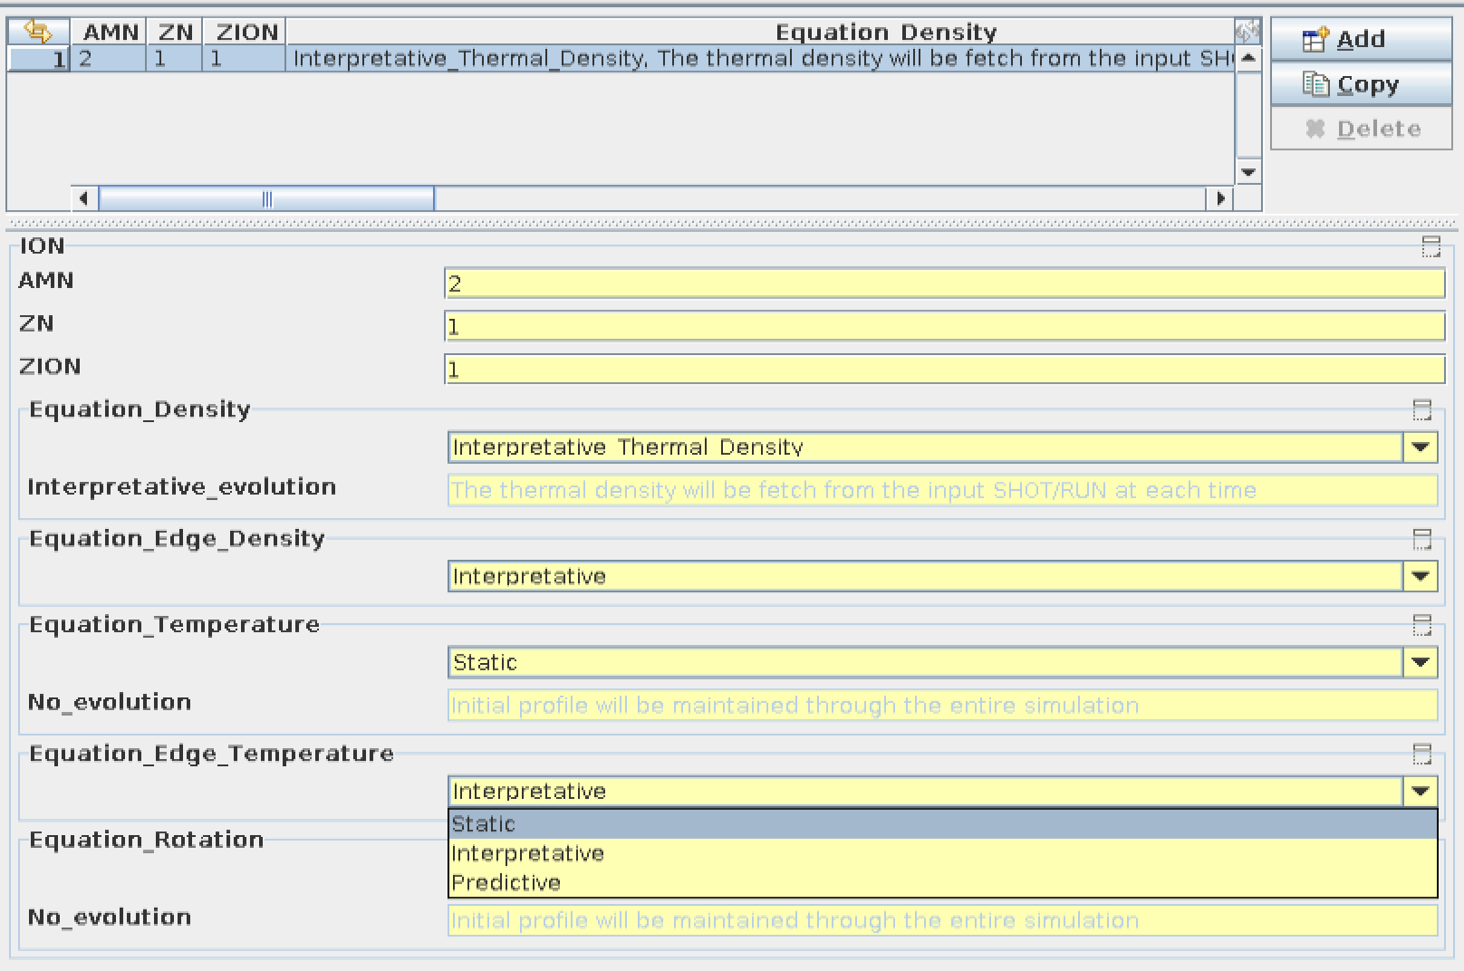
Codeparams – edge profiles for ions

Slide 10
Questions
How to set internal BCs for impurities?
How to set hyperdiffusion for impurities?
How to store hyper-diffusion?
Plan: Add hyper-diffusion to total diffusion from transport solver.
Accepted
Plan: Add hyper-diffusion as a separate transport model in core_transport
Accepted
How to calculate the energy flux from hyper-diffusion?
Do I include the particle flux, $T Γ$ ?
What flux multiplier should be applied for hyper-diffusion?
David: Use a zero flux multiplier
Alexei: A zero flux multiplier may make it difficult to study energy conservation.

